Slide 1
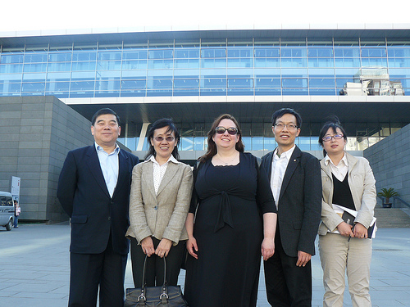
Team Members
Shuyong Jiang, Project Principal Investigator and Team Leader; University of Illinois at Urbana-Champaign
Sarah Shreeves, University Library, University of Illinois at Urbana-Champaign
Win Shih, University at Albany

Slide 2
Project Overview
Development of Web-based resources
  Promoting international standards and best practices
Identifying and establishing a registry of digital library projects
Establishing a pilot Web-based portal

Slide 3
Sites Visited
Pudong New Area Library
Suzhou Library
Suzhou University Libraries
Northeastern Normal University Libraries
Yi-Tong (伊通) county library
Information Resource Center, American Center for Educational Exchange
National Library of China

Slide 4
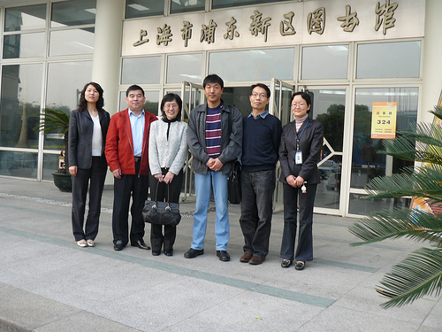
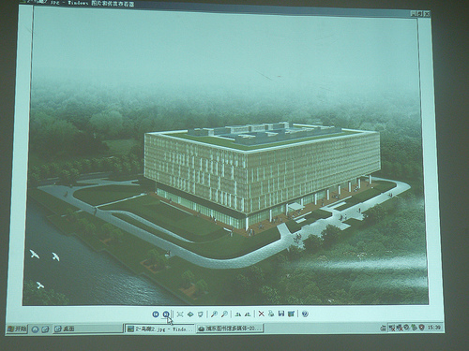
Pudong New Area Library

Slide 5
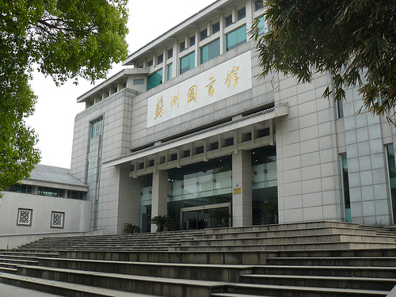
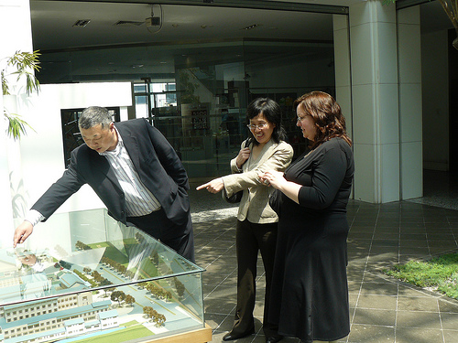
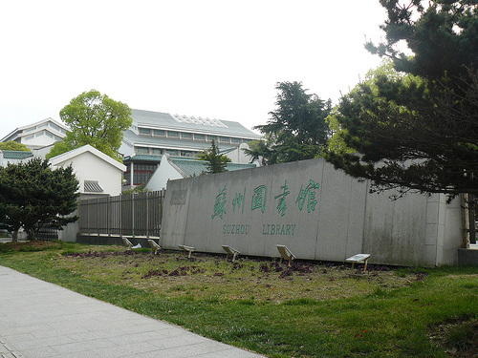
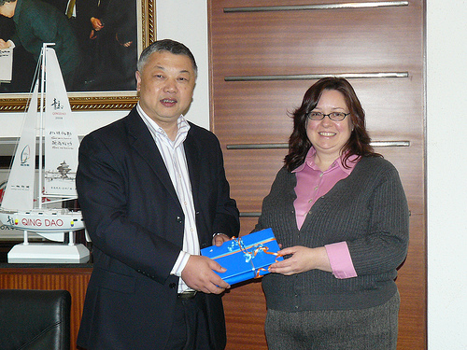
Suzhou Library

Slide 6
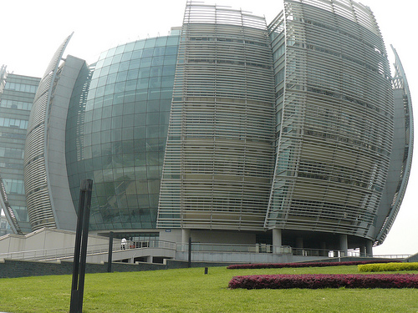
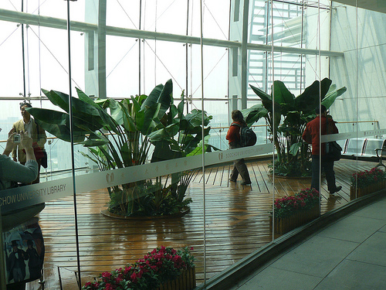
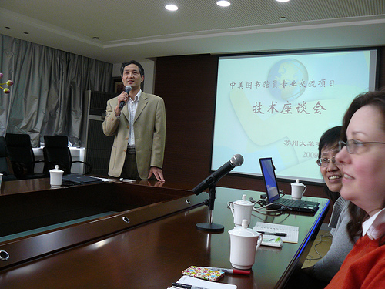
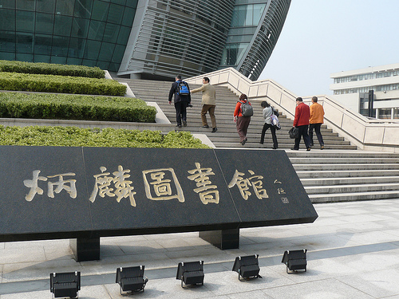
Suzhou University Libraries

Slide 7
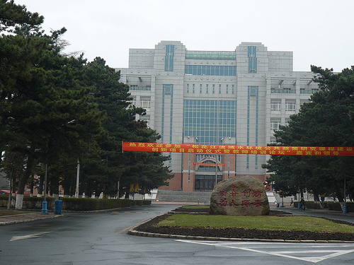
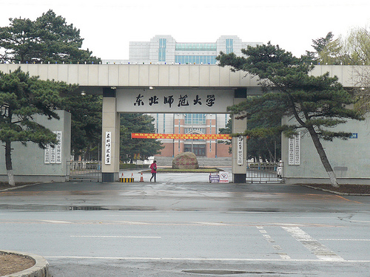
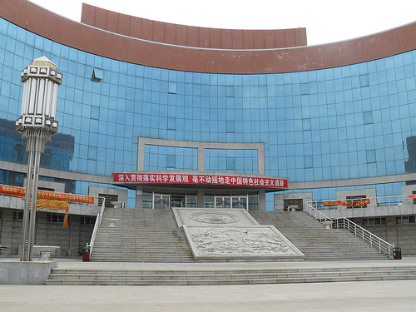
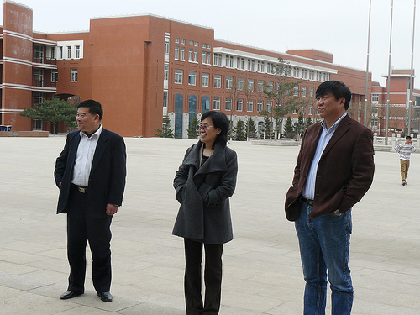
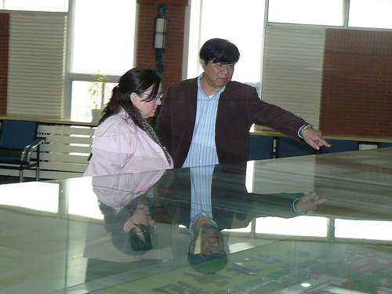
Northeastern Normal University Libraries

Slide 8
Yi-Tong (伊通) county library

Slide 9
Content Selected
Criteria
Cultural Suzhou
Special collection at Northeastern Normal University Library)

Slide 10
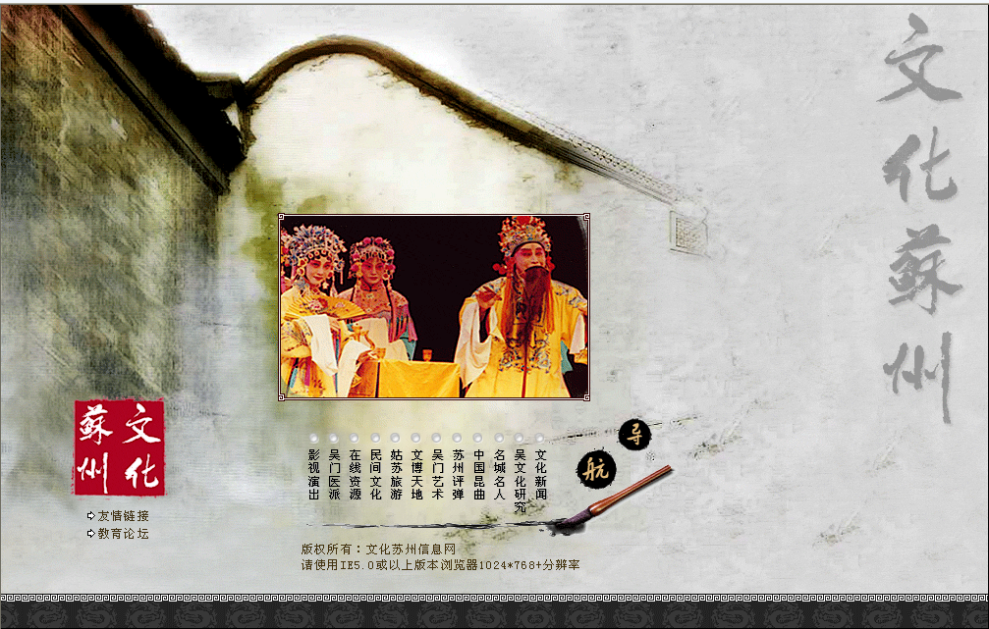
Cultural Suzhou

Slide 11
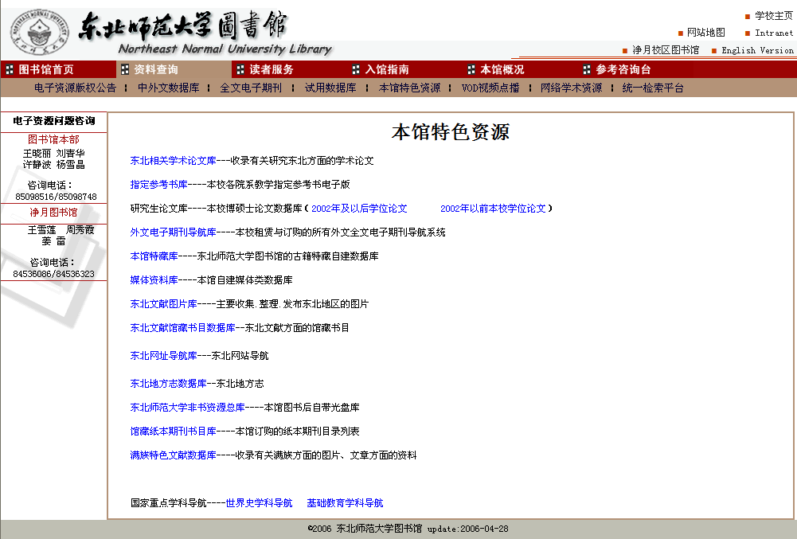
NENU Special Collection

Slide 12
Issues Discussed
Language barrier
Sustainable business model
International standard
Further interaction and exchange
Library consortium
Physical vs. soft infrastructure

