Slide 1
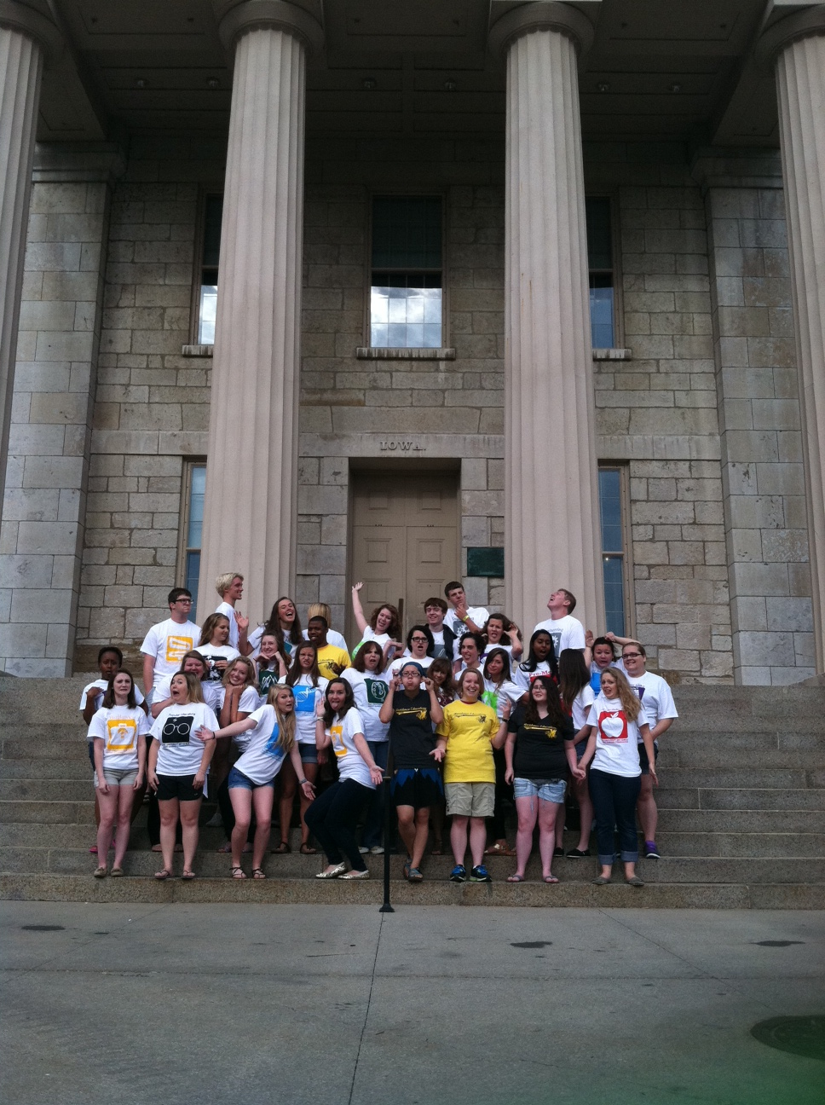
Step Right Up:
See How Iowa
Moves to All
Living-Learning
Communities
UMR-ACUHO 2013 Annual Conference, St. Louis, MO
Joshua Atcher, Von Stange, Linda Varvel, Becky Wilson
University of Iowa

Slide 2
Welcome
Introductions
Agenda for this Session
  Why Now?
  How
  Staff Implementation
  Addressing Changes in Campus Culture
  Programming Structure
  Programming Model
  Academic Courses Tied to LLCs
    LLC Placement and Housing Assignment Process
    Student Staff recruitment, hiring, and training
    Funding
    Fall 2013– How is it going so far?
    Questions, Comments, & Advice
Notes:
Introductions: Ask participants to say name, institution, size of the institution they work for, private/public, how many people live on campus, and what they are hoping to get out of this session.

Slide 3
Why Now?
Research at the University of Iowa shows that LLCs:
  Higher first to second year retention
  Higher satisfaction in EBI survey (vs. non-LLC)
  Students report strong sense of belonging, high satisfaction, and deeper interactions with faculty.
Renewing the Iowa Promise – Iowa’s Strategic Plan
Decision was made, in conjunction with Office of the Provost, to go “all in”
Notes:
2 Minutes
- Students who identified as living in a themed learning community in our residence halls scored statistically significantly higher in EVERY factor (and there were 19 factors) on our nationally based satisfaction survey.
- If this is true for the 1200 people in LLCs, why not provide it to all residence hall students?

Slide 4
2012-2013: Making the move
New Assistant Director for Academic Initiatives
Updated Residence Education Coordinator Job Description
Assistant Dean of University College
Chose 32 LLCs from a list of 75
Built relationship with Academic Departments
Notes:
12 Minutes
Hired new Assistant Director for Academic Initiatives (our 5th in 7 years) prior to this decision
Began revising job descriptions of Res Life Programming Coordinators
Informed before she arrived of the change in philosophy – she came anyway!
Developed relationship with Assistant Dean of University College
Provosts office supported program in meeting with faculty leadership
UH&D team developed 75 possible LLCs; pared down to 49
Provosts office vetted and eliminated 10 LLCs; combined concepts to get to 32
Met with faculty/staff in academic departments for possible partnerships

Slide 5
Activity – Choosing LLC Themes
Break into groups according to your notecard color
Small group discussion
Share your LLC Decisions
Notes:
12 Minutes
Break into groups according to institution profile and housing capacity
Medium/Large Public Institution
Small Public Institution
Private Institution (non affiliated)
Religiously Affiliated Institution

Slide 6
2012 – 2013: Staff Implementation
Directors staff – provided strategic vision
Assistant Director for Academic Initiatives – architect of change process
Academic Initiatives staff – did the groundwork of developing themes and goals
Contracts and Assignments – how to assign students based on LLC preferences/locations
Hall Coordinators – RA selection process, programming, and placement
Notes:
3 Minutes
Directors staff - provided strategic vision
Assistant Director for Academic Initiatives – architect of change process
Academic Initiatives staff – did the groundwork of developing themes and goals
Contracts and Assignments – how to assign students based on LLC preferences/locations
Hall Coordinators – worked with RA Selection process. Taught the RA Seminar prior to interviews. Helped implement the new returning RA process. Sat on committees such as programming model and placement of LLCs.

Slide 7
Addressing Changes in Campus Culture
Relationship with Office of the Provost
Training Admissions & Orientation Staff
Hawkeye Visit Days & Next Step Iowa trips
Notes:
7 Minutes
Director of Residence went to different offices to gather buy in, especially with Office of the Provost and budget
Trainings created for tour guides, hawkeye guides, and stuff that worked at campus visit days
New FAQ guide created, etc.

Slide 8
Program Structure
Professional Staff
  Assistant Director of Residence Education
  Residence Education Coordinators & Assistant Residence Education Coordinators
  Hall Coordinators & Assistant Hall Coordinators
Student Staff
  Living-Learning Community Programmers
  Resident Assistants
Partners
  Recruitment of Partners
  Partner Levels

Slide 9
Programming Model
Meetings
  Fall/Spring Retreat
  Fall/Spring Partner Planning Meetings
  Monthly Team Meetings
Programming
  6 programs per semester (3 planned by student staff, 3 planned by partners)
  Focused 1st 3 weeks programming
  Encouraged Programs
Notes:
6 programs per semester (3 planned by student staff, 3 planned by partners)
Programs occur in September, October, November, February, March and April
Focused 1st 3 weeks programming
Establish LLC identity, belonging, and community
Encouraged Programs
Impromptu community building events (Driven by Hall Coordinator Expectations)

Slide 10
Activity – Housing Application
On three Post-Its place your name, hometown, interests, and room type preferences
Place the cards on your three favorite LLCs in which you would to participate
Write the number in order of your preferences on the card as you place it on the LLC of your choice
Place your card next to a person who you believe would make a good roommate (if you don’t find one or are one of the first to put your name, just put the card by itself on the page)
Notes:
10 Minutes

Slide 11
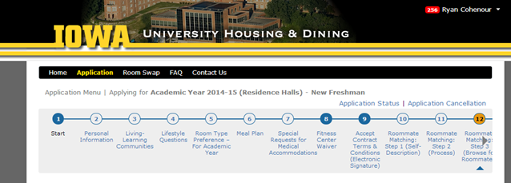
LLC Placement & Housing Assignments
Notes:
20 Minutes

Slide 12
Challenges prior to implementation
32 LLCs (All students will be placed in an LLC
All rooms need to be coded as an LLC
UIOWA has never had self selection for first year students
Upgraded to new version of HMS software
Campus Wide new Homegrown information system
lost 1key staff member; filled two critical staff positions
Limited staff in Contracts and Assignments
120 days to create a portal that worked, utilized the self-selection, and made every room on every floor an LLC

Slide 13
Applying for housing
System went from building preference based to LLC based
Chose their top five LLCs
Preferred their room type
Indicated if they had a roommate preference
If not, they could find one through the portal, based on LLC and profile from questionnaire
Paid $75 application fee
Selected a dining plan
If a mutual roommate, must have LLC preferences the same
Could come back and change any preferences until priority housing deadline

Slide 14
Application timeline for 2014
Mid October Portal Officially Opens Feb 3, 11:50 pm Deadline to be included in Self-Selection March 1, 11:59 pm Deadline for roommate matching, if application is complete by 11:59PM 2-3-14 Late March Email to self-selection students providing room self-selection date and time Early April Self-Selection begins May 1 Admissions deadline to accept at Iowa Mid May Students who did not self-select begin to be assigned Late May Official Assignment Letters will be sent by email Summer Official Assignment Letters continue to be sent by email July 1 Portal Closes to additional applications

Slide 15
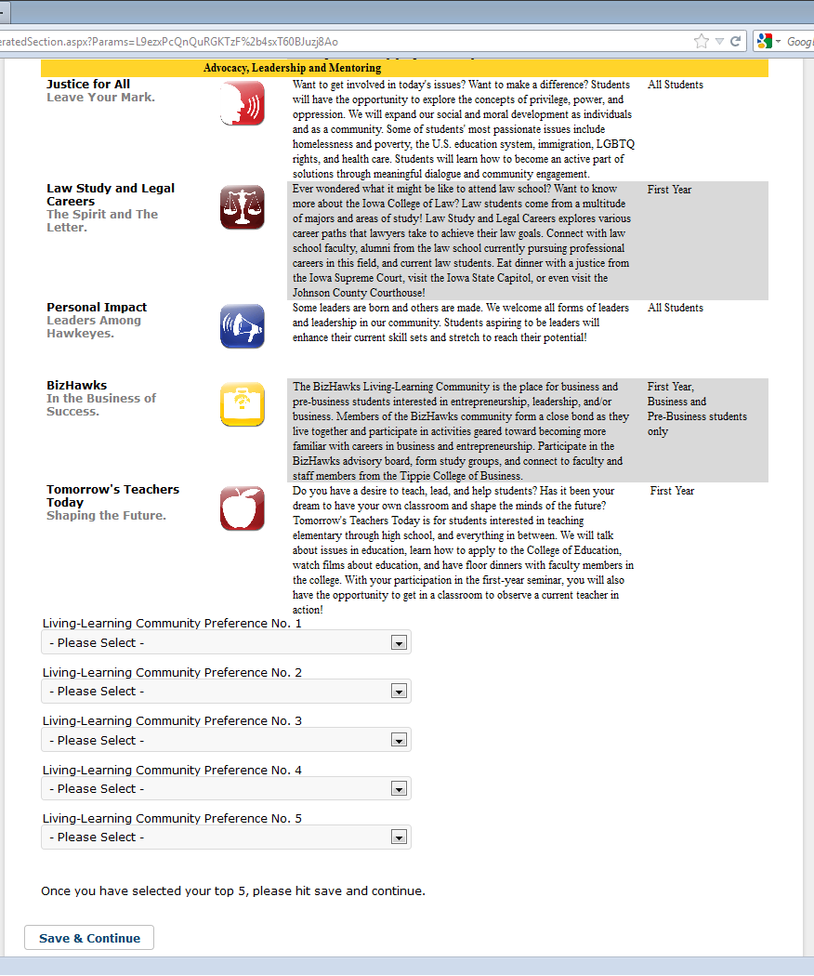
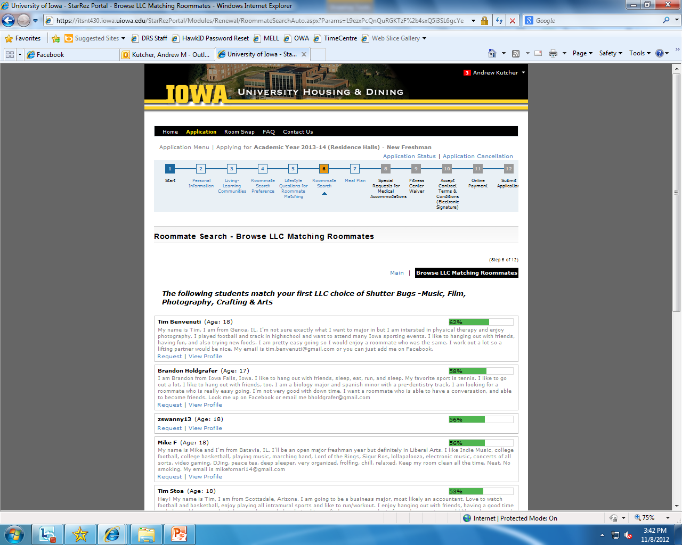
Application Portal

Slide 16
Assignment to Space
Assignments based on date of application
First year students were assigned a date and time to choose their space
Found available space in the halls within their 3-5 LLC preferences
Chose building, floor room, bed
Could reserve space for roommate of choice
Students who missed the deadline were auto assigned w/no roommate options
  System picked LLC based on room type options they selected

Slide 17
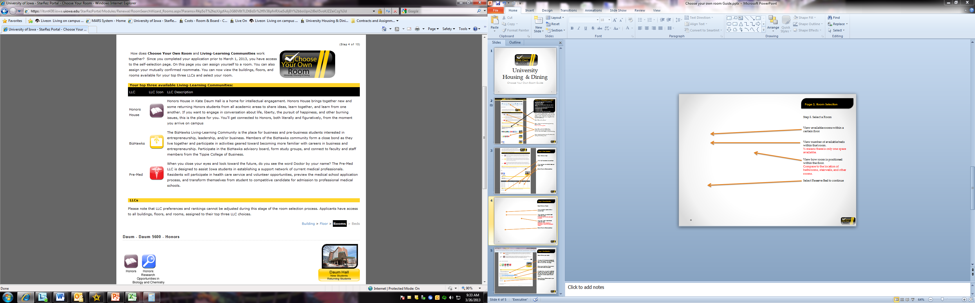
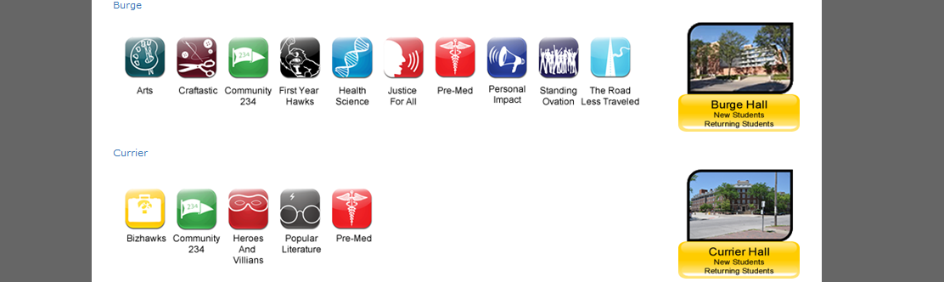
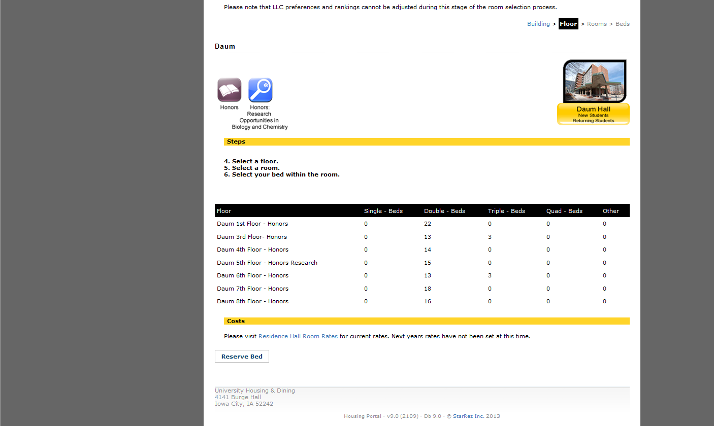
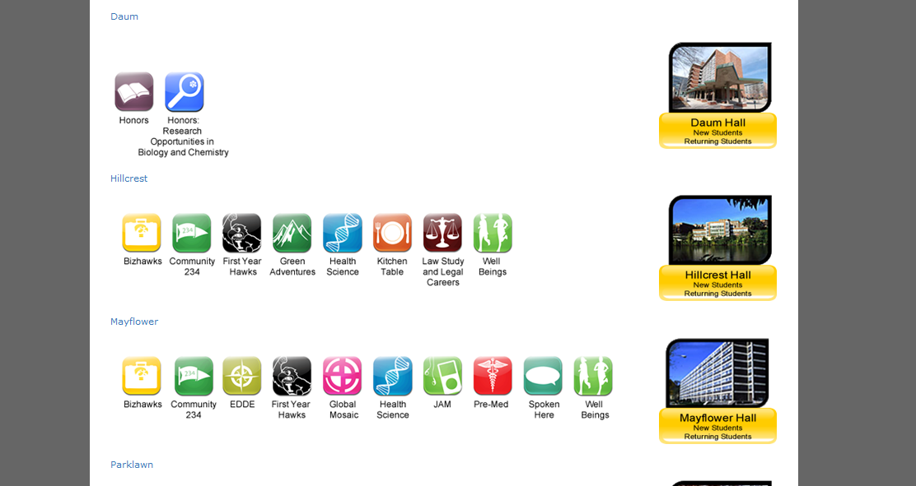
Assignment Portal,
Selecting Building

Slide 18
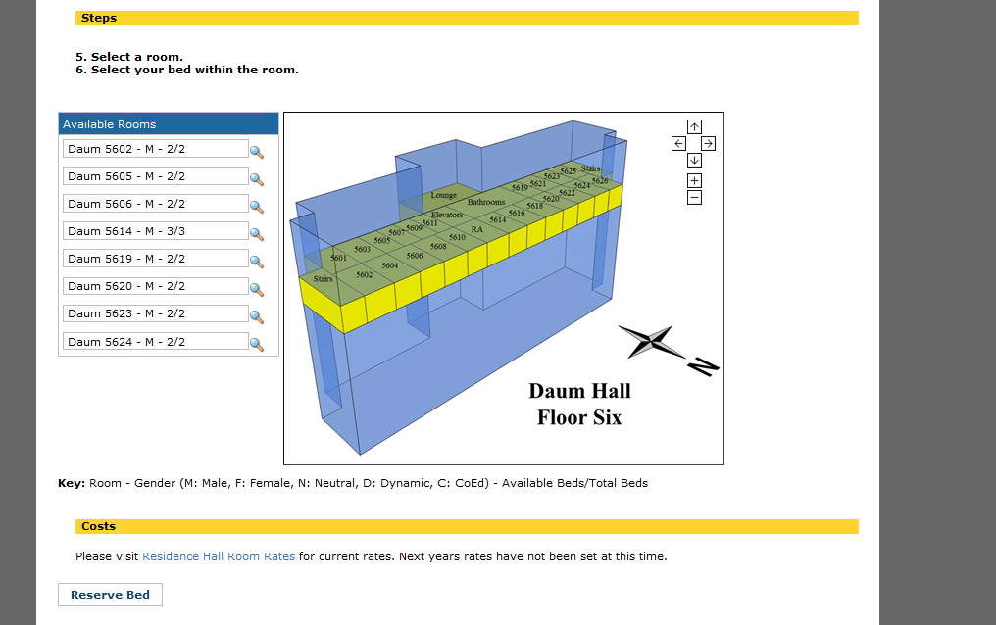
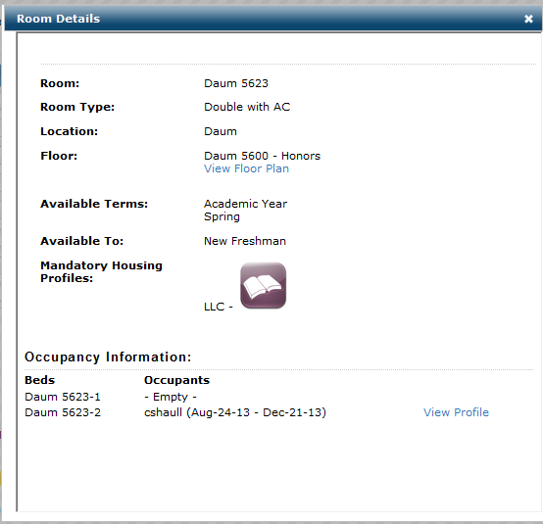
Selecting your Room

Slide 19
Unanticipated Issues with Application
Run on applications week of deadline
Strained bandwidth
Roommate Matching
Roommates didn’t accurately match up LLC preferences
High percentage of students chose First Year Hawks (42%)
Students selected building over favorite LLC
Last students frustrated by lack of “good” space in halls
Lack of interest in some LLCs
System was user friendly, but lots of calls after hours
Notes:
applications and revisions occurring in same period; left browsers open
(some students selected roommates before finalizing their housing)
(so they were not matched)

Slide 20
Student Staff Recruitment, Hiring, & Training
Resident Assistants
  Returning RA process change
  RA Seminar [Specific LLC Day]
  Interview format
  Selection
    Feedback from Academic Initiative staff
    Selection Day
LLC Programmers
  Separate hiring process from the RAs
  Training overlapped with RA training
Notes:
10 Minutes
LLC Programmer:
Recruitment – Students from RA class, Students from RA pool
Hiring –
Training –

Slide 21
Funding
Funding from Provost’s office
  LLC Programmer salaries, except a couple funded by individual departments
  LLC Partner Programming budgets
Funding from Residence Education
  LLC Partner Programming budgets
  Student Programs – Alcohol Fine Funds
  Professional Staff, Para-Professional Staff and RAs in Residence Education
Additional programming dollars
  Graduate assistants in some LLC areas
Notes:
5 Minutes
Provost’s office - $160,000 – $30,000 Programming, $10,000 Individual LLC initiatives, $120,000 Programmers
Money come from General Budget (tuition and state budget)
Allowed to use this money because LLCs are included in the strategic plan
Residence Education - $120,000 for Programming alone
Redistributed AFF budget to give more money to student programming
Student Success Coaches - $40,000

Slide 22
Fall 2013… How’s it going?
Successes
  Cross Collaborations
Challenges
  Clear Expectation
  Multiple Locations
  Flexibility in Programming Model
Notes:
10 Minutes

Slide 23
Questions, Comments, & Advice
Questions or Comments?
Advice from Iowa
  Think your plan through
  Create buy-in with key stakeholders
  Don’t give up on finding partners- Just adjust your strategy
  Know what you want to see in the end and create a multi-year plan to get there
Notes:
15 Minutes

Slide 24
Thank you!
Resources CDs
  Conceptual outline
  Job descriptions
  Training schedules
  Programming Model
    Program planning worksheet
  Campus & Community Partner Info
  Student Staff handbooks

