Slide 1
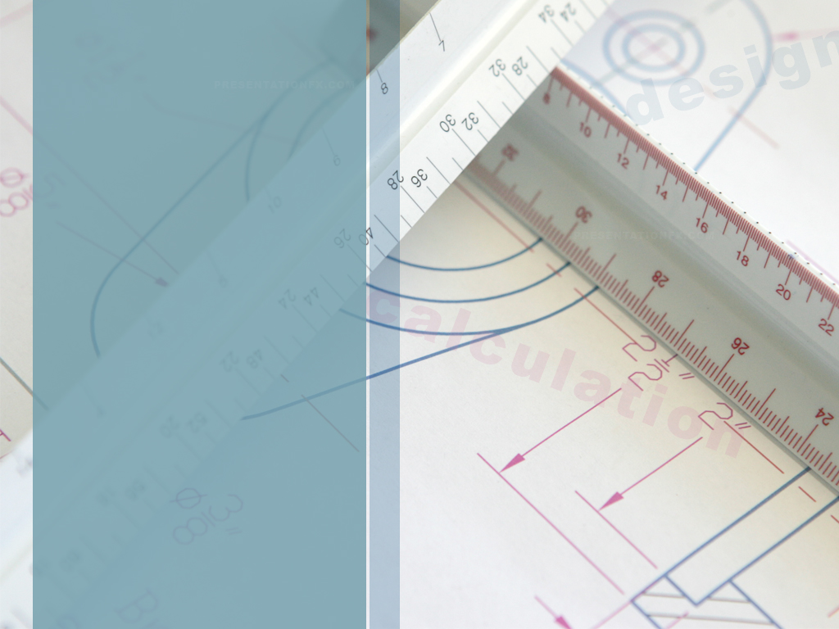
Building from Scratch: New Construction for the Newer Professional
Derek Jackson, Director
Housing and Dining Services
Kansas State University
Von Stange, Senior Director
University Housing & Dining
University of Iowa

Slide 2
Learning Outcomes
Through attendance at this program, conferees will:
better understand the language used in construction of residential facilities;
differentiate approaches between university construction and private sector construction;
learn how to utilize a wide variety of feedback to bring a project to completion;
navigate the potential political realities of residence hall construction on a university campus.

Slide 3
Concepts to cover
Master Planning
Program Development
Design development
Style of housing
Amenities
Cost and funding
Standards of construction
Method of construction delivery
Relationship between university, architect, and builder
Uniqueness of housing
Lessons learned

Slide 4
Construction:
Public vs. Private
Private Construction:
No approval (generally)
Cookie cutter design
Build faster
20-30 year buildings
Developer at risk
For profit business
Generally they own it; you lease it
Public Construction:
Trustee/Regent approval
Architect hired
Build slower
75-100 year buildings
University at risk
Not for profit auxiliary
You own it; you operate it

Slide 5
Definitions
Bond Authority
Bond Rating
Construction cost
Contingency
Cost per bed/per sf
Change orders
Debt coverage ratio
Design/bid/build
Design/build
Design-development
Guaranteed Maximum Price (GMP)
Liquidated damages
Lost opportunity costs
Operational costs
Pro forma
Program plan
Project cost
schematic design
Value engineering

Slide 6
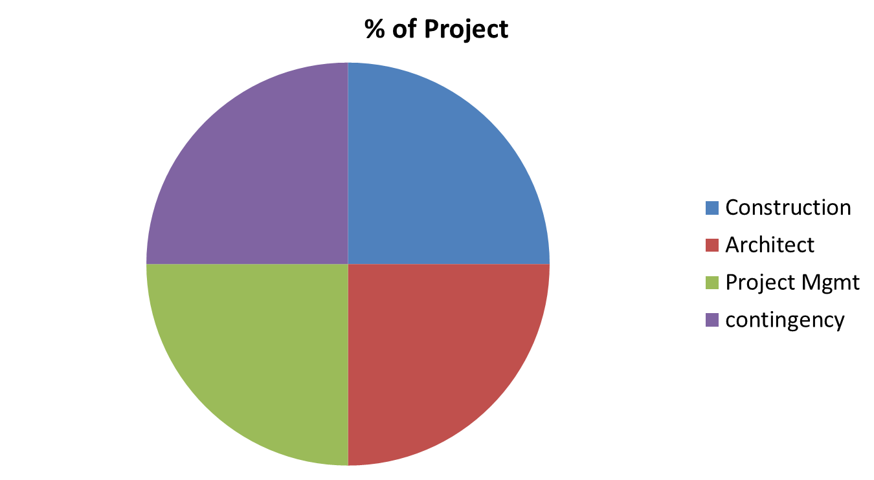
Activity: Guess the Percentages
University funded project

Slide 7
Activity: Guess the Percentages
UI New Residence Hall
Construction Costs | 38,652,281 | 74.8%
Architect Fees | 4,425,000 | 8.6%
Project Management | 1,705,336 | 3.3%
Contingency | 4,200,000 | 8.1%
Other Costs | 2,369,884 | 4.6%
Other costs include: commissioning, document printing, signage, keys, IT, utility distribution, insurance, art in state buildings, steam capacity fee, others

Slide 8
Philosophies/Logistics
Type of housing (who is your target audience)
How is this building funded? By University? Public Private Partnership? How much?
Do all students subsidize new construction?
Location of building site
Percent of fees paid for project management
LEED certification
Sustainability

Slide 9
More Philosophies/Logistics
Branding
Utility connections – own or plant
Naming of the building
Marketing and Communication
Social Media
Retail operations or classroom space considerations

Slide 10
Partners in the Process
University Planning and Design office (project management and construction management)
University Finance office complete/ oversee pro forma for project approval or bonding)
Architect of record (hired by university in design/bid/build)
Construction company (primary contractor who has multiple subcontractors under them)
Faculty and academic services
Student Services/Life/Affairs

Slide 11
More Partners in the Process
Facilities management – utilities, other projects impacting
Admissions or Business office – justification for need of new building – based on more students, decommissioning buildings, or retention goals.
Information Technology – what technology will be in building
Parking – regardless of your parking plans
City – impact on streets/traffic/pedestrians
Marketing/Communication
Media outlets

Slide 12
Steps in the Process typical Design/bid/build
Program Plan
Schematic Design
Approval by regents/trustees; with budget
Design Development; revisions and value engineering
Final draft
Construction documents
Bid on project; hope it meets budget
Groundbreaking and actual Construction
Punchlist and project completion
University accepts building and prepares for opening
Students arrive

Slide 13
Steps in the Process typical Design/build or PPP
Select project team; negotiate lease agreement
Approval by regents/trustees
Schematic Design/Design Development
Feedback on construction documents
Groundbreaking and actual Construction
Punchlist and project completion (in D/B)
University accepts building and prepares for opening
Students arrive

Slide 14
Potential Stumbling Blocks
Cost
Weather Delays
Liquidated damages
Bond market fluctuation
Construction material availability
Labor market availability and rates
Politics
Naming

Slide 15
The Voice of a
Newer Professional
“Being active in construction meetings has supplemented my professional development. The opportunity has educated me on construction terminology and processes ranging from architect’s drawings to punch lists. In addition, I have gained confidence by being in a male dominated area. In most situations, the ratio is 12:1 male to female in the meetings. My involvement has also allowed me consider the student perspective within the meetings and try to communicate updates to the residents in a timely fashion, which can be challenging.”
    Amy Baccei, University of Iowa

Slide 16
Included in your thumb drive:
KSU Campus master plan
KSU housing and Dining Master Plan
KSU and UI pro forma
New Residence Hall and Dining Center architectural program
RFQ/RFP architectural service/construction
KSU schematic design Jardine Apartments
UI construction documents New Res Hall

Slide 17
Closing Thoughts
A lot of information you won’t use immediately.
Spend time with your facilities staff
Ask to be involved in any of your projects in your building/area
Read about facilities related topics
If there is interest, you can land a job

Slide 18
Thanks for Your Attendance and Participation!
Derek Jackson, Director
Housing and Dining Services
Kansas State University
derekaj@k-state.edu
Von Stange, Senior Director
University Housing & Dining
University of Iowa
Von-stange@uiowa.edu

