Slide 1
MULTIPLE LITERACIES & LIBRARY INSTRUCTION
Vera Lux
Bowling Green State University
vlux@bgsu.edu
@thetruelight

Slide 2
WHY MULTIPLE LITERACIES?
Need to address subject-specific literacies. Often began in the disciplines
Information literacy lacking in addressing necessary skills of the digital age
Incorporate as a learning technique
Notes:
You’re not likely to be able to negotiate both the IL outcomes and the other literacy outcomes in the same 50 session.

Slide 3
“Visual literacy is a set of abilities that enables an individual to effectively find, interpret, evaluate, use, and create images and visual media.”
(ACRL, 2011)

Slide 4
“Digital literacy is the ability to use information and communication technologies to find, understand, evaluate, create, and communicate digital information, an ability that requires both cognitive and technical skills.”
(ALA, 2013)

Slide 5
“Data Literacy can be defined as the component of information literacy that enables individuals to access, interpret, critically assess, manage, handle and ethically use data”.
(Prado & Marzal, 2013, p. 126)

Slide 6
“Metaliteracy promotes critical thinking and collaboration in a digital age, a comprehensive framework to effectively participate in social media and online communities. It is a unified construct that supports the acquisition, production, and sharing of knowledge in collaborative online communities.”
(Mackey & Jacobson, 2011, p. 62)

Slide 7
INFORMATION LITERACY

Slide 8
“Information literacy combines a repertoire of abilities, practices, and dispositions focused on expanding one’s understanding of the information ecosystem, with the proficiencies of finding, using and analyzing information, scholarship, and data to answer questions, develop new ones, and create new knowledge, through ethical participation in communities of learning and scholarship.”
(ACRL, 2014, p. 4)
Notes:
“The increasingly hybridized, multi-modal nature of learning and scholarship require an expanded conception of information literacy learning” --ACRL Draft Framework for Information Literacy for Higher Education

Slide 9
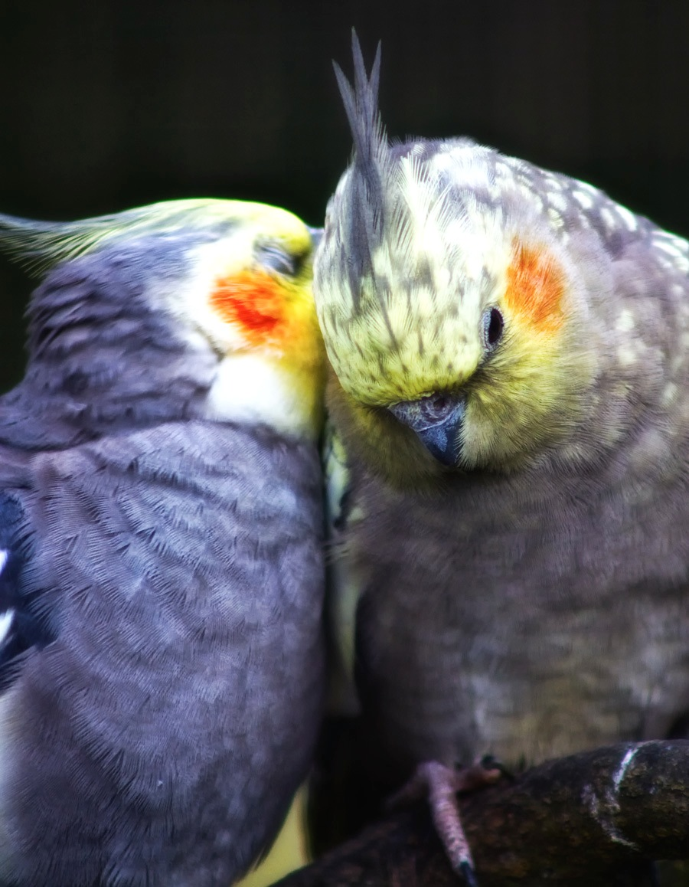
INCORPORATING MULTIPLE LITERACIES INTO ONE SHOTS IS HARD!
"Whispering at Walton Hall" by Ian Carroll Some Rights Reserved

Slide 10
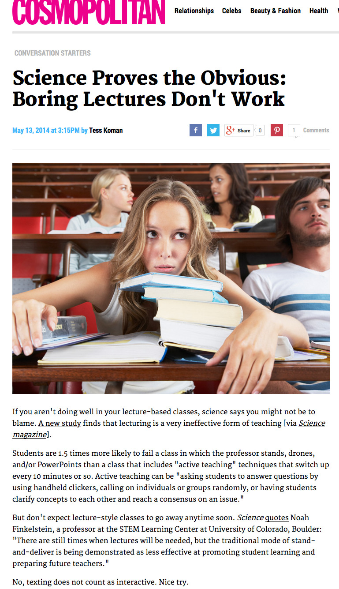

Slide 11
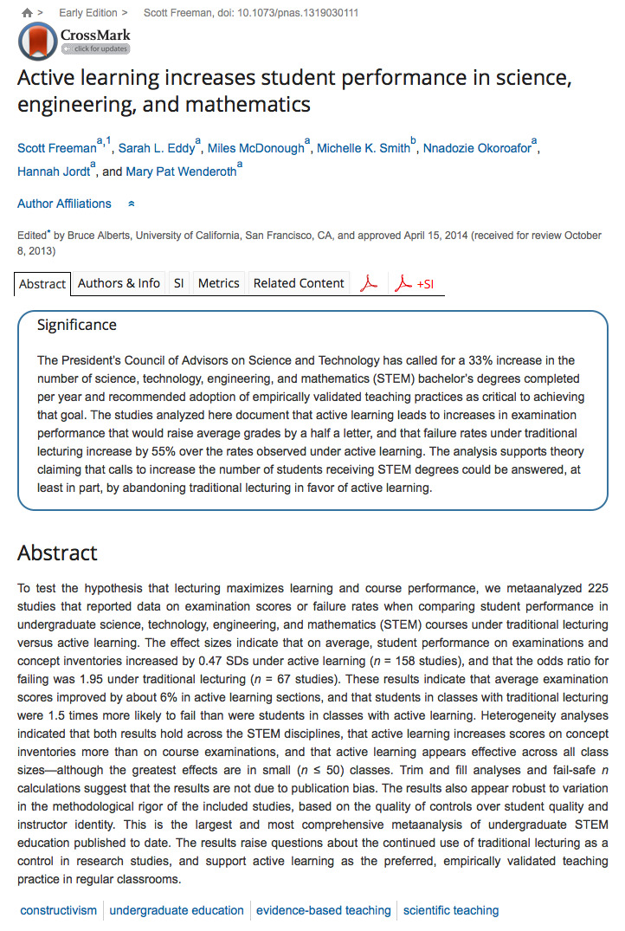
Notes:
Focus on the visuals. We don’t have time in a one shot for close readings of text so starting with visual distinctions can help our students and be functional for a 50 minute session. Help students to become more aware of the visual elements
Determine the main finding as described by the popular source. Skip to the Discussion section of the scholarly article. Is the information in the Cosmo article the real main finding? Are there nuances? Are there limitations to the study discussed that you should consider?

Slide 12
A RECENT STUDY FOUND…
Use the provided link to find the original study. If no link is provided in the article, gather information from the article to find the original study using the Article Lookup for Citations.
Take notes of the visual representation of the popular source and then the scholarly source. Focus on the factual rather than interpretations, think of this as collecting data.
Determine the main finding as described by the popular source and compare it to the findings/discussion section of the scholarly article. Explore methodology and study limitations, are these addressed in the popular source?
Notes:
(author(s), journal, study topic, institutional affiliation)
Data Literacy (foundation)
Methodology
Study Limitations
Media Literacy
Audience
Representation
Metaliteracy
Types of information
Information Literacy
Popular vs. Scholarly
Finding Scholarly Articles

Slide 13
LITERACIES ADDRESSED
Data Literacy (foundation)
  Methodology
  Study Limitations
Media Literacy
  Audience
  Representation
Metaliteracy
  Types of information
Information Literacy
  Popular vs. Scholarly
  Finding Scholarly Articles

Slide 14
Close Analysis
Visuals.
Sounds (if applicable).
Key Questions
  Who created this message?
  What creative techniques are used to attract my attention?
  How might different people understand this message differently from me? What lifestyles, values and points of view are represented in, or omitted from, this message?
  Why is this message being sent?
Review Your Insights.
  Center for Media Literacy (2003) P. 29
Notes:
1. Visuals Describe the visuals presented. Do not interpret the visuals.
2. Are there sounds or music? Are their spoken words? Who says them? Who is the audience?
3. Key Questions
4, Review your insights

Slide 15
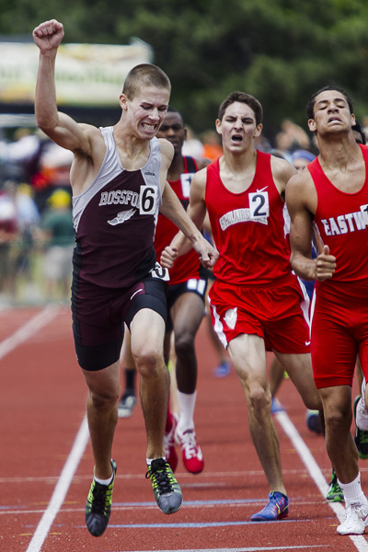
You used this photograph of a track & field athlete crossing the finish line in a web project. You just learned that it would be unethical and likely even illegal to use the image without permission if it is copyrighted. You don’t remember how you found the image and the project is due tomorrow.
Uh oh.

Slide 16
ETHICAL IMAGE USE
Conduct a reverse image search to identify the origin of the photo.
Determine copyright/permissions
If copyrighted, determine what the photograph represents and find a suitable replacement that is NOT related to sports using the sites on the “Find Images” section of your course LibGuide.
Determine an appropriate acknowledgement to accompany the new photograph.

Slide 17

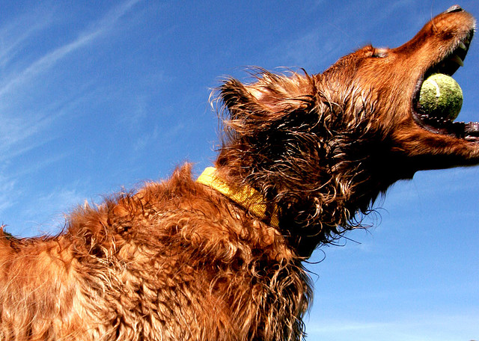
STUDENT SELECTIONS
    "I Win" by Kevin Labianco
    Some Rights Reserved
    "Success" by Volker Neumann
    Some Rights Reserved
Notes:
Visual Literacy
Find and access needed images and visual media effectively and efficiently
Interpret and analyze the meanings of images and visual media
Use images and visual media effectively
Understand many of the ethical, legal, social, and economic issues surrounding the creation and use of images and visual media, and access and use visual materials ethically
KEYWORDS!!!

Slide 18
OTHER ONE-SHOT IDEAS
Advertising analysis
Citation as image
Team-Based Learning
Infographics!
Notes:
1. Students identify the claim from an advertisement and locate a scholarly source that helps determine the accuracy of the claim.
2. Citations are visual representations of other content. Today’s students often lack the visual cues associated with print materials. Teaching students to deconstruct a citation like an image can improve their initial evaluation skills.
3. Team-based learning is ideal for developing the metaliterate learner with it’s focus on collaboration
4. Creating Infographics helps to develop desired skills across many literacies. Can it be done in an hour and include enough traditional IL skills to meet course needs? Probably not but someone should figure out a way.

Slide 19
RESOURCES
LOEX 2014 http://www.loexconference.org/program.html
ACRL Draft Framework for Information Literacy for Higher Education http://acrl.ala.org/ilstandards/?page_id=133
2014 IVLA Conference in Toledo, Ohio, November 5-8, 2014
  http://www.vislit.org/welcome/
http://metaliteracy.org/ml-in-practice/assignments/

Slide 20
REFERENCES
  American Library Association (ALA). (2013). Digital literacy, libraries, and public policy: Report of the Office for Information Technology Policy’s Digital Literacy Task Force. goo.gl/8epsJX
  Association of College and Research Libraries (ACRL). (2014). ACRL framework for information literacy for higher education: Part 1 [draft]. goo.gl/80sDBq
  Association of College and Research Libraries (ACRL). (2011). ACRL visual literacy competency standards for higher education. goo.gl/OLn0xH
  Calzada Prado, J., & Marzal, M. (2013). Incorporating Data Literacy into Information Literacy Programs: Core Competencies and Contents. Libri: International Journal Of Libraries & Information Services, 63(2), 123-134.

