Slide 1

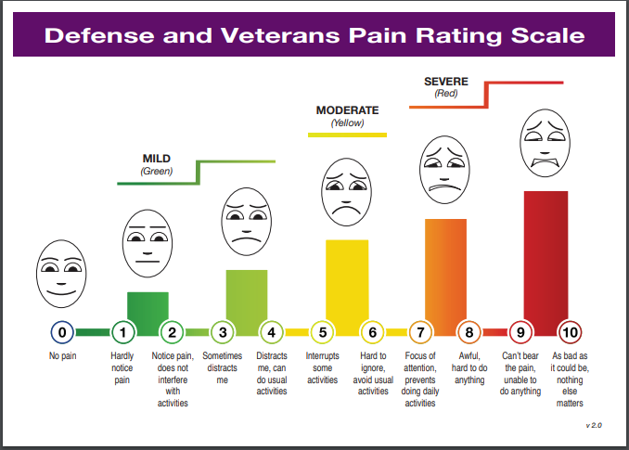

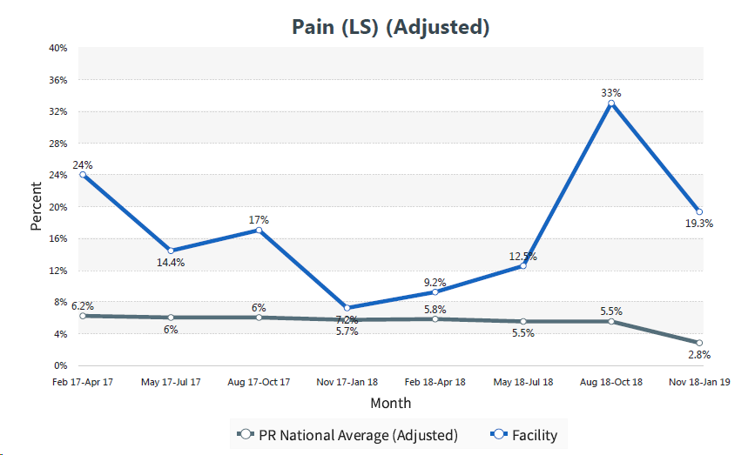
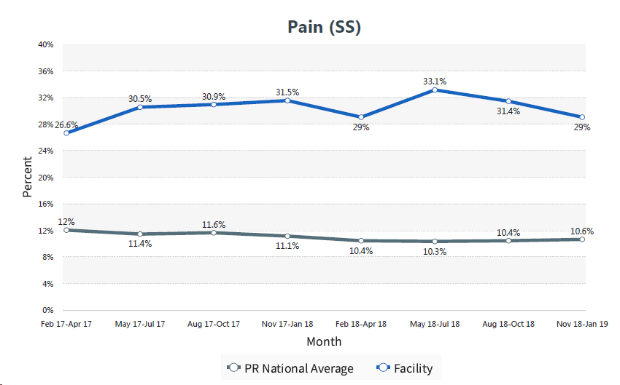

Reimagining pain and pain management for the older adult in long-term and transitional care
Karen M Sames, OTD, OTR/L, FAOTA, Meghan Mason, PhD, MPH, Shelley Rayborn, MSN, PHN, RN, Sarah Beman, PhD, RN, PHN, CNE, Denise Moen, RN, BC, Vera Stephenson, MSN, RN, PHN, Patricia Finch Guthrie, PhD, RN
Background
Purpose: To reduce the higher than average pain scores reported on the MDS forms in both transitional and long term care. Facility pain scores, as reported on the MDS, were 2-3 times the national and state averages in the years prior to this project. Evidence in the literature: Managing pain in the elderly is a challenge, affecting 40-80% of residents in long term care (Thielke, Sale, & Carrington Reid, 2010) and 40-85% in transitional care (Russel et al., 2010) Some nonpharmocologic interventions are known to be effective in reducing pain: Mindfulness, meditation, and guided imagery (Andersen, & Vægter, 2016; Bedford, 2012; Costa, Pinto-Gouveia, & Marôco, 2016; Cowan, 2011; Hernandez et al., 2014; McBee, 2003). Exercise (Fitzcharles et al., 2016; Laubenstein & Beissner, 2016; Niemelä, Leinonenk, & Laukkanen, 2011; Rhudy, Dubbert, Kirchner, & Williams, 2007; Tse et al., 2014; Tse et al., 2012; Tse et al., 2011). Massage (Adams et al., 2010; Cherkin et al., 2011; Sritooma, Moyle, Cooke & O'Dwyer, 2014) Consistency is important when measuring pain (Ayres et al. 2010). Staff education is vital to lowering pain scores (Eliopoulus, 2013; Hadjistavropoulos et al., 2016; Twycross, 2002).
Results
Satisfaction with Training Sessions (n=67) Participants’ average score was between “agree” and “strongly agree” for all three learning objectives (average scores: 4.43 - 4.61 out of 5.0) The content was presented in a way that was appropriate for the intended audience, consistent with learning objectives, could be applied to pratice and could be used to achieve personal and professional goals (average scores: 4.48 - 4.60 out of 5.0) Teaching methods clarified the content well, were appropriate for the subject matter and the length of the session (60 minutes) was adequate (average scores 4.20-4.25 out of 5.0) Participants liked the use of the DVPRS video in the training Audio/Visual challenges and the number of evaluations were the “least liked” part of the session Changes in Pain Knowledge (n=52 paired responses pre-/post-test) There was a statistically significant increase (12%) in the proportion of people responding “False” to the statement Pain is a normal part of aging (p = 0.01) There was a statistically significant increase (14%) in the proportion of people responding “True” to the statement People are more likely to report their concerns regarding their pain ig they are satisfied with their pain management plan (p = 0.02) The participants were already well-informed with the proportion of respondents answering the nine True/False questions correctly on the pre-test ranging from 72.1%-100% All of the nine True/False questions increased the percentage of respondents choosing the correct answer except for the statement The assessment, documentation, and treatment of pain is not our responsibility which already had 100% correct responses and maintained that level of correct responses in the post-test Although not statistically significant, there was an increase in the proportion of respondents who listed at least one integrative treatment option for addressing patient pain from pre- to post-test (69% to 75%) Changes in Perceptions about Pain Of the 28 questions on the survey, only two individual items had statistically significant changes in response from before and after the educational session. “If there were more time during the day, practitioners would perform pain assessments on residents with pain more routinely.” Moved down the scale (toward “strongly disagree”), p = 0.03 Average still between “neutral” and “agree” “In general, I am hesitant to give opioids to residents over the age of 70 who have chronic pain.” Moved up the scale toward (“strongly agree”), p = 0.02 Average still between “disagree” and “neutral” Changes in MDS Data Short stay declined for the two quarters after training Long stay declined for the most recent quarter
Demographics - From Perceptions Questionnaire
]
.
 | Pre-test (n=69) | Post-test (n=46
Qualifications | 36.2% RN 24.6% OT/PT 15.9% LPN 11.6% Wellness 5.8% TMA 5.8% other | 26.1% RN 34.8% OT/PT 17.4% LPN 17.4% Wellness 0% TMA 4.4 % other
Shifts | 71% Day 11.59% Evening 7.3% Night 10.1% Other | 77.8% Day 0% Evening 11.1% Night 4.5% Other
Education level | 39% Associate 15.9% Baccalaureate 5.8% AND 36.2% Other | 56.4% Associate 15.4% Baccalaureate 0% AND 28.2% Other
Av. years as practitioner | 13.3 | 12.9
Av. Years at St. Gertrude’s | 5.3 | 6.9
Discussion
Managing residents pain is an ongoing issue in long-term care and transitional care units. Through the coordinated effort of this interprofessional group the team was able to bring new knowledge to the nursing and therapy staff The team made progress on short terms outcomes of staff satisfaction with the training and the change in their knowledge The ultimate goal is to see a staff cultural change in the assessment, treatment, and documentation of pain on an ongoing basis which has the potential to shift the extended outcome indicators of adequate pain management such as those found in the PointWrite and MDS scores.
Interventions
Staff Training Nursing staff training sessions (6 times) Skills day for Nursing Assistants (CNA, RA, NAR, and CA) Reusable online training modules One-minute update newsletter (mailboxes) Comfort Menu poster for break rooms Instruction on Defense/Veterans Pain Rating Scale (DVPRS) Printed and laminated DVPRS: Placed in all resident rooms Placed on all med carts Copies for all staff lanyards Comfort Menu created Included in patient pain booklet Added to Matrix for documentation Redesigned patient pain booklet Appropriate reading level Readability
Methods
Project Design Process: Iowa Model Evidence Based Practice to Promote Excellence in Healthcare · Identified triggers · Stated a question · Appraised and synthesized our evidence · Determined if there was sufficient evidence · Engaged key personnel Outcome evaluation Quasi-experimental Design 1. Pre-test/post-test design re: Pain Knowledge Perceptions of Pain MDS Scores 2. Post-test re: Staff satisfaction with training and
Acknowledgements
We would like to acknowledge the following people who were involved in various parts of this project: Penny Moyers, EdD, OT, FAOTA Mary Chen, OTS Jennifer Luhrma, Honors Student Lindsey Roup, RN Ed Barron, PT Heather Meuleners, OT/L Marcie Donnelly, TR/Wellness Nathan Boucher, Quality Improvement Specialist

