Slide 1

The Cancer Conspiracy

Slide 2

T.L. Brink
Jackie Corona
Melissa Klaib
Crafton Hills College

Slide 3
Jackie Corona
University of California Riverside

Slide 4
Melissa Klaib
University of California
Irvine

Slide 5
INTRODUCCION

Slide 6
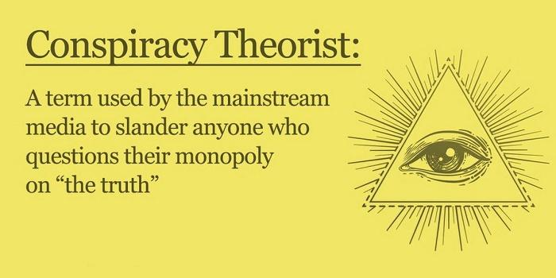
Cáncer y Conspiración

Slide 7
What is the rationale of the
theory of the cancer conspiracy?

Slide 8
Cancer Conspiracy
ways to prevent and/or cure cancer are already known (e.g., natural, holistic)

Slide 9
Cancer Conspiracy
But these are suppressed by the medical and pharmaceutical establishment in order to make profits

Slide 10
Brotherton (2016)
Belief in conspiracy is normal given the human tendency to assume agency

Slide 11
Schermer (2011)
There are no deities or spirits determining what happens here on earth. Human intensions and plans are sufficient to shape events, without resorting to random events and incompetence to explain the results.

Slide 12
Schermer (2011)
Conspiratorial thinking is pseudo-scientific and pseudo-rational.

Slide 13
Refutation #1: modus tollens
If such cures really existed, then natural & holistic health care advocates would be able to prevent or cure cancer in themselves, even if these advocates are unable to overcome the conspiracy that condemns the masses.

Slide 14
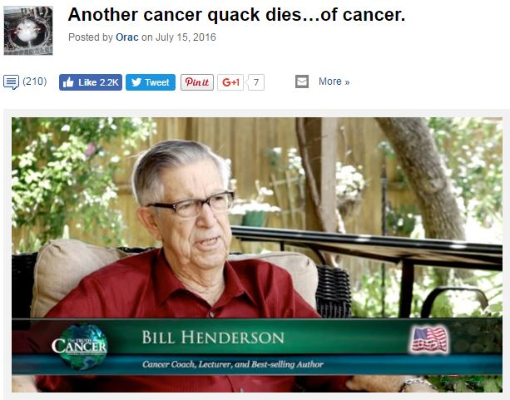

Slide 15
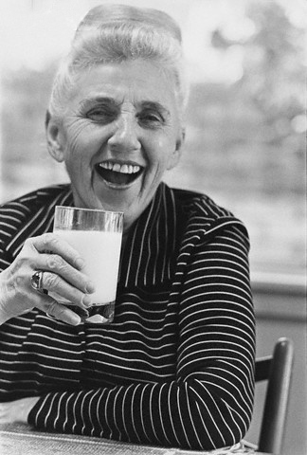
Adelle Davis

Slide 16
Refutation #2: modus tollens
The conspirators would at least save themselves and their families from cancer.

Slide 17
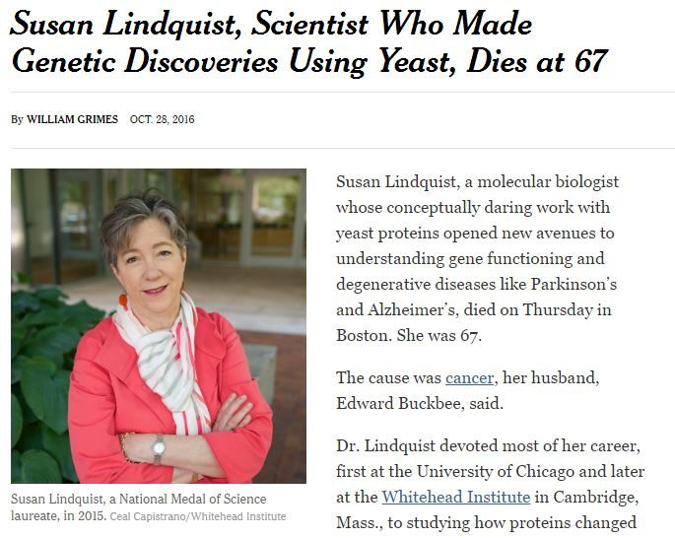

Slide 18
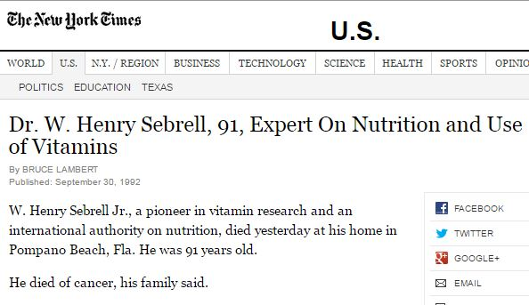
N.I.H. director

Slide 19
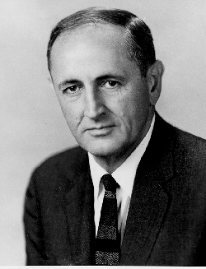
John Gardner, former Health Secretary

Slide 20
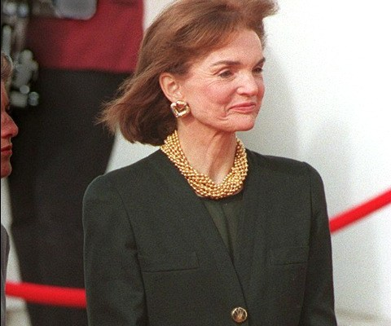

Slide 21
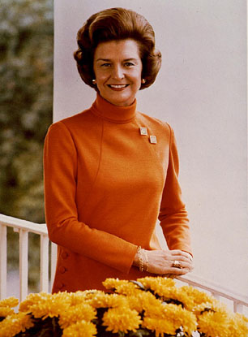
Betty Ford, mastectomy 1974

Slide 22
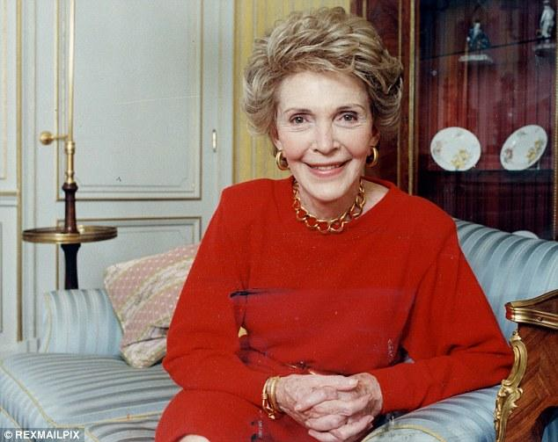
Nancy Reagan mastectomy 1987

Slide 23
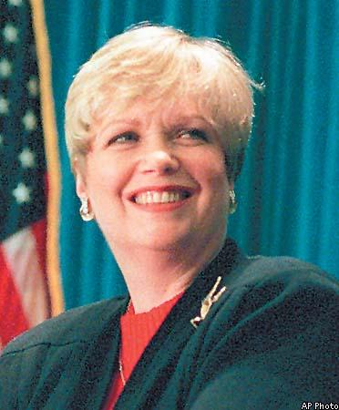
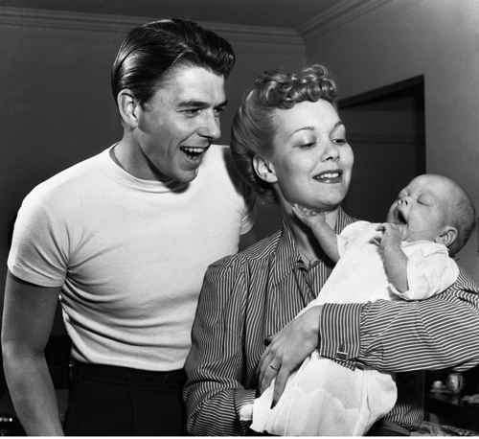
Maureen Reagan died of melanoma

Slide 24

Steve Jobs

Slide 25
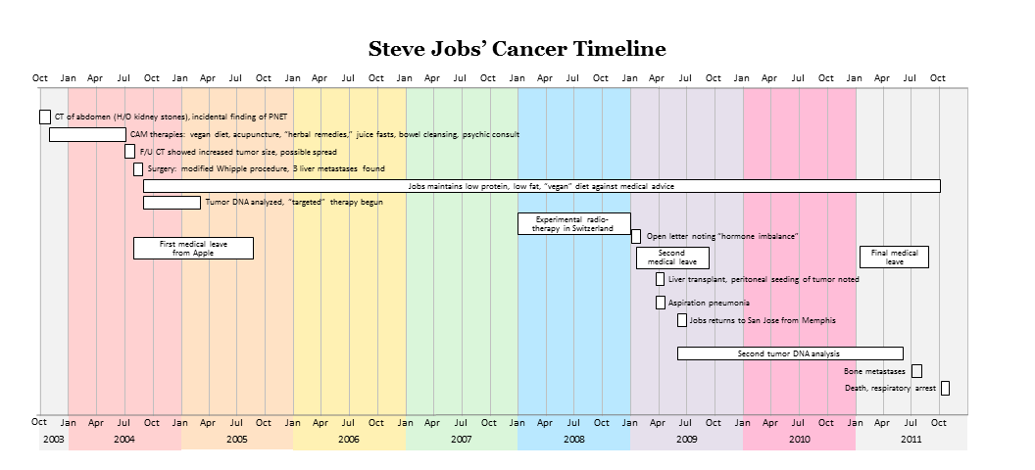
Steve Jobs’ Cancer Timeline

Slide 26
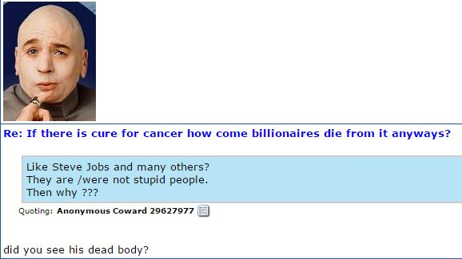
Conspiracy theorists explain away what refutes their theories as part of the conspiracy.

Slide 27
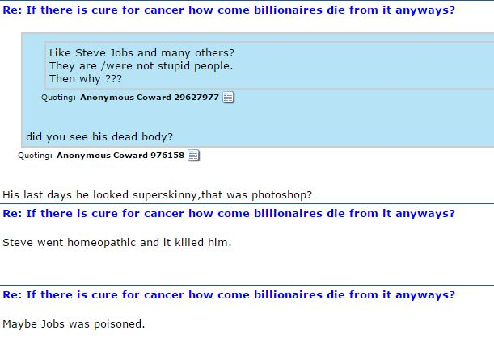

Slide 28
Alfred Adler
Inferiority Feeling

Slide 29
Alfred Adler
Inferiority Feeling
Guiding Fictions & Sham Superiority

Slide 30
Alfred Adler
Inferiority Feeling
Guiding Fictions & Sham Superiority
“I can see through the conspiracy that most people are fooled by!”

Slide 31
Bonime (1955, 1979)
Depression & Paranoia have similar dynamics

Slide 32
Meissner (1978)
Paranoia is a defense against depression

Slide 33
Meissner (1978)
Paranoia is a defense against depression
It’s not my fault

Slide 34
Meissner (1978)
Paranoia is a defense against depression
It’s not my fault
I’m a special target

Slide 35
Brink, et al (1979)
Paranoia & hypochondriasis are exacerbated by geriatric depression

Slide 36
Barkun (2003)
Conspiracy theorists think of themselves as of superior intelligence

Slide 37
Leon Festinger (1956)
When Prophecy Fails
Conspiracy theory is a self-sealing doctrine impervious to empirical refutation

Slide 38
Leon Festinger (1956)
Regardless what happens, there is an ad hoc explanation

Slide 39
Leon Festinger (1956)
Regardless what happens, there is an ad hoc explanation
Everything is evidence for the conspiracy

Slide 40
Offit (2013)
There are many false beliefs about medicine & health

Slide 41
Offit (2013)
There are many false beliefs about medicine & health
Cost of alternative treatments = $34 billion

Slide 42
Offit (2013)
Muchas creencias falsas sobre medicina
Costo para tratamientos alternativas
$34 b (dolares)

Slide 43
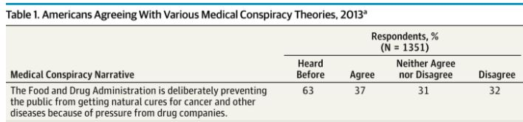
Oliver & Wood (2014)

Slide 44
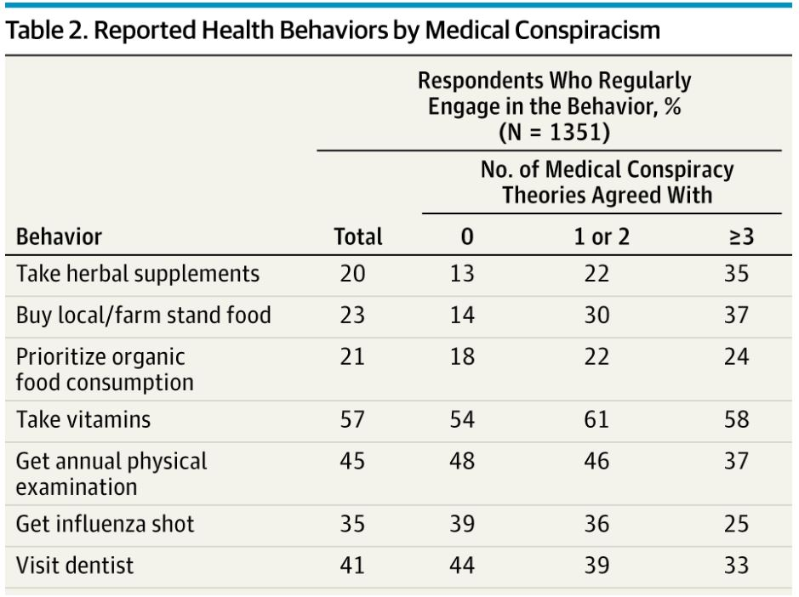
Oliver & Wood (2014)

Slide 45
Why so many pseudo-scientific beliefs about cancer?

Slide 46
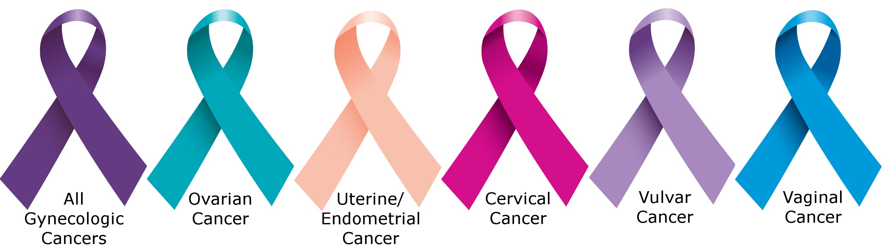
Why are there so many pseudo-scientific ideas about cancer?

Slide 47
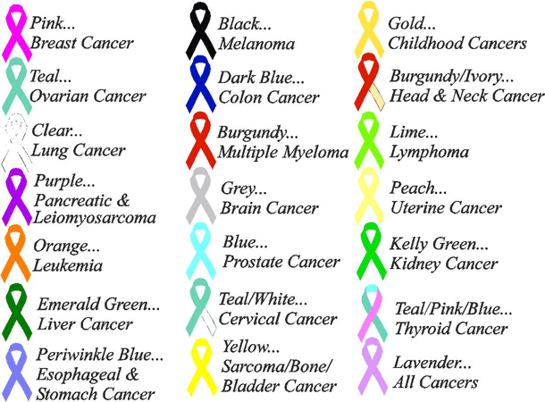
Cáncer

Slide 48
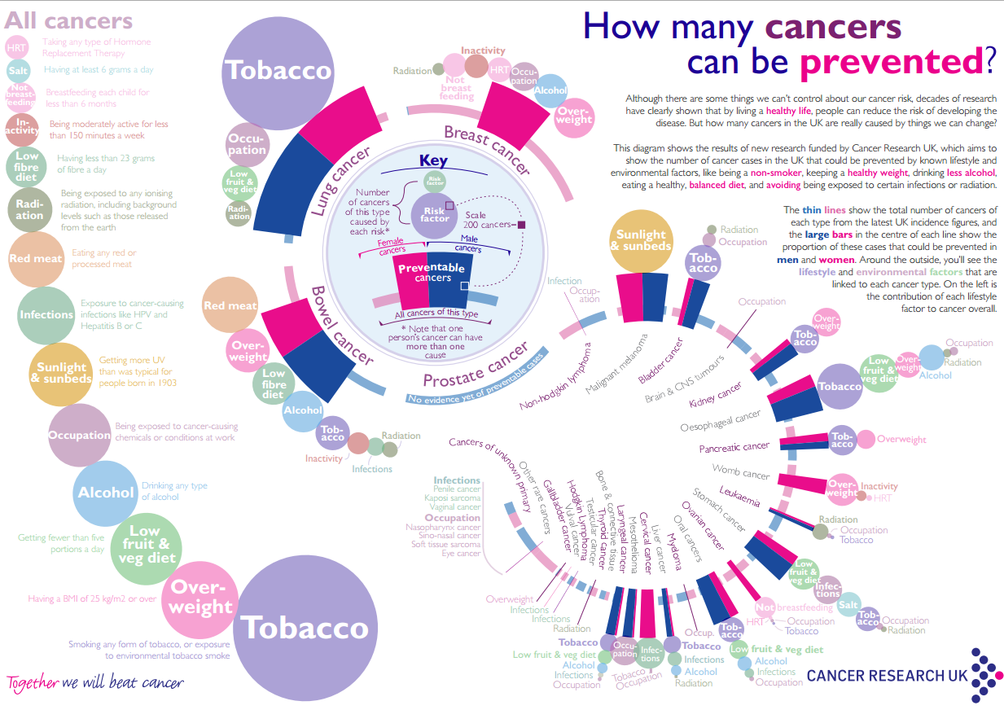
Cáncer

Slide 49
Current Consensus
“tumor cells cooperate with other tumor cells and host cells in their microenvironment. … the ecosystem evolves and adapts to ensure the survival and growth of cancer.” (Horning, 2017)

Slide 50
The facts seem counter-intuitive
Number of cases down by 23% in the last quarter century

Slide 51
The facts seem counter-intuitive
Number of cases down by 23% in the last quarter century
More patients are surviving

Slide 52
The role for psychology
Motivate preventive behaviors

Slide 53
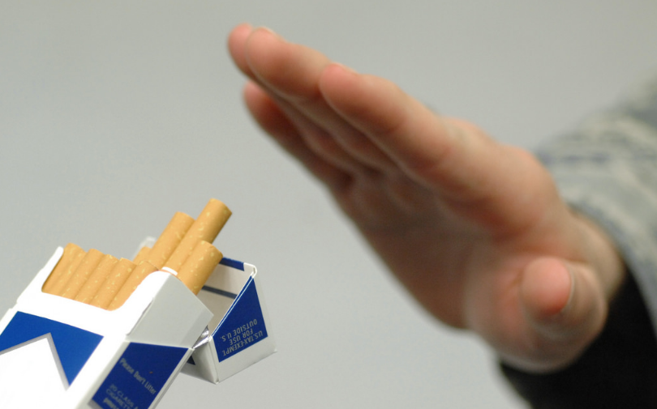
Dejar de fumar

Slide 54
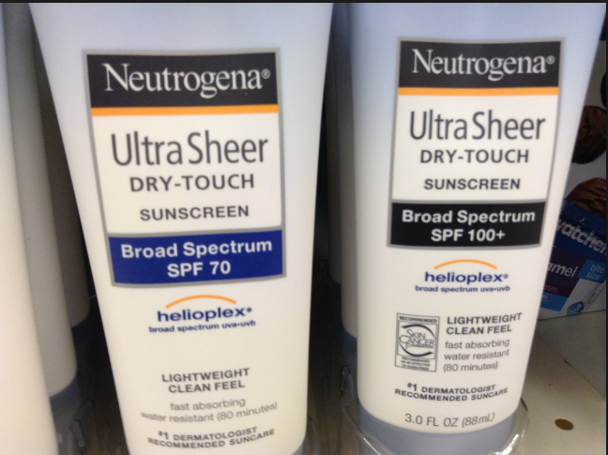

Slide 55
The role for psychology
Motivate early detection

Slide 56
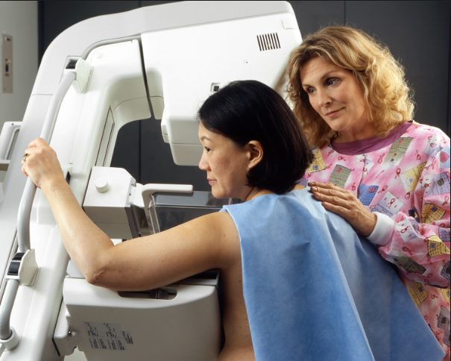

Slide 57
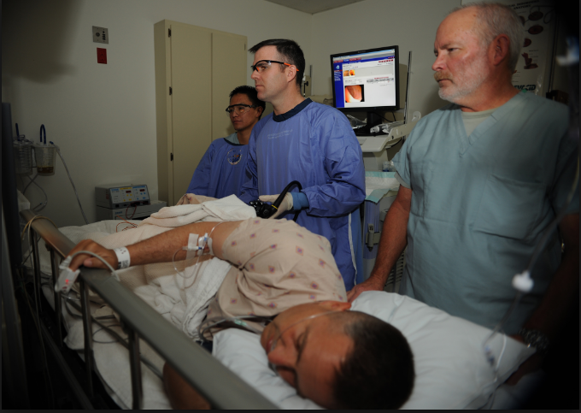

Slide 58
GUIDING QUESTION #1
How widespread acceptance of the cancer conspiracy theory among U.S. undergraduate university students?

Slide 59
GUIDING QUESTION #2
Is acceptance of the cancer conspiracy theory related to background factors such as gender, ethnicity or religiosity?

Slide 60
GUIDING QUESTION #3
Is acceptance of the cancer conspiracy theory related to coursework in science or career choices in medicine?

Slide 61
GUIDING QUESTION #4
Do U.S. & Mexican students differ in their acceptance of the cancer conspiracy theory?

Slide 62
METHOD

Slide 63
Sample
Undergraduate students at University of California campuses (UCI & UCR), total n = 133

Slide 64
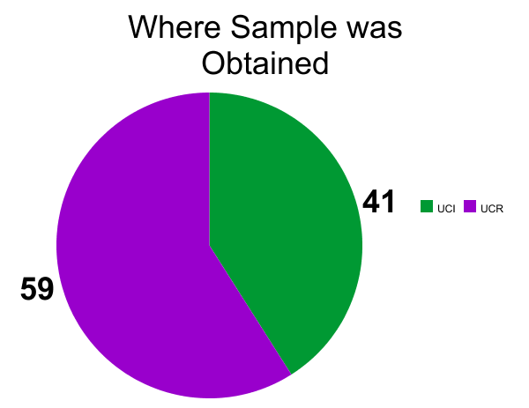
Sites: UCR & UCI

Slide 65
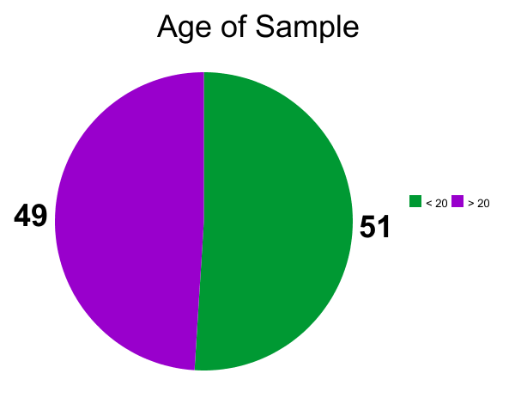
Half was under age 20

Slide 66
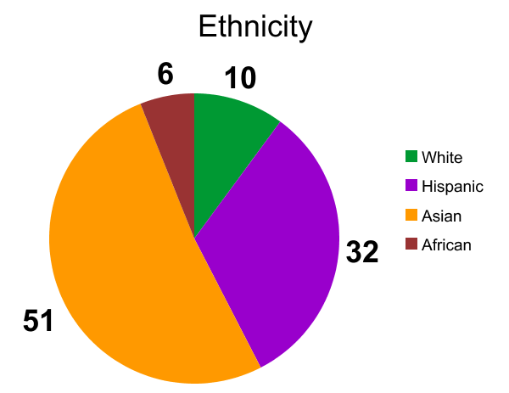
Half Asian / Third Hispanic

Slide 67
Mexican Sample
N = 49

Slide 68
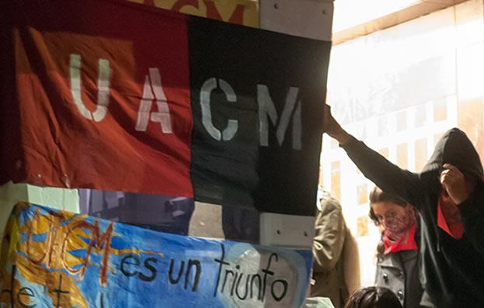
UACM

Slide 69

UCSJ

Slide 70

UAEM

Slide 71
Apparatus: questionnaire
Age | Courses in Science / Medicine
Ethnicity | Career in Science / Medicine
Religiosity | Cancer Conspiracy

Slide 72
Religiosity
How important is religion in your life?
(Gallup, 2013)

Slide 73
Religiosity
Very important
Fairly important
Not very important

Slide 74
Cancer Conspiracy
Do you agree that ways to prevent and/or cure cancer are already known, but that there is a conspiracy

Slide 75
Cancer Conspiracy
by the medical and pharmaceutical establishment to suppress this knowledge in order to make more profits?

Slide 76
Seven level Likert
Agree strongly
Agree
Agree mildly
Don’t know / not sure
Disagree mildly
Disagree
Disagree strongly

Slide 77
Data Analysis
VassarStats.net
& JASP

Slide 78
RESULTS

Slide 79
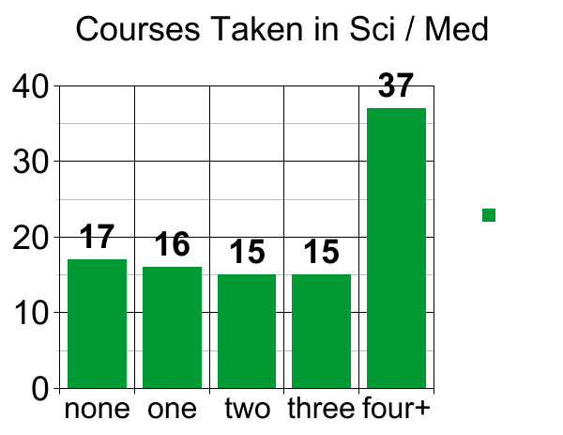
Number of courses taken in Science & Medicine

Slide 80
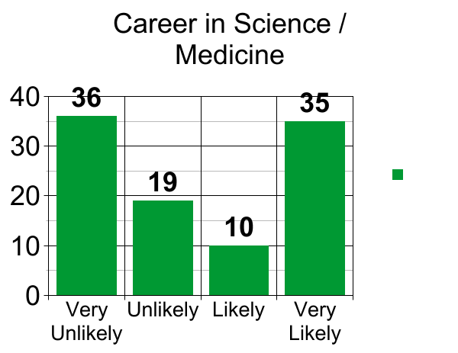
Headed for a career in science or medicine?

Slide 81
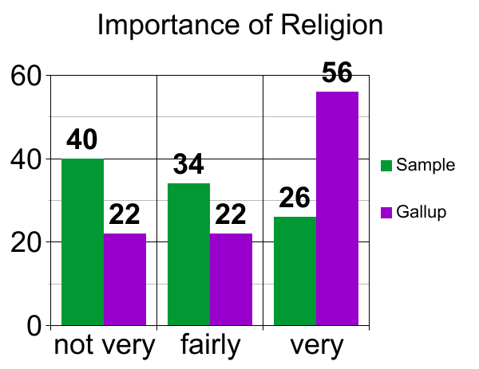
Low in Religiosity

Slide 82
Low in Religiosity
Significantly lower than the national norms.
P < .001 Kolmogorov-Smirnov Dmax = .297

Slide 83
Endorsement of Cancer Conspiracy?
Less than a quarter of the U.S. sample were on the side of disagreement.

Slide 84
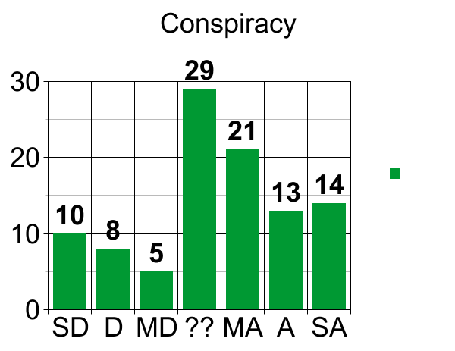
Endorsement of Cancer Conspiracy?

Slide 85
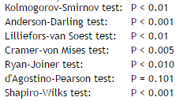
Endorsement of Cancer Conspiracy?
Differs significantly from normal distribution.

Slide 86
Endorsement of Cancer Conspiracy?
Differs significantly from flat distribution.
P < .01 Kolmogorov-Smirnov Dmax = .195

Slide 87
No significant differences (or interactions) between
Gender | Age | Ethnicity
Religiosity | Coursework | Career

Slide 88
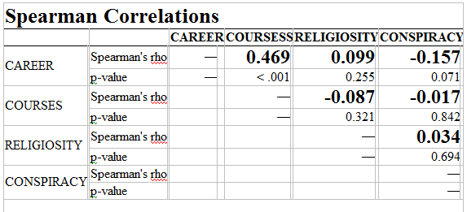
No significant differences (or interactions) between

Slide 89
No significant differences (or interactions) between
No correlations > .20
No significance < .05
No effect size > .30
No Bayes Factors > 3.0

Slide 90
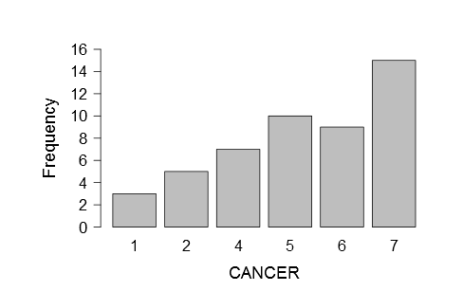
Mexican University Students

Slide 91
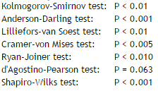
Mexican Data on Cancer Conspiracy
Differs significantly from normal distribution.

Slide 92
Mexican Data on Cancer Conspiracy
Differs significantly from flat distribution.
P < .01 Kolmorov-Smirnov
Dmax = .266

Slide 93


National Comparisons on Cancer Conspiracy
Country | Schools | Mean | Median | Mode | Min | Max | STD. DEV.
U.S. | UCR & UCI | 4.4 | 4 | 4 | 1 | 7 | 1.8
Mexico | UACM UAED UCSJ | 5.1 | 5 | 7 | 1 | 7 | 1.9

Slide 94
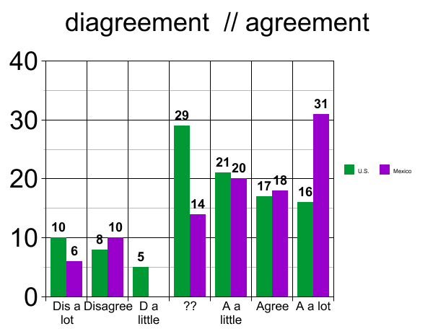
National Comparisons on Cancer Conspiracy

Slide 95
Significance of the Difference
t test p = .014
Welch p = .018
Mann-Whitney p = .006

Slide 96
Significance of the Difference
Kolmogorov-Smirnov p = .043
Dmax = .227

Slide 97
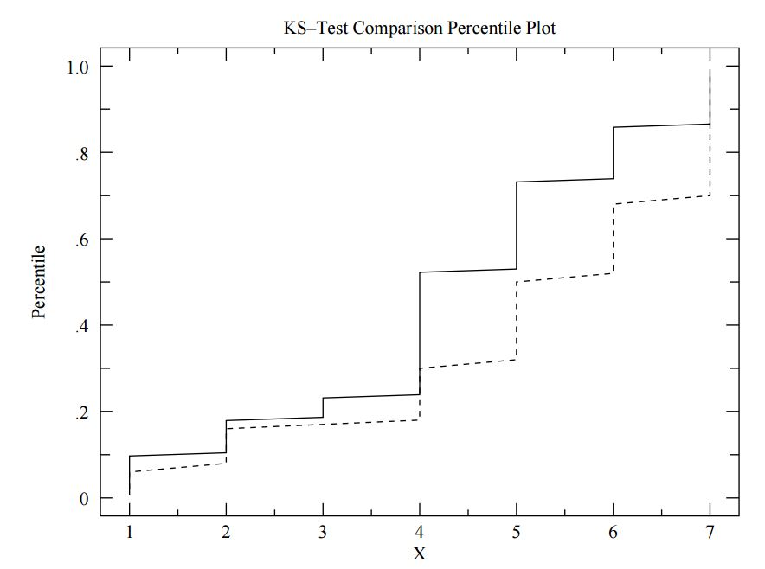
Significance of the Difference

Slide 98
Significance of the Difference
Bayes Factor = 2.9

Slide 99
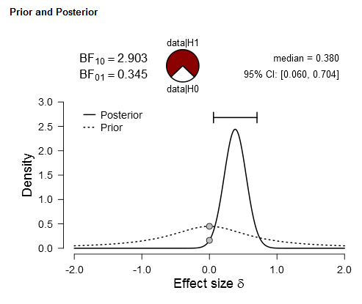
Significance of the Difference

Slide 100
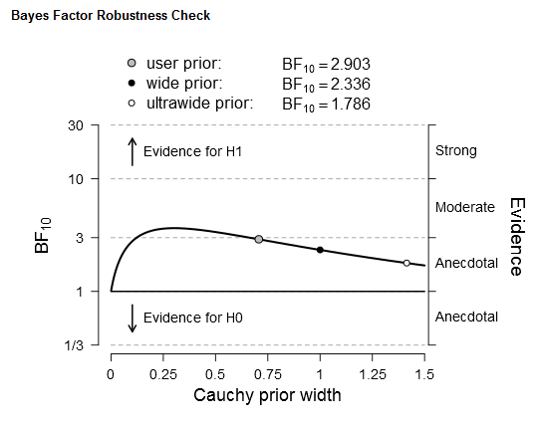
Significance of the Difference

Slide 101
Size of the Difference
Cohen’s d = 0.414
95% confidence interval of
the mean difference between
these two samples
0.128 to 1.354

Slide 102
DISCUSSION

Slide 103
Follow Up
I am an advocate of qualitative approaches, especially for following the processes of decision making (Brink, 1994, 1999, 2013, 2017)

Slide 104
Follow Up
Interviews of cancer patients and oncologists in Mexico

Slide 105
Follow Up
Interviews of cancer patients and oncologists in Mexico: lack of trust of health care system

Slide 106
Cognitive Dissonance (Festinger)
Behavior > Belief

Slide 107
Cognitive Dissonance (Festinger)
Behavior > Belief:
Lack of prevention & screening behavior leads to delegitimatization of oncology

Slide 108
Future Research
Bigger samples
Oncology patients
Manipulations of incentives for screening & prevention

Slide 109
Psychology has a key role in this
"medical reasoning is done in a social and collaborative setting"
(Patel, Arocha y Zhang, 2012)

Slide 110
Date QR code & URL

Slide 111
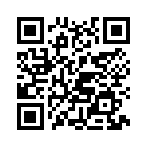
Data: https://goo.gl/GP6UFR

Slide 112
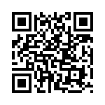
Presentation.ppt
https://works.bepress.com/tlbrink/

Slide 113
T.L. Brink, et al
Crafton Hills College
Brink@usa.com

