Slide 1

Ritualization & Resilience in a Mexican Hospital for the Aged
subtitle

Slide 2

T.L. Brink
Crafton Hills College
Yucaipa CA 92399

Slide 3
Contention of this Presentation
Don’t view the geriatric life review as a recovery of valid memory, but as a ritual that is repeated because of its relevance

Slide 4
Adler’s Early Childhood Recollections
The further back, the less valid the memory, the more reflective of present needs
(guiding fictions,
motives, values)

Slide 5
Dan McAdams (2016)
actor in performing present

Slide 6
Dan McAdams (2016)
actor in performing present
author of narrative

Slide 7
Dan McAdams (2016)
actor in performing present
author of narrative
reconstructed past
(with regret & alibi)

Slide 8
Dan McAdams (2016)
actor in performing present
author of narrative
reconstructed past
(with regret & alibi)
Creates relevance

Slide 9
How to look at reported memories
Determined more by the needs of the present than actual events of the past

Slide 10
Augustine’s Confessions
Not so much an accurate account of the motives of a 16 year old,

Slide 11
Augustine’s Confessions
Not so much an accurate account of the motives of a 16 year old,
But the self-definition of a 49 year old churchman

Slide 12
Pargament & Cummings (2010)
Role of religion in resilience

Slide 13
Dillon & Wink (2007)
Religion buffers poor health

Slide 14
Brink (1993)
Depression epidemic is due to less reliance on religion.

Slide 15
Grotberg (2003)
(Resilience theory)
“make it relevant in the marketplace, in the therapy room, and in the pew.”

Slide 16

The Dance of Life

Slide 17
Erikson’s stairs
integrity
generativity
intimacy
identity
competence
initiative
autonomy
hope

Slide 18
Erikson’s Limitations
1) northamerican;
2) 20th century;
3) male-oriented;
4) hetero-normative;
5) class normative;
6) failure focused;
7) application

Slide 19
Erikson’s Limitations
What is …
Generativity?
Integrity?

Slide 20
The Human Life Span is
Not stairs

Slide 21
but
People movers

Slide 22
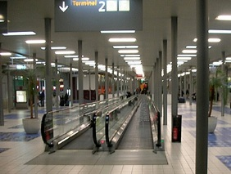
People movers at airport

Slide 23
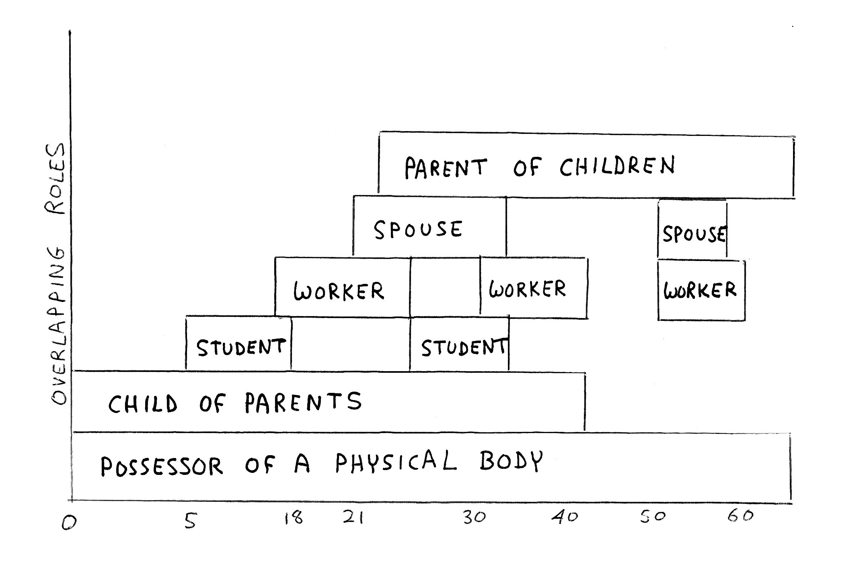
Adult life is juggling roles

Slide 24
The five R’s
Role overload

Slide 25

Role overload

Slide 26
The five R’s
Role Overload
Rapid Role Transition

Slide 27
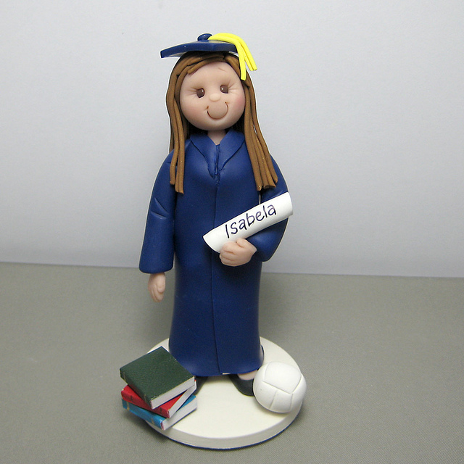
Rapid role transition

Slide 28
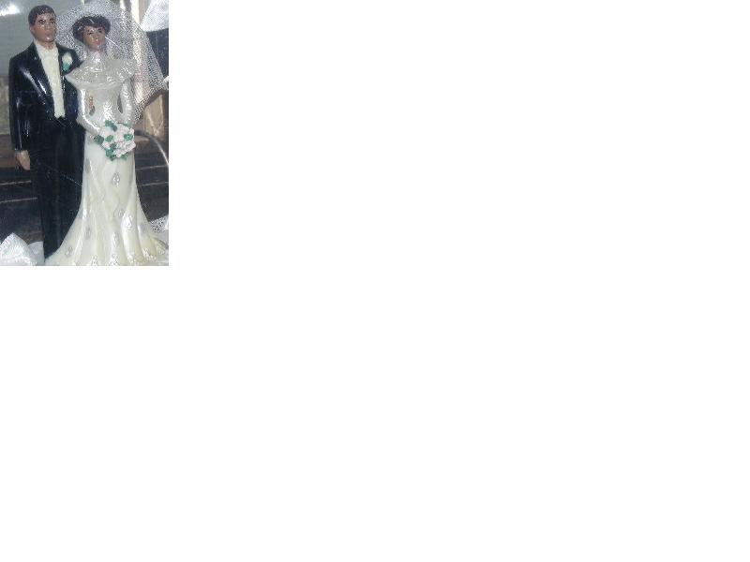
Rapid role transition

Slide 29
The five R’s
Role overload
Rapid role transition
Role timing

Slide 30
The five R’s
Role overload
Rapid role transition
Role timing
Role deficiency

Slide 31
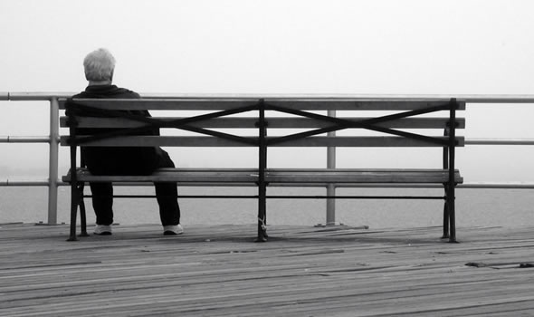
Role deficiency

Slide 32
The five R’s
Role overload
Rapid role transition
Role timing
Role deficiency
Role incompatibility

Slide 33
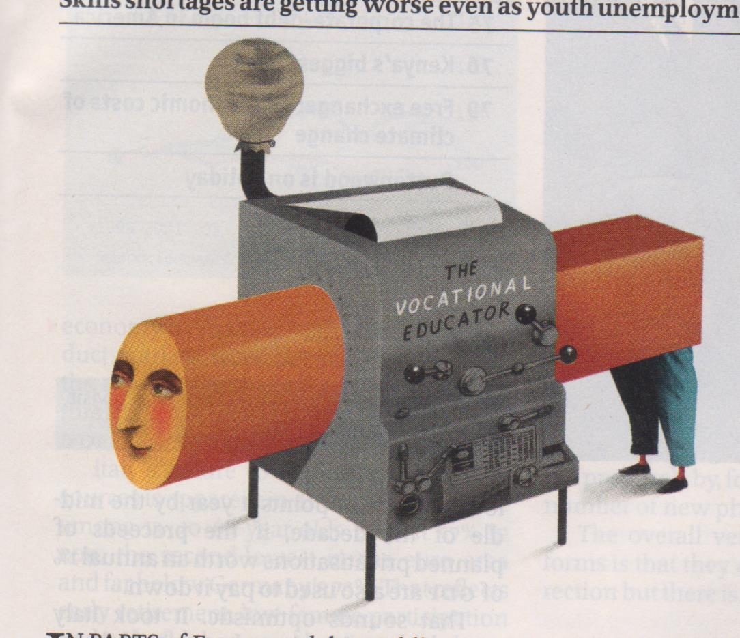
Role incompatibility

Slide 34
Generativity? Adult live is juggling roles

Slide 35
It is time for
The official definition of religion
(Carmody & Brink, 2013)

Slide 36
Religion is a system of
doctrines
ethics
rituals
myths
symbols
for the expression ofultimate relevance

Slide 37
Religion is a system of
Doctrines: statements about deities & afterlife
ethics
rituals
myths
symbols
for the expression ofultimate relevance

Slide 38
Religion is a system of
doctrines
Ethics rules guiding moral behavior
rituals
myths
symbols
for the expression ofultimate relevance

Slide 39
Religion is a system of
doctrines
ethics
Rituals: ceremonies
myths
symbols
for the expression ofultimate relevance

Slide 40
What’s wrong with this statement?
“My family doesn’t have any traditions. We just do the same thing year after year.”

Slide 41
“We’re Baptists
We don’t have any rituals.”

Slide 42
Religion is a system of
doctrines: statements about deities, afterlife, salvation
ethics: specific rules for governing behavior
rituals: ceremonies
myths: stories about the past
symbols:
for the expression of ultimate relevance

Slide 43
Myth
a story about the past
retold
because of its relevance for expressing certain values

Slide 44
Religion is a system of
doctrines: statements about deities, afterlife, salvation
ethics: specific rules for governing behavior
rituals: ceremonies
myths: stories about the past
symbols: images/objects pointing to sacred
for the expression of ultimate relevance

Slide 45
Interaction
Myths explain the origins of symbols & rituals

Slide 46
Interaction
Myths explain the origins of symbols & rituals
Symbols are used to make myths & rituals more relevant

Slide 47
Interaction
Myths explain the origins of symbols & rituals
Symbols are used to make myths & rituals more relevant
Rituals use symbols to reenact myths

Slide 48
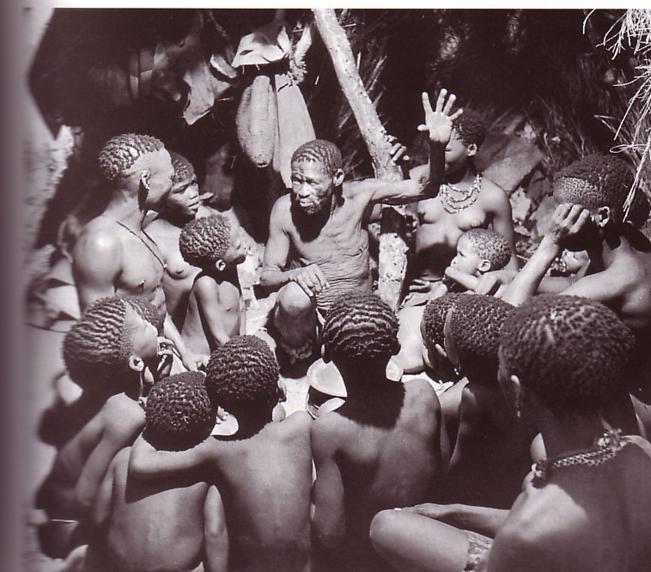
Myths are retold in ceremonies

Slide 49
Contention of this Presentation
Don’t view the geriatric life review as a recovery of valid memory, but as a ritual that is repeated because of its relevance

Slide 50
Specifically,
The Life Review occurs as a special ceremonial act in which normal criteria for fact-checking are suspended, and the relevant myths of one’s life are retold in the reconstruction of adult identity

Slide 51
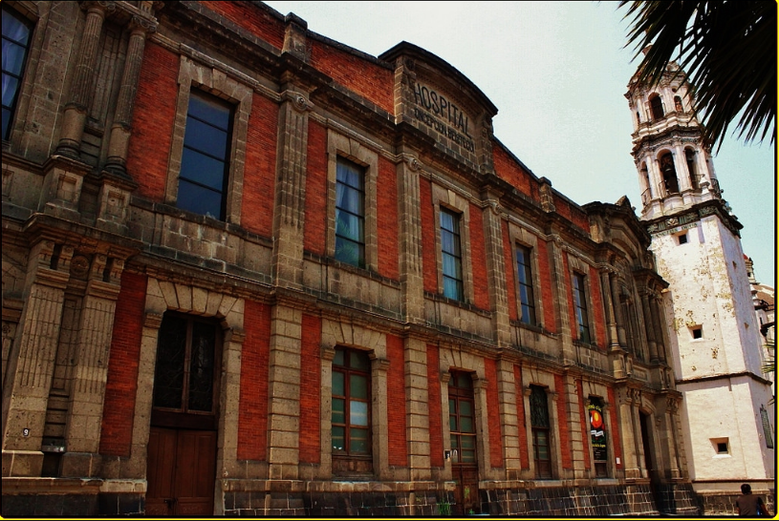
Hospital Beistegui

Slide 52
Hospital Beistegui
Founded 1886
Bequest from Maria Concepcion Maxima
Beistegui y Garcia

Slide 53
Hospital Beistegui
Founded 1886
Bequest from Maria Concepcion Maxima Beistegui y Garcia
Convent in Historic Center

Slide 54
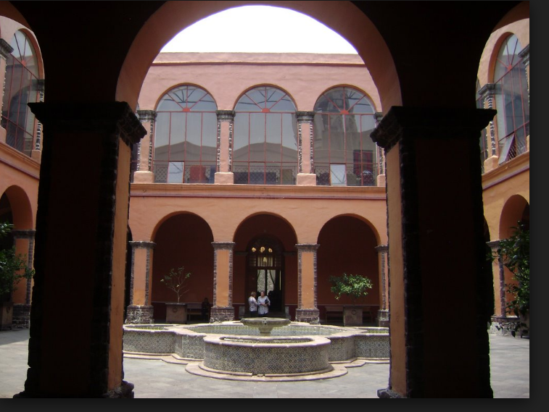

Slide 55
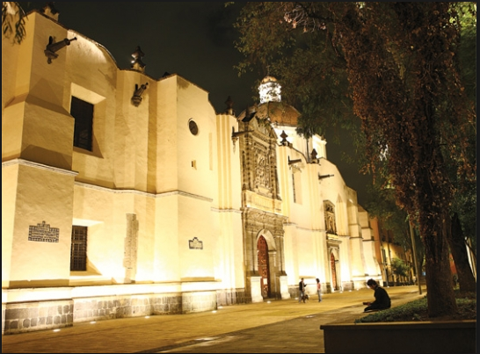

Slide 56
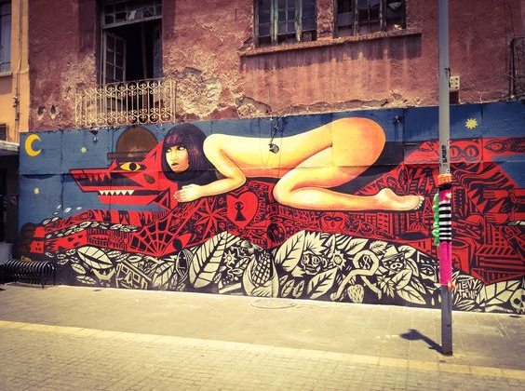

Slide 57
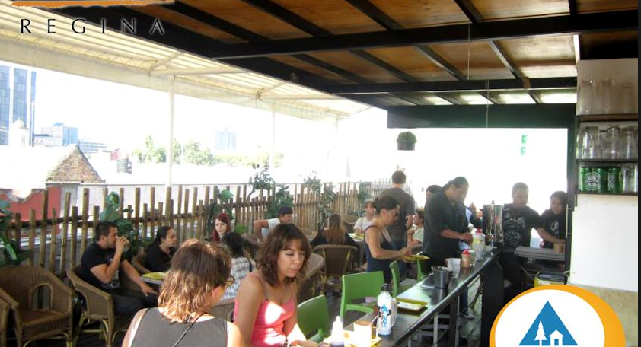

Slide 58
Sample
Selected by medical staff

Slide 59
Sample
Selected by medical staff
No dementia

Slide 60
Sample
Selected by medical staff
No dementia
Adequate hearing

Slide 61
Sample
Selected by medical staff
No dementia
Adequate hearing
Could speak
Would not easily tire

Slide 62
Sample
N = 13 (out of 100 bed)
(11 inpatients
+ 2 from day center)

Slide 63
Ms. A: previous info
Obese to the point of being immobile

Slide 64
Ms. A: previous info
Obese to the point of being immobile
Presumida, Aristocrata

Slide 65
Ms. A: first impressions
Projected dignity and status

Slide 66
Ms. A: first impressions
Projected dignity and status
“I don’t like frivolous people”

Slide 67
Ms. A: first impressions
Projected dignity and status
“I don’t like frivolous people”
“I hate undisciplined people”

Slide 68
Ms. A: first impressions
Projected dignity and status
“I don’t like frivolous people”
“I hate undisciplined people”
“That’s why I don’t like people of my country.”

Slide 69
Ms. A: first impressions
Projected dignity and status
“I don’t like frivolous people”
“I hate undisciplined people”
“That’s why I don’t like people of my country.”
“People don’t want to obey”
(authoritarian > egalitarian)

Slide 70
Ms. A: first impressions
“My roommate is a human donkey”
Otherwise, very happy here at Hospital Beistegui

Slide 71
Ms. A: birth
Born 1951
64 at interview

Slide 72
Ms. A: lineage
Maternal grandmother was Belgian

Slide 73
Ms. A: lineage
Maternal grandmother was Belgian
Rich paternal grandfather

Slide 74
Ms. A: lineage
Maternal grandmother was Belgian
Rich paternal grandfather
Father had much real estate

Slide 75
Ms. A: lineage
Maternal grandmother was Belgian
Rich paternal grandfather
Father had much real estate
Had large home, many servants

Slide 76
Ms. A: birth order
Oldest, first born

Slide 77
Ms. A: birth order
Oldest, first born
Three younger sisters

Slide 78
Ms. A: birth order
Oldest, first born
Three younger sisters
Youngest was brother

Slide 79
Ms. A: birth order
Oldest, first born
Three younger sisters
Youngest was brother
(sickly child)

Slide 80
Ms. A: birth order
Oldest, first born
Three younger sisters
Youngest was brother
(sickly child)
Had vision of God

Slide 81
Ms. A: birth order
Oldest, first born
Three younger sisters
Youngest was brother
(died at 40)

Slide 82
Ms. A: bereavement
“Still miss him so much”

Slide 83
Ms. A: bereavement
“Still miss him so much”
“God came to me and told me he was alright, in heaven”

Slide 84
Ms. A: childhood
“I have had marvelous dreams.”

Slide 85
Ms. A: childhood
“I have had marvelous dreams.”
“My mother said I was a mystic.”

Slide 86
Ms. A: childhood
“I have had marvelous dreams.”
“My mother said I was a mystic.
(like St. Teresa, of Avila?)

Slide 87
Ms. A: childhood
“I have had marvelous dreams.”
“My mother said I was a mystic.”
“a romantic fool”
Response: “but what do you want for me to be?”

Slide 88
Ms. A: childhood
“I have had marvelous dreams.”
“My mother said I was a mystic.”
“I have confidence with my Lord.”

Slide 89
Ms. A: childhood
“I have had marvelous dreams.”
“My mother said I was a mystic.”
“I have confidence with my Lord.”
“I see where my parents are, and they are very, very happy.”

Slide 90
Ms. A: childhood
“I have had marvelous dreams.”
“My mother said I was a mystic.”
“I have confidence with my Lord.”
“I see where my parents are, and they are very happy.”
“They can move and speak to each other.”

Slide 91
Ms. A: school
Catholic school at age 5

Slide 92
Ms. A: school
Catholic school at age 5
Learned embroidery
(“a great pleasure in my life”)

Slide 93
Ms. A: school
Catholic school at age 5
Learned embroidery
(“a great pleasure in my life”)
“I love doing and making things for others to appreciate”

Slide 94
Ms. A: school
Catholic school at age 5
Had to repeat 4th grade

Slide 95
Ms. A: school
Catholic school at age 5
Had to repeat 4th grade
“Strong character”
“Self-controlled”

Slide 96
Ms. A: school
Catholic school at age 5
“Strong character”
“Self-controlled”
“Got them up, fed, lunch packed, off to school”

Slide 97
Ms. A: school
Catholic school at age 5
“Strong character”
“Self-controlled”
“Got them up, fed, lunch packed, off to school”
“I got furious when they were late”

Slide 98
Ms. A: childhood
At age 8 or 9:
Left in charge of younger siblings

Slide 99
Ms. A: childhood
At age 8 or 9:
Left in charge of younger siblings
By 12 bossing around servants

Slide 100
Ms. A: childhood
At age 8 or 9:
Grandfather died
(not much impact)

Slide 101
Ms. A: childhood
At age 8 or 9:
Left in charge of younger siblings
Grandfather died
(not much impact)

Slide 102
Ms. A: childhood
Grandfather died
(not much impact)
Grandmother died a year later

Slide 103
Ms. A: childhood
Grandfather died
Grandmother died a year later
“Remember mother in black dress”

Slide 104
Ms. A: adolescence
Remembers assassination of JFK

Slide 105
Ms. A: adolescence
Remembers assassination of JFK
3 years of prep school with nuns

Slide 106
Ms. A: adolescence
Remembers assassination of JFK
3 years of prep school with nuns
“It was like the inquisition”

Slide 107
Ms. A: adolescence
Remembers assassination of JFK
3 years of prep school with nuns
They wanted her to become a nun

Slide 108
Ms. A: adolescence
Remembers assassination of JFK
3 years of prep school with nuns
They wanted her to become a nun
But she always wanted to marry

Slide 109
Ms. A: first job
Went to trade school for bilingual secretaries

Slide 110
Ms. A: first job
Went to trade school for bilingual secretaries

Slide 111
Ms. A: first job
Went to trade school for bilingual secretaries
Titulada con Excelencia

Slide 112
Ms. A: first job
Went to trade school for bilingual secretaries
At 19, got job with Banco Nacional

Slide 113
Ms. A: first job
Went to trade school for bilingual secretaries
At 19, Banco Nacional
Translated documents from Merrill-Lynch

Slide 114
Ms. A: first job
Went to trade school for bilingual secretaries
At 19, Banco Nacional
Translated documents from Merrill-Lynch
Answered correspondence “all by myself”

Slide 115
Ms. A: marriage
Married Augustin at age 22

Slide 116
Ms. A: marriage
Married Augustin at age 22
Had vision that she would marry a man by that name

Slide 117
Ms. A: marriage
Married Augustin at age 22
Lawyer, 2 years older

Slide 118
Ms. A: marriage
Married Augustin at age 22
Lawyer, 2 years older
“I adored him with all my heart”

Slide 119
Ms. A: marriage
Married Augustin at age 22
Lawyer, 2 years older
“I adored him with all my heart”
Had large house, servants

Slide 120
Ms. A: marriage
Married Augustin at age 22
Lawyer, 2 years older
He was “Samson” in bed

Slide 121
Ms. A: parenthood
At 24, son was born

Slide 122
Ms. A: parenthood
At 24, son was born
Had been thin, but put on weight

Slide 123
Ms. A: parenthood
At 24, son was born
put on weight
Used IUD afterward

Slide 124
Ms. A: career
Taught at a secretarial school: typing and English

Slide 125
Ms. A: career
Taught at a secretarial school: typing and English
Did not like textbook, developed her own materials

Slide 126
Ms. A: career
Taught at a secretarial school: typing and English
Did not like textbook, developed her own materials
Great source of pride & satisfaction

Slide 127
Ms. A: problems
At age 40, husband had an affair with his secretary

Slide 128
Ms. A: problems
At age 40, he had an affair with his secretary
Then “divorced me under the table”

Slide 129
Ms. A: problems
At age 40, he had an affair with his secretary
Then “divorced me under the table”
Died later of appendicitis

Slide 130
Ms. A: problems
At age 45 son left home (felt abandoned)

Slide 131
Ms. A: problems
At age 45 son left home (felt abandoned)
Started automatic writing of revelations

Slide 132
Ms. A: problems
At age 45 son left home (felt abandoned)
Started automatic writing of revelations
Predicted parents’ death

Slide 133
Ms. A: problems
At age 45 son left home (felt abandoned)
Started automatic writing of revelations
Predicted parents’ death
Around age 50 both died
(nursed father 3 years)

Slide 134
Ms. A: problems
At age 45 son left home (felt abandoned)
Started automatic writing of revelations
Predicted parents’ death
Around age 50 both died
(nursed father 3 years)
Around 55, started falling

Slide 135
Ms. A: problems
Around 55, started falling
Sent to psychiatric hospital by neurologist

Slide 136
Ms. A: problems
Around 55, started falling
Diagnosed as fibromyalgia
Sent to psychiatric hospital by neurologist

Slide 137
Ms. A: problems
Around 55, started falling
Diagnosed as fibromyalgia
Sent to psychiatric hospital
Spent 3 months inside
Prescribed Paxil

Slide 138
Ms. A: problems
Diagnosed as fibromyalgia
Sent to psychiatric hospital
Prescribed Paxil
“I don’t take it if the liquids of my brain are calm”

Slide 139
Ms. A: problems
Diagnosed as fibromyalgia
Sent to psychiatric hospital
Prescribed Paxil
“I don’t take it if the liquids of my brain are calm”
“I am calmed by listening to the voice of my brother.”

Slide 140
Ms. A: current
Not close to son
“He has a lot of work”

Slide 141
Ms. A: current
Not close to son
“He has a lot of work”
But he is paying for care and dental work (costs 30k)

Slide 142
Ms. A: current
Not close to son
“He has a lot of work”
Staff speculates that he is gay

Slide 143
Ms. A: current
Has cell phone, talks daily with sisters
Sees them occasionally

Slide 144
Ms. A: current
Talks daily with sisters
Sees them occasionally
Frequent mass (priest gives special attention), sings

Slide 145
Ms. A: current
Talks daily with sisters
Sees them occasionally
Frequent mass (priest gives special attention), sings
“The other patients follow me”

Slide 146
Ms. A: diagnosis
Role incompatibility
(not enough prestige)

Slide 147
Ms. A: diagnosis
Role incompatibility
(not enough prestige)
Role underload

Slide 148
Contention of this Presentation
Don’t view the geriatric life review as a recovery of valid memory, but as a ritual that is repeated because of its relevance

Slide 149
Mr. B: previous info
Not a priest, but a Catholic lay missionary

Slide 150
Mr. B: first impression
Slender
Well spoken,
writing autobiography

Slide 151
Mr. B: first impression
Very happy here, eats well
“Here they give me double or triple what I need”

Slide 152
Mr. B: childhood
Born 1948, 67 at interview

Slide 153
Mr. B: childhood
Born 1948, 67 at interview
Maternal grandmother related to Plutarco Calles

Slide 154
Mr. B: childhood
Father, 25, from Tepito
Mother, 20, from Guanajuato
Met through correspondence
Married in 1935

Slide 155
Mr. B: childhood
Parents were teachers for awhile
Taught math, science, business

Slide 156
Mr. B: childhood
Parents were teachers for awhile
Father then worked for Oil Company before expropriation
Mother in book publishing

Slide 157
Mr. B: birth order
Middle of seven brothers
All still alive, oldest is 72

Slide 158
Mr. B: childhood
Asthma due to 7 allergens

Slide 159
Mr. B: childhood
Asthma due to 7 allergens
10 years in bed

Slide 160
Mr. B: childhood
Asthma due to 7 allergens
10 years in bed
“the bed was my school”

Slide 161
Mr. B: childhood
Asthma due to 7 allergens
10 years in bed
“the bed was my school”
Later, school was boring

Slide 162
Mr. B: childhood
At 2 ½ went to live with aunts
(because of the asthma)

Slide 163
Mr. B: childhood
At 2 ½ went to live with aunts
Liked music & art & literature

Slide 164
Mr. B: childhood
At 2 ½ went to live with aunts
Liked music & art & literature
Feminism, respect for women

Slide 165
Mr. B: childhood
At 2 ½ went to live with aunts
Liked music & art & literature
Feminism, respect for women
“My infancy was like Christmas”

Slide 166
Mr. B: adolescence
Finished high school in two years

Slide 167
Mr. B: adolescence
Finished high school in two years
Technical school in
publicity & journalism

Slide 168
Mr. B: adolescence
Finished high school in two years
Very strong in math, got internship at Banco Nacional

Slide 169
Mr. B: adolescence
Finished high school in two years
Very strong in math, got internship at Banco Nacional
Finished degree in publicity

Slide 170
Mr. B: career
Got job at Televisa
Rose to director of publicity
Then became director of National Chamber of TV & Radio

Slide 171
Mr. B: career
Would perform at nightclubs, fiestas, Westin Hotels

Slide 172
Mr. B: career
Would perform at nightclubs, fiestas, Westin Hotels
Would edit books

Slide 173
Mr. B: career
Would perform at nightclubs, fiestas, Westin Hotels
Would edit books
Parallel careers = much money for a young man

Slide 174
Mr. B: love life
Women at bank (4 years older)

Slide 175
Mr. B: love life
Woman at bank (4 years older)
At age 26 married an 18 year old (in the church by a Jesuit)

Slide 176
Mr. B: love life
Woman at bank (4 years older)
At age 26 married an 18 year old
Wife was infertile, had hormonal treatments, one failed adoption, then adopted 3 year old boy

Slide 177
Mr. B: crisis
Wife was infertile, had hormonal treatments, one failed adoption, then adopted 3 year old boy
Marriage broke up
Boy went to live with relatives, then went to Paris to study, lost track of him

Slide 178
Mr. B: crisis
Marriage broke up
Boy went to live with relatives, then went to Paris to study, lost track of him
Tried to get marriage invalidated
Wanted to be permanent deaconate

Slide 179
Mr. B: crisis
Started tourist / events planning agency
Edited a book
Even more successful $$$
Business partner embezzlement

Slide 180
Mr. B: religion Rx
Denies using psychotherapy or medication
Turned to music & religion (Legionaries)
“My brothers said I was crazy, crazy with the love of Christ!”

Slide 181
Mr. B: another love
Through his music met a soprano, younger woman, student in bio-psyc

Slide 182
Mr. B: another love
Through his music met a soprano, younger woman, student in bio-psyc
She wanted to marry, but …

Slide 183
Mr. B: crisis
Bad fall in street
Hurt leg (limps) & head (blind in one eye)

Slide 184
Mr. B: crisis
Bad fall in street
Hurt leg (limps) & head (blind in one eye)
Sent to Beistegui, now recovered but “what a blessing”

Slide 185
Mr. B: current
Gives music classes
Leads prayer groups
Missionary work on streets

Slide 186
Mr. B: crisis
Mother died at 93, father at 104
“They are in heaven, they have finished their journey”

Slide 187
Mr. B: diagnosis
Role underload as child

Slide 188
Mr. B: diagnosis
Role underload as child
Role timing as adolescent

Slide 189
Mr. B: diagnosis
Role underload as child
Role timing as adolescent
Role overload in career
Role incompatibility in business

Slide 190
Mr. B: diagnosis
Role underload as child
Role timing as adolescent
Role overload in career
Role incompatibility in business

Slide 191
Mr. B: diagnosis
Role underload as child
Role timing as adolescent
Role overload in career
Role incompatibility in business
Rapid role transition after divorce

Slide 192
Mr. B: diagnosis
Role underload as child
Role timing as adolescent
Role overload in career
Role incompatibility in business
Rapid role transition after divorce
Role underload after accident

Slide 193
Contention of this Presentation
Don’t view the geriatric life review as a recovery of valid memory, but as a ritual that is repeated because of its relevance

Slide 194
Key References

