Slide 1

Robots in the Library:
Automated Storage & Retrieval Systems
Lowell Walters
Associate Dean of Library Technologies & Collection Services
Tom Fesmire
Head, Cataloging & Metadata Services
Gregory A. Smith
Director, Management Information Services

Slide 2
Notes:
Approximately 420K items based on BrightSpot consultation recommendation of 500K building capacity.

Slide 3
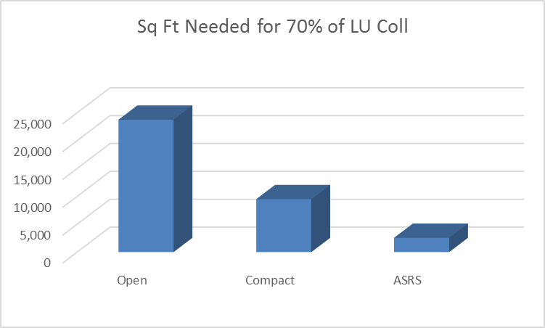
Sq Ft Needed for 70% of Collection
Open Compact ASRS
Notes:
Approximately 420K items based on BrightSpot consultation recommendation of 500K building capacity.

Slide 4
Distinctive ASRS Features
70+% of the total library holdings
Pre-loaded bins
1st library deployment for vendor
ASRS as technological showpiece

Slide 5
ASRS Planning & Implementation
Consultant recommends ASRS deployment
Library develops bin specifications
Empty bins become available
New building opens with constant access to ASRS
Library pre-loads bins
Warehouse Control Software is developed
ASRS vault/racks become available
Library retrieves materials from ASRS 3 times/day
Notes:
Bin specification: determined ratio of 6, 10, 12, 14, and 18” bins; required collection height sampling; size/volume of vault determined before bin quantities due to aggressive construction schedule.
Warehouse Control System: based on observation of workflows at GA Southern and UMKC; designed around what ExLibris Voyager offered
August 2013 deadline to make collection space in old library available for other purposes.

Slide 6
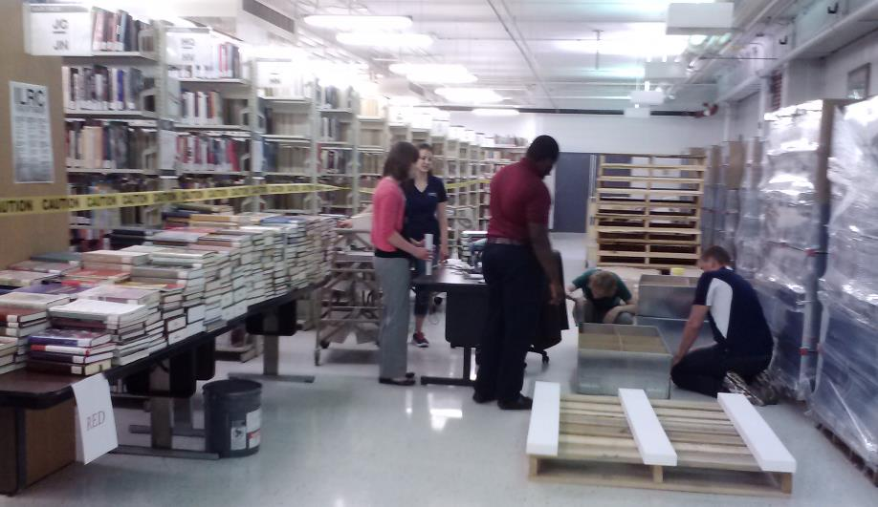
Three Teams
Collection Sampling & Bin Size Ratios
Software Tech Specs & Testing
Collection Prep, Pre-loading & Ingestion

Slide 7
ASRS Planning & Evaluation
Gregory A. Smith
Director, Management Information Services

Slide 8
4 Planning & Evaluation Questions
Can the library justifiably store ~75% of its collection in an ASRS?
How many bins of various depths are needed for current and projected holdings?
What criteria will qualify an item for display in open stacks?
What were the outcomes of the ASRS installation?

Slide 10
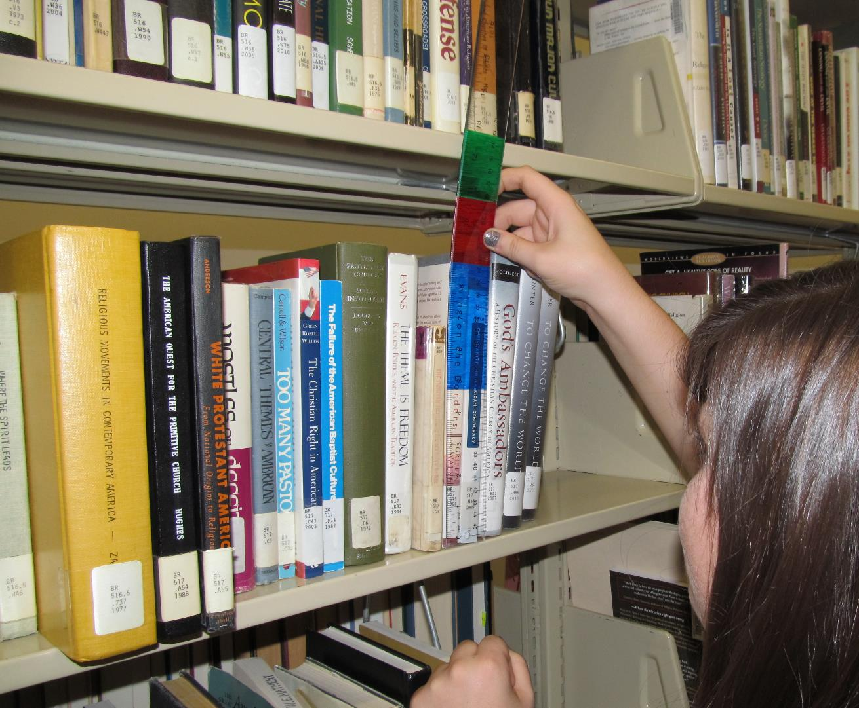
Notes:
Determining system specifications entailed consideration of the space required by the current collection as well as that required by projected future collection growth.
Since the intent is to optimize the system’s storage capacity, we were not merely interested in projected volume counts and average volume thickness, but also the spine height of items in the collection. This related to the distribution of bin sizes that we specified to our ASRS vendor.
Developing specifications for counts of each bin size thus involved . . .
Assessment of current collection size (based on annual holdings reports)
Projection of future collection growth (undertaken in collaboration with a consultant)
Physical measurement of collection samples (both item thickness and spine height)
Estimates of spine height based on catalog metadata
Attribution of spine height based on standard book sizes

Slide 11

The Tangled Web of Measurement
The octavo—the size of a standard novel
Approximately 1/6 of Main Stacks items approximated this size
6 in. x 9 in. | 15.2 cm. x 22.9 cm.
Load into 10” or 12” bin?
6”
9”

Slide 12
Browsable Collection Criteria
Acquisition date within the past 24 months
OR
2+ circulations within the past 2 years
OR
10+ circulations within the past 6 years
Ongoing collection growth and accumulation of circulation data will require periodic shifts of resources between open stacks and the ASRS.

Slide 13
Browsable Collection Models
Notes:
Recent Acquisitions [window to be determined]
Recent Circulations [2+ uses in past 2 years]
Persistent Circulations [10+ uses in past 6 years]

Slide 15
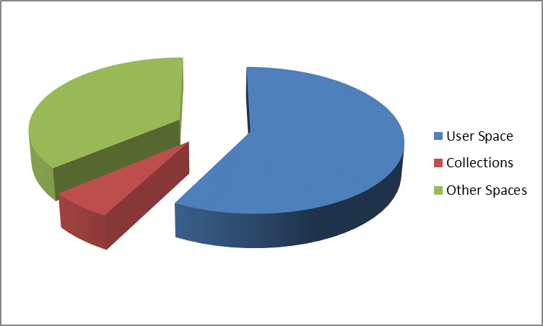
Space Distribution - New Building
Notes:
The choice to install an ASRS enabled us to devote the vast majority of our new building to house people rather than resources.

Slide 16
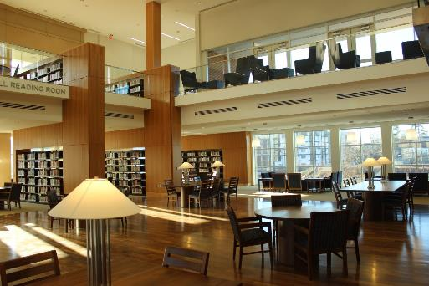
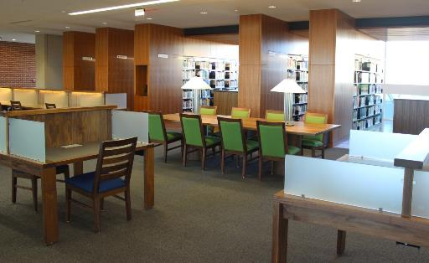
Notes:
As a result, our new building can seat 2,300 users and accommodate future collection growth. Spaces and furnishings support both individual and group activities.

Slide 17
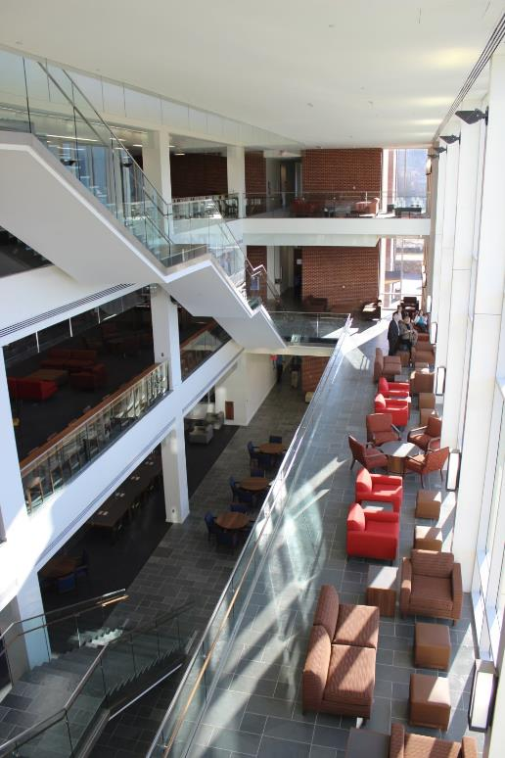
Notes:
As a result, our new building can seat 2,300 users and accommodate future collection growth. Spaces and furnishings support both individual and group activities.

Slide 18
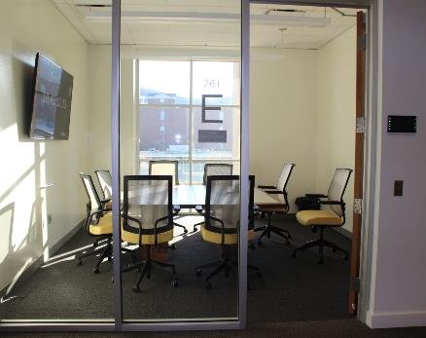
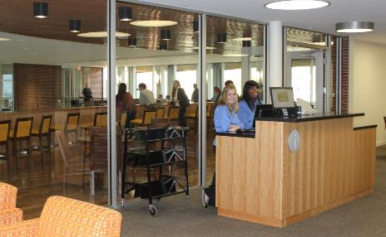
Notes:
As a result, our new building can seat 2,300 users and accommodate future collection growth. Spaces and furnishings support both individual and group activities.

Slide 19
Bin pre-loading
Lowell Walters
Assoc. Dean of Library Technologies & Collection Services

Slide 20
Bin Pre-loading: Advantages
Pack once (partially accomplished)
Packing able to start before rack installation
Bin loading at a passive pace/fast ingestion
Notes:
Institutional culture to build fast with a major push to move in quickly.

Slide 21
Bin Pre-loading: Physical Challenges
Bins are easily bent/warped
System sensor tolerances of just 52mm
Bins weigh approx. 200 lbs
Getting loaded bins from pallets onto workstations
Palletize for two 1-hour transports

Slide 22
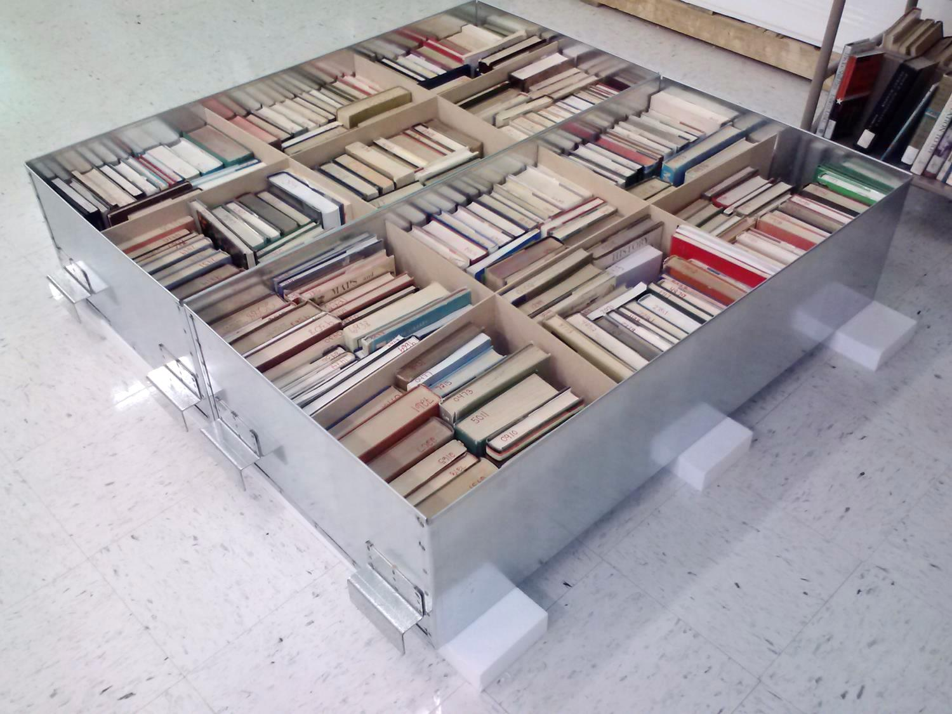

Slide 23
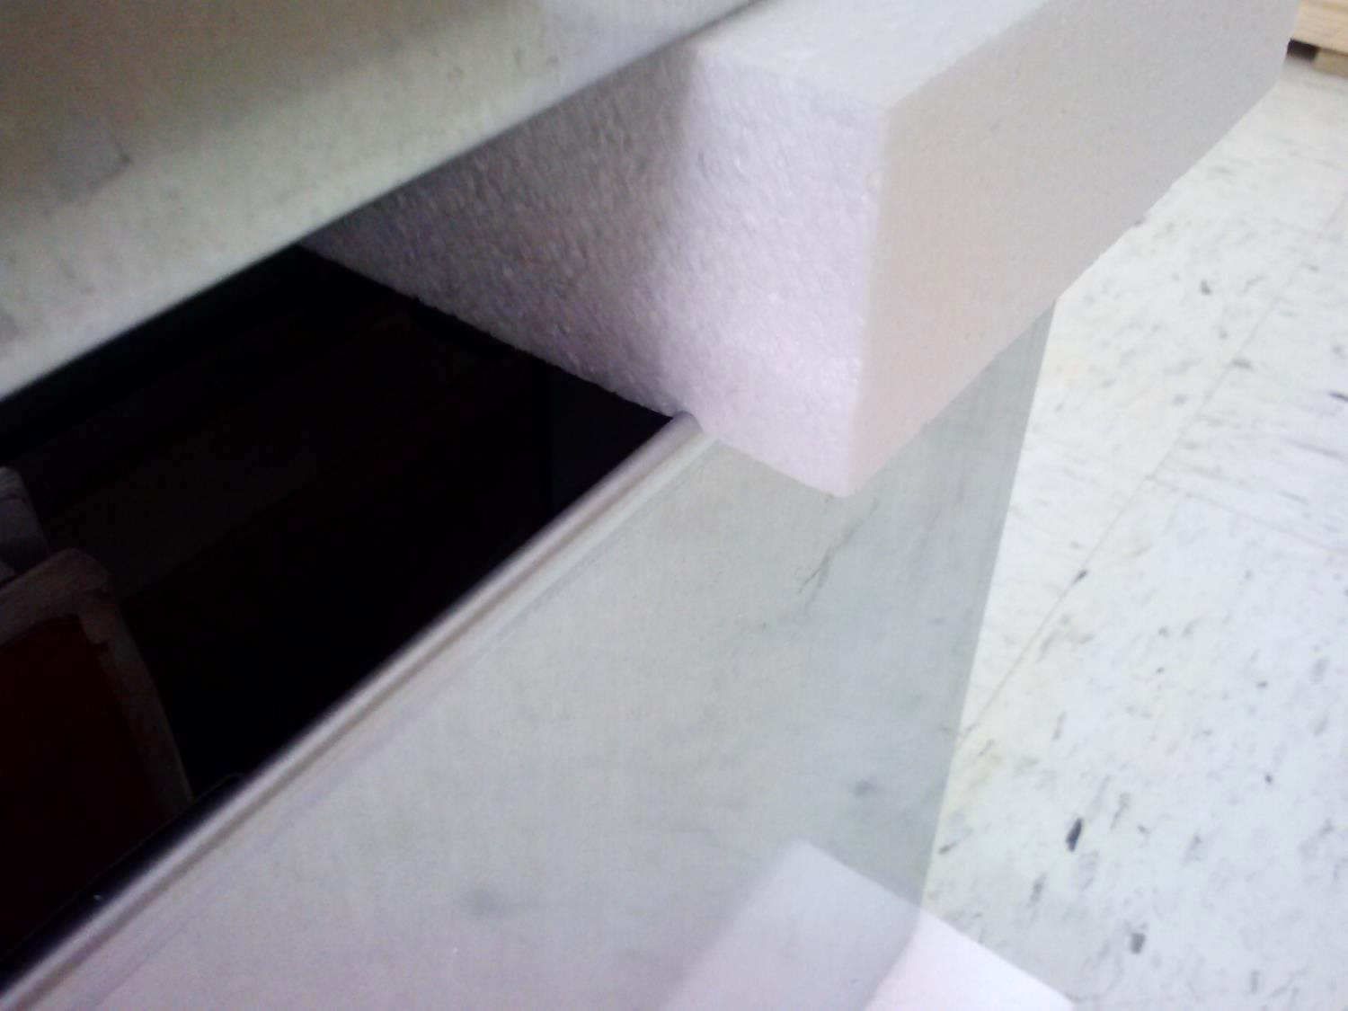

Slide 24
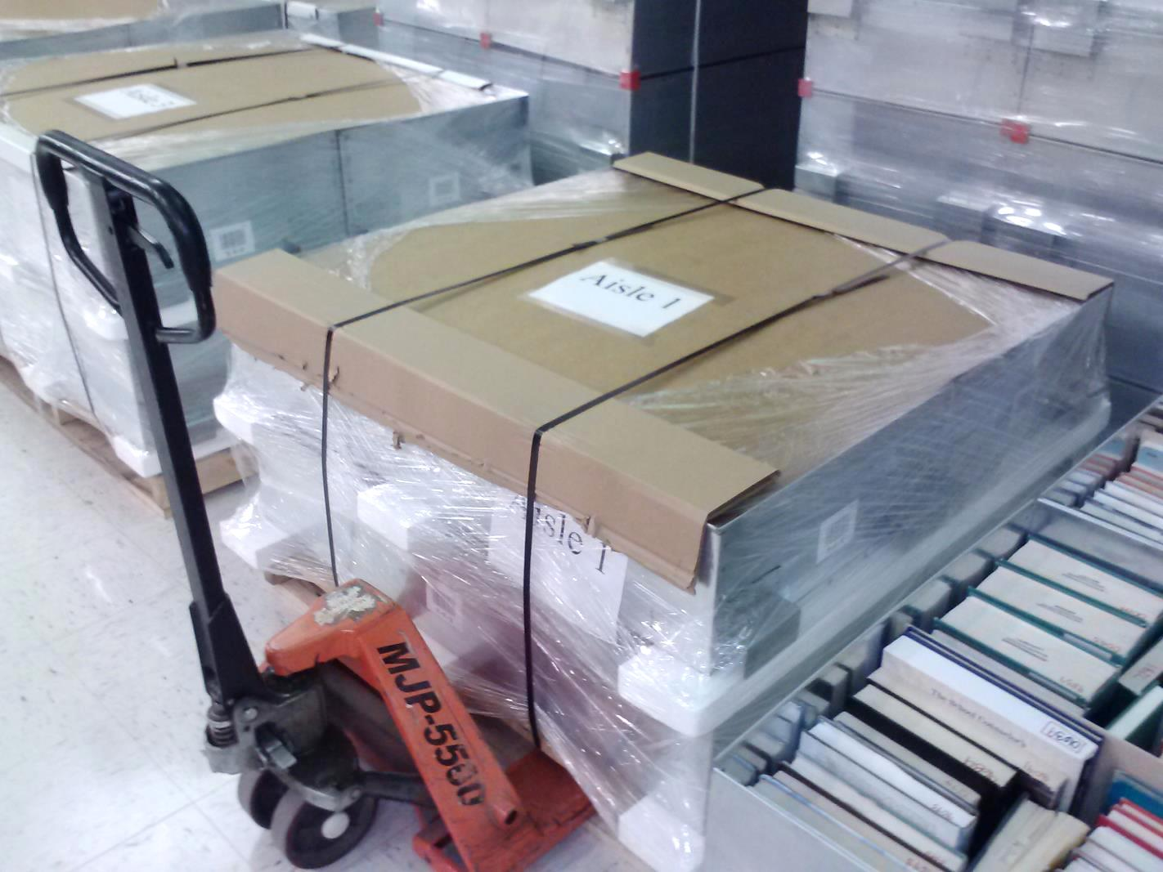

Slide 25
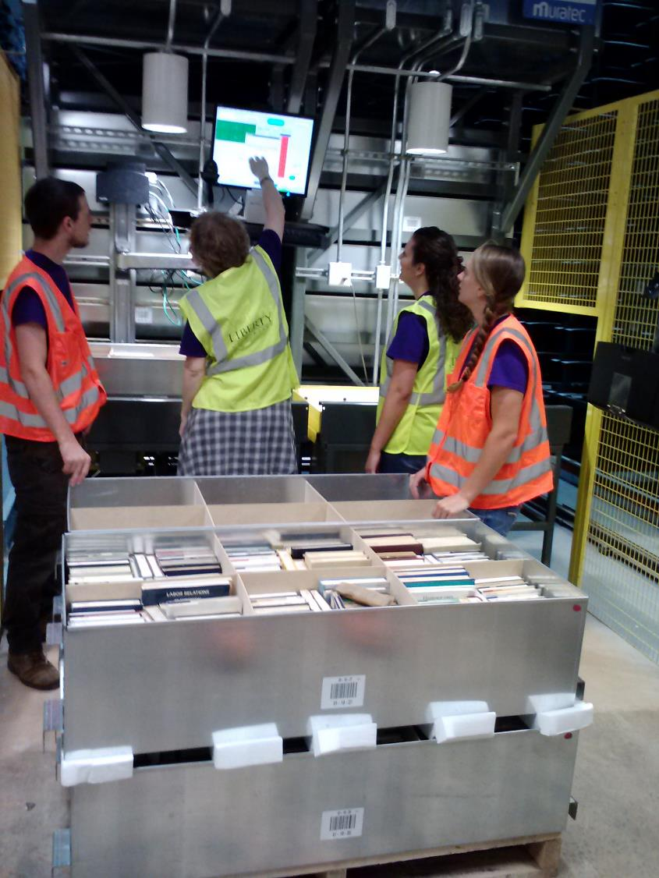
Notes:
Create software feature to allow an identical bin-to-bin transfer

Slide 26
ASRS and ILS Integration
Tom Fesmire
Head, Cataloging & Metadata Services
Notes:
So, for materials that are in our ASRS, how do they show up in the catalog?

Slide 27
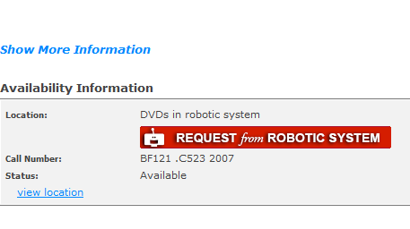
Representing ASRS materials in the OPAC
Notes:
This is a screen from our OPAC . First off, it makes the point that not only books but DVDs and other formats can be in the ASRS. We have curtailed the size of the browsing collection to the extent that the lesser-used materials in all formats need to be in storage.

Slide 28
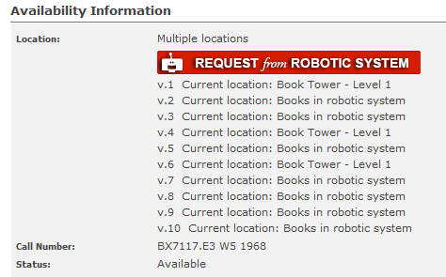
Multivolume works can be split
Notes:
We suspect not many ASRS libraries have done this, that is, spliting sets; but the reality is that in some cases, we can’t even afford to have all the volumes of the same work on the open shelves. We experimented with a single holdings record approach shown here (for those of you who do Voyager, a single MFHD approach), which uses a temporary location to force the ILS to display the items properly.

Slide 29
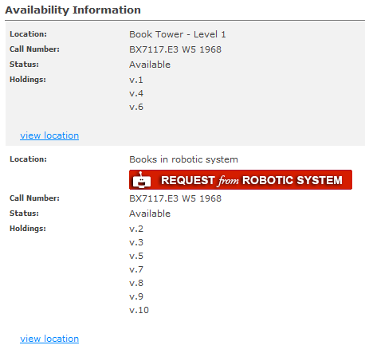
Separate holdings records approach
Notes:
However we’ve decided for a number of reasons that having separate holdings records for each location is the least confusing approach for the patron, so we’re going to transition that way.
Moving on, you can see here our big red request button. The out of the box provision for patrons to request an item was basically an extension of what was used to place holds and was not prominent on the page; so we did a hack by adding Java script to the html; it generates the button whenever “in robotic system” is present in the location display name.

Slide 30
Virtual Shelf Browse
Notes:
The degree to which researchers actually rely on stack browsing, and how effective that is, has been the subject of debate, but we were concerned about the loss of this ability for our patrons with so many of our books in the ASRS. So we implemented LibraryThing’s Virtual Shelf Browse …

Slide 31
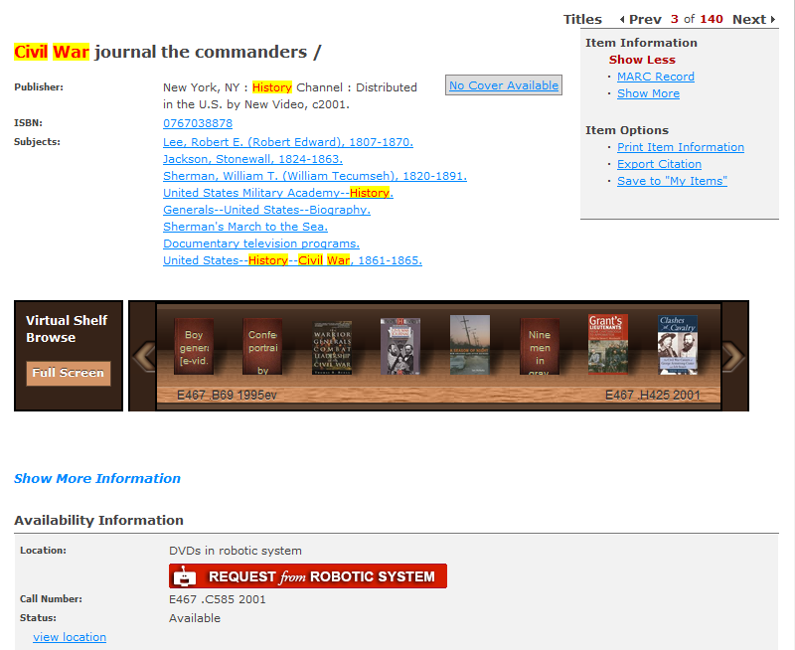
Virtual Shelf Browse integrates all formats, including e-resources
Notes:
… shown here on a record display screen. However we realized that we could add value by including all formats – including ebooks – in one big virtual shelf; thus we actually offer a fuller serendipitous experience than was possible in the physical stacks in our old building where all the books were still out in the open.
Clicking the full screen button to the left of the shelf brings up a multi-shelf display,

Slide 32
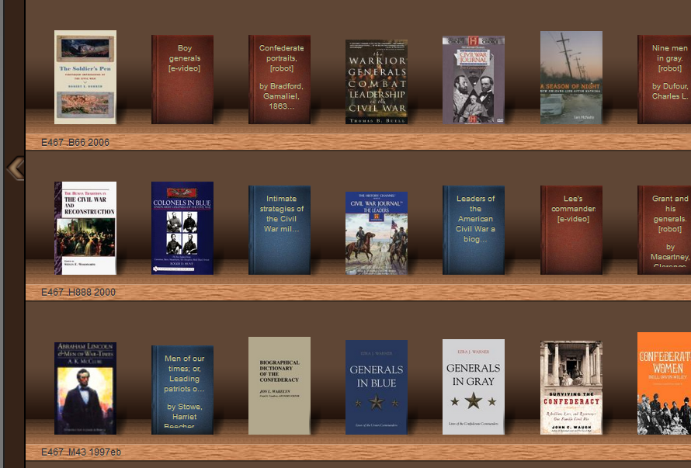
Representing ASRS materials in the OPAC
E-video
Print
DVD
Score
CD
DVD
E-audio
Ebook
Notes:
and you can see the multiple formats sitting together. By the way, the covers without art-work show what happens when the ISBNs for those books are not in LibraryThing’s database.

Slide 33
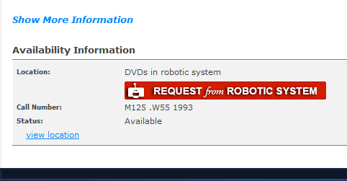
LibraryThing’s Stack Maps
Notes:
Since with our new building we had, for the first time, book stacks on multiple floors, we also decided to implement Stack Maps, another LibraryThing product. This presents an orientation map to help patrons find their item in the building. Patrons click the “view location” button to show the map.

Slide 34
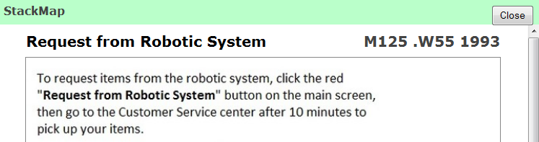
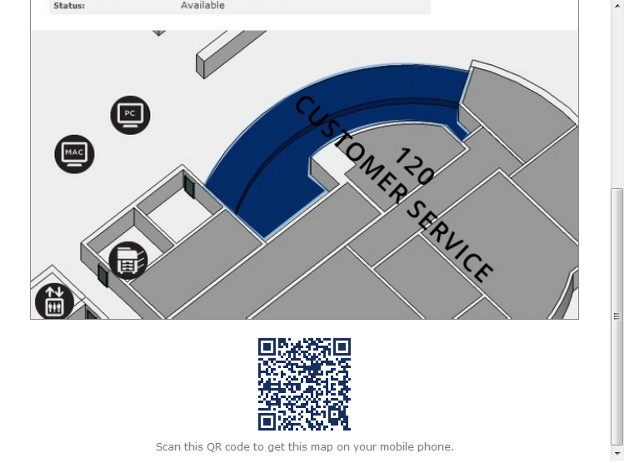
Notes:
For our ASRS materials, the map is a page with instructions, and a view of where they go to pick up the item -- our main Customer Service desk.

Slide 35
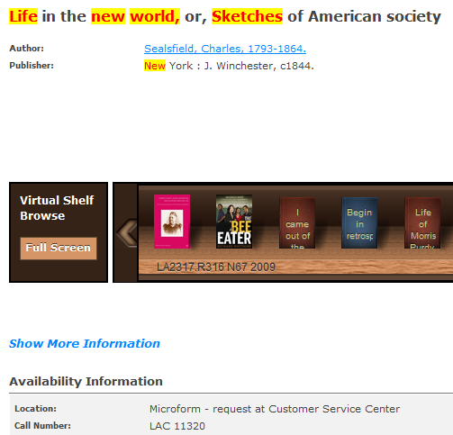
Patron request-able vs. staff mediated items
Notes:
For most books, DVDs, CDs, etc., a library patron can use the request button to directly trigger an ASRS retrieval. But when it comes to a record for a microform, such as this one, “Life in the new world,” from the Library of American Civilization series, we send the patron to our Customer Service Center, where staff use a separate set of hidden Voyager retrieval records to initiate the ASRS pick.

Slide 36
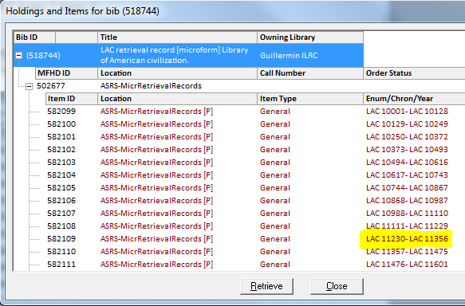
Notes:
This view from the Voyager cataloging module shows some of the item records – the ones in red – that are used for retrieval. Each row represents a range of microfiche sheets stored in a barcoded box in the ASRS. The correct item for the “Life in the new World title” is hi-lighted. You can see why we thought it would be confusing for the patron to try to single this one out on their own.

Slide 37
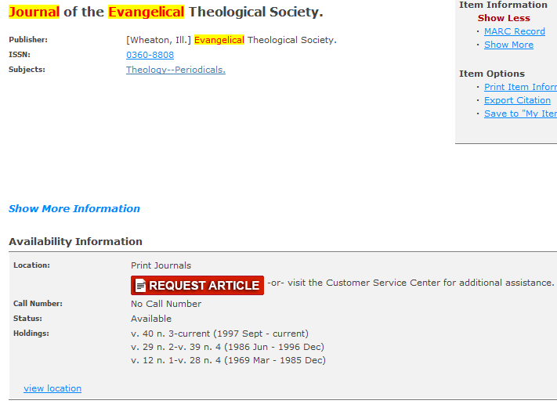
Notes:
Our staff also mediates requests for print journals. However, when the patron clicks this red button, she comes to an ILLIAD interlibrary loan screen where she fills out the particular article details. That data then comes to the ILL staff, who pull the right issue from the ASRS, scan the article, and deliver it to the patron by e-mail.

Slide 38
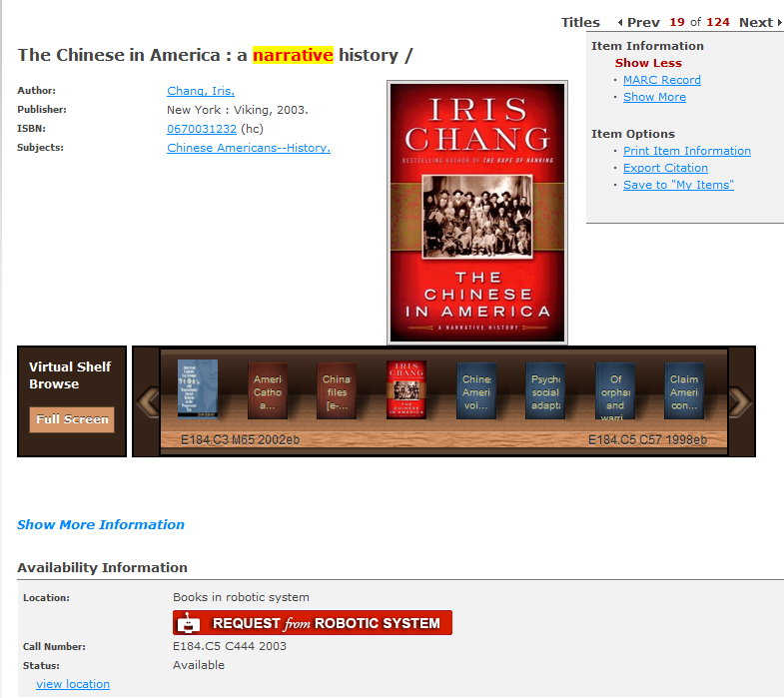
Request process
Notes:
Now, going back to the bulk of our ASRS materials, which can requested by the patron, when big the red button is clicked …

Slide 39
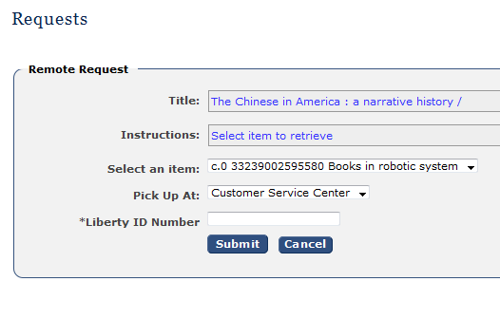
Voyager remote request screen
Notes:
… the patron comes to a login screen for his Voyager account, and then to this screen where he selects the item. Once the patron clicks submit, the request is set in motion.
So what do we wish was different about this process?
Well, the biggest thing is that Voyager does not know whether the item is actually in the ASRS; we wish we could indicate that back on the record screen; but as it is, either way the patron gets a “success” message from Voyager, and won’t find out if there has been a failure till he comes up to the desk.
Second problem: if the pick is successful and the book is waiting at the desk, we currently have no way of telling the patron that, either through his Voyager account or through e-mail.
Finally, that “success” message the patron gets isn’t tailor made.

Slide 40
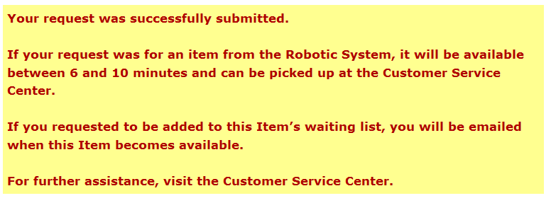
For ASRS request
For hold request
For confused patrons
Notes:
We can only show one message and it has to awkwardly cover both ASRS requests and hold requests.
Now, how does Voyager actually communicates with the ASRS? There is a process running on the Voyager Server that checks for requests on a regular basis. When it finds a request it sends it to a place where it can be picked up by the Warehouse Control System or WCS, the software that runs the ASRS.

Slide 41
ILS & WCS: one-way talking
Messages from ILS to WCS
  Request
  Add
  Delete
Notes:
A request is one of three types of messages that Voyager can send to the WCS. When the WCS receives an Add message, it adds a bibliographic item record to its database. When it receives a Delete message, it deletes a record from its database.
Add and delete messages send only a barcode, no title or other metadata. So, we opted to have the WCS set up to accept a CSV file which contains the metadata for each barcode. Right now we produce the file as needed using a catalog report, but we hope to automate this process and have it run every day.
We can’t limit the Add messages to items designated in Voyager as ASRS items. But we actually think this is not so bad, and plan to have our entire Library catalog represented in the WCS database; if Voyager was down, in a pinch we could look up an item and thus use it as sort of a substitute ILS.
[What would an ideal world be like?] I suppose that in an ideal world, there would be full integration between the ASRS and the ILS, and we would never have to move any metadata as a separate operation. Or even better, you would not need a WCS, period; all of its functionality would be built into a module that was part and parcel of the ILS.

Slide 42
ILS & WCS: one-way talking
Message from WCS to ILS
  Got the request (?)
Notes:
The Voyager ASRS module is set up to receive a confirmation message from the WCS that the WCS received the message from Voyager. But we don’t know what role this plays from the Voyager perspective, so the WCS is not set up to send such a confirmation. So we really do have a one-way conversation, as the title of the slide suggests.
Back in the OPAC then, as soon as the patron clicks submit, the item is given a Voyager status of “requested” …

Slide 43
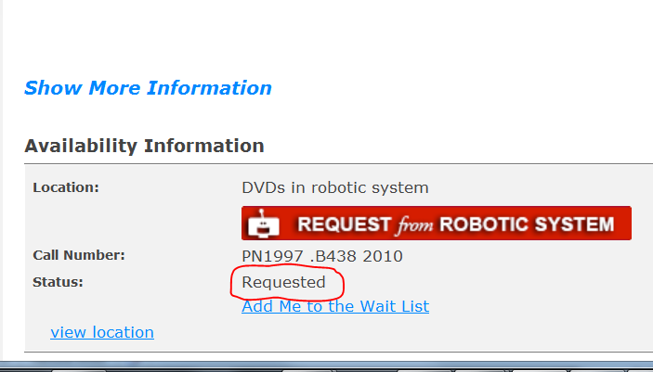
Requested status can be problematic
Notes:
… as you see here.
Now this can be a problem if the patron never comes to pick up their item; the status sticks – and no one else can request the item -- unless a library staff person remembers to take the item through a Voyager discharge process before returning it to the ASRS. Ideally, Voyager would accept a communication from WCS that the item was now back in the ASRS and could again be requested.
By the way this slide shows another problem: the big red request button is still available even though the item has already been requested.

Slide 44
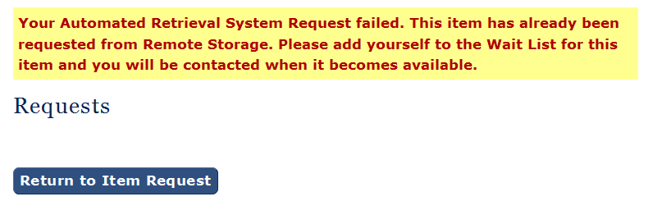
Notes:
The only work around we have found for these problems is to present a pretty decent error message if the unfortunate patron tries to make a request.

Slide 45
WCS fields
ITEM_BARCODE
ITEM_ID
LOCATION_CODE
TITLE_BRIEF
AUTHOR
DISPLAY_CALL_NO
ITEM_ENUM
SOURCE
Notes:
This is the metadata the WCS maintains for its bibliographic item records. We were planning to store artifacts for our campus museum, and that’s where the SOURCE field comes in. This would have allowed us to differentiate library and museum records. And then a partition within the WCS would allow us to control access to the two groups of material. In a subsequent development, however, the museum’s future location changed to somewhere else on campus.

Slide 46
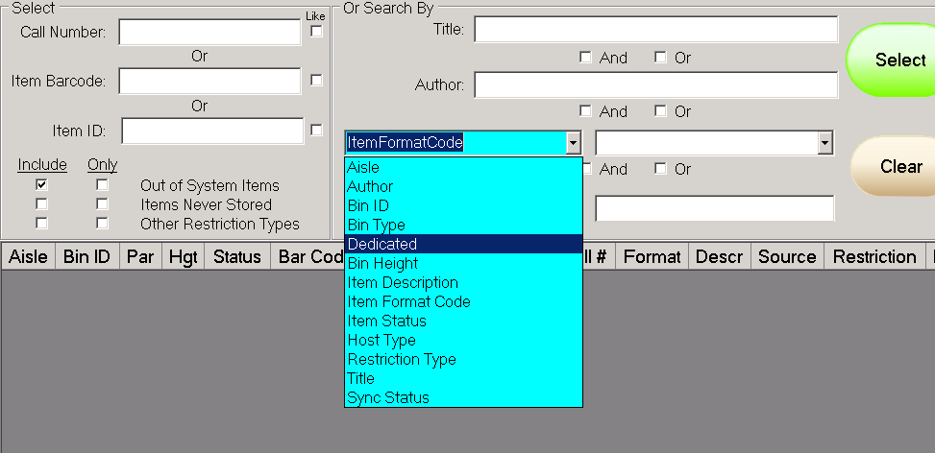
Notes:
I mentioned using the WCS as a substitute ILS to find an item in a pinch. Of course there are also routine reasons to want to search in the WCS. Here is the Boolean search interface for item inquiries; we feel that the software developer worked with us to achieve a pretty effective capability.

Slide 47
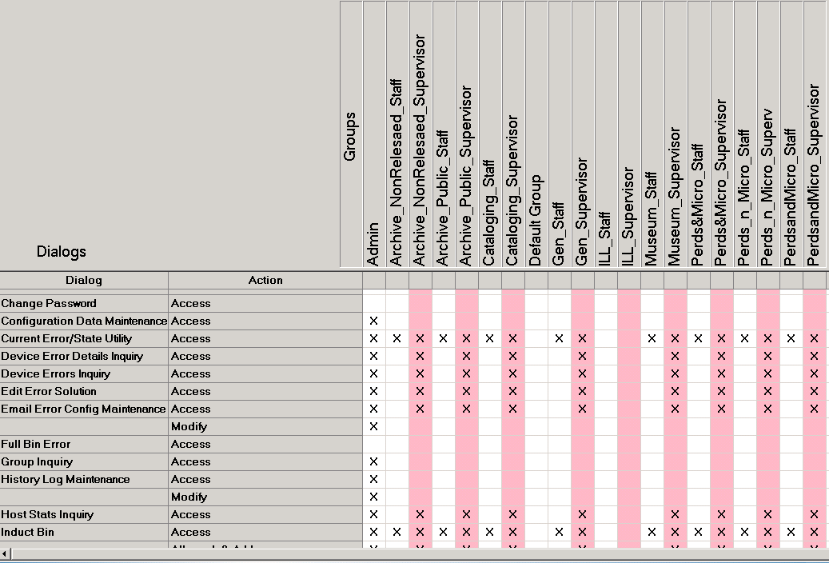
Security configuration
Notes:
Finally, my last slide shows one of the WCS screens featuring a matrix where we can determine what dialog screens (on the left side), can accessed by various staff user groups (shown along the top). Enough to show that the system is fairly robust when it comes to security.
Thank you

Slide 48
New Vendor Experience
Lowell Walters
Assoc. Dean of Library Technologies & Collection Services

Slide 49
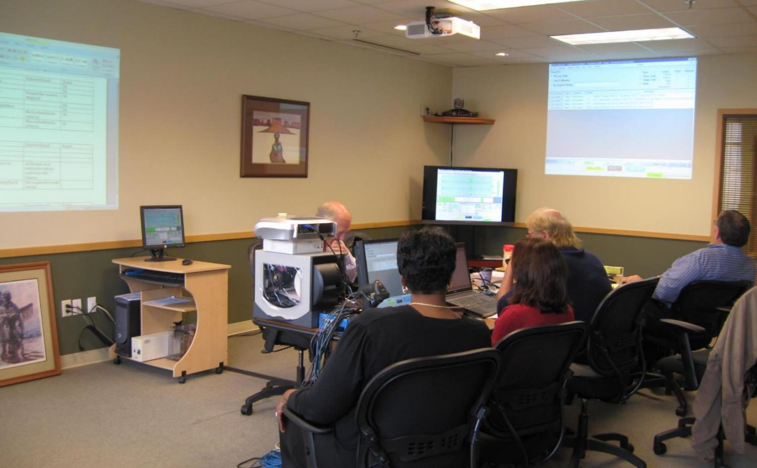
Notes:
Bin to bin transfer at the workstations.

Slide 50
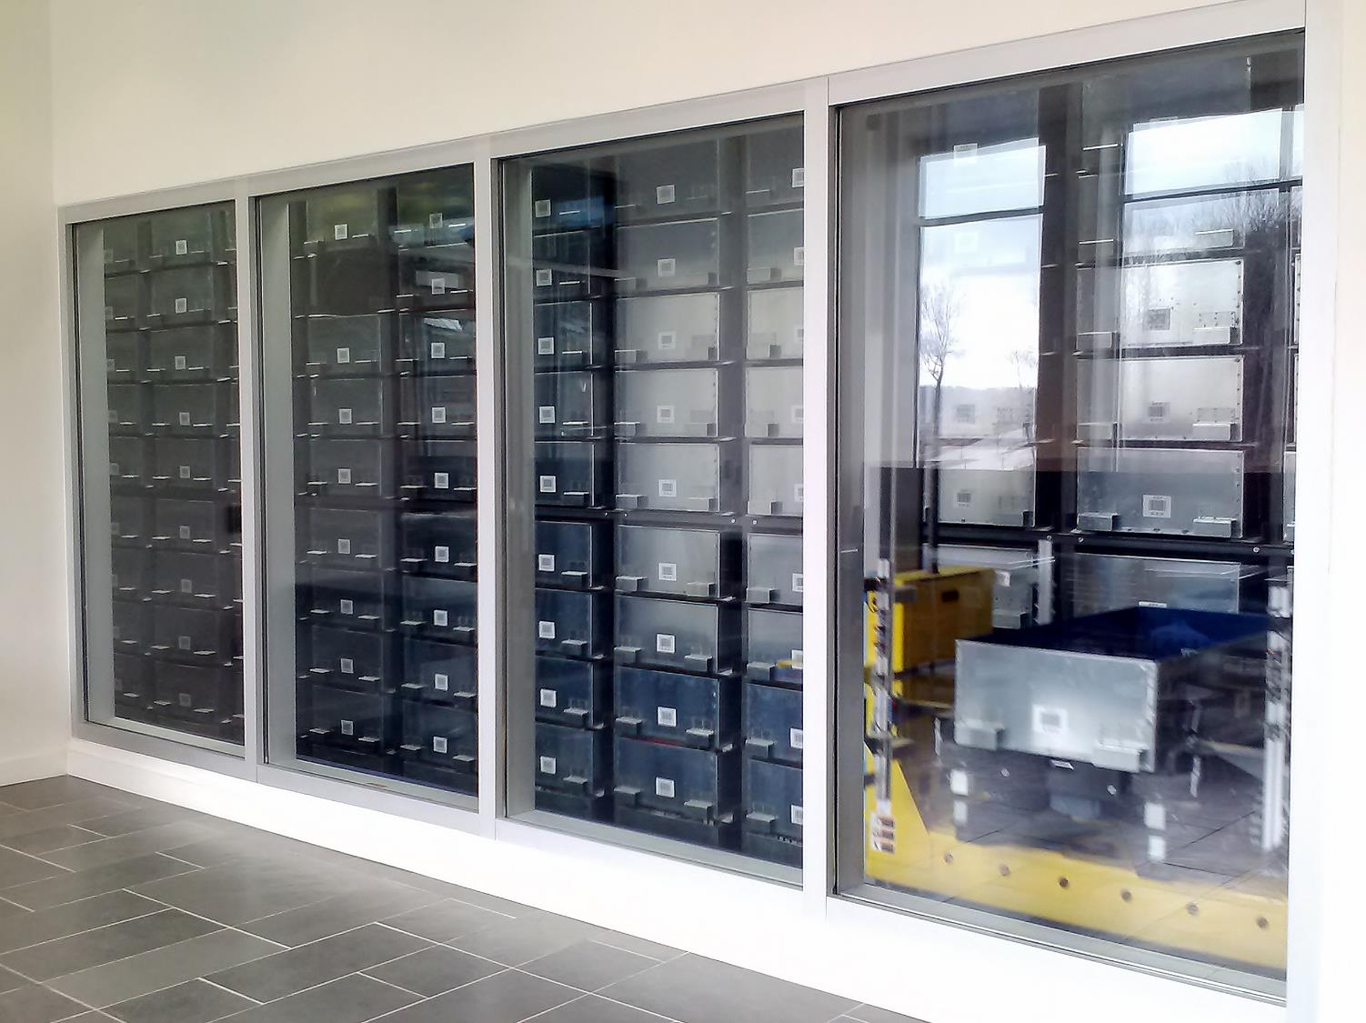
“Making It Dance”

Slide 51
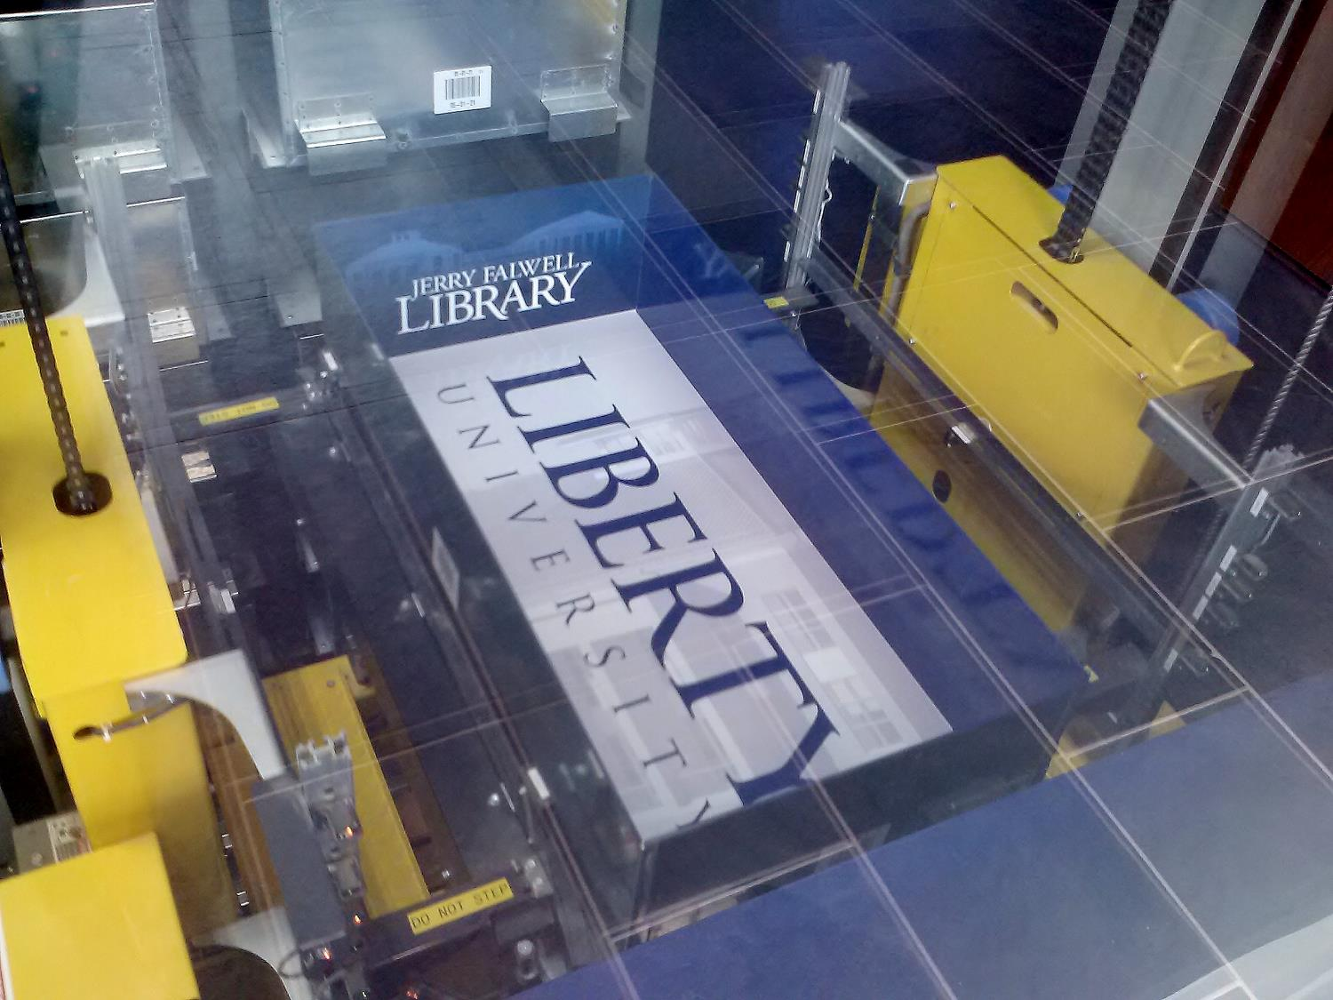

Slide 52
New Vendor Experience
Proposed Enhancements:
Remote access to conveyance system (PLC)
Enhanced e-mail functionality
Expanded slip printing capabilities
More pop-ups to prevent human errors
Compartment to compartment transfer
Notes:
Slip Printers
Change the Station Maintenance dialog and add the ability to redirect a workstations Slip printer to a different printer.
Create a new dialog that can be used to reprint a Pick Ticket. This dialog would show a list of picks done by station. The list would shows the picks in reverse order, that is the last pick done first would be the first on the list. The operator will simply select which ticket to reprint and press a button to have it re-printed.
Emails
Add the ability to send late pick response message to different e-mails depending upon special considerations. Destination = 'Basement' or 'CSC'. Patron name starting with 'ILL'.
Add a new dialog where the error messages sent via Email can have a group designation and a severity specified. This would be used in the Email Error Config Maintenance dialog to help decide which messages are selected for Emailing. This dialog would also allow a subject line to be specified for each message.
Add new dialog that would be used to search the history of Email messages.
Store Confirmation
Add an additional Pop up message to warn the operator that they have not selected a storage partition when they scan a second item number for storage. This would prevent the operator from scanning 2 items in a row and not selecting the storage partition.
Email Export Files
Add the ability to Email export files to specified users.
Compartment Transfer
Modify the Transfer Bin dialog to would allow the transfer of contents from one compartment to another compartment within the same bin or a different bin.
Remote PLC Access
Add the ability to remotely reset various equipment like Lifters, Conveyors, or Tilters.

Slide 54
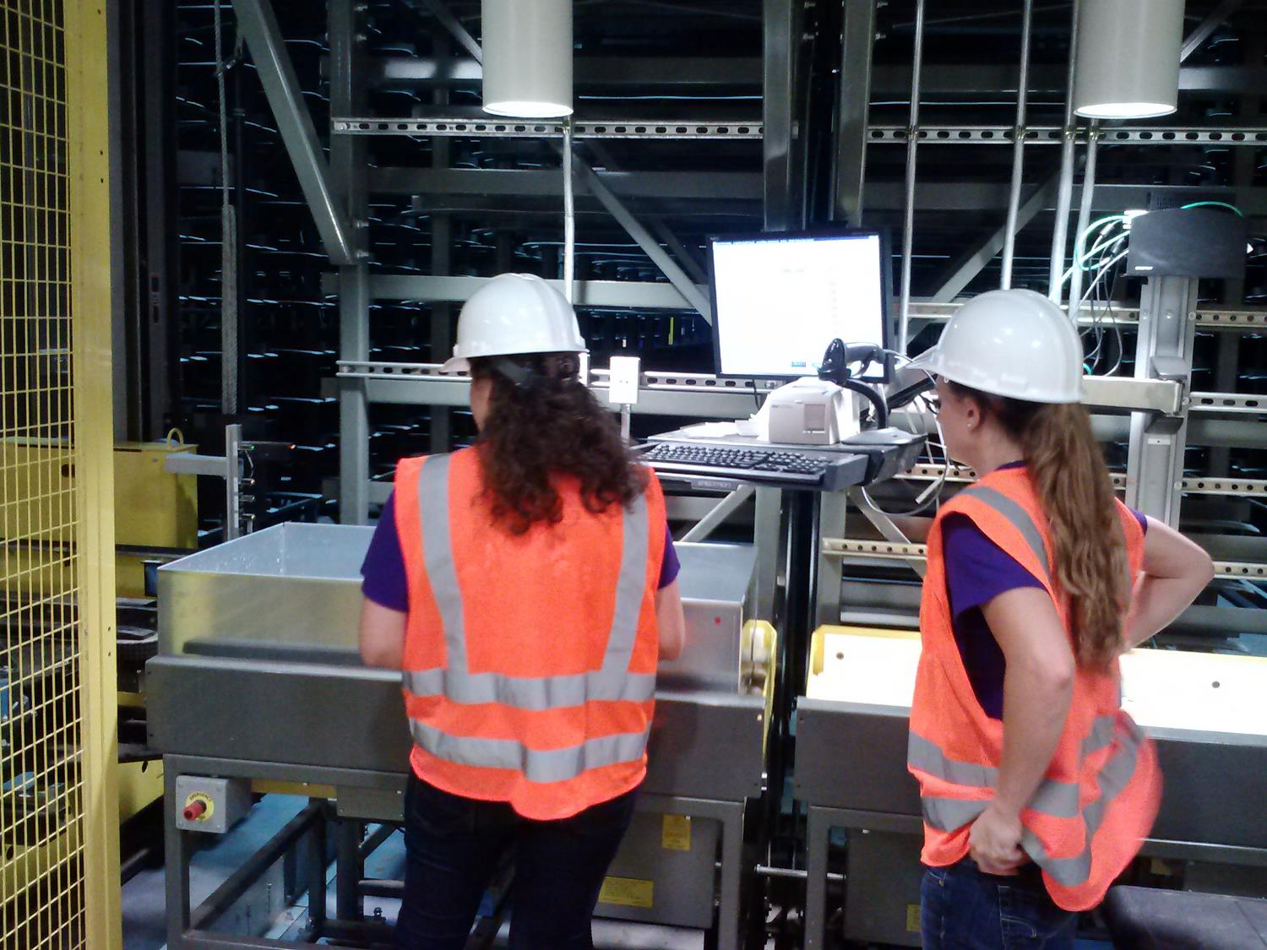
Notes:
Lowered workstation height.

Slide 55
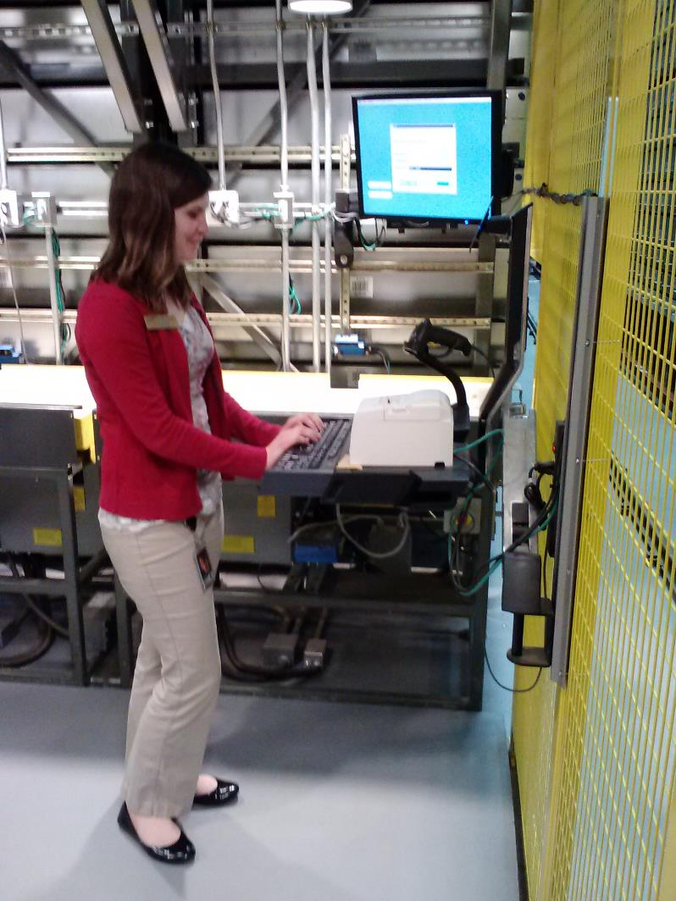
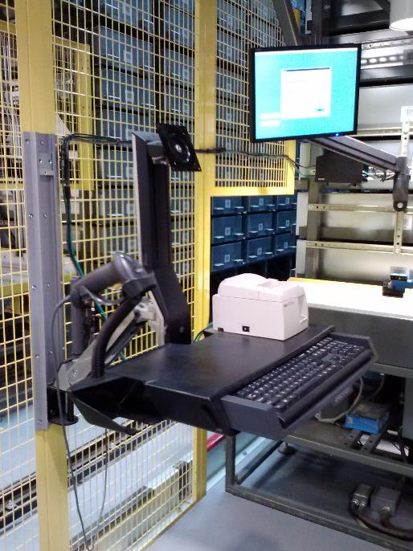
Notes:
Workstation rearrangement

Slide 56
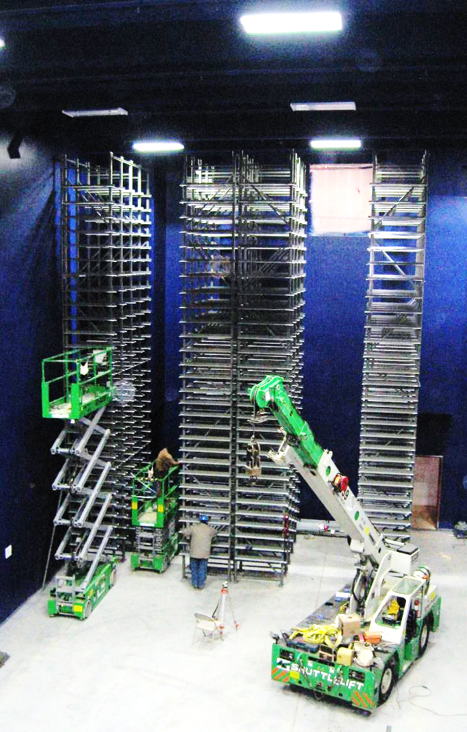

Slide 57
Contacts
Lowell Walters
Assoc. Dean of Library Technologies & Collection Services
  lwalters@liberty.edu
Tom Fesmire
Head, Cataloging & Metadata Services
  twfesmire@liberty.edu
Gregory A. Smith
Director, Management Information Services
  greg@liberty.edu
Hal “Buddy” Shearer
  Library Systems Administrator
  hjshearer@liberty.edu

