Slide 1

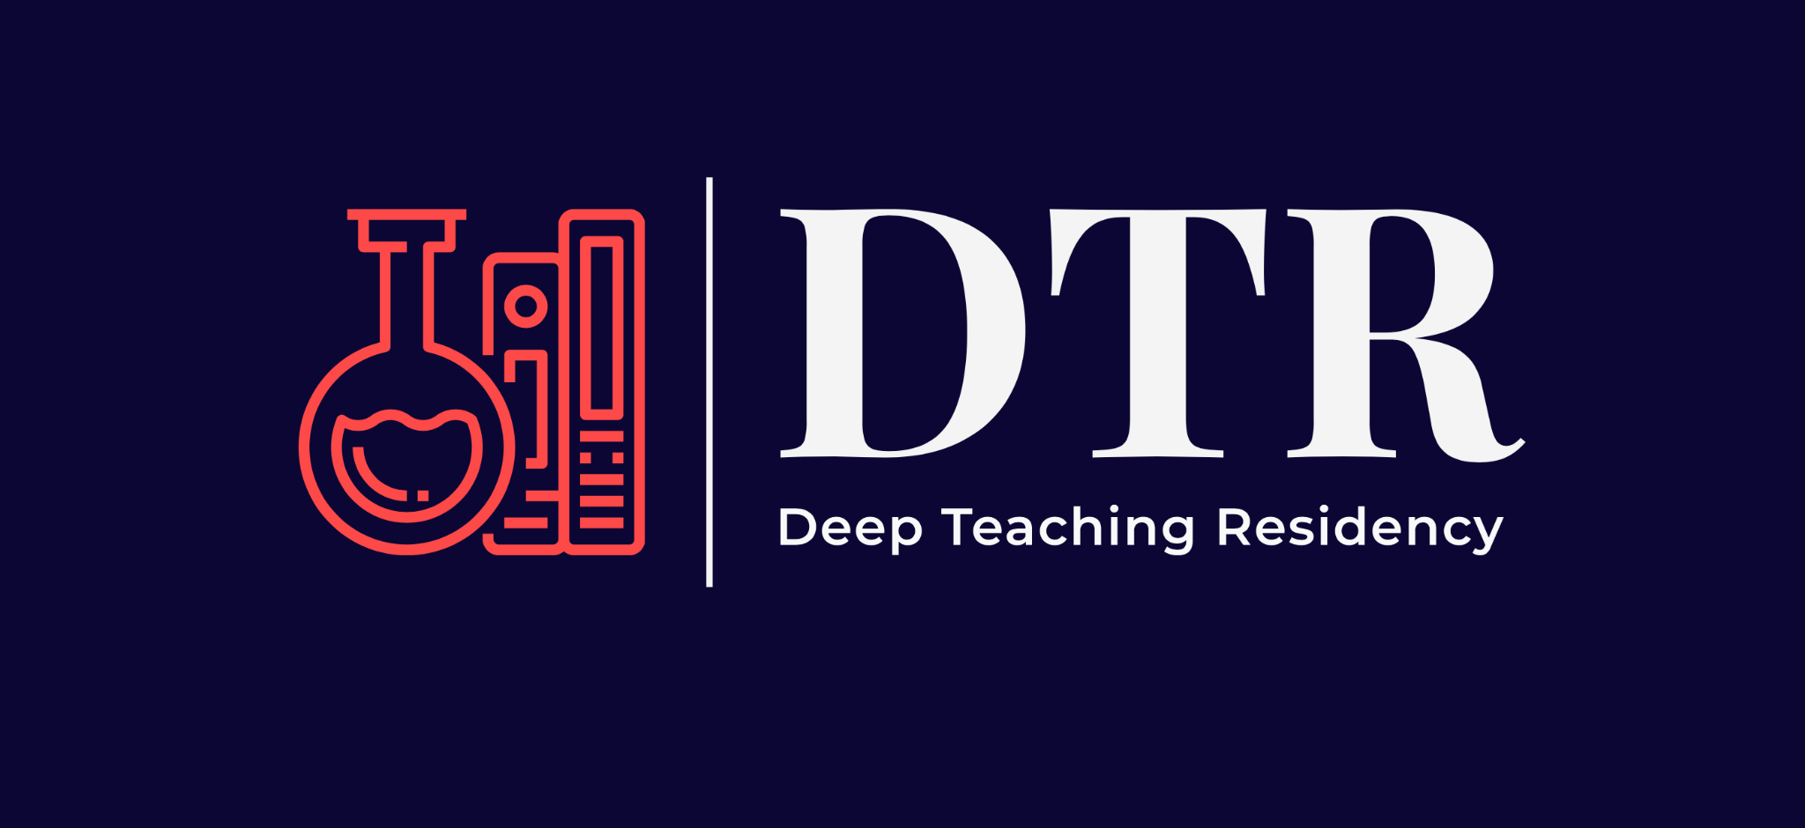

Deep Teaching Residency:
A faculty development community for inclusive practices
Tess Killpack, Ph.D., Salem State University
Bryan Dewsbury, Ph.D., Florida International University
Carolyn Sandoval, Ph.D., University of California-San Diego
NSF IUSE Grant #2021494

Slide 2
Quick
“Turn-and-Talk”!
Think about inclusive STEM professional development programs at your institutions or in your networks.
What are 1-2 limitations you have observed?
Motivation for IUSE Grant:
Funding and programs for inclusive STEM teaching and equitable undergraduate STEM programs have increased in recent decades
Despite interest and preparation, minoritized students continue to leave STEM at a disproportionate rates*
Faculty roles as teachers, advisors, and mentors make them well-positioned to be change-agents
*See Summarized data in Asai, 2020 “Race Matters” Cell 181 and data sources in National Center for Science and Engineering Statistics & National Center for Education Statistics reports
Notes:
30% of PEERs entering college want to study STEM and only about 30% of those students persist to a STEM Bachelor’s degree

Slide 3
Deep Teaching Residency
A year-long faculty development community for inclusive pedagogy that aims to meaningfully transform faculty mindsets and practices.
*Pilot in January 2020; Two grant-funded cohorts: Summer 2022 & Summer 2023 (soon!)
*P
Pre-Work | 5-day In-Person Workshop | Virtual Learning Community
Readings Podcasts Reflections | Interactive sessions Large and small group discussions Development of inclusive teaching project in own STEM course | Teaching project implementation & assessment of outcomes Monthly virtual meetings to maintain connection, conversation

Slide 4
Deep Teaching Philosophy
Develop a Trusting Climate
Instructor
Self-
Awareness
Empathy for the Student Experience
Transform Teaching
Use Varied Pedagogies
Leverage Networks
& Resources
*Start here*
Dewsbury, 2019. Cultural Studies of Science Education

Slide 5
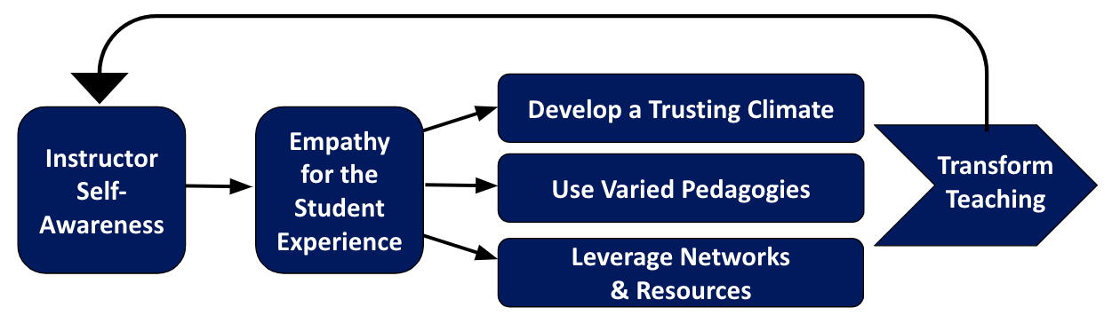
Immersive 5-day workshop at Howard Hughes Medical Institute
Day 1
Explore historical roots of educational inequity and how our own identities and biases influence our mindsets as instructors
Day 2
Interrogate exclusionary norms of STEM culture while considering student identity, experience, and belonging in STEM
Day 5 Celebration!
Poster Presentations of project plans
Day 3
Bring an equity lens to pedagogical
practices and adjustments
Day 4
Identify institutional allies and resources to support faculty and students
+ Project planning + Project planning + Project planning + Project planning

Slide 6
Analysis of DTR is underway, but some initial themes:
Value of Self-Reflection on Identity, Challenging Norms, and Centering Humanity and Empathy in Course Design & Interactions
“I unpacked a lot of feelings about my own identity that I wasn't even aware I was carrying.
“After the DTR workshop…
I focused more on building relationships rather than imparting content.”
“…The more I learn the more
I realize how much more learning I have to do to put myself in the shoes of other people and to tap into the full spectrum of the human experience”
“…helped me to understand how my personal experiences in education may be placing unnecessary demands on students for the sake of tradition and former ways of doing.”
“I totally backed away from the ‘teacher as authoritarian’ and did away with silly punitive course policies that policed behavior and due dates”

Slide 7
“”
Analysis of DTR is underway, but some initial themes:
Value of DTR Community and of Dedicated & Supported Time to Hone Approaches
“The DTR group has a cohesive common goal kind of vibe that even when we are discussing challenges, there's a positive place that we are all coming from or are trying to get to …With colleagues in the department…it feels like so much work just to get to the same place in a conversation...[and its] very surface level.”
“A lot has happened … in education and at my institution that made me feel burnout and detachment, and this…really helped pull me up to a more positive and hopeful place. I feel refreshed and ready to start a new academic year in a way that I haven’t felt in years.”
“It’s helped me devise a plan on how to move forward and provided a community to consult with without judgment.”
“…I have not had much of an opportunity working with faculty from [other institution types] and listening to every one of my colleagues talk about their challenges, and their approach has been really important for me to develop my understanding and deepened my approach.”
feel like it has helped me to refocus on my “why” and given me tools to do the things that I have been ideating about. More importantly, I feel like it gave me the time, space and mental freedom to wonder and to focus on me and my practice. I feel like I have a village that will support me as push forward to make the changes I desire to make.

Slide 8
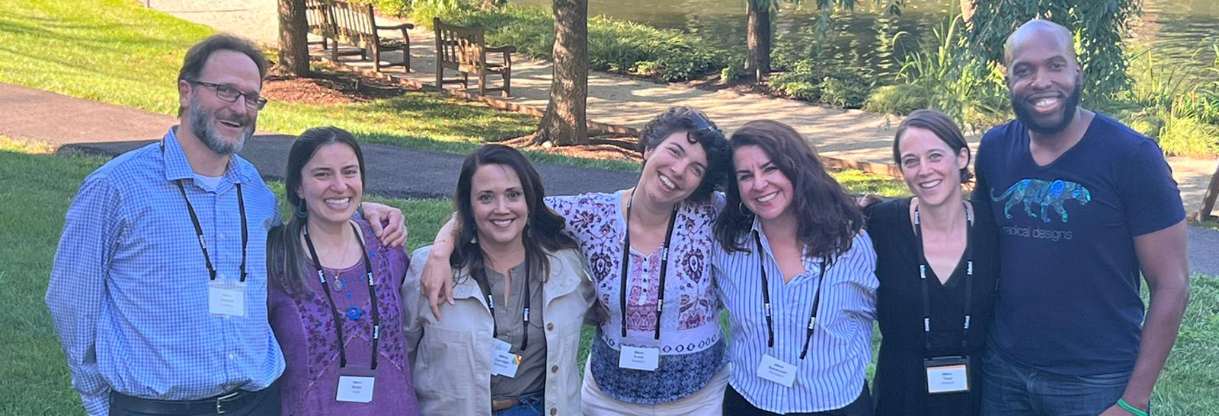
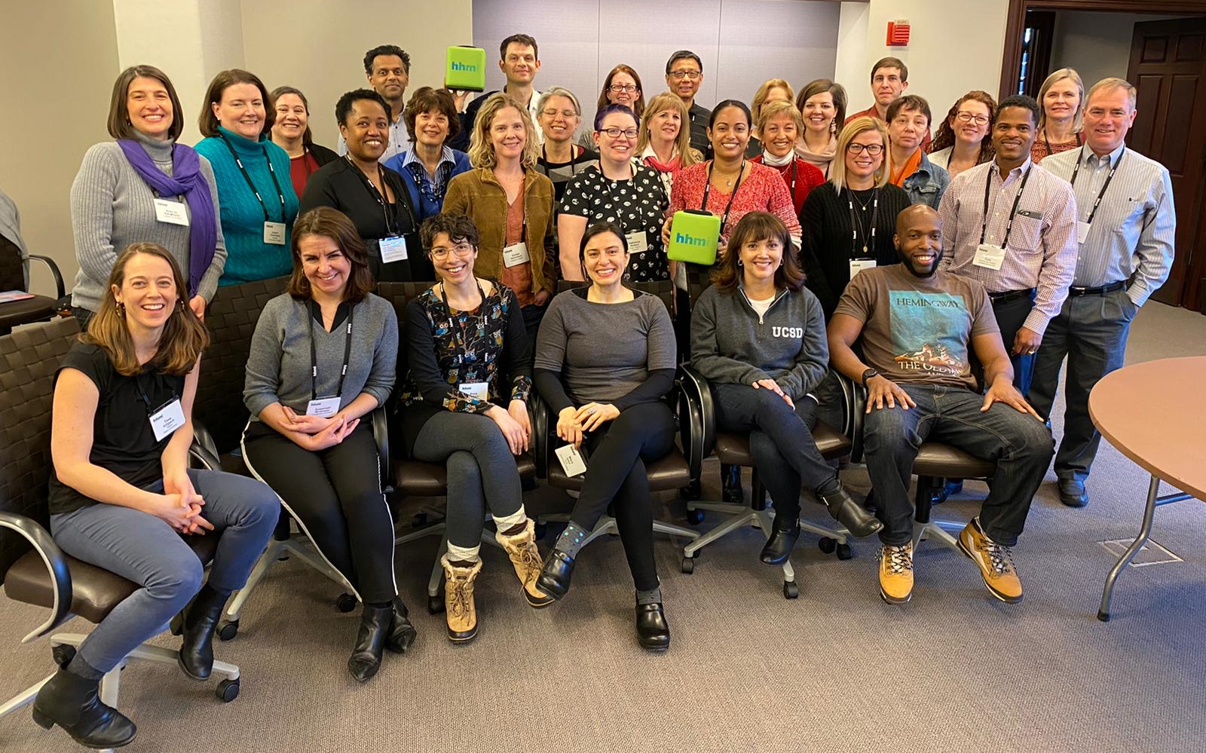
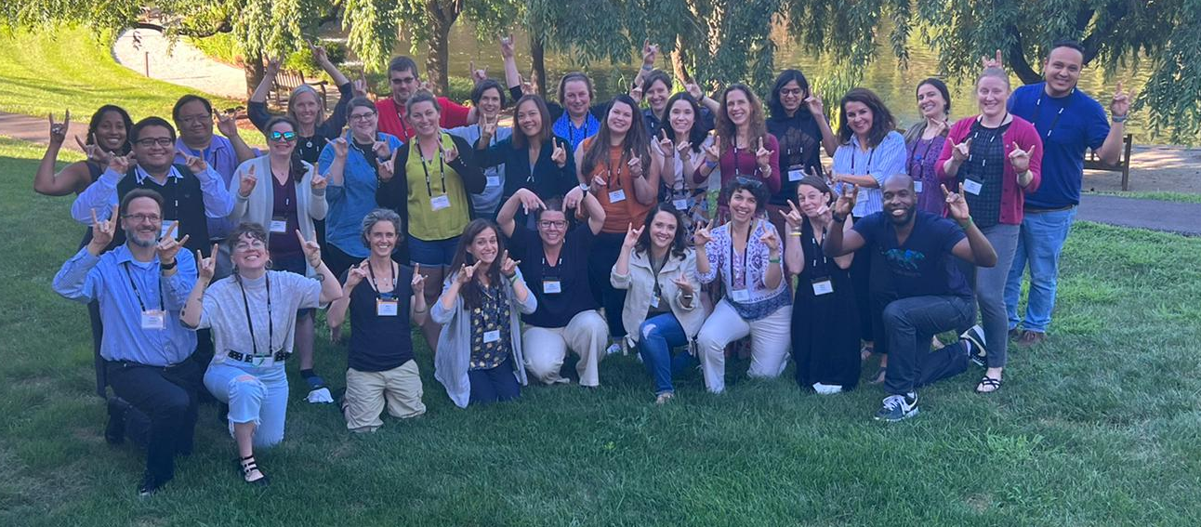
Acknowledgements
DTR Facilitators:
Joshua Caulkins, Ph.D., Embry-Riddle Aeronautical University
Mays Imad, Ph.D., Connecticut College
Anna Santucci, Ph.D., University College Cork (Ireland)
Susannah McGowan, Ph.D., Georgetown University
DTR 2022 Cohort
Pilot DTR Cohort, January 2020
Funding & Support: Howard Hughes Medical Institute, NSF IUSE Grant #2021494
More Info: https://qubeshub.org/community/groups/dtr
Notes:
https://qubeshub.org/community/groups/dtr

Slide 9
How can we enhance effectiveness of professional development programs for inclusive STEM teaching?
Explore underlying social structures and systems that drive inequities
Create a supportive and collaborative community of educators
Increase workshop time
for learning and engagement
Interrogate exclusionary norms that are entrenched in STEM culture and STEM teaching
Engage in self-reflection of our own identities and biases
Provide dedicated time to substantially work on course changes

Slide 10
