Slide 1




Confident & Creative Mentoring:
Finding Your Voice Supporting OT Professionals
START!
Notes:
Mentoring as an occupational therapy professional (OTP) can be demonstrated in many different ways, creatively intersecting our current roles and relationships. By assessing and sharpening our competencies, we can begin to find our unique voice in teaching and supporting our colleagues and students.

Slide 2

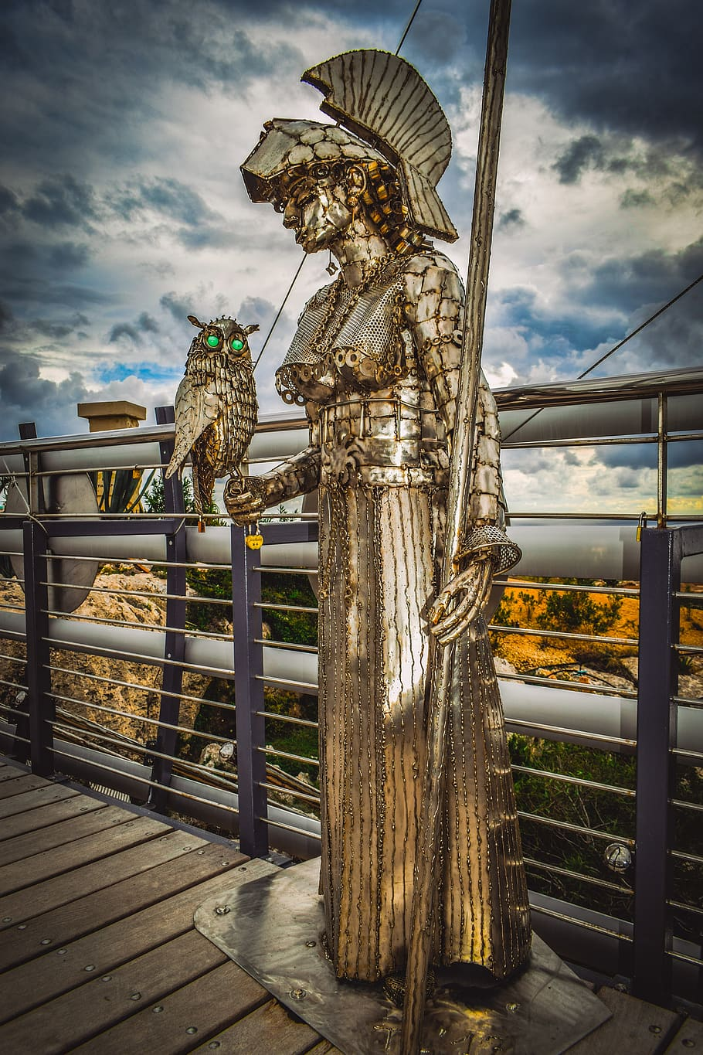
NEXT!
“A trusted counselor or guide.” -Merriam Webster
“Mentoring is defined as sharing, teaching, or supporting a colleague in order that they may grow in their profession.”
Notes:
In the book The Odyssey (Fitzgerald, 1961) Odysseus entrusted, Telmachus, his son, to his dear friend Mentor so that he might be his guide and advisor. Mentor was actually the goddess Athena in disguise.

Slide 3


Table of Contents
Section 1
Section 3
Section 2
Section 4!
References
Taking stock of your skills...
Who can mentor?
Mentoring as an occupation
Who benefits?
Next steps
NEXT!
Notes:
We have broken out poster session into 4 areas; Section 1 will allow you to reflect on you unique skills, Section 2 will look at some of the factors surrounding mentoring, Section 3 Mentoring requirements, and Section 4 ways to get started.

Slide 4

Slide 3: Table of Contents
Take Stock of Your Skills!
Section 1
Section 2
Section 3
Section 4
References
01.
Clinical Skills
Soft Skills
Communication
Teamwork
Adaptability
Problem-Solving
Creativity
Work Ethic
Interpersonal Skills
Time Management
Knowledge
Critical Reasoning
Interpersonal Skills
Performance Skills
Ethical Reasoning
Notes:
What would you put on your resume? Reflect on reasons why people seek out your help both professionally and non professionally …
Clinical skills Assessing your own strengths in Role Competencies (AJOT)
We all have our clinical skills, but we often don’t think about our soft skills like communication, teamwork, adaptability, problem-solving, creativity, work ethic, interpersonal skills, and time management. These are all skills we learned and we can help teach to others.

Slide 5
Contributing Factors
Slide 3: Table of Contents
Section 1
Section 2
Section 3
Section 4
References
02.
Setting factors….
Personal factors...
How willing are you to embrace error?
What is your willingness to become a storyteller?
Informal vs. Formal
Onsite vs. Remote
Notes:
To mentor, you need to be willing to share a bit of yourself. In the book, Mentoring Leaders, the authors encourage us to identify a past event, a present challenge, or a future vision as the core of our story. They further go on to say the full power of that story is realized when we share it and that sharing stories in a mentoring relationship aids in building a leadership culture in an organization.
Considering setting factors is important, especially in this current time. Will you be onsite or remote? Is an informal mentorship a better fit based on time commitments and nature of your relationship. A formal mentorship might be more appropriate in a workplace and even more beneficial for measuring goals.
Two important contributing factors are your willingness to embrace error and your willingness to become a storyteller. Mistakes are bound to happen and our ability to embrace a “present over perfect” mindset helps to build trust. To mentor, you need to be willing to share a bit of yourself. In the book, Mentoring Leaders, the authors encourage us to identify a past event, a present challenge, or a future vision as the core of our story. They further go on to say the full power of that story is realized when we share it and that sharing stories in a mentoring relationship aids in building a leadership culture in an organization.

Slide 6


+/- of Mentorship
Slide 3: Table of Contents
Section 1
+ Deepen personal knowledge on a topic
- Time commitment, divided loyalties
Section 2
Networking
Section 3
Section 4
-/+ trust building/vulnerability
Reverse mentoring
Credits
Notes:
+/- of Mentorship
+ Deepen personal knowledge on a topic
- Time commitment, divided loyalties
+ networking
-/+ trust building/vulnerability
- confusion with management responsibilities, role delineation
+ reverse mentoring (p.30)

Slide 7
Slide 3: Table of Contents
Who can Mentor?
Any OTP at any stage!
Section 1
Section 2
FW II Students - FW I Students
Section 3
New grads - OTP Students
Section 4
Become a FW Educator
References
Long-time OTPs- New OTPs
03.
Notes:
Any OTP at any stage!
FW II Students can be mentors to FW I Students
New graduates can serve as informal mentors to OTP Students in the program
After being a practitioner for one year, and OTP can be a FW Educator
At any stage we can be formal or informal mentors to someone in our field
So I guess what we are trying to tell you is that YOU can be a mentor!

Slide 8

Possible Next Steps!
Slide 3: Table of Contents
Section 1
Section 2
Section 3
Section 4
References
04.
How do I let others know I am open to mentoring?
Host a lunch and learn at your workplace!
Formally present!
Volunteer!
Participate in CommunOT!
Take a FW student!
Speak up!
What about if I’d like to be the one who is mentored?
Notes:
How do you start mentoring? Share your clinical knowledge over a lunch break with your coworkers. Or, dig into a case study or research article with them. Teach them a new technique. All of these activities can open the door to natural connections. Present at a district TOTA meeting, or conference. Not sure you are ready to present at a conference? Then volunteer to be a support person for the conference or serve on a committee at the district level. Offer to take the new employee under your wing.CommunicOT is a wonderful place to connect and grow in your area of interest or specialty. Host a FW student - call your local college, I promise they will work with you! Finally, speak up, advocate, Tweet, share, create a blog.

Slide 9
Table of Contents
Colleagues are a wonderful thing- but mentors, that’s where the real work gets done.
Section 1
Section 2
Section 3
Section 4
References
Mentoring
as an Occupation!
Junot Diaz
Notes:
We hope this poster session will inspire you to confidently seize the opportunity to mentor in a way that works for you.

Slide 10
References
Gilfoyle, E., Grady, A., Nielson, C., (2011) Mentoring Leaders. AOTA Press.
Ilott, I., & Allen, S. (1995). The Magic of Mentoring with Part-Time Students. British Journal of Occupational Therapy, 58(7), 291–296. https://doi.org/10.1177/030802269505800706
Role Competencies for a Fieldwork Educator. Am J Occup Ther 2006;60(6):650–651. https://doi.org/10.5014/ajot.60.6.650

Slide 11

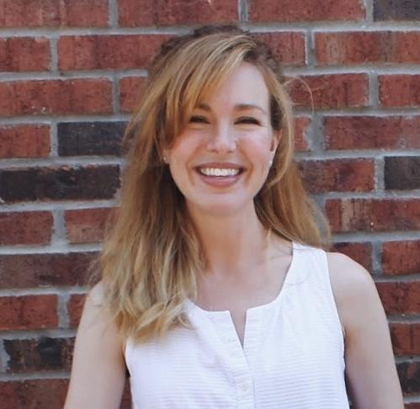
Thanks!
Table of Contents
Section 1
Section 2
Section 3
Section 4
References
Terri Grundy
tagrundy518@stkate.edu
Katie Toon
ketoon218@stkate.edu
Notes:
Thank you for viewing our poster session! Please feel free to reach out to us if you have any questions or comments.

Slide 12



Table of Contents
Section 1
Section 2
01.
Section 3
Section 4
Section 1
Credits
START!
Taking stock of your skills

