Slide 1
Visuals
Data
Simple
Add your logo here
Change the color to match your library’s colors.
Presented by:
Date:
For Beginners
To use this Power Point please include: Adapted from the Data Visualization Workshop by Terri Gotschall, MLIS, AHIP, University of Central Florida College of Medicine.

Slide 2
Logistics
This is an interactive workshop.
I encourage you to ask questions throughout the session.
The play data we will be using today is found in the Data Visuals folder on the desktop.
Be creative and have fun.

Slide 3

Why Visualize Data?
To share information that gets lost in text.
Which career has the highest median salary?
All career counselors need to share the same information which we have obtained from the Occupational Outlook Handbook. Registered nurses median salary is $33.65 per hour and the job outlook is 15%, nursing assistants median salary is $13.23 per hour and the job outlook is 11%, licensed practical nurses median salary is $21.65 per hour and the job outlook is 12%. Please advise students of which career has the highest job outlook and median salary.
Data from: https://www.bls.gov/ooh/
Notes:
Optional: Have half the participants use the text and the other half use the graph, to see who can answer the question faster.

Slide 4
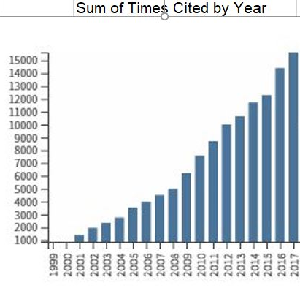
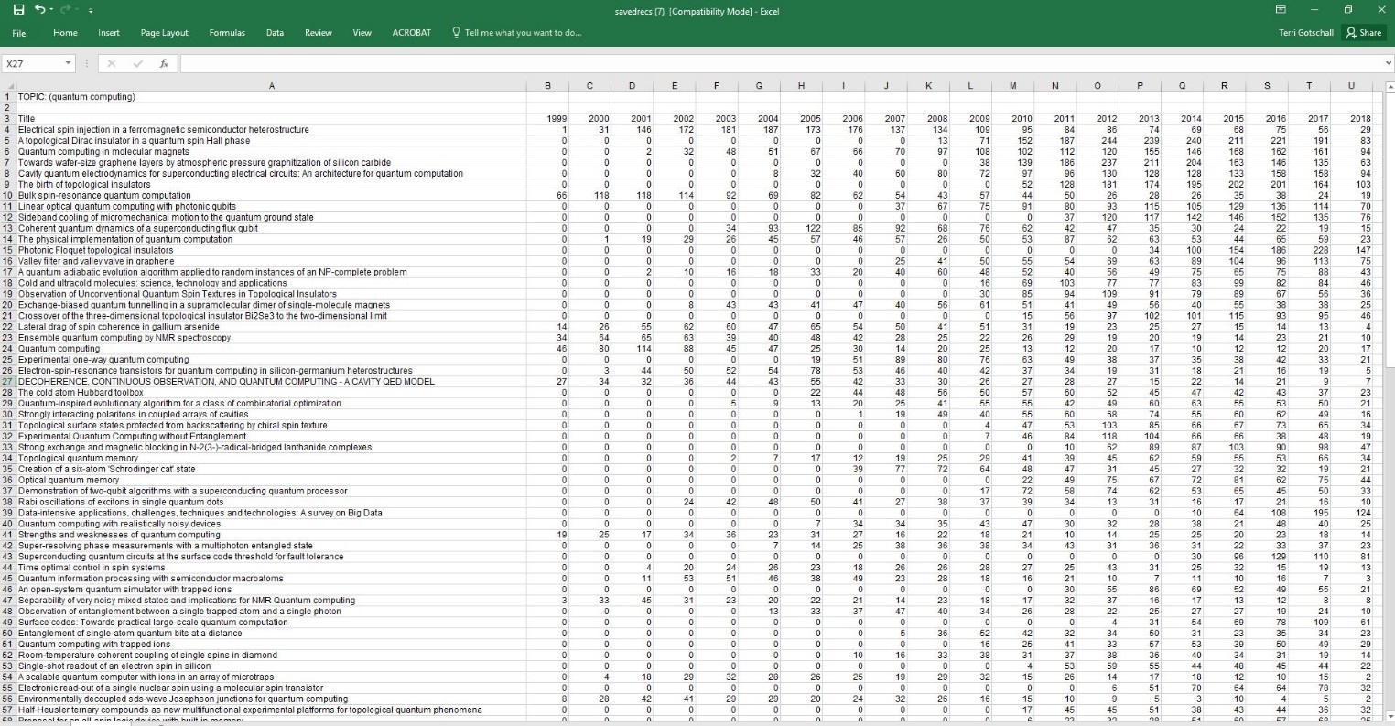
Why Visualize Data?
To communicate large data sets in an easy to read manner.

Slide 5
Why Visualize Data?
Visuals help stakeholders remember key information.
Test your recall:
Do you remember which career has the highest median salary?
Was the citation trend going up or down?

Slide 6
Using PowerPoint
Convert Data to SmartArt in Three Clicks
Click on the text box containing the information.
Under the Home tab click on Convert to SmartArt.
Select the art that best represents your process.
  Resize and recolor to fit your slide.
Jane Smith
7 Publications
25 Citations
h-Index 2

Slide 7
Using PowerPoint
Convert Data to SmartArt and add pictures
Jane Smith
7 Publications
25 Citations
h-Index 2
John Doe
8 Publications
23 Citations
h-Index 2
Sam Brown
6 Publications
72 Citations
h-Index 5

Slide 8

Using Excel
Convert a Table to a Chart in Four Steps Demonstration
Select the data.
Under the Insert tab click on People Graph.
In the People Graph box click on data.
  Change the title
  Click on select your data.
Click Create
  Click on settings to change the type, theme and shape.

Slide 9
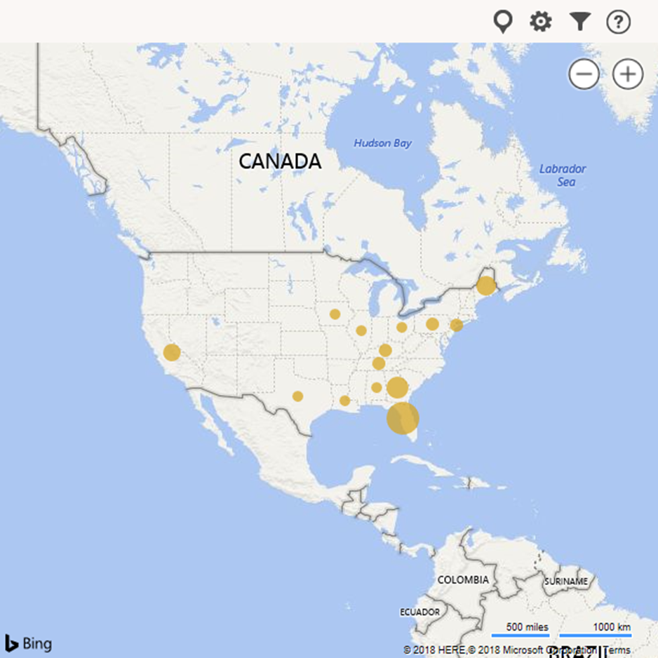
Using Excel
Convert a Table to a Map Demonstration
Select the data.
Under the Insert tab click on Bing Maps.
Click on the icon to see your data.

Slide 10
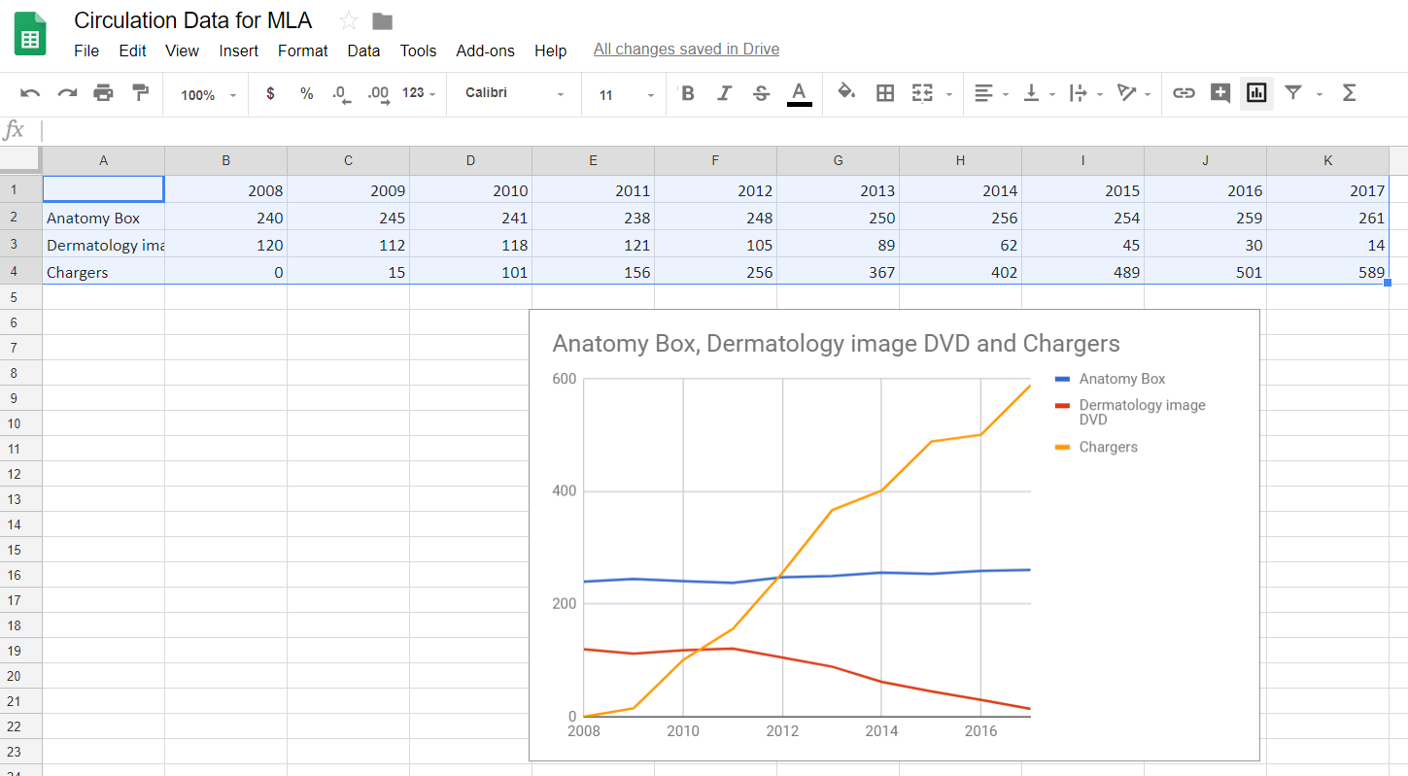

Using Google Spreadsheet
Step Two
Convert Data to a Graph in Two Steps
Select the data.
Click on to insert chart.
Step One

Slide 11
Hot Tips!
For charts and graphs
1. Start with clean data
  Units need to be the same
  No blank fields or missing data
  Remove duplication
Ingredient | Unit
Water | 1/4 cup
Vinegar | 4 TBS
Oil | 59 ml
Vinegar | 4 TBS
Ingredient | Unit
Water | 2 ounces
Vinegar | 2 ounces
Oil | 2 ounces

Slide 12
Hot Tips!
For charts and graphs
2. Keep it simple
Notes:
This demonstrates how changing the perspective of a graphic can skew the data being displayed.

Slide 13
Hot Tips!
For charts and graphs
Cite your data set.
Provide a legend.
Label your x and y axis.
Use colors with purpose.
  Red often means loss or stop,
  especially when dealing with money.
  Green is usually associated with positive or go.
  [add your colors here, black and gold represents UCF.]
Data from: https://www.bls.gov/ooh/

Slide 14
Protected Data
Restricted Data
Is your data highly restricted or restricted data?
Are the tools you are using appropriate for the classification of the data?
If you are using restricted data you must follow your organizations policies.

Slide 15
Give it A Try!
Play with Your Data
The files on your desktop included Power Point, Excel and a link to Google Spreadsheets.
Each one has “play data” for you to create your own data visuals.
Start with Power Point.
Have fun and let me know if you need help.

Slide 16
Share your Creations!
To share your design with the class
[include the link to your shared Google presentation here.]

Slide 17
Share your Thoughts!
Feedback Survey
Please take a minute to complete our four question survey. Copy and paste this link into your browser or (ctrl + click):
[insert link here]

Slide 18
Thank you!
[Add contact information here.]

