Slide 1
Faculty Power:
A Renewable Energy Source for Teaching Information Literacy
Elisa Slater Acosta
Susan [Gardner] Archambault
Loyola Marymount University
Image by Jürgen from Sandesneben, Germany (Flickr) [CC-BY-2.0], via Wikimedia Commons

Slide 2
Whose Job Is It To Teach Students Information Literacy?

Slide 3
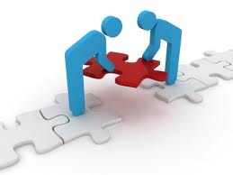
Librarians and Faculty Work Together
Librarians are experts in information retrieval, new technologies, and electronic information resources
Faculty provide disciplinary context for the information literacy instruction, motivate students to learn (including grades), and assess lasting impact of information literacy instruction outside of the library

Slide 4
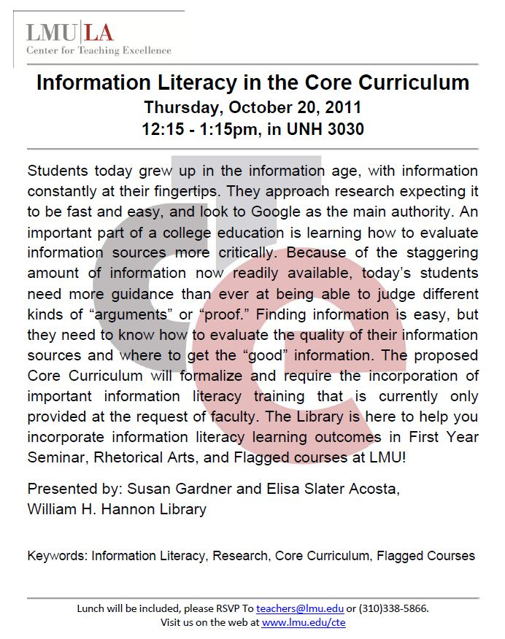
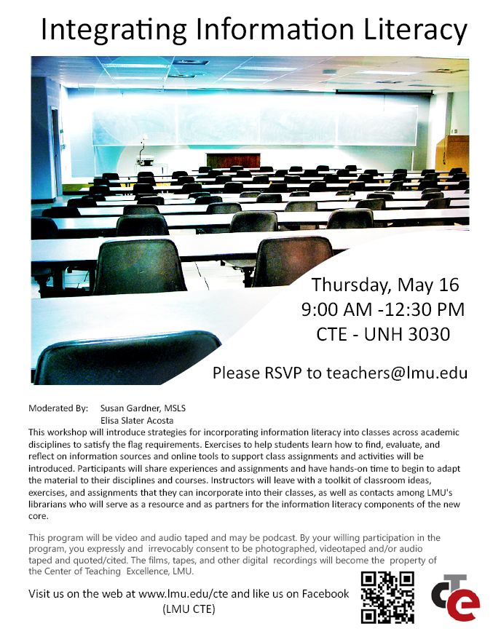
What is Train the Trainer?
“Teach the teacher” approach in which librarians train faculty to teach information literacy in their courses
Faculty, rather than students, become the target of information literacy
Faculty are educated through classroom activities, ideas, materials, and techniques

Slide 5
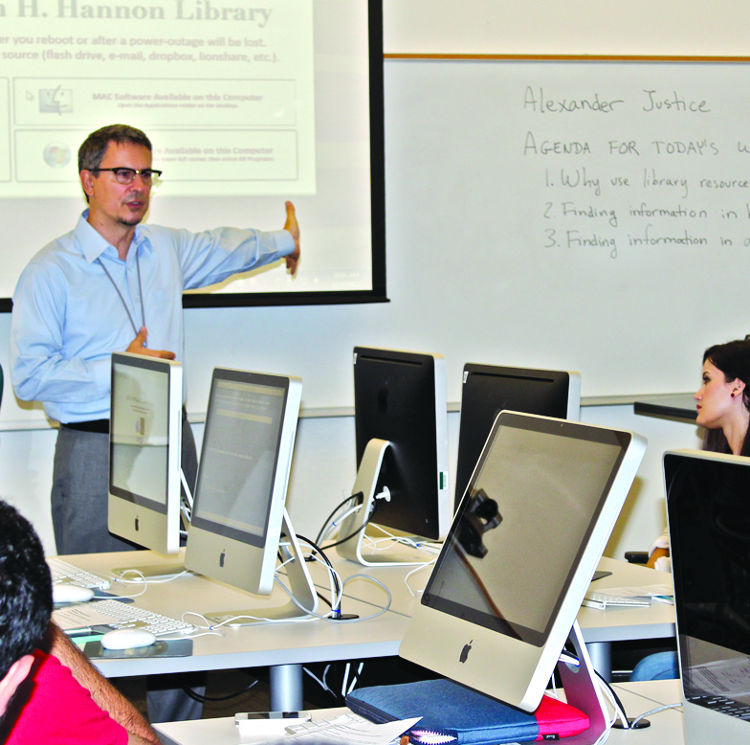
Why Train the Trainer?
Time constraints
Inadequate staffing of librarians, sustainability
Course integrated
Avoid scattershot approach; make systematic
Notes:
Work smarter not harder. Strategic library instruction. Embed better IL assignments.

Slide 6
Planning the Workshop
✔ Teacher Materials | Handouts, technology, dry erase markers, etc.
✔ Learning Outcomes | 1. 2. 3.
✔ Curriculum | What knowledge and skills do they need in order to achieve the learning outcomes?
✔ Pedagogy | What activities will you use?
✔ Evidence | How will I know they have learned?
✔ Outline | Learning Outcome #1 Curriculum Activities Comprehension Check
Notes:
Annual 3.5 hour faculty workshop started 3 years ago in 2012. Part of CTE (LMU Center for Teaching Excellence) Core Course Development Workshops http://www.lmu.edu/libraries_research/cte/Resources/Core_Curriculum/Summer_Grants_and_Workshops_2014.htm
Usually mid-May, one week after finals before faculty leave for the summer. A variety of workshops are offered. Two librarians present at one workshop.
New Core Curriculum started fall 2013.

Slide 7
Sample Learning Outcomes
1. Understand the definition, basic concepts, and importance of information literacy in order to incorporate information literacy into your assignments 2. Understand information literacy in the context of the new core curriculum at LMU in order to embed information literacy into your new core courses 3. Experience an information literacy assignment from the student perspective in order to improve and adapt the assignment for your own course 4. Develop an increased awareness of LMU library resources in order to use them in future months

Slide 8
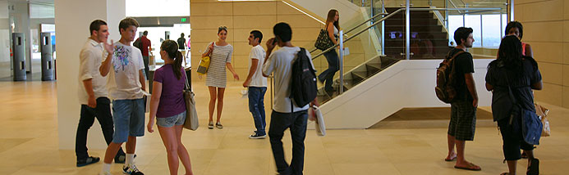
What is Information Literacy and why do students need it?
Notes:
Workshop outcome #1

Slide 9
Activity Ideas: Information Literacy Overview
Reflective discussion questions on scholarly discourse in their disciplines; their expectations for students; describe an assignment that addresses one standard
Present key research findings on information literacy (PIL, Citation Project, ERIAL)
Mix up information literacy learning outcomes with other learning outcomes and make them guess which ones are the info lit outcomes
Present a list of technologies or tools and have them match with the corresponding information literacy standards
Use polling software to see which information literacy standards they teach the most frequently in their assignments; which standard they find the most difficult to teach; present examples of student assignments and have them vote on the learning outcome it covers

Slide 10
Activity
Faculty self-reflection exercise
Click here for full text
Notes:
We do this activity every year! (several versions on the libguide)
(2014)Icebreaker Activity: (10-15 min.)
Questions on handout: Answer, then discuss with a neighbor and report back to the bigger group. --What is information literacy, in your own words? --How are you using info lit in your own field (e.g. to locate data, find opinions)? --At what stage in your Dept. curriculum (or during which courses) do students encounter information literacy?
--When you did research for the first time, what were the most challenging things or things that were most “foreign” to you?
(2013) Activity: Self-Reflective Exercise (25 min.) give 15 minutes; report back for 10
Core Curriculum quote: “scholarly discourse”
How is “scholarly discourse” defined in your discipline? Where do scholars in your discipline go to find information? How do scholars present their research in written, oral, and visual formats in your discipline? What are your expectations for students in your classes/discipline regarding scholarly discourse? Do your students meet your expectations? Reflect; Discuss with a neighbor and report back to group on your commonalities and differences. (Frame 1 “scholarship is a conversation”)

Slide 11
ACRL Information Literacy Standards
Notes:
Understand the definition, basic concepts, and importance of information literacy in order to incorporate information literacy into your assignments

Slide 12
Use Research
Project Information Literacy
Citation Project
ERIAL Project
http://site.citationproject.net/
Notes:
Present key research findings on information literacy (PIL, Citation Project, ERIAL)

Slide 13
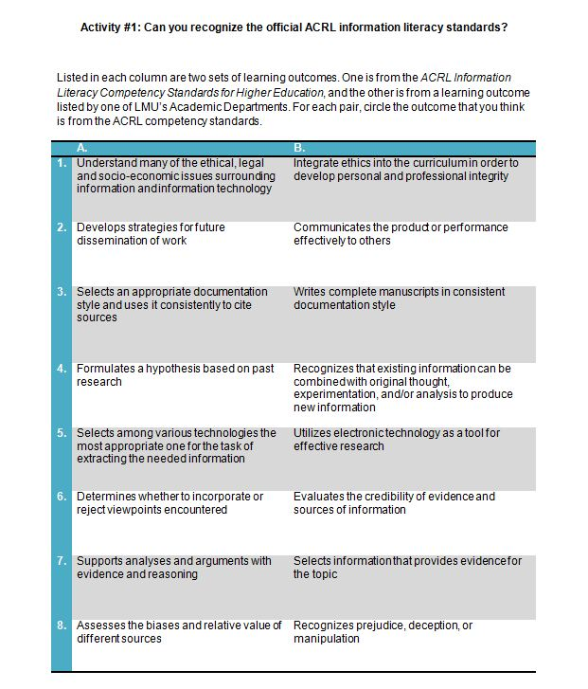
Activity
What does an information literacy learning outcome look like?
Click here for full text
Notes:
Proves IL outcomes are not foreign or difficult to incorporate. Some departments are already doing it!
We got this idea from Patricia Iannuzzi (2013 ACRL Academic/ Research Librarian of the Year). Icebreaker “Learning outcomes: What’s in a name?” She used ACRL standards and AAC&U VALUE rubrics, MAAP test, etc. http://libguides.lmu.edu/content.php?pid=334119&sid=4913625

Slide 14
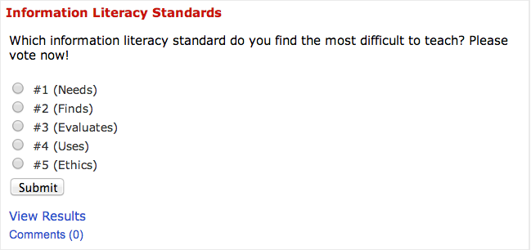
Polls
Notes:
Use polling software to see which information literacy standards they teach the most frequently in their assignments; which standard they find the most difficult to teach; present examples of student assignments and have them vote on the learning outcome it covers
Incorporate polling during the powerpoint presentation (as you talk about definition of IL)

Slide 15
Information Literacy Timeline
Notes:
Introduce “Info. Lit. Timeline” (shows FYS, RA, and flags plus the learning outcomes for each) and give faculty post-it notes.
Think about… Where else in the curriculum could there be information literacy within my Dept? Where would info lit ideally be introduced, reinforced, and mastered in my Dept’s curriculum? Write at least one course number on the sticky note and add it to the timeline. Think about how your course fit in this landscape?

Slide 16
where does your course fit?
Notes:
Workshop outcome #2
Understand information literacy in the context of the new core curriculum at LMU in order to embed information literacy into your new core courses.

Slide 17
How Do You Design a Good Information Literacy Assignment?

Slide 18
Activity Ideas: Information Literacy Assignment Design
Carry out assignment “from student perspective” and then modify
“Assignment Pitfalls”
“Best practice” rubrics or checklists for evaluating assignments
Assignment Database
Explore a library database and think about how your students could use it in an assignment
Use a tutorial evaluation checklist to explore and evaluate an information literacy tutorial. Think about if/how you might want to modify it and adapt for your course

Slide 19
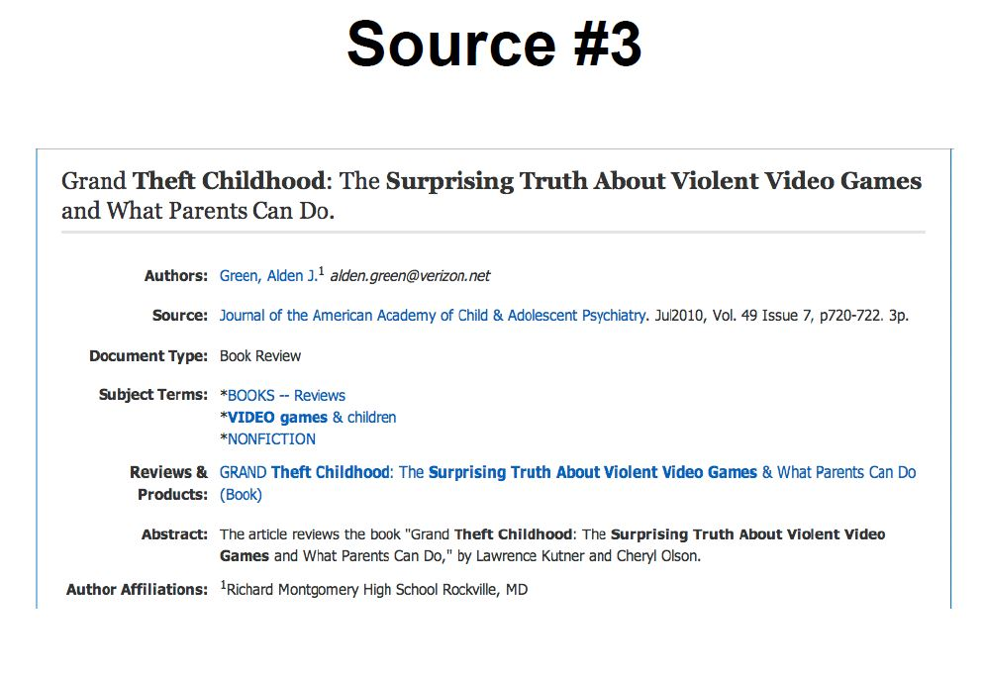
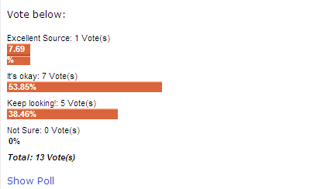
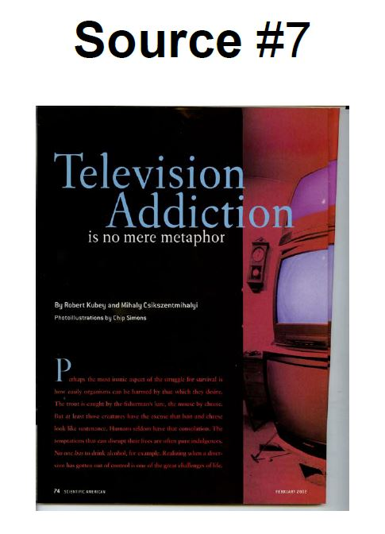
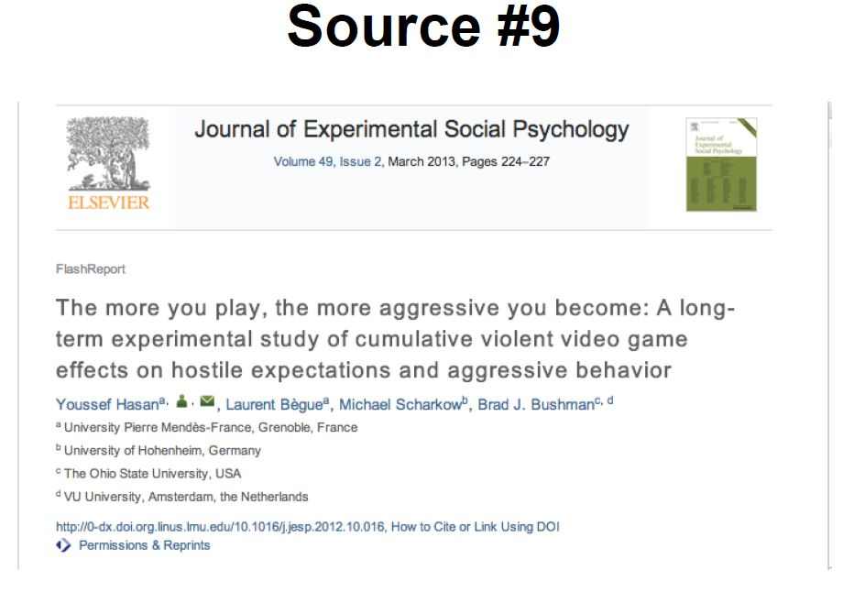
Model Information literacy Instruction
Evaluating Sources Activity
Click here for full text
Notes:
(2013) In the Student’s Shoes: Evaluate Sources Activity
Experience an information literacy assignment from the student perspective in order to improve and adapt the assignment for your own course
(40 min.)
(2012) RADAR Framework Exercise: assign each group a web site, popular magazine, journal article or source. Career Discovery- Occupational outlook handbook; yahoo news article related to a career; professional organization related to a career; scholarly article related to a career; a union web site. (identify Relevancy; authority; date; accuracy; Reason for Writing). They calculate the Earned Scholarly Average for the sources.
Share other types of "Evaluation" LibGuides CRAP Test , etc.
Faculty work in groups or alone to construct an evaluation chart for their discipline, discipline specific. use to build evaluation list.
Partners again or just large group, share on white board.

Slide 20
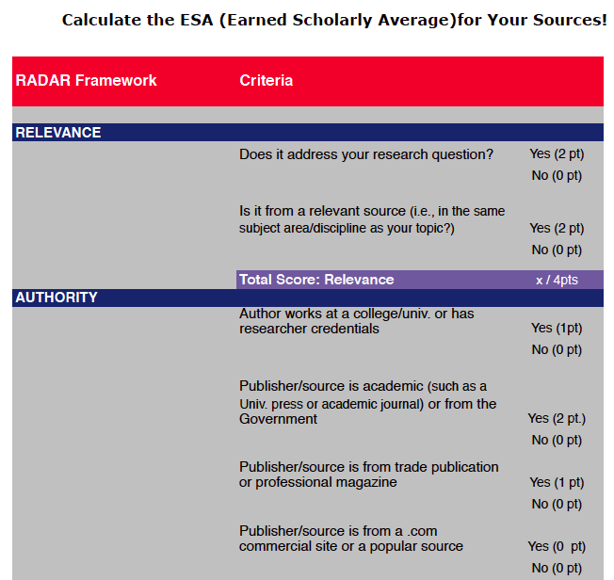
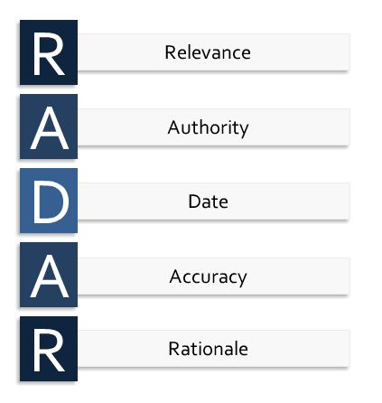
The earned scholarly average
Click here for full text
Notes:
Some faculty don’t like “check lists” and some love them. This became an interesting, lively discussion about evaluating sources!
As a result the librarians call RADAR a “framework” or “guideline” and not a “check list.”

Slide 21
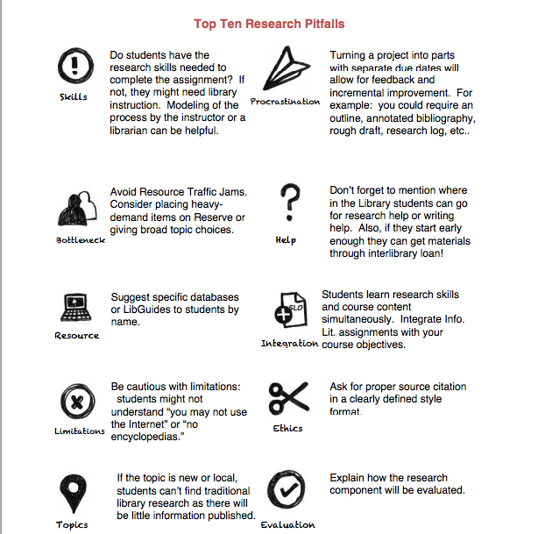
Anticipate Problems
Click here for full text
Notes:
“Assignment Pitfalls”

Slide 22
Rubric or checklist
Adapted from the Libraries of the Maricopa Community College District
(http://libguides.maricopa.edu/research_assignment_handouts_workshop)
Click here for full text
Notes:
Hand out 4 bad assignments- have people work in groups to answer “How could you improve this assignment? What level is this appropriate for (e.g. Freshman? Upper level?) If you had to change the assignment to go up or down a level, what would you change?)” Give 1 assignment per group. Report back to the bigger group to begin establishing a list. (10-15 min.)
Video: Show PIL video “Handout Study” (findings from PIL about good handout design) Show generic checklist on handout design & assignment pitfalls handout Activity: Take this & begin to develop it for your own discipline (15 min.)
This checklist is from Practical PIL http://projectinfolit.org/practical-pil)

Slide 23
How Do I Incorporate A Specific Information Literacy Learning Outcome?
https://www.flickr.com/photos/usnationalarchives/5589177693/

Slide 24
Activities for Incorporating a Specific Info Lit Outcome
Guest faculty speakers talking about “best evidence” of student work for a specific learning outcome
Overview of key library resources that can be used in assignments
Discussion between faculty and librarians about what “good practice” looks like for a specific learning outcome- then designing an assignment and rubric together
Worksheets to guide in development of assignment creation for a specific learning outcome

Slide 25
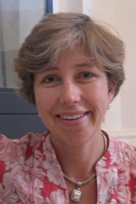
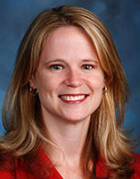
Faculty speakers
Why faculty guest speakers?
Faculty like to share and learn from each other
Share IL assignments - good/bad
Highlight successful Faculty-Librarian collaborations
Who should you ask?
Library “super users”
Frequent requestors of library instruction
Both our guest speakers had students who won the Library Research Award
Dr. Noreen
Art History
Dr. Almstedt
Health and
Human Sciences
Notes:
Guest faculty speakers talking about “best evidence” of student work for a specific learning outcome
(45 minutes) 2013
Very popular!

Slide 26
Librarians Can Help…
Designing & Revising IL Assignments
Instruction - teaching search strategy, how to evaluate sources
Custom Research Guides/Online Tutorials
Assessment - rubrics & testing
Get Help - research consultation appointments, chat or text-a-librarian, in-person or phone help
Image created by Jamie Hazlitt, Outreach Librarian
Notes:
Overview of key library resources that can be used in assignments
Develop an increased awareness of LMU library resources in order to use them in future months. (Workshop outcome #4)

Slide 27
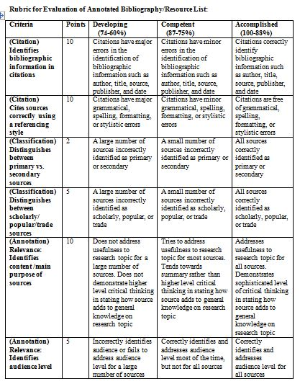
Designing an assignment & rubric together
Notes:
Discussion between faculty and librarians about what “good practice” looks like for a specific learning outcome- then designing an assignment and rubric together .
Faculty share assignments and syllabi.

Slide 28
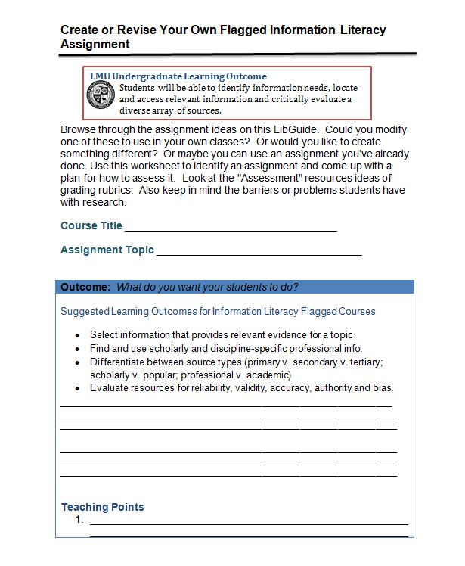
Create your own assignment!
Click here for full text
Notes:
Worksheets to guide in development of assignment creation for a specific learning outcome
Revise your own or create a new info lit assignment worksheet (1 hour, 20 min.). Keep in mind your expectations for students in your courses regarding info lit. Then in small groups, evaluate other peoples’ assignments
What are the positive elements you see about this assignment? What are the things that need improvement?

Slide 29
faculty Feedback
Notes:
Faculty survey (administered by CTE) very positive ratings
Informal comments
More time to workshop assignments
More examples of assignments and rubrics
More faculty presenters, faculty showcase
Next year have participants comment on how their assignments worked/didn’t work out
Really liked the interaction between faculty, time to talk, meet new people
Not enough time
Early results
12-20 faculty attend every year
An additional workshop planned for Fall (Aug. 2014) called “Designing Information Literacy Assignments”
Some elements of our sample assignments have been incorporated into their assignments (especially the annotated bibliography)
Some elements of the assignment checklist have been incorporate into their assignments (especially research help and writing help contact info.)
Requirement for CTE grant – syllabi and reports posted online
Librarian feedback
Bring back faculty presenters. Faculty love it.
The evaluation activity is fun and lively
After three years… move away from defining ACRL standards. Concentrate on LMU IL outcomes and new core curriculum outcomes. More time can now be devoted to assignment re-design.

Slide 30
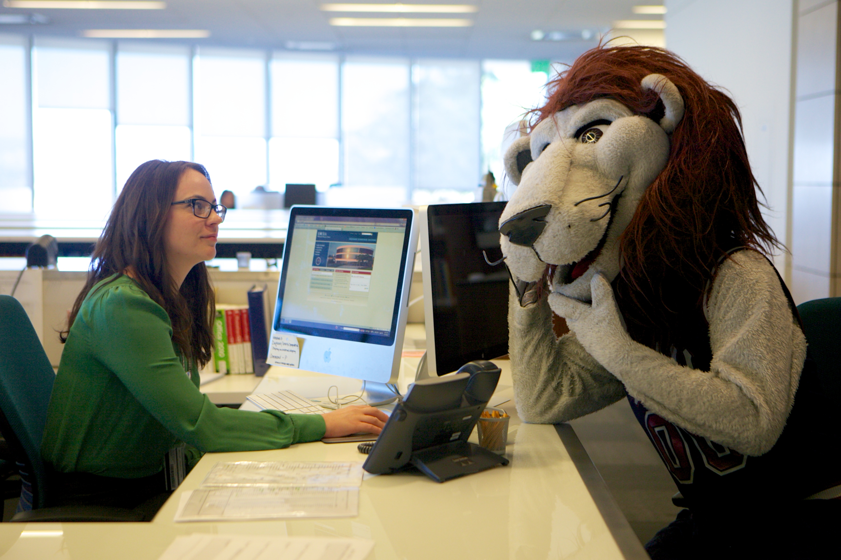
Questions?

Slide 31
Additional Resources
Information Literacy Workshop for Faculty http://libguides.lmu.edu/infolitworkshop
First Year Seminar LibGuide for Faculty http://libguides.lmu.edu/FYS
Information Literacy Flagged LibGuide http://libguides.lmu.edu/flag
Librarian Retreat on Information Literacy http://libguides.lmu.edu/librariansretreat

Slide 32
Contact Us
Contact Information:
Elisa Slater Acosta
elisa.acosta@lmu.edu
Susan [Gardner] Archambault
susan.gardner@lmu.edu
PPT Slides: http://works.bepress.com/elisa_acosta/8

Slide 33
Acknowledgements
Thank You
William H. Hannon Library Research Incentive Travel Grant
Image by Jürgen from Sandesneben, Germany (Flickr) [CC-BY-2.0], via Wikimedia Commons

