Slide 1

Using Learning Objects to Enhance Distance Reference Services
ASCLA Webinar
January 18, 2011
1-2:30 PM

Slide 2

Contact Information
Susan Ariew
sariew@usf.edu
974-0304
Blog: http://usflibraries.typepad.com/edlibreport/

Slide 3
Who you are
Academic librarians?
From large institutions?
From small institutions?

Slide 4
Objectives for Today’s Session
Identifying characteristics of learning objects
Classifying types of learning objects & their uses for reference and instruction
Examples of learning objects that can offer reference assistance
Tips on how to get started in creating and using learning objects

Slide 5
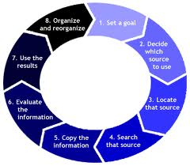
What Are Learning Objects?
“A learning object is any digital resource that can be reused to mediate learning.”
“Learning Objects in Higher Education”, EDUCAUSE Research Bulletin, Vol. 2001, Issue 19, October 1, 2002.

Slide 6
Definition of LOs
“Learning Objects are small stand-alone “chunks” of information designed to be easily reused and repackaged to meet the needs of different audiences. They are typically designed to achieve a certain narrow learning objective and may contain an assessment to determine success against that objective.” (Learning Objects Network, 2004, para 1)

Slide 7

Characteristics of Digital LOs
Are Reusable
Are Portable
Are Accessable
Are Sharable and stand alone
Mediates learning

Slide 8

Learning Objects and Course Management Systems
Widespread use of learning management systems (LMS) or course management systems (CMS) on college campuses has made the concept of learning objects very popular.
http://www.screencast.com/users/SAA60/folders/Jing/media/e7c84a28-355e-41e8-be5e-0f69bfb0c130
(a two minute hybrid webcast on library subject guides).

Slide 9
New Kinds of Teaching Librarians
The Blended Librarian (Stephen Bell)
  Librarians with new skill sets such as instructional design/technology skills
The Embedded Librarian
  Becoming an integral part of courses and curricula—moving from coordination, cooperation to collaboration & partnerships

Slide 10
Embedded-ness & Instruction
You can push out the basics with tutorials, webcasts, podcasts in the course management system so face to face instruction is at a higher level
You can put in content that helps scaffold student learning (handouts, PowerPoints, and other materials).

Slide 11
Using LOs for Online Consultations & Reference
Helping students with the basics
Answering specific reference questions
Providing tutorials for specific tools/resources
Example: ILL tutorial
Example: How to Guides & More

Slide 12
Finding Ready Made LOs
Learning Object Repositories—Become a Consumer, then a Creator
Ants
Creative Commons
Merlot
PRIMO Database
YouTube
Google Videos

Slide 13
What Are Your Favorites?
The Library Minute: Academic Search Premier
Avoiding Plagiarism: What Do I Need to Cite?
APA Exposed
LibGuides!

Slide 14
Types of Learning Objects--Audio
Podcasts
(Library Guy/Library Gal Series)
Free Music for Videos etc
Sound editing tools

Slide 15
Photos and Images
Using images to show rather than tell patrons what you want them to know
Common Image Tools
Screen Capturing Tools

Slide 16
Screencasts
Screencasts are digital movies in which the setting is partly or wholly a computer screen and in which audio narration describes the on-screen action.
Screen capturing tools

Slide 17
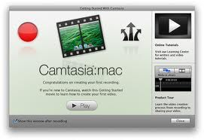
What Tools Have You Used?
In the chat screen type in some of the screencasts you’ve used and what you like about them. You can also request the microphone to talk to other participants today.

Slide 18

What Are the Challenges in Creating Screencasts?
List some of the challenges you’ve encountered in creating screencasts for your library.

Slide 19
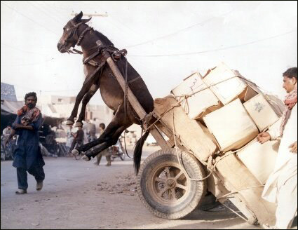
Challenges
Learning curve—Learning and mastering new technology and skills
Quality of production
Ability to post and share
online

Slide 20
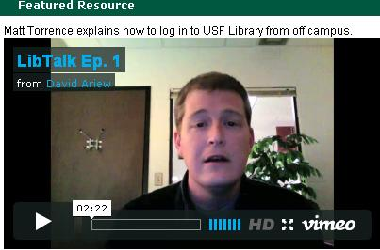
Videos
Video/Movie Tools

Slide 21

Presenting/Web Conferencing
PowerPoint
Prezi (free)
Dim Dim
GotoMeeting
Adobe Connect
Elluminate

Slide 22
Screen Captures/Getting Started
Start with the basic tools and work your way up.
JING (see demo) a cool tool
Quicktime 10 (Snow Leopard on Mac OS X) See this demo to learn how easy it is
It helps to write a script when doing webcasts, videos, podcasts, etc.

Slide 23

Xtranormal—the latest
A Way to create flash animated videos with just a script.
Example: So You Want to Get a PhD in the Humanities
Example: MBA Research Guide by Business Librarian Steve Cramer

Slide 24
Helpful Links
Learning Objects LibGuide: http://uiuc.libguides.com/content.php?pid=64638&sid=477559 (special thanks to Lori Mestre).
Learning Object Tutorial:
http://www.eduworks.com/index.php/Publications/Learning-Object-Tutorial.html

Slide 25
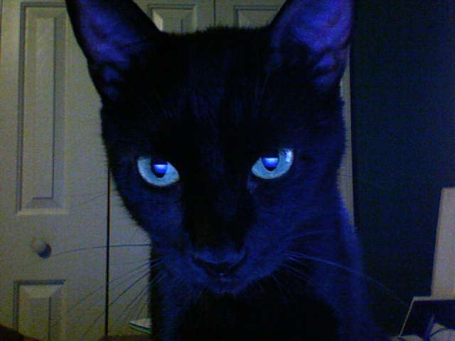
Questions/Comments?
?

