Slide 1
Show, don’t tell
Embedding Library services into the campus website and community
Stephanie Davis-Kahl, The Ames Library
Charleston Conference
November 8, 2017
Notes:
We have been dc customers since 2007 – we joined specifically to showcase and share undergraduate student work.
Our IR hosts a number of undergraduate journals, honors projects, other exemplary students work, WGLT, oral histories.
Also a few closed collections - the home for a psychology professor’s research data, collection of faculty governance documents.

Slide 2
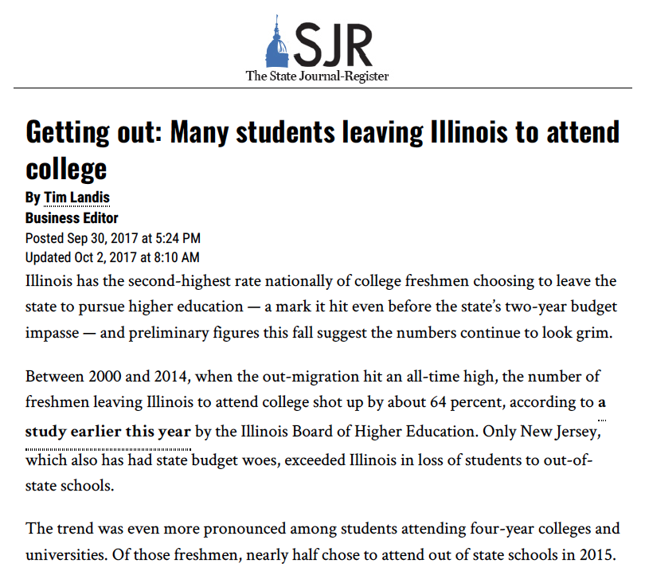
“Eliminating the net loss would result in more than $215 million in additional tuition and fees revenue to Illinois universities (using the average tuition and fees for Illinois public universities, but not including the increased revenues to communities from other normal student expenditures for room, board and living expenses).”
Outmigration Context Reports, Illinois Board of Higher Education, http://ibhesac.org/site/outmigration-context-reports/
http://www.sj-r.com/news/20170930/getting-out-many-students-leaving-illinois-to-attend-college
Notes:
Something you need to know about Illinois is that we are the second-highest exporter of high school students to other states for their university experience. (New Jersey is the first).
In addition to our state’s budget impasse (which thankfully ended this past summer), the shift in demographics in the number of high school students (both in Illinois and in the US) has had an impact on our enrollment. We’re fighting an uphill battle to keep students in state, and to attract students from outside of Illinois to attend IWU given the quality of students we are competing for.

Slide 3
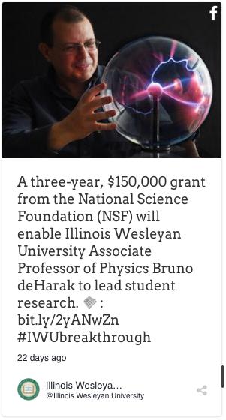
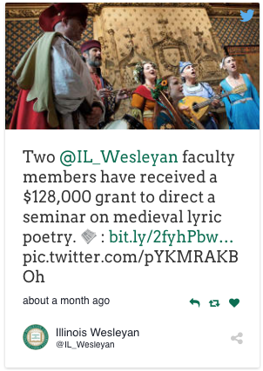
Notes:
We know great things are happening on our campus – faculty are receiving funding to involve students in their research and scholarship, and Forbes named @il_wesleyan one of the top five “best value colleges” in 2016.

Slide 4
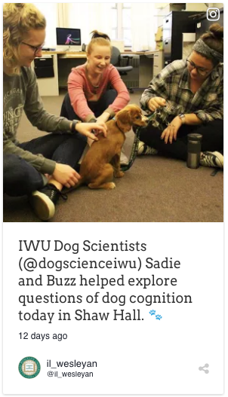
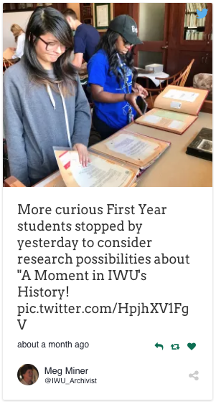
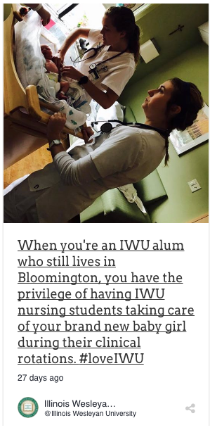
Notes:
And we know that students have distinctive opportunities and experiences that are all part of, and essential to, the liberal arts.

Slide 5
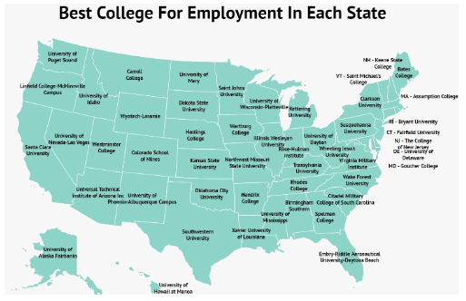
“So much of what we hear in the popular media flies in the face of what we know to be true: there is no better preparation for a meaningful career than a liberal arts education.”
https://www.iwu.edu/news/2017/illinois-wesleyan-best-college-for-job-placement.html
Map from https://www.zippia.com/advice/best-colleges-for-jobs/
Notes:
We also have consistently strong employment rates for our graduates - Ninety-six percent of the Class of 2016 were employed or attending graduate school within six months of graduation.
[Our Career Center of four professionals and eight student staff members is doing amazing work]
All of this supports what we are trying to communicate with Digital Commons – that IWU is an intellectually vibrant community, that faculty and staff are student-centered and dedicated to academic rigor and creativity, and that our students consistently exceed the high standards we set for them.

Slide 6
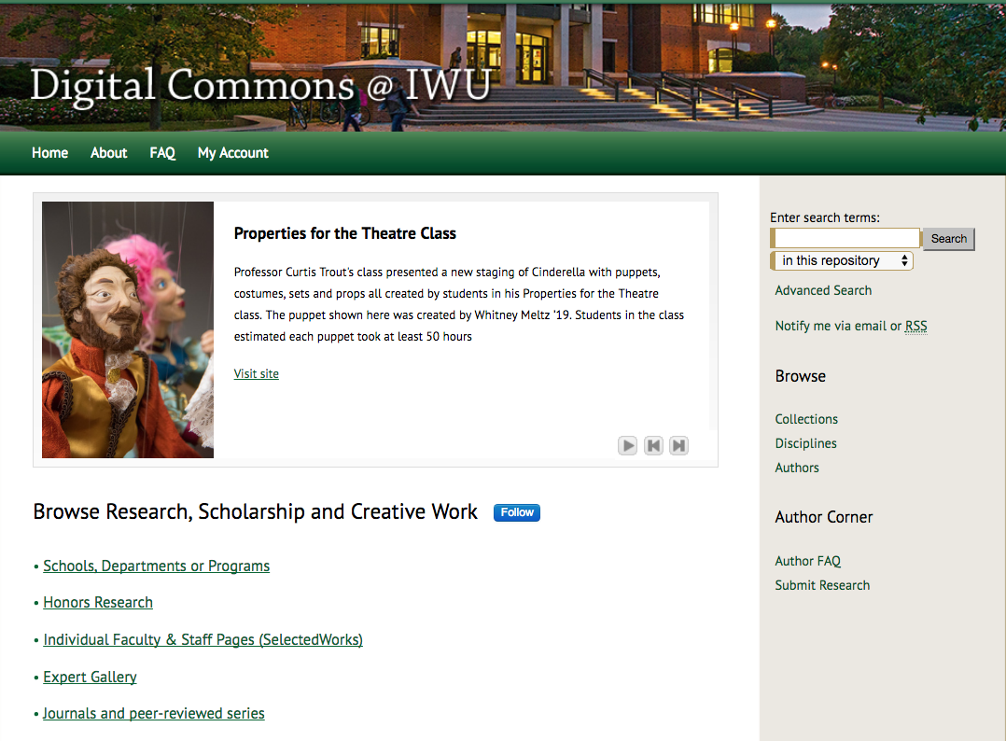
Three million downloads as of September 24, 2017
Notes:
Back in 2004, campus went through an identity study as part of an effort to improve our marketing. In one of the faculty forums, one of our English professors said that what he wanted people to know about IWU was that it is a intellectually vibrant community.
That idea resonated very strongly with us, and continues to guide our efforts.
In short, we wanted to help tell the story of liberal arts education. When we had built up a good amount of content in the IR, we asked for it to be linked from our campus homepage, and we were told no. Repeatedly, even after a million downloads, even after two million downloads, and even after a presentation to the President’s Cabinet, and even after requests from our then-Associate Provost.
So, we got to work.

Slide 7
audience
visuals
mission
Notes:
Raise visibility of IR content through strategic cross-links, embedding of features/functions throughout IWU site
Audience – primary, secondary, tertiary
Visual elements – readership map, images
Mission – intellectually vibrant community
On site, but also within DC itself

Slide 8
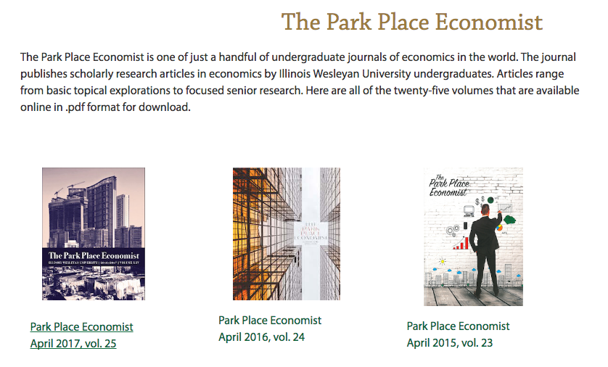

Department of Economics
https://www.iwu.edu/economics/
Notes:
Department of Economics has been a long-time champion due to their long-standing undergraduate research journals and the importance placed on undergraduate research in general. They feature both of their journals on their departmental website, embedding cover images and links to the Park Place Economist, and direct links into the UER. Park Place covers are designed by IWU graphic arts students, so it’s a nice way to feature two programs at once.

Slide 9
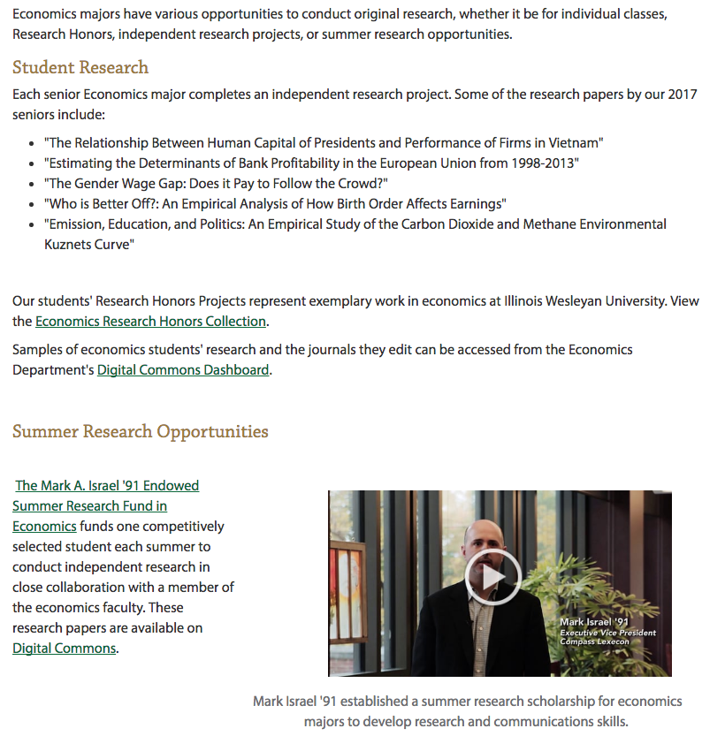
Department of Economics - Research
Notes:
They also feature links to recent student work on their Research page – the green arrows are all links into Digital Commons, and the red arrows are links we could (and will) add. The video would be a perfect complement to this collection…NEXT SLIDE.

Slide 10
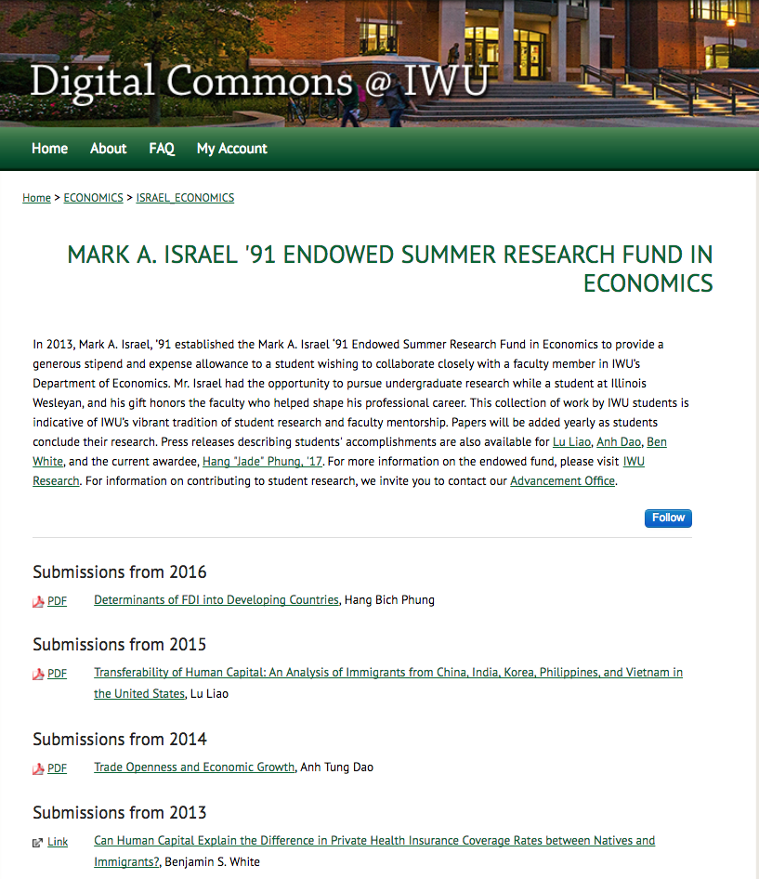
Includes links to:
Department
Information about fund
Press releases
Advancement
Individual records include:
Name of faculty advisor
Press release
Abstract
Suggested citation
Full text of paper
Notes:
Example of how we connect funding opportunities with products of research.
Cross-linking to press release collection, to our Advancement Office, as well as providing full text of papers.

Slide 11
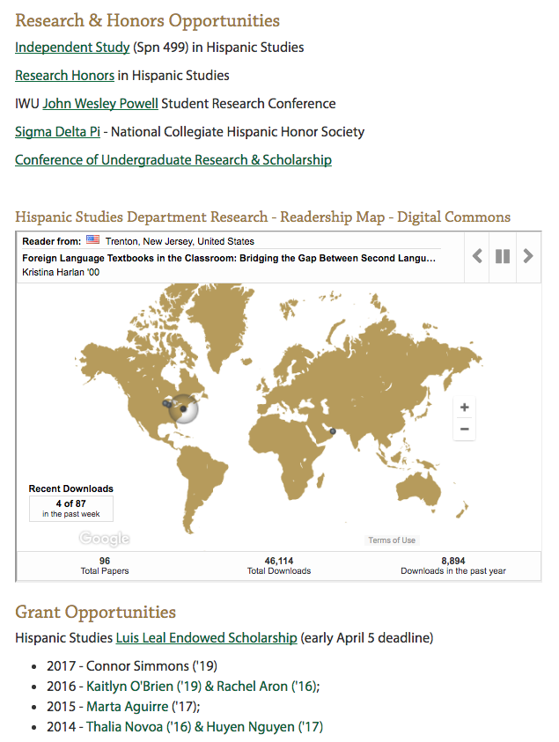
Department of Hispanic Studies
https://www.iwu.edu/hispanic-studies/students/honors_research.html
Notes:
Another department that has been a champion is Hispanic Studies – they have a number of independent research opportunities for their students, and they have been an active user of Digital Commons to profile both student and faculty research.
The former department chair used DC to show prospective and current students how the department fulfills our mission, our learning goals?
She would sits with students and gs through website, highlighting the different ways in which their studies aligns with the departmental learning outcomes, university mission
Grants & Research page – presents the opportunities in the department for extending and expanding upon what students do in the classroom, through internships, through study abroad, through research.
Emphasizes that their work isn’t just for an audience of one (professor). Their work has potential to reach and impact many others. The department embedded their Readership map into their departmental site, and can also talk to students about the download reports they will receive, which communicates the reach of their work.

Slide 12
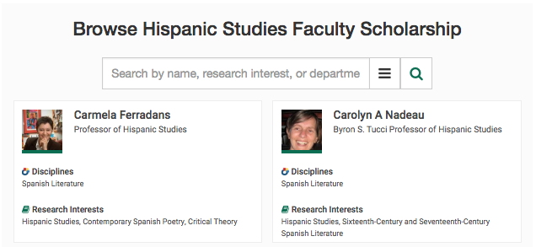
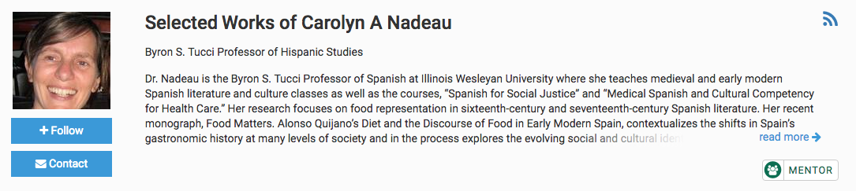
Department of Hispanic Studies – Faculty – Scholarly Achievement
Notes:
The department has also embedded the Expert Gallery after we built SelectedWorks pages for their faculty members, and because we add links to student research to faculty’s SW pages, we have the option of adding a “Mentor” button to each profile. This communicates that the faculty member is open to and supportive of undergraduate research. When you click on the button, it takes you to the Mentor Gallery, which lists all the photos and profiles of faculty who have the button on their site.

Slide 13

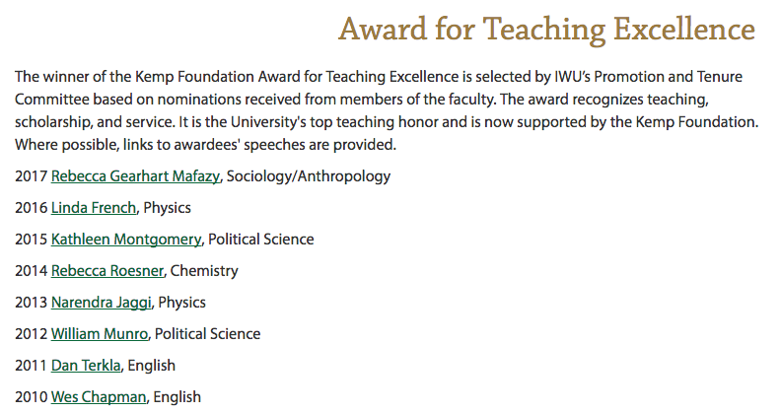
Faculty-Focused Collections
http://digitalcommons.iwu.edu/teaching_excellence/
Notes:
So Digital Commons is paid for by the Office of the President, our Mellon Center for Teaching Excellence, the Office of the Provost and the library.
Each year our Promotion and Tenure Committee selects the Kemp Foundation Award Winner, a campus award for teaching. The page on the screen is a page on the Provost’s website, which links into each individual faculty member’s record in the collection. Thanks to one of the past awardees, Professor of Religion Carole Myscofski, we were able to collect most of the speeches in print or electronic form (since the collection goes back to the early 1960s), and for more recent speeches, we also have video.

Slide 14
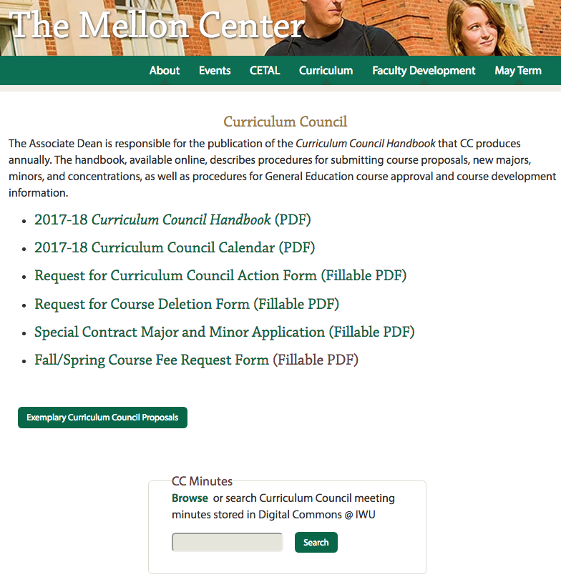
Search box enables full text searching of past Committee meeting minutes
Excellent companion collection to our collection of Faculty Meeting minutes
Notes:
So you may not think meeting minutes enhance or fulfill the mission of showcasing “intellectually vibrant community,” BUT! This is a fantastic piece of code that bepress developed for us at the request of our University Archivist Meg Miner, who wanted to provide very easy access through a single point for faculty serving on the Curriculum Council, or for administrators who wanted to understand the discussions around programs or curricular discussions on campus. The search box lives on our Associate Provost’s Curriculum Council site. I credit our collection of faculty governance minutes and other documents with faculty “getting” what Digital Commons is all about.

Slide 15
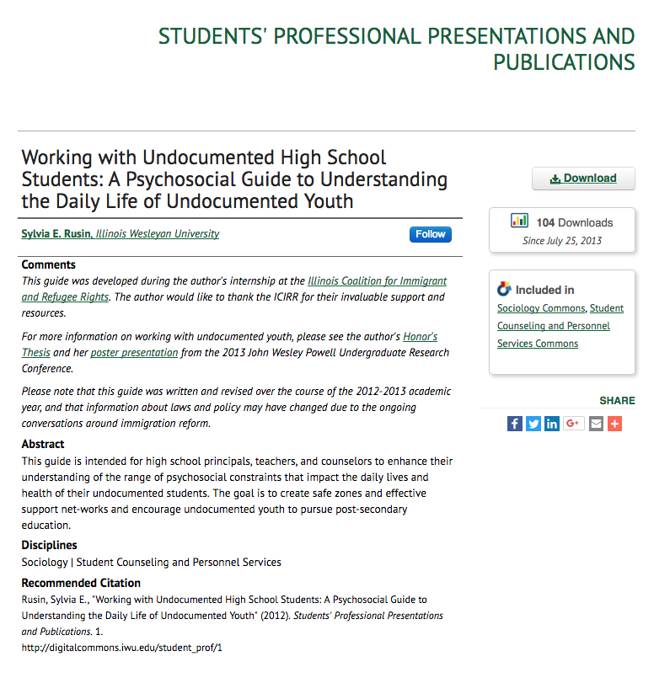
Cross-linking within IR:
Internship site
Guide
Honors Project
Poster presentation
Press release
Notes:
So on the topic of “getting it” – this is the record in Digital Commons from a guide written by one of our alumna, Sylvia Rusin. She did an internship at the IL Coalition for Immigrant and Refugee Rights during her junior year, and wrote this guide to help educators and counselors work with undocumented youth. One of her Honors projects – the one in Sociology – presents her research on the same topic, for a scholarly audience, and her presentation at the JWP Conference at IWU was geared towards a general audience of fellow students, faculty, administrators, parents, and members of our Board of Trustees. (her other Honors Project was in Hispanic Studies, titled “The White Hand: A parallel between Cervantes and the 1.5 generation” and is also available in DC.
This is my favorite example of student work in Digital Commons – it brings together EVERYTHING we hope for and plan for our students. Through her own experience as an immigrant and through her studies and internship experience, Sylvia created not only a scholarly product but also different forms of scholarship for different audiences. It’s an amazing example of intellectual entrepreneurship, which is simply, “– individuals who own and are accountable for their education and who utilize their intellectual assets to add to disciplinary knowledge and as a lever for social good.” (Cherwitz, R. (2000) “Intellectual Entrepreneurship: can intellectuals innovate in ways that produce a better world?”, available at https://web.archive.org/web/20090815022551/http://whitman.syr.edu:80/eee/campus/ie.asp (accessed November 16, 2017).)
Sylvia went on to earn her Masters in Social Science from the University of Chicago, and now works for IMPRINT, “a coalition of organizations that supports national, state and local efforts to incorporate multilingual/multicultural talent, and to create and implement policies and best practices that support the successful integration of skilled immigrants into the US economy. Through its member organizations, IMPRINT also supports the direct provision of career and re-credentialing services to workers.” (https://www.imprintproject.org/about/)

Slide 16
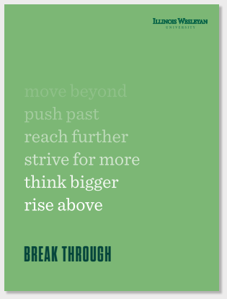
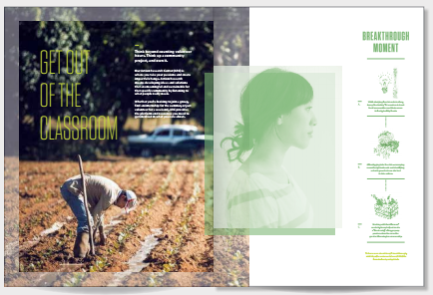
New Faces = New Strategies = Opportunity
Vice President for Admissions & Marketing
Director of Marketing
Assistant Director of Marketing
Director of Communication
(Our Champion!)
Notes:
So – lots has been changing on our campus. We have nearly a completely new set of colleagues in our Admissions and Communications offices.
They understand and value what we are doing with DC@IWU.
These are examples of our new branding campaign, which is beautiful and communicates our liberal arts advantage.

Slide 17
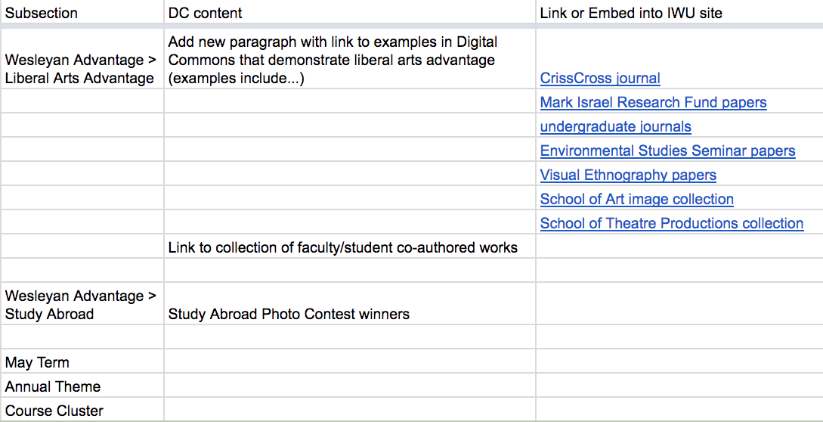
Subsections
under
Academics
Our suggestions for revising content on page
Collections in Digital Commons to link to from IWU site
Notes:
Since September, we’ve met with the Director of Marketing.
Developed spreadsheet for website redesign – talk it through.
Since the meeting, they have written a press release for our 3 millionth download, included Digital Commons in our new Viewbook, and arranged an interview with our local NPR affiliate. We are very grateful for their work!

Slide 18
Getting Started
Connect with colleagues:
  Marketing, Communications, Admissions
  Liaison librarians, outreach
  Current students
Know your audience: Prospective and current students, parents, and counselors
Explore: campus website, marketing materials for opportunities to link to IR or embed content
Be specific, give examples, and use visuals
Notes:
So if you want to get started – here are some tips.

Slide 19
Stakeholders
Library
Students
Notes:
So why do all this work?
Stakeholders interest – Admissions, Marketing, Alumni. Departments – communicating how students can take their interests, research them, and produce excellent scholarship.
Library – value, financial responsibility to expand and capitalize on our investment of time and money, continue positioning ourselves as stewards of student research IN ADDITION TO teachers and scholars in our own right. We cover all the bases in scholarly communications from beginnings of research to dissemination to archiving.
Students – formalizes their identify as scholars and artists, communicates value of their research with stamp of approval via inclusion in the repository, builds future readership for their work. Contributes back to their discipline or community of practice so others can build on their work.

Slide 20
THANKS/Q&A
Stephanie Davis-Kahl, The Ames Library
sdaviska@iwu.edu
@StephDK
J.G. Bankier, bepress
jgbankier@bepress.com
@JGBankier
Notes:
Thank you so much for your attention – please ask us questions.
Thank you!

Slide 21
Attribution
Slides 3, 6: attribution provided on slide
Slides 4-5: Social media posts from the IWU website
Slide 15: reference in notes to Cherwitz, 2000:
  Cherwitz, R. (2000) “Intellectual Entrepreneurship: can intellectuals innovate in ways that produce a better world?”, available at https://web.archive.org/web/20090815022551/http://whitman.syr.edu:80/eee/campus/ie.asp (accessed November 16, 2017).
Slide 16: images from IWU Brand Guidebook
Slide 19:
  leader by Wilson Joseph from the Noun Project
  education by Maria Kislitsina from the Noun Project
  graduate by Shastry from the Noun Project

