Slide 1


Library Publishing and Undergraduate Education: Strategies for Collaboration
Stephanie Davis-Kahl, Scholarly Communications Librarian
Professor Michael Seeborg, Department of Economics
#acrllibpub
Notes:
Good morning – my name is Stephanie Davis-Kahl and I’m the Scholarly Communications Librarian at Illinois Wesleyan University. I’m joined today by my colleagues Professor Michael Seeborg, Professor of Economics at Illinois Wesleyan University, and Isaac Gilman, Scholarly Communications & Research Services Librarian at Pacific University.

Slide 2
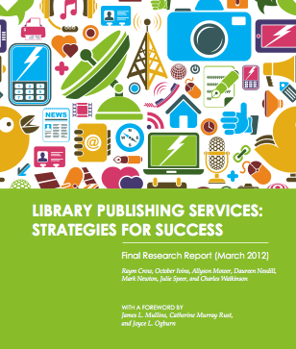



#acrllibpub
Notes:
Our goal today is to explore library publishing and how publishing experiences can involve and impact undergraduate students.
Library publishing in general is fully emerged and active area of research and engagement – since Library Publishing Services: Strategies for Success was published as the final report of an IMLS grant in 2011, the LPC has been established, Amherst College announced their open access press, the Library Publishing Toolkit (SUNY Geneseo and the Monroe County Library System) sent out a call for proposals, and University of Michigan’s Mpublishing is going strong as the “primary academic publishing division of the University.”
Our presentation aims to present two case studies of two primarily undergraduate institutions that have integrated publishing into their curricula in different ways.

Slide 3
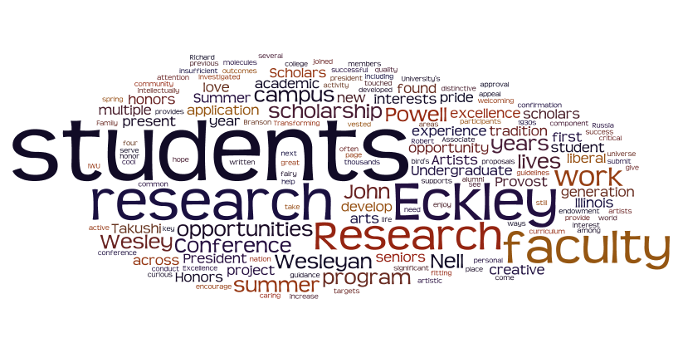
Value & Tradition: Undergraduate Research
#acrllibpub
Notes:
IWU is a small private liberal arts college with four professional schools, located in Central Illinois
We have just over 2000 students and 180 full time faculty
IWU has a strong commitment to undergraduate research which is demonstrated in several different ways: undergraduate research conference (going into its 24rd year), thriving research honors program across all departments/disciplines, including the newly-established endowment for a summer undergraduate research program, and an additional summer research fund to support research in the Humanities. IWU also has a long history of supporting student publications. Currently there are six student journals thriving on campus – two in English, another in political science, another in history, and two in economics. The library hosts nearly all of these in Digital Commons, and works in different ways with the students and faculty advisors involved in each publication. The journal that I and Professor Seeborg will be focusing on today is the Undergraduate Economic Review.

Slide 4
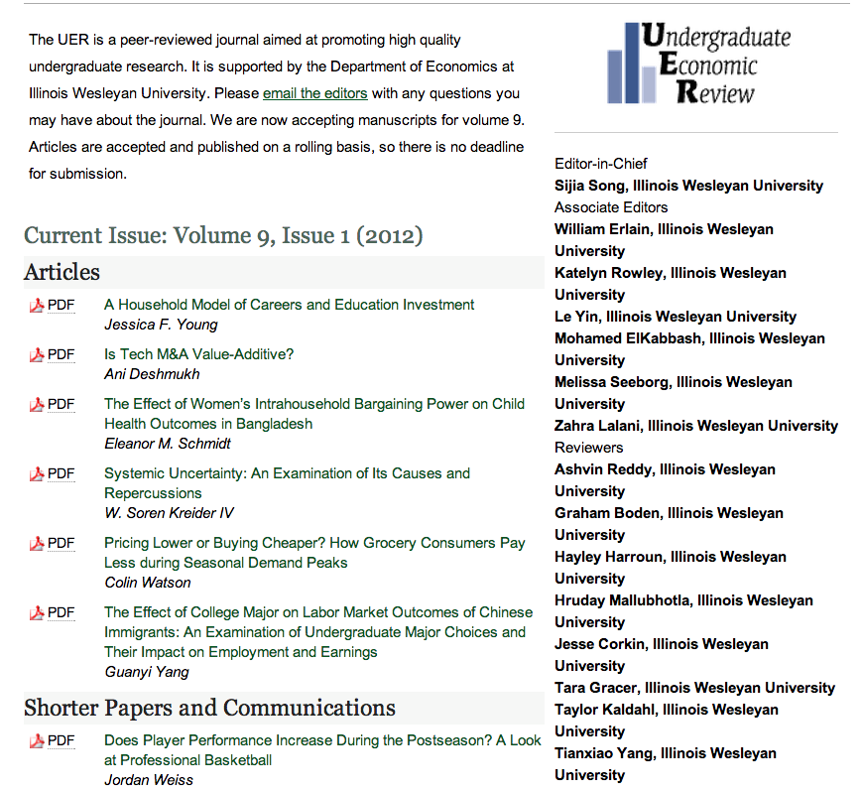
http://digitalcommons.iwu.edu/uer
#acrllibpub
Notes:
The UER is:
Sponsored by the Department of Economics
With infrastructure provided by The Ames Library through its implementation of bepress
It’s born-digital, open access, peer-reviewed. Our authors retain all copyright.
The collaboration with the UER began after we implemented Digital Commons as a experiment to see how the library and the economics department could work together – we were eager to explore how we could expose students to an experiential publishing experience while integrating education and advocacy around Open Access and authors rights. It’s my hope that the library can develop similar partnerships with the other journals on campus to move beyond simply hosting to being an integral part of their publishing processes and to educate students about scholarly publishing.
What sets it apart from other journals on campus is that our submissions are open to any undergraduate economic student, anywhere in the world – in fact, this year we had submissions from Mexico, England, China and India, to name a few.

Slide 5
Student Roles
General Education:
Gateway, Writing requirements + Information Literacy
Major:
Writing Intensive requirement + Discipline specific Information Literacy + economics courses relating to econometrics,
Publishing Roles and Functions
#acrllibpub
Notes:
Another element of the UER that makes it unique is that interplay between the intellectual and skill-based preparation students participate in to take on and succeed as reviewers and as the editorial staff of the Undergraduate Economic Review.
Through their General Education and through their major courses, students in the economics department are consistently asked to employ methods of critical thinking, information literacy and peer review, whether it’s in an introductory statistics course, an econometrics course or an upper-level course labor economics or the economics of the environment.
All of these experiences prepare students to apply what they’ve learned to carry out the editorial processes required by the journal. Students serve as peer reviewers, as members of the editorial board, and one student is selected by the faculty each year to be the editor-in-chief. They work together to shape the journal’s content over the course of the year, and each year we’ve seen our submissions increase, which means the students not only have more work, but can be even more selective than they already are.

Slide 6
Librarian Roles
advise
educate
liaise
#acrllibpub
Notes:
As one of the managing co-editors of the journal and as a librarian, my roles are to
advise from my perspective, especially as it relates to standards and best practices in publishing in general,
serve as liaison between bepress, Professor Seeborg and the students,
and most importantly, to teach and educate students about their contribution to the overall open access movement through their work on the UER.
Most of our reviewers are drawn from the Economics’ Department Senior Seminar and also include younger students who have excelled at writing in the department – each fall, we meet as a group and review the criteria for publication as well as the mission of the journal, its history.
I give a presentation and lead a discussion about scholarly publishing, the tension and stressors on the scholarly publishing environment (as well as generally within higher education and for libraries), and how open access (while not without its own challenges and issues), is a way to achieve the mission of research – to contribute to the common good by sharing knowledge. It’s a new topic for the majority of the students, and it’s often a thought-provoking conversation with them. For this group of students, especially, the experience of working on the UER and the education that accompanies it is key, for many of them will go on to graduate school with the goal of joining academia.
The work I do with the UER helps me to better understand the student perspective, and this endeavor has allowed me to blend elements of Standard Five of the IL Standards with my work as a SC librarian. The longer I work with the UER, I become more convinced that introducing students to open access, public access and author rights, especially how they pertain to economics and policy in the US, is crucial in closing the loop of information literacy instruction.
At this point, I’m going to transfer the mic over to my colleague Professor Seeborg, who will discuss the journal from his perspective as the faculty advisor for the UER.

Slide 7
Curricular Level
Reinforces curricular activities
Encourages quality research, writing
Integrates information technology, information literacy into curriculum
Supports disciplinary depth, discipline-specific proficiencies
#acrllibpub
Notes:
Writing across the curriculum
Capstone courses
Honors projects
In-class
Require original research
Provide opportunities to revise
Provide opportunities to review other research
Co-curricular
Conference presentation
Undergraduate publication
Disciplinary depth
Active learning
Discipline specific “proficiencies”

Slide 8
Undergraduate Publishing is a Good Co-curricular Activity
Undergraduates benefit from the peer review process.
Peer pressure provides incentives for better research and writing.
Student editors benefit by being involved in critical review, teamwork, and leadership.
Student authors develop writing and reasoning skills
#acrllibpub

Slide 9


IWU’s Economics Journals
Undergraduate Economic Review
Park Place Economist
#acrllibpub
Notes:
Faculty advisors should be very involved in:
Establishing organizational structure for journal (Editor in Chief, Associate Editors, Reviewers).
Establishing editorial guidelines
Content
Documentation requirements
Page limits
Review criteria
Student Editors have responsibility for
Accepting and rejecting submissions
Marketing the journal
Etc.
Faculty Advisor for general supervision
Student Editor-in-Chief to guide operations and make final decisions on article acceptances
Associate Editors with specialized responsibilities
Reviewers
A network of Faculty Advisors from other universities could encourage their best students to submit and review articles.

Slide 10
Using the Journals in Class
Peer review of published work: Assign students to write critical reviews of published articles
Peer review of submitted articles: Assign students to be part of the journal review process
Submit work: Encourage students to polish and submit their own research
#acrllibpub

Slide 11
Article Evaluation Criteria (UER)
Please Evaluate the article based on the following criteria using a 5 point scale (where 1=poor & 5=excellent)
1. Is concerned with an important research problem.
2. Describes the research problem clearly and persuasively.
3. Uses a theoretical framework that is appropriate to the research problem.
4. Provides adequate supporting arguments, evidence, examples, and details.
5. Relates the principle findings back to the research problem.
#acrllibpub

Slide 12
Article Evaluation Criteria (Continued)
6. Draws policy implications (if any) from the principle findings.
7. Uses appropriate research design and data
(if applicable).
8. Is well organized and unified.
9. Uses appropriate, direct language.
10. Correctly acknowledges and documents sources.
11. Maintains a level of excellence throughout.
12. Shows originality and creativity in realizing (1) through (11).
13. Overall evaluation of the article. _____
#acrllibpub

Slide 13
Reviewer’s Recommendation
Recommendation:
Accept_____
Accept Subject to Minor Revisions_____
Decline_____
Comments (especially if recommended to decline):
Undergraduate Economic Review
http://digitalcommons.iwu.edu/uer/
#acrllibpub

Slide 14
Assessment of student learning
Assessment of student learning from journal participation is rare.
Ongoing assessment of student article reviewers
  32 online surveys administered so far to assess how reviewers of UER submissions benefit from the review experience.
    Results indicate benefits to most.
#acrllibpub

Slide 20
Benefits & Challenges: Faculty Perspective
Benefits
Challenges
Provides examples of quality undergraduate research to upper-division students
Rewards student authors for doing excellent work
Develops critical thinking skills & leadership skills
Cultivates linkages with alumni and colleagues at other schools
Promotes productive relationships between faculty and library professionals
Frequent transition of student editors and authors
Soliciting the best work
Assuring consistent application of editorial criteria in the review process
#acrllibpub

Slide 21
Benefits & Challenges:
Librarian Perspective
Benefits
Challenges
Integrated into Capstone experience
Engaged faculty advisor and students
Well-developed set of criteria
Training/development for reviewers
Open Access education
Consistency
Marketing
Assessment
Recruiting and involving outside advisors and reviewing
#acrllibpub

Slide 22
The Big Picture
Open access undergraduate research journals are feasible and can complement curricular goals.
Many institutions have the resources in place to establish undergraduate journals.
More assessment of student learning via undergraduate journal participation is needed.
#acrllibpub
Notes:
Our collaboration has been very rich – it’s been a great learning experience for the both of us, and I’m confident that the journal has benefited from our work together. It’s especially exciting to think about our future efforts to improve marketing, build on our current study, and to work on ways to expand the experience even more for the students.
Thank you very much, and now I’ll pass the mic to my colleague Isaac Gilman from Pacific University, to discuss their publishing program.

Slide 23
Resources
Mullins, J. L., Murray-Rust, C., Ogburn, J. L., Crow, R., Ivins, O., Mower, A., Nesdill, D., Newton, M. P., Speer, J., & Watkinson, C. 2012. Library Publishing Services: Strategies for Success: Final Research Report. Washington, DC: SPARC. [http://docs.lib.purdue.edu/purduepress_ebooks/24/]
Library Publishing Coalition [http://www.educopia.org/programs/lpc]
Library Publishing Toolkit [http://www.publishingtoolkit.org]
Library Publishing Survey [https://surveys.dal.ca/opinio/s?s=18060]

