Slide 1

Information Literacy &
Scholarly Communication:
Mutually Exclusive or Naturally Symbiotic?
Stephanie Davis-Kahl, Kim Duckett, Julia Gelfand & Cathy Palmer
ACRL 2013 § Indianapolis, IN
April 11, 2013
#scil
Notes:
UPDATED APRIL 10 2013
Good morning and welcome! Thank you for being here with us today.
My name is Stephanie Davis-Kahl and I’m the Scholarly Communication Librarian at Illinois Wesleyan University, a small private liberal arts college in Central Illinois. I’m joined by my colleagues Julia Gelfand, from the University of California Irvine Libraries, and Cathy Palmer, also from UCI, and Kim Duckett from North Caroline State University.
Our goal today is to inspire conversation and debate through our discussion of the philosophical and concrete examples of the connections between IL and SC.

Slide 2
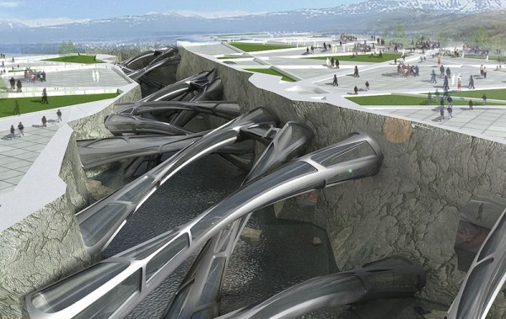
#scil
Notes:
The four of us have been working in this area for the past few years – we became aware of each other’s work through various ACRL channels and through personal connections. Each of us brings a distinct perspective and a lot of passion to how we can blend information literacy and scholarly communication, as you’ll see. Julia and Cathy, my colleagues from UC-Irvine, have been presenting and writing on this topic from their respective viewpoints of collection development and information literacy instruction since 2009, and Kim has been very active in integrating SC concepts into her instruction, which she wrote about in her article with Scott Warren, titled “Why Does Google Scholar ask for Money?” As a librarian with responsibilities in both SC and in information literacy instruction in my four liaison areas at a small liberal arts college, I have been experimenting with how to best integrate these two parts of my work effectively for an undergraduate population.
Through our conversations and preparing for this presentation, what stood out to each of us was the potential for deep and vital connections between these different areas in the classroom, within the library and on campus, and within our profession.
(image credit on Attribution slide)

Slide 3
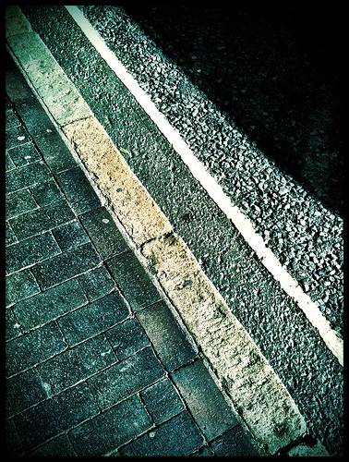
Information Literacy:
“a set of abilities requiring individuals to "recognize when information is needed and have the ability to locate, evaluate, and use effectively the needed information."”
Scholarly Communication: “the system through which research and other scholarly writings are created, evaluated for quality, disseminated to the scholarly community, and preserved for future use.”
#scil
Notes:
false that these two areas co-exist in their own spheres without touching – they do overlap in terms of what they strive to achieve:
They both strive to illuminate and enable discovery of old and new ideas, expand our knowledge and push us to experiment. IL comes at it from the learner perspective, and SC comes at it from the expert perspective, but when we think about their core missions, they meet in the middle.
So we can agree that IL and SC are interwoven together at least philosophically. The divide that this presentation seeks to address and improve is the divide that we have created by putting each in their own silo within our organizations. That organizational gap has not served us well, and we need to address it by first examining where the two have the greatest potential for intersection.
(image credit on Attribution slide)

Slide 4
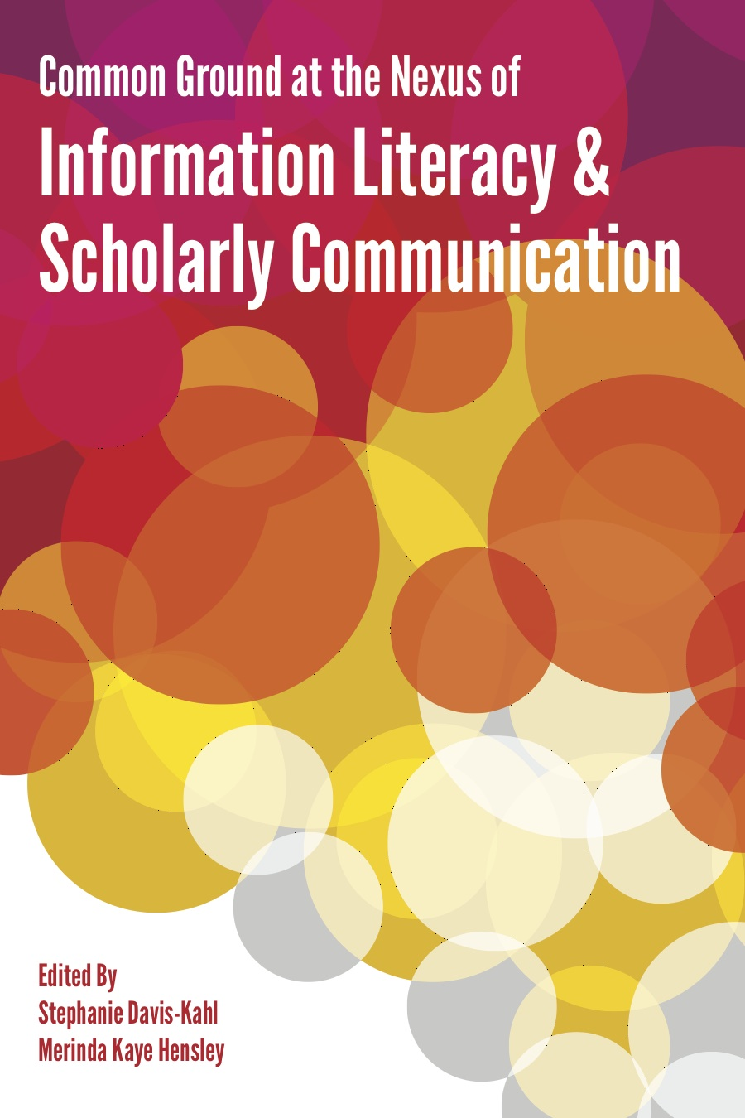
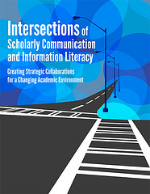
Intersections/Common Ground
#scil
Notes:
Where do they intersect?
Intersections of Scholarly Communication and Information Literacy, a white paper recently released by ACRL identifies three points of connection:
First, Economics of the distribution of scholarship;
Second, Digital literacies;
Finally, Our changing roles.
The white paper also establishes early on that all librarians, in some way shape or form, educates their users.
In Common Ground at the Nexus of IL and SC, there is a strong theme throughout the book of collaboration, of sharing teaching practices and creative, active outreach to all levels of academic users from undergraduates to faculty through a mix of both case studies of specific programs and foundational chapters.
We’re also starting to see this topic appear more frequently in the library literature – we’ve identified a few resources at the end of our slideset, which will be online soon.
I was fortunate to be involved in both efforts and can say that there’s no shortage of knowledge, expertise and passion on the part of both groups of librarians. I can say with confidence that there is significant and very exciting momentum behind the idea that bringing these two elements of librarianship together in the classroom is mutually beneficial for our relationships as colleagues, for our organizations, and most importantly, for our users.
(image credit on Attribution slide)

Slide 5
Converge
“The aim of Intellectual Entrepreneurship is to educate “citizen-scholars” – individuals who own and are accountable for their education and who utilize their intellectual assets to add to disciplinary knowledge and as a lever for social good.”
Professor Richard Cherwitz, 2000 (emphasis added)
#scil
Notes:
For me, these two areas converge at a very specific point. As a librarian with responsibilities in both areas, the idea of IE is particularly resonant.
IE, a program at the Univ of Texas at Austin, strives to push students beyond the boundaries of their disciplines to use their knowledge in order to improve their communities.
The convergence here is that the disciplinary knowledge they gain will – ideally – include integrated information literacy within their major or program, and ideally, that instruction will ask them to consider the economics of access and distribution of information. It will ask them to consider the idea of research as a public good, and it will give them the language they need to be critical consumers of the publishing landscape that they may take part in at some point in their future (either as a reader or as a creator).
This is an idea that spans across both undergraduate education and graduate education, and could also be applied in professional development experiences for faculty.
NOTE: More information about IE is online at https://webspace.utexas.edu/cherwitz/www/ie/

Slide 6
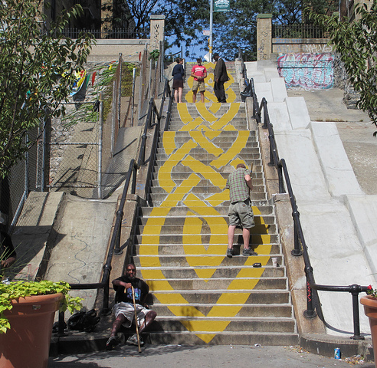
#scil
Notes:
How can we converge and blend these two areas?
Offer three different frames through which we can view this question – and we can apply these frames in either generally or in the context of a specific discipline:
The student-centered frame
The discipline frame
The pedagogy frame
(image credit on Attribution slide)

Slide 7
Student-Centered Frame
novice
engaged
expert
#scil
Notes:
First, the student frame –
We know that students move through distinct stages of development as they move through our curricula – they start as novices and through engagement in coursework and extracurriculars, they become engaged in discussions that force them to expand their intellectual and creative thinking – in their chosen area of study, they become expert. They move from passive users of information to active creators of knowledge, from casual users to critical users of the resources we provide.
We can work along this continuum to educate our students (and on the way, our faculty) about the econ, social, cultural and legal aspects of information

Slide 8
Discipline Frame
Scholarship
Creative Works
Data
User-Created Content
Publishing
Sharing
Collaboration
Impact
Legal/Policy
Economic
Social
Cultural
#scil
Notes:
Second, the discipline frame:
Each discipline has specific habits of mind and behaviors and each area of scholarship has its own set of pressures and stressors that we can address not only with our students, but with each other to educate each other about the quirks and characteristics of our faculty.

Slide 9
Pedagogy Frame
Learning
SC
IL
#scil
Notes:
Finally, what activities and learning objects can we create, and what experiences (both passive and active) can we devise – to help students make these connections?
How can we leverage IL techniques and methods to teach SC concepts, and then use evaluation data to feed back into education and advocacy efforts for students and faculty?
What learning experiences can we actively cultivate for each other, within the library and within our profession, to bring together IL and SC?
I ask you to keep these questions in mind as we listen to our next presenter, Cathy Palmer, Head of Education and Outreach at the UC Irvine Libraries.

Slide 10
Information Literacy and Scholarly Communication: or What Difference Did that One-Shot Really Make?
Cathy Palmer, Head, Education & Outreach
UC-Irvine Libraries
#scil
Notes:
Cathy
Description of my section:
The next member of our panel will speak from her perspective as a information literacy coordinator and faculty liaison on how to work strategically to influence undergraduate education in a research university setting. Talking persuasively to faculty and administrators about information literacy in order to gather support for efforts to promote it is only half of the story. Administrators require evidence that students are in need of information literacy skills and faculty need to be educated about what students don't know about scholarly communication. Once the need is identified and documented, librarians must be able to suggest ways in which they can work with faculty to promote student information literacy and to help them understand how scholars create new knowledge, as well as how to access, evaluate, and use the scholarly output for their own purposes.
Learning Outcomes:
1. Learn what persuasive evidence is needed to develop talking points and communication strategies to initiate and facilitate conversations about scholarly communication and information literacy with faculty and administrators;
2. Weave scholarly communication topics into information literacy instruction in order to deepen students’ understanding of how scholarly information is created, shared, discovered and accessed;
3. Engage colleagues within the library in order to develop strategies for developing common understanding and articulate shared outcomes around scholarly communication issues and information literacy instruction.

Slide 11
Information Literacy 101
An information literate individual
  Recognizes an information need and
  Finds
  Evaluates
  and Uses information
  Effectively, efficiently, and ethically.
#scil
Notes:
Cathy
Following on Stephanie’s introduction, I’m going to share where I’ve arrived in my thinking about the relationship between Information Literacy and Scholarly Communication and then I’ll share a short version of the story of how I came to this particular point.
Start with the question: How does information literacy relate to scholarly communication?

Slide 12
Scholarly Communication 101
How knowledge is
  Created
  Disseminated
  Evaluated
  Archived
  Accessed
  within a discipline
#scil
Notes:
Cathy
Scholarly communication refers to the process by which knowledge is created, disseminated, evaluated, archived, and accessed for later use (and in the academy those activities are understood as occurring w within a discipline).

Slide 13
Something to think about…
  Scholarly communication is a threshold concept in information literacy.
  Information literacy is a threshold concept in the mastery of a discipline.
#scil
Notes:
Cathy
How does this relate to information literacy instruction?

Slide 14
Threshold Concepts
  Core ideas and processes that define ways of thinking and practicing for a discipline
  So ingrained that they often go unspoken or unrecognized by practitioners
#scil
Notes:
Cathy
Let me define a “threshhold concept”.
Based on the work of Jan Meyer and Ray Land.
Threshold concepts are the core ideas and processes that define the ways of thinking and practicing for a discipline, but are so ingrained that they often go unspoken or unrecognized by practitioners.

Slide 15
Characteristics
  Transformative
  Integrative
  Irreversible
  Troublesome
  Bounded
#scil
Notes:
Cathy
Transformative: causes the learner to experience a shift in perspective.
Integrative: brings together separate concepts (often identified as learning objectives or competencies) into a unified whole
Irreversible-once grasped, cannot be ungrasped
Troublesome-often counter-intuitive, the place where students stumble or get stuck
Bounded-may help define the boundaries of a particular discipline; are perhaps unique to the discipline.

Slide 16
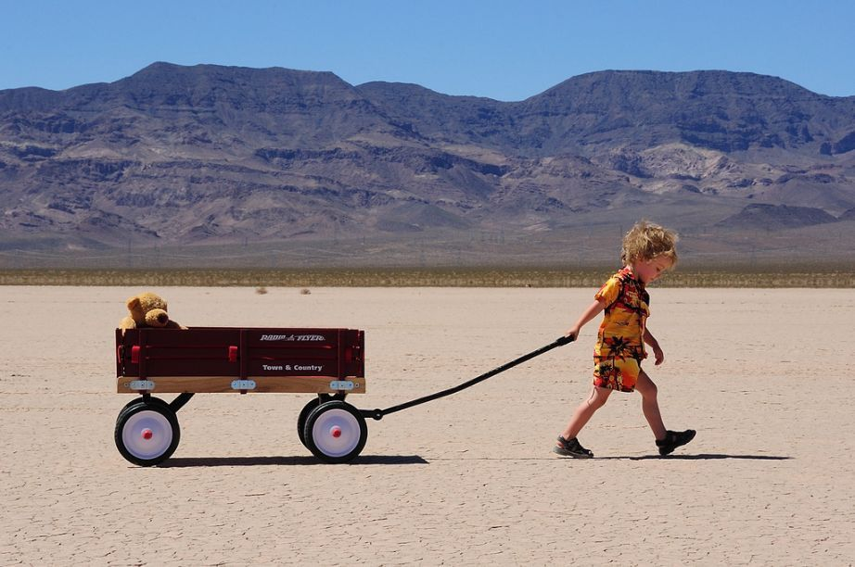
UCI Libraries’ Information Literacy Assessment Journey
Notes:
Photo: http://www.photobomba.com/download/15937-1/boy-and-bear.jpg
Cathy
So now that I’ve shared some of my conclusions, please indulge me while I share the Spark Notes version of our Information Literacy Assessment Journey.
UC Irvine Libraries’ Information Literacy Assessment Journey
Motivation:
Why assess?
Measure libraries’ contribution to student learning
2011-12
Sessions Taught: 517
Participants: 14, 303
Contact Hours: 590
WASC
Resource allocation
What do they know?
Methodology
Phase I: Research Practices Survey
Pre- and Post-test of first year students
First four weeks of Fall Quarter, last four weeks of Spring Quarter
After an extensive review and evaluation of existing information literacy assessments, we decided to create our own Research Practices Survey using the St. Olaf College Research Practices Survey as our model.
(http://www.stolaf.edu/offices/ir-e/assessment/instruments/RPS/RPS_SurveyInstrument.pdf) The St. Olaf’s test was an excellent model because it was free and freely adaptable, as long as we gave attribution to the original in any publication of our results, asked the kinds of questions (both attitudinal and knowledge-based) that we wanted to ask, and could be easily adapted and administered using tools available in our University’s course management system.
1. Attitudes and Beliefs about Research
How challenging?
Research process
Identification and retrieval of sources
Writing process
2. Personal Definition of Research
3. Familiarity with Research Terms and Strategies
4. Use of Sources
5. Importance of Research for Undergraduates

Slide 17

So what DO they know?
#scil
Notes:
Cathy
The research questions
Project methodology
1. Research search practices survey during 1st four weeks of Fall Quarter
Same survey during the last five weeks of Spring Quarter
Research Practices Survey
Used EEE.
After an extensive review and evaluation of existing information literacy assessments, we decided to create our own Research Practices Survey using the St. Olaf College Research Practices Survey as our model.
(http://www.stolaf.edu/offices/ir-e/assessment/instruments/RPS/RPS_SurveyInstrument.pdf) The St. Olaf’s test was an excellent model because it was free and freely adaptable, as long as we gave attribution to the original in any publication of our results, asked the kinds of questions (both attitudinal and knowledge-based) that we wanted to ask, and could be easily adapted and administered using tools available in our University’s course management system.
36 questions. Twenty-one of the questions are designed to capture students’ attitudes and beliefs about research, including a free-text question which asks them for their personal definition of research, and a question which allows them to rate the importance of library research to undergraduates. Fourteen questions cover research terms, strategies and the use of sources and the last item is a free text field for student comments.
2. Create rubric to assess information literacy traits in student writing produced for lower division writing courses.

Slide 18
The $64,000 Questions
“What do first year incoming students know about library research and resources when they begin their first year at UC Irvine and what do they know by the end of their first year?”
“How do they use what they learn about library research in their first year writing assignments?”
#scil
Notes:
Cathy
The research questions
Project methodology
1. Research search practices survey during 1st four weeks of Fall Quarter
Same survey during the last five weeks of Spring Quarter
Research Practices Survey
Used EEE.
After an extensive review and evaluation of existing information literacy assessments, we decided to create our own Research Practices Survey using the St. Olaf College Research Practices Survey as our model.
(http://www.stolaf.edu/offices/ir-e/assessment/instruments/RPS/RPS_SurveyInstrument.pdf) The St. Olaf’s test was an excellent model because it was free and freely adaptable, as long as we gave attribution to the original in any publication of our results, asked the kinds of questions (both attitudinal and knowledge-based) that we wanted to ask, and could be easily adapted and administered using tools available in our University’s course management system.
36 questions. Twenty-one of the questions are designed to capture students’ attitudes and beliefs about research, including a free-text question which asks them for their personal definition of research, and a question which allows them to rate the importance of library research to undergraduates. Fourteen questions cover research terms, strategies and the use of sources and the last item is a free text field for student comments.
2. Create rubric to assess information literacy traits in student writing produced for lower division writing courses.

Slide 19
Librarians Contribute to Student Learning Outcomes
Lower-division writing:
After completing this GE requirement, successful students should be able to do the following:
demonstrate rhetorically effective, accurate academic writing and communication across a variety of contexts, purposes, audiences, and media using appropriate stance, genre, style, and organization;
develop flexible strategies for generating, revising, editing, and proofreading texts;
develop abilities in critical reading across a variety of genres and media;
#scil
Notes:
Cathy
(UC Irvine 2011-12 General Catalog, p. 56.)
(http://www.editor.uci.edu/catalogue/11-12Catalogue.pdf)

Slide 20
and…
demonstrate information literacy skills by locating, evaluating, and integrating information gathered from multiple sources into a research project. [emphasis added]
#scil
Notes:
Information Literacy is also articulated as a learning outcome for UCI’s upper-division writing courses:
Upper-division writing:
demonstrate rhetorically effective, discipline-specific writing for appropriate academic, professional, and public audiences;
demonstrate, at an advanced level of competence, use of discipline-specific research methods, genres, modes of development, and formal conventions;
and demonstrate advanced information literacy skills by locating, evaluating, and integrating information gathered from multiple sources into discipline-specific writing. [emphasis added]

Slide 21
In other words…
An information literate individual understands how scholars in a discipline create, share, and preserve knowledge.
#scil
Notes:
Cathy
Help faculty and others make the connection between scholarly communication and information literacy.

Slide 22
Research Practices Survey Results
Fall, 2010 Entering First Year Students
40% have not used an electronic index like Academic Search Complete
22% have no experience locating full text of articles
Confidence vs. Competence
#scil
Notes:
Cathy
Undergraduate respondents appeared to be fairly confident in their ability to conduct research, with responses ranging from 55% to 87% of respondents reporting that the different elements were either very easy or somewhat easy
Confidence in ability to use some information retrieval systems, not others.
When asked how challenging it was to identify and retrieve sources, undergraduates reported a high level of confidence in their ability to retrieve sources through some mechanisms, but less ease, and less experience with others. Not surprisingly, an overwhelming majority of students (94%) report that using an internet search engine is very easy (75%) or somewhat easy (19%). However, as the skill identified and tested becomes more specific, the less confident and knowledgeable the students’ responses are. When asked about the ease of using an electronic index like EBSCOhost Academic Search or Expanded Academic or Reference Gold to find articles on a topic, more students report that they have no experience (40%) with this, than report that it is very easy (10%) or somewhat easy (28%). The results are similar when students are queried on how easy it is for them to locate the full text of articles. Only 44% find it very or somewhat easy, while 33% admit that it is somewhat or very difficult, and 22% report that they have no experience locating article full text.

Slide 23
Research Practices Survey Results
Spring, 2011 Exiting First Year Students
Competency improves, confidence declines
Students who completed the first-year writing requirement have the highest confidence AND competence levels.
HOWEVER, over 50% of all students surveyed still cannot answer simple questions about the location, evaluation, and use of information correctly at the end of their first year.
#scil
Notes:
Cathy
The librarians don’t accomplish this on their own. The writing instructors work very hard to teach students the fundamentals of how to find, evaluate, and incorporate new information into their writing.

Slide 24
Phase II:
Information Literacy Trait Assessment
Created and used information literacy rubric (based on lower-division writing assessment rubric) to evaluate IL traits in writing produced by students in lower-division writing courses
73 student papers, 8 librarians
Measured 17 traits using a 4 point scale
#scil
Notes:
Cathy

Slide 25
Phase II: IL Trait Assessment Results
Average overall score = 48.9 (out of 68)
Highest scoring category = “number of sources” (avg 3.86)
Lowest scoring categories:
  Source integration (avg 2.48)
  Use of quotations (avg 2.45)
  Range of sources (avg 2.32)
  Incorporating multiple points of view (avg 2.17)
  Including enough bibliographic information in citations to identify and locate the material cited
#scil
Notes:
Cathy
Student papers averaged between 2 and 3 on a 4 point scale of 17 traits

Slide 26
So what?
Libraries
Reviewed and revised learning objectives and outcomes for our lower-division writing workshops
Librarians more cognizant of the end result of library instruction for first year students
Librarians have data to communicate to communicate to their faculty
Added Make Citations module to our Begin Research tutorial
UC Irvine Information Literacy Rubric
#scil
Notes:
Cathy
What has happened so far as a result of our assessment project?
Within the Libraries
UC Irvine Libraries Information Literacy Rubric
https://drive.google.com/#folders/0B0z0ItTYwbAINFhxVW1CQ0gxNDA

Slide 27
Increased Campus Visibility
Closer and stronger relationship with Campus Writing Center
Libraries’ contributions to general education learning outcomes recognized as a model during campus WASC Accreditation
Academic Senate Committee presentations
Teaching Colloquies—professional development for faculty and lecturers
#scil
Notes:
Cathy

Slide 28
Librarian’s perspective
Scholarly communication includes:
  Author’s Rights and Intellectual Property
  Copyright and Fair Use
  Open Access
  Management of Research Data
  New Publishing Opportunities and Options
#scil
Notes:
Cathy
As library professionals, we understand and teach the methods of scholarly communication.
So in my opinion, scholarly communication is one of the things we teach when we teach information literacy in higher education.

Slide 29
Cathy’s Information Literacy Standard 6
  Information literate individuals understand the scholarly communication methods of their discipline.
#scil
Notes:
Cathy
Adopting this understanding provides a multitude of opportunities to engage in conversations and other more formal collaborative activities with campus faculty and administration.

Slide 30
Scholarly Communication
+ Info Literacy:
An NCSU Libraries Case Study
Kim Duckett
Associate Head, Research and Information Services
North Carolina State University Libraries
#scil

Slide 31
“Unfortunately, students are too often asked to use the tools of a discipline without being able to adopt its culture. To learn to use tools as practitioners use them, a student, like an apprentice, must enter into that community and its culture.”
Brown, J., Collins, A. & Duguid, P. (1989). Situated cognition and the culture of learning. Educational Researcher, 18(32), 33.
#scil

Slide 32
Beginning Thoughts
Academic information literacy necessitates some understanding of scholarly communication.
#scil

Slide 33
Beginning Thoughts
Academic information literacy necessitates some understanding of scholarly communication.
The distinction between discovery of information and access to information is a threshold concept in information literacy.
#scil

Slide 34
The Sandbox: ENG 333
Communication for Science and Research
  Junior / senior science majors
  Many desire to go to grad school
  On campus and online sections
#scil

Slide 35
The Workshop Setting
75 minute “one-shot”
½ scholarly communication
½ how to find scientific literature
  Keywords
  Disciplinary databases
  Google Scholar
#scil

Slide 36
Scholarly Communication Topics
Role of journal articles in research
Peer review
Economics of scholarly information
Impacts on discovery and access
Role of library
#scil

Slide 37
Articles in Science & Research
Dissemination of research results
Gives credit for work
Provides permanent record
Validity of research – PEER REVIEW
Important where a scientist publishes
  Tenure
  Exposure
  Grants
  Reputation
#scil

Slide 38
Provide Context for Peer Review
Get students to talk about what they already know.
Then build on it…
      why not post it on a blog?”
      career management
      rejection rates
      how the process works
      “not all journals are created equal”
      journal rankings, page rates
      copyright
      who owns the article?
#scil

Slide 39
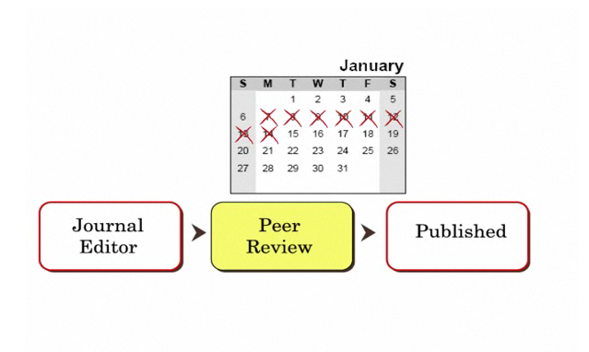
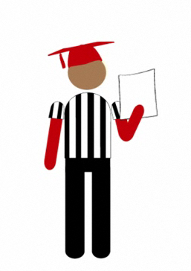
Peer Review in Five Minutes Video
Peer Review in 5 Minutes video:
go.ncsu.edu/peer-review
YouTube:
http://bit.ly/2qStp
#scil

Slide 40


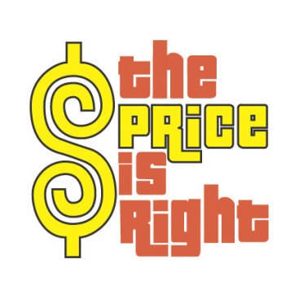
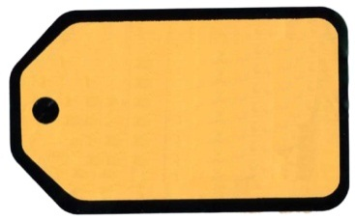
Which costs more…?
2011 Mini Cooper S
1 year subscription to Brain Research
$23,000
$23,446
#scil

Slide 41
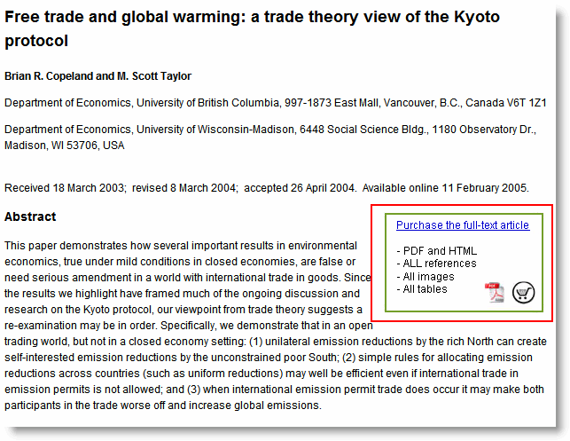
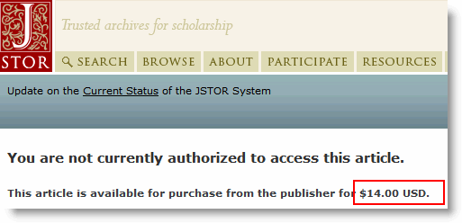
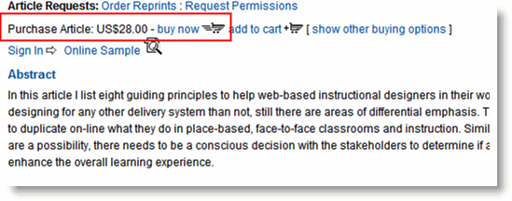

#scil
Notes:
Scott

Slide 42
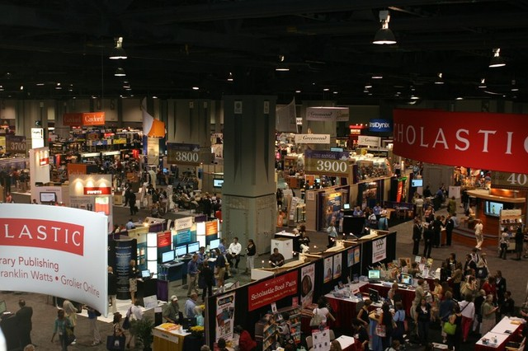
Notes:
Scott

Slide 43
Ask Probing Questions
Why do you think publishers can charge so much money?
Why are libraries willing to pay so much money?
#scil

Slide 44
Economics Affects Access
Deep “Invisible” Web
Journal Subscriptions
Article Databases
Google Scholar
#scil

Slide 45
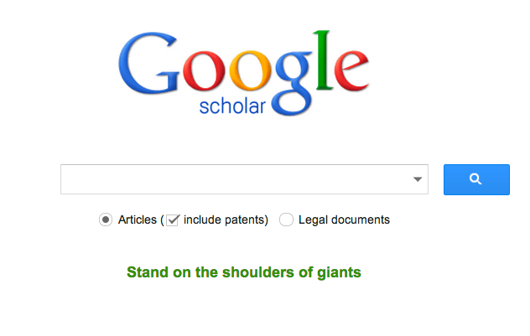
Free & For-Fee is Porous
#scil

Slide 46
Follow Up Online Forums
What is your reaction to the cost of journals & databases?
What was most shocking to you about the economics of scientific information?
What do you think about scientists paying journals to publish their work?
#scil

Slide 47
Pretty Sophisticated Thinking
“How is it possible that much of the research published in these journals was funded by taxpayers’ money through federal grants yet publishers make it almost impossible for those same taxpayers to have access to the research they helped to fund?”
ENG 333 Junior
Spring 2012
#scil

Slide 48
Using Other Topics
Open Access
Preprints
Costs of Knowledge petition
NIH Public Access Policy
Debate over Research Works Act
#scil

Slide 49
Expanding Beyond ENG 333
First Year Writing (ENG 101)
  Peer Review in Five Minutes, journal prices
Social Life of Information: Communication, Law, and Culture
  Honors Seminar
  Full range of scholarly communication topics
Elements of instruction used in variety of disciplines
#scil

Slide 50
Appreciation!
“Thank you so much for the wonderful presentation! … I think the explanation of the library costs on journals, books, and databases, as well as the process that authors undergo to make information available to the scientific community and the students is really important. It really lends a lot of insight…”
ENG 333
Biochemistry major
Spring 2013
#scil

Slide 51
Scholarly Communication in
New Scholarly Environments
Julia Gelfand
Applied Sciences & Engineering Librarian
University of California, Irvine Libraries
#scil

Slide 52
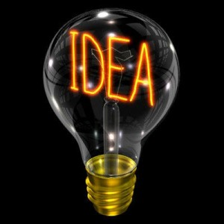
The light bulb goes off…
www.kuukusblog.com
#scil
Notes:
As noted, like many libraries, UCI had a mature information literacy program, but struggled with how to inform all campus stakeholders about scholarly communications. This included faculty, researchers, graduate students and eventually undergraduates. Finally, the light bulb when off and we thought – why not try the same methods we applied when we developed and rolled out a balanced curriculum for information literacy that spanned lower division instruction through specialized information literacy across the disciplines and approach scholarly communication in the same methodological and thoughtful approach

Slide 53
How Information Literacy Can
Inform Scholarly Communication
Instructional methods are changing as fast as technology allows
Major challenges & opportunities in distance education are creating new learning environments
Reading, browsing, searching, accessing, citing all depend upon developing new scholarly communication practices
Learning & teaching are increasingly collaborative processes involving faculty, librarians, educational technologists, pedagogical experts and content developers working together, in teams
#scil
Notes:
We developed a matrix that had several components to compare what common elements applied to either or both information literacy and scholarly communication. Some of the summary points are noted in these slides that flip the mutual informants -

Slide 54

How Scholarly Communication Can Inform Information Literacy
Understanding relationships demonstrates intellectual maturity
  Determines access rights to information
Complex grid of economic interests & costs
  Raises awareness of intellectual property, publishing dynamics, legislative manipulations, public interest, technological innovation, academic traditions and changing expectations
Authors’ Rights are central to understanding scholarly communications
Past practices, current changes and future uncertainties contribute to great ambivalence and instability in new scholarly enterprises
Scholarly publishing can influence commercial competition
Can information be a free commodity?
Open Access is new equalizer –
#scil
Notes:
The elements of scholarly communication have been shared and noted. How can we contextualize or frame the critical factors? What is realistic, what is part of the current academic landscape and typical of today’s business transactions – how can we establish building blocks that are relevant for different constituencies as undergraduates become graduate students and perhaps faculty and scholars/scientists in practice?

Slide 55
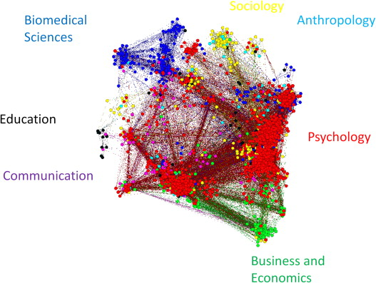
Realizing Disciplinary Influences
STM, Social Sciences, Arts, Humanities
History of printing & publishing
Role of libraries
Launch of Internet
ePublishing trends
Monographs vs. Serials
Promoting interdisciplinarity
Repositories
Text, Media, Data
www.sciencedirect.com
#scil
Notes:
The nuances of how disciplines have evolved suggest how libraries have responded to treating content from different subject areas while supporting the interdisciplinary intersections that are now birthing entirely new fields and creating a downstream of new information products. ePublishing is the common denominator of all these influences that contributes to creating new publishing opportunities.

Slide 56
Responding to New Models for
Academic Library Services
Libraries are using multiple strategies to address knowledge creation, transformation, dissemination and preservation of knowledge related to teaching, research & scholarship
Information literacy promotes librarians teachers, collaborators and now creators, authors, publishers, archival keepers of the record
Libraries are moving from collection warehouses to knowledge creation
Digital services and resources are central to library functions and enhancements
#scil
Notes:
Some of this response corresponds to organizational culture, staffing models, campus placement, whether there is an academic press or repository with which the library has relationships or hosts and obviously other elements.

Slide 57
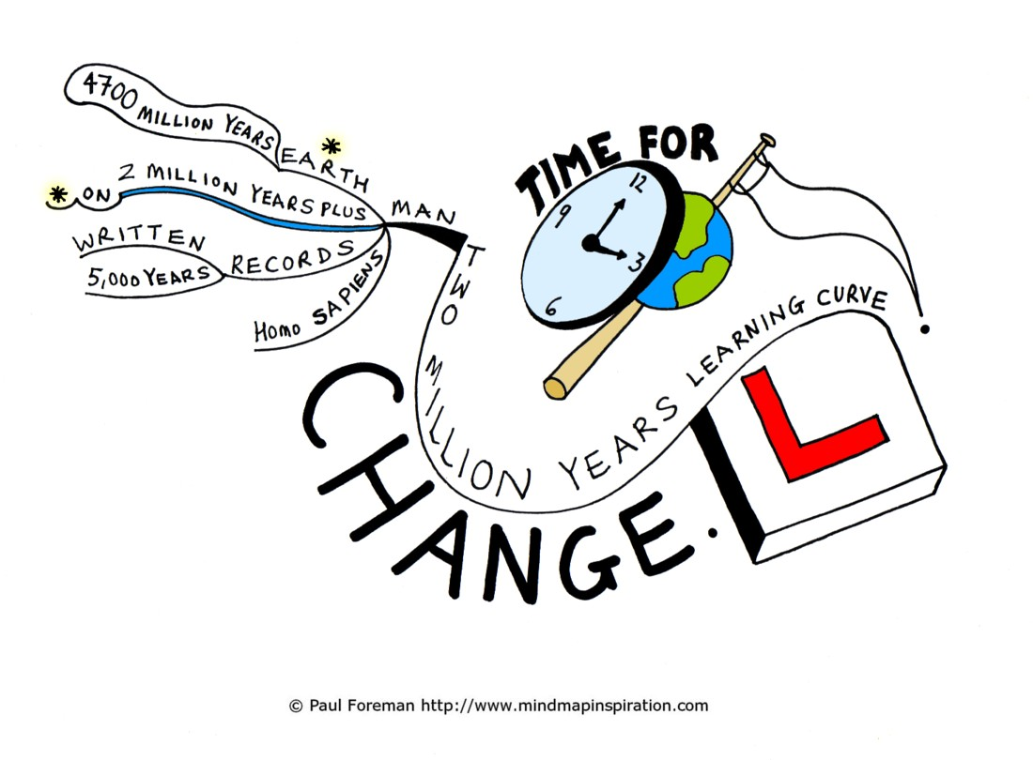
Faculty & Student Learning Curves
More engagement, more options
Current students are next generation workforce & faculty
Classroom delivery rapidly changing
Students currently enrolled at multiple institutions
MOOCs are changing landscape
Student output part of new publishing horizon
Notes:
The current Higher education landscape demands more coordination with more blended access options. Previously it was faculty who were affiliated with multiple institutions concurrently and collaborated with colleagues in other departments, institutions and across the globe; now increasingly students are; there are different paths to obtaining degrees, and research grants increasingly support affiliates at numerous institutions working to solve research questions. Collaboration is central and how it is achieved is the moving target that requires dedication, commitment and patience.

Slide 58
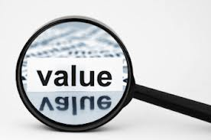
Assessing Value
Let’s ask:
  What is the value of education to the knowledge society?
  What kind of evidence or outputs do we want to retain and archive?
  How do we promote innovation?
  How do we respond to abstract information that is constantly changing?
  What are the consequences or risks if we don’t promote best practices for scholarly communication?
  How do we protect the creative outputs of our institutional community?
  How can we be more effective at what we do?
www.opticompinc.com
Notes:
Parenthetical questions to which we as librarians try to answer as we create appropriate learning and resource environments – most of us assume that we can ponder many of the questions but tackle at best a couple of them to provide clarity to the functions we perform. Personally, I grapple with the last two and have sleepless nights exploring the others!

Slide 59

New Roles for Subject Librarians
Developing comfort zones
Thinking of local opportunities – repositories, distance education platforms
Collection building is ever changing
Fee, free, and cost containment / sustainability concerns
Develop curriculum for scholarly communication
More engagement with publishing enterprise
Subject expertise remains important
#scil
www.haynerlibrary.org
Notes:
Making ourselves relevant to users needs has been a traditional mandate of subject librarians. Today, outreach is conducted in different ways as users do not physically come to the library like in the past. Library organizations have changed dramatically and as a result the expectations of outreach, liaison, embedded and subject librarians has changed as well. New library services and the need to communicate about information resources demands different forms of information sharing. The traditional roles of collection support (anticipating and responding to collection needs in all formats to support instruction & research), bibliographic/library instruction – information literacy (course related and general), reference services (through different mediums), scholarly communication, data management, and other assignments per institution’s prerogative and needs dominate a librarian’s time. Librarians are also increasingly engaged in promoting how to best generate and package knowledge.

Slide 60

Collection Agnostic Yet
Information Rich
Information comes from many different sources
Archival & preservation functions are critical for traditional & born digital content
Collection management functions are blending
Web offers increased ways to generate new forms of knowledge
Information is multimedia/multi-format
Commercial not always better
Growing respect for creative, local
content
#scil
socialana.com
Notes:
Collection development vs collection management activities; selection is increasingly being conducted through approval plan profiling, and now users are determining perpetual access; different relationships with publishers, providers, suppliers and patron driven acquisition alternatives enter the mix. The traditional structure of technical services and public services has been blended to support Readers’ Services or Research Services, with the emphasis on users and efficiencies in promoting digital directives and products.

Slide 61

Economic Realities Dictate
Need for Change
Definition of collection changing
  Ownership models redefined
  Subscription model needs correction
  Patron driven access offers greater choices
Electronic access appears to be preference
Resource sharing potentially at risk
Digitization
Public funding mandates challenge publishing trends
Open Access has its own dilemmas
Data intensity
Affordability
#scil
Notes:
Electronic formats offer new options but also many challenges; librarians already have and continue to need to alter current practices – ex) ILL as we know it is changing; licensing determines what we can/can’t do, but we can educate publishers about new institutional needs and users about best practices.

Slide 62

Reinforcing Alignments Promote
Best Practices
Information Literacy standards have opened a global dialogue about new roles for teaching
Scholarly publishing is global enterprise
Scholarly Communication embraces author & user/reader
Information Literacy intersections with Scholarly Communication practices address digital divide
Forge new opportunities
Complimentary role for librarians to promote information generation and knowledge management
Libraries adopt & perform more roles on campus
#scil
Notes:
Nearly a decade after the launch of the original IL standards, they are undergoing revision.
Libraries may be more central to the campus in different spheres – physical structures are reemphasized as learning commons & labs; shelving spaces shrink as collections expand; collaboration is promoted and reinforced and multiuse and remote or virtual landscapes is part of the landscape.
Concerns about access and economics are the turf of most library administrators.

Slide 63

Intensifying Relationship between Instruction & Scholarly Outputs
New authorship role for students – from undergraduates through graduate & professional schools
  Student work is nurtured for posterity through deposits in repositories; ETDs increasingly widespread; student authorship highly promoted
Rethinking pathways & methods
Exposure to intellectual property is front & center
Media & software playing critical role
#scil
www.marshallip.com
Notes:
New roles for librarians have created new opportunities for library users. Encouraging students to think outside the box and want to preserve some of their academic work to share beyond the lifespan of a course has empowered a new population that will be sensitive and aware of intellectual property and technology transfer in ways that previous generations were not. Building on the threshold concepts of instruction and applying them to scholarly communication allows for how libraries will plan and move forward in the digital future.

Slide 64

Anticipating Change, Looking Forward, Making Sense of the Future
Libraries & Librarians will:
Monitor the higher education landscape
Assume a greater advocacy role
Encourage scholarly publishing with best practices
Reinforce local and institutional needs
Develop information literacy to include topics encompassed by scholarly communication themes
www.strategydriven.com
#scil
Notes:
As we move forward, engage in planning and think of coming years and how we will respond to changes, we will likely observe less exclusivity and more symbiotic relationships.

Slide 65
Alignments or Disconnects?
Scholarly Communication
Information Literacy
?
Notes:
We can determine how much this resonates with each of our positions and library environments and how much overlap there is and what that means for how we perform our activities and work with our users at all kinds of campuses.

Slide 66


Contact Information
Stephanie Davis-Kahl
sdaviska@iwu.edu
Kim Duckett
klduckett@ncsu.edu
Julia Gelfand
jgelfand@uci.edu
Cathy Palmer
cpalmer@uci.edu

Slide 67
Becoming Catalysts in Exceptional Research and Learning:
The Intersections of Information Literacy and Scholarly Communication
Friday, April 12
8:30 am – 9:30 am
Marriott Hotel, Grand Ballroom 9-10
Erin Ellis, Head of Instructional Services, University of Kansas, Lawrence, KS
Joyce Ogburn, University of Utah
Kevin Smith, Duke University, Durham, NC

Slide 68
Resources
Common Ground at the Nexus of Information Literacy & Scholarly Communication, eds. Stephanie Davis-Kahl and Merinda Kaye Hensley, ACRL, 2013. [OA edition available via: http://www.alastore.ala.org/detail.aspx?ID=4383]
Intersections of Scholarly Communication and Information Literacy: Creating Strategic Collaborations for a Changing Academic Environment, Association of College & Research Libraries, March 2013. [http://acrl.ala.org/intersections/]
Keane, Edward P. (2012) “Librarian Viewpoints on Teaching Open Access Publishing Principles to College Students,” The Serials Librarian, 63:3-4, 333-349.
Palmer, Cathy & Julia Gelfand. Information Literacy & Scholarly Communication Alignments & Disconnects, ACRL 2011 Poster. [http://libguides.lib.uci.edu/infolit-scomm_acrl2011Poster]
Warren, S. and Duckett, K. (2010). “'Why Does Google Scholar Sometimes Ask for Money?’ Engaging Science Students in Scholarly Communication and the Economics of Information,” Journal of Library Administration, 50:4, 349 - 372. [post-print: http://surface.syr.edu/sul/78/]

Slide 69
Attribution
Slide 2: Mikado Housing, Laurent Saint-Val, Alexandre Sarazin, Shahyar Shakiba, eVolo, used with permission. [http://www.evolo.us/architecture/mikado-housing/]
Slide 3: Definition of Information Literacy [http://www.ala.org/acrl/publications/whitepapers/presidential]
Slide 3: Definition of Scholarly Communication [http://www.ala.org/acrl/publications/whitepapers/principlesstrategies]
Slide 3: Parallel Lines by Keith Bloomfield [http://www.flickr.com/photos/hardluck-hotel/6144480772/]]
Slide 4: Intersections of Scholarly Communication and Information Literacy, ACRL 2013 [http://acrl.ala.org/intersections]
Slide 4: Common Ground at the Nexus of Information Literacy and Scholarly Communication, ACRL, 2013.
Slide 5: “Intellectual Entrepreneurship: Can Intellectuals Innovate in Ways that Produce a Better World?” [http://replay.web.archive.org/20090131123626/http://whitman.syr.edu/eee/campus/ie.asp]
Slide 6: The Bridge and the Devil by Steed Taylor, NYCDOT Urban Art Program, CC BY-ND 2.0 [http://www.flickr.com/photos/nycstreets/8027885575/]
Slide 16: Boy and Bear [http://www.photobomba.com/download/15937-1/boy-and-bear.jpg]

