Slide 1
Can Accounting Standards Help Address Defined Benefit Pension Problems?
Shyam Sunder, Yale University
Global ARC, Boston
October 17, 2012

Slide 2
An Overview
Why can’t they do the accounting for DB plans “right”?
Because the “right” accounting for DB plans can exist only in a world of dreams
DB plans are designed to make it impossible to do any sensible or defensible accounting for them
Even if we devise “better” accounting, the plans will be, and are modified to defeat that goal
  Bad incentives all around
And the consequences of “better” accounting are basically unacceptable
Few options other than abandoning DB plans altogether in favor of alternatives
Public sector has yet to learn this lesson from the private sector

Slide 3
Why can’t we do the accounting for DB plans right?
Let us look at the logic of DB plans

Slide 4
Logic of Defined Benefit Plans
Cost of living is constant, at least predictable, over several generations
Rates of return are constant, at least predictable, over several generations
Shape of demographic tree (mouths-to-hands ratio) is stable
Economic growth, employment and wages are stable
Any deviations from assumed parameters are random, allowing the law of large numbers to keep the accumulated gap between funding and obligations near zero
Future generations have as much voice as the current retirees in setting DB policy
Socio-political mechanisms for setting premiums and benefits look beyond the election cycles and take a multi-generational steady-state perspective

Slide 5
Consumer Price Index (U) Changes
1914-2011

Slide 6
Rates of Return on Investment
Does the future look like the past?
What do you wish to invest in?

Slide 10
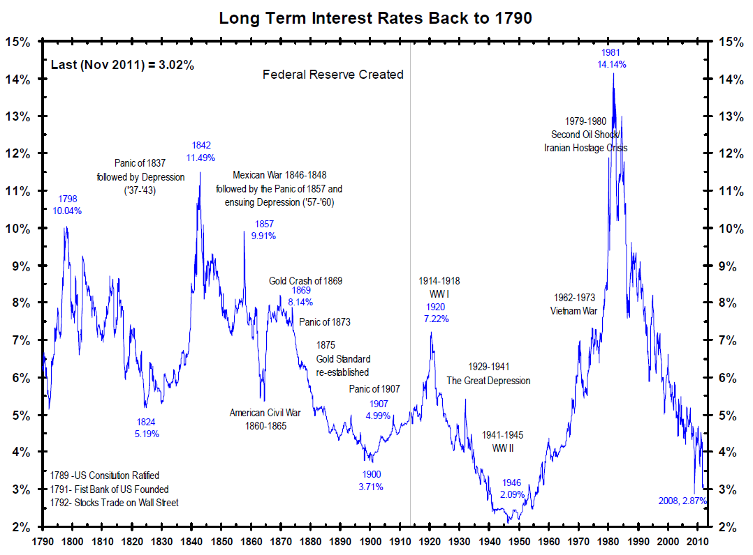

Slide 11
And the demography?
Birth and death rates
Working life and retired life
Gender
Age distribution
Mouths/hands (consumer/workers) ratio

Slide 15
Economic Factors
Economic growth
Employment
Wages

Slide 16
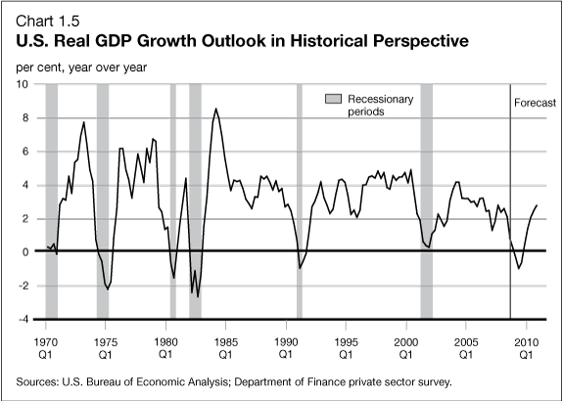

Slide 17
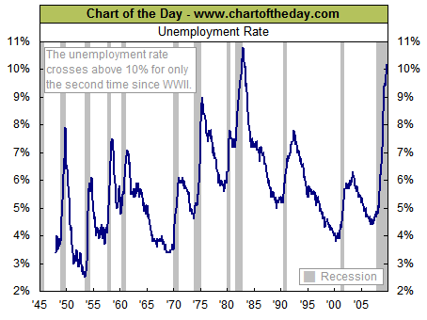

Slide 18
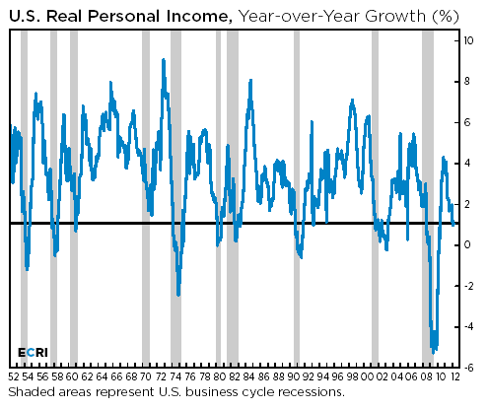

Slide 19
Who knows the “right” assumptions for the future:
cost of living,
rate of return,
Number of beneficiaries,
Economic growth,
Unemployment, and
Wage growth
Depending of what economic and econometric method you use, you can come up with virtually any number
Accountants and actuaries can do this right when they can call The Future to get the right numbers
Until then, we shall have surprises—neither small nor infrequent

Slide 20
On Top of that, Assumptions about Socio-Political Decision Mechanisms
Any deviations from assumed parameters are random, allowing the law of large numbers to keep the accumulated gap between funding and obligations bounded near zero
Future generations have as much (any?) voice as the current retirees in setting DB policy
Socio-political mechanisms for setting premiums and benefits look beyond the election cycles and take a multi-generational steady-state perspective

Slide 21
DB Is an Impossible Dream
It can work only as a Ponzi scheme, or by shear luck in periods of high growth, not in steady state or decline
It has all the wrong incentives for just about everyone
No accounting standards and actuarial assumptions can be devised to deal with the uncertainty and incentives challenges
  That is not what accountants and actuaries can do
Accounting standards have difficulty dealing with short-term uncertainty, much less multi-generational projections to get the DB obligations right
Looking to accountants and actuaries for the solution is barking up the wrong tree
They cannot solve the DB problem

Slide 22
Business Firms: Some US Facts (2007)
56% companies in US have DB plans (41 Intl)
DB Obligations/Mkt. Capitalization 19% (18%); range 800%-0%
Average underfunding 8% (23%);
Average service cost 15.8% of OP Profit
New accounting standards have helped push the private sector away from DBs

Slide 23
When the Public Sector Abandon DBs?
“Almost every state in the U.S. has made cuts to its public-employee pensions, seeking to dig out from the economic downturn, but so far the measures have fallen well short of bridging a nearly USD 1 trillion funding gap.” Wall Street Journal, September 21st 2012
DB bankruptcies may help drive reforms
Bankruptcies may be the only effective way of getting claw-backs of excessive benefits promised in such plans

Slide 24
How do we define a government’s role in retirement planning?
Educational to inform,
Convening to get everyone to the table,
Drafting boiler plate alternatives,
Compulsion to minimize free riding, and ultimately,
Risk pooling and safety net for the truly unfortunate

Slide 25
Thank You!

