Slide 1
Accounting for Good Governance
Shyam Sunder, Yale University
Fourth Accounting Conference
University of Brasilia
Brasil, November 29, 2018

Slide 2
An Overview
Better accounting
Better governance
Better society (by mitigating corruption)

Slide 3
Better Accounting
What could be the meaning(s) of better accounting? Three perspectives:
  Descriptive
  Functional
  Procedural
A judicious combination of
  Regulation and compliance
  Tradition and social norms
  Market competition and innovation
How do we develop such institutions?
Merits of creating good processes and institutions, not just rules (which receive much attention in financial reporting)

Slide 4
Perspectives on Accounting
Descriptive: based on identifiable properties of accounting systems or their output
Functional: based on purposes it may serve
Procedural: based on procedures used
Possibly others

Slide 5

Descriptive Perspectives
Based on identifiable properties of accounting systems or their output
faithful representation
Timeliness
Relevance
Reliability
Verifiability
Uniformity
Consistency
Comparability
Cost-benefit efficiency
Conservatism
Robustness to manipulation and fraud
Governmental organizations: transparency, public accountability, and citizen empowerment and engagement with the organization

Slide 6
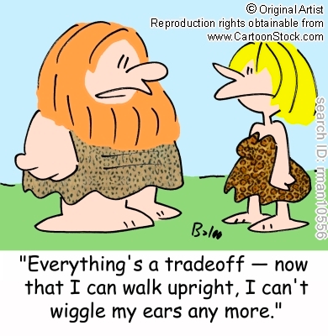
Descriptive Perspectives
Three caveats:
  No guidance for trade-offs: e.g., faithful representation and timeliness; relevance and reliability
  Conflicts on desirability among prepares, auditors, and users
  Ambiguity of meaning: e.g., uniformity, comparability, and conservatism
    Obvious at distance, not in close scrutiny
    What does uniformity mean in a multi-attribute world?
    What does comparability mean in a world where no two transactions are exactly alike?

Slide 7
Functional Perspectives
(Based on the purposes it may serve)
Facilitating efficient operations (factory, office, receivable, inventory, taxation, etc.)
Helping maintain “better” markets (financial)
Better management of public finances
Better macro-economic management
Provision of information to relevant economic agents
Serving broader societal goals

Slide 8
Meanings: Serve Societal Goals/Functions
Creation of wealth and livelihood
Promotion of social cohesion and justice
Creation of markets for physical, financial and human capital that promote economic efficiency
Creation and operation of organizations to create and distribute social surplus
Coordination and disciplining of individual participation in organizations and society so personal pursuits do not overwhelm their collective functions
Discipline alternative and competing sources of information to add stability and predictability to organization.
Reduce organizations’ cost of capital (?)

Slide 9
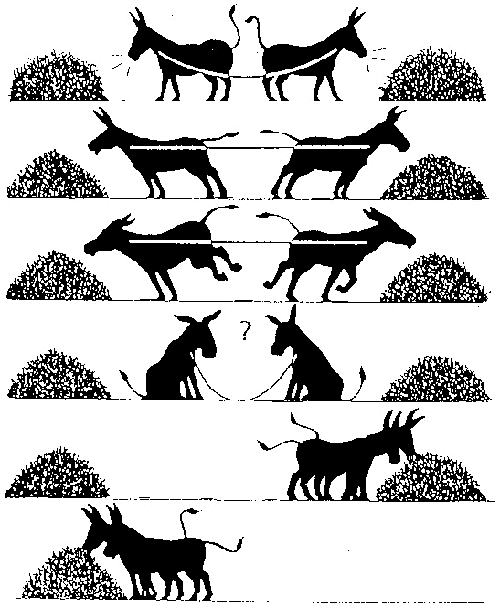
Meanings: Serve Individual Goals
Enabling participants in an organization to make better informed private decisions to improve their individual welfare
Four sources of ambiguity:
Diverse goals and information demands of groups of participants; may include diametrically opposed interests. Equal weight to all interests?
Needs of individuals depend on personal circumstances, change dynamically, unknown and unknowable to others
Assumes no interaction among their decisions
Demski (1973): Blackwell’s fineness condition for informativeness; not likely to be met by any standard, except by Sorter’s (1965) events approach

Slide 10
Procedural Perspectives
(Based on procedures used)
Computerized
Continuously audited
Regulatory compliance
Tradition and ritual

Slide 11
Financial Reporting as a Ritual
Continued as a tradition, by convention, with no documentable connection to any putative goals
Habit,
  Rain dance
  Shaking hands or other forms of greetings
  Birth, wedding and death ceremonies
  University commencement exercises
  Research publications
  Faculty meetings

Slide 12
Meanings: A Summary
“Better” in financial reporting means many things:
  meeting specified societal or individual goals, or
  possessing some general qualitative or specific statistical attributes and disclosures
Difficult, even at a conceptual level, to obtain agreement on what kind of financial reports do or can meet criteria within any one or all of these four classes. What can be done in absence of broad agreement?
Given the nature of collective choice and social policy, it is rare for any attempt to clearly identify better financial reporting. Trade-offs must be made in presence of non-commensurate and conflicting within- and across-person objectives. The absence of even reasonable data on preferences, costs and benefits lead to ambiguous conclusions. Indeed, it is a challenge to be both knowledgeable and confident
Such divergence in social policy is not unique to financial reporting;
We can look at aspects of economic life outside accounting for help
Analytical solution of collective choice problem is difficult
Alternative: look at the processes; develop a socially acceptable process for defining and developing financial reporting

Slide 13
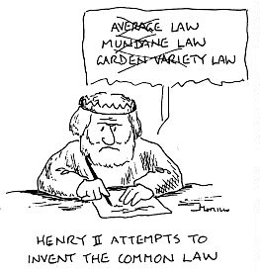
Means
Over millennia, human societies have developed and employed a variety of social choice mechanisms to solve such problems
Standards written by a regulatory body are the most frequently employed and analyzed mechanism in the domain of financial reporting
But not necessarily the best mechanism for all aspects of financial reporting
Consider the characteristics of the available alternatives:
  common law
  popular vote or referendum
  Legislation and statutory law
  Courts
  administrative-regulatory agency
  self-regulation
  Markets
In practice, two or more may be used in parallel.

Slide 14

What is missing in the meaning of better financial reporting?
Stability
Emergence
Robust to financial engineering (Sorites Paradox)
Learning systems
Fit with local business and legal environment
Recognize endogeneity of transactions and complexity
Active engagement of academics with issues and debates (John Bourn)
Governance: discuss next

Slide 15
Corporate Governance
Corporate governance is frequently interpreted narrowly to mean the organization, processes and duties of the board of directors
We take a broader perspective of governance and discuss: :
  Organizations: alliances among various people, each pursuing self-interest
  Culture of an organization: the shared expectations of the behavior of one another held by its participants
  Good governance: balance or match between the culture (mutual expectations) and self-interest of the participants
  Why Good Governance? It makes all participants better off
  Elements of Good Governance: balance among regulation, market forces, and social norms
  Threats: changes in environment, markets, self-interest
  Strategic Management: anticipating and addressing the threats
  Organization and Society: evaluation of organization by the sum of surplus received by all participants
  No Holy Grail: Good governance is a constant struggle to maintain balance under ever-changing conditions; it is a journey, not a destination

Slide 16
Organization as an Alliance among People

Slide 17
Business Organizations
For present discussion, consider business organizations
Consider them as an alliance among contributors of
  Capital (shareholders, creditors)
  Labor (employees, managers)
  Factors (vendors)
  Cash (customers)
  Public services (government)
  Support (Community)
Each party gets resources in exchange

Slide 18
Accounting in Organizations
Operating mechanism for contracts
Necessary to assemble, implement, enforce, modify and maintain the contract set
Five functions
  Measure resource contributions from agents
  Monitor resource outflows to agents
  Relate inflow and outflow for each agent
  Maintain liquidity of factor markets
  Shared knowledge to facilitate contract renegotiation

Slide 19
Culture of Organizations
We can think of culture of an organization as the shared mutual expectation of behavior of the members of a group
  Starting meetings on time
  Wearing a suit to office
Developed through social interactions
Mostly bottom-up, not top-down
Maintained through social, not formal sanctions
Takes time for new entrants to learn
The difficulty of maintaining the culture increases as the rate of new entrants increases

Slide 20
Good Governance
Concept of good governance can be derived from the concepts of
  Organizations as alliances or sets of contracts,
  Mutual expectations,
  Shared knowledge, and
  Culture
An organization or group is governed well when all of its participant find it in their own best interests to do what is expected of them by the other members of the organization

Slide 21
Matching Expectations and Self-interest
This is a difficult task for management
Management can influence but not control expectations of people (example of a large bonus)
Every action, event, and outcome affects peoples’ expectations of the future
Individual self-interest is not always known to the manager
Both expectations as well as self-interest change constantly

Slide 22
Why Care for Good Governance?
Good governance is a more reliable route to
  Creation of wealth
  A satisfying work environment, and
  A better life for all participants.
On occasion, individuals may gain advantage for themselves by surprising others (i.e., behave in ways not expected of them)
Such advantages tend to be ephemeral
  Create personal and social anxiety and disruption
  Are ultimately counterproductive.

Slide 23
Organization and Society
We have looked at organization from the point of view of the individual participants so far
How do we evaluate the organization from the point of view of the society as a whole?
Let us return to the model of organization as an alliance among people
Remember, each participant contributes and receives resources
Each participant earns an income from participation
This income = (the value of resources received - the opportunity cost of the resources contributed)

Slide 24
Income from Organization to Society
Extensive income is the sum of income to all participants, government, community (including positive and negative externalities)
Income to shareholder is included in extensive income
But extensive income (to society as a whole) also includes income to all other parts of society
Components of extensive income accrue to various participants and serve as criterion for their respective decisions
Extensive income is the appropriate criterion for social policy and decisions

Slide 25
Threats to Good Governance
Established systems of good governance are threatened by
  Changes in environment
  Changes in markets in which the organization transacts, and
  Self-interest of the participants
  Changes in expectations
A contract set which is in good governance today, may not be in good governance tomorrow if the conditions change
People for who such changes render participation in the alliance disadvantageous seek to leave. If these people are essential to the alliance
Their departure may make the alliance undesirable for others too, possibility of cascading departures and collapse of the organization
A fixed set of contracts cannot remain in balance (expectational equilibrium) except by sheer chance

Slide 26
Functions of Top Management
This function goes by many labels (long term planning, strategic management, etc.)
It always amounts to the same thing:
  Monitor your environment
  Anticipate changes in factor and product markets
  Redesign contracts to be in control under the new conditions
  Renegotiate contracts
  Communicate and implement new contracts
Perpetual revision of corporate plans to retain their desirability from the point of view of all participants

Slide 27
Corruption and Failure of Governance
Most anticorruption drives and investigations fail
To improve the chances of success, we need to understand the nature of corruption
It is not simply a problem of greedy individuals using their office for personal gain at public expense
It is a state of degenerated expectations citizens hold about the (bad) behavior of one another
Expectations of good behavior on part of citizens are an important part of wealth of a society: social wealth
When replaced by expectations of bad behavior, this form of societal wealth is depleted, and society becomes and stays corrupt
Rebuilding the expectations capital of a society is a generational project which has no quick fixes

Slide 28
Corruption as a Disease of Social Norms
When people expect others to behave properly, they also tend to do so, and vice versa
Change a person’s expectations of others’ behavior, and that person starts behaving differently
Transformation of a non-corrupt society to corrupt society involves such change in expectations from good to bad
To rebuild this form of social capital also takes effort and time.
Once rebuilt to higher levels, it can sustain itself, lower transaction costs, raise productivity, but is not easy to transfer across societies.

Slide 29
Depletion of Expectations Capital
During natural disasters, wars, revolutions, social upheavals, and inflation, when survival is at stake, some people take short cuts
They may pay lip service to prior norms but gradually actual norms and behavior decline to lower levels.
Unless carefully monitored, societies under prolonged stress tend to cascade down to corrupt expectations and behavioral norms
Periodic scandals in such societies damage their self-esteem, eliciting cynicism, cover up, or naiveté.
Inquiry commissions are just cleaning dirty window with a dirty cloth; need to rebuild societal expectations to higher levels.

Slide 30
Some Suggestions for Rebuilding Depleted Expectations
Shrink government to essential functions
Cut employment and increase productivity in the essential functions
Pay opportunity wages to government employees
Election financing reforms
Transparent and accessible government
Modernize the payment system
Education
Enforcement

Slide 31
To Summarize
Organizations are sets of contracts among people and accounting is the essential operating system of them
For this purpose accounting must serve many individual and social goals through well designed processes
Good governance bring benefits to all, but requires a balance among the expectations and self-interest of participants in the organizations
When mutual expectations of good behavior are replaced by bad behavior, societies become corrupt, and it takes much time and effort to rebuild expectations of good behavior to restore higher welfare in society

Slide 32


Perspectives

Slide 33
Thank You
Shyam.sunder@yale.edu
faculty.som.yale.edu/shyamsunder/research.html

