Slide 1
Grand Design for Sustaining Civilization
SHYAM SUNDER, YALE UNIVERSITY
INTERNATIONAL SEMINAR ON SUSTAINABILITY & CORPORATE GOVERNANCE
EIILM, IAA Research Foundation & Bengal Chamber
Kolkata March 1, 2012

Slide 2
AN OVERVIEW
WHAT IS CIVILIZATION?
WHAT IS SUSTAINABLE?
WHAT IS GRAND DESIGN?
HOW WE MIGHT CREATE AND IMPLEMENT IT?

Slide 3
WHAT IS OUR CIVILIZATION?
TWO KEY ELEMENTS OF MORAL CODE

Slide 4
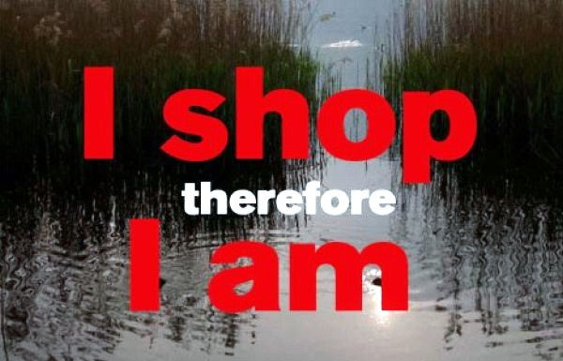
1. CONSUMPTION IN MORAL CODE

Slide 5
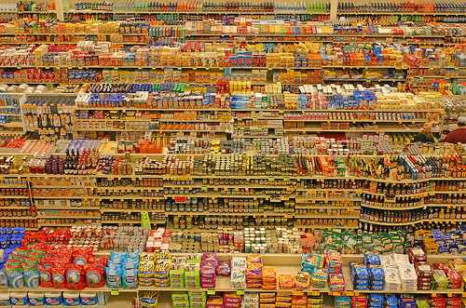
1. CONSUMPTION IN MORAL CODE

Slide 6
2. REPRODUCTION AND PRESERVATION OF LIFE

Slide 7
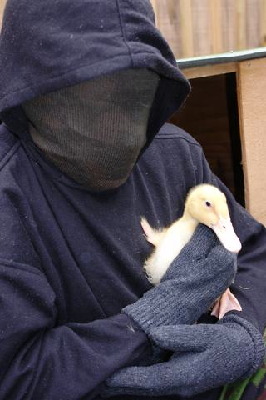
PRESEVATION OF LIFE IN MORAL CODE

Slide 8
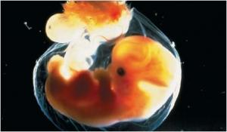
REPRODUCTION IN MORAL CODE

Slide 9
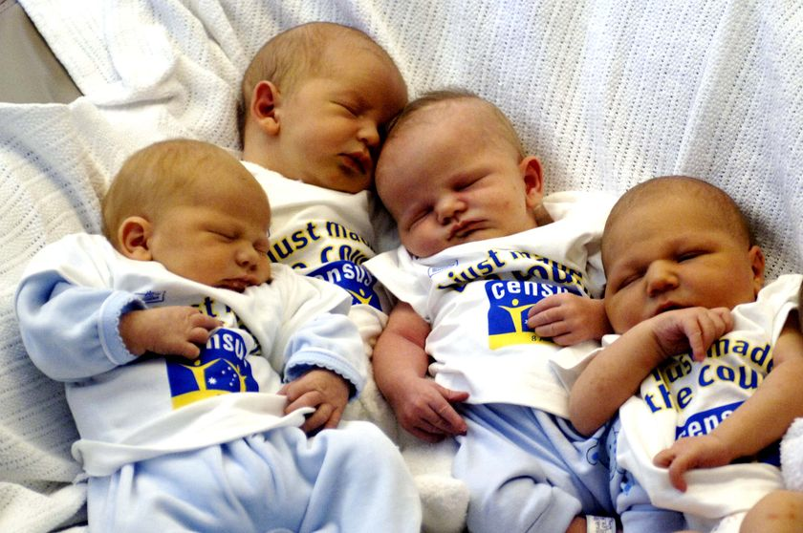
WE LOVE BABIES: LIFE IN OUR MORAL CODE

Slide 10
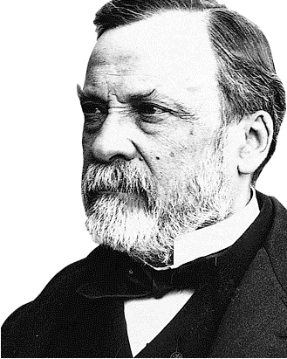
REVOLUTION IN TECHNOLOGY

Slide 11
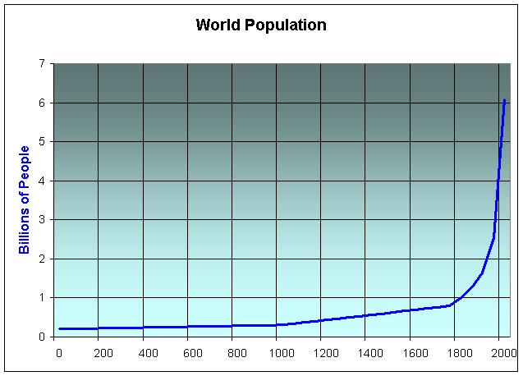
MORAL CODE MEETS TECHNOLOGY

Slide 12
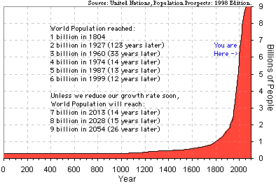
HOW MANY OF US?

Slide 13
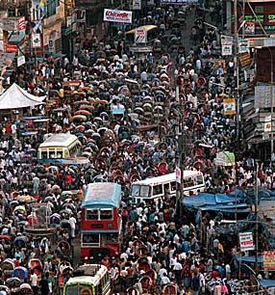
HOW MANY OF US?

Slide 14
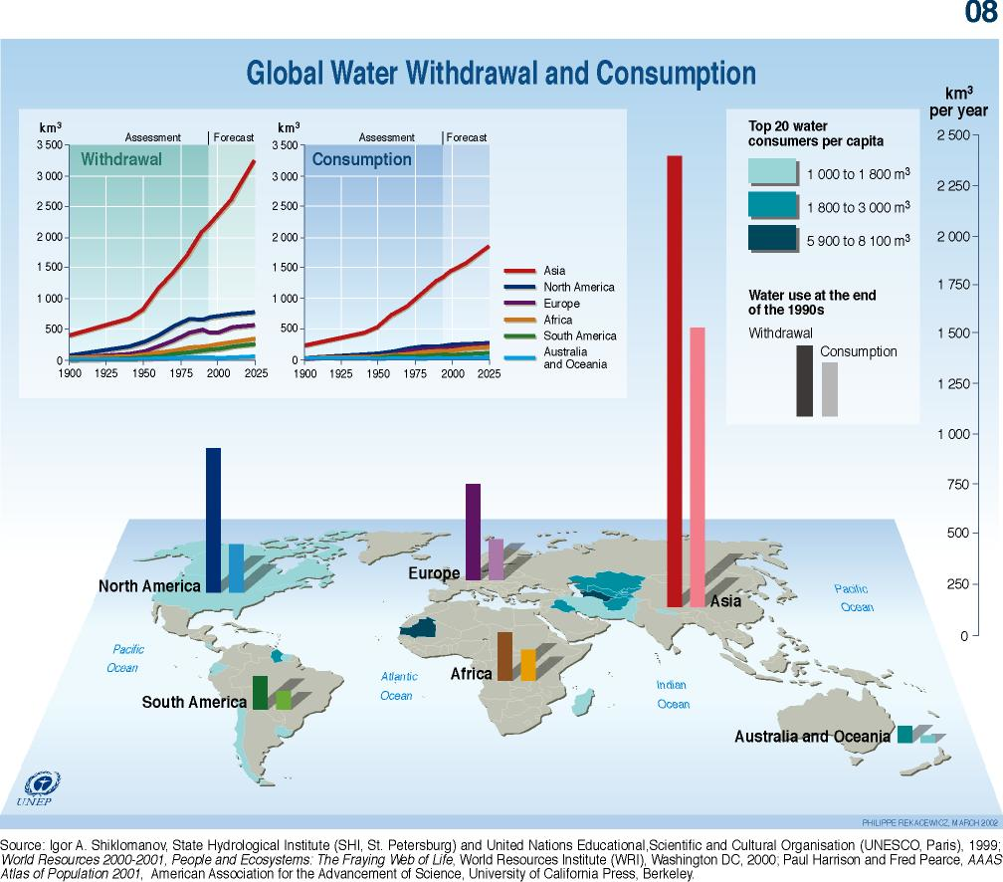

Slide 15
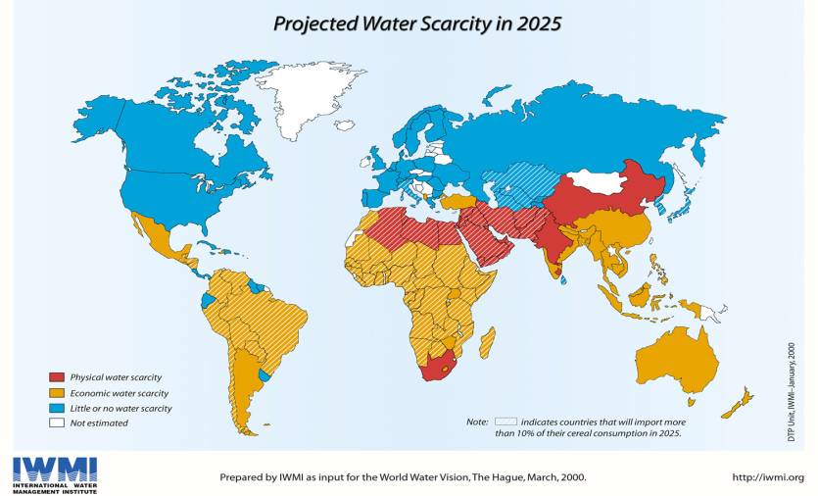
Water

Slide 16
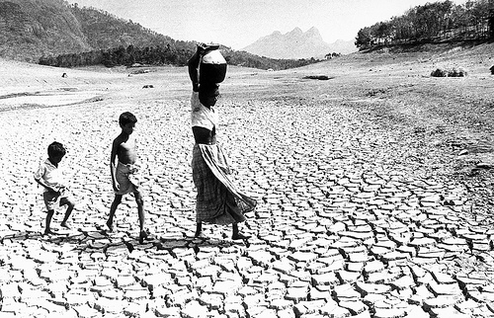
Water Supply

Slide 17
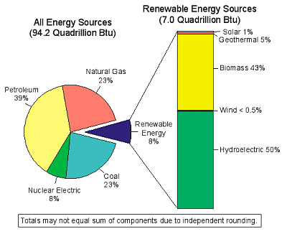
CONSUMPTION

Slide 18
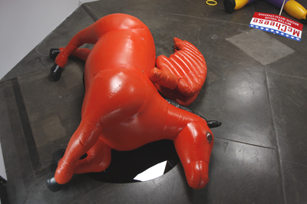

Slide 19
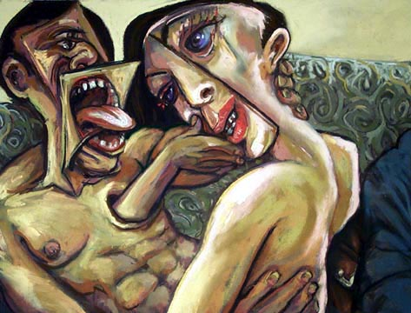
DOES OUR TECHNOLOGY MATCH OUR MORAL CODE OF LIFE AND CONSUMPTION?

Slide 20
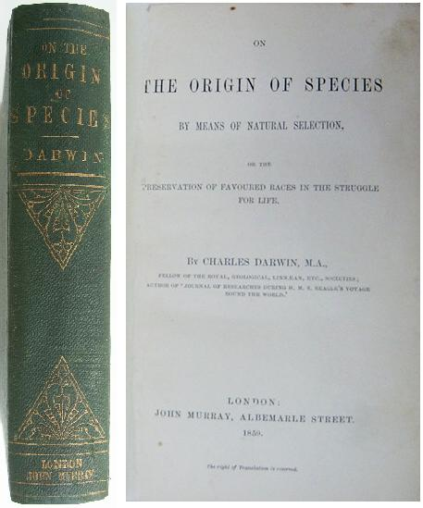

Slide 21
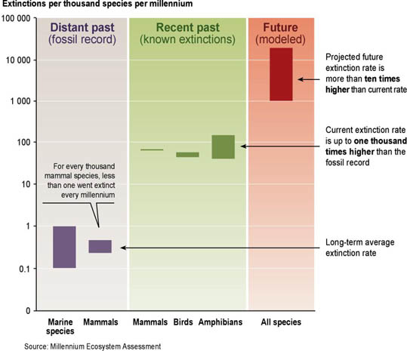
Species Extinction

Slide 22
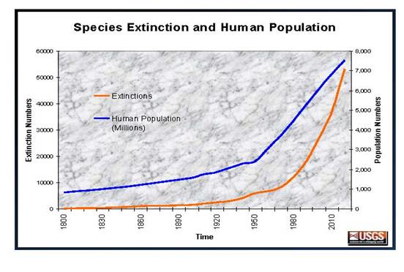
Causation or Just Correlation?

Slide 23
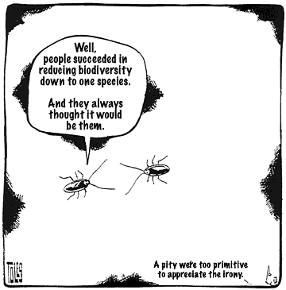

Slide 24
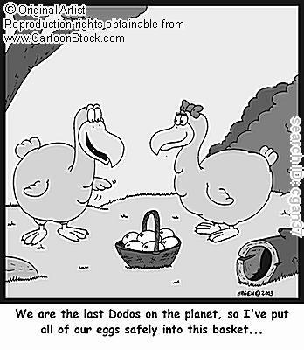
What is Human’s Grand Design?

Slide 25
GRAND DESIGN
MOST SPECIES ON EARTH HAVE NOT LASTED MORE THAN A FEW MILLION YEARS
HUMANS ARE ABOUT AT AVERAGE RIGHT NOW?
SHALL WE EXCEED THE AVERAGE?
ISOLATED HUMAN CIVILAZATIONS HAVE GONE EXTINCT IN KNOWN HISTORY BECAUSE THEY COULD NOT FIND SOCIO-POLITICAL-ECONOMIC SOLUTIONS TO RESOURCE SCARCITY
IT CAN HAPPEN AGAIN IN A GLOBALIZED SOCIETY—EXCEPT THIS TIME AT A GLOBAL SCALE
WHAT WILL IT TAKE TO SUSTAIN THE SPECIES?

Slide 26
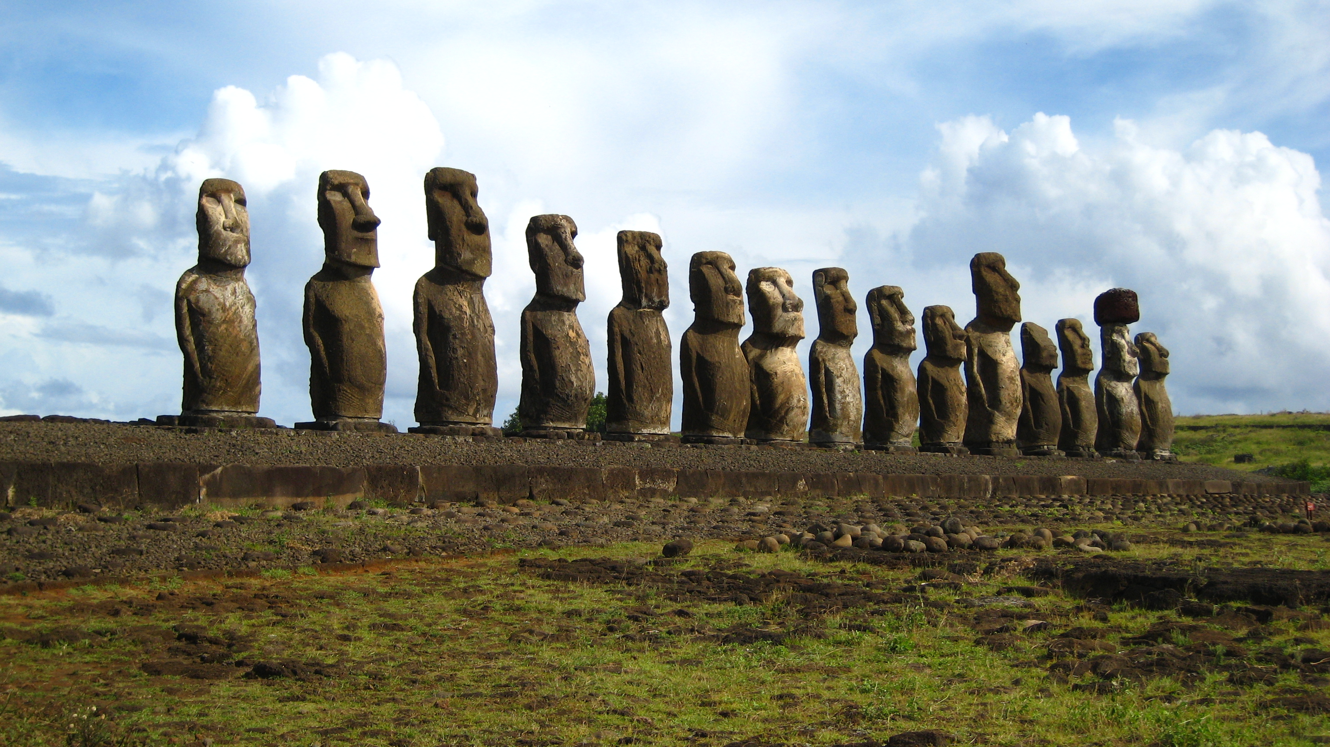

Slide 27
SUSTAINABILITY
AT WHAT RATE OF CONSUMPTION PER CAPITA: C?
FOR HOW MANY PEOPLE: N?
FOR HOW LONG: T?
THE RESOURCE CONSTRAINT ON C-N-T
SOME DISCUSSIONS OF SUSTAINABILITY MIGHT REFER TO CONSUMPTION BUT RARELY TO POPULATION
NOT ALLOWING FOR MANNA FROM HEAVEN TO SAVE US FROM OURSELVES

Slide 28
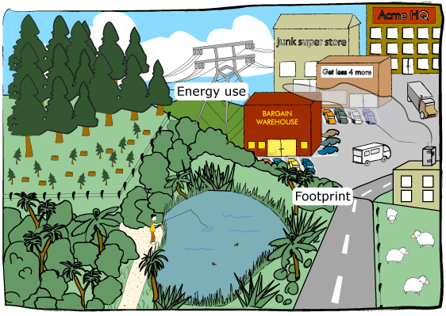

Slide 29
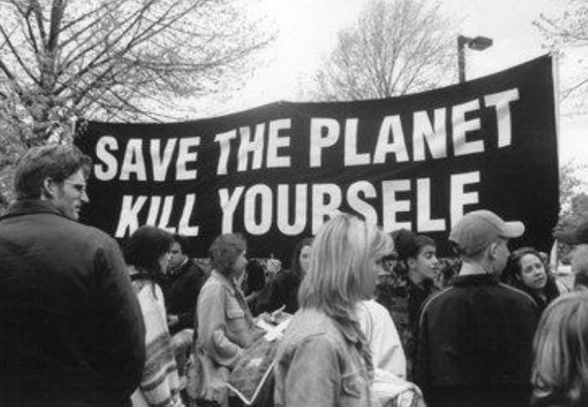

Slide 30
LEADERSHIP AND VISION
DO WE HAVE THE VISION?
DO WE HAVE THE LEADERSHIP?
WHAT DO WE DO, IF WE THINK SUSTAINING THE SPECIES BEYOND A COUPLE OF MORE GENERATIONS IS IMPORTANT?
  MAY BE IT IS NOT IMPORTANT!
  MAY BE WE CAN FIND A WAY
WILL RECYCLING BOTTLES AND KYOTO PROTOCOL BE ENOUGH?

Slide 31
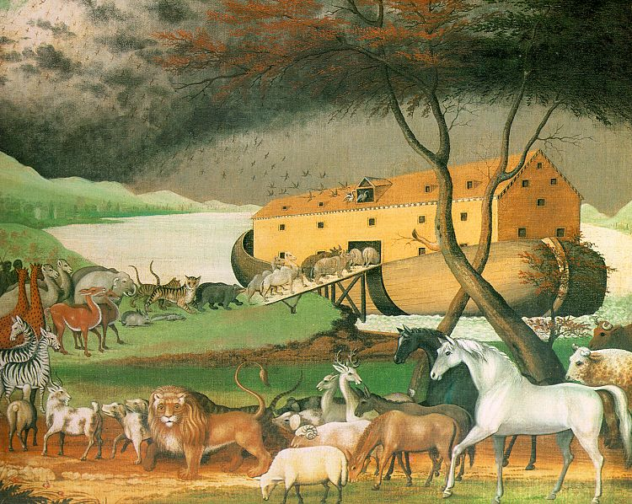

Slide 32
OPEN DISCUSSION
WHAT DO YOU THINK?

Slide 33
SHYAM SUNDER
YALE UNIVERSITY
WWW.SOM.YALE.EDU/FACULTY/SUNDER
SHYAM.SUNDER@YALE.EDU

