Slide 1
Financing of a Public Good by Taxation in a General Equilibrium Economy:
Theory and Experimental Evidence
Juergen Huber, Martin Shubik and Shyam Sunder
Indian Institute of Management, Calcutta
March 2, 2012

Slide 2
Overview
Predictions of a general equilibrium model in which public goods are efficiently financed by a democratically-chosen rate of taxation are largely supported in laboratory economies
In contrast, voluntary anonymous contributions fail to support efficient level of public goods
The results point to the possibility that the social institution of government-enforced taxation may have evolved to address the problem of under-production of public goods
Q: Chances of success of continuing the search for decentralized mechanisms for financing public goods?

Slide 3
Public Goods and Taxation
Project to explore the role of institutions in economic life through theory and experimentation
Complexity of public financing in a modern society
Importance of taxation in providing the coordination needed for the provision of public goods

Slide 4
Context and the success of Microeconomics
Success of microeconomic analysis to specific problems such as industrial organization and taxation
Context specificity of human rationality
Without the guidance from context and institutions the individual may be overwhelmed by information overload and limited skills in a complex world

Slide 5
Economic Dynamics
      Much of microeconomic theory built on the static model of utility or profit maximizing agent that provides a gross simplification of economic behavior
      Dynamics frequently treated by comparative statics
Our basic premise: institutions and the context of the socio-political structures are critical to the understanding of economic dynamics.

Slide 6
Minimal Institutions
We build (here and in related work) fully specified game theoretic models of the phenomenon of interest, and to observe their performance in laboratory.
Minimal institutional structures emerge as part of the rules of the game
These include representations of markets, money, government, taxation enforcement mechanisms, and depending on the question at hand, financial instruments and institutions

Slide 7
Comparing Theory and Experimental Observations
These models of strategic market games are solved for their sub-game perfect non-cooperative equilibria, using dynamic programming
Observations from experimental games are compared with these equilibrium predictions
The experimental subjects are not briefed to solve dynamic programs; yet the institutional structures reflected in the rules of the game often yield outcomes that approximate optimal outcomes, even with agents having limited cognitive abilities

Slide 8
“As If” versus Institutional
This approach may appear to be consonant with Milton Friedman’s views that we merely have to show that individuals behave “as if” they are rational optimizers.
Our argument: this apparently sweeping statement is in actuality highly context and institution specific
It is the institution that bears the burden of providing the means for the ordinary individual agent acting relatively simply and locally to coordinate, and yield outcomes in the neighborhood of the optima

Slide 9
Taxation with and without Voting
      In game theory, RE equilibrium (often used in macroeconomic studies) is the same as a sub-game perfect non-cooperative equilibrium with a continuum of agents
Game theoretic models of tax-financed public goods yield different non-cooperative equilibria with and without voting
These differences appear in experimental observations from laboratory exercises

Slide 10
Prior Experimental Work on Public Goods
Experimental work, mostly voluntary anonymous contributions in partial equilibrium economies
Ledyard survey of pre-1995 literature; more recently Fehr and Gächter (2000); Gunnthorsdottir, Houser and McCabe (2007); Brandts and Schram (2001); Palfrey and Prisbrey (1997)
High initial contributions, e.g., 50 percent of optimal), tend to decline towards 10 percent over time and experience in laboratory
Few, little noted, papers with voting on a contribution rate (tax) that is then either implemented or “cheating” is possible.
Main finding: close to 100% contribution rates when enforced or punishment possible, otherwise low contributions (Kroll et al. Economic Inquiry, 2007)

Slide 11
Financing Public Goods in General Equilibrium
We modify a general equilibrium model of the economy to include government and a full process description of agents playing both economic (market) and political (voting) roles
Provision of public goods financed through taxation on private income
Each tax rate yields a unique equilibrium solution and consumption/investment policy for individuals
Dynamic programming solution for an optimal rate of taxation for society as a whole using symmetry of the agents

Slide 12

The Model
One private good that is produced and traded.
Can be used for consumption or as input for
production of private or public good.

Slide 13

The Model
Private good that is produced and traded.
Can be used for consumption or as input for
production of private or public good.
Public good (PG) that benfits everybody.
Financed through tax (or voluntary
contribution) on income. Government
buys private good from tax collected and
produces public good. The production of public good is added to its
stock which depreciates over time at a given rate.

Slide 14

The Model
Private good that is produced and traded.
Can be used for consumption or as input for
production of private or public good.
Public good (PG) that benfits everybody.
Financed through tax (or voluntary
contribution) on income. Government
buys private good from tax and
Provides PG from this. Stock of PG depreciates over time.
Money is just a means of exchange (and taxation)

Slide 15
Procedure
10 subjects in an economy, all are producer/consumers of the private good.
Equal starting endowments (217 private goods, 4700 cash)
Government is computer-run; its only function is to collect taxes (fixed or set by subjects by a vote), use all tax to produce public good (no waste).
Initial endowment with
  money (4,700 each subject, 13,000 government, for a total of 60,000, remains fixed throughout the session) and
  private goods (217 each subject), as well as
  An initial stock of public goods (427 which is the optimal level, or one half of that at 213)

Slide 16

Sequence of decisions
Determine tax rate (exogenously, or by vote--median)
Stock of public good depreciates by 10%
Sell-all minimal market structure for private goods:
All the money (47,000 in period 1 in the hands of the ten agents and 13,000 with the government in period 1) is pooled and divided by all units of the private good in the hands of the ten agents (2,170 in period 1) to determine the price (27.65 in period 1)
Allocations to ten agents (170 units of good and 6,000 units of money in period 1) and government (470 units of private good in period 1)
Government collects taxes on money income of agents
Agents divide their allocation of good between consumption and production of private good for the next period
UNITS OF THE PRIVATE GOOD PRODUCED = 80*(UNITS INVESTED)^{0.25}
Government converts its share of private goods to produce public goods:
PUBLIC GOODS PRODUCED = 2*(UNITS OF PRIVATE GOOD INVESTED)^{0.5}
Period payoff of agents = private goods consumed +public good stock/4

Slide 17
2x2 Experimental Design
 |  | Starting Level of PG
 |  | Optimal | 0.5 X Optimal
Tax Rate Determination | Exogenous | T1: 4 Sessions | T2: 4 Sessions
 | By Vote | T3: 6 Sessions | T4: 6 Sessions
Anonymous voluntary contrib. |  | T0: 2 Sessions

Slide 18
Experimental Design
2x2 treatment
We examine the model in a laboratory setting when
  The economy starts from an optimum level of public good, and
  When it starts at 50 percent of the optimum level
The efficiency of the outcomes of the economy will be compared
  When Tax rate exogenously fixed at the theoretical optimal level, practical only in a world of an omniscient government;
  When tax rate can be adjusted by the political process that moves on a longer time scale than the day-to-day economic process (tax rate set to the median of the individual proposals)
Compare the outcomes of the human-subject against :
  The general equilibrium solution to the model

Slide 19
Payoff Function
POINTS = CONSUMPTION OF PRIVATE GOOD + PUBLIC GOOD/4

Slide 20
Different Time Scales
Much economic theory (and experimental work) neutral in time scale
But different decisions may involve quite different time scales
A small step to address this matter by introducing “annual” economic decisions on production and consumption alongside “quadrennial” the politico-economic decisions for choosing the tax rate, to implement at 4:1 ratio in the two time scales.

Slide 21
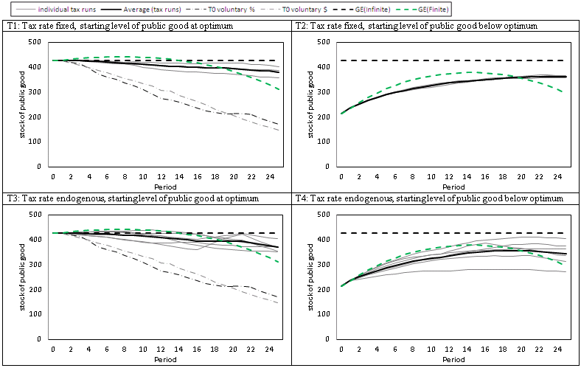
Figure 1: Stock of Public Good in Economies Grouped by Types of Sessions

Slide 22
Figure 1: Stock of Public Good in Economies Grouped by Types of Sessions

Slide 23
Figure 1: Stock of Public Good in Economies Grouped by Types of Sessions

Slide 24
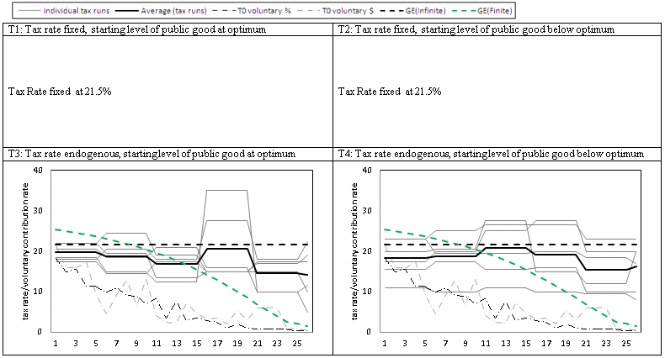
Figure 2: Tax Rates

Slide 25
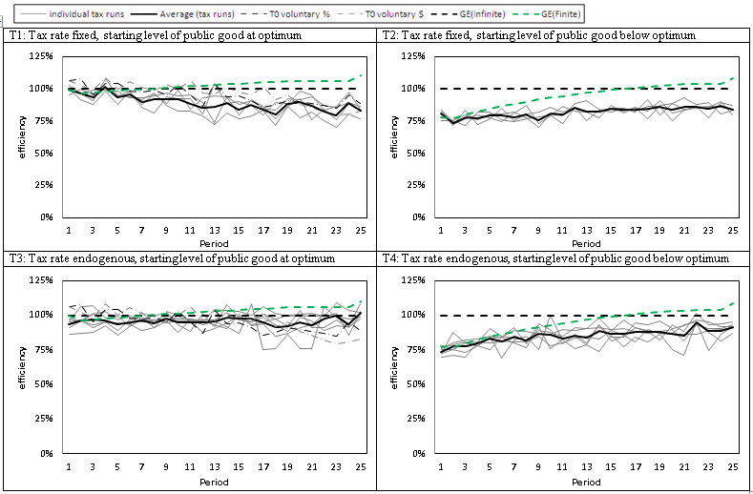
Figure 3: Efficiency
Grouped for Four Types of Sessions

Slide 26
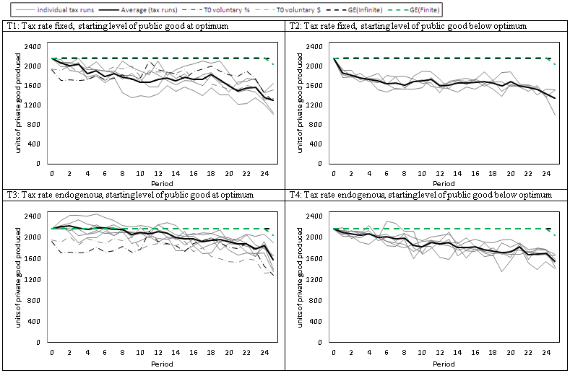
Figure 4: Total Production of Private Good
Grouped by Four Types of Sessions

Slide 27
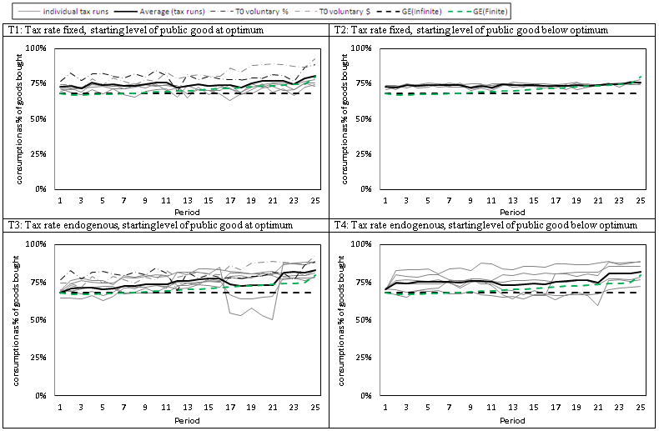
Figure 5: Total Consumption as Percentage of Total Individual Purchases of Private Good

Slide 28
Summary
Contribution rates fall to zero when contributions are voluntary, but remain fairly high when set through a (binding) vote on rate of taxation
Consumption rates are on average higher than in the theoretical optimum
In a fairly demanding public goods setting, democratic vote as a mechanism to set contribution rates achieves high levels of efficiency

Slide 29
Thank you!
Huber, Juergen, Shubik, Martin and Sunder, Shyam, Financing of Public Goods Through Taxation in a General Equilibrium Economy: Theory and Experimental Evidence (October 28, 2011). Cowles Foundation Discussion Paper No. 1830. Available at SSRN: http://ssrn.com/abstract=1950643

Slide 30
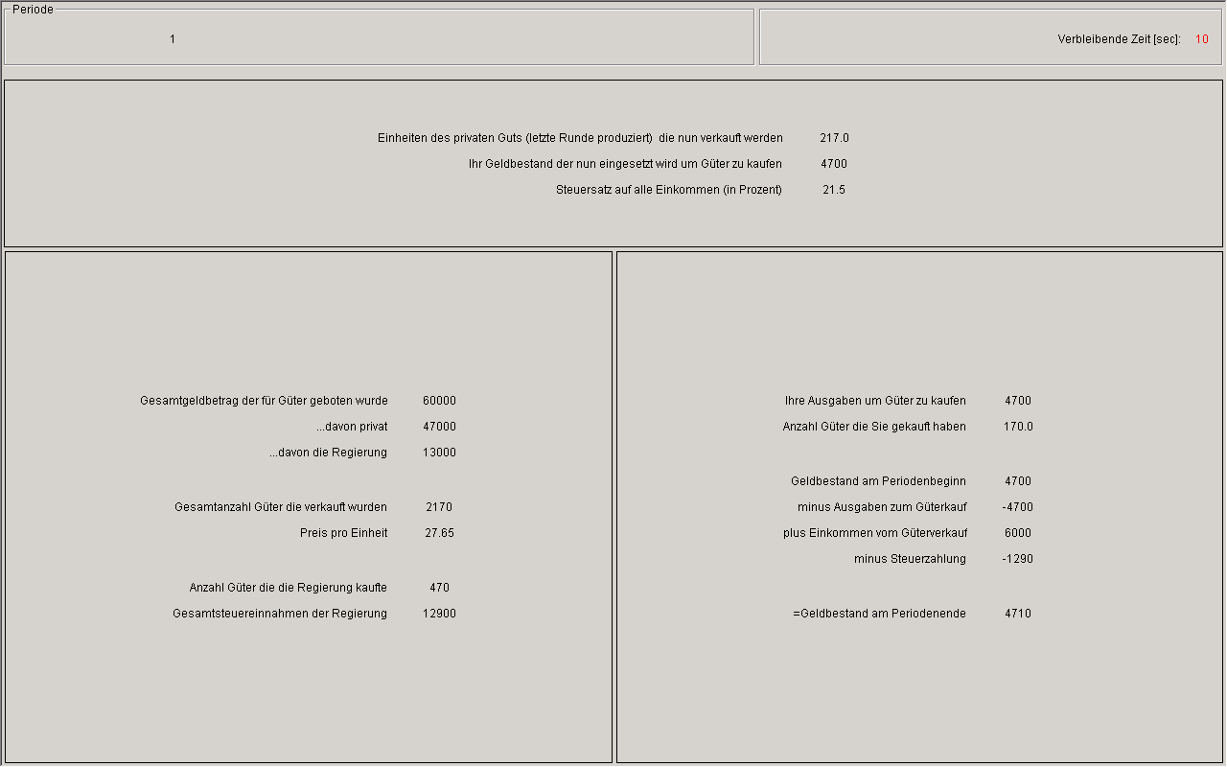

Slide 31
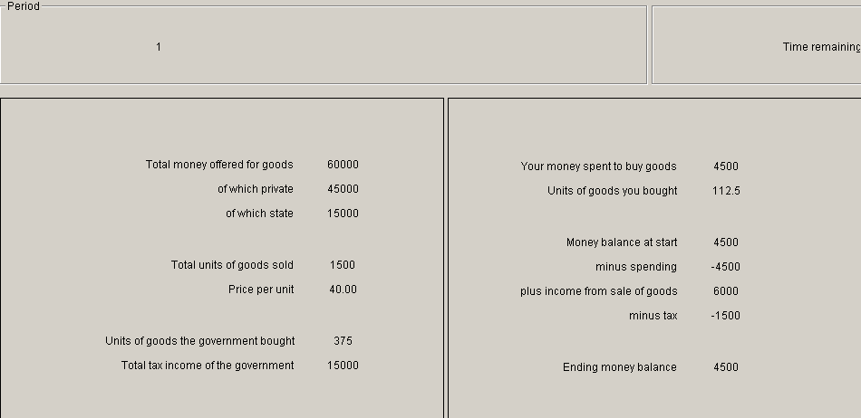
Screen 2

Slide 32
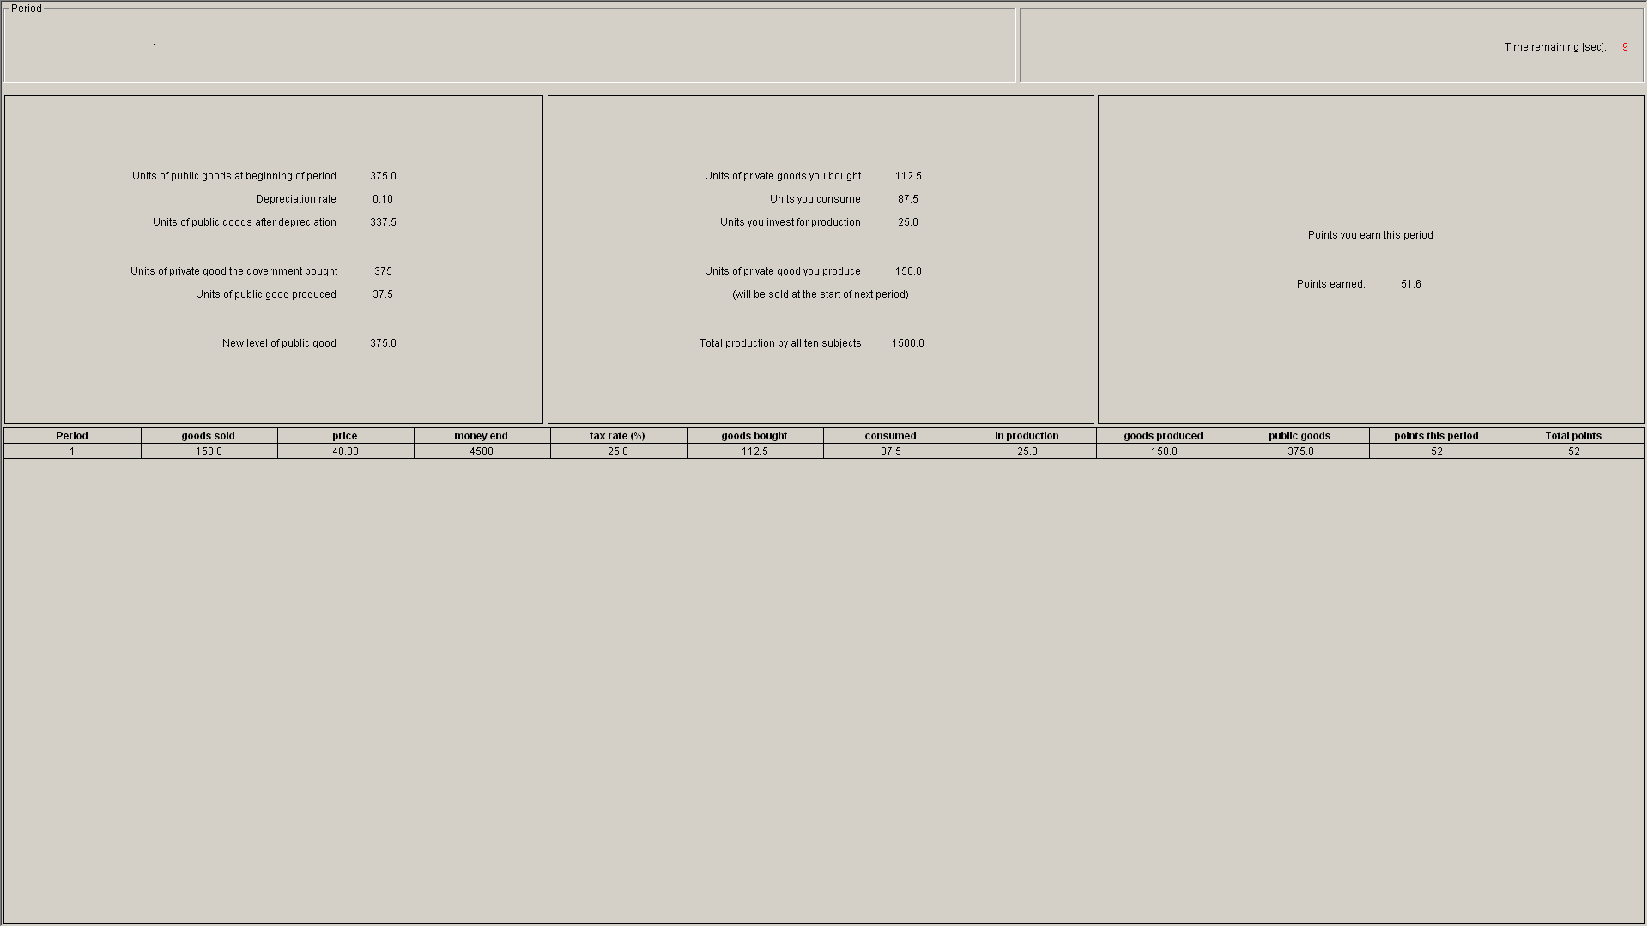
History Screen

Slide 33
Private Good Production Function
UNITS OF THE PRIVATE GOOD PRODUCED = 80*(UNITS INVESTED)^{0.25}

Slide 34
Public Good Production Function:
UNITS OF THE PUBLIC GOOD PRODUCED = 2*(UNITS OF PRIVATE GOOD INVESTED)^{0.5}

Slide 35
Payoff Function
POINTS = CONSUMPTION OF PRIVATE GOOD + PUBLIC GOOD/4

