Slide 1
Risky Curves: From Unobservable Utility to Observable Opportunity Sets
Shyam Sunder, Yale University
(Joint work with Daniel Friedman, UC Santa Cruz)
Laboratory for Economics, Management and Auctions
Smeal College of Business, PennState University
State College PA, April 5, 2012

Slide 2
Fire: Circa 1750 CE
Everyone knew fire to be an element
  In the preceding century, the precise scientific term phlogiston had replaced the vague, Aristotelian label: fire.
  Johann Joachim Becher (1667): a fire-like element, later called phlogiston, was contained within combustible materials; released during combustion, leaving calx behind.
What is the mass of this element? E.g., burning wood produced ashes:
But empirical problems arose with metals (mercury and magnesium):
mHg = mCalx + mp , and the calx weighs more than the metal…
Imagine the theme for an 18th century chemistry conference:
  How many varieties of phlogiston (with positive and negative mass)?
  And not: what does it mean to have an element of matter with negative mass?
2
Notes:
W is wood. Similar equation works for fuels with higher phlogiston content like charcoal or oil. (Discrepancies remain in heat per unit mass of phlogiston)
Hg is mercury. Several complications; see Priestly’s final essay. But metals we usually infer negative mass for phlogiston.

Slide 3
Risk Preferences: Circa 2000 CE
Everyone knows that people have risk preferences.
  In recent decades, more precise scientific labels have come into vogue: expected utility theory and the Bernoulli function.
Measuring the curvature so we can predict behavior in novel risky situations has proved to be elusive
  Portfolio choice etc. usually suggest concave functions
  But gambling suggests convexity, …
  Extreme differences on the degree of curvature inferred from data (equity risk premium puzzle, Mehra and Prescott)
  Possibility of segmented Bernoulli functions with different curvatures, reference points, and kinks, distortions of probability, etc.
Can we straighten it out…. Perhaps.
Can we establish “risk preference” as an explanation of observed choice behavior under uncertainty?
  As opposed to a description of observed choices
3

Slide 4
Which Risk?
There are various concepts for which the term “risk” is widely used in different, and sometimes overlapping contexts
Two important variations:
  Risk in the sense of uncertainty of outcomes (for example, measured by dispersion of outcomes; Markowitz)
  Risk as the possibility of harm
In economics literature on risk preferences, the first of these two meanings dominates (mathematical tractability of variance measure, perhaps)
  Although, the second meanings slips in many contexts (credit, bond ratings, insurance, health, engineering, internal controls, etc., and lay usage)

Slide 5
What is this Person’s Bernoulli function?
Operates two portfolios:
  Portfolio X: consists only of short maturity Government securities and insured CDs.
  Portfolio Y: consists only of deep out of money call options on oil futures.
Both are held by the same person!
  She manages X for her great uncle (fiduciary).
  She holds Y in a national contest (competition)
5

Slide 6
Is the Bernoulli function u an intrinsic personal characteristic?
Estimation from choice data is a mechanical process: entering observations into an estimation algorithm necessarily yields a u
The specific estimate depends on the criterion used to select the “best fit”
Existence of an estimated u says nothing about its validity (regression estimates ≡ valid estimates?)
How well can u predict the out-of-sample choice data?
For a given person or population, how generalizable is u to new tasks and new contexts?
6

Slide 7
Degrees of Freedom
The parameter space for increasing Bernoulli functions is infinite dimensional (we have unlimited flexibility)
If we impose CRRA or CARA restriction
  use 1 df, (2 if multiple families allowed)
Friedman and Savage and Markowitz use at least 4 df
Prospect theory uses at least 5 df:
  location of reference point, derivatives on each side, curvatures on each side
  Many more df used when you consider probability distortions
7

Slide 8
The Best Case: u is Universal
E.g., binocular vision or bipedal motion
Bernoulli (1768), Friedman and Savage (1948) and Markowitz (1952) had hoped so.
  Bernoulli proposed a simple log function
  The other two proposed rather complex functions: 3-4 segments alternately convex and concave.
But empirics said otherwise, e.g., Ward Edwards (1953, 1955) found interpersonal differences, and little resemblance to these proposals.
No universal alternative u has been found to improve on the explanatory power of a straight line u.
8

Slide 9
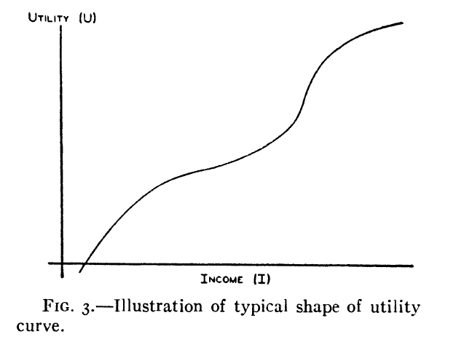
Friedman & Savage (1948)

Slide 10
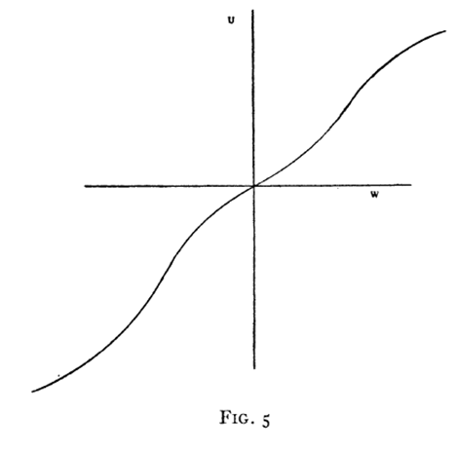
Markowitz (1952)

Slide 11
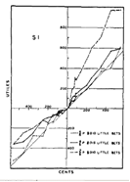
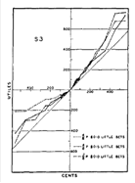
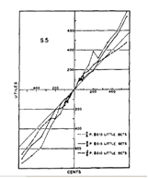
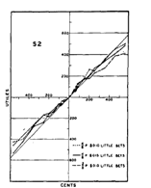
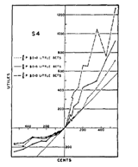
Edwards (1955): FIG. 1. Experimentally determined individual utility curves. The 45° line in each graph is the curve which would be obtained if the subjective value of money were equal to its objective value.

Slide 12
Fall Back Position #1
Human population could consist of a few basic risk types
  Such as blood types: O, A, B, etc.
  Stable after measurement: doesn’t change.
Binswanger (1980, 1981, 1982) study of 380 farmers in India is the most cited support, but it doesn’t hold up.
  Lottery outcomes significant relative to farmer incomes
  Lottery choices didn’t predict farming decisions.
  Luck was the only significant explanatory variable in lottery choices!
So far, evidence is unkind to the idea that human population consists of individuals of a given set of risk types.
12

Slide 13
Fall back position #2
Observable demographic characteristics map into u in a knowable manner.
  age, gender, wealth, education, race, etc. (e.g., susceptibility to heart disease)
  E.g., lower middle class American males have a Friedman-Savage type utility function with the lower inflection point near income 0, the upper near 20, and absolute risk aversion in the three segments is approximately a = 2.5, -1.2, and 2.2 respectively.
  An upper middle income Japanese housewife of age 50-55 tends to have a CRRA utility function with r = 3.0
Dozens of gender studies, but inconclusive:
  “Our findings suggest that gender-specific risk behavior found in previous survey data may be due to differences in male and female opportunity sets rather than stereotypic risk attitudes. Our results also suggest that abstract gambling experiments may not be adequate for the analysis of gender-specific risk attitudes toward financial decisions.” [Schubert et al, 1999, p. 385]
  Eckel and Grossman (2003) meta-study finds support for gender difference in about half, and reverse or no effect in the other half.
Effects of age, etc. are even more obscure.
  Leland and Grafman (2003) undercut even the Ventromedial cortex damage story!
13

Slide 14
Binswanger and Sillers Field Studies
Binswanger found that wealth, schooling, age, and caste were all insignificant
Sillers (1980) field study with Filipino farmers:
  “This chapter briefly describes an attempt to use household risk preferences, as measured in the experimental game sequence, to test the impact of household risk aversion on the rate of fertilizer applied to the dry season rice crop. This effort failed to produce a satisfactory test of the importance of this relationship or its direction…”
Neither Binswanger nor Sillers could explain farmers’ decisions in familiar tasks using risk preferences inferred from their experimental tasks
Our partial screening of the literature has not yet revealed a validated evidence on how the curvature of utility functions might be systematically related to some observable human characteristics

Slide 15
Fall back position #3
Bernoulli functions are idiosyncratic but have some identifiable population distribution (e.g., intelligence or creativity?).
  Many such individual properties have been tabulated for populations: income, food and clothing preferences, body sizes and weights, etc.
  “Goldman-Sachs risk preference tables” don’t yet exist, however. Why not?
  We know of no attempts to try to build such tables.
  So the evidence is negative, but only circumstantial.
15

Slide 16
Fall back position #4
Bernoulli functions are idiosyncratic but at least are stable at the individual level.
Harlow and Brown (1990) is the most favorable evidence we could find.
  weak but significant correlations across choice and physiological risk measures for male Ss; no relation for the female Ss; artifact indications even for males.
Isaac and James (2000) is a blow to this position
  strong negative correlation between risk aversion measured in (a) 1P-IPV auction vs. (b) BDM task.
Sillers (1980) thesis at Yale
  Risk attitudes estimated from experimental tasks could not explain crop decisions of Filipino farmers
16

Slide 17
Rock-Bottom Position #5: Can’t Fall Any Further
Bernoulli Functions are person and context specific
  Contexts: investment, insurance, sports, gambling, health, etc.
These functions vary (according to some fixed discoverable laws) across N persons and M contexts to yield a set of N*M; still plenty of degrees of freedom in choice data to estimate so many functions
Evidence: no such functions, and laws governing them discovered so far
No room for further retreat within science
  Unless we postulate that risk preferences are unique to each act of choice
  One or more parameters need to be estimated from each observed choice (not enough degrees of freedom)
  May be difficult to defend it as science
17

Slide 18
Micro-Level Summary
The micro-level evidence so far is not palatable to non-linear utility
If non-linear utility u shifts arbitrarily even for a given individual and context, it seems to have little scientific value (attributing choices to themselves!) or arbitrary moods or spirits (outside the domain of science)
Friedman and Savage (1948, p. 282) promise:
  This special shape, which can be given a tolerably satisfactory interpretation (sec. 5), not only brings under the aegis of rational utility maximization much behavior that is ordinarily explained in other terms but also has implications about observable behavior not used in deriving it (sec. 6).

Slide 19
Do We Have Macro Level Evidence?
Even if we cannot measure them at individual (micro) level, perhaps Bernoulli functions for “representative agents” (or population distribution across heterogeneous agents) can give us macro-level insights into important aspects of the economy and society, e.g., in:
  Stock Market
  Bond Market
  Insurance
  Gambling
19

Slide 20
Portfolio Theory and Stock Market
Portfolio theory built on the assumption of risk preferences (Markowitz)
A special interpretation of risk (dispersion of outcomes) which is at variance with the interpretation of risk in many other fields (harm and uncertainty); possibly for mathematical convenience
In equilibrium, mean return on a security is proportional to its market risk (Sharpe 1964, Lintner 1965)
Risk-return trade-off is a foundation result in finance taught to students for almost five decades
Supporting evidence from voluminous transactions and return data?
20

Slide 21
Evidence from Stock Market on Risk and Return
(Source: Prepared by authors from data in Black (1992, Exhibits 3 and 4)
21

Slide 22
Evidence from Stock Market on Risk and Return
(Source: Prepared by authors from data in Black (1992, Exhibits 3 and 4)
22

Slide 23
Consensus in Finance?
“Our tests do not support the most basic prediction of the Sharpe-Lintner-Black model, that average stock returns are positively related to market betas. “(Fama and French 1992, p. 428)
“Since William Sharpe published his seminal paper on CAPM (capital asset pricing model), researchers have subjected the model to numerous empirical tests. Early on, most of these tests seem to support the CAPM’s main predictions. Over time, however, evidence mounted indicating that the CAPM had serious flaws.” (Smart, Magginson and Gitman 2004, pp. 210-212).
“What is going on here? It is hard to say. …One thing is for sure. It will be very hard to reject the CAPM beyond all reasonable doubt.” (Brealy & Myers, pp. 187-8). Note the reversal of Fisher-Neyman-Pearson hypothesis testing framework (failure to reject the null interpreted as evidence in favor of the null?)
23

Slide 24
Consensus in Finance (contd.)
“…do not feel that the evidence for discarding beta is clear cut and overwhelming” (Chan and Lokanishok 1993)
“…despite widely differing specifications and estimation techniques, most studies find a weak or negative relation. Examples include French, Schwert and Stambaugh (1987), Campbell (1987), Glosten, Jagannathan and Runkle (1993), Whitelaw (1994), Goyal and Santa-Clara (2003) and Lettau and Ludvigson (2003).” Guo & Whitelaw 2003.
Few doubts raised about the existence of concave utility functions

Slide 25
Equity Risk Premium Puzzle
Theoretical predictions of equilibrium equity risk premium are an order of magnitude smaller than what has been observed during the past 100 years (Mehra and Prescott 1985)
Recommendations of market risk premiums vary widely across finance text books; US mean 6.0, Europe mean 5.3, 3.6 in Denmark, 10.9 in Mexico, average within country range 7.4, average std 2.4% for 33 countries (Fernandez 2010)
No explanation/consensus in finance, behavioral or otherwise

Slide 26
The Bond Market
Unlike the stock market, most analyses of risk in the bond market still use the “possibility of harm” concept of risk
Popular bond ratings (Moody’s and Standard & Poor’s) not based on dispersion measure of risk
Even with (dispersion) risk neutral investors, one should expect to see a higher promised yield on higher risk (lower rated) bonds
Lawrence Fisher (1959) model, based on default risk and marketability explains 74 percent of the variability of bond yields in excess of treasury securities
  No role for concavity of utility function
  Altman (1989) finds monotonic link between bond ratings and returns net of defaults which is not consistent with CAPM
  Many explanations available; most do not require concave utilities
26

Slide 27
Insurance
Most common basis for theories of risk aversion
But risk aversion is only one possible explanation for why people buy insurance
Alternatives include
  Concave net payoffs (see later)
  Legal requirements
  Social pressure and conventions (not seen in primitive societies, insurance sales and marketing)
  Simplifying planning for contingencies
Amazingly—insurance is inconsistent with the currently popular prospect theory that predicts that people would pay to bear (dispersion) uncertainty in loss domains!
One sided nature of insurance suggests appropriateness of applying option theory here
27

Slide 28
Gambling
Extensive use of curved utility functions to generate facile but inconsistent explanations of gambling
The same people also buy insurance
We could not find estimates or predictions of actual individual or aggregate behavior using Friedman and Savage or Markowitz type of utility functions with multiple points of inflection; no identification of parameters or laws that determine these parameters
Marshall (1984), Figure 6: Optimal fair bet involves only two outcomes a and d in FS the utility function
Nonmonetary motivations behind gambling (emotional, social, addictive, compulsive, entertainment aspects of gambling)
Utility curvature rarely appears in serious scientific analyses of gambling in any field (or in design of gambling systems)
  In economics, gambling is just assumed away to have been generated by convex but unobservable utility function (effectively treating utility function as a plug for observed behavior)
28

Slide 29
Where Does This Leave Us?
At individual level, curved utility functions have remained beyond scientific measurement and validation (from any given perspective—universal, a few basic types, demographic, population distribution, idiosyncratic, or idiosyncratic context dependent)—so far
At macro level, few phenomena are explained by an assumption of a universal risk attitude of “representative” agents or population distribution of heterogeneous agents
What, then, is the substance behind the concept of risk attitudes? In what sense is it “real” or scientific?
How useful has it been, and what insights might it yield into economic phenomena in the future? If so, how?
29

Slide 30
Occam’s Razor
Utility functions are neither deduced from fundamental propositions, nor observed directly
They are inferred from observed behavior
Scientific value of inferred functions derives from their usefulness in organizing and predicting out-of-sample observations
Sufficient stability and consistency is necessary for scientific value
Nonlinear Bernoulli functions, in spite of multiple degrees of freedom, do not seem, after more than six decades of intensive investigation, to have an established advantage over simple linear function
Principle of parsimony (Occam’s Razor) favors linear function, ceteris paribus

Slide 31
Looking Forward: What Can We Do?
Return to the first principles: DM chooses the most preferred of the available opportunities
Simplest possible assumption about utility—linear utility so EU ≡ EV.
Careful analysis of opportunity sets and choose the highest expected value alternative
Look at the out-of-sample explanatory power of this fundamental rule across a wide range of decision contexts and populations
Demand better explanatory power before yielding to those who come hawking “better” solutions with hidden free parameters and special contexts
31

Slide 32
Gross and Net Payoffs
Net payoff is what DM values
Gross payoffs are the lottery prizes
There is often a gap between the two
How far can examination of net payoffs as a function of gross payoffs in the context of linear utility help?
This puts any nonlinearities in directly observable opportunities rather than in preferences
  More parsimonious, observed, not inferred

Slide 33
Example 1: Concave Net Payoffs
DM has some obligation z > 0 (e.g., credit card balance, payroll of a firm, bond indentures)
DM has random cash flow g to meet the obligation
Failure to meet the obligation brings a penalty proportional to the shortfall (a*(z-x) if x < z)
Net payoff as a function of gross is in Panel A
It is piecewise linear and concave for a >0; if z is random, strictly concave over support of z
Also, progressive income taxes, fiduciary duties due to penalties and legal costs
Also, turning down a superior job offer may be due to the option value of waiting for an even better offer, and not concave utility (Dixit, Pindyck);
An uninformed outsider may not be able to distinguish between risk averse DM with linear net payoff and risk neutral DM with concave net payoff (specification error)

Slide 34
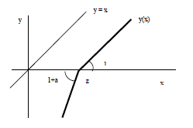
Panel A: Additional cost a>0 on shortfall from z
34
Notes:
Kink is smoothed out if obligation z is uncertain

Slide 35
Example 2: Convex Net Payoffs
Opposite specification error: An outsider infers risk neutral DM with convex net payoff to be risk loving with linear net payoff
E.g., tournament payoffs: only the highest x gets a prize P; each of the K >0 contestants draws gross payoff independently from a cumulative distribution G then the expected net payoff is n(x) = PG(x^{)K} whose concavity increases with K (Panel B)
Other examples: decisions under shadow of bankruptcy with shortfalls passed to creditors (Panel C): net payoff n(g) = x-z for x>z but n(x) = (1-a)(x-z) for x<z where 0<a<1 is the share of shortfall borne by others; random support for x smooths óut the chart
Bank bailouts create similar convex net payoffs which induce DM to choose riskier gambles US Savings and loan industry 1980s, Global Financial Crisis, Greek Crisis

Slide 36
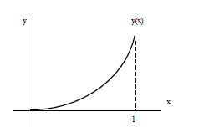
Panel B: Tournament (Convex Net Payoff)
36

Slide 37
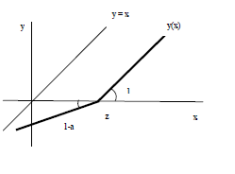
Panel C: Bailout a > 0 for shortfall from z
Risky Curves
37

Slide 38
Bernoulli Functions with Concave and Convex Segments (Markowitz, Friedman and Savage)
Possible reinterpretation of Friedman and Savege (1948) and Markowitz (1952) proposals with the opportunity set approach
Markowitz: Income below certain level z(1) gets housing subsidy at rate a > 0, and income above certain level z(2) makes the person ineligible for subsidy makes an outsider infer a Markowitz type utility function (Panel D) when in fact it is linear; only the net payoff function has the shape proposed by Markowitz
Friedman-Savage story of upward mobility yields a similar inference about utility in presence of costs of private schools and other cash flows that might be associated with the move to a better neighborhood (Panel E); Marshall (F)

Slide 39
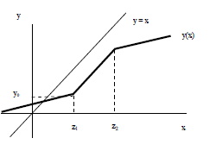
Panel D: Means-Tested Subsidy (Markowitz)

Slide 40
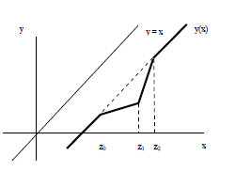
Panel E: Social Climbing (Friedman and Savage)

Slide 41
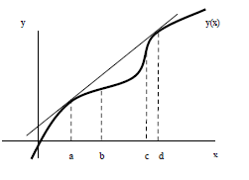
Panel F: Marshall´s Friedman and Savage Gamble

Slide 42

Masson: Unequal Borrowing and Lending Rates
Friedman and Savage and Markowitz type net-to-gross payoff functions when borrowing and lending rate of the DM or unequal
St. Petersburg Paradox which inspired Bernoulli to propose log utility can also be understood in terms of options:
With finite ability of gamblers to pay. If the gambler will default above B = 2^{n ,} then the expected value of the first n(B) = lnB divided by ln 2

Slide 43
Phlogiston Goes Up in Smoke
Is non-linear utility phlogiston of economics (proposed by Gabriel Cramer and Daniel Bernoulli (1738)) entered mainstream with vNM in 1944
It has not yet fulfilled its early promise: no stable consistent estimates of individual utility functions or explanations of macroeconomic phenomena, has not aged well.
Lavoisier’s radical oxidation/reduction theory took hold in the 1780s and was orthodox by 1800 (oxygen = antiphlogiston; or phlogiston = antioxygen).
J. Priestly and friends never accepted it, but phlogiston died with them.
A radical new theory of risky choice could yet emerge eventually (perhaps from neuroscience).

Slide 44
Better Alternatives from Behavioral Economics?
Behavior economics might seem to be a promising source for a better alternative
But it takes nonlinear utility as a given, and is preoccupied with finding specific non-linear functions that might fix the empirical inadequacies of the EUT.
Therefore most behavior economics is subject to our critique and is included above; no better theoretical alternatives offered yet by behavioral economics
KT (1979) prospect theory is central to behavioral economics (S-shaped function similar to Markowitz’, convex below an inflection point z and concave above
It has at least four free parameters and slope and shape parameters for upper and lower ranges of outcomes
Yet it is inconsistent with insurance for losses
Additional use of probability weighting and other theories (regret, rank-dependent, etc.) for ex post rationalization of any observations
Yet to show powers of prediction based on observable explanatory variables

Slide 45
45

Slide 46
Way Forward
Until something better comes along, it seems better and scientifically defensible to stick to what we can directly observe: analysis of opportunity sets of decision makers
  Use simplest possible (linear) preferences; EV=EU
  Careful examination of observable opportunity sets and how possible outcomes interact with future opportunities and past commitments
  Insurance: examine observable commitments and embedded options
  Gambling: potentially observable bailout options

Slide 47
Concluding Remarks
What would it take to vindicate empirically non-linear Bernoulli functions?
  Consistency at the individual level: not transient.
  Predictability in new tasks and contexts
What is the radical new approach?
  Who knows? Not prospect theory…
What to do in the meantime?
  Conservative program: focus on observable opportunities in gross versus net payoffs.
  Let’s not base a theory of choice on unobservable concepts and untestable propositions
  Sixty five years of concentrated efforts to validate curved utility to explain risky choices has not taken us very far
  Try option theory instead of risk attitudes as the foundation
47
Notes:
Shyam—
Probably we’ll have to retreat from that last phrase…

Slide 48
Thank You.
dan@ucsc.edu Shyam.sunder@yale.edu
For the paper: http://ssrn.com/abstract=1858769

