Slide 1
Short Investment Horizons, Higher Order Beliefs, and Difficulty of Backward Induction: Price Bubbles and Indeterminacy in Financial Markets
Shinichi Hirota, Juergen Huber, Thomas Stoeckl, and Shyam Sunder
Yale School of Management Faculty Workshop
April 30, 2014

Slide 2
An Overview
Explore
  Why prices may deviate from fundamental values in otherwise well-functioning markets?
Focus on
  Effect of the Investors’ Time Horizon
Conduct
  Laboratory Experiments

Slide 3
Main Findings
Prices tend to deviate from fundamental levels (bubbles, indeterminacy) when investors have horizons shorter than the maturity of securities they trade
Difficulty of forming higher order beliefs about future cash flows
Difficulty of backward induction through higher order beliefs to fundamental present values

Slide 4
Previous Research on Bubbles
(A) Rational Bubbles
  Blanchard and Watson (1982), Tirole (1985)
  Infinite Maturity
(B) Irrational Bubbles
  Shiller (2000), Behavioral Finance
  Emotion, Psychological Factors

Slide 5
Our Paper
Provides a different view.
  includes (A) as a special case.
  suggests when (B) is likely to occur.

Slide 6
Fundamental Value vs. Price for a simple, single dividend security
Fundamental value:
(1)
Long-term Investor’s Valuation:
(2)
Short-term Investor’s Valuation:
(3)
P_{t} is not necessarily equal to F_{t}

Slide 7
For P_{t} to be equal to F_{t}
Rational Expectation of P _{t+k}
Homogeneous Investors
The Law of Iterated Expectations
By recursive process, P_{t} = F_{t} is derivable by the backward induction.

Slide 8
Difficulty of Backward Induction
Backward Induction may fail.
  Infinite maturity (rational bubbles)
    Blanchard and Watson (1982), Tirole (1985)
  Infinite number of trading opportunities
    Allen and Gorton (1993)
  Heterogeneous Information
    Froot, Scharfsten, and Stein (1992), Allen, Morris, and Shin (2002)
  Rationality may not be common knowledge
    Delong et al. (1990a)(1990b), Dow and Gorton (1994)

Slide 9
Price Bubble sans Dividend Anchors
There are cases where short-term investors have difficulty in backward induction.
Stock prices (P_{t} ) form deviate from fundamentals (≠ F_{t} )
No longer anchored by future dividends

Slide 10
In an Earlier Experimental Study
Hirota, Shinichi and Shyam Sunder. “Price Bubbles sans Dividend Anchors: Evidence from Laboratory Stock Markets,” Journal of Economic Dynamics and Control 31, no. 6 (June 2007): 1875-1909.
What happens when short-term investors have difficulty in the backward induction?
Two kinds of the lab markets
  (1) Long-term Horizon Session
  (2) Short-term Horizon Session
Bubbles tend to arise in (2), but not in (1)

Slide 11
Long-term Horizon Session
Period 1
Period 15
(Trade)
D
Single terminal dividend at the end of period 15.
An investor’s time horizon is equal to the security’s maturity.
Prediction: P_{t} = D

Slide 12
Short-term Horizon Session
Period 1
Period x
Period 30
(Trade)
E_{x} (P_{x+1})
D
Single terminal dividend at the end of period 30.
The session will “likely” be terminated earlier.
If terminated earlier, the stock is liquidated at the following period predicted price.
An investor’s time horizon is shorter than the maturity and it is difficult to backward induct.
Prediction: P_{t} ≠ D

Slide 13
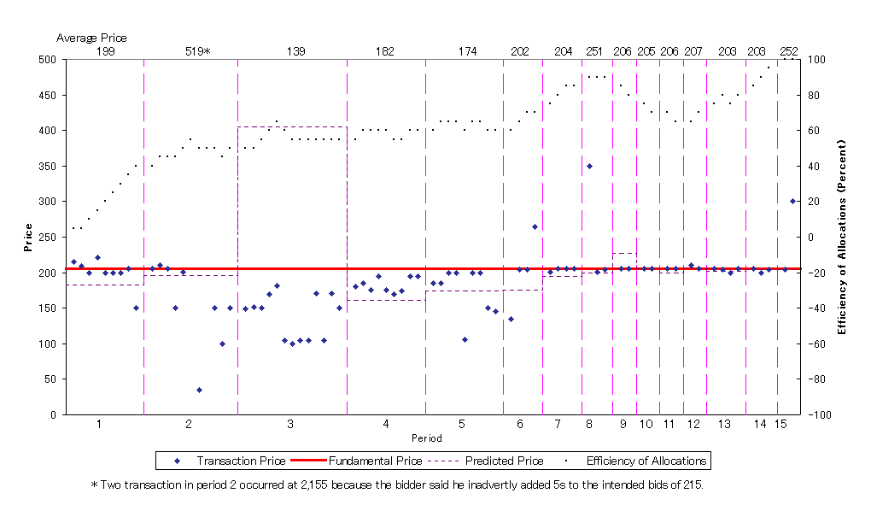
Figure 4: Stock Prices and Efficiency of Allocations for Session 4
(Exogenous Terminal Payoff Session)

Slide 14
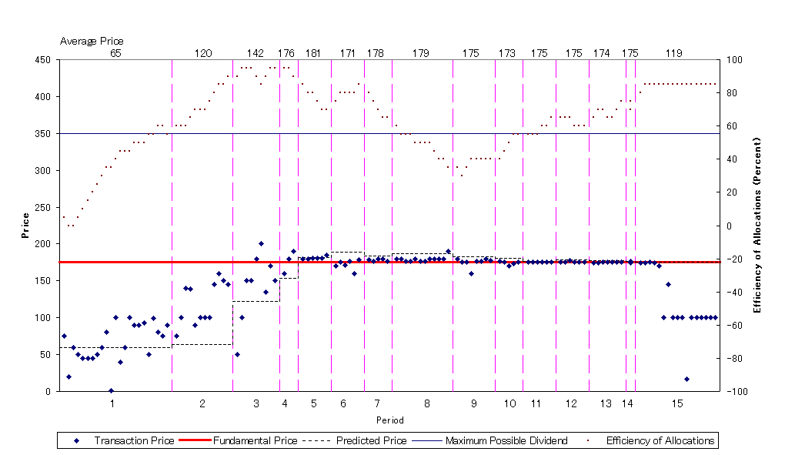
Figure 5: Stock Prices and Efficiency of Allocations for Session 5
(Exogenous Terminal Payoff Session)

Slide 15
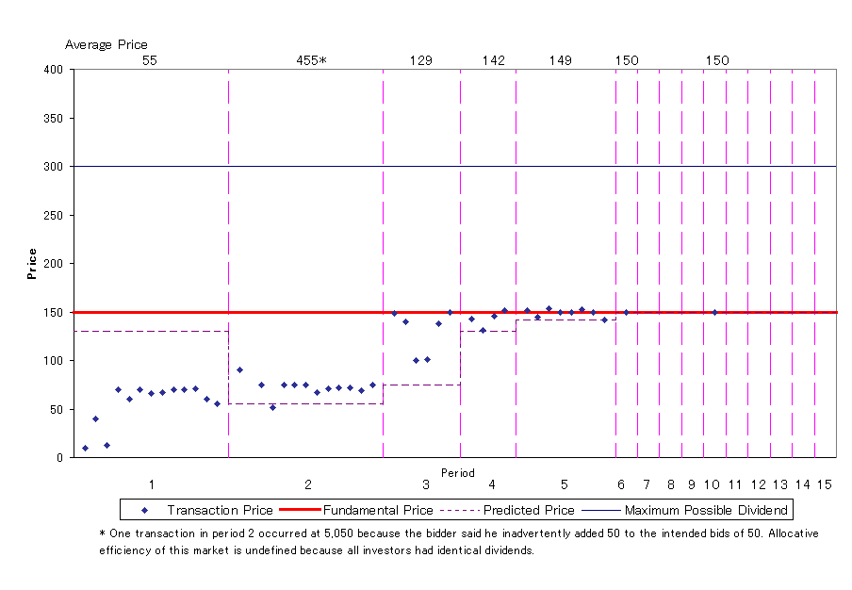
Figure 6: Stock Prices for Session 6
(Exogenous Terminal Payoff Session)

Slide 16
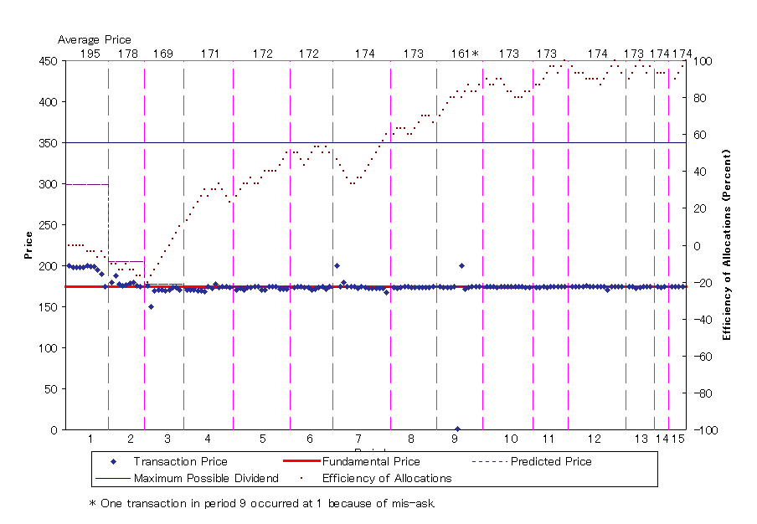
Figure 7: Stock Prices and Efficiency of Allocations for Session 7
(Exogenous Terminal Payoff Session)

Slide 17
In long-horizon sessions
Long-horizon Investors play a crucial role in assuring efficient pricing.
  Their arbitrage brings prices to the fundamentals.
Speculative trades do not seem to destabilize prices.
  39.0% of transactions were speculative trades.
By contrast, in short horizon treatments:

Slide 18
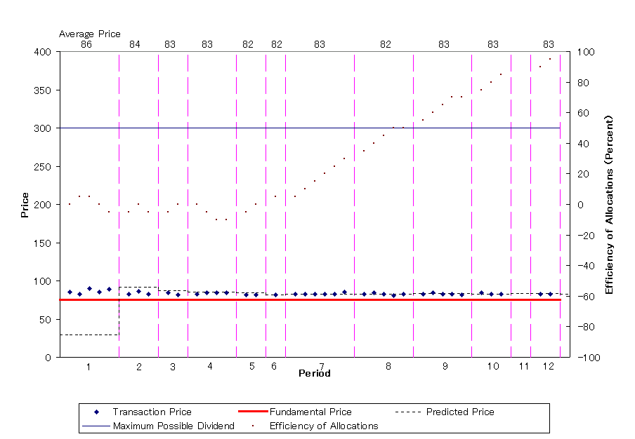
Figure 8: Stock Prices and Efficiency of Allocations for Session 1
(Endogenous Terminal Payoff Session)

Slide 19
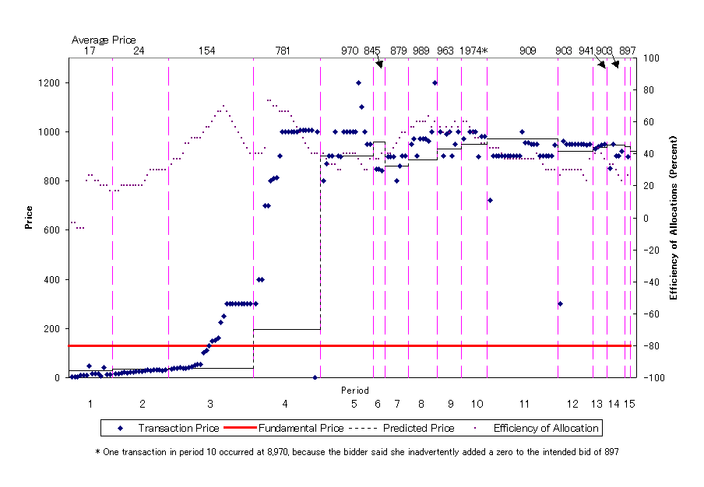
Figure 9: Stock Prices and Efficiency of Allocations for Session 2
(Endogenous Terminal Payoff Session)

Slide 20
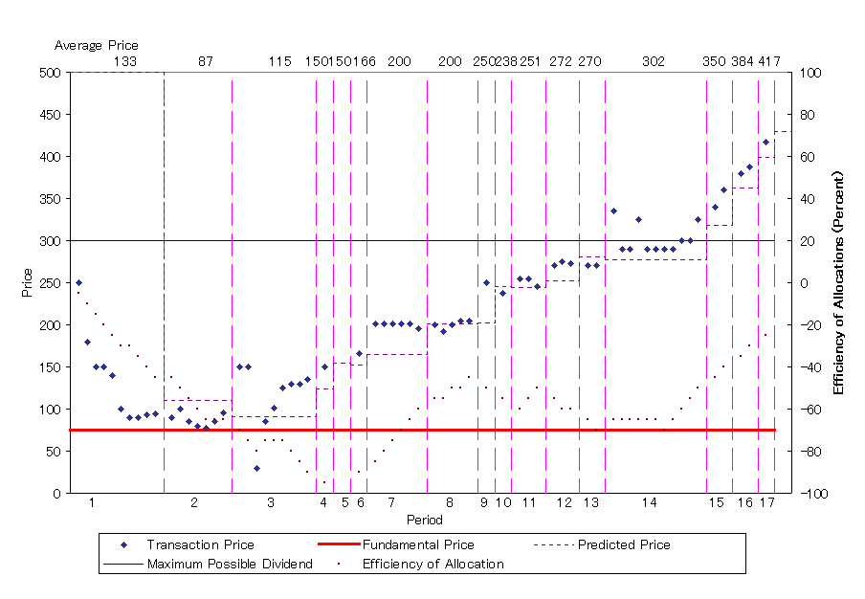
Figure 10: Stock Prices and Efficiency of Allocations for Session 8
(Endogenous Terminal Payoff Session)

Slide 21
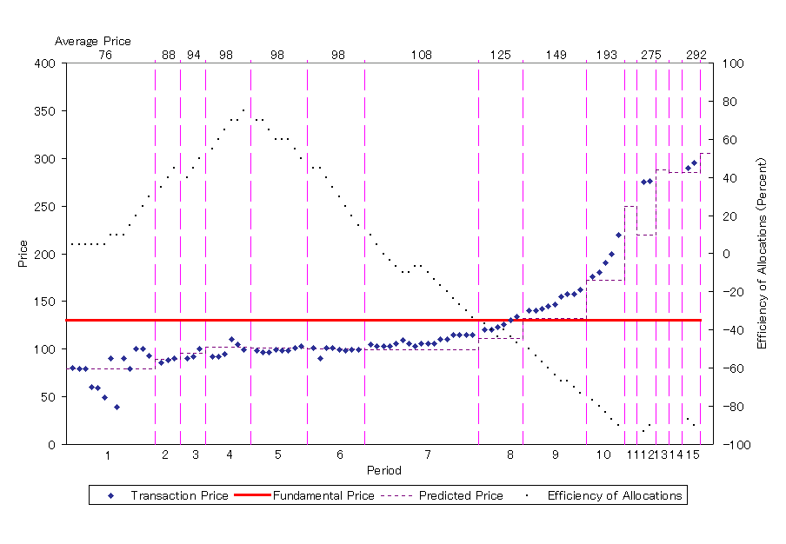
Figure 11: Stock Prices and Efficiency of Allocations for Session 9
(Endogenous Terminal Payoff Session)

Slide 22
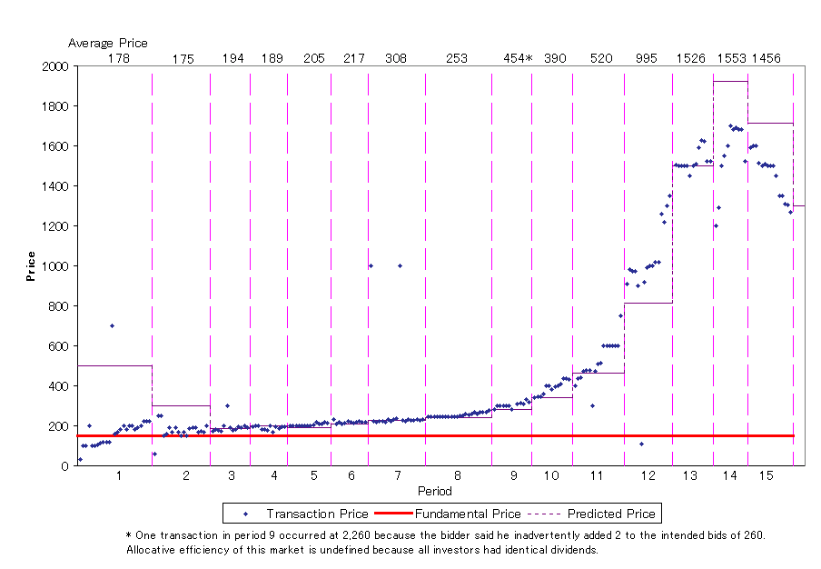
Figure 12: Stock Prices for Session 10
(Endogenous Terminal Payoff Session)

Slide 23
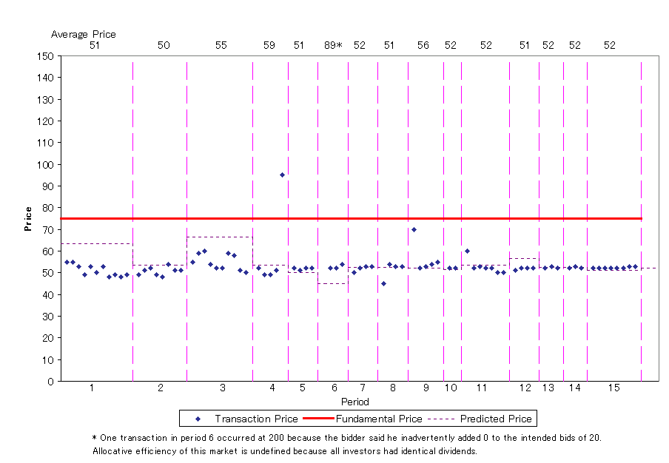
Figure 13: Stock Prices for Session 11
(Endogenous Terminal Payoff Session)

Slide 24
Discussion (short-horizon sessions)
Price levels and paths are indeterminate.
  Level
    Small Bubble (Session 1)
    Large Bubble (2, 8, 9, 10)
    Negative Bubble (11)
  Path
    Stable Bubble (1, 11, 2 ?)
      Rational Bubble
    Growing Bubble (8, 9, 10)
      Amplification Mechanism, Positive Feedback

Slide 25
Result
In the long-horizon sessions, price expectations are consistent with backward induction.
In the short-horizon sessions, price expectations are consistent with forward induction.

Slide 26
However, Objections to Design of the Short-Horizon Sessions
Period 1
Period x
Period 30
(Trade)
E_{x} (P_{x+1})
D
Single terminal dividend at the end of period 30.
The session will “likely” be terminated earlier.
If terminated earlier, the stock is liquidated at the following period predicted price.
Environment not fully specified
In the current work, we use a fully specified overlapping generations structure

Slide 27
Markets with Overlapping Generations of Traders
All markets have 16 periods of trading
Each period lasts for 120 seconds
Every period has two overlapping generations of five traders each in the market
Only one initial generation is endowed with assets (single common knowledge dividend of 50 paid at maturity—end of period 16)
All other generations enter with cash, can buy assets from the “old” generation, and sell them when they become “old” to exit the market with cash
Individuals may re-enter after sitting out the market for one or more (random number) of generations (in T4 and T8 only)
Each session is repeated six times (independently with different subjects)
Equilibrium transaction volume per session: 160

Slide 28
Table 1: Overlapping Generations Experimental Design
 | Period Subjects | 1 | 2 | 3 | 4 | 5 | 6 | 7 | 8 | 9 | 10 | 11 | 12 | 13 | 14 | 15 | 16
T1 | 5 | G0
 | 5 | G1
T2 | 5 | G0
 | 5 | G1
 | 5 |  |  |  |  |  |  |  |  | G2
T4 | 5 | G0
 | 5 | G1
 | 5 |  |  |  |  | G2
 | 5 |  |  |  |  |  |  |  |  | G3
 | 5 |  |  |  |  |  |  |  |  |  |  |  |  | G4
T8 | 5 | G0
 | 5 | G1
 | 5 |  |  | G2
 | 5 |  |  |  |  | G3
 | 5 |  |  |  |  |  |  | G4
 | 5 |  |  |  |  |  |  |  |  | G5
 | 5 |  |  |  |  |  |  |  |  |  |  | G6
 | 5 |  |  |  |  |  |  |  |  |  |  |  |  | G7
 | 5 |  |  |  |  |  |  |  |  |  |  |  |  |  |  | G8

Slide 29
Table 3: Treatment Parameters
Treatment | T1L | T1H | T2L | T2H | T4L | T4H | T8L | T8H
Market setup
No. of generations | 2 | 2 | 3 | 3 | 5 | 5 | 9 | 9
Terminal dividend | 50 | 50 | 50 | 50 | 50 | 50 | 50 | 50
Initial No. assets/trader G0 | 32 | 32 | 16 | 16 | 8 | 8 | 4 | 4
Initial No. assets G(i) | 0 | 0 | 0 | 0 | 0 | 0 | 0 | 0
Total assets outstanding | 160 | 160 | 80 | 80 | 40 | 40 | 20 | 20
Total value of assets | 8,000 | 8,000 | 4,000 | 4,000 | 2,000 | 2,000 | 1,000 | 1,000
Initial cash/trader G0 | 0 | 0 | 0 | 0 | 0 | 0 | 0 | 0
Initial cash/trader G(i) | 3,200 | 16,000 | 1,600 | 8,000 | 800 | 4,000 | 400 | 2,000
Total cash | 16,000 | 80,000 | 8,000 | 40,000 | 4,000 | 20,000 | 2,000 | 10,000
Cash-asset-ratio (C/A-ratio) | 2 | 10 | 2 | 10 | 2 | 10 | 2 | 10
Invited subj. (3n+3) | 15ª | 15ª | 18 | 18 | 18 | 18 | 18 | 18
Participating subjects | 90 | 90 | 108 | 108 | 108 | 108 | 108 | 108
Exchange rates (Taler/€)
Generation 0 (G0) | 100 | 100 | 100 | 100 | 100 | 100 | 100 | 100
Transition generations |  |  | 100 | 500 | 100 | 500 | 100 | 500
Last generation | 200 | 1,000 | 200 | 1,000 | 200 | 1,000 | 200 | 1,000
Predictors | 133 | 133 | 133 | 133 | 133 | 133 | 133 | 133
Exp. payout/subject (euros) | 16 | 16 | 16 | 16 | 16 | 16 | 16 | 16
NOTES: The following parameters are identical across all treatments: Number of traders/generation (5); number of active generations (2); market size (10 traders); period length (120 sec.); total number of periods (16); number of markets per treatment (6); number of expected transactions (160). ª In treatments T1LH we invited 15 subjects instead of 18 as no subject pool for future generations is needed. However we invited five subjects to serve as predictors.

Slide 30
Table 2: Treatment Overview
 |  | Liquidity
 |  | Low (C/A ratio=2) | High (C/A ratio=10)
Number of entering generations | 1 | T1L | T1H
 | 2 | T2L | T2H
 | 4 | T4L | T4H
 | 8 | T8L | T8H

Slide 32
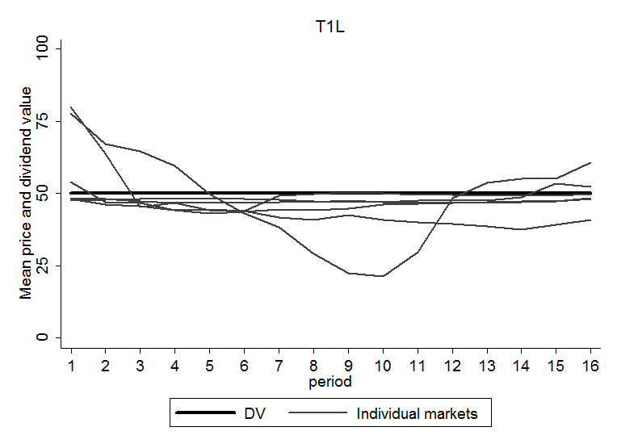
Treatment: 1 Generation, Low Liquidity

Slide 33
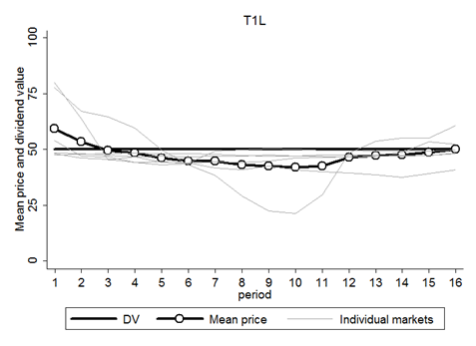
Treatment: 1 Generation, Low Liquidity

Slide 34
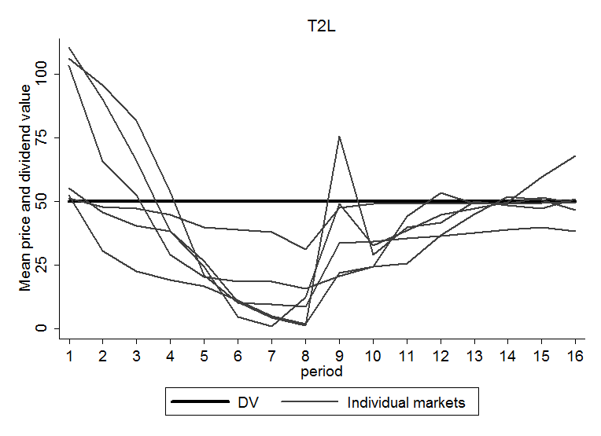
Treatment: 2 Generations, Low Liquidity

Slide 35
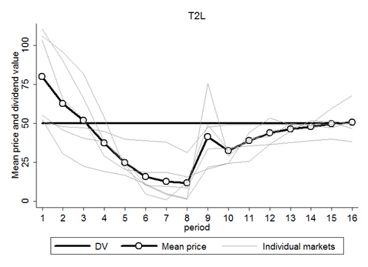
Treatment: 2 Generations, Low Liquidity

Slide 36
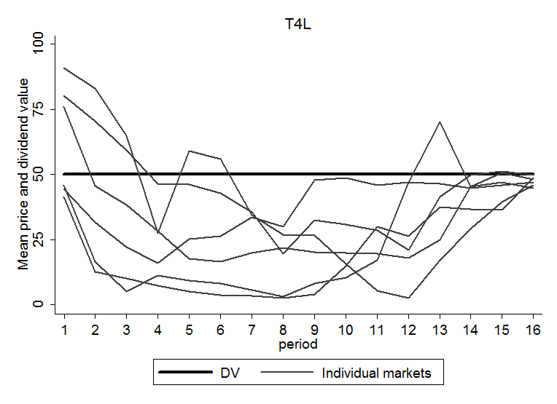
Treatment: 4 Generations, Low Liquidity

Slide 37
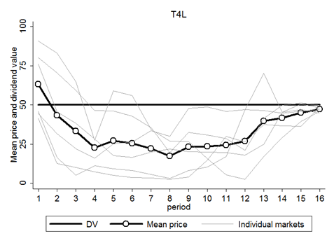
Treatment: 4 Generations, Low Liquidity

Slide 38
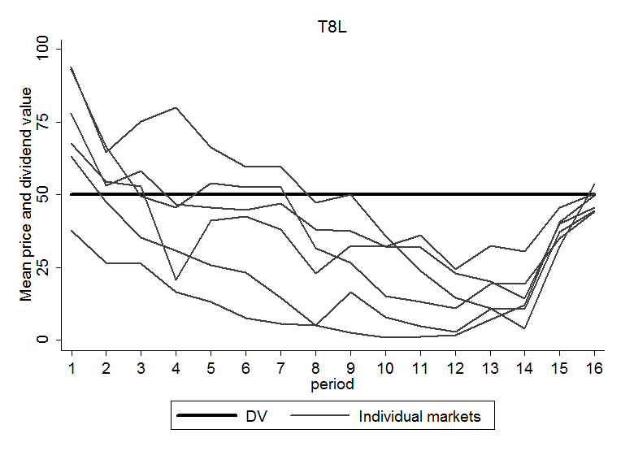
Treatment: 8 Generations, Low Liquidity

Slide 39
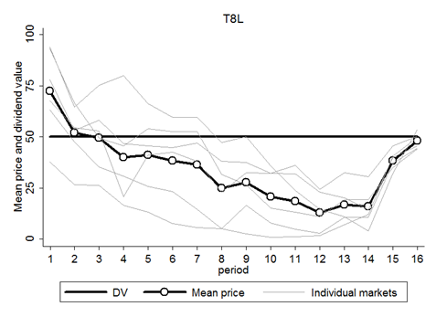
Treatment: 8 Generations, Low Liquidity

Slide 40

Figure 1: Low Liquidity Treatments

Slide 41
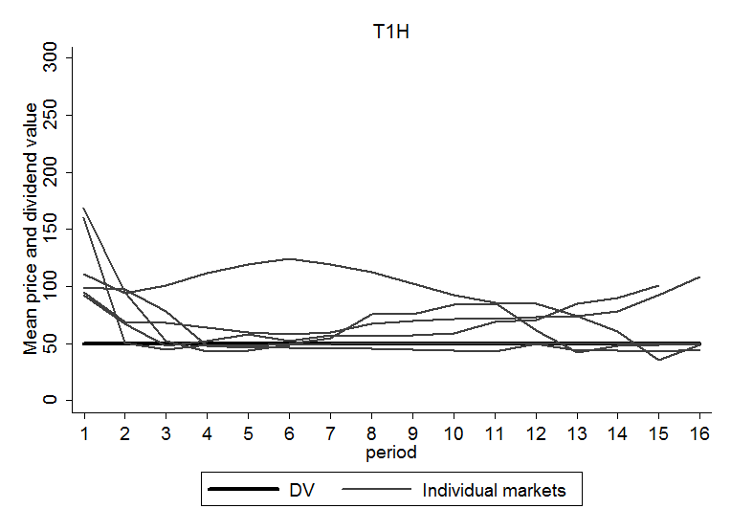
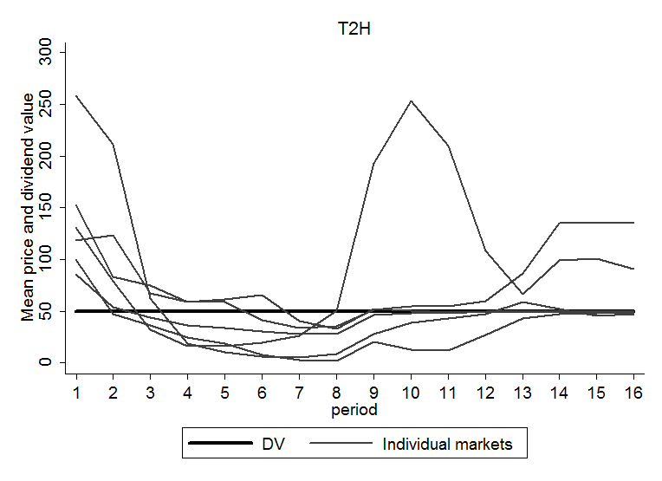
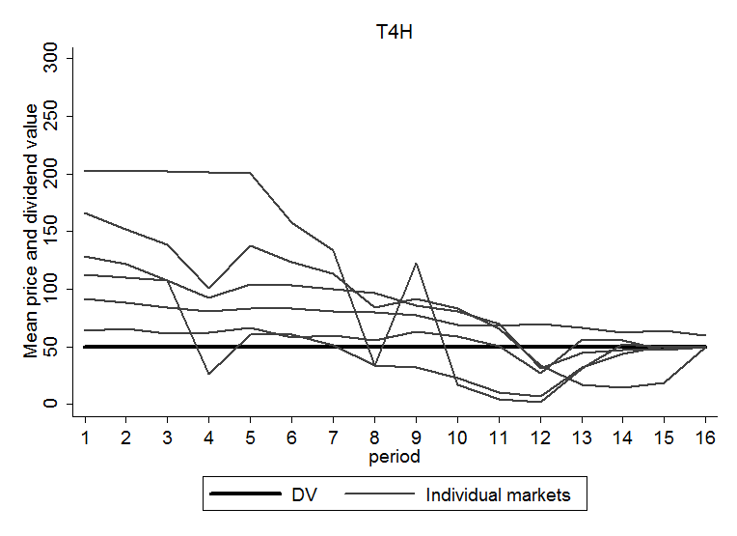
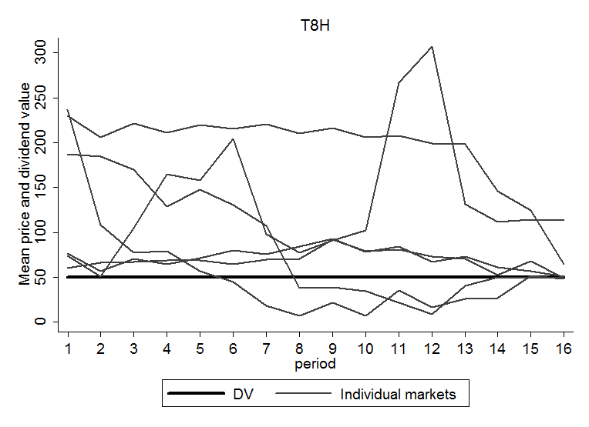
Figure 2: High Liquidity Treatments

Slide 42
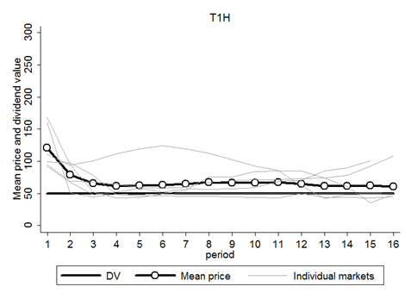
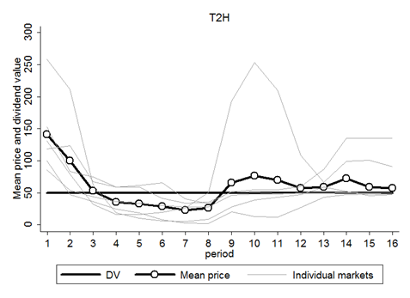
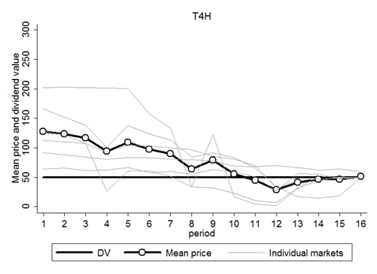
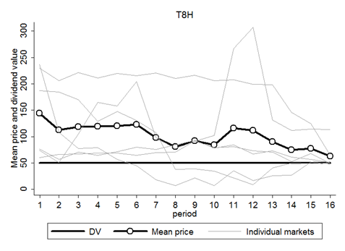
Figure 2: High Liquidity Treatments

Slide 43
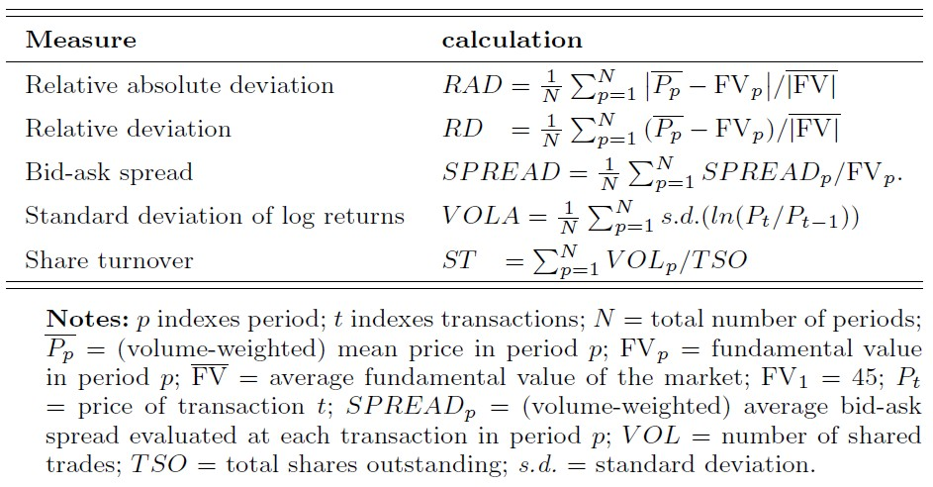
Table 4: Formulae for market efficiency measures

Slide 45
Table 5: Treatment averages for market efficiency measures
 |  | Relative Absolute Deviation | Relative Deviation | Bid-Ask Spread | Std. Dev. of Log Returns | Share Turnover
 | T1L | 11.43% | -5.24% | 8.79% | 4.70% | 1.60
 | T2L | 35.47% | -18.95% | 19.92% | 17.56% | 1.69
 | T4L | 42.92% | -34.07% | 22.52% | 25.16% | 1.56
 | T8L | 43.03% | -30.48% | 21.69% | 26.24% | 1.05
 | T1H | 41.99% | 37.39% | 29.61% | 14.08% | 2.01
 | T2H | 77.02% | 38.81% | 55.04% | 22.70% | 1.59
 | T4H | 73.86% | 52.11% | 23.37% | 17.72% | 1.57
 | T8H | 118.67% | 103.48% | 65.95% | 18.17% | 1.07

Slide 46
Table 6: Differences between averages across treatments, same Liquidity
(RAD, RD, SPREAD, VOLA, and ST two-sided Mann-Whitney U)
RAD | T2L | T4L | T8L |  |  | T2H | T4H | T8H
T1L | 24.03%** | 31.48%*** | 31.60%*** |  | T1H | 35.03% | 31.87% | 76.67%*
T2L |  | 7.45% | 7.56% |  | T2H |  | -3.16% | 41.64%
T4L |  |  | 0.11% |  | T4H |  |  | 35.03%
RD | T2L | T4L | T8L |  |  | T2H | T4H | T8H
T1L | -13.70%** | -28.83%*** | -25.23%** |  | T1H | 1.42% | 14.71% | 66.09%
T2L |  | -15.13% | -11.53% |  | T2H |  | 13.29% | 64.67%
T4L |  |  | 3.60% |  | T4H |  |  | 51.38%
SPREAD | T2L | T4L | T8L |  |  | T2H | T4H | T8H
T1L | 11.13%* | 13.73%** | 12.90%** |  | T1H | 25.43% | -6.24% | 36.34%
T2L |  | 2.59% | 1.76% |  | T2H |  | -31.67% | 10.91%
T4L |  |  | -0.83% |  | T4H |  |  | 42.58%**
VOLA | T2L | T4L | T8L |  |  | T2H | T4H | T8H
T1L | 12.86%** | 20.46%*** | 21.54%*** |  | T1H | 8.61% | 3.64% | 4.09%
T2L |  | 7.60% | 8.68%* |  | T2H |  | -4.98% | -4.53%
T4L |  |  | 1.08% |  | T4H |  |  | 0.45%
ST | T2L | T4L | T8L |  |  | T2H | T4H | T8H
T1L | 0.09 | -0.03 | -0.55** |  | T1H | -0.43 | -0.44 | -0.94**
T2L |  | -0.12 | -0.64*** |  | T2H |  | -0.02 | -0.52**
T4L |  |  | -0.51 |  | T4H |  |  | -0.50**

Slide 47
Table 7: Differences between averages across treatments, different Liquidity
(RAD, RD, SPREAD, VOLA, and ST two-sided Mann-Whitney U)
H minus L | RAD | RD | SPREAD | VOLA | ST
T1 | 30.56%** | 42.64%*** | 20.82%*** | 9.39%* | 0.42
T2 | 41.56% | 57.76%** | 35.12%* | 5.14% | -0.10
T4 | 30.95% | 86.18%*** | 0.86% | -7.44% | 0.01
T8 | 75.64%* | 133.96%*** | 44.26%** | -8.07% | 0.02

Slide 48
Price Predictions/Expectations
Not yet analyzed for the current study
Hirota and Sunder (2007): results show that when subjects cannot do backward induction, they resort to forward induction, and simply project past data in forming their expectations about the future
In long-horizon sessions, future price expectations are formed by fundamentals.
  Speculation stabilizes prices.
In short-term sessions, future price expectations are formed by their own or actual prices.
  Speculation may destabilize prices.

Slide 49
Wrap Up
Investors’ short-term horizons, and the attendant difficulty of the backward induction, tends to give rise to price bubbles/indeterminacy.
  When prices lose dividend anchors and tend to become indeterminate.
  Future price expectations are formed by forward induction.

Slide 50
Implications
Bubbles are known to occur more often in markets for assets with
  (i) longer maturity and duration
  (ii) higher uncertainty
Consistent with the lab data
Inputs to expectation formation matter:
  Dividend policy matters!
Ex post, market inefficiency, anomalies, and behavioral phenomena more likely to be observed in markets dominated by short-horizon investors (difficulty of backward induction)

Slide 51
Thank You!
Shyam.sunder@yale.edu
http://faculty.som.yale.edu/shyamsunder/research.html

