Slide 1
Risky Curves: On the Empirical Failure of Expected Utility
Daniel Friedman, R. Mark Isaac,
Duncan James , and Shyam Sunder
Foundations of Utility and Risk Conference
Erasmus School of Economics,Rotterdam
June 30-July 2, 2014

Slide 2

This short presentation is based on our recent book
Daniel Friedman, R. Mark Isaac, Duncan James, and Shyam Sunder. 2014. Risky Curves: On the empirical failure of expected utility. London: Routledge.
The book deals with the broad economics challenge of understanding, explaining, and predicting risky choice by curved utility functions
Following Markowitz, we also assume that: “Utility function is just a device for explaining and predicting responses to choices involving risk.”
  Harry Markowitz (Quoted in Rosett, 1967, p. 157)
Predictive content (out of sample, and out of context) is essential to value of a theory
As a science, economics cannot be based on theories without predictive power

Slide 3
Summary
D. Bernoulli (1738) ---Von Neumann Morgenstern (1943): curved utility (Bernoulli) functions to understand choice under risk combined with dispersion of outcomes as risk
This idea (EUT) is widely accepted in the field; theorists devise new parameterized curves (e.g., CPT); experimenters devise protocols to elicit data and estimate the parameters
Meager empirical harvest: little stability in parameters outside the fitted context; power to predict out of sample poor-to-nonexistent; no convincing victories over naïve alternatives; surprisingly little insight into phenomena outside the lab (insurance, security, labor, forex markets, gambling, business cycles, etc.)
  Very quick reviews (research through 1960; measuring individual risk preferences; aggregate level evidence from the field)
Raise doubts; not sure of way forward, some possibilities
  Alternative meanings/measures of risk
  After Stigler/Becker 1978, look for explanatory power in decision makers’ opportunity sets, real options, and net pay-offs, instead of in unobserved curved Bernoulli functions
  Current work in evolution, learning theory, neuroeconomics, and physiology

Slide 4
Research Through 1960s
D. Bernoulli’s “Exposition of a New Theory on the Measurement of Risk” (1738): E (log x), not E (x), to explain St. Petersburg paradox (but not gambling)
Jevons (1871) links Bernoulli to decreasing marginal utility, but he and Marshall had difficulty with gambling
Soon the ordinal paradigm took over, in which changes in marginal utility were undefined
John Von Neumann and Oskar Morgenstern’s challenge: Theory of Games and Economic Behavior (1943 [1953]) axiomatization; more general; and empirical procedure to estimate Bernoulli function from choice data over lotteries and certain prospects
Since then, neoclassical ordinal and VNM’s cardinal utility have co-existed in graduate seminars in economics through mutual non-recognition (F&S denied derivability of their utility curve from riskless choices, p. 464)

Slide 5
Measuring Individual Risk Preferences
Unambiguous definitions and methods of measurement at the heart of sciences
Seven decades of attempts to furnish empirical content to VNM theory include:
  Free form thought experiments (Friedman and Savage 1948, Markowitz 1952), both rejected Bernoulli

Slide 6
Free Form Thought Experiments
Friedman and Savage 1948
2 points of inflexion
Markowitz 1952
3 points of inflexion

Slide 7
Empirical Task of Mapping Utilities
Mosteller and Nogee (1951): elicited data from payoff-motivated choice experiments over sample “poker” hands to construct Bernoulli/VNM utility functions (no statistical estimation)
  Max EU not unreasonable; Inconsistency in behavior relative to VNM; meager support for F&S; Harvard students “conservative” (i.e., concave), National Guard subjects “extravagant” (i.e., convex)

Slide 8
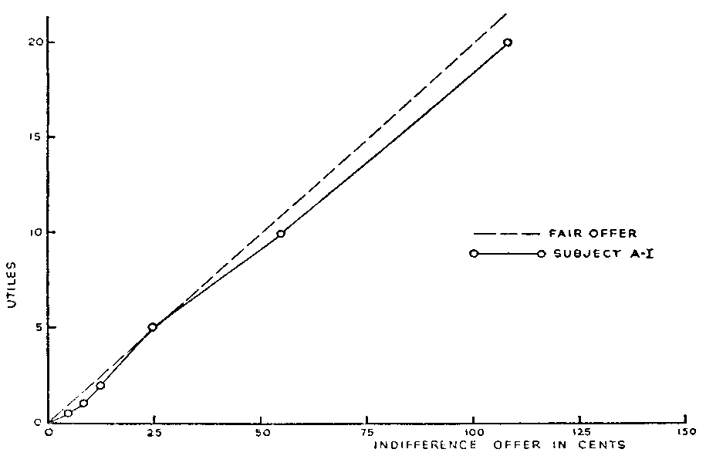
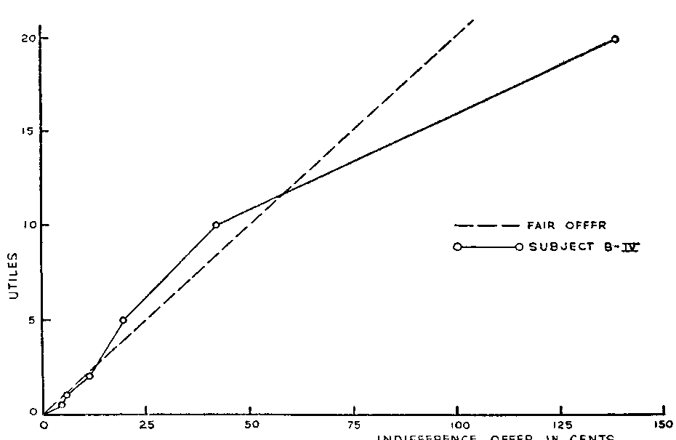
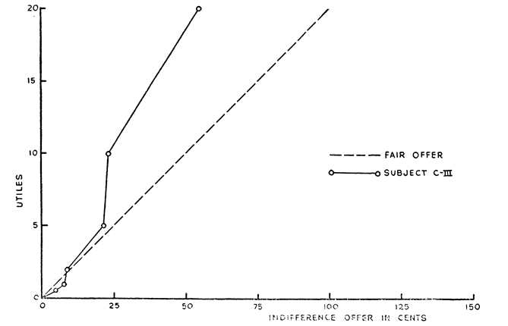
Mosteller & Nogee 1951

Slide 9
Empirical Task of Mapping Utilities
Ward Edwards (1955): “Another model, which assumes that Ss choose so as to maximize expected utility, failed to predict choices successfully.” (p. 214)
Grayson (1960): “Drilling decisions by oil and gasoperators” (Howard Raiffa’s graduate student

Slide 10
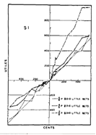
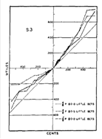
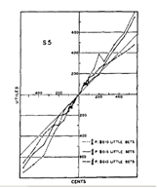
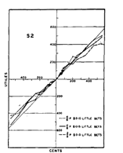
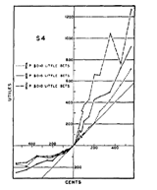
Edwards (1955): FIG. 1. Experimentally determined individual utility curves. The 45° line in each graph is the curve which would be obtained if the subjective value of money were equal to its objective value.

Slide 11
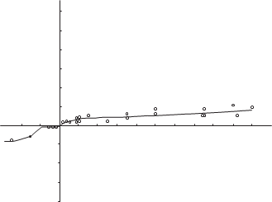
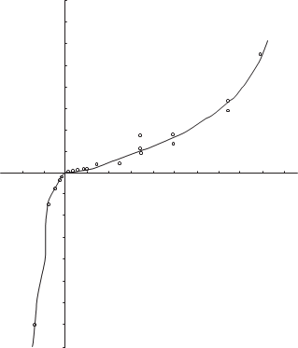
Grayson (1960)

Slide 12
Parametrized Utility Functions: Pratt; Diamond, Rothschild, and Stiglitz (1964-74)
Pratt; Diamond, Rothschild, and Stiglitz during this decade, EUT with dispersion-based measures of risk (e.g., variance and Arrow-Pratt) were in the driver’s seat
Pure vs. speculative risk distinction of insurance theory and industry fell into disuse
Explosion of interest in EU with analysis of parameterized utility function, and giving empirical content to the VNM program through elicitation of choices over risky lotteries
To what extent did these elicitations yield dependable estimates of a person’s propensity to choose under risk?

Slide 13
Examples of Parametric Estimation from Lab and Field Experiments: Absolute (ARA) and Relative (RRA) Risk Aversion
Certainty equivalent (Dillon and Scandizzo 1978)
Lottery choice from menu (Binswanger 1980)
Auctions
Becker-DeGroot-Marschak procedure
Holt-Laury procedure
Pie Chart procedures
Physiological measurements
Payment methods
BDM vs. auctions
Small and large stakes
Problem solving ability
Perception of institutions
Heuristics

Slide 14
Binswanger’s Field Work in India
Binswanger 1980 used lottery choice and certainty equivalent elicitation methods
Different results from two methods
Only F is inconsistent with risk aversion
Landlord RA > tenants
No high stakes effect
“Luck” was best explanation
Farming investment decisions “cannot be explained by differences in their attitudes…”
Ditto Jacobson and Petrie 2007
Lottery | Payoff if heads | Payoff if tails
O | 50 | 50
A | 45 | 95
B | 40 | 120
D* | 35 | 125
C | 30 | 150
D | 20 | 160
E | 10 | 190
F | 0 | 200

Slide 15
Auctions
Vickrey 1961 independent value first price sealed bid auction: empirical work yields overbidding relative to risk neutral prediction
CRRAM (Cox et al. 1988): modification to allow for risk aversion as explanation of overbidding: mixed results
Kagel and Levin 1993: third price sealed bid auction to estimate coefficient of relative risk aversion: risk aversion with n = 5; risk seeking for n = 10

Slide 16
Becker-DeGroot-Marschak (1964) Procedure
A special case of second-price auction pitting a lottery-endowed single subject (who submits an ask) against a robotic bidder generating random bids
If bid exceeds the ask, subject sells at the bid price
Otherwise, subject plays the lottery
Harrison 1986, James 2011, Kachelmeier and Shehata 1992: different implementations and institutions yield estimated coefficients that imply risk aversion or risk seeking behavior

Slide 17
Holt-Laury Procedure
Option A |  | Option B
1/10 of $2.00, 9/10 of $1.60 |  | 1/10 of $3.85, 9/10 of $0.10
2/10 of $2.00, 8/10 of $1.60 |  | 2/10 of $3.85, 8/10 of $0.10
3/10 of $2.00, 7/10 of $1.60 |  | 3/10 of $3.85, 7/10 of $0.10
4/10 of $2.00, 6/10 of $1.60 |  | 4/10 of $3.85, 6/10 of $0.10
5/10 of $2.00, 5/10 of $1.60 |  | 5/10 of $3.85, 5/10 of $0.10
6/10 of $2.00, 4/10 of $1.60 |  | 6/10 of $3.85, 4/10 of $0.10
7/10 of $2.00, 3/10 of $1.60 |  | 7/10 of $3.85, 3/10 of $0.10
8/10 of $2.00, 2/10 of $1.60 |  | 8/10 of $3.85, 2/10 of $0.10
9/10 of $2.00, 1/10 of $1.60 |  | 9/10 of $3.85, 1/10 of $0.10
10/10 of $2.00, 0/10 of $1.60 |  | 10/10 of $3.85, 0/10 of $0.10
Choose left or right column in each row
Should switch only once (row 5 if risk neutral; above risk seeking)
But 28% multiple switches (in Laury-Holt 2008)
Bosch-Domenech Silvestre 2006: estimate depends on # of rows
Levy-Garbboua et al. 2012 and Taylor 2013: dependence of results on various procedural details

Slide 18
Pie Chart Procedures
Lotteries shown as pie charts, more transparent and intuitive
Inconsistent results from Becker-DeGroot-Marschak and pie chart procedures Lichtenstein and Slovic 1971; Grether and Plott 1979
Hey and Orne 1994: Inconsistent choices
Results depend on the number of pie charts presented to subjects; Engle-Warnick et al. 2006

Slide 19
Physiological Measurements: Hormones
Harlow and Brown 1990: bidding behavior related to enzyme MAO for men, not women
Sapienza et al. 2009: relationship between Holt-Laury estimates and salivary testosterone levels is highly conditional on gender and background hormone levels
Mixed results from various other studies of risky choice and various hormones (cortisol, estradiol, progestorone), often mutually inconsistent
Effect of pre-natal exposure to testosterone revealed in 2D:4D ratio: inconsistent results
Biometric data tends to vary with time, raising new questions about interpretation of preferences and their stability and usefulness for prediction

Slide 20
Payment Methods
Frustration with obtaining consistent measurements of risk attitudes from observational data drew attention to details of how subjects are paid
Monetary, consumable, hypothetical?
Paid for all rounds or randomly selected subset of rounds
Single or multiple rounds
Paid each round, or paid sum at the end
Payment in public or private
Whole literature on payments methods influencing the estimates
Generally, everything seems to matter some of the time; no general results

Slide 21
Becker-DeGroot-Marschak vs. Auctions
Isaac and James 2000: Estimated risk coefficients from different elicitation methods are not only different, they are not even rank-preserving
Subjects identified to be far risk averse by one method of elicitation tend to be far risk seeking from the other method
Difficulty of reconciling the results with extant models
N

Slide 22
Math/Problem Solving Ability
Frederick 2005: could problem solving skills and learning during the task affect the estimates?
Higher CRT scores related to lower risk aversion
Differences in numeracy could be the common cause of the variability of risk coefficients estimated from observed choice data

Slide 23
Subject Perception of Institution
The choice of the format in which the data and the task are presented to the subjects alter the estimated risk coefficients

Slide 24
Where Are We Now?
Different ways of eliciting risk parameters in cash-motivated controlled economics experiments yield different results
Little evidence that EU (and its variations), based on elicited preferences, predict individual choice better than naïve alternatives
  Estimation procedures applied to any choice data necessarily yield a risk coefficient; but exhibit little stability outside contexts
Perhaps the failure to find stable results is the result
Let us look if Bernoulli functions may help us understand aggregate phenomena and furnish some consilience across macro domains

Slide 25
Are Aggregate Level Phenomena in the Field Explained Better by Bernoulli Functions?
Health, medicine, sports, illicit drugs
Gambling
Engineering
Insurance
Real estate
Bond markets
Stock markets
Uncovered interest rate parity
Equity premium
Aggregate model calibrations
  Labor markets
  Social/unemployment insurance
  Central bank reserves

Slide 26
Health and medicine, illicit drugs
Dispersion meaning of risk almost absent; risk factors for:
Drug addiction: family history of addiction, being male, having another psychological problem, peer pressure, lack of family involvement, anxiety, depression, loneliness, and taking a highly addictive drug
Heart disease: old, male, family history of heart disease, post-menopausal, non-Caucasian race, smoking, high level of low density lipoprotein, hypertension, obesity, diabetes, high level of C-reactive protein, sedentary lifestyle, and stress
No mention of expectation of a Bernoulli function, or dispersion of outcomes

Slide 27
Engineering
NASA: Engineering Reliability Analysis quantifies system risks through a combination of probabilistic analyses, physics-based simulations of key risk factors, and failure timing and propagation models. ERA develops dynamic, integrated risk models to not only quantify the probabilities of individual failures, but also to learn about the specific systems, identify the driving risk factors, and guide designers toward the most effective strategies for reducing risk.
No mention of dispersion measure of risk

Slide 28
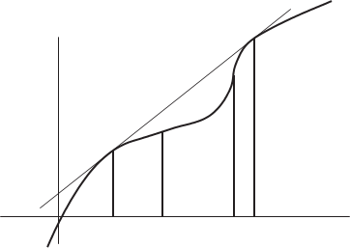
Gambling
NRC 1999: $550b wagered in US alone
Attempts to explain by convex Bernoulli functions (F&S 1948)
Markowitz 1952 and Marshall 1984: Optimal bet is implausibly large
Alternatives: entertainment, thrill, bluff, arousal, competition, auto-erotic,
Variable ratio form of Skinnerian conditioning
Design of state lotteries not explainable by Bernoulli functions

Slide 29
Insurance
Industry size in 2011: $4.6t in premiums; best case for risk aversion
Almost all have negative actuarial value to policy holders; textbook example of widespread aversion to risk; but
  Marketing emphasizes loss/harm/injury, not dispersion risk
  Other explanations: policy as a put option, cuts costs of contingency planning
  Some versions of EUT specify convexity in losses; inconsistent with insurance
  Lack of universality of insurance suggests social learning, marketing, and legal requirements may play roles
  Einav et al. (2012): correlations among individual risk attitudes obtained from various domains of insurance vary widely (0.06-0.55); but their subjective ordinal measures of risk unrelated to Arrow-Pratt

Slide 30
Bond Markets
Moody’s and S&P ratings define credit risk as likelihood of default and associated financial loss
No mention of dispersion of outcomes or concave Bernoulli functions
Fisher 1959: Chances of default and marketability of bonds explained 75% variation in yield
Altman 1989: Realized yields net of defaults increase with lower rating for all except B and CCC bonds; not explained by dispersion measure of risk

Slide 31
Stock markets
Markowitz 1952/1959 presented variance as a measure of risk, tentatively, because of familiarity, convenience, and computability
Sharpe 1964 and Lintner 1965: Linear equilibrium relationship between expected return and covariance risk
Intensive research on empirical evidence on CAPM and diversification
Fama and French 1992: “Our tests do not support the most basic predictions of the SLB model, that average stock returns are positively related to market betas.”
Fama and French 2004: “Unfortunately, the empirical record of the model is poor — poor enough to invalidate the way it is used in applications. . . . In the end, we argue that whether the model’s problems reflect weaknesses in the theory or in its empirical implementation, the failure of the CAPM in empirical tests implies that most applications of the model are invalid.”

Slide 32
Stock Markets (2)
Brealey and Myers 2003: “There is no doubt that the evidence on the CAPM is less convincing than scholars once thought. But it will be very hard to reject the CAPM beyond all reasonable doubt. Since data and statistics are unlikely to give final answers, the plausibility of the CPAM will have to be weighed along with the empirical ‘facts’”

Slide 33
Diversification implication of risk aversion?
Worthington 2009 on household diversification: “Australian household portfolios have very low levels of asset diversification . . . household portfolios appears to bear little relation to the central predictions of classic portfolio theory.
Similar results for other economies (U.S., France, the Netherlands, U.K., Germany, and India). Guiso et al. 2000: “The country studies find that the extent of diversification between and within risk categories is typically quite limited.”
Why aren’t (dispersion) risk averse households partake of almost “free lunch” of diversification?
Holderness 2009 on distribution of corporate ownershi: “Given that 96% of a representative sample of CRSP and Compustat firms have large shareholders and these shareholders on average own 39% of the common stock (Table 1), it is now clear that atomistic ownership is the exception, not the rule, in the United States.”

Slide 34
Uncovered interest parity
Li et al. 2012: “Uncovered interest parity (UIP) is one of the most important theoretical relations used in analytical work in both international finance and macroeconomics. It is also a key assumption in many of the models of exchange rate determination.”
Exch. Rate Appreciation = a + b*InterestDifferential + error
Where a =0 and b = 1 and error has mean zero.
Froot and Thaler 1990 meta study: most estimates of b have wrong sign, average = - 0.88!
Li et al. 2012: data from 10 countries, mixed results; estimates vary widely by currency pairs and over time
Concave Bernoulli functions have not helped resolve the puzzle; “…hard to explain the failure of UIP even using a sophisticated measure of risk” (p. 168).

Slide 35
Equity Premium Puzzle
Difficulties in reconciling empirical estimates of the market risk premium P_{M} = E(R_{M}) – R_{f} with its theoretical determinants
Mehra and Prescott 1985: assuming plausible levels of CRRA, risk premium should be 0.4%;
But, over 1889-1978 realized risk premium was about 15 times (6%)
Fernandez et al. 2012 survey: 2223 answers from US ranged over 1.5-15%; mean 5.5%
After reviewing dozens of attempts over quarter century to resolve the puzzle, Mehra 2008 states: “The puzzle cannot be dismissed lightly because much of our economic intuition is based on the very class of models that fall short so dramatically when confronted with financial data. It underscores the failure of paradigms central to financial and economic modeling to capture the characteristic that appears to make stocks comparatively riskier.” (emphasis added).
Down in the Wall Street world of traders and financiers, Investopedia dispenses this wisdom: “Equity premium puzzle is a mystery to financial academics.”

Slide 36
Aggregate model calibrations
Besides equity premium puzzle, calibrated models of aggregate consumption are used in labor and business cycle theory
Kydland and Prescott 1982 and Mehra and Prescott 1985 and use 1 < r < 2, rule out assuming extreme risk aversion
Kydland and Prescott 1991 tighten to r = 2
Ljungqvist and Sargent 2004: r < 2 or 3
Resolving the EPP requires r > 10
Chetty 2006: 33 sets of wage and income elasticities imply r in range 0.15-1.78, mean 0.71. “… Hence, one interpretation of the result is that it provides new evidence against canonical expected utility theory as a descriptive model of choice uncertainty”
Unemployment insurance puzzle: r =2 CRRA consumption model yields 0-20% of wage compared to 50% observed in the field (Baily 1978 and Gruber 1997)
Central banks’ international reserve levels yield r = 2 (CRRA) for Latin America, about 10 for Asia

Slide 37
Aggregate Level Evidence From the Field
The hope that curved Bernoulli functions, combined with dispersion concept of risk, might yield insights into a variety of socio-economic phenomena in the field waits to be fulfilled
Surprisingly little aggregate level insights or consilience across domains populated by the same agents: credit, insurance, corporate equity, real estate, currency markets, gambling, labor, and business cycles
Academic literature often assumes such functions, but attempts to tie the resulting models to data often lead to wildly different, and mutually inconsistent, implied innate preferences in specified populations.
These empirical inconveniences now carry optimistic labels such as “the interest parity puzzle” suggesting that, one day, solutions may be found without abandoning the paradigm based on Bernoulli functions

Slide 38
What is next?
Parameter r for the same population has to vary from 0.15 to 14 (by about two orders of magnitude) to explain observations in various domains of our lives
Possible ways forward:
  Alternative meanings/measures of risk
  Looking for explanatory power in decision makers’ obseravable opportunity sets, real options, and net pay-offs, instead of in unobserved curved Bernoulli functions
  Current work in evolution, learning theory, and neuroeconomics

Slide 39
Phlogiston: Science can get trapped in its own eddy currents!
Greeks; Becher (1635–1682); Stahl (1660–1734)
Invisible compressible fluid; able to organize disparate physical phenomena better than alchemists’ earth, air, fire, water
Generated some puzzles of its own: context-dependent mass
Proponents of phlogiston added free parameters, even negative mass to account for the data
Phlogiston theory did not disappear when
  It created puzzles instead of explanations, or
  Its supporters failed to isolate phlogiston in the laboratory
Phlogiston vanished from respectable science only, when Lavoisier’s powerful oxidation/reduction theory emerged in the late 1780s
Even “Priestley and Cavendish, on whose work much of the new theory was based, clung to the phlogiston theory to the end of their lives.”

Slide 40
Measuring Risk
Variance or standard deviation
Lower semi-variance (Markowitz considered it but dropped it, tentatively, for reasons of familiarity, convenience, and computability of portfolios)
Probability of a loss
Value at risk (VaR at x%)
Expected loss
Measures based on third and higher moments--prudence, temperance, and beyond
  Given the difficulty of dealing with the first two moments, the higher moments appear unlikely to add much predictive power to risky choices

Slide 41
Relationship between Expected Loss vs. Standard Deviation
121 Lotteries with uniform distribution with different parameters
121 Lotteries on (-0.5, 0.5) with beta distribution with different parameters

Slide 42
Alternatives?
Not Prospect Theory, just another variant for EU, with free parameters; the value function predicts that people are risk seeking in the loss domain, e.g., would not purchase insurance even at moderately subsidized prices; more free parameters added for probability curve w
This flexibility (supplemented with an unmodeled phase of editing and adjustment) allows prospect theory to rationalize risky-choice data in sample. No evidence on out-of-sample prediction ability in new tasks
Even in-sample, improvement is small (Gloekner and Pachur (2012, Figure 2, 29); after including a standard penalty (such as Akaike or Schwartz–Bayes) for the number of free parameters, often a one-parameter version of expected utility, or even (parameter free) expected value maximization is better: e.g., Hey and Orme (1994), Harless and Camerer (1994), and
No evidence on out-of-sample, out of context predictive power

Slide 43
Context as an Opportunity Set
Stigler and Becker (1977): suggest holding preferences constant across people and time and focus on how contexts (opportunity sets) affect what we observe
Risk aversion and risk preference is the first in their list of future applications, and that agenda can now be implemented
Risks change opportunity sets of DMs in observable ways, yielding testable predictions (versus unobservable BFs and probability weights)
Rich applications of real options (Dixit and Pindyck 1994)

Slide 44

Potential Observable Opportunity Sets
Revealed preferences reflect intrinsic preferences as well as the circumstances
Consider a shift in perspective and explanatory burden:
  From treating circumstances as a nuisance variable in recovering intrinsic preferences (white vase)
  To circumstances/context as the determining factor in risky choice within neoclassical constrained optimization of simple (linear) utility (black profiles); they are potential source of regularities in risky choices
  If successful, may not need to estimate curved Bernoulli functions
  Similar to Stigler-Becker “De Gustibus…”, and unlike much of behavioral econ emphasis on individual taste

Slide 45
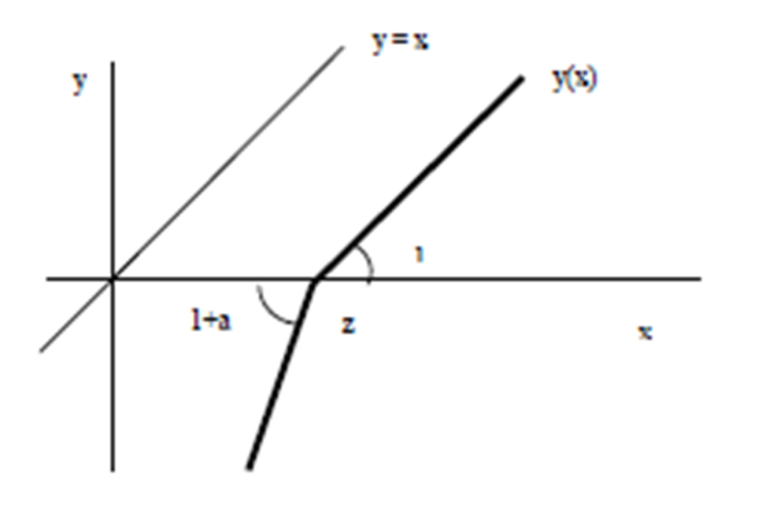
Concave Revealed Preferences from Linear Intrinsic Preferences
Household: credit card, mortgage, rent, utility and car debt penalties
Firms: payroll, debt service, bond indentures
Biology: calories needed to maintain normal activity, survival

Slide 46
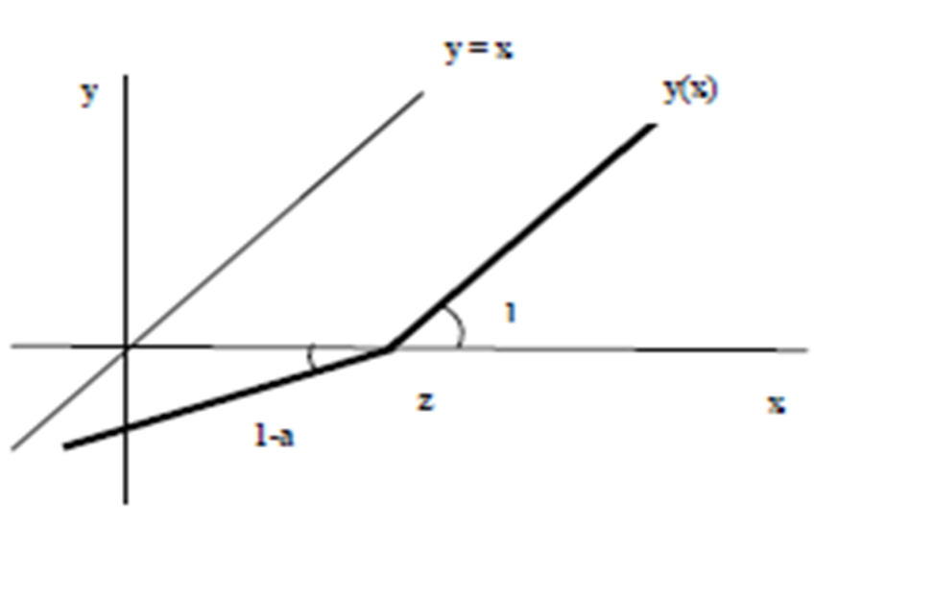
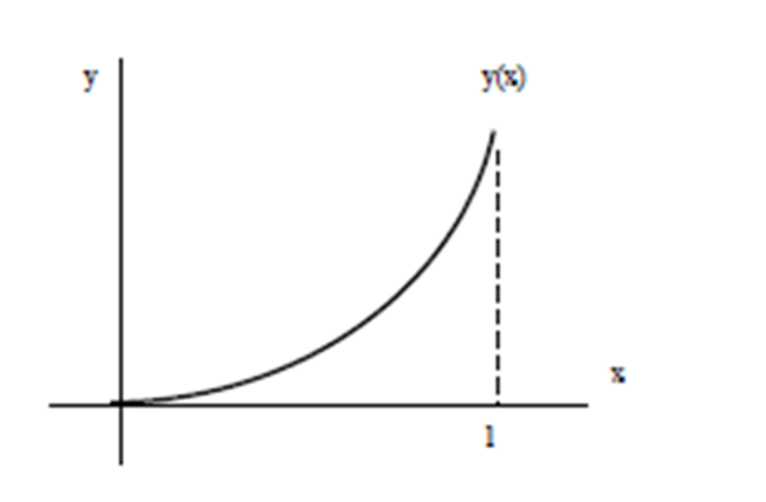
Convex Revealed Preferences from Linear Intrinsic Preferences
Tournament incentives
Decisions under possibility of bailout

Slide 47
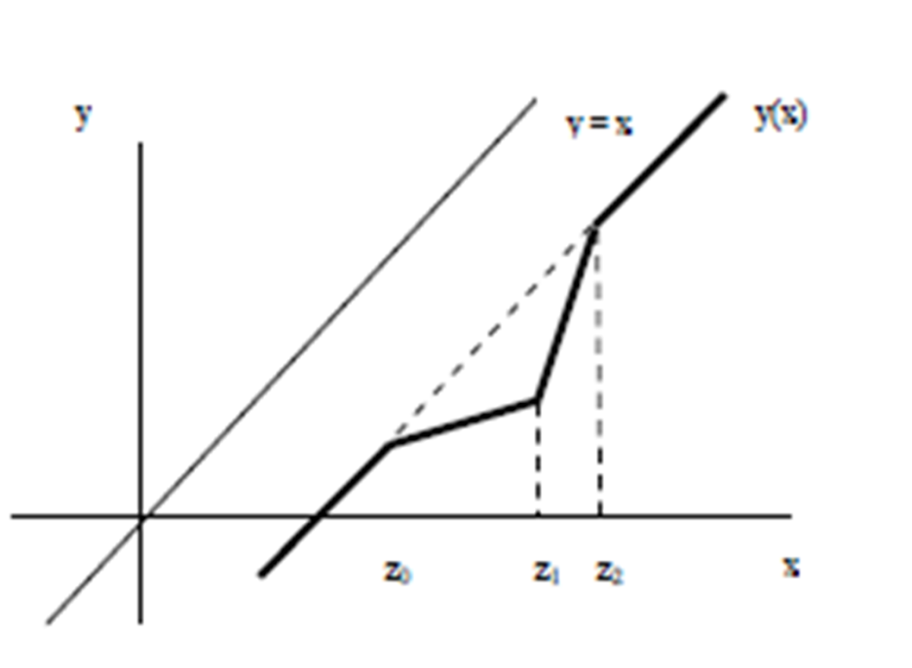
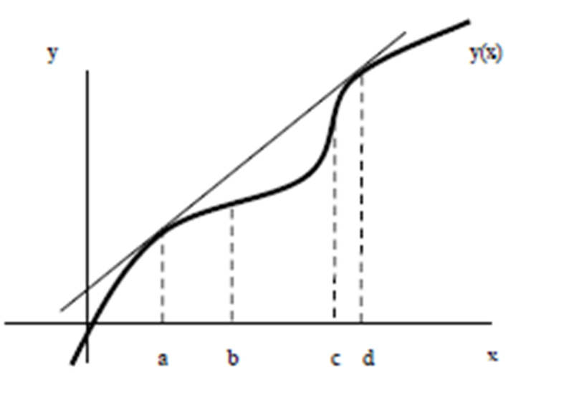
Mixed Revealed Preferences from Linear Intrinsic Preferences
Means-tested subsidy
Friedman & Savage
Marshall 1984
Masson 1972
Chetty 2012

Slide 48
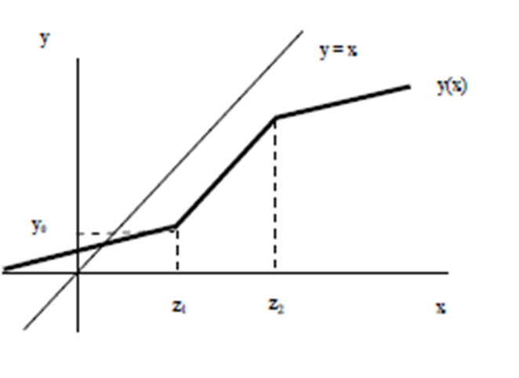

Slide 49
Real Options
  Insurance: Other explanations: policy as a put option, cuts costs of contingency planning
  Real estate: But higher uncertainty also increases the option value from waiting to sink typically irreversible construction costs
  Bulan et al. 2009: analysis of 1214 condominium projects in Vancouver Canada during 1979-98 finds that empirical evidence supports the risk-neutral predictions of real options theory.
  We should explore how far linear utility of net payoffs combined with careful analysis of opportunity sets and embedded real options will take us.
  Perhaps farther than curved but unobservable BFs have

Slide 50
Brain Science
Many studies on neurological responses to stimuli to study risky choices of humans and animals (e.g., Preuschoff et al.’s “Markowitz in the Brain” 2008)
Interpretations are disputed; possibility of protocol effects, caution for now

Slide 51
Linking Theory and Observation
Consequences of unsupported widely-held belief in explanatory/predictive usefulness of Bernoulli functions has consequences
  Efforts to find new curved Bernoulli functions
  Insufficient careful attention to opportunity sets of decision makers
  Increasingly complex theory without benefit of better explanatory power
Prospects for a better theory to replace curved functions
  Within orthodox economics, seek explanatory power in potentially observable opportunity sets instead of unobservable instead of unobservable preferences (considering bankruptcy, taxes, penalties and other frictions); real options; risk as exposure to harm
  Possibilities of combining process-based understanding of risky choice: brain science and heurstics (Gigrenzer) with opportunity set focused decision theory

Slide 52
Thank You.
Shyam.sunder@yale.edu
Daniel Friedman, R. Mark Isaac, Duncan James, and Shyam Sunder. 2014. Risky Curves: On the empirical failure of expected utility. London: Routledge.

