Slide 1
Short Investment Horizons, Higher Order Beliefs, and Difficulty of Backward Induction: Price Bubbles and Indeterminacy in Financial Markets
Shinichi Hirota, Juergen Huber, Thomas Stoeckl, and Shyam Sunder
Tinbergen Institute, Amsterdam
July 2, 2014

Slide 2
The purpose of this paper
Explore
  Why prices may deviate from fundamental values in financial markets.
Focus on
  Investors’ short trading horizons and the difficulty of backward induction.
Conduct
  Laboratory experiments
Notes:
.

Slide 3
Main Findings
Prices tend to deviate from fundamental values (bubbles, indeterminacy) when investors have horizons shorter than the maturity of securities they trade.
Short-horizon investor fails to backward induct to bring prices to the fundamental values.
The shorter the investment horizon, (the larger number of generations), the more difficult the backward induction, and the more likely that price deviate from fundamentals.
Notes:
.

Slide 4
Main Findings
Prices tend to deviate from fundamental levels (bubbles, indeterminacy) when investors have horizons shorter than the maturity of securities they trade
Difficulty of forming higher order beliefs about future cash flows appears to be a key factor
Difficulty of backward induction through higher order beliefs to fundamental present values

Slide 5
Previous Research on Bubbles
(A) Rational Bubbles
  Blanchard and Watson (1982), Tirole (1985)
  Infinite Maturity
(B) Irrational Bubbles
  Shiller (2000), Behavioral Finance
  Emotion, Psychological Factors

Slide 6
Our Paper
Provides a different view.
  includes (A) as a special case.
  suggests when (B) is likely to occur.

Slide 7
Background
Bubbles and price volatility in financial markets are often attributed to short-term investors’ speculative trading.
In standard finance theory, however, variations in decision horizons of investors do not enter the theory.
Even in a market dominated by short-horizon investors, their backward induction is supposed to lead prices being close to the fundamental values.
Notes:
.

Slide 8
Two critical assumptions in finance theory
All generations of investors form rational expectations of future sales prices.
Rational expectation is common knowledge
By recursive process, P_{t} = F_{t} is derivable by the backward induction.

Slide 9
In practice, backward induction may not hold.
Some generations of investors may not form rational expectations.
Even if all generations of investors do, rational expectation may not be common knowledge.
Under such conditions, investors cannot backward induct from first and higher order expectations to the present value of securities.
Prices are no longer anchored to the fundamental values and become indeterminate.

Slide 10
Fundamental Value vs. Price for a simple, single dividend security
Fundamental value:
(1)
Long-term Investor’s Valuation:
(2)
Short-term Investor’s Valuation:
(3)
P_{t} is not necessarily equal to F_{t}

Slide 11
For P_{t} to be equal to F_{t}
Rational Expectation of P _{t+k}
Homogeneous Investors
The Law of Iterated Expectations
By recursive process, P_{t} = F_{t} is derivable by the backward induction.

Slide 12
Difficulty of Backward Induction
Backward Induction may fail.
  Infinite maturity (rational bubbles)
    Blanchard and Watson (1982), Tirole (1985)
  Infinite number of trading opportunities
    Allen and Gorton (1993)
  Heterogeneous Information
    Froot, Scharfsten, and Stein (1992), Allen, Morris, and Shin (2002)
  Rationality may not be common knowledge
    Delong et al. (1990a)(1990b), Dow and Gorton (1994)

Slide 13
Price Bubble sans Dividend Anchors
There are cases where short-term investors have difficulty in backward induction.
Stock prices (P_{t} ) form deviate from fundamentals (≠ F_{t} )
No longer anchored by future dividends

Slide 14
In an Earlier Experimental Study
Hirota, Shinichi and Shyam Sunder. “Price Bubbles sans Dividend Anchors: Evidence from Laboratory Stock Markets,” Journal of Economic Dynamics and Control 31, no. 6 (June 2007): 1875-1909.
What happens when short-term investors have difficulty in the backward induction?
Two kinds of the lab markets
  (1) Long-term Horizon Session
  (2) Short-term Horizon Session
Bubbles tend to arise in (2), but not in (1)

Slide 15
Long-term Horizon Session
Period 1
Period 15
(Trade)
D
Single terminal dividend at the end of period 15.
An investor’s time horizon is equal to the security’s maturity.
Prediction: P_{t} = D

Slide 16
Short-term Horizon Session
Period 1
Period x
Period 30
(Trade)
E_{x} (P_{x+1})
D
Single terminal dividend at the end of period 30.
The session will “likely” be terminated earlier.
If terminated earlier, the stock is liquidated at the following period predicted price.
An investor’s time horizon is shorter than the maturity and it is difficult to backward induct.
Prediction: P_{t} ≠ D

Slide 17
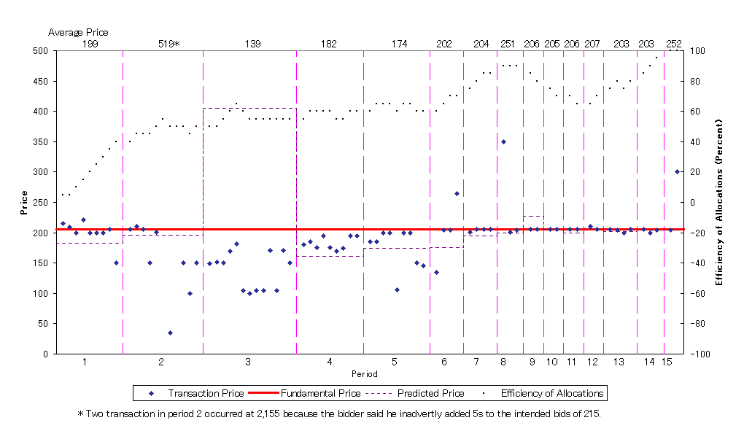
Figure 4: Stock Prices and Efficiency of Allocations for Session 4
(Exogenous Terminal Payoff Session)

Slide 18
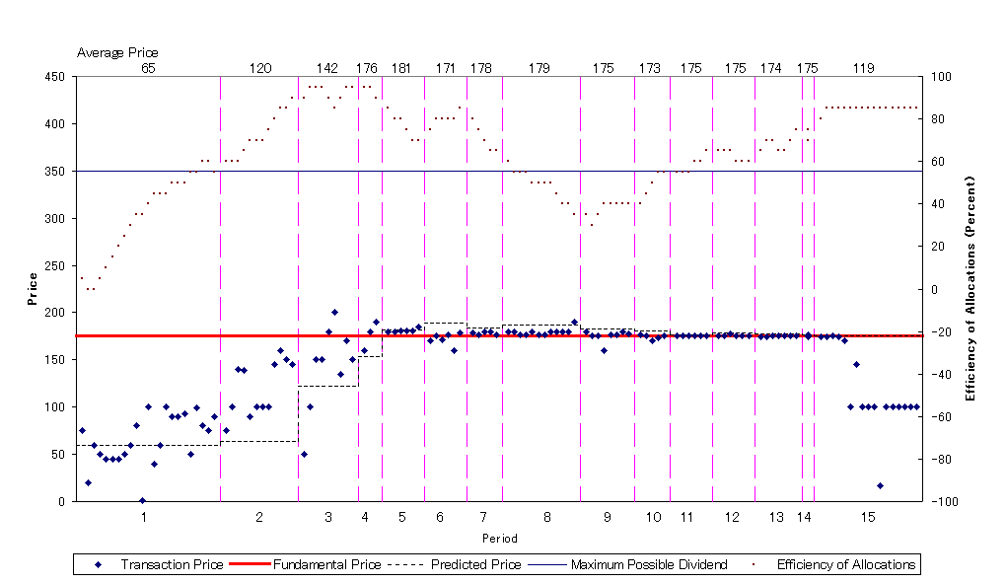
Figure 5: Stock Prices and Efficiency of Allocations for Session 5
(Exogenous Terminal Payoff Session)

Slide 19
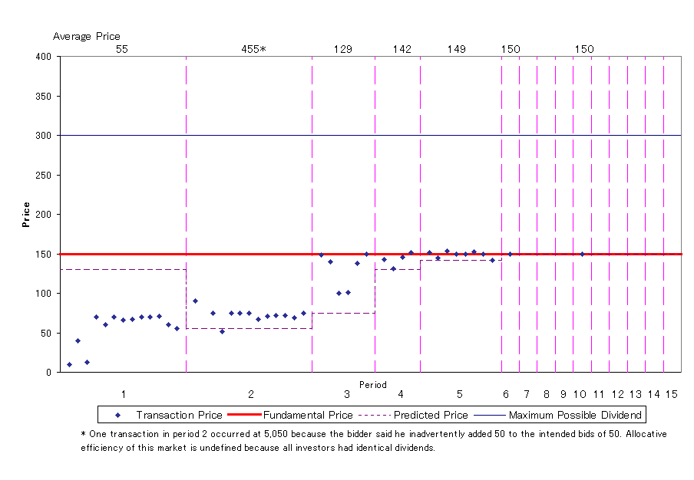
Figure 6: Stock Prices for Session 6
(Exogenous Terminal Payoff Session)

Slide 20
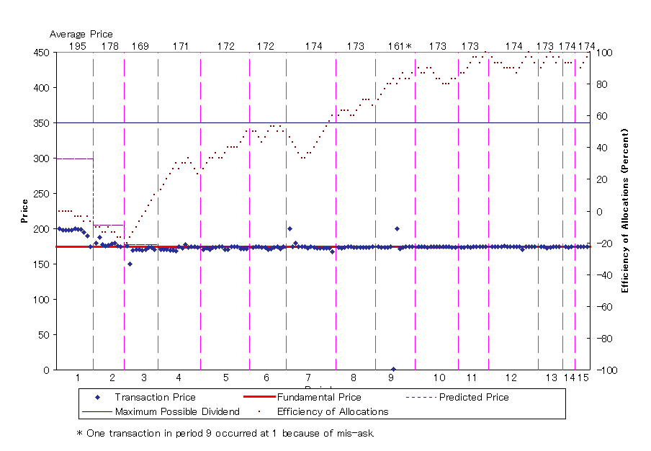
Figure 7: Stock Prices and Efficiency of Allocations for Session 7
(Exogenous Terminal Payoff Session)

Slide 21
In long-horizon sessions
Long-horizon Investors play a crucial role in assuring efficient pricing.
  Their arbitrage brings prices to the fundamentals.
Speculative trades do not seem to destabilize prices.
  39.0% of transactions were speculative trades.
By contrast, in short horizon treatments:

Slide 22
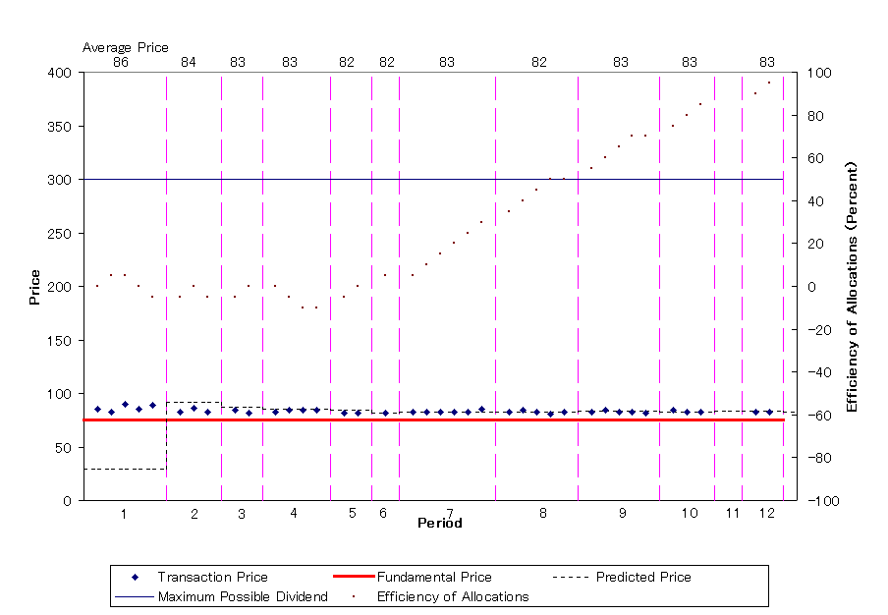
Figure 8: Stock Prices and Efficiency of Allocations for Session 1
(Endogenous Terminal Payoff Session)

Slide 23
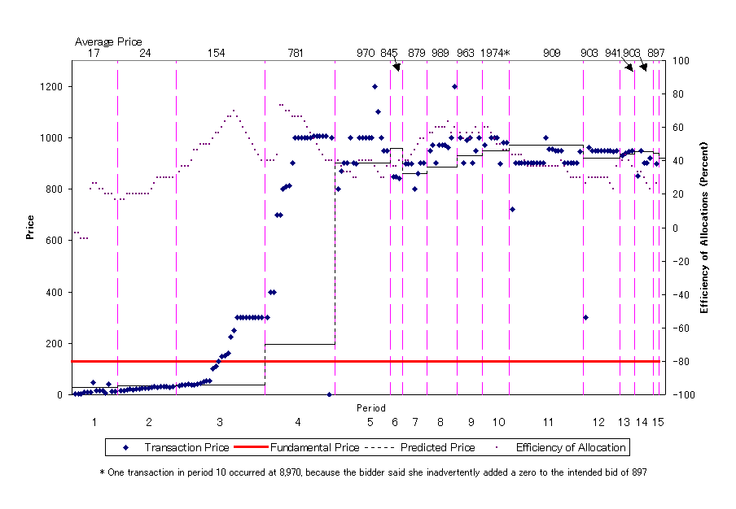
Figure 9: Stock Prices and Efficiency of Allocations for Session 2
(Endogenous Terminal Payoff Session)

Slide 24
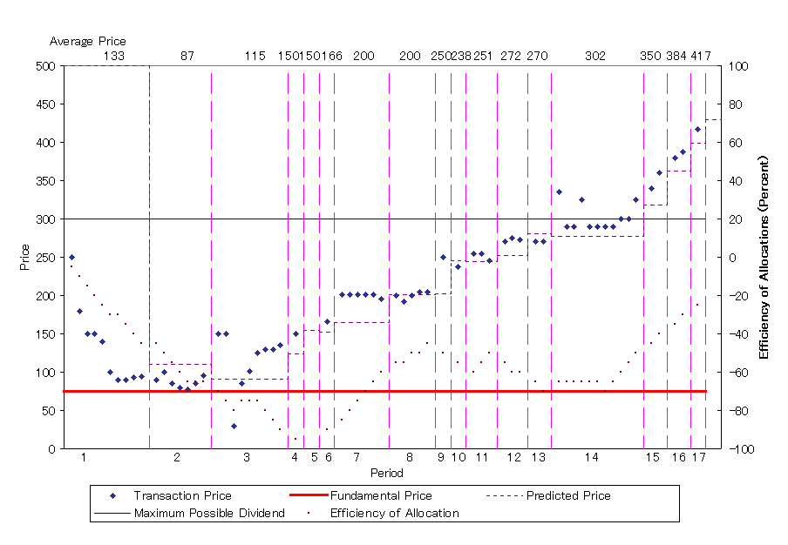
Figure 10: Stock Prices and Efficiency of Allocations for Session 8
(Endogenous Terminal Payoff Session)

Slide 25
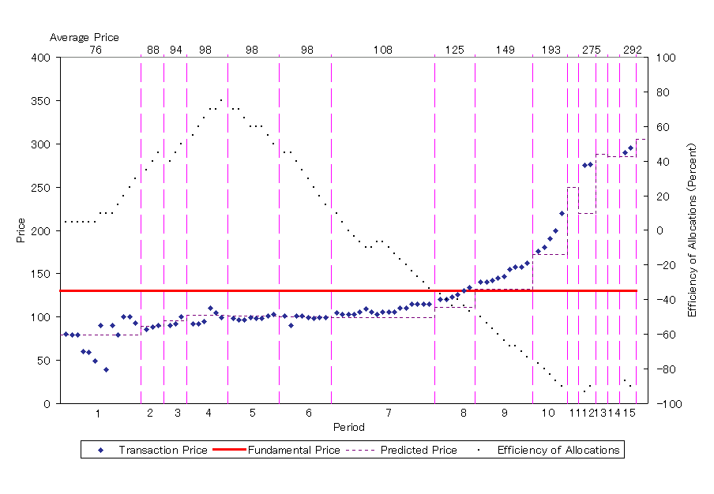
Figure 11: Stock Prices and Efficiency of Allocations for Session 9
(Endogenous Terminal Payoff Session)

Slide 26
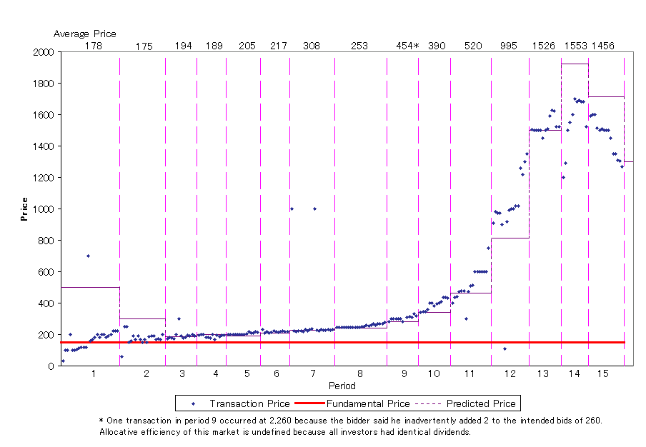
Figure 12: Stock Prices for Session 10
(Endogenous Terminal Payoff Session)

Slide 27
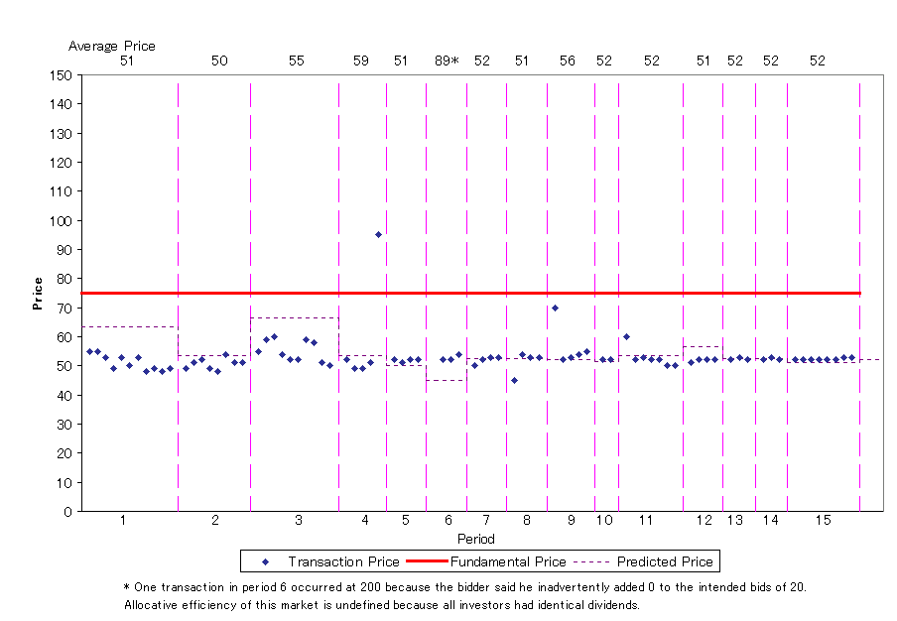
Figure 13: Stock Prices for Session 11
(Endogenous Terminal Payoff Session)

Slide 28
Discussion (short-horizon sessions)
Price levels and paths are indeterminate.
  Level
    Small Bubble (Session 1)
    Large Bubble (2, 8, 9, 10)
    Negative Bubble (11)
  Path
    Stable Bubble (1, 11, 2 ?)
      Rational Bubble
    Growing Bubble (8, 9, 10)
      Amplification Mechanism, Positive Feedback

Slide 29
Result
In the long-horizon sessions, price expectations are consistent with backward induction.
In the short-horizon sessions, price expectations are consistent with forward induction.

Slide 30
However, Objections to Design of the Short-Horizon Sessions
Period 1
Period x
Period 30
(Trade)
E_{x} (P_{x+1})
D
Single terminal dividend at the end of period 30.
The session will “likely” be terminated earlier.
If terminated earlier, the stock is liquidated at the following period predicted price.
Environment not fully specified
In the current work, we use a fully specified overlapping generations structure

Slide 31
Laboratory Experiment
All markets have 16 periods of trading
  Each period lasts for 120 seconds.
Single kind of simple assets
  Single, certain, common knowledge terminal dividend of 50 at the end of period 16.
Overlapping generations structure
  See the next slide
Low / High liquidity treatment
  See the slide after next

Slide 32
Markets with Overlapping Generations of Traders
Every period has two overlapping generations of five traders each in the market
Only one initial generation is endowed with assets (single common knowledge dividend of 50 paid at maturity—end of period 16)
All other generations enter with cash, can buy assets from the “old” generation, and sell them when they become “old” to exit the market with cash
Individuals may re-enter after sitting out the market for one or more (random number) of generations (in T4 and T8 only)
Each session is repeated six times (independently with different subjects)
Equilibrium transaction volume per session: 160

Slide 33
Table 1: Overlapping Generations Experimental Design
 | Period Subjects | 1 | 2 | 3 | 4 | 5 | 6 | 7 | 8 | 9 | 10 | 11 | 12 | 13 | 14 | 15 | 16
T1 | 5 | G0
 | 5 | G1
T2 | 5 | G0
 | 5 | G1
 | 5 |  |  |  |  |  |  |  |  | G2
T4 | 5 | G0
 | 5 | G1
 | 5 |  |  |  |  | G2
 | 5 |  |  |  |  |  |  |  |  | G3
 | 5 |  |  |  |  |  |  |  |  |  |  |  |  | G4
T8 | 5 | G0
 | 5 | G1
 | 5 |  |  | G2
 | 5 |  |  |  |  | G3
 | 5 |  |  |  |  |  |  | G4
 | 5 |  |  |  |  |  |  |  |  | G5
 | 5 |  |  |  |  |  |  |  |  |  |  | G6
 | 5 |  |  |  |  |  |  |  |  |  |  |  |  | G7
 | 5 |  |  |  |  |  |  |  |  |  |  |  |  |  |  | G8

Slide 34
Table 3: Treatment Parameters
Treatment | T1L | T1H | T2L | T2H | T4L | T4H | T8L | T8H
Market setup
No. of generations | 2 | 2 | 3 | 3 | 5 | 5 | 9 | 9
Terminal dividend | 50 | 50 | 50 | 50 | 50 | 50 | 50 | 50
Initial No. assets/trader G0 | 32 | 32 | 16 | 16 | 8 | 8 | 4 | 4
Initial No. assets G(i) | 0 | 0 | 0 | 0 | 0 | 0 | 0 | 0
Total assets outstanding | 160 | 160 | 80 | 80 | 40 | 40 | 20 | 20
Total value of assets | 8,000 | 8,000 | 4,000 | 4,000 | 2,000 | 2,000 | 1,000 | 1,000
Initial cash/trader G0 | 0 | 0 | 0 | 0 | 0 | 0 | 0 | 0
Initial cash/trader G(i) | 3,200 | 16,000 | 1,600 | 8,000 | 800 | 4,000 | 400 | 2,000
Total cash | 16,000 | 80,000 | 8,000 | 40,000 | 4,000 | 20,000 | 2,000 | 10,000
Cash-asset-ratio (C/A-ratio) | 2 | 10 | 2 | 10 | 2 | 10 | 2 | 10
Invited subj. (3n+3) | 15ª | 15ª | 18 | 18 | 18 | 18 | 18 | 18
Participating subjects | 90 | 90 | 108 | 108 | 108 | 108 | 108 | 108
Exchange rates (Taler/€)
Generation 0 (G0) | 100 | 100 | 100 | 100 | 100 | 100 | 100 | 100
Transition generations |  |  | 100 | 500 | 100 | 500 | 100 | 500
Last generation | 200 | 1,000 | 200 | 1,000 | 200 | 1,000 | 200 | 1,000
Predictors | 133 | 133 | 133 | 133 | 133 | 133 | 133 | 133
Exp. payout/subject (euros) | 16 | 16 | 16 | 16 | 16 | 16 | 16 | 16
NOTES: The following parameters are identical across all treatments: Number of traders/generation (5); number of active generations (2); market size (10 traders); period length (120 sec.); total number of periods (16); number of markets per treatment (6); number of expected transactions (160). ª In treatments T1LH we invited 15 subjects instead of 18 as no subject pool for future generations is needed. However we invited five subjects to serve as predictors.

Slide 35
Table 2: Treatment Overview
 |  | Liquidity
 |  | Low (C/A ratio=2) | High (C/A ratio=10)
Number of entering generations | 1 | T1L | T1H
 | 2 | T2L | T2H
 | 4 | T4L | T4H
 | 8 | T8L | T8H

Slide 36
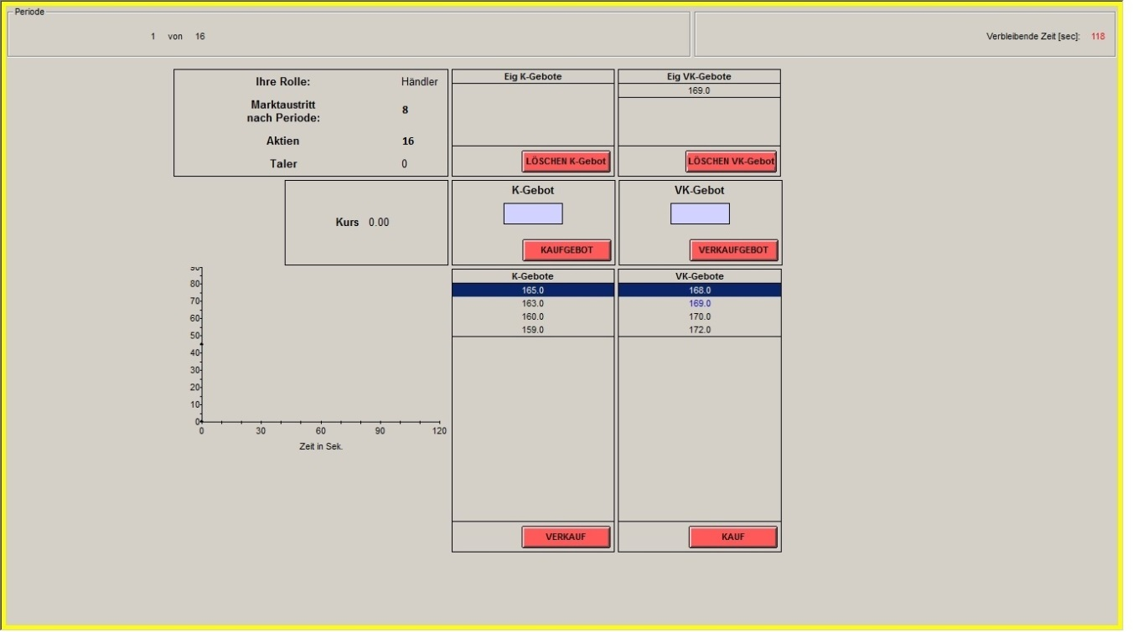
Continuous double auction markets
Trader: Information about your task (trader), period you leave the market, current Share and Taler holdings.
Predictors: Information about your task (predictior) and your forecast.
BID: enter the price you are willing to pay for one unit. Trade does not take place until another participant accepts your bid!!!
Current Market Price (of Stock)
ASK: seller’s analogue to BID - see above.
List of all BIDS: from all traders - your own bids are written in blue. The bid with blue background is always the most attractive, yielding the highest revenues for the seller.
List of all ASKS: from all traders - your own asks are written in blue. The ask with blue background is always the most attractive, because it is the cheapest for the buyer.
Price-Chart of current period
SELL: You sell one unit, given the price with the blue background.
BUY: You buy one unit, given the price with the blue background.

Slide 37
Conducted Experiments
Innsbruck-EconLab at University of Innsbruck
September, October and November 2013
A total of 828 University of Innsbruck students (bachelor and master from different fields).

Slide 38
Hypothesis
H1: Prices tend toward fundamentals in the presence of long-horizon investors (when the last generation is present).
H2: Prices become indeterminate in the presence of short-horizon investors.
  The degree of indeterminacy increases as the investment horizon gets shorter (the backward induction becomes more difficult).

Slide 39
Experimental Results

Slide 41
G0
G1
Notes:
Red line: Fundamental value
Thin grey line: Prices in individual sessions
Bold line with circles: mean prices across 6 sessions
We find that in T1L markets with long-horizon investors (G1), prices are mostly close to fundamentals (50) throughout the session.

Slide 42
G0
G1
 |  |  |  |  |  |  |  | G2

Slide 43
G0
G1
 |  |  |  | G2
 |  |  |  |  |  |  |  | G3
 |  |  |  |  |  |  |  |  |  |  |  | G4

Slide 44
G0
G1
 |  | G2
 |  |  |  | G3
 |  |  |  |  |  | G4
 |  |  |  |  |  |  |  | G5
 |  |  |  |  |  |  |  |  |  | G6
 |  |  |  |  |  |  |  |  |  |  |  | G7
 |  |  |  |  |  |  |  |  |  |  |  |  |  | G8

Slide 45
Summary of results (low Liquidity)
Notes:
Low liquidity treatments

Slide 46
G0
G1

Slide 47
G0
G1
 |  |  |  |  |  |  |  | G2

Slide 48
G0
G1
 |  |  |  | G2
 |  |  |  |  |  |  |  | G3
 |  |  |  |  |  |  |  |  |  |  |  | G4

Slide 49
G0
G1
 |  | G2
 |  |  |  | G3
 |  |  |  |  |  | G4
 |  |  |  |  |  |  |  | G5
 |  |  |  |  |  |  |  |  |  | G6
 |  |  |  |  |  |  |  |  |  |  |  | G7
 |  |  |  |  |  |  |  |  |  |  |  |  |  | G8

Slide 50
Summary of results (high Liquidity)

Slide 51
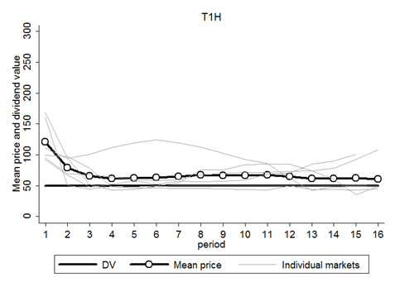
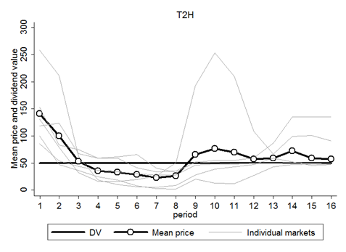
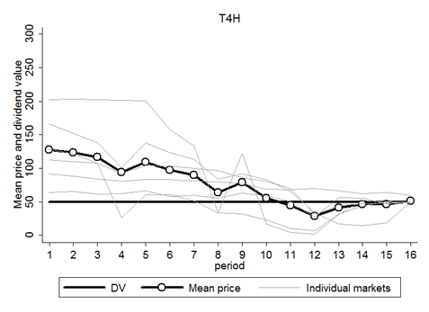
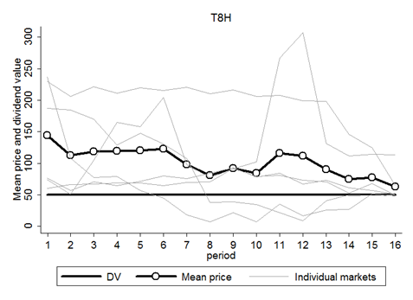
Figure 2: High Liquidity Treatments

Slide 52
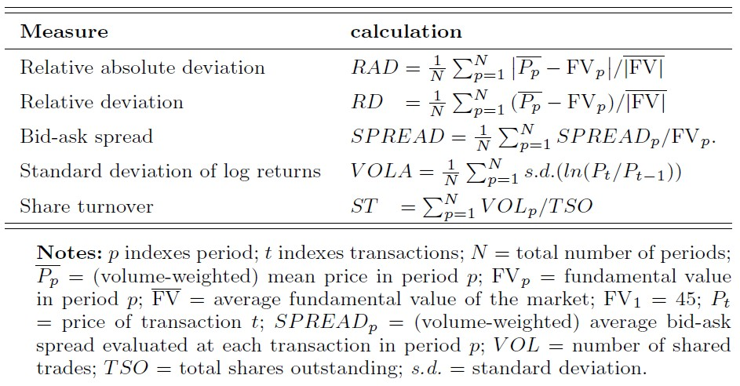
Table 4: Formulae for market efficiency measures

Slide 54
Table 5: Treatment averages for market efficiency measures
 |  | Relative Absolute Deviation | Relative Deviation | Bid-Ask Spread | Std. Dev. of Log Returns | Share Turnover
 | T1L | 11.43% | -5.24% | 8.79% | 4.70% | 1.60
 | T2L | 35.47% | -18.95% | 19.92% | 17.56% | 1.69
 | T4L | 42.92% | -34.07% | 22.52% | 25.16% | 1.56
 | T8L | 43.03% | -30.48% | 21.69% | 26.24% | 1.05
 | T1H | 41.99% | 37.39% | 29.61% | 14.08% | 2.01
 | T2H | 77.02% | 38.81% | 55.04% | 22.70% | 1.59
 | T4H | 73.86% | 52.11% | 23.37% | 17.72% | 1.57
 | T8H | 118.67% | 103.48% | 65.95% | 18.17% | 1.07

Slide 55
Table 6: Differences between averages across treatments, same Liquidity
(RAD, RD, SPREAD, VOLA, and ST two-sided Mann-Whitney U)
RAD | T2L | T4L | T8L |  |  | T2H | T4H | T8H
T1L | 24.03%** | 31.48%*** | 31.60%*** |  | T1H | 35.03% | 31.87% | 76.67%*
T2L |  | 7.45% | 7.56% |  | T2H |  | -3.16% | 41.64%
T4L |  |  | 0.11% |  | T4H |  |  | 35.03%
RD | T2L | T4L | T8L |  |  | T2H | T4H | T8H
T1L | -13.70%** | -28.83%*** | -25.23%** |  | T1H | 1.42% | 14.71% | 66.09%
T2L |  | -15.13% | -11.53% |  | T2H |  | 13.29% | 64.67%
T4L |  |  | 3.60% |  | T4H |  |  | 51.38%
SPREAD | T2L | T4L | T8L |  |  | T2H | T4H | T8H
T1L | 11.13%* | 13.73%** | 12.90%** |  | T1H | 25.43% | -6.24% | 36.34%
T2L |  | 2.59% | 1.76% |  | T2H |  | -31.67% | 10.91%
T4L |  |  | -0.83% |  | T4H |  |  | 42.58%**
VOLA | T2L | T4L | T8L |  |  | T2H | T4H | T8H
T1L | 12.86%** | 20.46%*** | 21.54%*** |  | T1H | 8.61% | 3.64% | 4.09%
T2L |  | 7.60% | 8.68%* |  | T2H |  | -4.98% | -4.53%
T4L |  |  | 1.08% |  | T4H |  |  | 0.45%
ST | T2L | T4L | T8L |  |  | T2H | T4H | T8H
T1L | 0.09 | -0.03 | -0.55** |  | T1H | -0.43 | -0.44 | -0.94**
T2L |  | -0.12 | -0.64*** |  | T2H |  | -0.02 | -0.52**
T4L |  |  | -0.51 |  | T4H |  |  | -0.50**

Slide 56
Table 7: Differences between averages across treatments, different Liquidity
(RAD, RD, SPREAD, VOLA, and ST two-sided Mann-Whitney U)
H minus L | RAD | RD | SPREAD | VOLA | ST
T1 | 30.56%** | 42.64%*** | 20.82%*** | 9.39%* | 0.42
T2 | 41.56% | 57.76%** | 35.12%* | 5.14% | -0.10
T4 | 30.95% | 86.18%*** | 0.86% | -7.44% | 0.01
T8 | 75.64%* | 133.96%*** | 44.26%** | -8.07% | 0.02

Slide 57
Price Predictions/Expectations
Not yet analyzed for the current study
Hirota and Sunder (2007): results show that when subjects cannot do backward induction, they resort to forward induction, and simply project past data in forming their expectations about the future
In long-horizon sessions, future price expectations are formed by fundamentals.
  Speculation stabilizes prices.
In short-term sessions, future price expectations are formed by their own or actual prices.
  Speculation may destabilize prices.

Slide 58
Wrap Up
Prices are close to the fundamental values when Investors have long-term horizons.
Prices deviate from the fundamental values and become indeterminate when there are only short-term investors in the market.
  Investors fail to backward induct to bring prices to the fundamental values.
  The shorter the investment horizon (the larger number of generations), the more difficult the backward induction.
  Prices in high liquidity treatments are higher and deviate more from fundamentals than those in low liquidity treatments.

Slide 59
Implications
Bubbles are known to occur more often in markets for assets with
  (i) longer maturity and duration
  (ii) higher uncertainty
Consistent with the lab data
Inputs to expectation formation matter:
  Dividend policy matters!
Ex post, market inefficiency, anomalies, and behavioral phenomena more likely to be observed in markets dominated by short-horizon investors (difficulty of backward induction)

Slide 60
Thank You!
Shyam.sunder@yale.edu
http://faculty.som.yale.edu/shyamsunder/research.html

