Slide 1
Simple Agents, Intelligent Markets
K. Jamal, M. Maier, and S. Sunder
University of Southern Denmark
Odense, June 6, 2016

Slide 2
An Overview
Background: How did we get here?
Research question: Can simple boundedly-rational individual behavior yield market outcomes theoretically derived from assuming complex optimization and advanced cognition?
Design: combine Newell-Simon means-end heuristic with Gode-Sunder zero-intelligence in trading algorithm
Results: Minimally intelligent individual trading algorithm yields market outcomes approximating rational expectations equilibria (also achieved in markets with profit motivated human traders)
Conclusions: Tight coupling between the properties of market institutions and the properties of individual agents who populate them is not necessary
Conjecture: The result may be generalizable to a broader set of socio-economic-political organizations

Slide 3
Background
Adam Smith: It is not from the benevolence of the butcher, the brewer, or the baker that we expect our dinner, but from their regard to their own interest. We address ourselves, not to their humanity, but to their self-love, and never talk to them of our own necessities, but of their advantages. (I.2.17)
Competitive equilibrium
  Pareto efficiency
  Convexity
  Maximization
  Uniqueness (?) in presence of wealth effects

Slide 4
Background
Alan Newell and Herbert A. Simon (1959)
  Limited human cognition
  Bounded rationality and satisficing instead of maximization
  Means-end heuristic as a descriptive model of human behavior (~ first order adaptive process) in General Problem Solver (GPS)
  Selten

Slide 5
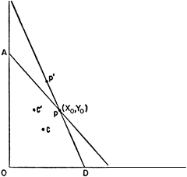
Background
Gary S. Becker (JPE 1962)
Distinguish rationality at market and individual levels
Negatively-sloped demand curves result from the change in opportunities sets alone, largely independent of the decision rule; derivable from maximizing as well as random behavior

Slide 6
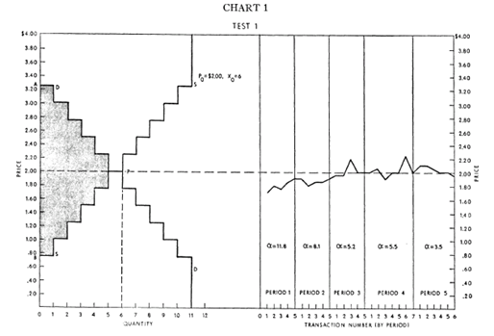
Background
Vernon L. Smith (JPE 1962)
In a double auction
Profit motivated human traders
Only 10-20 traders
Observed market outcomes close to competitive equilibrium (derived from maximization, Walrasian auction, and atomistic competition)

Slide 7
Background
Gode and Sunder (JPE 1993): serendpitously combined
  Double auction market institution (without randomization in Smith), and
  Budget constrained random choice (without market institution in Becker)

Slide 8
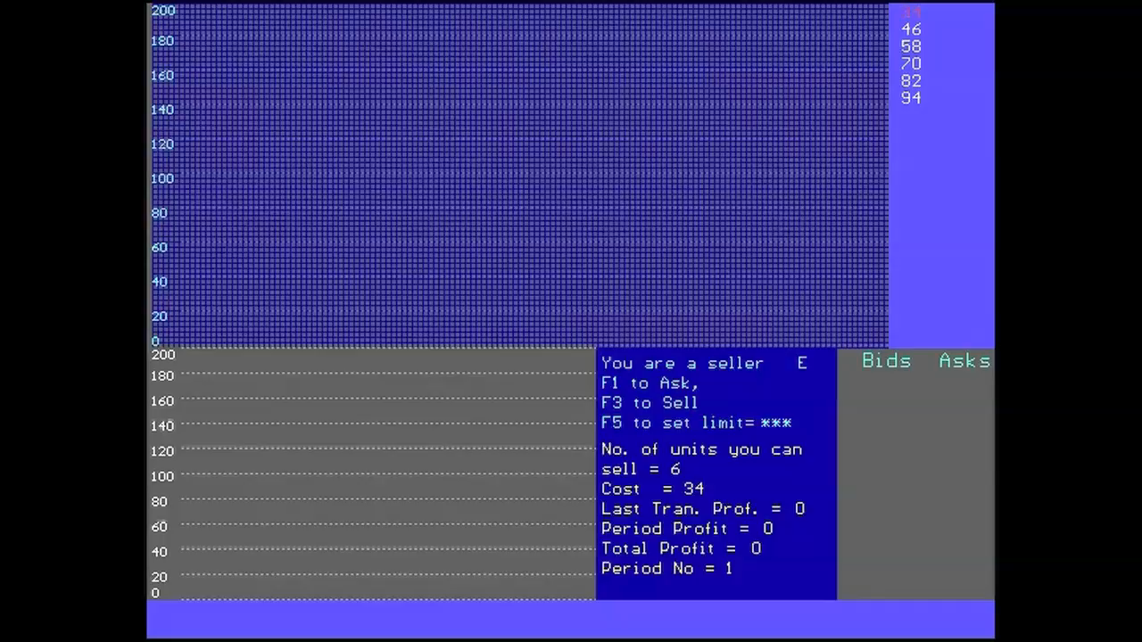
Market Behavior 1

Slide 9
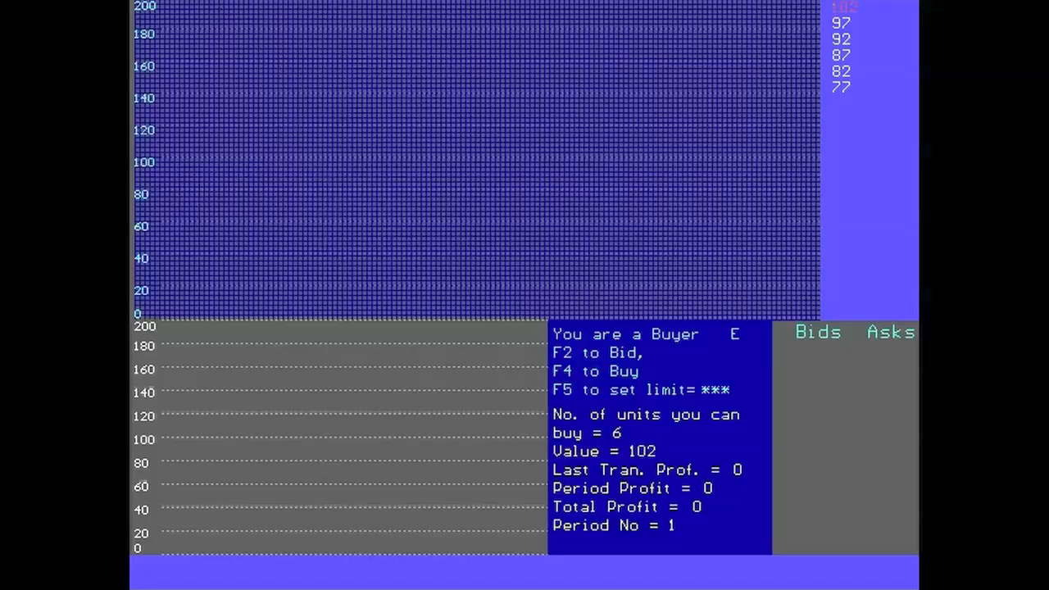
Market Behavior 2

Slide 10

Market Behavior 3

Slide 11
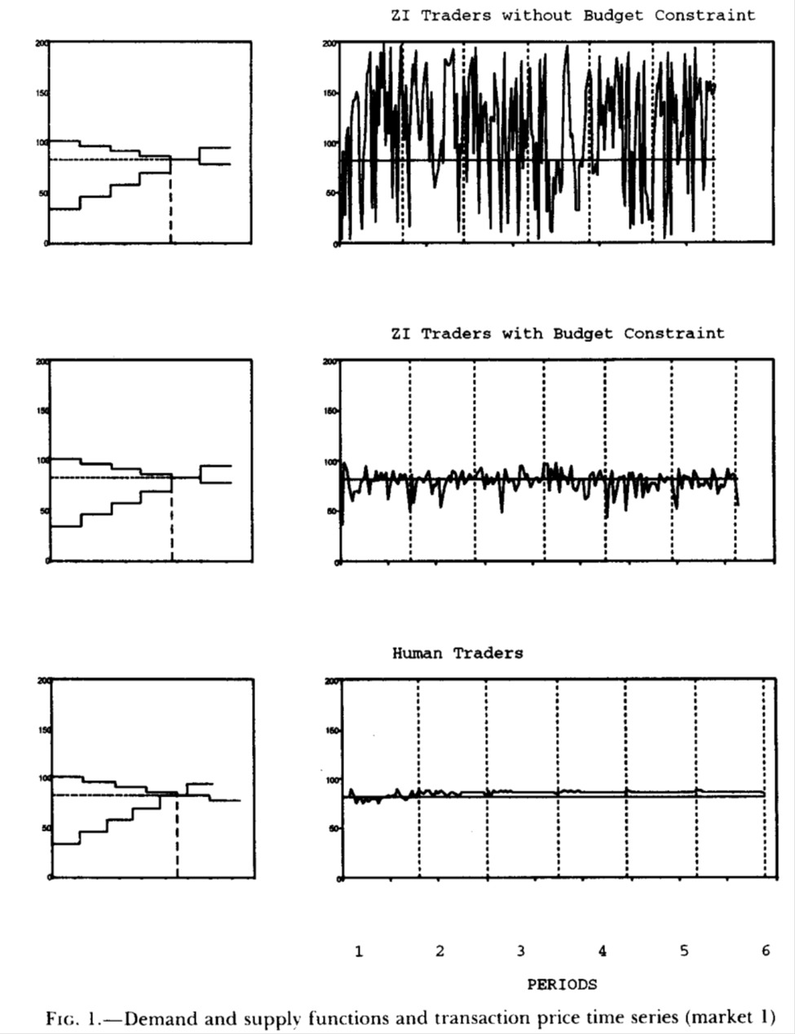

Slide 12
Background
Gode and Sunder (JPE 1993): Combine
  Yields market outcomes approximate predictions of competitive equilibrium
  Allocative efficiency of markets populated by “zero-intelligence” traders is high, and comparable to efficiency of markets populated with profit-motivated human traders

Slide 13
Background
Plott and Sunder (JPE 1982) examined asset markets with uncertain, heterogeneous payoffs, and asymmetric information
In double auction markets information can be disseminated from informed to uninformed traders to yield approximate rational expectations equilibria as measured by prices and allocations

Slide 14
Equilibria in an Asset Market
 | State X | State Y
 | Prob.=0.4 | Prob.=0.6
Trader Type |  |  | Expected Dividend
I | 0.4 | 0.1 | 0.22
II | 0.3 | 0.15 | 0.21
III | 0.125 | 0.175 | 0.155
PI Eq. Price Asset Holder | 0.4 Trader Type I Informed | 0.22 Trader Type I Uninformed
RE Eq. Price Asset Holder | 0.4 Trader Type I | 0.175 Trader Type III

Slide 15
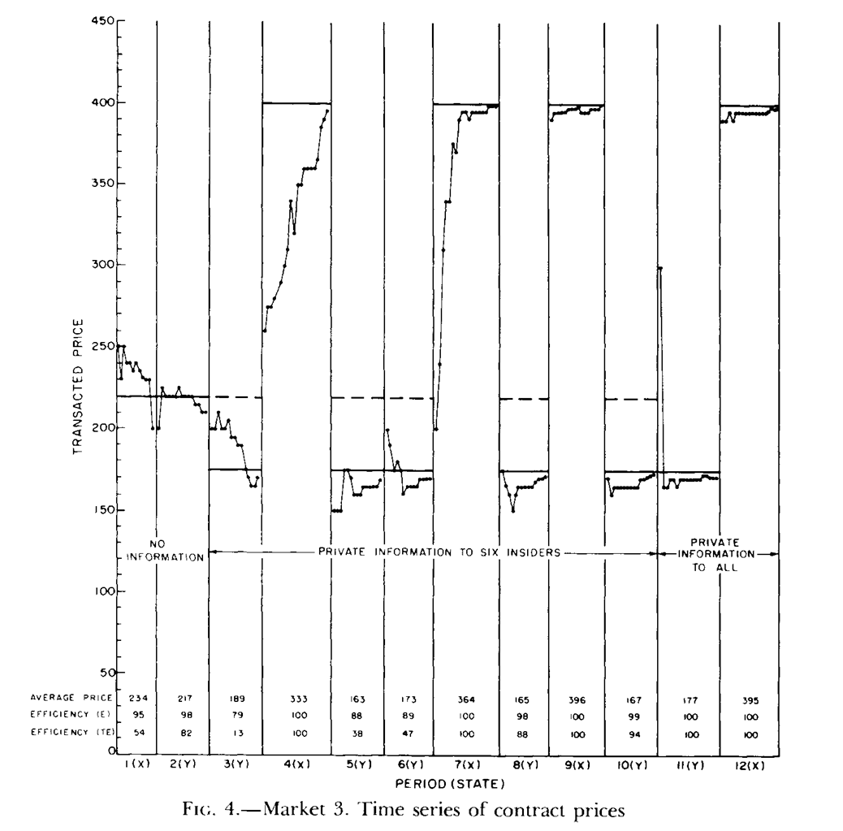

Slide 16
Present Research Question
Do the results from markets without uncertainty (Becker, Smith, Gode and Sunder) extend to markets with uncertainty and asymmetric information populated by minimally-intelligent traders?
  Note that profit-motivated human traders converged near RE equilibria in Plott and Sunder (1982) markets
  But we do not know how and why
  Attaining RE equilibria calls for making the right conjectures
  We cannot directly observe human trading strategies
  So we replace human traders by trading algorithms to unpack the aspects of behavior that may be sufficient to yield theoretically derived equilibria

Slide 17
Design of Algorithmic Traders
Populate double auctions with simple algorithmic traders with two characteristics
  Means-end heuristic to adjust their aspiration levels
  Zero-intelligence bids and offers relative to the current aspiration levels

Slide 18
Means-End Heuristic
Use Newell and Simon (The Simulation of Human Thought, 1959)
  Given a current state and a goal state, an action is chosen which will reduce the difference between the two. The action is performed on the current state to produce a new state, and the process is recursively applied to this new state and the goal state
Initial aspiration
  For the uninformed: expected payoff
  For the informed: pay off under the known state
Adjustment of aspiration levels with each observed price P(t) using parameter α ~U(0.05, 0.5)
  ASP (t+1) = (1-α) ASP (t) + α P(t)

Slide 19
Zero-Intelligence Bids and Offers
Bids: ~ U(0, ASP)
Offers: ~U(ASP, 1)
Double Auction Rule
  At the start of each period
  Set current bid = 0, and current ask = 1
  A higher bid replaces current bid, and a lower ask replaces current ask
  As soon as a current bid equals or exceeds current ask, a transaction is recorded at the bid/ask submitted first

Slide 20
Algorithmic Flow
Inside Trader
Set CAL = its dividend for the realized state
Yes
No
At time = 0
Set CAL = Expected Value of Dividend for the trader
CAL_{i} = Pr(X) * (DX_{i}) + Pr(Y) * (DY_{i})
Transaction Price Observed (p_{t})
After each transaction
CAL Updated Based on Prior CAL and Observed Transaction Price
CAL _{t+1} = (1-γ) (CAL _{t}) + (γ P_{t})

Slide 21
Algorithmic Flow
No
Randomly Choose Number # ~U[0,1]
Is # ≤ 0.5
Randomly Choose Number @ ~U[0,CAL]
Is @ > Current Bid?
Yes
Yes
Current Bid = @
No
No
Randomly Choose Number @ ~U[CAL, 1]
Is @ < Current Ask
Current Ask = @
Bid ≥ Ask
Yes
No
Yes
Trade Occurs

Slide 22
Results
Plott and Sunder (1982) results of markets with profit-motivated human traders shown in blue
Simulated results of same markets populated by minimally-intelligent algorithmic traders shown in red (cloud of 50 independent simulations and the median, α ~U(0.05, 0.5) drawn for each simulation)
RE equilibrium price in green line
Walrasian equilibrium price in broken line
Also shown, comparisons of mean squared deviation, trading volume, and allocative efficiency

Slide 23
Equilibria in an Asset Market
 | State X | State Y
 | Prob.=0.4 | Prob.=0.6
Trader Type |  |  | Expected Dividend
I | 0.4 | 0.1 | 0.22
II | 0.3 | 0.15 | 0.21
III | 0.125 | 0.175 | 0.155
PI Eq. Price Asset Holder | 0.4 Trader Type I Informed | 0.22 Trader Type I Uninformed
RE Eq. Price Asset Holder | 0.4 Trader Type I | 0.175 Trader Type III

Slide 33
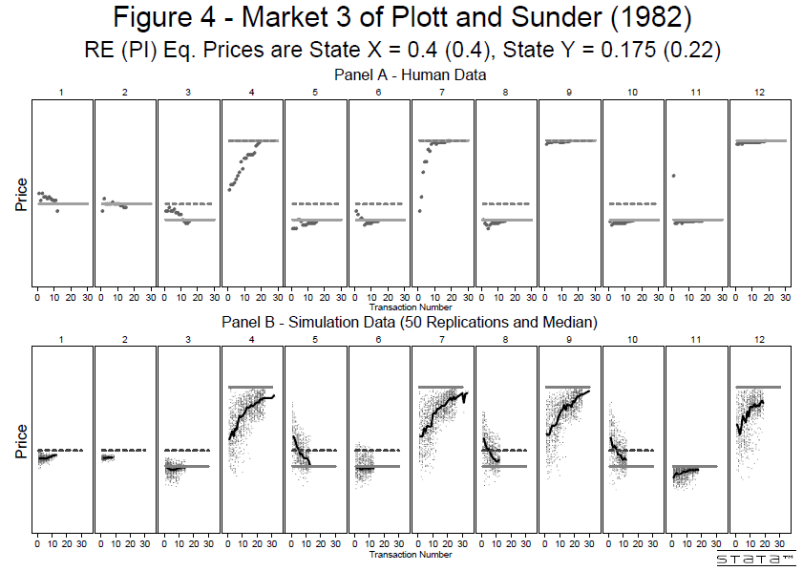

Slide 40
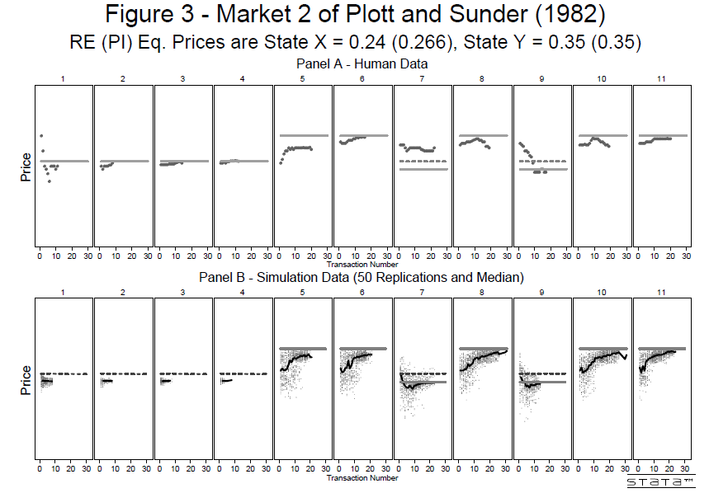

Slide 51
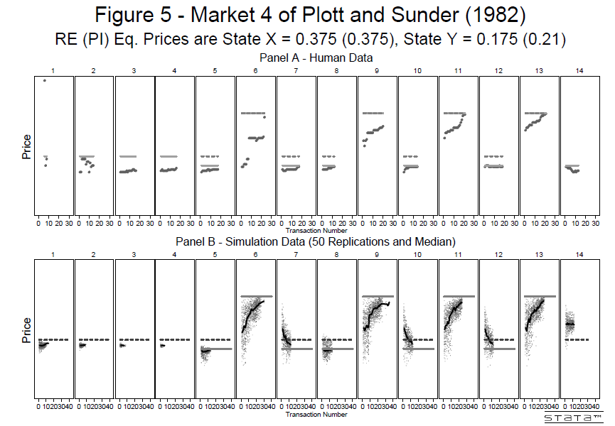

Slide 63
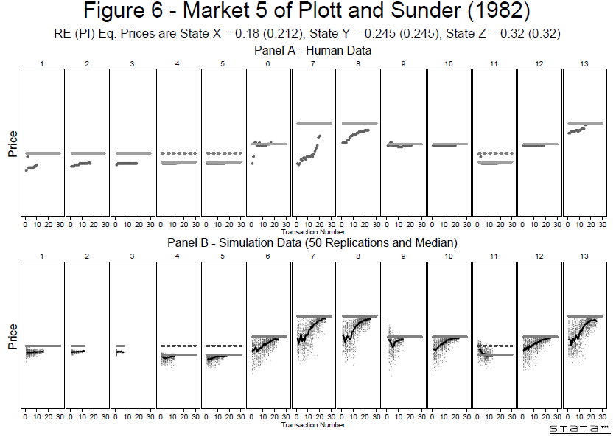

Slide 80
Conclusions
Equilibrium results are mostly derived by assuming optimization by agents populating the model economies
At least since Simon, cognitive limitations of intuitive human behavior have been well-documented, raising doubts about the descriptive validity of such derived results
Given rise to a critique of rationality assumption as outdated psychology, lightning-fast calculation, perfect anticipation, perfectly ordered preferences, hedonistic motivation, and other presumably unrealistic individual behavior
Defense of economic theory from cognitive sciences critique of rationality assumption has often relied on:
  Rationality as a broad tendency, need not apply to all
  Selection and survival of the fittest (Alchian)
  Proof of the pudding in the eating (empirical evidence)
  Some important results (e.g., Becker 1962, downward sloping demand functions) are robust, derivable not only from rational but also from non-rational behavior

Slide 81
Simon on Reductionism
The approach used here suggests that some important properties of market institutions are not simple translation of individual level behavior
Spirit of Sonnenschein-Mantel-Debreu Theorem: the excess demand function for an economy is not restricted by the usual rationality restrictions on individual demands in the economy
Herbert Simon, after originating the rationality critique in 1950s, and documenting bounded rationality of humans, also realized the necessity of decoupling aggregate and individual behavior
“This skyhook-skyscraper construction of science from the roof down to the yet unconstructed foundations was possible because the behavior of the system at each level depended on only a very approximate, simplified, abstracted characterization of the system at the level next beneath. This is lucky, else the safety of bridges and airplanes might depend on the correctness of the ‘Eightfold Way’ of looking at elementary particles.” (The Sciences of the Artificial,3rd edition, p. 16)

Slide 82
Equilibria as Basins of Attraction
Indeed, the powerful results of economic theory have been derived from “a very approximate, simplified, abstracted characterization of the system at the level next beneath.”
Simon and Selten’s bounded rationality of individual behavior, and Smith and Plott’s markets may not be mutually inconsistent , even under uncertainty, information asymmetry, and heterogeneous preferences
The “economic man” is maligned by a misunderstanding of its scientific purpose and role
Economics borrowed optimization from physics as a structural principle to identify basins of attraction (not as a behavioral description)
Adam Smith may not have gone far enough; a large part of economic efficiency is generated by common-sense constraints on economic choices made in the context of institutions evolved for social interaction

Slide 83
  “At multiple hierarchical levels—brain, ganglion, and individual cell—physical placement of neural components appears consistent with a single, simple goal: to minimize cost of connections among the components. The most dramatic instance of this "save wire" organizing principle is reported for adjacencies among ganglia in the nematode nervous system; among about 40,000,000 alternative layout orderings, the actual ganglion placement in fact requires the least total connection length. In addition, evidence supports a component placement optimization hypothesis for positioning of individual neurons in the nematode, and also for positioning of mammalian cortical areas.”
  - Cherniak, C., 1994 in Journal of Neuroscience.

Slide 84
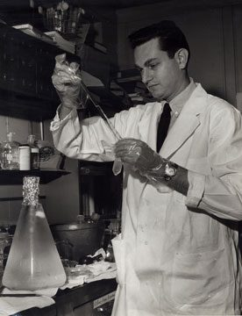
Beautiful Experiments in Science
After Crick and Watson reported the discovery the double helix structure, theorists and empiricists raced to the search for the code that RNA uses to translate information in DNA to synthesize 20 amino acids and their peptide chains or proteins
It was a hopelessly complex problem, until Nirenberg tried a breathtakingly simple test tube manipulation: Let us see what amino acid an artificial RNA sequence that repeats the same letter again and again (UUUUU… which does not appear in nature) produces? It produces phenylalanine.
The code began to crumble and was soon deciphered: each of the 64 possible codons or “words” consisted of three “letters” each produced one of the 20 amino acids.
Examples of other masters of beautiful experiment in biology: Severo Ochoa, Matthew Meselson, Franklin Stahl, and Joshua Lederberg

Slide 85
Thank You.
Jamal, Maier and Sunder, "Simple Agents, Intelligent Markets".
Cowles Foundation Discussion Paper No. 1868R.
(http://papers.ssrn.com/sol3/papers.cfm?abstract_id=2478665)

Slide 86
This skyhook-skyscraper construction of science from the roof down to the yet unconstructed foundations was possible because the behavior of the system at each level depended on only a very approximate, simplified, abstracted characterization of Determinants of Economic Interaction, 3/25/2006 15 the system at the level next beneath. This is lucky, else the safety of bridges and airplanes might depend on the correctness of the ‘Eightfold Way’ of looking at elementary particles.
- Simon, H., 1998. The Sciences of the Artificial.

