Slide 1

Critical Collaborators for Student Success: Finding Out What Students (Don’t) Know
Cara Cadena
Gayle Schaub

Slide 2
What do students understand?
What don’t they understand?
Who needs to know?

Slide 3
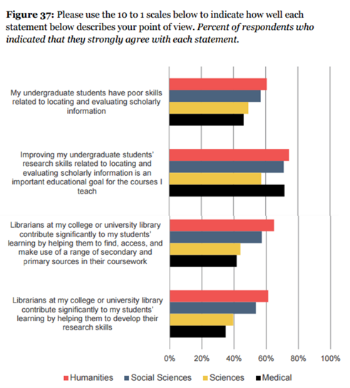
“More than half of [Ithaka Survey] respondents (54 percent) described those skills as poor, up from 47 percent in 2012.”
INSIDE HIGHER ED, April 4, 2016
https://www.insidehighered.com/news/2016/04/04/study-explores-faculty-views-scholarly-communication-and-information-use

Slide 4
How do we find out what our students understand?

Slide 5
Do students understand…?
Citation
Bibliography
Keyword
Full Text
Abstract
Database
Peer Review
Journal
Catalog
Open Access
Subject Heading
Scholarly
Source
Stacks

Slide 6
Winter 2015 Study
Random sample 400 UG courses
  Statistically valid representative sample
  21,235 total students
  773 responses
Survey of 14 information literacy terms
  Chosen by GVSU librarians
  Paper pilot
  Emailed to professors in selected courses

Slide 9
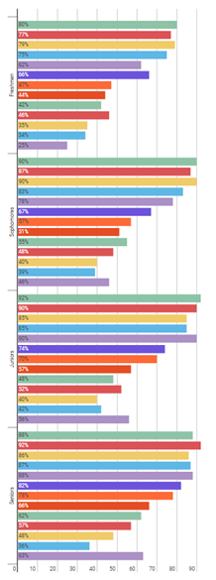

Results by Class Standing

Slide 10
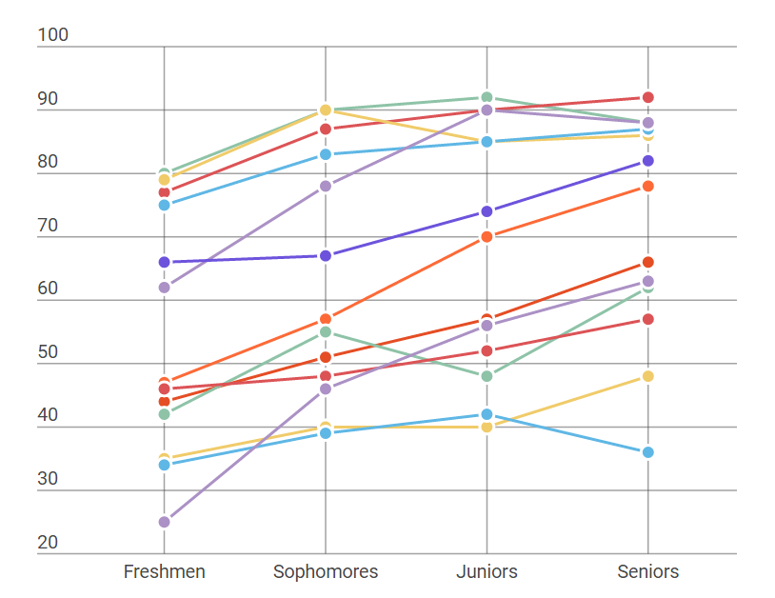
There seems to be an increase in understanding of terms over time.

Slide 11
Is this just a library instruction thing?

Slide 12
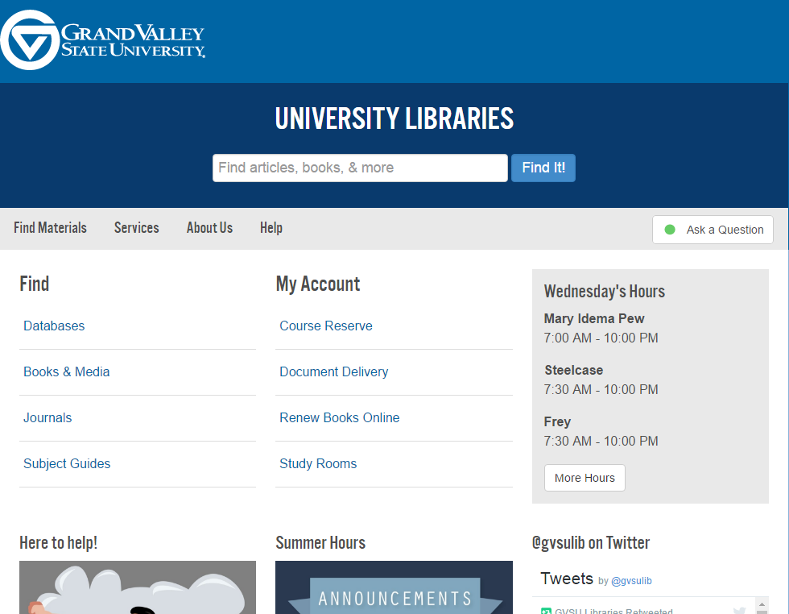
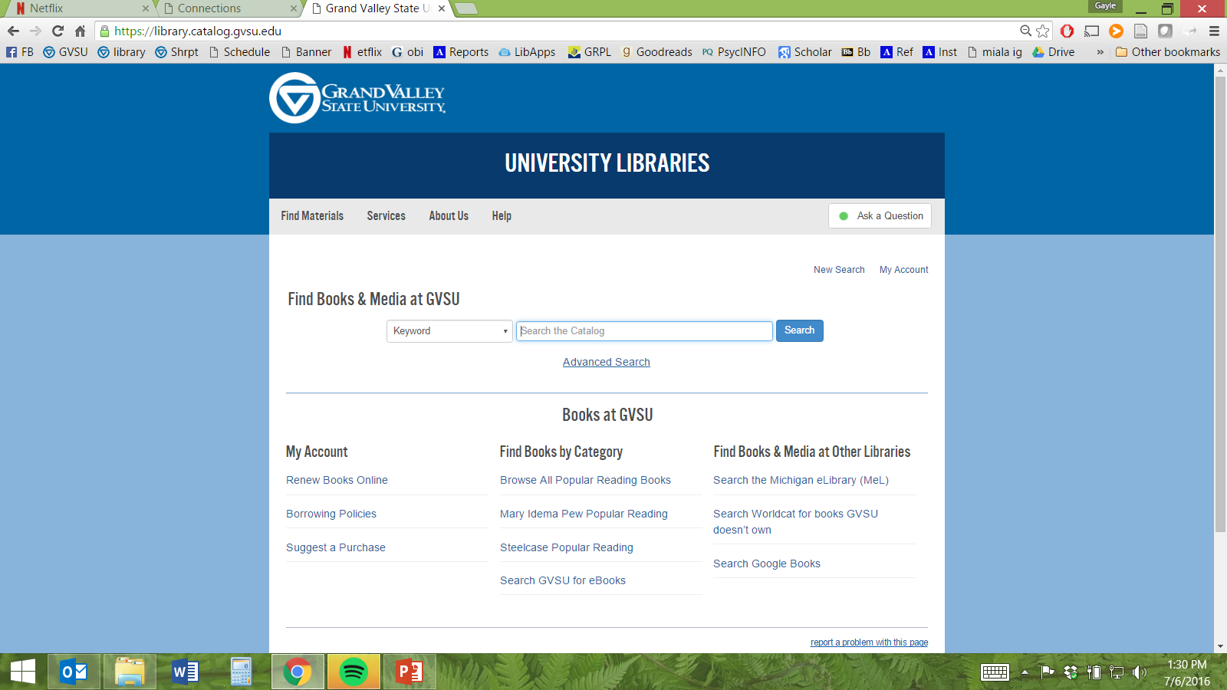

Slide 13
Is this just a library thing?

Slide 14
Terms found in GVSU Syllabi
  professional journal sources
  selected journal article
  empirical article from a journal listed below
  peer-reviewed journal article
  peer-reviewed/refereed
  no more than 2 non-peer-reviewed resources
  articles include those from journals, publications, the Internet, the newspaper, etc.

Slide 15
So, now what?

Slide 16
Present findings on campus
Design professional development program
Provide glossary

Slide 18
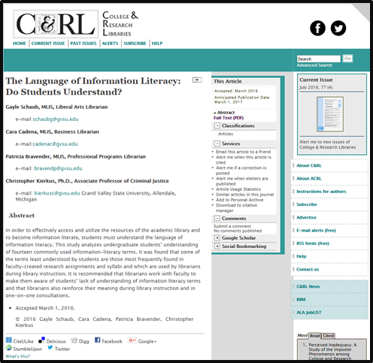
Questions?

