Slide 1
Library-Led Open Education Initiatives: Strategies for Engaging Faculty
Sarah Beaubien
Grand Valley State University
MLA Academic, May 2013

Slide 2
Defining OER
“Free-to-Use Teaching and Learning Content from Around the World”
    oercommons.org
“…high-quality, openly licensed, online educational materials that offer an extraordinary opportunity for people everywhere to share, use, and reuse knowledge.”
    William and Flora Hewlett Foundation

Slide 3

For example:
Textbooks
Courses, Course modules
Learning objects
Media objects
Tests
Software

Slide 4
The OER Landscape
Faculty, students, parents, administrators are painfully aware of the high cost of textbooks
Growing number of faculty are using or creating OER
Many OER collections & repositories
  See UMass Amherst guide on Open Educational Resources http://guides.library.umass.edu/oer

Slide 5
Benefits
Potentially significant cost savings for students
  Bonus points: this is popular with parents, administrators, etc.
Global, ethical benefits of shared educational content
Pairs naturally with information literacy

Slide 6
Benefits
Pedagogical implications:
  Increased control of course content
  Opportunity to rethink/redesign course
  More engaging for students
  Potentially more collaborative

Slide 7
Barriers
Time consuming to find high quality OER
Time consuming to create OER
May lack prepared tests/quizzes that commercial textbooks offer

Slide 8
Why Librarians Should Lead the Way
We know things. We do things. Like:
  Provide leadership and education in the open access movement
  Support the curriculum with resources & services
  Build relationships with all/most departments
  Assist students and faculty with finding and evaluating content

Slide 9
Why Librarians Should Lead the Way
We know things. We do things. Like:
  Develop assignments, courses, and information literacy tools
  Work with copyright and Creative Commons licensing
  Offer infrastructure via institutional repositories
  Offer publishing services

Slide 10
What We’re Doing
Publishing OER authored by GVSU faculty
Presenting, participating in conversation
Facilitating campus-wide discussion
Engaging in outreach
Learning as we go

Slide 11
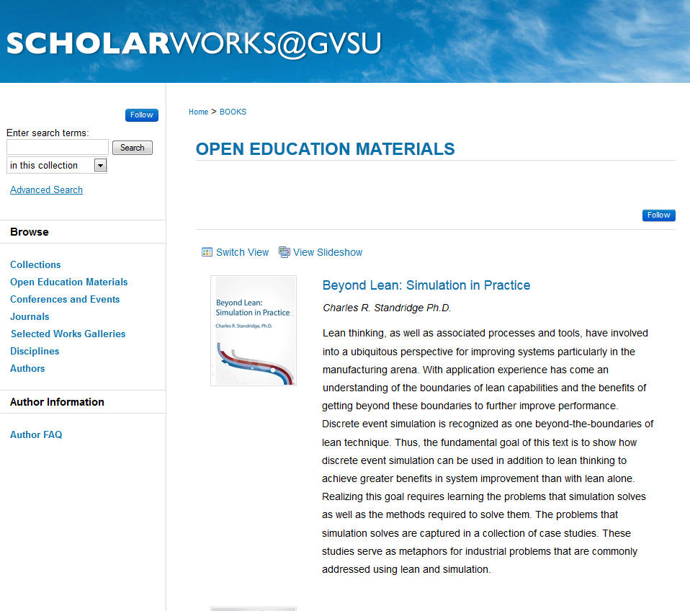
Hosted OER

Slide 12


Slide 13
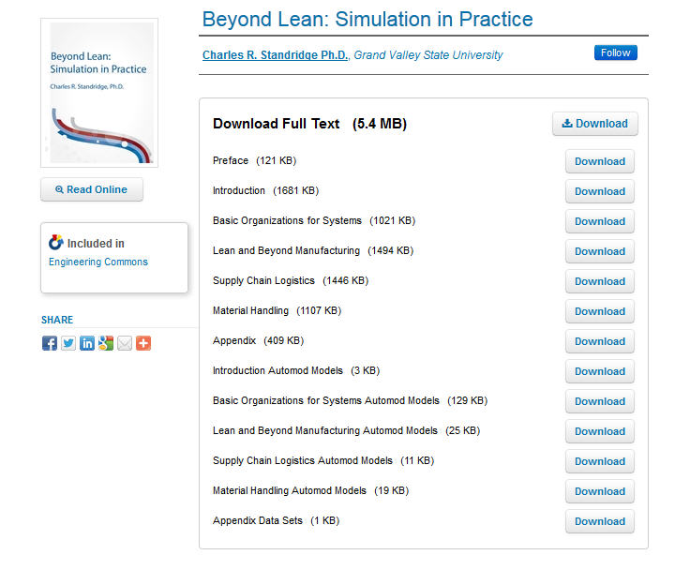
Engineering Text
Specialized subject matter
Entire text open access (except solutions!)
Supplemental files/programs
259 downloads since January 2012

Slide 14
Student and Author Comments
“Students prefer electronic copy of text”
“Students can download related course materials from the same site”
“Helps expand GVSU and program visibility through web searches”

Slide 15


Slide 16
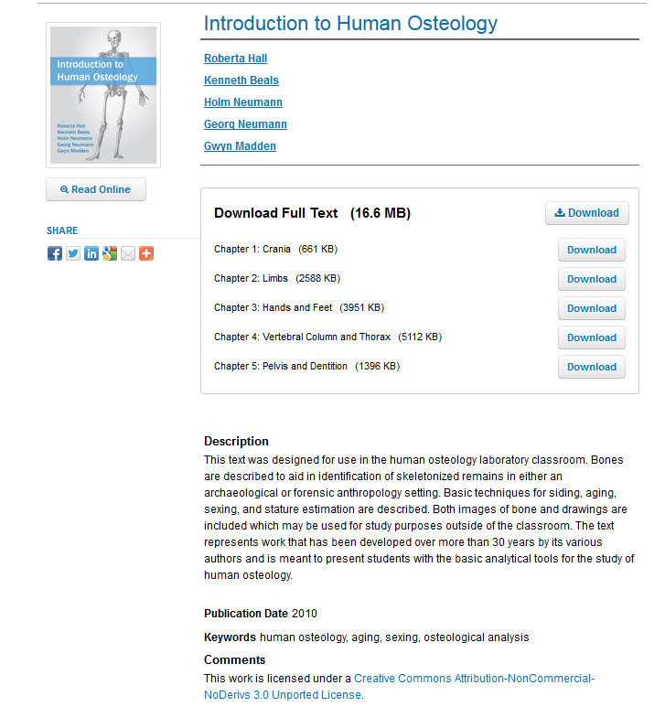
Anthropology Text
Written collaboratively
All copyrights owned by authors, including images
Creative Commons licensed
109 downloads since May 2012

Slide 17


Slide 18

Writing Texts
Collaborative & peer-reviewed
Creative Commons licensed
Print-on-demand option
Volume 1: 544 downloads since May 2012
Volume 2: 456 downloads since May 2012

Slide 19
Publishing Services
We Provide
  Outreach
  Cover design
  Advising on Creative Commons
  Advising on print-on-demand
  Reports on usage
We Do Not Provide (yet…)
  Copy editing
  Formatting
  Peer-review
  ISBN

Slide 20
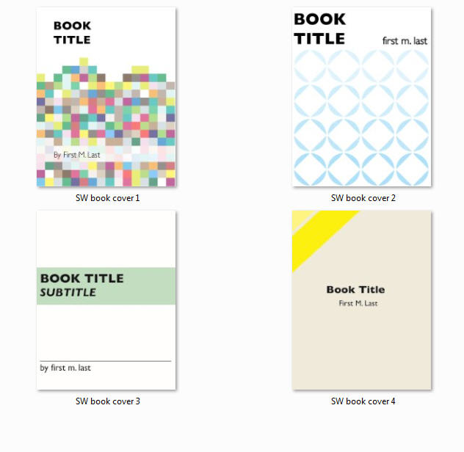
Cover Design Templates

Slide 21
Cover Design
Disclaimer: I am not a graphic designer
Collaborative project with colleague
  Small investment for Adobe Illustrator
  Templates that can be adapted by non-expert
  Could make use of free options
Value of the service
  Great for marketing OER
  Give works a visual identity

Slide 22
Anecdotal Evaluation
Faculty
  Pleased with services
  Appreciate usage reports, cover design
  Grateful for venue to share OER
Students
  Appreciate free textbooks
  Find format convenient to use
We will continue to gather feedback as this program evolves

Slide 23
Faculty Discussion Group
Co-facilitated (myself and Writing faculty member)
Cross disciplinary
Broad focus
Each group member develops project with individual outcomes
Launch Fall 2013

Slide 24
And Now, A Call to Action
You can:
  Reach out to faculty
  Develop resource guides
  Host discussion groups or workshops
  Support dissemination of OER authored by your faculty
  Partner with offices such as Faculty Teaching & Learning, Instructional Technology, etc. to develop programs

Slide 25
A Reality Check
So are you saying that if I start talking about OER, faculty will line up and give away free textbooks?
  Umm….no. Well, some of them will.
  Expect challenges. Expect some skepticism. And some enthusiastic participants.

Slide 26
And a Few Strategies
Identify existing needs at your institution
Initiate conversation with open access champions
Share cost savings data, if possible
Align conversation about OER with your institution’s mission
Use your librarian powers to expand partnerships and services

Slide 27
Want More Information?
A great starting point is the LibGuide created by Marilyn Billings at UMass Amherst:
http://guides.library.umass.edu/oer

Slide 28
Questions?
Sarah Beaubien
Scholarly Communications Outreach Coordinator
Grand Valley State University
beaubisa@gvsu.edu
http://scholarworks.gvsu.edu/

