Slide 1

Lessons Learned: Developing a Sustainable Publishing Program
Sarah Beaubien
Grand Valley State University
beaubisa@gvsu.edu

Slide 2
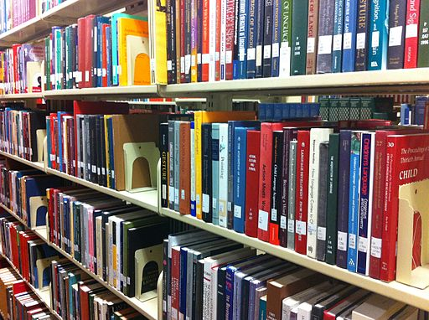
We publish
799 ETDs
21 Journals
10 Open access textbooks
10 Conference proceedings/sites

Slide 3
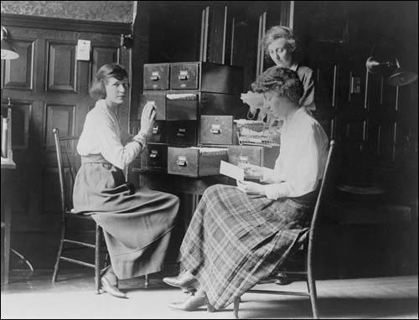
2.75 FTE
8-10 hours per week student help
Unlimited support from Digital Commons consultant & publishing services staff

Slide 4
Services we provide
Infrastructure & support
Set-up process & MOU
Digitization
(Some) uploading & metadata
First point of contact for training & questions
Statistical reports
ISSN application
Copyright consultation
Advising on open access models, best practices

Slide 5
Services bepress provides
Consulting Services:
Technical support
Training
Site design
Patience, creativity, preservation of sanity
Publishing Services:
DOIs
Delivery to indexes
Archiving

Slide 6
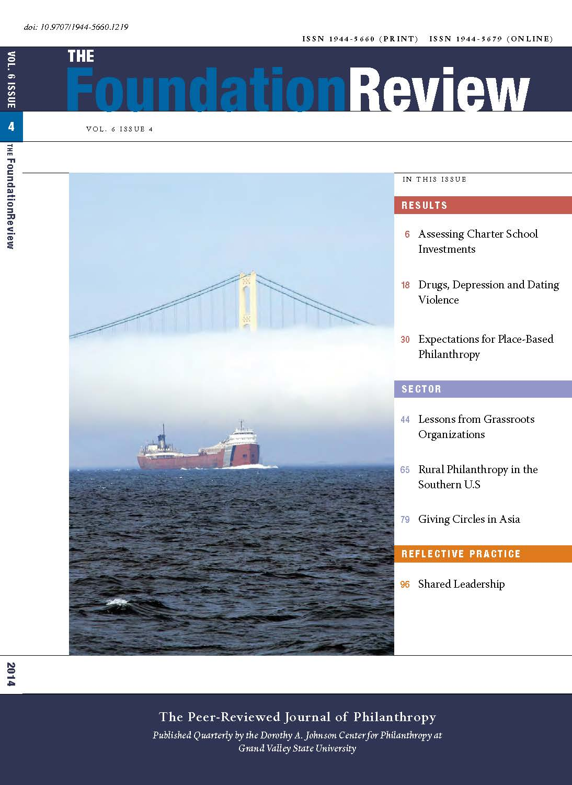
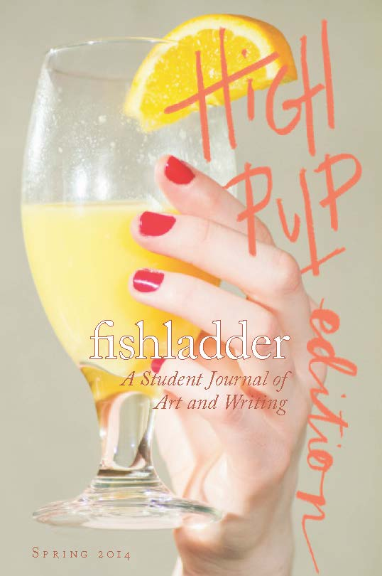
Journal overview

Slide 7
12 faculty-edited journals

Slide 8
9 student-edited journals

Slide 9
14 active titles

Slide 10
7 ceased titles

Slide 11
19 open access

Slide 12
2 partial OA/moving wall

Slide 13
8 Use EdiKit

Slide 14
13 uploaded by us

Slide 15
4 started on Digital Commons

Slide 16
17 transitioned to DC

Slide 17
How do we define sustainable publishing?

Slide 18
Working toward sustainability
Journal proposal form
MOUs
Clear(er) expectations
Ongoing training & communication
Staffing
Journal inventory & evaluation
Editor workshops & educational programming

Slide 19
Biggest rewards
Actively supporting changing scholarly publication models
Sharing unique content, providing outlet for niche areas & new disciplines
Increasing visibility and reach of institution
Building partnerships with faculty, students, programs, etc.

Slide 20


Slide 21
Things we’ve learned
Have clear policies, expectations, and roles
Ask questions early on with each new project
Communicate your values (and decide how flexible you can be)

Slide 22
Things we’ve learned
Make the editors and their department/sponsoring association your partner in sustainability
Communicate successes and learn from mistakes
Call bepress

Slide 23
Sarah Beaubien
beaubisa@gvsu.edu
Head of Collections & Scholarly Communications
Grand Valley State University Libraries

