Slide 1

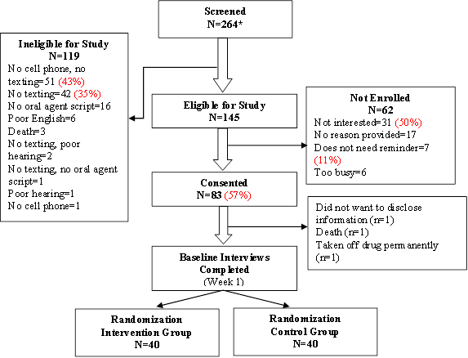

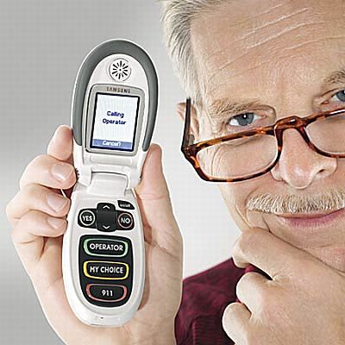

Proof-of-Concept & Preliminary Efficacy of a SMS Text Message Intervention to Promote Symptom Management & Medication Adherence for Patients Prescribed Oral Anti-Cancer Agents: An RCT
S. Spoelstra, PhD, RN¹; C. W. Given, PhD²; A. Sikorskii, PhD³; C. K. Coursaris, PhD⁴; A. Majumder, PhDc, BS³; T. DeKoekkoek, RN¹; M. Schueller, BA¹; B. A. Given, PhD, RN, FAAN¹
Problem
Results
Conclusions
Cancer rates are increasing, as is the number of cancer patients treated with oral anti-cancer agents.
Therapeutic effects may depend on adherence.
This study determined proof-of-concept and examined preliminary efficacy of a SMS text messaging (TM) intervention among cancer patients prescribed oral agents for symptom management and adherence.
Mean age 58.5 (SD 10.7); 60% female (n=48); 83% Caucasian (n=67)
Proof-of-Concept:
98% (n=39 of 40) completed entire intervention
97% (n=34) thought TMs were helpful
97% (n=34) reported satisfaction with TMs
86% (n=30) read the TMs all the time
57% (83 of 145) of eligible consented
Preliminary Efficacy:
Higher rates of adherence (ES .62)
Fewer symptoms (ES .50; p=.04)
Proof-of-concept and preliminary efficacy of TMs to promote symptom management and medication adherence for patients prescribed OAs was demonstrated.
Most patients read the TMs
Most had high satisfaction.
CONSORT
Conceptual Framework
Self-Efficacy Theory to promote adherence and symptom management.
Post-intervention Least Square (LS) Means of Outcomes & Standard Errors (SE) Adjusted for Baseline Values (Except for MARS-M, self-reported Adherence, RDI)
Factor | TM Group (n=37) | Control (n=31) | p-value | Effect Size (ES)
Adherence: # weeks adherent RDI | 5.95 (0.45) 1.06 (0.14) | 5.95 (0.46) 0.74 (0.15) | 0.99 0.13 | 0 0.62 ^{c}
Total # of symptoms | 3.86 (0.50) | 5.26 (0.46) | 0.04 | 0.50 ^{c}
Summed symptom severity | 22.67 (3.00) | 24.42 (2.56) | 0.66 | 0.12 ª
Summed symptom interference | 17.14 (2.34) | 18.80 (2.00) | 0.59 | 0.14 ª
PROMIS depression | 44.69 (1.27) | 44.90 (1.16) | 0.90 | 0.03
PROMIS physical function | 47.56 (1.21) | 44.87 (1.09) | 0.11 | 0.40 ^{b}
Cognitive function, effective action subscale | 49.81 (1.86) | 51.46 (1.65) | 0.51 | 0.16 ª
Cognitive function , attentional lapses subscale | 23.63 (1.04) | 24.04 (0.94) | 0.77 | 0.07
Cognitive function, interpersonal effectiveness subscale | 22.60 (0.80) | 23.54 (0.72) | 0.39 | 0.21 ª
BMQ-specific | 26.31 (0.82) | 26.62 (0.74) | 0.78 | 0.07
MASES-R | 30.67 (0.30) | 31.18 (0.27) | 0.22 | 0.31 ^{b}
MARS-M (Not in baseline interview) | 0.65 (0.21) | 0.57 (0.19) | 0.78 | 0.07
Medication Specific Social Support | 3.48 (0.42) | 3.03 (0.38) | 0.44 | 0.20 ª
Methods & Analysis
N=80 enrolled in a longitudinal RCT
2 community cancer centers & specialty pharmacy
Data collected weekly for 10-weeks
Satisfaction survey were conducted on text group.
1,359 TMs (intervention) sent timed to medication regimen and weekly for symptoms for 21-28 days.
Implications for Nursing Practice
TMs shows promise for a engaging cancer patients to manage symptoms and OA adherence.
Additional research is needed prior to use in practice.
This research was supported by a grant entitled: Text Messaging to Improve Symptom Management and Adherence to Oral Chemotherapy Agents from the McKesson Foundation Inc., Mobilizing for Health Grant Program, in San Francisco, California
¹College of Nursing; ²Department of Family Medicine; ³Department of Statistics and Probability; ⁴College of Communication Arts & Sciences at Michigan State University

