Slide 1
FY21 Library Acquisitions Budget Reductions
Fall 2020

Slide 2
Town Hall Topics
Resetting Our Course
Libraries’ Acquisitions Budget Update
Cancellations Project and Feedback

Slide 3
Resetting Our Course: From your scholarship to open scholarship
Notes:
In this first segment we’ll talk briefly about the broad connections between the Acquisitions budget, the 3rd party providers it pays to give limited access to scholarship (including yours), and a different vision for open scholarship and scholarly publishing
Despite our longstanding commitment to Open Access, scholarly communication systems continue to prioritize consolidated publisher profit, prestige and control over scholarly works and the platforms that deliver and preserve them.

Slide 4
Knowledge as a Public Good
and the University’s Mission
“The mission of the University of Massachusetts Amherst is to create positive impact on the commonwealth and the broader society we serve through education and advancing knowledge...We draw from and support diverse experiences and perspectives as an essential strength of this learning community and accept for ourselves and instill in our students an ongoing commitment to create a better, more just world.”
Notes:
Foundational to the University’s mission, and that of many academic institutions, is the ideal of knowledge as a public good
According to a recent study (NGLP) of 100 documents that describe what scholarly publishing should seek to uphold in its work, these principles and values are held in common: Access to Knowledge; Diversity, Equity and Inclusion; Financial & Organizational Stability; Openness & Interoperability; Representative Governance; and Transparency
Your scholarship and the Libraries’ collections and services are connected with wider scholarly networks that serve (or strive to serve) these principles

Slide 5
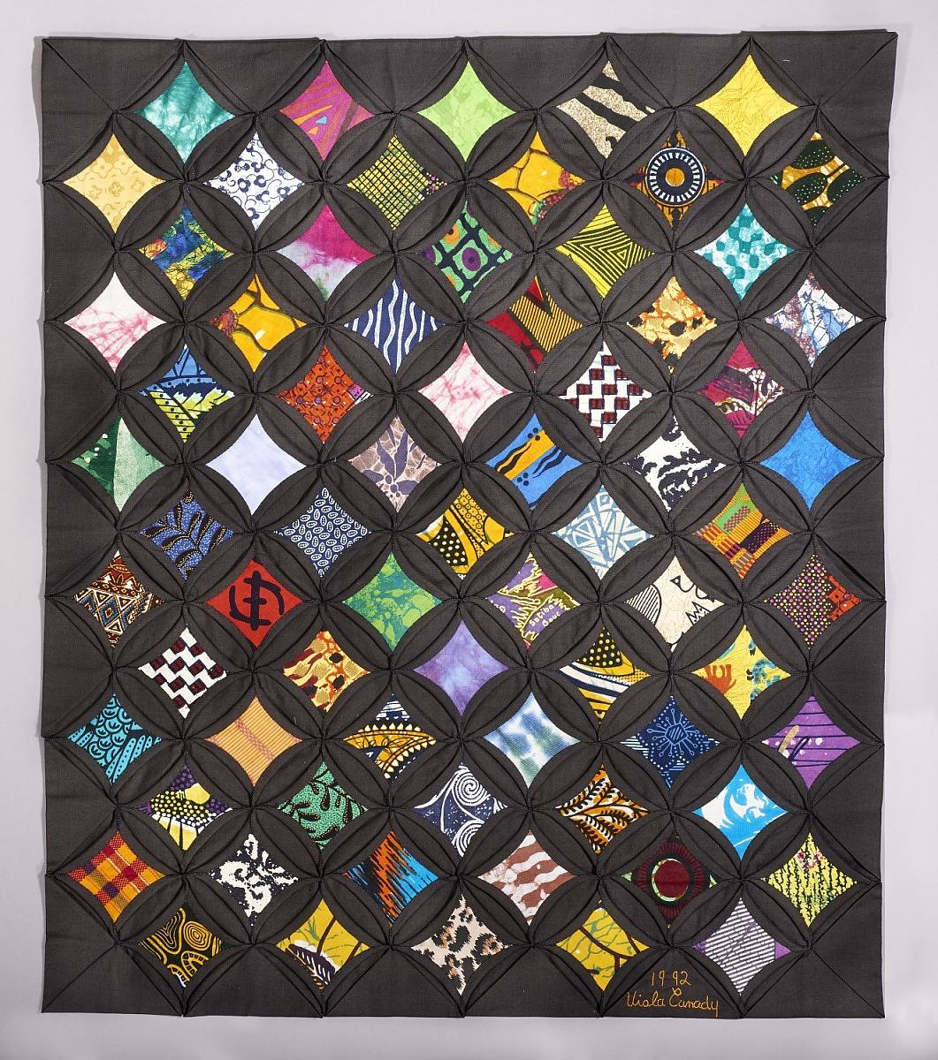
Our Vision for the Future of Scholarly Publishing
https://www.si.edu/object/cathedral-window-quilt:acm_1995.5009.0003
Notes:
Based on the Libraries’ experiences and knowledge of these wider networks and informed by ongoing consultations with UMA faculty, we envision diverse, open systems of scholarly information exchange that facilitate:
Author/creator control of their works;
Use/reuse rights to a broad range of outputs, including but not limited to books, articles, images, datasets, protocols, code, etc.;
Equitable access to both production and use of public knowledge
Peer review and ethical publishing practices
To achieve this vision, we’ll need shared investment in and governance of the closely intertwined content and infrastructure providers

Slide 6
Reasserting Control Over Scholarship
Getting There: Principle-Based Practices
Exert greater control over our investments.
Invest in systems and services that give back to the scholarly enterprise.
Remain engaged with partners to treat infrastructure and content as public goods.
Work as part of the larger scholarly publishing ecosystem to realize a path that is more diverse and equitable across disciplines.
Notes:
How will we reassert control over scholarship? The Libraries are actively developing principles-based practices for investing in and managing our collections. These principles articulate our academic values as expectations for our partners in scholarly publishing.
Implementing principle-based practices will guide our engagements with a range of stakeholders and enable us to:
Exert greater control over how our investments are distributed across the scholarly publishing ecosystem, rather than continue in the cycle of paying exorbitant licences to a narrow range of providers.
Invest in systems and services that give back to the scholarly enterprise rather than extract from it.
Remain engaged with partners to treat infrastructure and content as public goods, rather than perpetuate transactional engagements that restrict ownership and limit access to scholarship.
Work as part of the larger scholarly publishing ecosystem to realize a path that is more diverse and equitable across disciplines. Our networks are our strength and there is an increasing momentum across academic libraries to make change.
Although our principles are still being developed, this effort has already informed decision making during this cancellation process, so our work in realizing this vision has already begun.

Slide 7
Reasserting Control Over Scholarship
Getting There: Faculty Participation
Engage in the governance of your discipline’s publications and research tools
Choose publishers with sustainable models for publication
Learn about the advantages of open scholarship for your field
Be mindful of and negotiate publishing agreements
Self-archive
Assign open scholarship and open textbooks to your students
Know that the Libraries are your partners in scholarship
Notes:
If you are wondering how you might help achieve this vision of a more diverse and open scholarly publication system, here are some suggestions for actions that enable you to reassert control over your own scholarship.
Each of these actions can impact how scholarship is created and consumed. For example, choosing publishers that publish openly (for free) affords scholarship more exposure and reuse. That open content in turn might contribute to an open textbook that saves students hundreds of dollars.
Always, remember that the libraries have experience and expertise in scholarly publishing and are your partners. We are available to guide and answer questions as you pursue these actions. (in particular, the Office of Scholarly Communications)

Slide 8
Investing in the Future
Expenditures on continuing resources leaves no flexibility to support other forms of scholarship.
Majority of academic scholarship locked behind paywalls.
COVID-19 demonstrates how detrimental paywalls are.
Vision to continue to partner with you and invest in creating a larger scholarly publishing ecosystem that is more diverse and equitable across disciplines.
Notes:
The academic publishing market is very inelastic. There is very little relationship between the price of resources and the demand.
As you’ll learn shortly, we currently spend more than 80% of our acquisitions budget on continuing resources. This leaves very little flexibility to support the purchase of monographs and data sets for which there is a growing demand.
This tension between the amount/percentage we spend on continuing resources has been an issue for 30+ years. Every 5-10 years we go through this exercise of cancelling continuing resources due to budgetary ebbs and flows. Each time we come out of a budgetary downturn, we go right back toward reinvesting in these resources which typically inflate at an annual rate of 5-6%. This leaves faculty and students with increasingly less access to an ever increasing amount of scholarship because with each passing cycle our purchasing power decreases.
Further majority of academic scholarship is locked behind paywalls. This includes your scholarship. This means that institutions which can afford to subscribe to these items are able to provide access for their faculty and students.
COVID-19 has reinforced how problematic paywalls are. While many publishers have opened up access to their resources on a temporary basis to provide their customers some relief, their “generosity” is not something we can count on for the indefinite future. The pandemic, combined with economic upheaval, climate change and racial injustice has demonstrated that our instruction, research, and social context requires timely and reliable research results, shared equitably by all.
We’re sharing with you today background on the situation we are in and outline future plans with you. As we start to recover from the COVID-19 induced budget constraints, we will not return to business as usual. That model would have us reinvest heavily in subscriptions to continuing resources as we have in previous cancellation rounds. This moment is our opportunity to break away from that cycle. Instead we want to continue to partner with you and make strategic investments to create a larger scholarly publishing ecosystem that is more diverse and equitable across disciplines.

Slide 9

Questions?

Slide 10
Libraries’ Acquisitions
Budget Update

Slide 11
Library Acquisitions Budget Update
Due to campus budget restraints, the Libraries are reducing the acquisitions budget by 5%
As well, the Libraries will not be receiving our annual inflationary offset, bringing the total reduction to 8.8%
Librarians have been reviewing quantitative data for subscription resources to identify potential cancellations
  Scott Stangroom will provide details of the process later in the presentation
Your feedback is needed as a source of qualitative data

Slide 12
Reductions at Other Institutions
Columbia University: 6.25%
  Planning for acquisitions budget to be flat for 3 subsequent years
  We may be looking at a similar scenario
Rutgers: 10%
Stanford: 10%
Syracuse: 5%
UConn: 25%
Univ. of Delaware: 25%
Yale: 10%

Slide 13
Acquisitions Budget Breakdown
Category | FY20 | FY21 | Notes
Continuing Resources | 82% | 88% | Annual increases range from 3-9%; includes databases and journals that are paid for annually
Other Resources | 7% | 6% | Books, book series, demand driven purchases for e-books and streaming media
Strategic Investments | 7% | 2% | One-time purchases, primarily of electronic resources, but also some special collections materials; emergency fund for unexpected expenses
Collections Services | 4% | 4% | Memberships, bibliographic & processing services, interlibrary loan, record sets, binding

Slide 14
Biggest Expenses
Publisher/ Vendor | FY20 Cost | FY21 Cost | Notes
Elsevier | $1,510,000 | $1,571,000 | 4% increase
Wiley | $707,000 | $707,000 | 4% increase waived for FY21, saving us $28K
Springer Nature | $423,000 | Undetermined | Negotiations in progress
Clarivate | $289,000 | $247,000 | 3% increase waived for FY21 & cancelling InCites, saving us $49K

Slide 15

Questions?

Slide 16
Cancellation Process and Feedback

Slide 17
Cancellations Process: Liaison Librarians
Large and complicated project with short turnaround time
  Getting and analyzing statistics is a time-consuming process
Increased needs for support in online teaching and learning due to the pandemic
Liaisons worked thoughtfully and carefully to review:
  Databases in their discipline(s) / 260+ databases
  Over 820 print journals and serials
  Over 730 ejournals
Liaisons worked on this project during a marked increase in supporting online teaching and learning
Notes:
The cancellations project was a large and complicated project with a short turnaround time.
There were a lot of statistics to gather from our largest vendors down to individual vendors for single journal titles.
This work also came at a time when librarians had a significant increase in their workload as they supported the needs for finding and accessing electronic resources and alternate resources from faculty and students due to the pandemic and the move to online teaching.
Liaison librarians worked very thoughtfully and carefully to review databases across the disciplines they support, which was more than 260 databases. They reviewed more than 1500 print journals, print serials and ejournals. They reviewed each database and the list of journal and serial titles one by one using different criteria and statistics depending on the format.

Slide 18

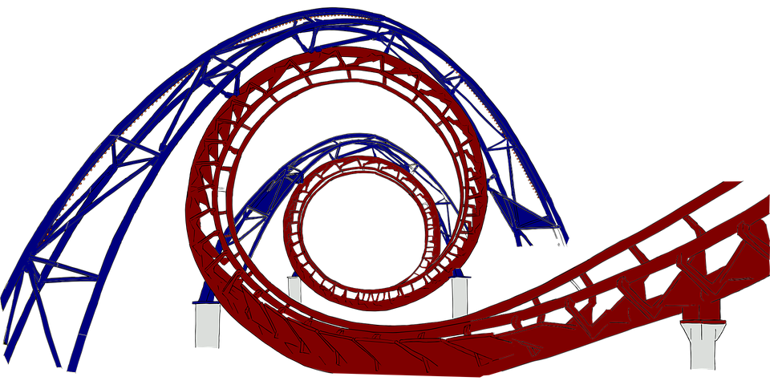
Notes:
Liaisons worked on this project during our busiest times – the prelude to the fall semester and the first few weeks of the fall semester.
This slide was our mascot slide in our bi-weekly group meetings to represent the project and how determined we were to do our very best to minimize the impact of the budget reductions and also acknowledge all the work that was happening at exactly the same time.

Slide 19
Cancellations Process: Overview
Summary of how we identified potential cancellations
  Databases where content had significant overlap or where use was minimal
  E-journals where the cost per article was high, over $53 per article download
  Print journals and serials where content was duplicated online and/or use was minimal
Guiding Principles
  Attention to resources supporting diversity and inclusion
  Preservation of resources with sustainable publishing practices
  Distribution of cuts across subject areas

Slide 20
Cancellations Process: Databases
Usage statistics sought from vendors of 264 databases
Liaisons looked at:
  Title overlap with other resources
    Was the majority of the content available in other databases we have?
  Statistics
    How many times did someone click on or download an item from a database?
Notes:
As Sally said earlier, in order to compensate for the 5% reduction to the Acquisitions Budget, the Libraries naturally have to reduce our spending.
In the spirit of being transparent about our process, I want to give you some brief details of our approach without getting too far into the weeds.
For a general picture of how we allocated Acquisitions money this year.
* • We have, of course, allocated less this year for books – request only basis.
* • We allocated money for DVDs and Streaming Video, but are taking a cautious approach to these purchases
* • We’re also holding a small amount in reserve to plug holes
To make cuts to the budget, we concentrated our reductions on continuing resources. (88%)
Continuing Resources are those resources we pay for on an annual subscription basis.
We started this cancellation process from the premise that no particular continuing resource in the categories of resources we looked at was off the table (I am carefully choosing my words here, which I’ll clarify when I talk about e-journals).
While sheer cost of a resource was considered, it was NOT the sole driving factor in our decision making.
The process for identifying Databases for possible cancellation involved a combination of
* • Looking at usage statistics; identifying how many times someone clicked on a link or downloaded content
* • And comparing one Database with another to see where there was overlap in content or alternative access to the content elsewhere.

Slide 21
Cancellations Process: Ejournals
Usage statistics sought from vendors of 730+ e-journals
Cost Per Use calculated for resources with available statistics
  Cost of the journal subscription divided by the # of articles downloaded
$53 is the average cost for getting an article through Interlibrary Loan (ILL)
  If the cost per use is higher than $53, it saves the Libraries money to get the articles for you through ILL
Notes:
For E-Journals we looked at usage statistics for our over 730 individually subscribed to titles. In our initial analysis we calculated cost per use per title; a use being a full-text download of an article.
We used the dollar figure of $53 as a median. $53 being the average cost for getting an article through InterLibrary Loan. Any title with a cost per use above $53 went on the possible cancellation list, those under $53 were held aside and not considered at this time for cancellation.
The list you are considering for cancellation contains the above $53 per use e-journal titles.
In addition to the quantitative analysis, however, subject librarians and faculty have been and are now doing the qualitative analysis.
When we looked at usage statistics, we focused on individually subscribed to titles. We did not focus on package collections of journals. For example, we have over 200 Taylor & Francis e-journal titles we subscribe to individually (not as a package), but we do have, for example, a package of Cambridge University Press e-journals. We considered cancelling titles from Taylor & Francis, but not Cambridge University Press list
We did this partly because of current contractual obligations for the packages, but also because of the very time consuming and involved process of cancelling Journal packages and then trying to contain costs associated with re-subscribing to select individual titles that were once part of the package. We simply did not have the time for this now, but these journal packages are not untouchable and as they come up for renewal, we’ll analyze things like cost per use per title and compare that with the cost of subscribing to titles individually.

Slide 22
Cancellations Process: Print Journals & Serials
Circulation statistics pulled for print journal and serial titles
  The majority of titles had ZERO circulations since January 2019.
Department liaison librarians analyzed items in their discipline(s):
  Did we already have electronic access to this print title?
  Was this title available via open access?
Notes:
For print journals and serials we did not have cost per use figures – in this case a use would be a circulation – most titles had no discernable circulation. A circulation could be a title that was checked out from the Libraries or simply taken from the shelf and left on a table or countertop.
With the nuances of “usage” of print titles in mind, we started from the premise that we will cancel all of them. And we would walk ourselves backwards from that cliff, so-to-speak.
We are relying now on subject librarians to see if we have electronic access to these titles in our full-text databases or if they are open access. We are paying particular attention to things like the absence of online access. For example, to non-English language print titles. We are also relying on librarians and faculty to do the qualitative analysis.

Slide 23
Cancellations Process: Feedback Process
Please email us at libraries-reduction-feedback@library.umass.edu with questions or comments
Cancellation list is available on the library website at https://www.library.umass.edu/news/fy21-acquisitions-budget-reductions/
Some cancellations have already occurred due to renewal date
  InCites, for example
Since cancellation processing takes time and resources have cancellation deadlines, we’ll need feedback by next Friday, Oct. 2
Resources maintained must be balanced by additional cuts
Notes:
Finally,
I want to emphasize, or re-emphasize? That Subject Librarians are here to help make decisions and suggest alternative resources or means of access to the content you need

Slide 24

Questions?

Slide 25
Presenters
Leslie Button, Associate Dean for Research and Learning
Sarah Fitzgerald, Assessment and Planning Librarian
Jennifer Friedman, Head of Research Services
Sally Krash, Associate Dean for Content and Discovery
Rebecca Reznik-Zellen, Head of the Science & Engineering Library
Scott Stangroom, Acquisitions Unit Coordinator
Christine Turner, Scholarly Communications Librarian

Slide 26
Thank you!

