Slide 1
Licensing Transformations
In today’s scholarly publishing environment
Sally Krash
Associate Dean for Content & Discovery
University of Massachusetts, Amherst March, 2019

Slide 2
Topics
Background
Model A: Subscription to Open Access
Model B: Publish & Read
Model C: Offsetting
Model D: Discount
Alternative: Token Access
Impact on Umass
Many thanks to U. of Vienna collaborations
https://openaccess.univie.ac.at/en/funding/oa-publishing-agreements/

Slide 3
Background
Peer-reviewed electronic journals introduced in 1993
  Online Journal of Current Clinical Trials
The costs of annual increases in licensing far exceeds the annual increases that libraries get (see next slide)
Libraries have had to make hard choices on what to retain so that they can continue to fund big deal packages, which are often locked into multi-year deals
Several Open Access movements have been initiated, not necessarily to improve access to scholarly literature, except in the case of Plan S, but to put a lid on out of control journal price increases that cannot be sustained

Slide 4
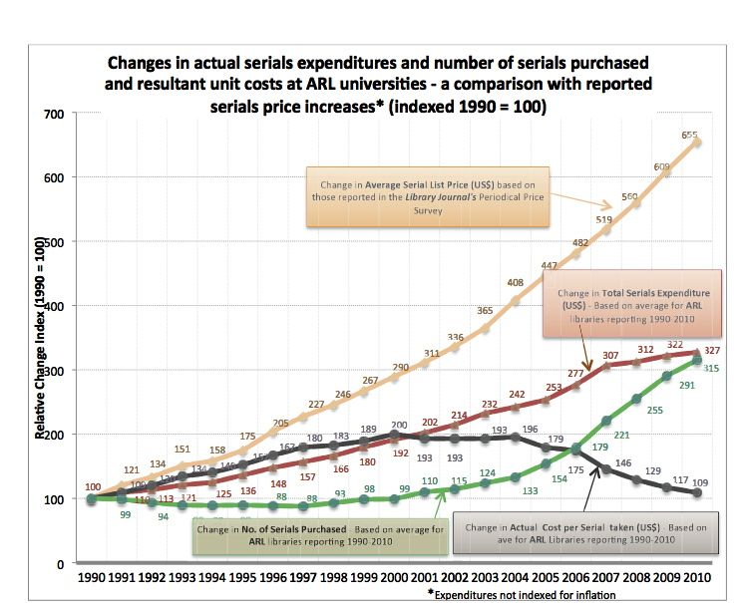
https://scholarlykitchen.sspnet.org/2016/03/10/revisiting-have-journal-prices-really-increased-much-in-the-digital-age/

Slide 5
Model A: Subscription to Open Access
Common characteristics
  Publisher flips journal(s) to Open Access
  Library pays the same fee to support OA that was paid under the subscription model
  Publication(s) are openly available to all
Drawbacks
  If a significant number of libraries drop out, the model is not sustainable
Examples
  SCOAP3
    High energy physics; successful since 2014
    Some libraries dropped out, but most still support this
    Some journals were pulled out by publishers
  Annual Reviews Subscribe to Open
    New model for 2020 for 5 of their journals

Slide 6
Model B: Publish & Read
Common characteristics
  One fee to access subscription journals
  PAR fees (replace APCs) to publish articles OA without cost to faculty authors
Drawbacks
  Costs could spiral out of control (PAR fees)
  The publisher will want an agreement that covers both the subscription fee and the amount that the university spends on publishing
    Most universities do not have a good idea of how much they are spending on publishing
    The total cost of publishing is not paid by the library
  Additional processing workflows for library staff
Examples
  Wiley
  Springer
  Taylor & Francis
Failures
  Elsevier
    UC System
    Norway
    Germany
    Sweden

Slide 7
Model C: Offsetting
Common characteristics
  The license allows for an offsetting of Article Processing Charges (APCs)
  The library pays up front, and gets reimbursement from the publisher, depending on the number of OA articles published by faculty authors
Drawbacks
  Additional processing workflows for library staff
  Only one publisher is trying this model
Examples
  Institute of Physics
    Cambridge University
    University of Vienna

Slide 8
Model D: Discount
Common characteristics
  Faculty authors receive a discount on publishing Open Access
  Some models provide free publishing for all or a subset of journals/ebooks
Drawbacks
  If not part of a license agreement, requires investment/pledge from libraries
Examples
  Open Library of the Humanities
  InTechOpen (Knowledge Unlatched offering)
  BioMed Central

Slide 9
Alternative: Token Access
Has been around since before OA movement
Libraries negotiate a set cost for article downloading
  As part of a license negotiation
  As part of a license termination
Access options
  Unmediated
  Mediated by library staff
Drawbacks
  Unsustainable for larger universities
Examples
  Elsevier Token Acess
    Amherst College
    Trinity University (San Antonio)
  Wiley Article Select
    Southwest Research Institute

Slide 10
Impact on UMass
  Approach
    No running with scissors – watch what is happening with other larger libraries and systems
    Establish goals/models/tools for new license models
    Communications with faculty is key
      They will still get the resources that they need
      We will take a measured approach to license transformations
    Participate in forums and initiatives to facilitate transformation
    Provide leadersrhip in transformative frameworks
      Collections Priorities
      Collections Strategies Colaition
  Initiatives
    NERL (North East Regional Libraries) activities
      BLC members are working with this group
    TSPOA (Transitioning Society Publications to Open Access) grassroots initiative
  Upcoming opportunities
    Elsevier system-wide renewal expires Dec. 31, 2022
    Springer Nature transformative deal with NERL for 2019
  Questions, comments?

