Slide 1
The Big“gest”
Deal Renewal
Umass System Libraries 2018
Sally KrasH
Associate Dean, Content & Discovery
Umass Amherst Libraries

Slide 2
Activities
Renewal process
Data Inventory & Analysis : Data Working Group
Negotiations: Steering Committee
Post-negotiations: Acquisitions Working Group
Next steps

Slide 3
Renewal Process
Implemented subscription review process* as recommended by the Collections Analysis Task Force (CATF)
  Form groups: Steering Committee, Data working group, acquisitions Working group
  Develop communication plan
  Set goals and establish timelines
Initial license & Budget review
  What access does each campus have?
  How much notification does Elsevier require for changes?
  What is a reasonable increase that will not create budget stress?
  Are we comfortable entering into a multi-year agreement?
  Can we negotiate a decrease?
Data Working Group activities
Steering Committee negotiations
Finalize licensing
Acquisitions Working Group activities
*Collections Analysis & Assessment Guidelines
https://works.bepress.com/sallykrash/17/

Slide 4
Data Inventory & Analysis
Data Working Group
Qualitative data
  Surveyed all 5 campuses:
    10 essential journal titles for research & teaching
    5 essential journal titles for your subject area
Quantitative data – past 3 full calendar years
  Citation analysis
    Where are faculty publishing?
    What journals are faculty citing?
  Usage analysis
RedCAP used for survey tool & data analysis

Slide 5
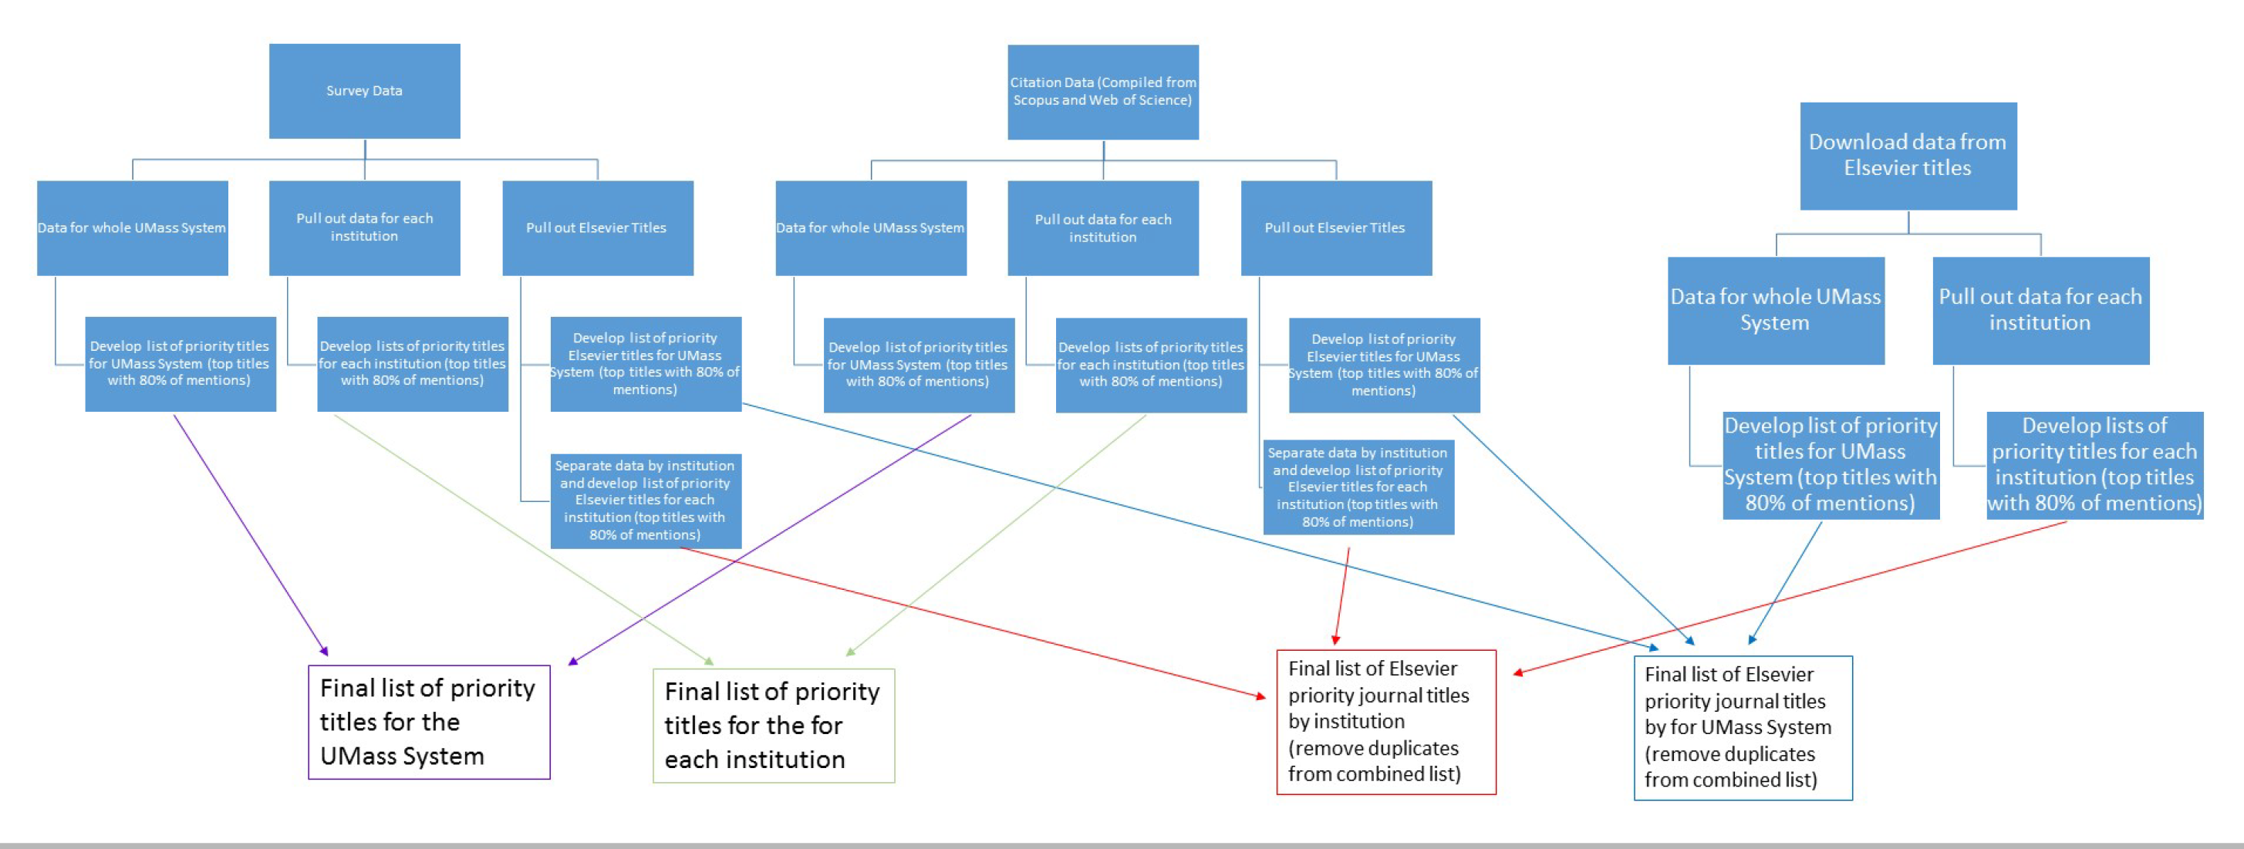
Data Diagram

Slide 6
Negotiations
Steering Committee
What we asked for and got
  One title list for all 5 campuses
    Previously we had 3 separate lists
    Freedom & Cell Press collections for all 5 campuses
  E-Only for all titles/campuses
    All print has been cancelled
  One Fee schedule for all 5 campuses
    Previously we had 3 fee schedules
  Consolidation of billing
    Previously we were invoiced separately for different licensed content
What we asked for and did not get
  Allow annual cancellations
    Must be an even swap-out
  Annual price cap should be in-line with Library budget capacities
    Final was 3% with an increase to 4.5% in year 5
  Offsetting of Article Processing Charges (APC*)
  Consideration for all Elsevier products that we purchase
    Bepress is too new to include

Slide 7
*Article Processing Charges
One Campus library analysis
faculty published articles in Elsevier Open Access (OA)/Hybrid journals (Elsevier paid Open Access) 2016
Of 1698 total articles published in 2016, 303 are published by Elsevier
Of those 303 articles, 137 are behind pay walls and 166 are openly available
Of the 166 openly available articles, 46 are in full OA journals and 119 are in Hybrid/FBOA journals (1 is undetermined)
Of those 119 openly available journals published in hybrid journals, our faculty paid a total of $430,675 dollars in APCs (Article Processing Charges in one year)

Slide 8
Post-negotiations
Acquisitions Working Group
included one person from each campus library and one coordinator
Elsevier supplied a spreadsheet with one tab for each
  Currently subscribed titles
  Elsevier complete journal list (full pricing for 2018)
  Journals we want to include in our 2018 license
  Journals we want to remove from our 2018 license
  Complete journal list for 2018 contract
Activities included
  Making sure priority titles were included In contract list
  Making sure inclusions/deletions were listed on the appropriate tab
    Deduped multiple subscriptions across Three title lists
  Bringing the spend up to the contract amount
    Priority List – $2.6M list price (single subscription)
    Licensed amount – $3.8M (5 campuses)
  Finalizing title list
  Working with Elsevier to get access turned on

Slide 9
Cost Analysis
Actual cost breakdown by campus
  Amherst 37%
  Boston 8%
  Dartmouth 9%
  Lowell 18%
  Worcester/Medical 29%
Cost for priority title list $7.7M if paid separately
  Assuming we would not be able to negotiate a multi-campus deal with decreased spending
Umass System-wide savings is 50%
  Plus, we are getting more content than what was included in the Priority Title List

Slide 10
Next Steps
Members of the steering committee are now on system-wide efficiencies & effectiveness committee to look at how to leverage system-wide Resource access and licensing
In the next 4 years:
  Year 2
    determine how to better allocate costs across the 5 libraries
    develop a list of “asks” for our next renewal
  Year 3
    Refine our “asks” for our next renewal
    Initiate renewal process
    Conduct faculty survey for qualitative analysis
    Start Preparing our campuses for the possibility of walking away from this deal
  Year 4
    Finalize our “asks” for our next renewal
    Conduct data inventory & Analysis
    Move into negotiations
The End

