Slide 1
Technical Services in the 21st Century Academic Library
Sally Krash
Head of Acquisitions
Howard-Tilton Memorial Library
Tulane University
LUC 2015

Slide 2
Challenges & Opportunities
Transitioning and overlapping workflows
  Where does technical services fit in the organizational structure?
  Cross-training of staff, elimination of silos, broadening of skill sets
Metadata creation/management
  Who is responsible?
  Establishing guidelines for consistency across the library
Standards landscape
  How to keep up with changes?
  Move towards globalization
BIBFRAME & Linked data
  How to move from MARC to eXtensible Markup Language (XML)
  Using the semantic web to share metadata beyond the library
Changing scholarly formats
  What will we be cataloging in 5 years? 10 years?
  Open-access, digital repositories, streaming media ...
Dynamic systems
  Future of the OPAC
  The role of resource & access management systems [for inventory, access, both?]
Notes:
This presentation will address major challenges and opportunities facing technical services departments in academic libraries, assessing our current environment and looking forward 5 to 10 years. The presentation will be limited to 5 hot topics in technical services - tentatively: scholarly formats, space/backlogs, transitioning/overlapping workflows, linked data and evolving standards, and resources and access management systems. The session is intended to be conversational and spark discussion among attendees.

Slide 3
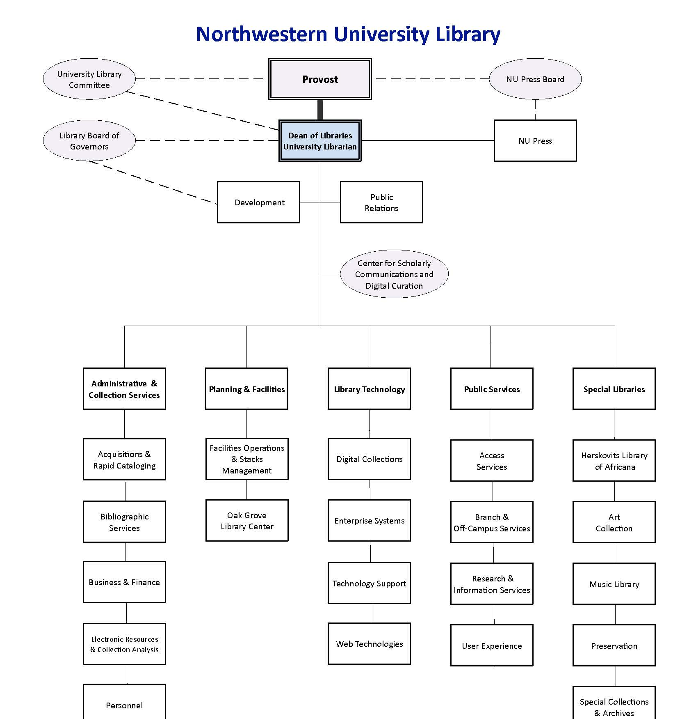
Transitioning Workflows: Libraries 1.0

Slide 4
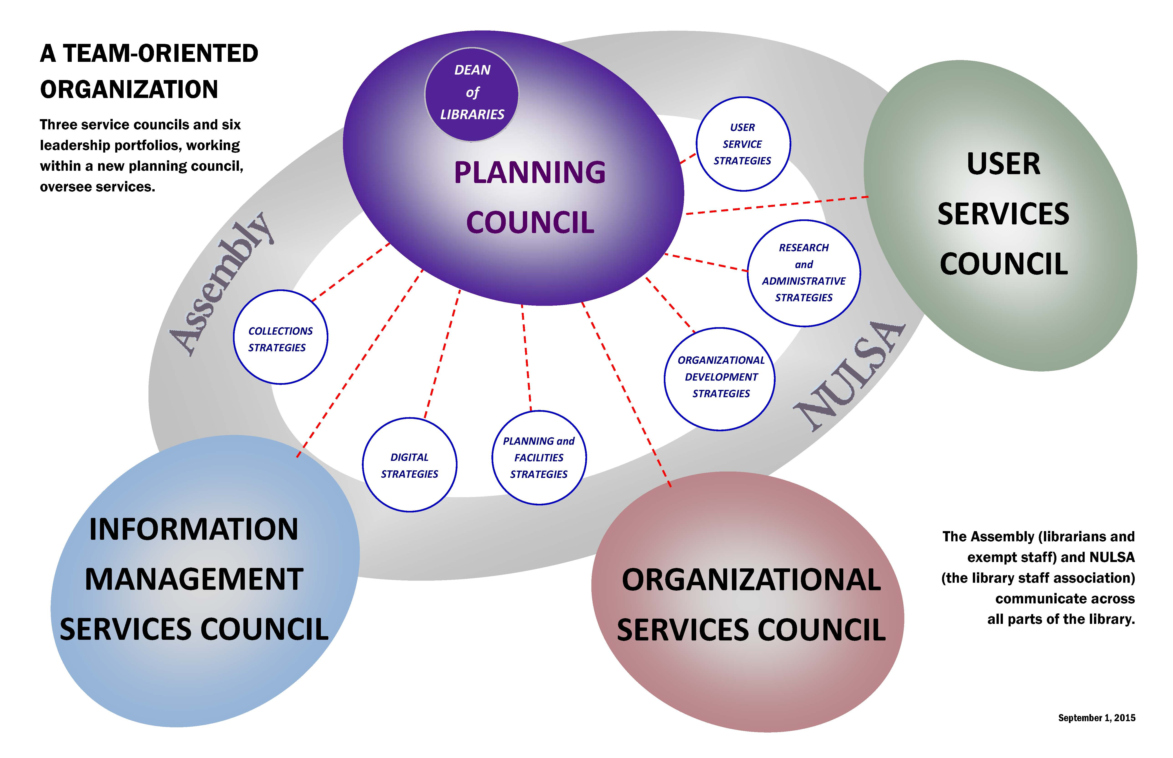
Transitioning Workflows: Libraries 2.0

Slide 5
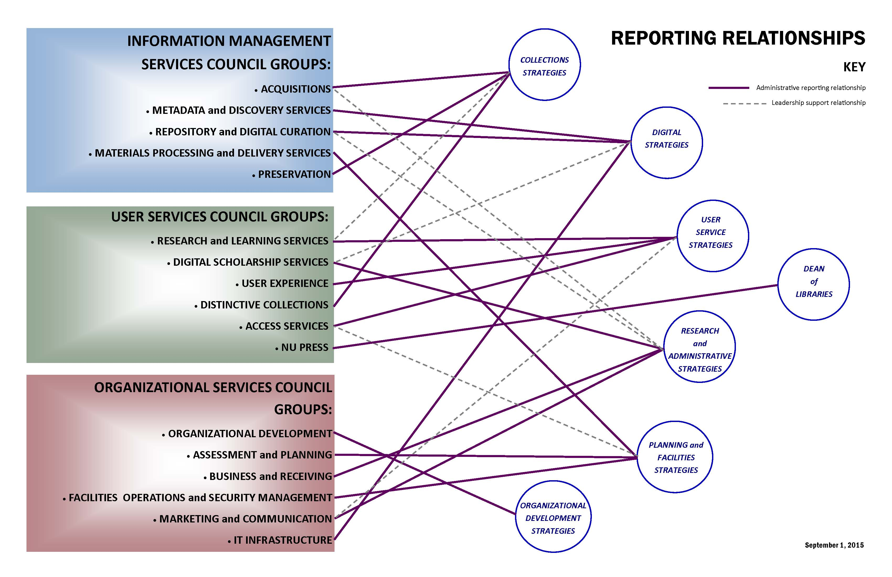
Transitioning Workflows: Libraries 2.0 Details

Slide 6
Metadata Creation/Management at UMass Amherst
Working Group
Guidelines
“Provide direction for and coordination of metadata creation and management with the goal of interoperability. Develop appropriate guidelines and documentation for shared metadata in the libraries.”
Includes librarians from across the library (TS, IT, Special Collections)
Developed for optimal indexing and display in an aggregated environment.
Define basic metadata principles
Provide content guidelines and examples for different data elements
Not format-specific, but rather identify those elements commonly needed across all formats.

Slide 7
Evolving Standards
  AACR2→RDA (ALA →JSC)
    Evolution of descriptive cataloging standard based on FRBR
    FRBR (IFLA) conceptual model that links different manifestations of the same work
    End goal: enhance the user’s ability to discover, select and link to desired resources
  Other content standards
    CCO - Cataloging Cultural Objects (ALA)
    DACS – Describing Archives: A Content Standard (SAA)
  Data Value Standards
    NACO/SACO & VIAF (LC & OCLC)
    Library of Congress Subject Headings - LCSH
    Getty thesauri & naming standards: AAT, TGN, ULAN
    Thesaurus of Graphic Materials: TGM-1 & TGM-II
  Structural Standards
    Dublin Core
    Encoded Archival Description – EAD
    Metadata Object Description Schema – MODS
    VRA Core 4.0
    MARC
  Syntax Standards
    Extensible Markup Language – XML
    Standard Generalized Markup Language - SGML
    MARC→Bibframe (see next slide for comparison)
      Moving catalog records beyond the intellectual work/physical container to a networked entity-relationship model
      Library community’s formal entry into the much larger world of data*
      Work in progress – when complete, vendors and systems will need to adapt
  NISO initiatives
    Sushi – Standardized Usage Statistics Harvesting Initiative
    PESC – Protocol for Exchanging Serial Content
    Bibliographic Roadmap Development Project
      Enable the use and exchange of bibliographic data in a linked data environment
    Bibliographic vocabulary exchange
    Access and License Indicators
    Demand-Driven Acquisitions (DDA) of Monographs
    KBART (Knowledge Base and Related Tools)
    JATS: Journal Article Tag Suite
      Standardized Markup for Journal Articles
*http://www.loc.gov/bibframe/pdf/marcld-report-11-21-2012.pdf, pg. 4
Notes:
Resource Description & Access, Functional Requirements for Bibliographic Data, Virtual International Authority File, Program for Cooperative Cataloging

Slide 8
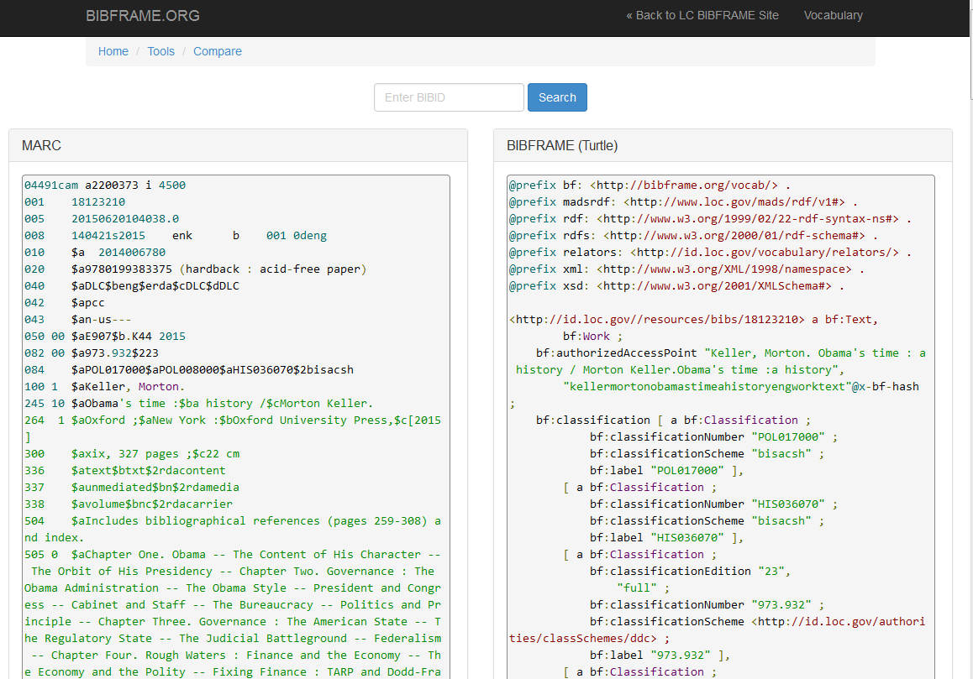
MARC to Bibframe
http://bibframe.org/tools/compare/

Slide 9
Scholarly Formats
What will we be acquiring, describing, organizing, providing access to, and preserving in the future?
  Repositories for government funded research
    Data sets
    Researcher notebooks
    Technical reports
    Data contained in (dated) formats that require emulation environments or conversion/migration for access
  Scholarly Repositories
    Open-access articles
    Dissertations & theses
    Conference publications
  Streaming Media
    Streaming audio
    Streaming video
  Open Educational Resources
    E-textbooks
    Media files (interactive?)
    Courses and course materials
    Software

Slide 10
Dynamic Systems
  Sushi feeds for automated COUNTER statistics gathering and distribution
    Vendor to vendor to library system
    vendor→UStats→Alma transitioning to vendor→Alma Analytics
  ONIX vendor licensing distribution
    Vendor to ERM /URM - still in development
  Discovery
    Voyager, ArchivesSpace, Islandora→Primo
    OCLC←Voyager, ArchivesSpace, Islandora
  Electronic Data Interchange (EDI)
    Orders: Voyager→Vendor
    Invoices: Vendor→Voyager
  Vendor APIs for automated order processing and records ingestion
    Alma/YBP real-time acquisitions
      Gobi→Alma (manual review possible in Alma)

Slide 11
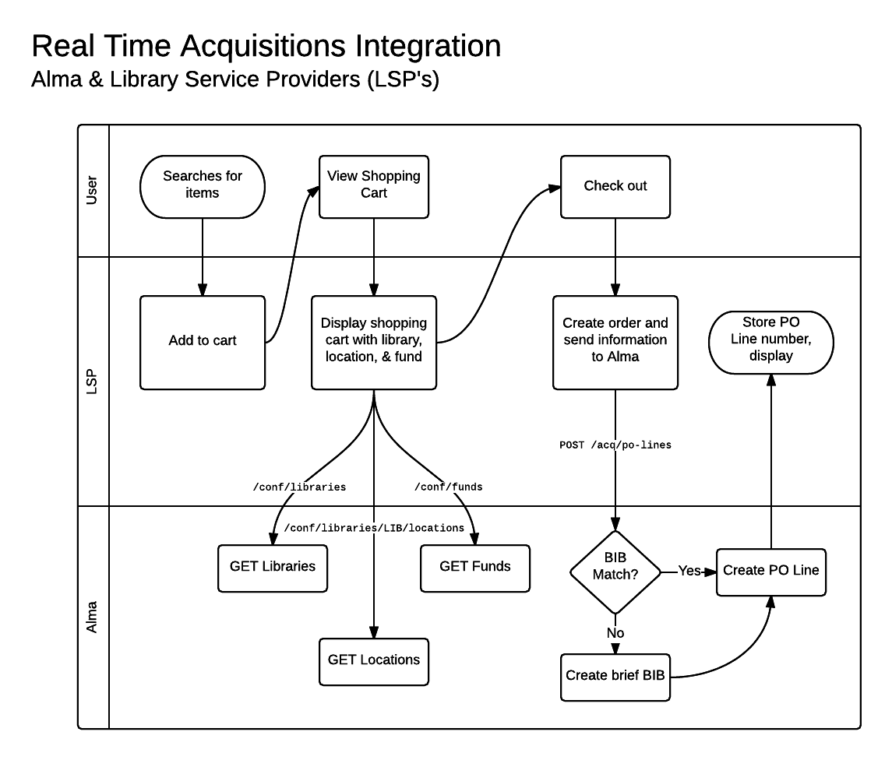
Real Time Acquisitions Integration
Alma/YBP
https://developers.exlibrisgroup.com/blog/Real-time-Acquisitions

Slide 12
URM
  Cloud-based open platform
  Pulls elements under one umbrella for more efficient workflows and reduced system interactions
Improved analytics
  Within the user interface
    No more Reporter client
    No more extracting information directly from Access Reports
  Will require reimagining workflows and training
  Staff will have to learn about licensing terms and how to enter them, or standards will have to be further developed (ONIX) to feed licensing terms directly into the library system
  APIs will streamline order processes
  Records can be selected from within the library system
    From OCLC or shared databases
    Will we need other tools? (like MarcEdit & BibDelete)
  Will we even be loading records into the URM, or will we just provide link-outs from a Knowledge Base?

Slide 13
Bibliography
Bibliographic Framework as a Web of Data: Linked Data Model and Supporting Services, Library of Congress, Washington DC, November 21, 2012. http://www.loc.gov/bibframe/pdf/marcld-report-11-21-2012.pdf
Bibliographic Framework Initiative, Library of Congress, Washington DC, retrieved August 11, 2015. http://www.loc.gov/bibframe/
Metadata Guidelines, UMass Amherst Libraries, Amherst, MA, retrieved August 30, 2015. http://www.library.umass.edu/assets/Digital-Strategies-Group/Guidelines-Policies/Metadata-Guidelines-v4.pdf
NISO, National Information Standards Organization, Baltimore, MD, retrieved August 11, 2015. http://www.niso.org/home/
NISO Bibliographic Roadmap Development Project, Baltimore, MD, retrieved August 12, 2015. http://www.niso.org/topics/tl/BibliographicRoadmap/
Tech Blog: Real-time Acquisitions: Alma – YBP integration, ExLibris, Chicago, IL, retrieved August 12, 2015. https://developers.exlibrisgroup.com/blog/Real-time-Acquisitions

