Slide 1
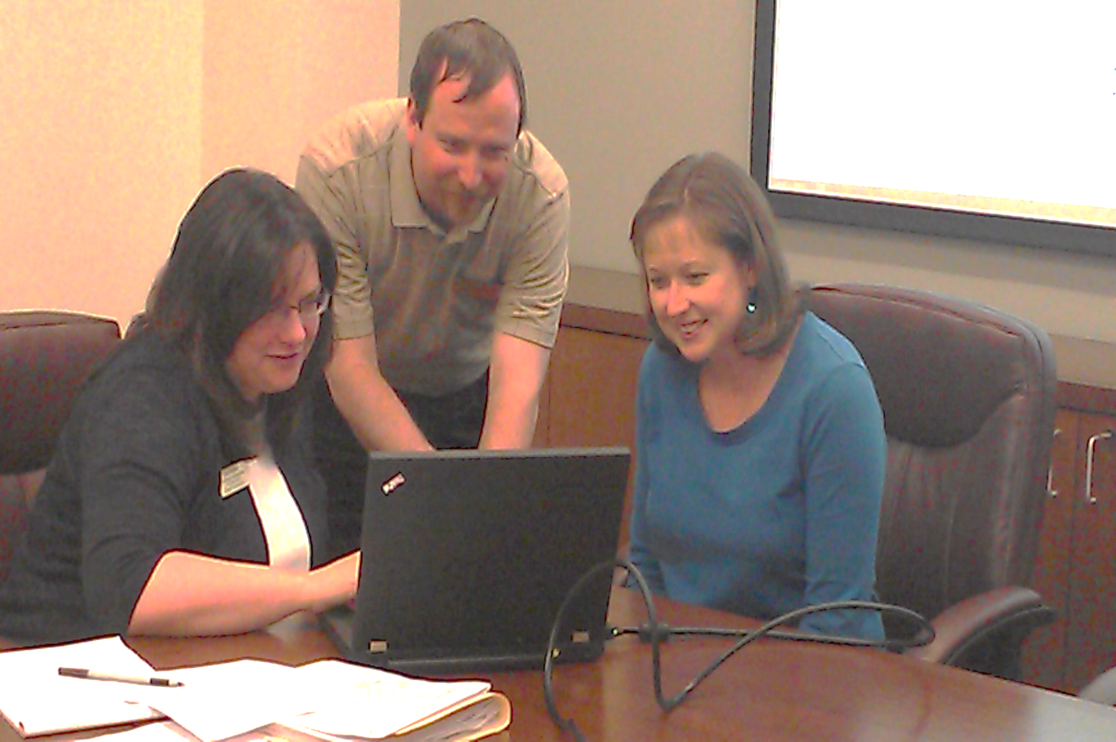
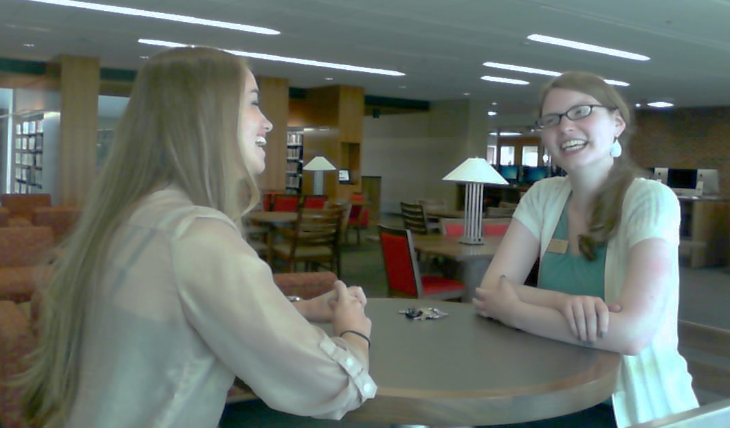
Making Connections:
Helping New Employees Find Their Place
Rory Patterson, Angela Rice, and Lori Snyder, Liberty University Jerry Falwell Library
Objective
Acclimate new employees to increase probability of workplace success and satisfaction
The Pilot
2013-3014 academic year
14 Connectors (mentors)
34 new employees
Weekly meetings first month
Monthly meetings remainder of year
Surveys at 1month and 6 months
End of program celebration planned
Lessons Learned
Shorten program duration (3 months)
Reduce number of Connector/new employee meetings
Reduce number of committee meetings
Need funds for activities
Development
Steering committee formed
Proposal to Dean
Program materials developed
Recruitment of Connectors
Matching criteria (same gender, different department, personality)
Future Plans
Transition from steering to standing committee
New committee service terms, including chair
Matching of Connector and new employees as hiring occurs, not academic year

