Slide 1
The World’s Least Expensive Documentary
Copyright @ Roberto Bahruth 2010

Slide 2
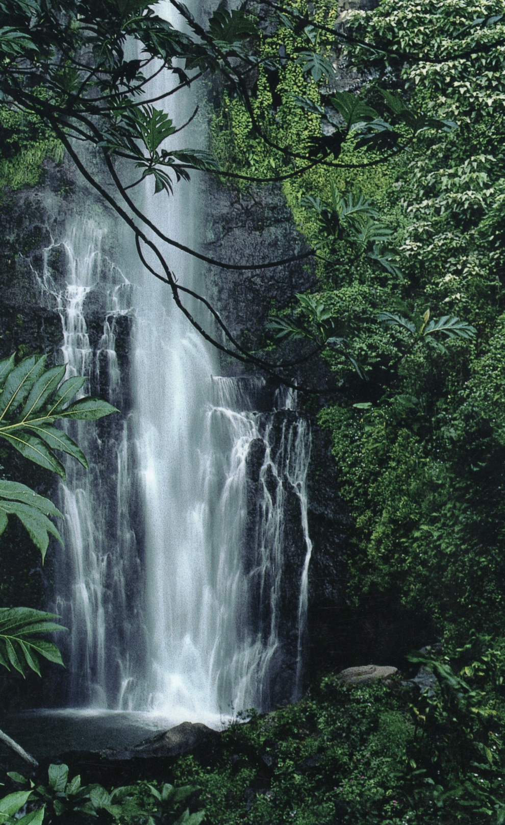

Slide 3
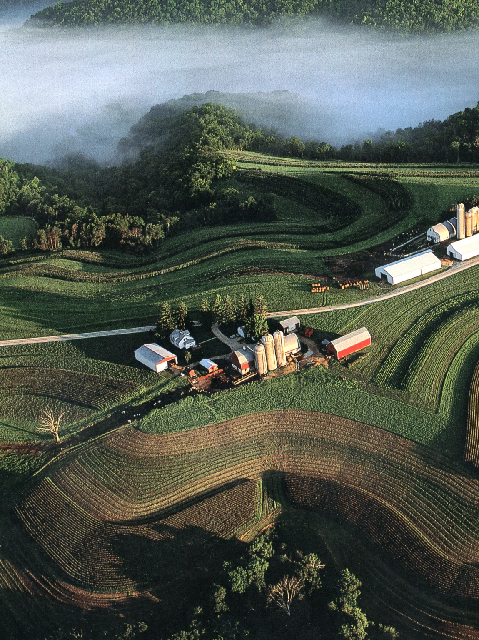

Slide 4
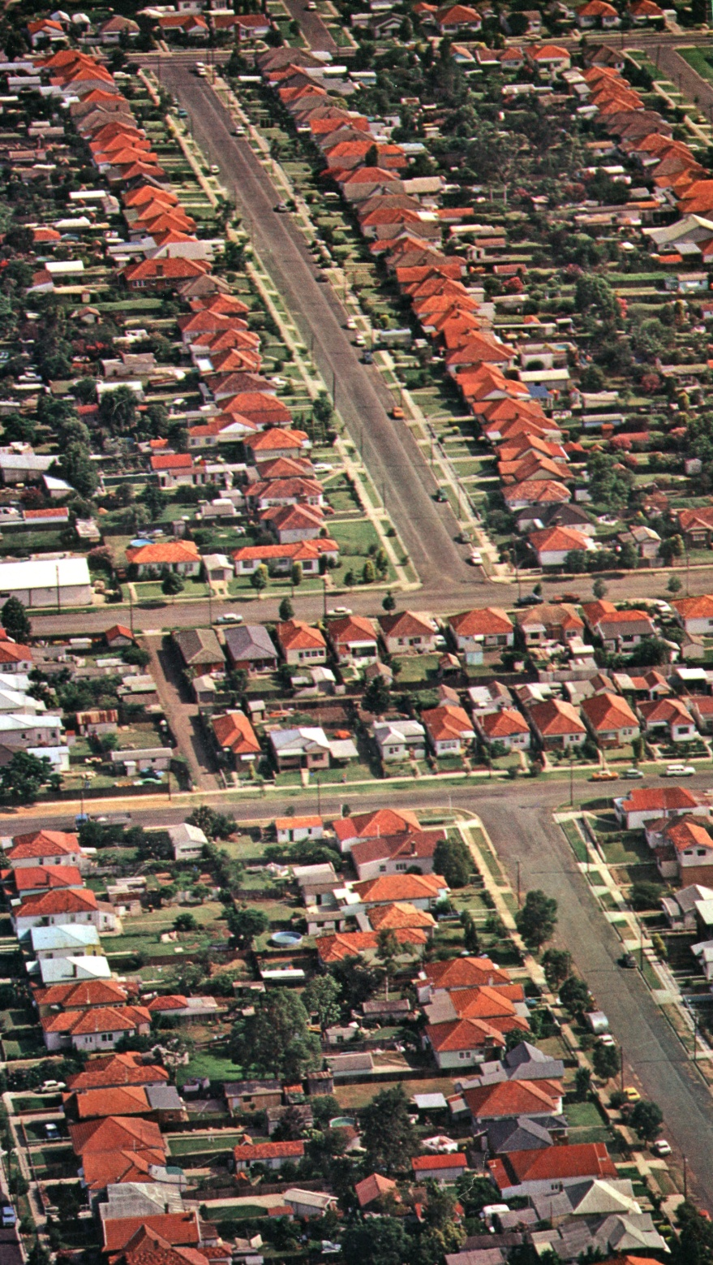

Slide 5
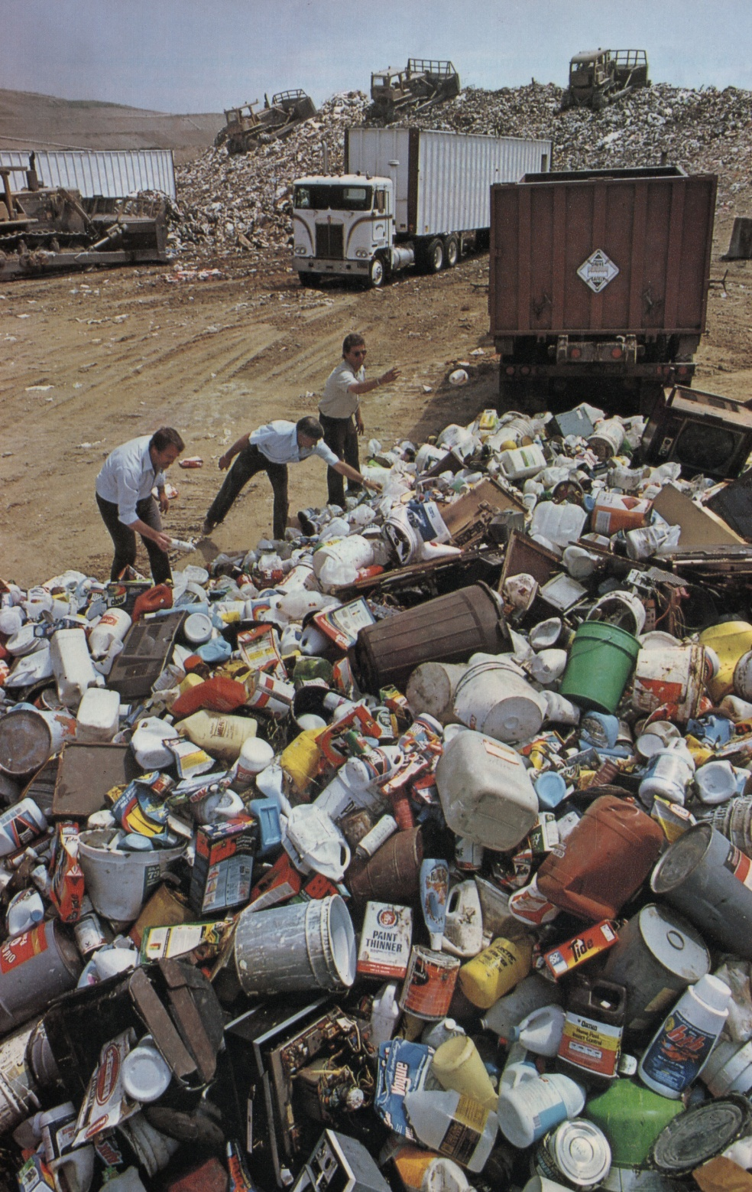

Slide 6
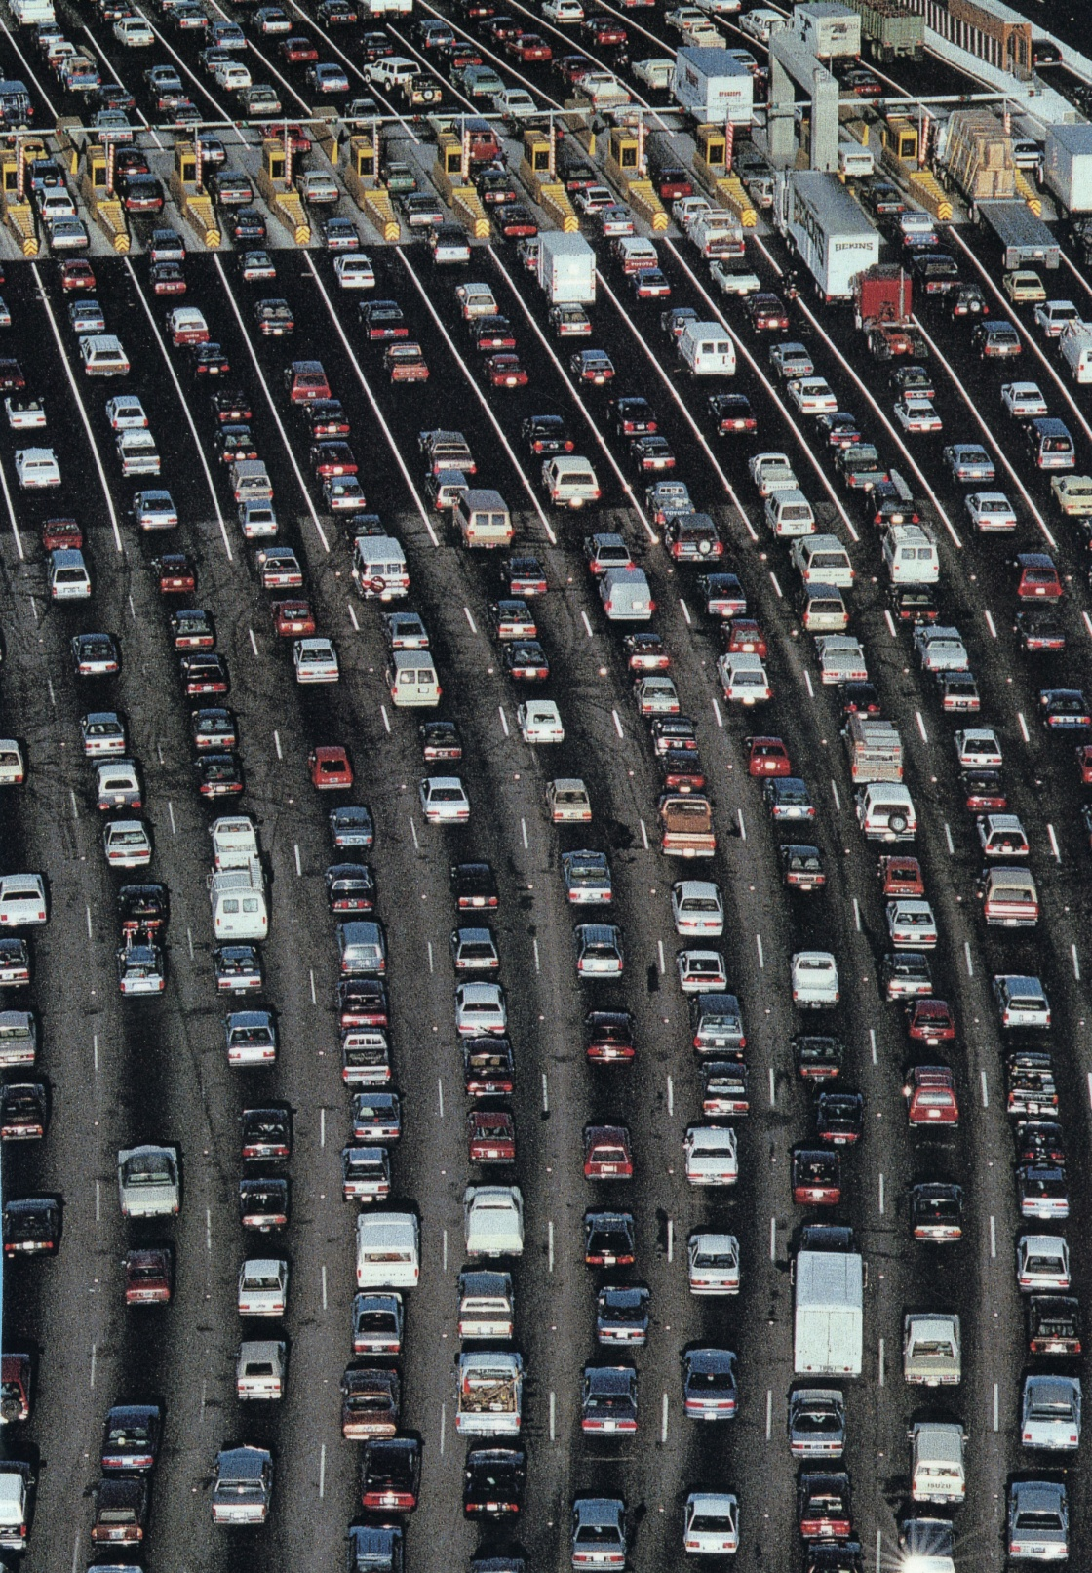

Slide 7
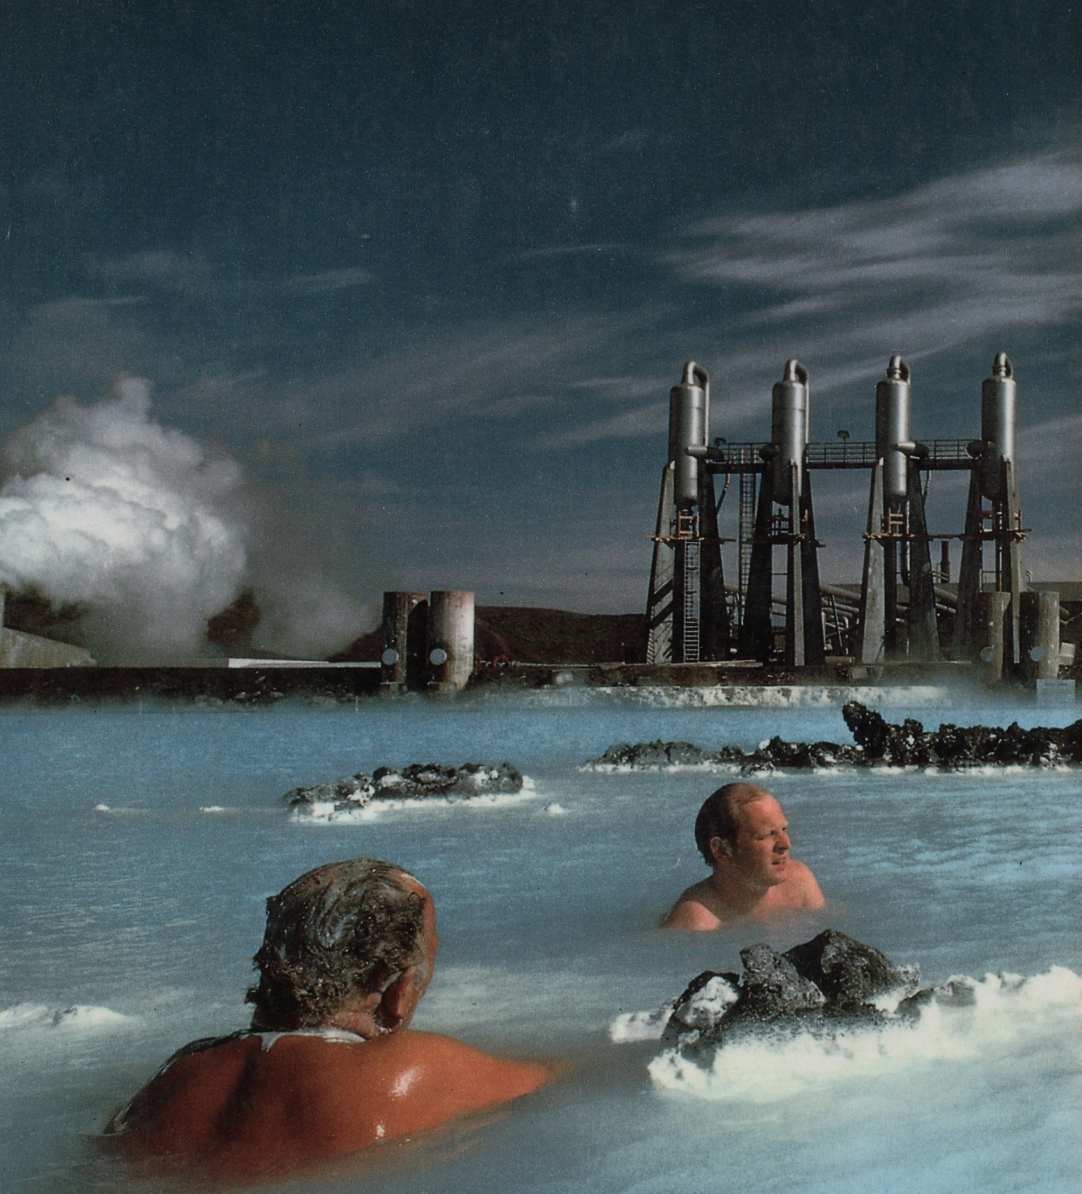

Slide 8
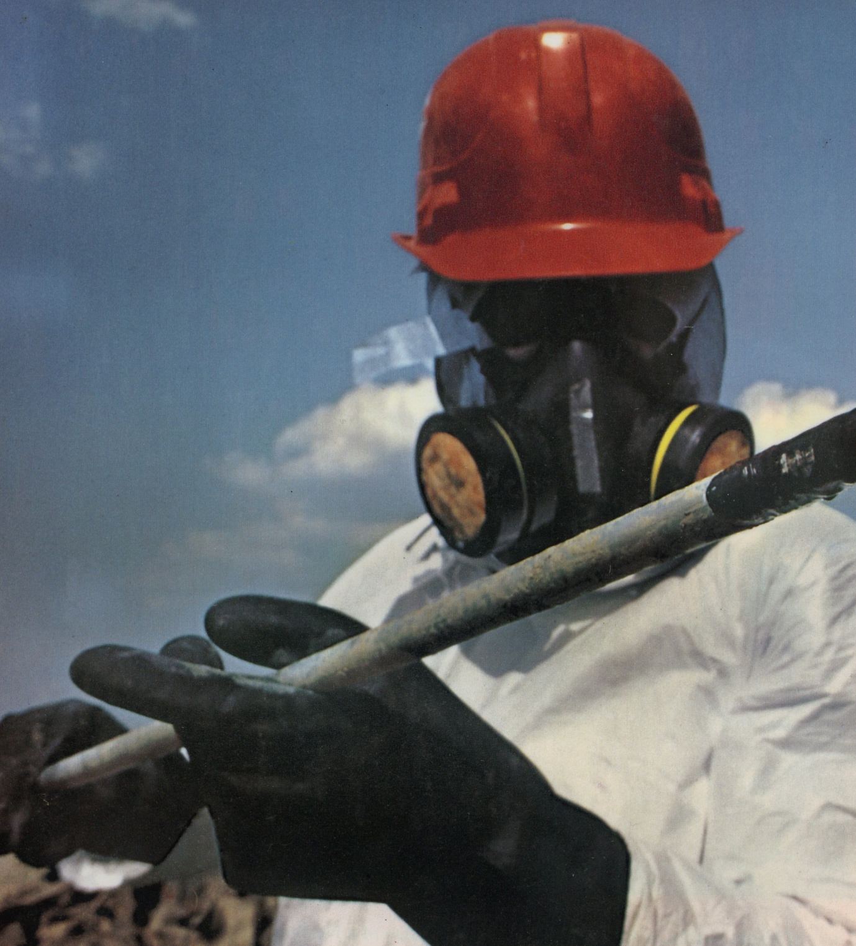

Slide 9
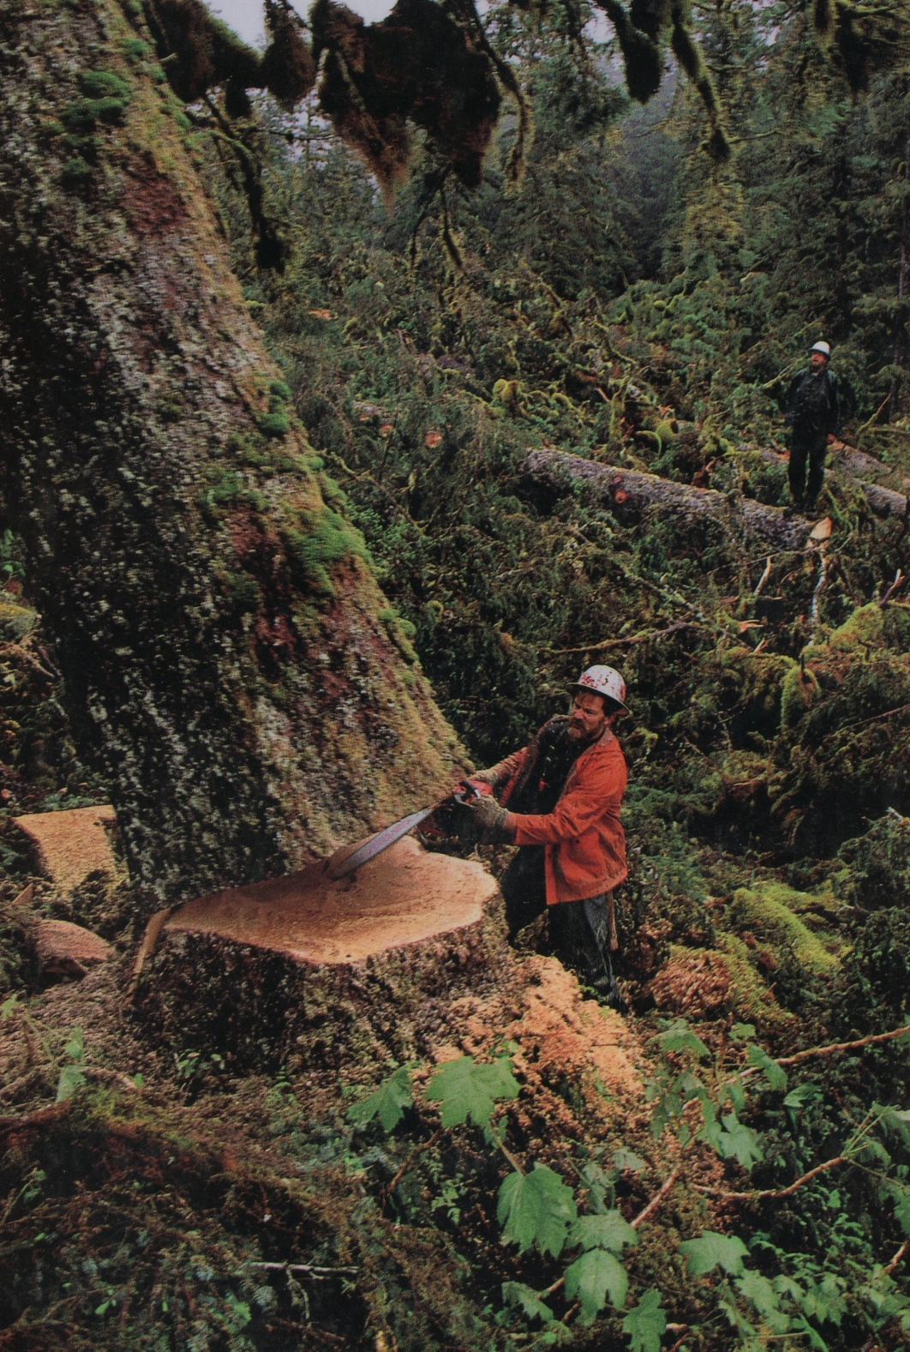

Slide 10
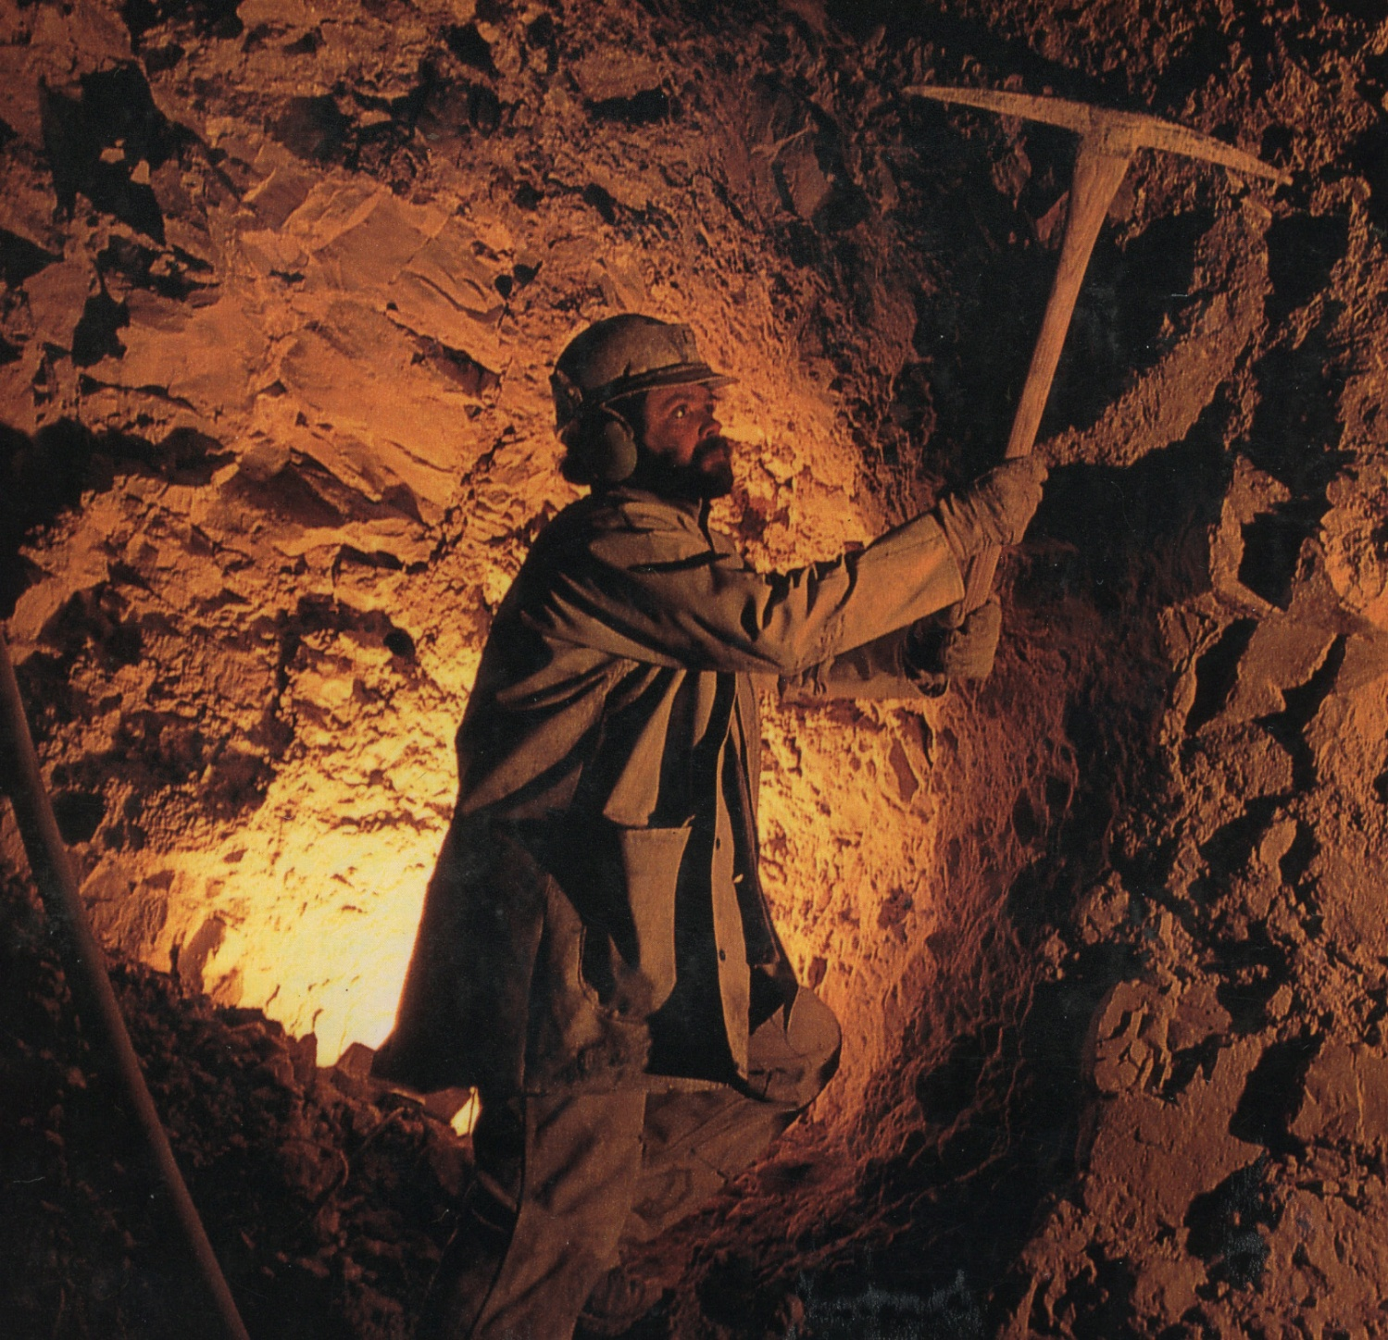

Slide 11
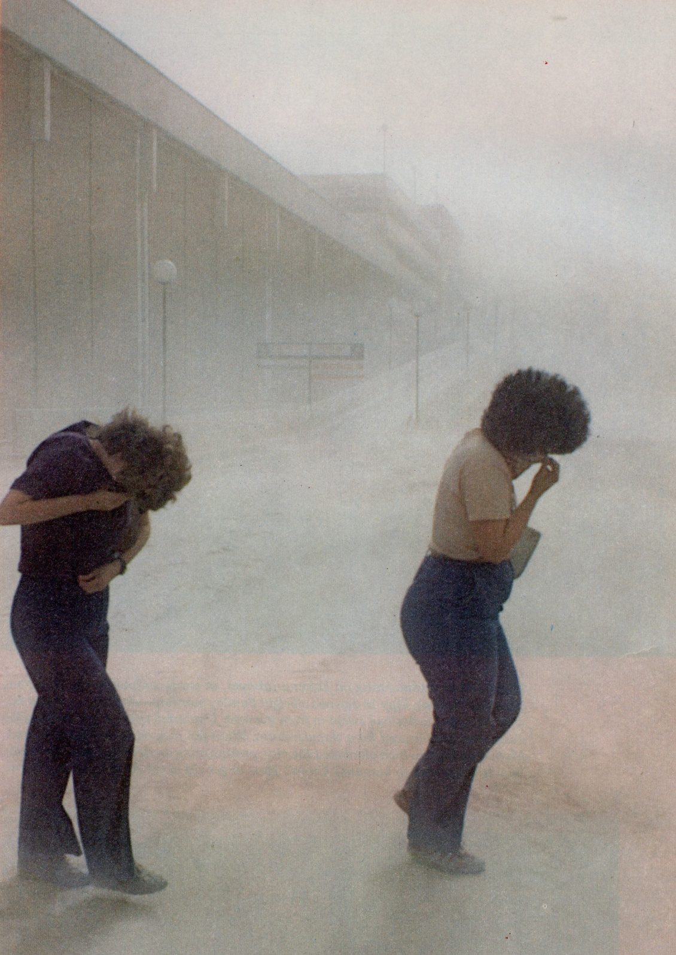

Slide 12
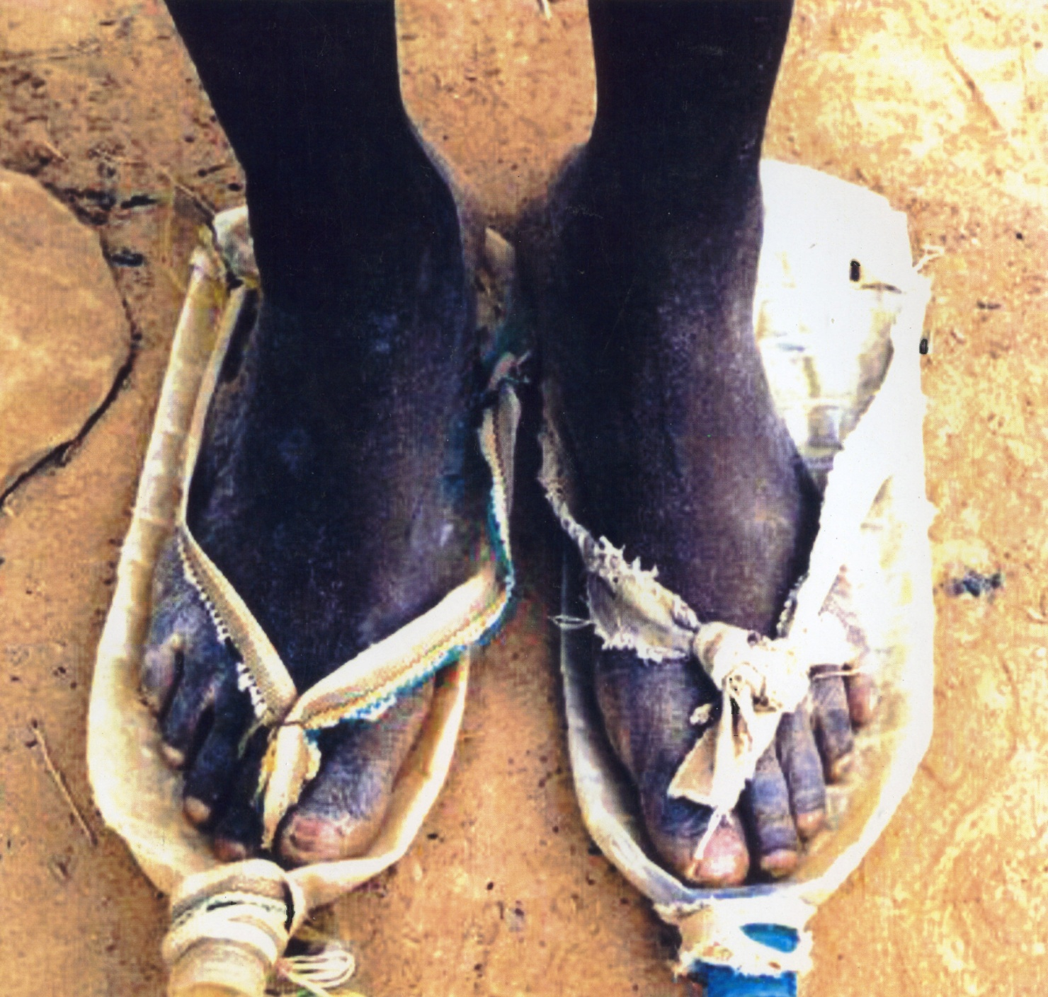

Slide 13
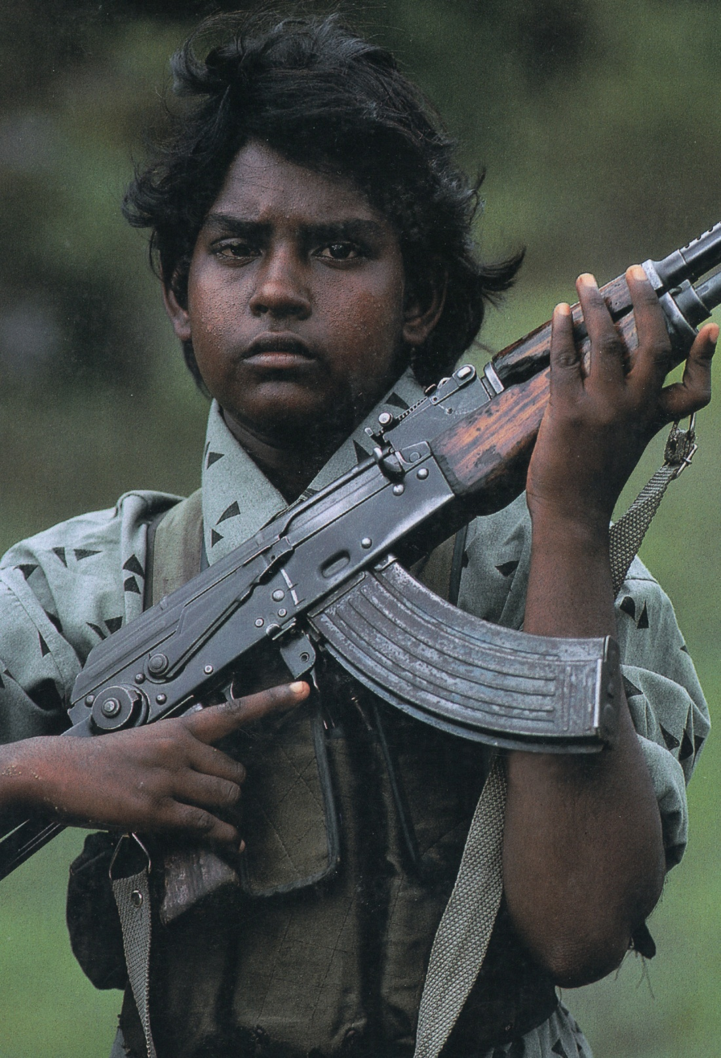

Slide 14
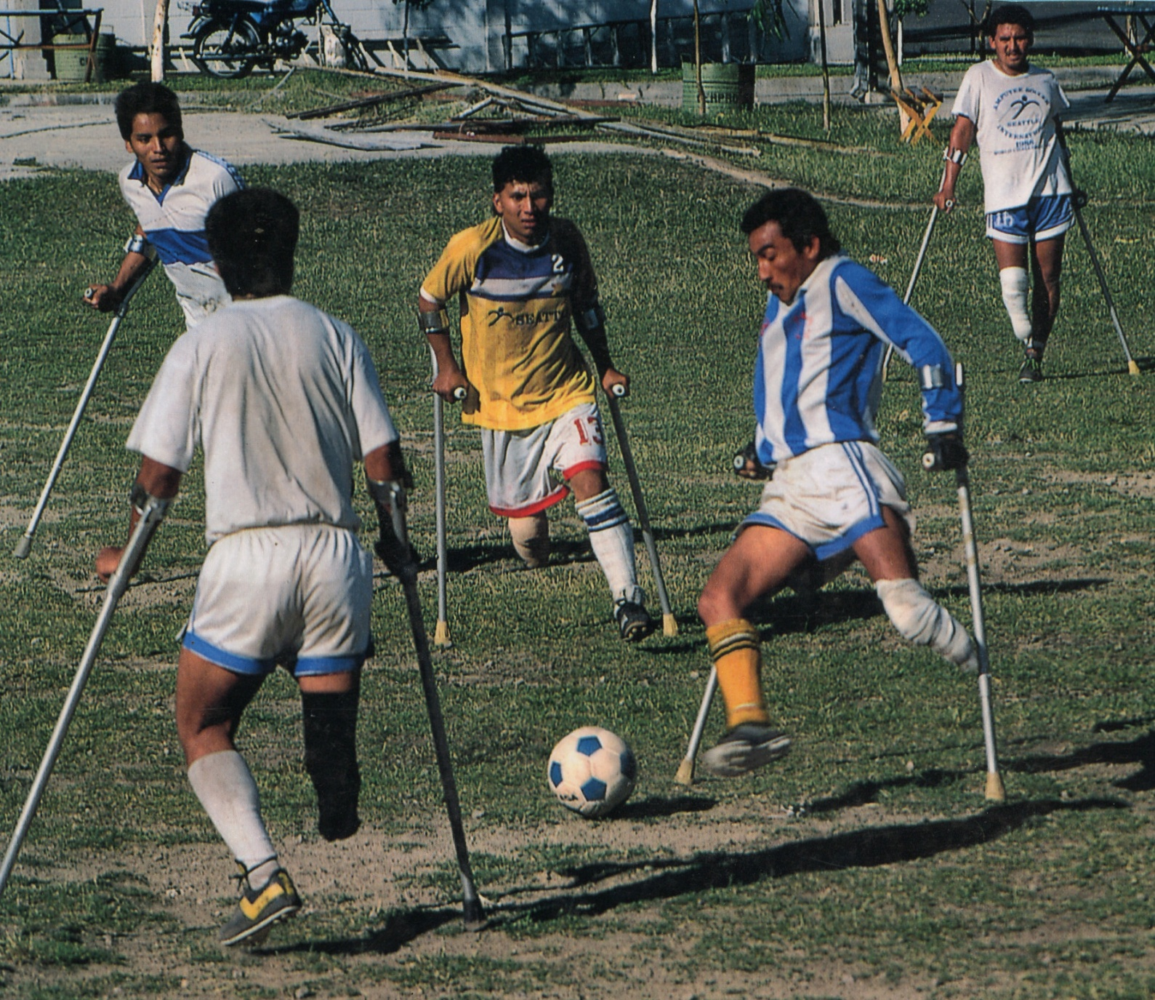

Slide 15



title

Slide 16
Produced, edited, and directed by
Roberto Bahruth, PhD.
2010

Slide 17
Instructions
1. Create a title for this documentary.
2. Quickly write your response to the documentary (five minutes).
3. Share your response with a neighbor.
4. Volunteer or nudge your neighbor to share.
5. What changes can you make in response to the documentary?
6. Quickly write your response to this experience.

