Slide 1
Student Library Employment as a High-Impact Practice
High Impact Practices in Academic Libraries
October 27th, 2020
Dr. Rick Stoddart
Library Assessment & Strategic Communications Coordinator
Notes:
Hello, I am Rick Stoddart – the Library Assessment and Strategic Communications Coordinator at the University of Oregon Libraries. I am here to speak with you about student library employment as a high impact practice.

Slide 2
Intersections with my library practice…
Library Student Employment
Student Worker Learning Outcomes
Library Student Employment Exit Documents
Assessing Workplace Readiness
Library Student Ambassadors
Who are Library Alumni?
Notes:
The idea of library student employment as a high impact practice weaves together many strands within my own practice in libraries that for me personally contribute to this idea. I come at this topic as instruction librarian interested in info lit, educator interested in learning. and as anassessment librarian interested in library impact. Obviously as an assessment librarian I am interested in how libraries contribute to high impact practices but I am also looking for impact we make on people’s lives with library services and programs – one program that is often overlooked from my assessment purview is the impact of student employment in the library. We all have stories about former library student employees who go on to do great and interesting things… or even become librarians themselves. Academic libraries would do well to better articulate the impact student employment has had on shaping or contributing to student development. Then consider formalizing, reinforcing, and adding resources to support the development of student employees (and also supervisors of student employees – often forgotten part of the equation). Libraries put a lot of resources – money, staff time, training to student employment – let’s consider assessing the return on that.

Slide 3
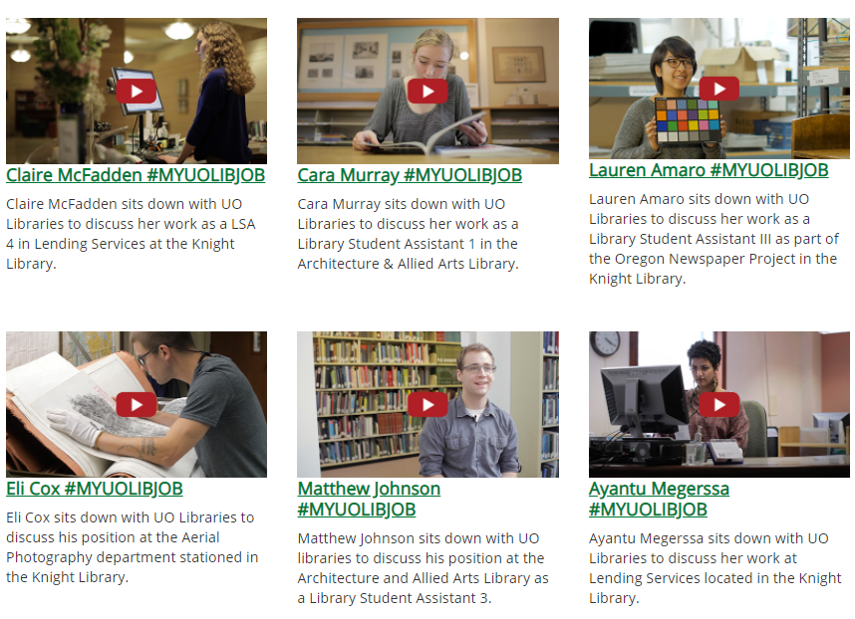
#MYUOLIBJOB
Notes:
Emphasizing student employment in the libraries has been an ongoing effort within the UO Libraries. #MYUOLIBJOB was a previous campaign highlighting the diversity of the student work experience in the UO Libraries and shared out what students were learning on the job. This was a great qualitative example of gathering stories and evidence that support the impact libraries can have on the overall student experience. But it wasn’t intended to be a deliberate and ongoing effort.

Slide 4
Library Student Employment is an Investment….
At UO Libraries
  Over $1 million dollars a year
  Accounts for over 50 FTE
  Staff time
  Training

Slide 5
Impact: Student Employment @ UO Libraries
Higher GPA and Graduation Rate
  Per UO Institutional Research: Students employed in the UO Libraries (and on campus) have about a 2% greater graduation rate and slightly higher GPA
Potentially Higher Information Literacy Scores
  Per Project SAILS Information Literacy testing: Students employed at UO Libraries scored 10 points higher than students at other institutions (N=34)
Greater Civic Competency and Engagement w/ Environment
  Per UO Student Life: 91% of student employees were proficient/advanced in civic competency. 53% participated in protecting the environment activities compared to 26% nationally.
Notes:
Here is what I know about student employment at the University of Oregon Libraries (and on campus)…
Per institutional research – they found statistically significant results that Students have a slightly higher graduate rate and GPA when employed
Per some information literacy testing over the previous term – where we were able to administer testing to 34 student employees. Found generally high information literacy – but it was also associated with library interventions such as instruction, reference consultations, etc – that goes to say about reinforcing library resources and services as part of the student worker experience can potentially pay dividends – more research is needed.
Per UO Student Life: 91% of student employees were proficient and advanced in civic competency which is statistically higher than national average.

Slide 6
Not your traditional High Impact Practice…
Student Employment as a High-Impact Practice in Academic Libraries: A Systematic Review. The Journal of Academic Librarianship (2018) By: Mitola, Rinto, and Pattni
  Characteristics of High Impact Practices
  Time & Effort
  Faculty & Peer Interactions
  Diversity
  Formal & Informal Feedback
  Integration, Synthesis, & Application
  Connection
Notes:
High Impact practices offer a framework to consider the library return on investment with library student workers in a more sustained and impactful way. It is Not your traditional High Impact Practice. However work has been done to articulate how student employment in academic libraries mirrors the characteristics of HIPS that are suggested to be highly effective - in particular Time & Effort and Faculty & Peer Interaction
https://digitalscholarship.unlv.edu/lib_articles/572/

Slide 7
What is in the works... At UO Libraries
Working with campus partners such as Student Affairs & Institutional Research to articulate value of student employment.
Charm campaign with supervisors of students about their impact as educators
Discussions with library units about piloting career readiness competencies and assessments
  National Association of Colleges and Employers - (NACE) – career readiness
Contacting former student workers for a panel presentation about their work experience
Notes:
Most likely student affairs folks have already done some work in this area.

Slide 8
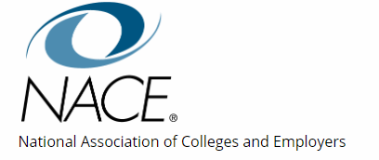
NACE Career Readiness Competencies
Critical Thinking/Problem Solving
Oral/Written Communications
Teamwork/Collaboration
Digital Technology
Leadership
Professionalism/Work Ethic
Career Management.
Global/Intercultural Fluency
Notes:
One of the ways we are hoping to frame our student worker efforts -- Not that different from AACU and other learning outcomes you might encounter – I suggest looking at our campus core learning outcomes or talking with your campus career services offices
Critical Thinking/Problem Solving: Exercise sound reasoning to analyze issues, make decisions, and overcome problems. The individual is able to obtain, interpret, and use knowledge, facts, and data in this process, and may demonstrate originality and inventiveness.
Oral/Written Communications: Articulate thoughts and ideas clearly and effectively in written and oral forms to persons inside and outside of the organization. The individual has public speaking skills; is able to express ideas to others; and can write/edit memos, letters, and complex technical reports clearly and effectively.
Teamwork/Collaboration: Build collaborative relationships with colleagues and customers representing diverse cultures, races, ages, genders, religions, lifestyles, and viewpoints. The individual is able to work within a team structure, and can negotiate and manage conflict.
Digital Technology: Leverage existing digital technologies ethically and efficiently to solve problems, complete tasks, and accomplish goals. The individual demonstrates effective adaptability to new and emerging technologies.
Leadership: Leverage the strengths of others to achieve common goals, and use interpersonal skills to coach and develop others. The individual is able to assess and manage his/her emotions and those of others; use empathetic skills to guide and motivate; and organize, prioritize, and delegate work.
Professionalism/Work Ethic: Demonstrate personal accountability and effective work habits, e.g., punctuality, working productively with others, and time workload management, and understand the impact of non-verbal communication on professional work image. The individual demonstrates integrity and ethical behavior, acts responsibly with the interests of the larger community in mind, and is able to learn from his/her mistakes.
Career Management: Identify and articulate one's skills, strengths, knowledge, and experiences relevant to the position desired and career goals, and identify areas necessary for professional growth. The individual is able to navigate and explore job options, understands and can take the steps necessary to pursue opportunities, and understands how to self-advocate for opportunities in the workplace.
Global/Intercultural Fluency: Value, respect, and learn from diverse cultures, races, ages, genders, sexual orientations, and religions. The individual demonstrates, openness, inclusiveness, sensitivity, and the ability to interact respectfully with all people and understand individuals’ differences.

Slide 9

Student employment as a HIP requires a shift in thinking…
FROM
Training
Managing
Transactional (Mitola, 2018)
Student Success as a by-product (Mitola, 2018)
TO
Learning
Educating
Transferable
Student Success as core element of employment
Notes:
All

Slide 10
What can you do to get started?
Reach out to campus stakeholders – Student Affairs is a good place to start.
Review the literature – there is good stuff out there. UNLV has been doing some good work looking at student worker impact and programming.
Identify Learning Outcomes that are meaningful to your library, your campus, and your student employees
Start small – this may be a big library culture change in focus and thinking.

Slide 11
Works Mentioned
Student Employment as a High-Impact Practice in Academic Libraries: A Systematic Review (2018) By: Mitola, Rinto, and Pattni - https://digitalscholarship.unlv.edu/lib_articles/572/
National Association of Colleges and Employers - (NACE) – career readiness https://www.naceweb.org/career-readiness/competencies/career-readiness-defined/
My SelectWorks page includes some related academic posters presentation and example of exit documents & learning goals for library student employees: https://works.bepress.com/richard_stoddart/
Notes:
Not your traditional High Impact Practice. However work has been done to articulate how student employment in academic libraries mirrors the characteristics of HIPS - in particular

Slide 12
THANK YOU
&
Get in touch!
Dr. Rick Stoddart
Library Assessment & Strategic Communications Coordinator
ricks@uoregon.edu

