Slide 1
Forging Online School Counseling Education through CACREP Accreditation

Slide 2
Introduction
Dr. Justin Silvey
Former Clinical Director for Liberty University’s online CACREP accredited School Counseling program
Licensed School Counselor in Virginia
Experience as a Middle and High School counselor
Let’s talk about you...

Slide 3
Objectives
Participants with explore the history of online counselor education
Participants will explore the benefits of accrediting online school counseling programs
Participants will address the support and processes that in place within one online school counseling program.

Slide 4
Questions
What do you know/what do you want to know about Online Education?
What do you know/what do you want to know about School Counseling?
What do you know/what do you want to know about CACREP?

Slide 5
Distance/Online Education Background
1728-1960: Correspondence schools
1960: University of Illinois develops PLATO to deliver course materials via Intranet
1969: Department of Defense commissions ARPANET (pre-cursor to the internet)
1985: Liberty begins LUSLL and included a M.A. in Counseling
Notes:
PLATO: Programmed Logic for Automated Teaching Operations
ARPANET: Advanced Research Projects Agency Network
LUSLL: Liberty University School of Lifelong Learning

Slide 6
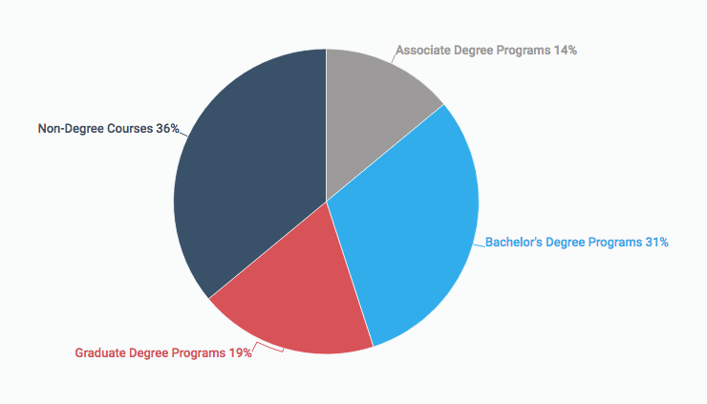
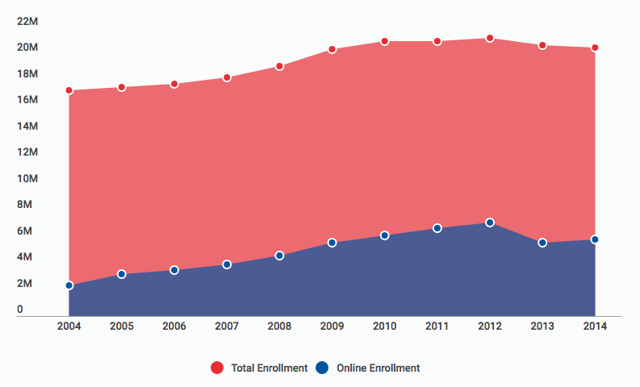
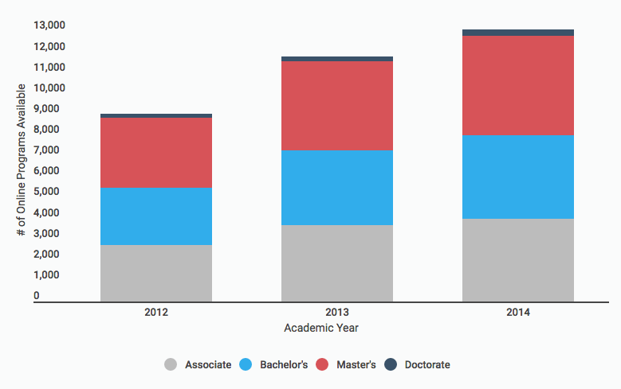
By the numbers
http://www.bestcolleges.com/features/top-online-schools/
http://www.onlinelearningsurvey.com/reports/gradechange.pdf
https://nces.ed.gov/

Slide 7
Accreditation
Late 1960s: ACES develop standards for accreditation of counseling programs
1981: ACES and APGA (pre-cursor to ACA) combine efforts in establishing CACREP
2009 standards
2016 standards
Notes:
APGA: American Personnel and Guidance Association

Slide 8
School Counseling Background
Early 1900s
  Career focus brought on Jesse Davis and Frank Parsons
1930s-1940s
  College admissions counseling
  Standardized, group testing for World War II
1950s
  Sputnik; National Defense Education Act
  Heavy focus on career and “guidance”
1990s
  Shift in educational reform
  ASCA Standards for School Counseling were developed
2000s
  Continued development and distinction of the role of a “Professional School Counselor”
Notes:
First known as “vocational guidance”
Frank Parsons – “Father of Vocational Guidance”

Slide 9
School Counseling Programs
First online CACREP accredited school listed: University of Louisiana at Monroe (1989)
13 online, CACREP-accredited, master’s level school counseling programs currently

Slide 10
Benefits of CACREP
Standardization
Preparation for the field (Hollis, 1998), credentialing exams (Adams, 2005; Milsom & Akos, 2007), further education, etc.
Strengthens the “Counselor” identity

Slide 11
Questions
What direction is online education going? Will it end?
Is there a stigma placed on online education? If so, will that change?
How is online education going to impact residential programs?
Can there be rigor and flexibility simultaneously?
What other benefits do you see regarding CACREP?
Are there any downsides to accreditation?
Should we have a nationalized standard?

Slide 12
2009 and 2016 standards
2009
2016
More vague, but still university autonomy
Emphasized counselor identity
“Provide” Supervision
10:1 FTE
More clarity, but still university autonomy
Still emphasized counselor identity
Produce an even more unified field
“Participate” in Supervision
12:1 FTE

Slide 13
Big Standards
Clinical labs
Assessment
FTE
Group Supervision
8 core areas

Slide 14
Questions
Should there be a 9th core area?
Are there other big standards that you have come across?
Do you feel that CACREP is conducive/inclusive to online program?

Slide 15
Cycle of Life
Students
Become Parents
Experiences
Experiences

Slide 16
What do School Counselors Do?
Dual role
Support outside counseling through referral
Solution-focused approach
Evidence-based practices
A school counselor might be the first counselor a person sees
A school counselor might be the only counselor a person sees

Slide 17
How It All Fits (in my mind)
School Counseling
Clinical Mental Health
Addictions
Marriage, Couple, and Family
Career
Student Affairs and College
Rehabilitation

Slide 18
Supports and Processes to Consider If/When Seeking CACREP Accreditation
Administration, Faculty, and Student Support
Strong Counselor identity
Assessment Model/Tools
Supervision Tools and Tracking
Be able to tell your story well
Understand the “domino effect” of assessment

Slide 19
Questions
Are there other tools that you have found helpful or questions about tools?
What have you learned about Online Education, School Counseling, and/or CACREP?
Is accreditation the glue that forges us all together?

Slide 20
References
Adams, S. A. (2005). Does CACREP accreditation make a difference? A look at NCE results and answers. Journal of Professional Counseling: Practice, Theory, & Research, 33(2), 60-76
Hollis, J. W. (1998). Is CACREP accreditation making a difference in mental health counselor preparation? Journal of Mental Health Counseling, 20, 89-92
Milsom, A., & Akos, P. (2007). National certification: Evidence of a professional school counselor? Professional School Counseling, 10(4), 346-351.

