Slide 1
Therapeutic Powers of PLAY
Incorporating Play Therapy in a Comprehensive School Counseling Program
Josephine M. Olson, MA, LPC, NCC, RPT

Slide 2
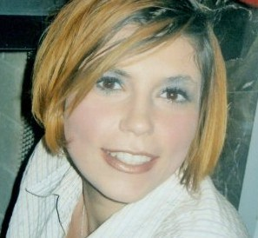
About Me
Josephine Olson, MA is a Licensed Professional Counselor, Nationally Certified Counselor and Registered Play Therapist (Association for Play Therapy). Josephine (Josie) received her undergraduate degree in Communication Studies from Liberty University and her MA in Community and School Counseling from Regent University. She has conducted play therapy sessions in her work as a clinician in an agency setting, in-home setting, and residential treatment facility as well as during her time as a school counselor. She also enjoys incorporating play therapy in a group setting and has conducted anger management, ADHD, divorce, and deployment groups. She has also facilitated grief and loss groups in her volunteer work with Kid’s Haven as well as Filial Therapy groups at Miriam’s House and YWCA. She has found play therapy to be effective with children struggling with a variety of social, developmental and trauma-related issues. She has specifically worked ­­­­­­­­­­­­­­­­­­­­­­­­­­­­­­­­­­­­­­­­­­­­­­­­with children diagnosed with ADHD, Asperger Spectrum Disorder, Developmental Trauma Disorder, Reactive Attachment Disorder, Anxiety, Depression, Bipolar Disorder and children struggling with grief and loss, suicidal ideation, and children in the foster system. She has most recently authored “The Therapeutic Powers of Play: Promoting Healing and Resilience in Children” for Christian Counseling Today and had the privilege of presenting her work at AACC’s 2013 World Conference. She also teaches on a part-time basis in Liberty University’s MA School Counseling program as an instructor practitioner. She is an active member in good standing of the American Association of Christian Counselors, Association for Play Therapy, Virginia Counselor’s Association, Virginia Association of Multicultural Counseling and Development, and Virginia Association for Specialists in Group Work. She is currently practicing at Light Counseling in Lynchburg, VA.

Slide 3


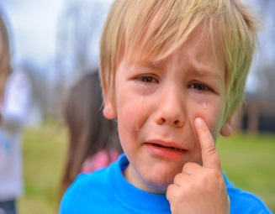
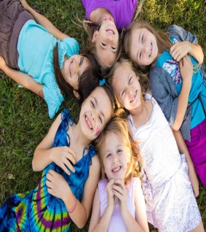


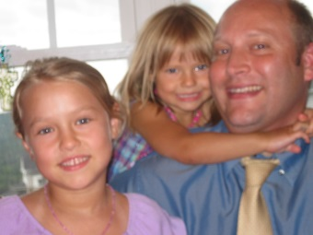
Promoting Healing & Resilience in Children…
Self-esteem
(Rennie & Landreth, 2000)
Physical Growth & Agility
(Ginsburg, 2007)
Regulating emotions/coping skills
(Hall, Kaduson, & Schaefer, 2002)
Social Effectiveness
Bereavement, Trauma & Loss
(Ray, 2011)
(Green and Connolly, 2009)
(Ginsburg, 2007)
Navigating Transitions
ocial Effectiveness
(Hall, Kaduson, & Schaefer, 2002)
(www.a4pt.org/ps.index.cfm?ID=2289)
(Ray, 20011)
(Ray, 2011)

Slide 4
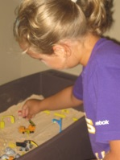
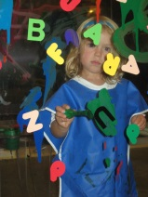
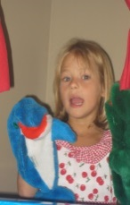
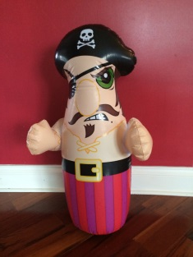

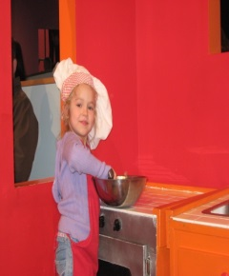
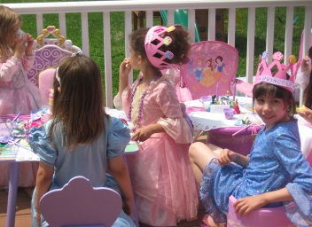
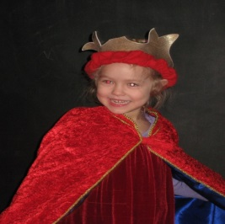
Play Therapy Techniques that may be incorporated in your CSCC
Sand play Expressive Arts
Puppets
Imaginative Play
Emotive Play
Nurturing play
Dramatic!

Slide 5
Practical applications for school counselors
Agenda Items:
Several Common Personal/Social growth areas
  For the each area:
    Specific Activities/Techniques (explained) that I can be adapted for Individual, group, or classroom Guidance (as well as for Grade/Developmental level)
    Required Materials
      & Examples of a Corresponding:
      ASCA standard
      VA school Counseling Standard
      VA Academic Standards of Learning (Standard Blending)

Slide 6
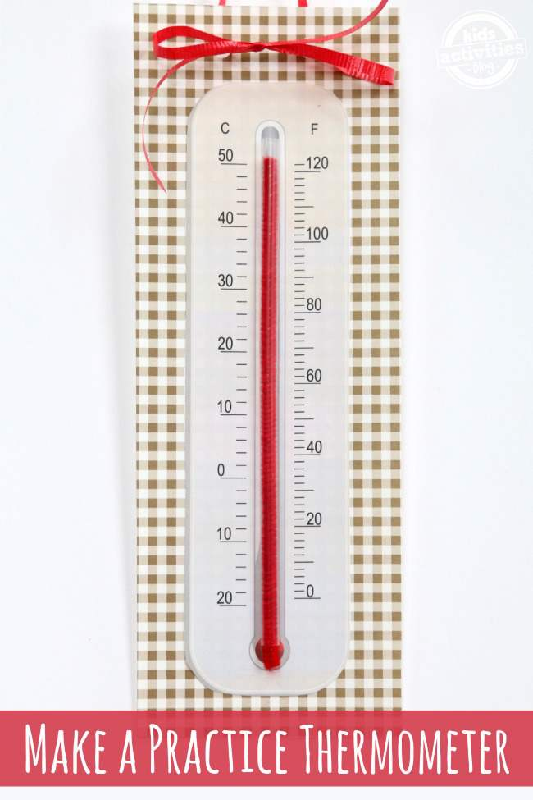
Emotional Regulation
“Of all human emotions, anger has created the most harm and caused the greatest destruction within individuals, couples, families, social groups & nations” (Borcherdt, 1989)
Activity: Feeling Thermometer-Objective: Student will compare different levels of emotions (cool to hot) & will understand the process of managing emotions.
Materials: Thermometer/models; What is the Temperature Printable, clear straw, red pipe cleaner, scissors, glue stick, paint chips, small cutouts with circle shapes for drawing feeling faces
ASCA PS.A1.5: Identify & Express Feelings
VA Counseling SOL EP5: Demonstrate self-discipline & self-reliance
Academic SOL (mathematics) 3.13 The student will read temperature to the nearest degree from a Celsius & Fahrenheit thermometer. Real thermometers and physical models will be used
http://kidsactivitiesblog.com/49412/read-thermometer-printable-practice

Slide 7
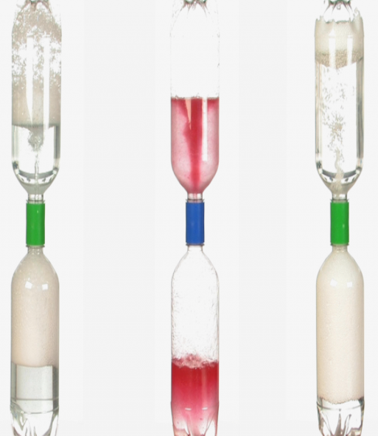
Emotional Regulation:
Anger Triggers
“Of all human emotions, anger has created the most harm and caused the greatest destruction within individuals, couples, families, social groups & nations” (Borcherdt, 1989)
Activity: Tornado in a bottle-Objective to understand anger triggers, the effects of anger escalation & strategies to restore calm
Materials: Two plastic 1-liter bottles water bowl or other container, duct tape metal washer pitcher or funnel
ASCA: PS:A1.6 Distinguish between appropriate and inappropriate behavior
Virginia Counseling SOL EP12: Use strategies handling conflict in a peaceful way
Academic SOL: (Science-interrelationships in 2.6 a) identification of common storms & other weather phenomena
Trauma Informed Care Disclaimer
http://www.stevespanglerscience.com/lab/experiments/tornado-in-bottle#sthash.9WEzgS7r.dpuf

Slide 8
Emotional Regulation:
Anxiety
Activity: Worry Mountain
Objective: Student(s) will understand sources of worry & will identify tools to navigate personal anxiety
Materials: Large cut out of a mountain, construction paper,
glue stick, scissors, markers, crayons, paints, pencils
ASCA: Identify personal strengths and assets
VA Counseling SOL: EA.2 Understand the importance of individual, hard work, and persistence
Academic SOL: (social studies) The student will develop map skills by locating mountain ranges

Slide 9
Other Activities Related To Emotional Regulation:
Sand tray/Sand Play
Play Dough/Clay
Worry Jars
Worry Map
Expressive Arts
Stress Balls
Uncoloring Book
Bibliotherapy (ie: When Sophie Gets Angry - Really, Really Angry by Molly Bang)
Puppets
Feeling Charades/role plays/dramatic
Feeling Jenga, feeling matching, feeling bingo

Slide 10
Grief & Loss
Activity: Memory Board
Objective: The student will make a board to display things that they remember about the individual that died & the relationship they had.
Materials: Poster board (cut in half), magazines, feathers, stickers, post-it-notes, scissors, glue stick
ASCA PS.A1.5: Identify & Express Feelings
VA Counseling SOL EP1: Exhibit the principles of character….caring
Academic SOL: (math) The student will sort and classify objects according to attributes

Slide 11
Other Activities Related To Grief & Loss
Memory Box
Memory Stones
Plant a tree
Creative Writing (Poetry)
Journaling
Lion King video clip

Slide 12
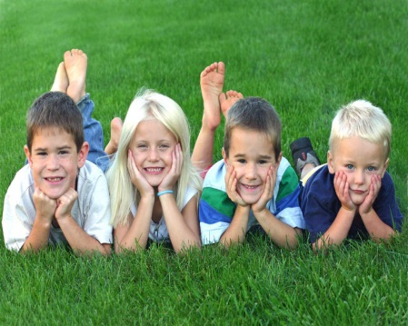
Social Skills/Friendship
Activity #7: Compliment Jar
Objective: To understand how to communicate positively with peers
Materials: Jar with prompts (ie: “A way you have helped me is…”)
ASCA: PS: A2.6 Use effective communication skills
VA Counseling SOL: EP2 Understand how to make & keep friends and work cooperatively with others
Academic SOL: (oral language) Express ideas clearly & in an organized manner

Slide 13
Other Activities To Social Skills/friendship
feeling charades (Non-verbal communication)
bee a friend, don’t bug a friend
role plays
dramatic play
Puppets
Group sand tray
Feeling Jenga (group)
Beach Ball Toss (All About you Questions)
Bucket filling (carol Mccloud)

Slide 14

Enhancing Self-esteem
Activity: Mandalas
Objective: Student will communicate positive attributes about self & likes & dislikes
Materials: picture of student, paper plates, pieces of shiny paper, felt, cotton balls, foil, perfume samples, magazines (picts of food, activities
ASCA: PS:A1.1 Develop positive attitudes toward self as a unique and worthy person
VA Counseling SOL: Overall Goal-Students will acquire an understanding of & respect for, self and others…
Academic SOL: (Health Education) The student will explain that the body is a living and growing organism: c) the five senses (sight, sound, smell, taste, touch)

Slide 15
Other Activities To Enhance
Self-esteem
Positive Self-talk flowers
All about me board
“Just like Me” Game
Dramatic/Imaginative Play
Self-Portrait
Journaling
Creative Writing
Expressive Arts

Slide 16
Diversity
Activity : Sneetches, by Dr. Suess
Objective: Students will learn to understand and appreciate other’s differences
Materials: Sneetches, Dr. Suess, stars, props for role play
ASCA: Recognize, accept, respect and appreciate individual differences.
VA Counseling SOL: EP3 Understand that Americans are one people of many diverse racial and ethnic backgrounds and national origins who are united as American by common customs and traditions
Academic SOL: K.8 The student will demonstrate
comprehension of fiction and nonfiction
http://everydaylife.globalpost.com/activities-teach-diversity-children-1385.html
Creative Activities: disability awareness, bullying prevention initiative, cultural diversity awareness

Slide 17

6 ways to teach mindfulness
Mindful Breathing
2. Mindfulness Sound Game
3. Mindful Eating Game
4. Walking Mindfully
5. Mindful Play
6. The Hunting Game
http://mrsmindfulness.com/how-to-teach-mindfulness-to-children/

Slide 18
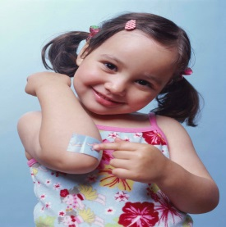
Therapeutic factors that promote healing among children
Virginia Axline (VanFleet et. Al)
Unconditional Positive Regard
Safe environment: Allows for exploration
Patience-does not impose time constraints
Boundaries-personal space/returns responsibility
Trauma Informed Care

Slide 19
References
Borcherdt, B. (1989). Think straight, feel great! Sarsota, FL,: Professional
Ginsburg, K. R. (2007). The importance of play in promoting healthy child development and maintaining strong parent-child bonds. [journal]. Pediatrics, 119(1), 182-191.
Green, E.J., Connolly, M.E. Jungian Family Sandplay With Bereaved Children: Implications for Play Therapists. International Journal of Play Therapy, 18(2), 84-98.
Hall, T. M., Kaduson, H. G., & Schaefer, C. E. (2002). Fifteen Effective Play Therapy Techniques. Professional Psychology: Research and Practice, 33, 515-522.
Ray, D. C. (2011). Advanced Play: Essential Conditions, Knowledge, and Skills for Child Practice . New York: Taylor And Francis Group.

Slide 20
References Continued
Reddy, L.A., Files-Hall, T.M., & Schaefer, C.E. (2005). Announcing empirically based play interventions. In Green, E.J., Connolly, M.E. Jungian Family Sandplay With Bereaved Children: Implications for Play Therapists. International Journal of Play Therapy, 18(2), 84-98.
Rennie, R., & Landreth, G. (2000). Effects of Filial Therapy on Parent and Child Behaviors []. International Journal of Play Therapy , 9(2), 19-37.
VanFleet, R., Sywulak, A. E., & Sniscak, C. C. (2010). Child-Centered Play Therapy. Retrieved from New York
http://everydaylife.globalpost.com/activities-teach-diversity-children-1385.html
http://kidsactivitiesblog.com/49412/read-thermometer-printable-practice
http://mrsmindfulness.com/how-to-teach-mindfulness-to-children/

Slide 21
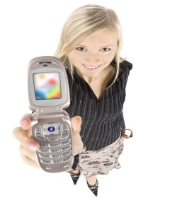

Connect with me
http://josephineolson79.wix.com/play2heal
www.lightcounseling.net
Light Counseling
2811 Linkhorne Dr. Suite B
Lynchburg, VA 24503
(434) 384-1594
Email josephineolson79@gmail.com
FB Josephine Olson’s Play2heal
Twitter @olson_josephine
Pinterest jolson79

