Slide 1

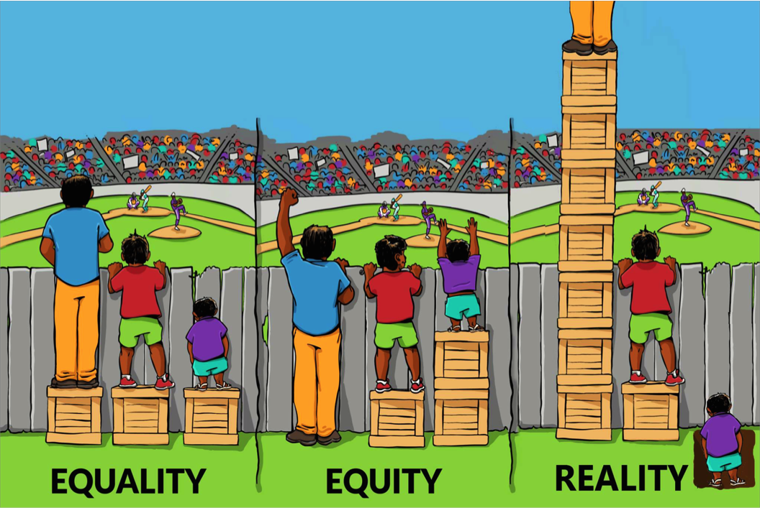
A Change Is Gonna Come:
Renewing Information Workers’ Commitment to Social Justice
CARL 2018: The Academic Library in Times of Change
April 14, 2018
This work is licensed under a Creative Commons Attribution-NonCommercial-ShareAlike 4.0 International License.
Elisa Slater Acosta
Library Instruction Coordinator
Loyola Marymount University
Aisha Conner-Gaten
Instructional Design Librarian
Loyola Marymount University
Javier Garibay
Librarian-In-Residence
Loyola Marymount University
Rhonda Rosen
Circulation Services Librarian
Loyola Marymount University
Desirae Zingarelli-Sweet
Reference & Instruction Librarian for Theology, Loyola Marymount University
Image credit: http://interactioninstitute.org/the-4th-box-sparks-imagination/

Slide 2
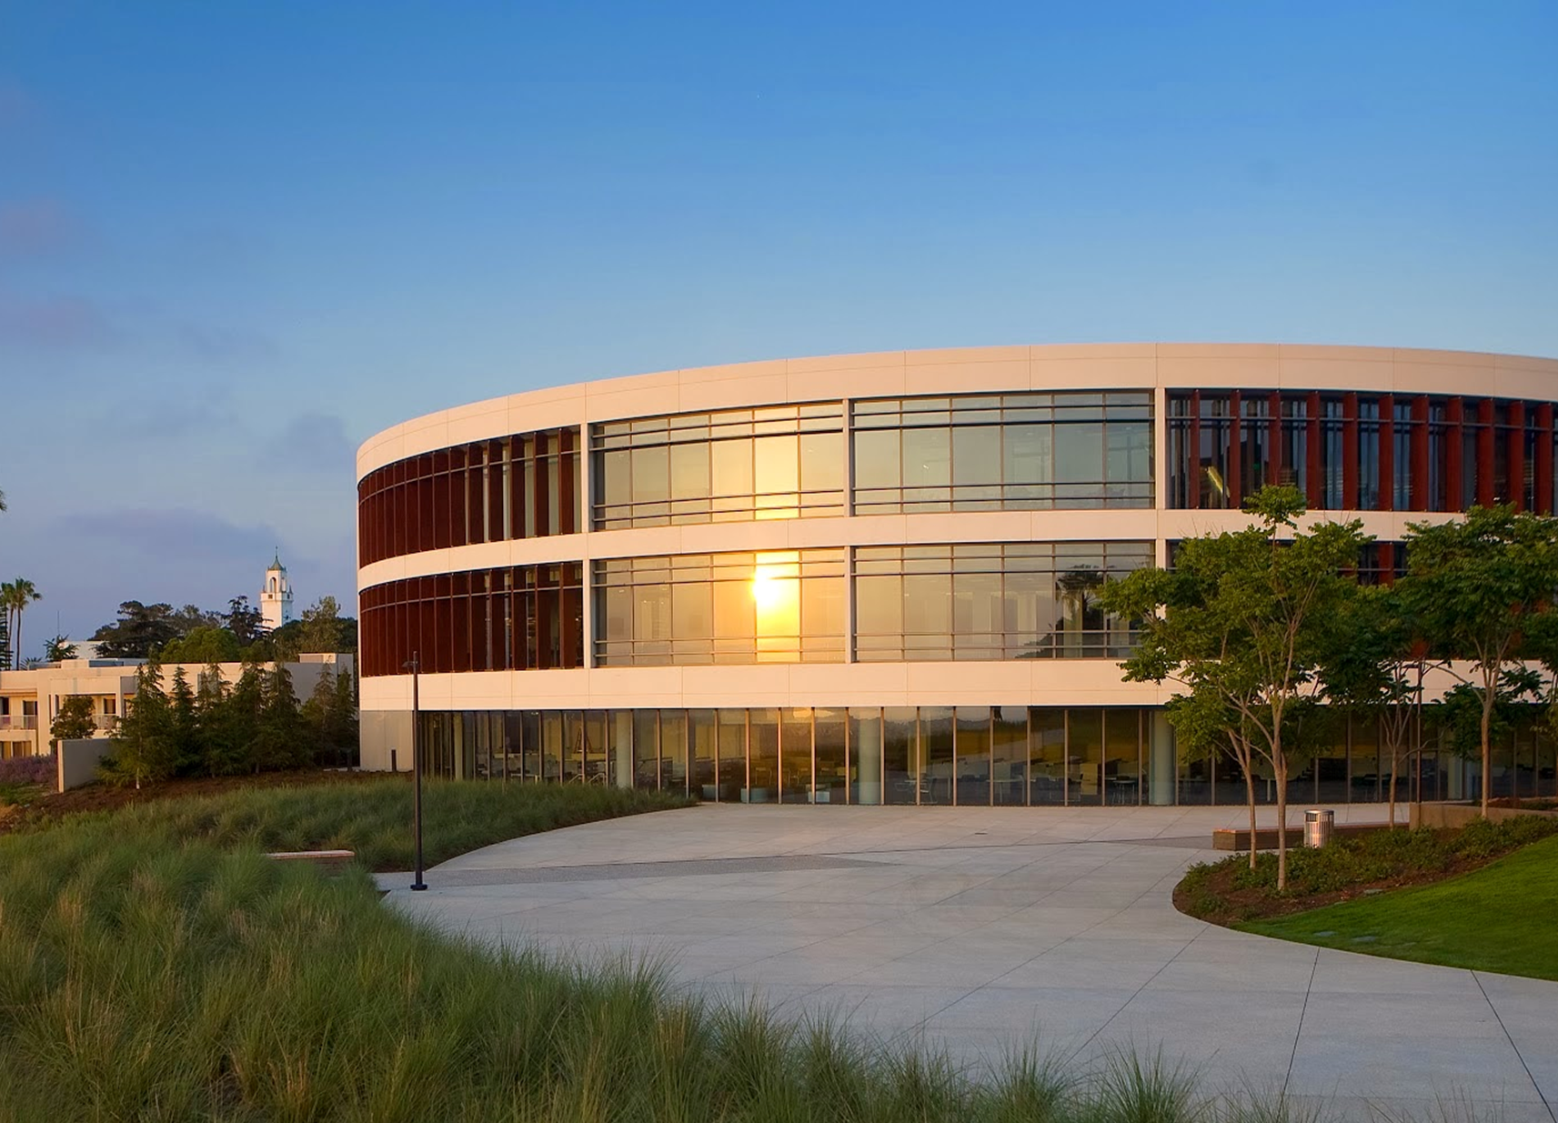
Loyola Marymount University (LMU)
University’s Mission Statement
Encouragement of learning
The education of the whole person
The service of faith and the promotion of justice
Notes:
Notes:
Undergraduate: 6,257; Graduate: 2,151; Law School: 1,076; Total: 9,484
24 permanent librarians + 3 temporary librarians + 19 staff = 46 total (as of 2/18/2018)

Slide 3
Purpose
Priority issues: Communication, Psychological Safety, Teambuilding
“What do you value most about your role in the library?”
Library Staff and Organizational Development Committee (LSOD) Charge: Training, Continuing Education, Assessment, All-library Staff Meetings and Retreats
Notes:
NOTES:
Library Staff and Organizational Development Committee (LSOD)
Charged with supporting individual learning & growth and sustaining the library as a learning organization: Training, Continuing Education, Assessment, All-library Staff Meetings and Retreats
Priority issues to address (from Climate Surveys, Focus Groups)
Communication, Psychological Safety, Teambuilding
“What do you value most about your role in the library” (from Listening Sessions)
Making a contribution, Service to students & faculty, Collegial relationships & collaboration

Slide 4
Staff Development Day: Social Justice
Outcomes
Discuss connections between our institutional heritage, libraries, and social justice issues.
Identify potential actions or areas for improvement in our library.
Share experiences with and reflect on microaggressions, stereotypes, and unconscious bias.
Facilitate collegiality and social bonding to promote psychological safety (ClimateQUAL).
Notes:
Notes:
GOAL: The service of faith and the promotion of justice is an important part of the LMU mission statement. Our goal was to renew a conversation about our diverse campus community, social justice issues, and our work in the library.
Library Staff and Organizational Development Committee (LSOD)
Charged with supporting individual learning & growth and sustaining the library as a learning organization: Training, Continuing Education, Assessment, All-library Staff Meetings and Retreats
Priority issues to address (from Climate Surveys, Focus Groups)
Communication, Psychological Safety, Teambuilding
“What do you value most about your role in the library” (from Listening Sessions)
Making a contribution, Service to students & faculty, Collegial relationships & collaboration

Slide 5
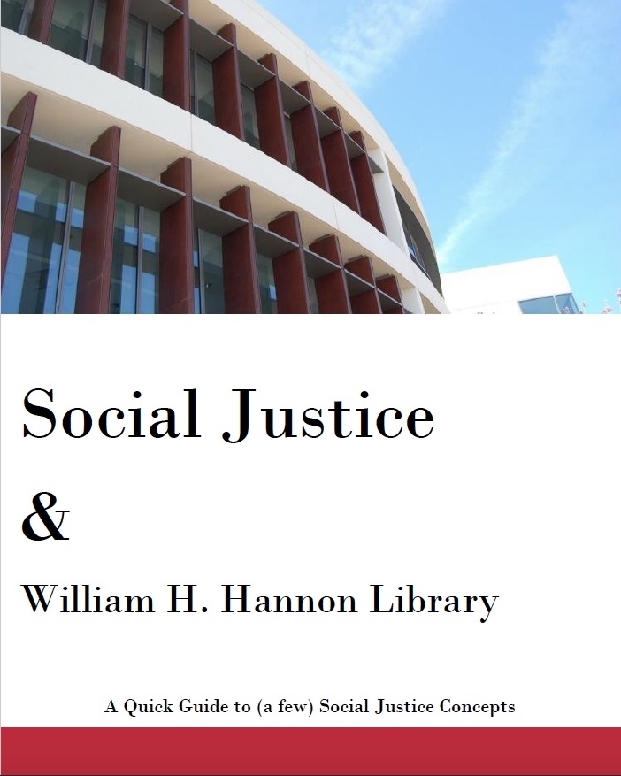
Resource Guide
Distributed ahead of time to all staff
Common understandings
Campus demographics
Definitions of social justice, stereotyping, microaggressions, and unconscious bias
Notes:
***RESOURCE GUIDE SLIDE
Before Staff Development Day - we provided the agenda for the day’s events so that staff could plan their choice of activity.
We also sent out a Resource Guide, which introduced staff to terms relating to Social Justice Concepts being used throughout the day’s program.
It also included websites and citations to articles relating to Social Justice in general, and specific to libraries.

Slide 6
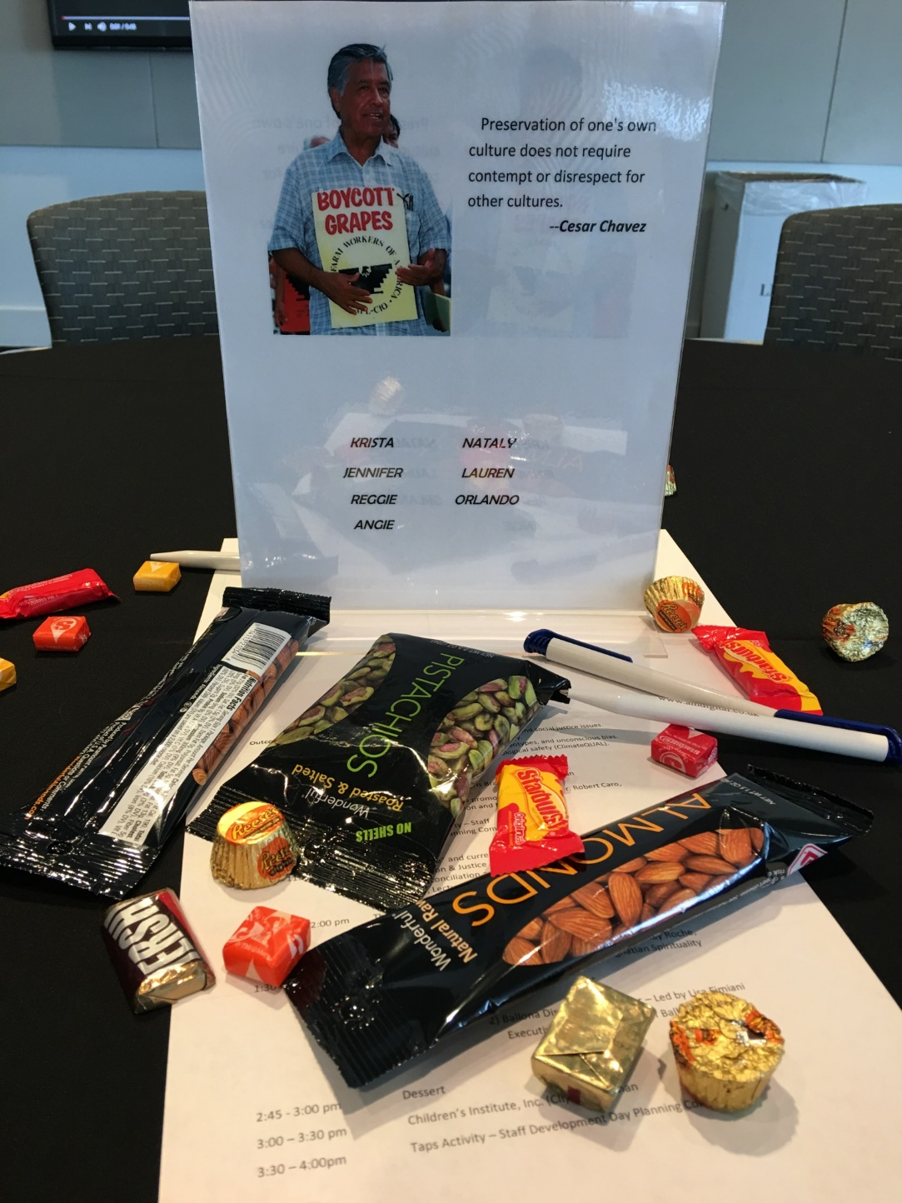

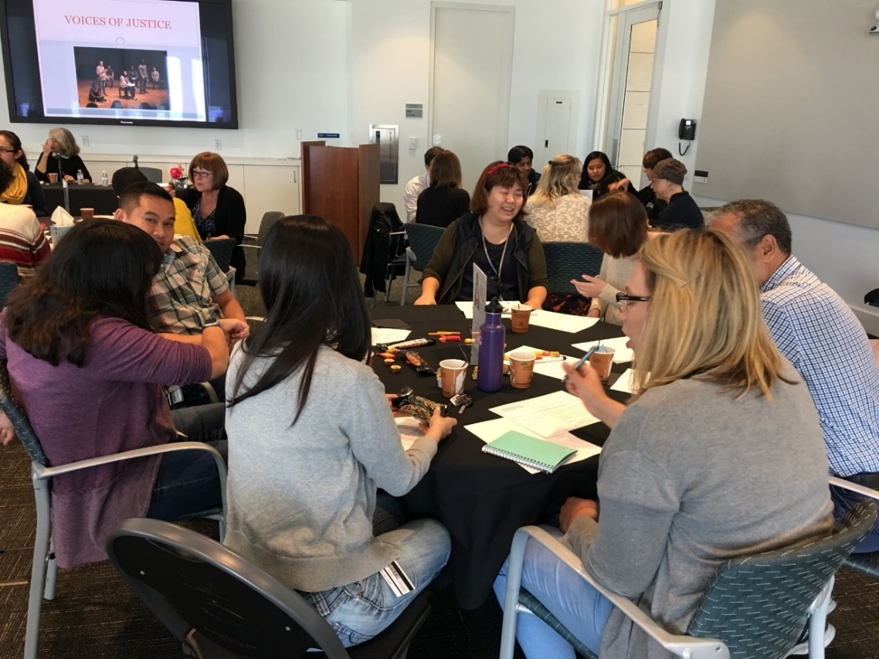
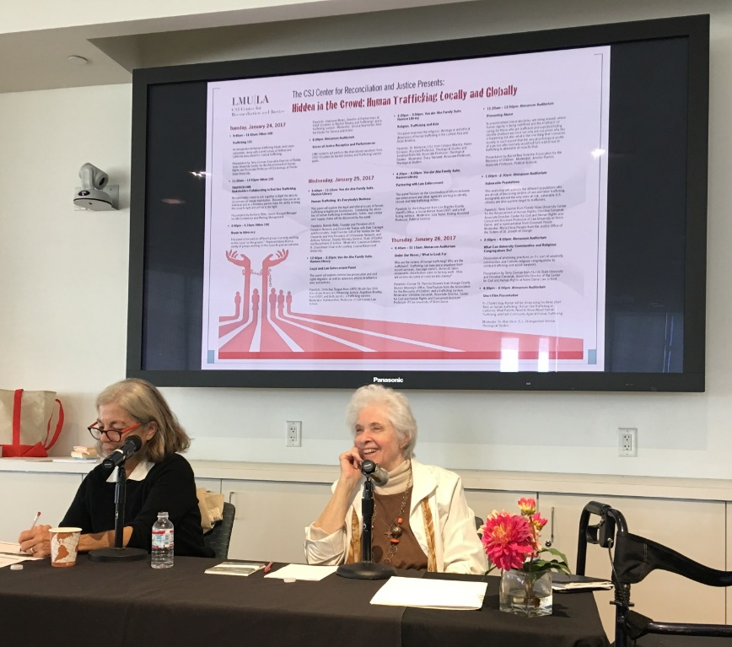
Outline of Day
Notes:
***OUTLINE OF THE DAY SLIDE
WHAT WAS OUR DAY ALL ABOUT?
Preparation began with our “intentional grouping”. We created “Social Justice Team tabletops” with the photo and a reflective quote of a well-known Social Justice leader to guide staff to their designated table. Each group was chosen carefully by us, making sure that staff from different departments and status were mixed, including Library Administration.
After a short welcome from our Library Dean to open the day’s events, --we began the program with LMU’s Vice President for Mission and Ministry who talked about “The Service of Faith and the Promotion of Justice” discussing the relationship between the Ignatian Jesuit beliefs and our campus mission.
Afterwards, we presented our first group activity called “Think-Pair-Share” --asking staff to engage with each other on issues of Unconscious Bias –
- and which we will describe later.
We followed this activity with a presentation by LMU Theatre Arts faculty who discussed their class, “Voices of Justice”, a course which asks students to meet, interview and then perform stories from members of various LA advocacy agencies who work with social justice issues such as: human trafficking, immigration, homelessness and gangs. We then openly discussed ways in which the library could support this class.
Next, we engaged our group in a 2nd “Think-Pair-Share” activity, this time asking staff to think about the Library’s Role in Social Justice.
***NEXT SLIDE

Slide 7
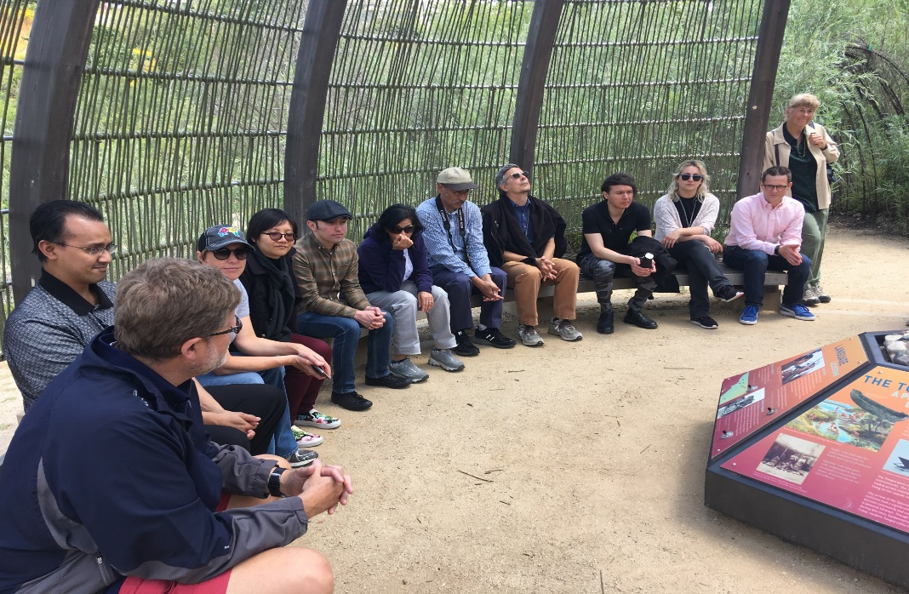
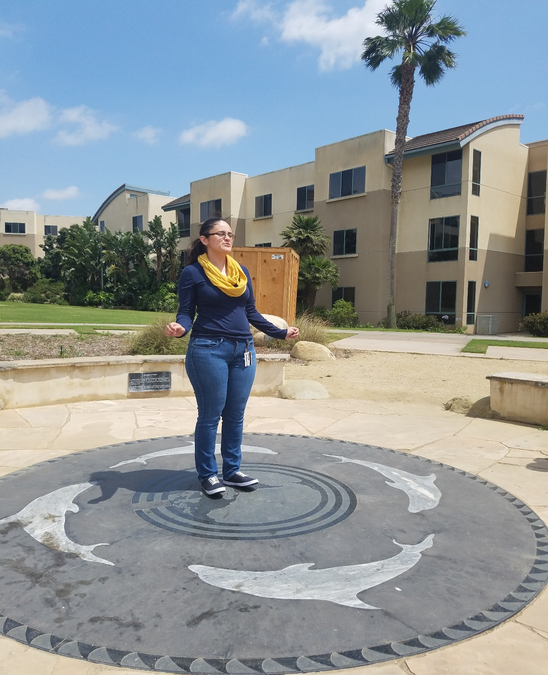
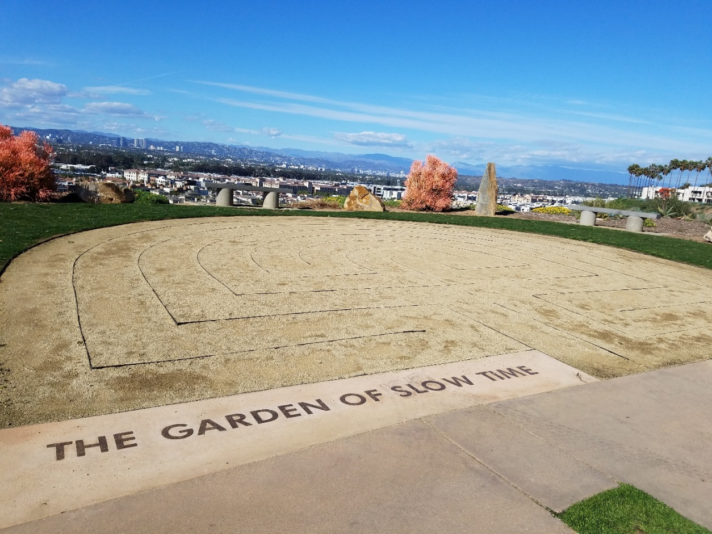
Notes:
After a catered lunch, all staff took part in one of two walking tours.
**Please note that we advised staff as to which was the most strenuous; and to wear comfortable shoes and hats for the sun!
The Seeking Peace Tour –visited some of LMU’s most sacred spaces. Many staff had never had the chance to visit our Sacred Heart Chapel, the Gabrielino/Tongva Native American tribe memorial, or the Labyrinth in the Garden of Space and Time which has the appearance of a maze, but it offers those who walk only one path, from the outside to the center, an encouragement to slow down and reflect.
The 2nd tour offered was the Ballona Wetlands Discovery Park Tour – The Wetlands is a 2-acre site situated just below our campus… The non-profit organization which protects and restores the wetlands has long enjoyed a relationship with the faculty and students at LMU. Just like most things close by, many of us had driven by it, but had never been able to experience it -- what a glorious site to see half of our library staff walking and talking down the road to the environmental center!
We returned for Dessert and more program…
We wanted our staff to leave the day with an opportunity to engage in an activity to promote social justice. We invited the Director of Community Services of the Children’s Institute-- an off-campus organization that provides a variety of services to children and families who are victims of violence, abuse, neglect, and poverty-- to talk to us about their urgent need for volunteers with the experience necessary to catalog new books in their small library’s backlog.
And before we ended the day, our last group activity was “Taps” –where all staff stood in two concentric circles. When given a positive reinforced phrase, like “works well with others” they would anonymously walk around and tap a shoulder of those colleagues who represented that ideal.

Slide 8
Activity: Unconscious Bias
What is Unconscious Bias?
Bias that happens automatically and is triggered by our brain making quick judgments and assessments of people and situations
Influenced by our background, cultural environment and personal experiences
Phenomenon in which stereotypes, positive or negative, influence decisions and behaviors without the individual consciously acting on the stereotype or being aware that he or she is doing so
Can occur even when individuals know or believe the stereotype to be false
Notes:
Elisa – 2 min
There is a worksheet at your table, that looks like this (point at it). Please refer to Activity 1: Unconscious bias.
Originally this was part of a Think-Pair-Share activity scheduled for about 15 mins.
There were three different prompts so that staff could choose to respond to 1 or more prompts. We gave them all three prompts just in case our second guest speaker arrived late. All three prompts are included in our online tool kit:
Microaggressions
Stereotyping and stereotyping threat
Unconscious bias
Today we are going to limit our activity to just one prompt, Unconscious bias.
Read prompt…
What is Unconsious Bias?
Bias that happens automatically and is triggered by our brain making quick judgments and assessments of people and situations
Influenced by our background, cultural environment and personal experiences
Phenomenon in which stereotypes, positive or negative, influence decisions and behaviors without the individual consciously acting on the stereotype or being aware that he or she is doing so
Can occur even when individuals know or believe the stereotype to be false

Slide 9
Activity: Unconscious Bias
Name an event in your life that impacted how you see or think about authority in the workplace.
How does this event impact your interactions with others at work?
THINK
5 min
SHARE
What can you do to manage this bias?
7 min
Notes:
Elisa
Due to a lack of time, we are going to do the abridged version today, Think-Share. (instead of Think-Pair-Share)
Read prompt…
Name an event in your life that impacted how you see or think about authority in the workplace.
How does this event impact your interactions with others at work?
What can you do to manage this bias?
You have 5 minutes to think and write a response on your worksheet. After 5 minutes my timer will go off and I’ll ask for volunteers to share with the whole room.
<5 min. timer>
Who would like to share? What can you do to manage this bias?
<Limit sharing to 2-3 participants>
<7 minute timer>

Slide 10
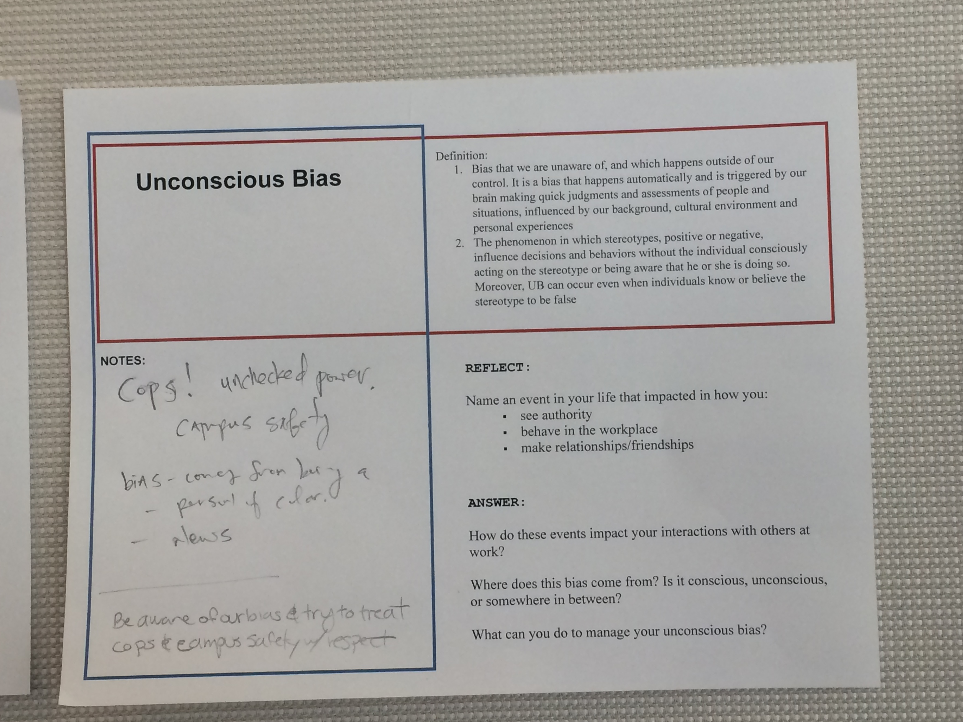
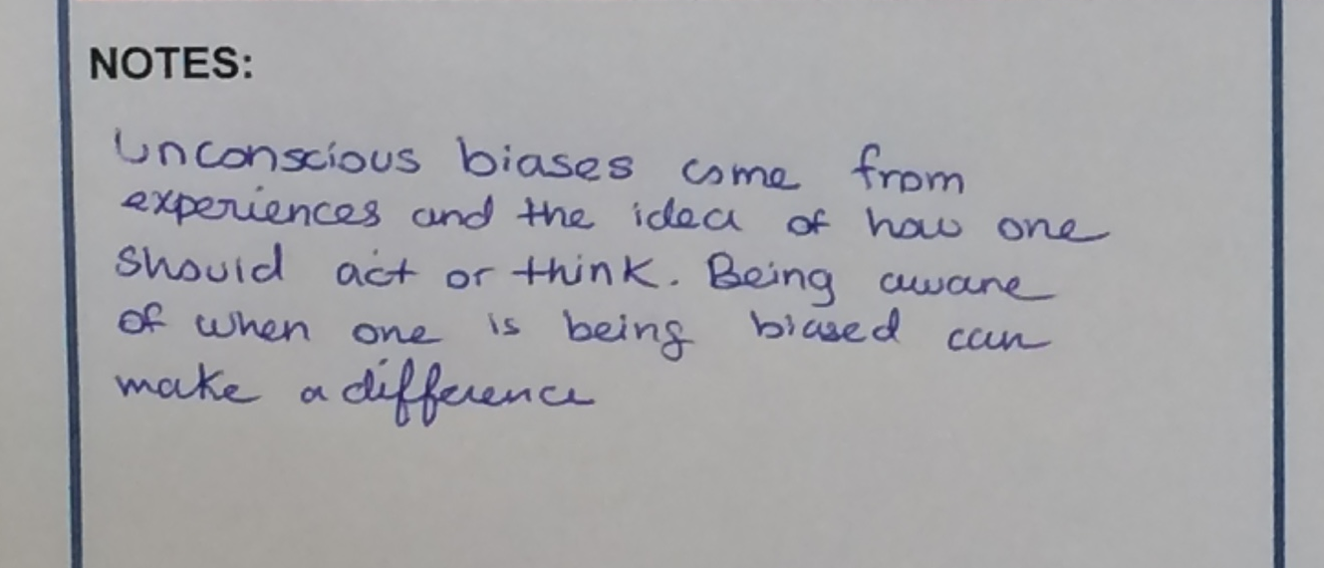
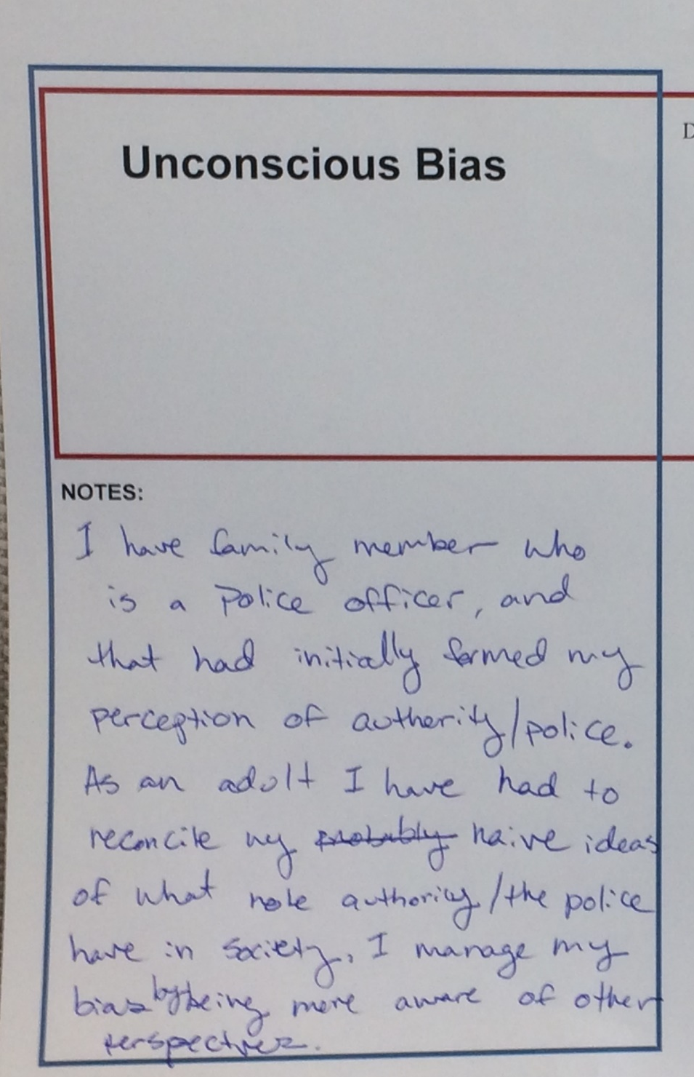
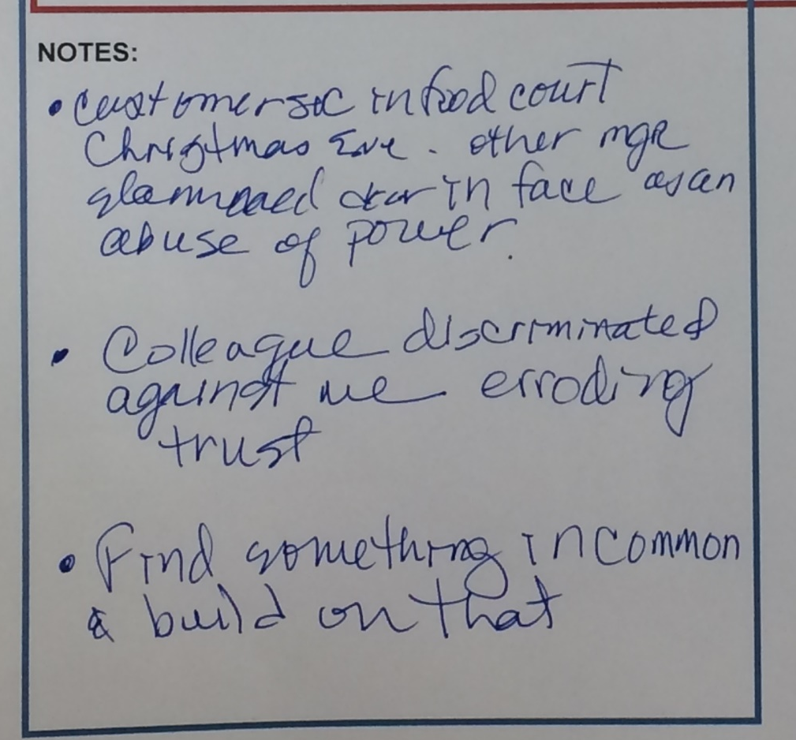
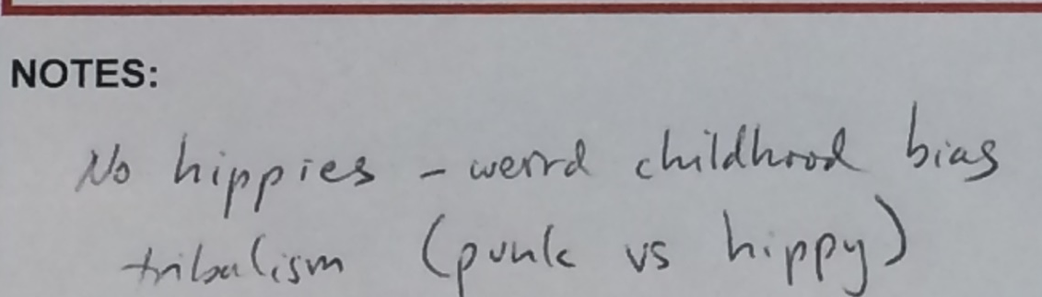
Notes:
Elisa – 1 min.
Sorry we are out of time. If you didn’t get a chance to share, please turn in your worksheet. We will post comments in the toolkit. (Mostly likely scan them)
In our meeting room, there were 3 signs on the wall, one for each prompt (Microaggressions, Stereotyping, Unconscious bias). Staff posted their written responses on the walls. After lunch, staff were encouraged to do a “gallery walk” and read the responses of their colleagues. These are some of the staff responses to the Unconscious Bias prompt.

Slide 11
Activity: Libraries & Social Justice
How do power dynamics shape our building, services, and policies as they are now? What can we do about it?
PAIR
10 min
Example: Faculty, staff, graduate students, and undergraduate students often have different privileges and opportunities at academic libraries (including borrowing limits, loan periods, fines, and so on). When is the library justified in treating these groups differently? When are these privileges barriers for patrons?
SHARE
Raise your hand if you would like to share to the whole group.
10 min
Notes:
Aisha (both slides are 20 min)
Making concrete connections from social justice to individual libraries and departments
30 minutes of whiteboard work with a gallery walk in the afternoon
Original group discussion included 4 different prompts with 2 questions each including:
How dominant culture & social groups influence, empower, or limit access
What voices are prioritized in decision-making processes
How social and economic privilege play out in library spaces
How first time users see you library including barriers and navigation
We will do a shortened form of our prompt regarding power dynamics and privilege in your institution. During this activity, think about: how bias manifests itself in your institution.
You will find one buddy to chat with for 10 minutes and we will share out for 10 minutes. Record your thoughts under Activity #2, on the back of your handout.
If you want your comments shared in the toolkit, we will collect the handout at the end of our presentation.

Slide 12
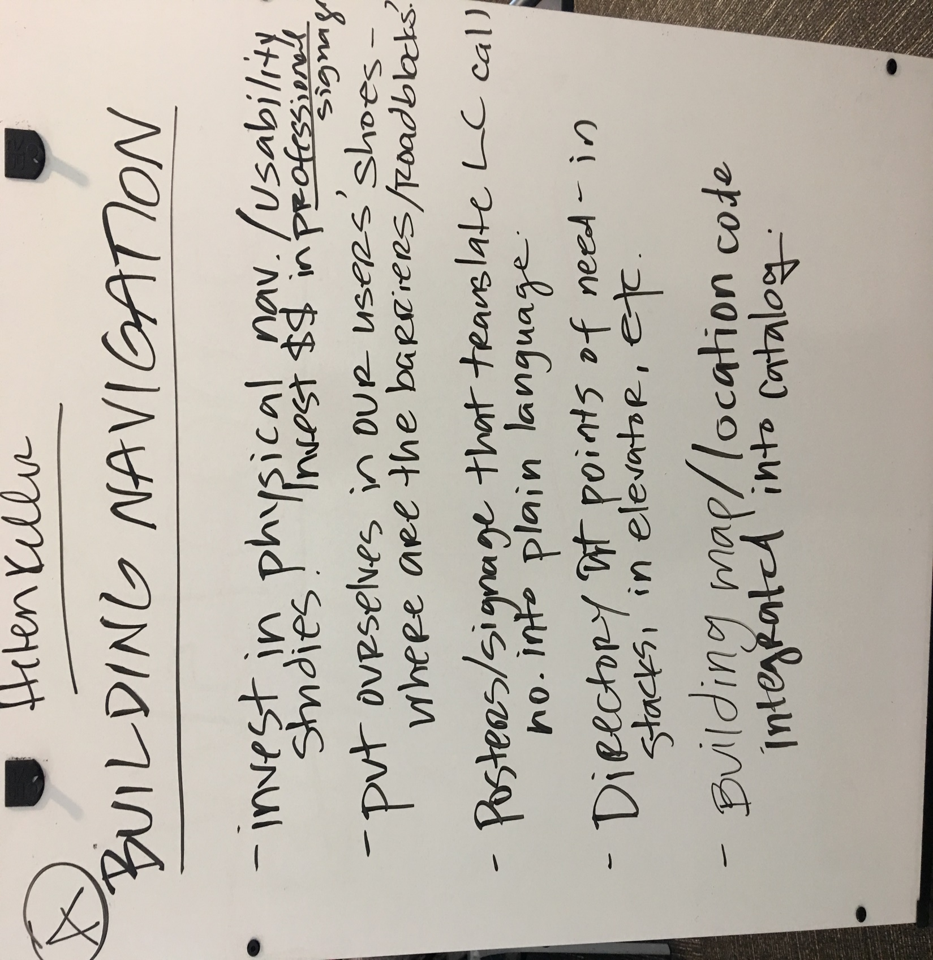
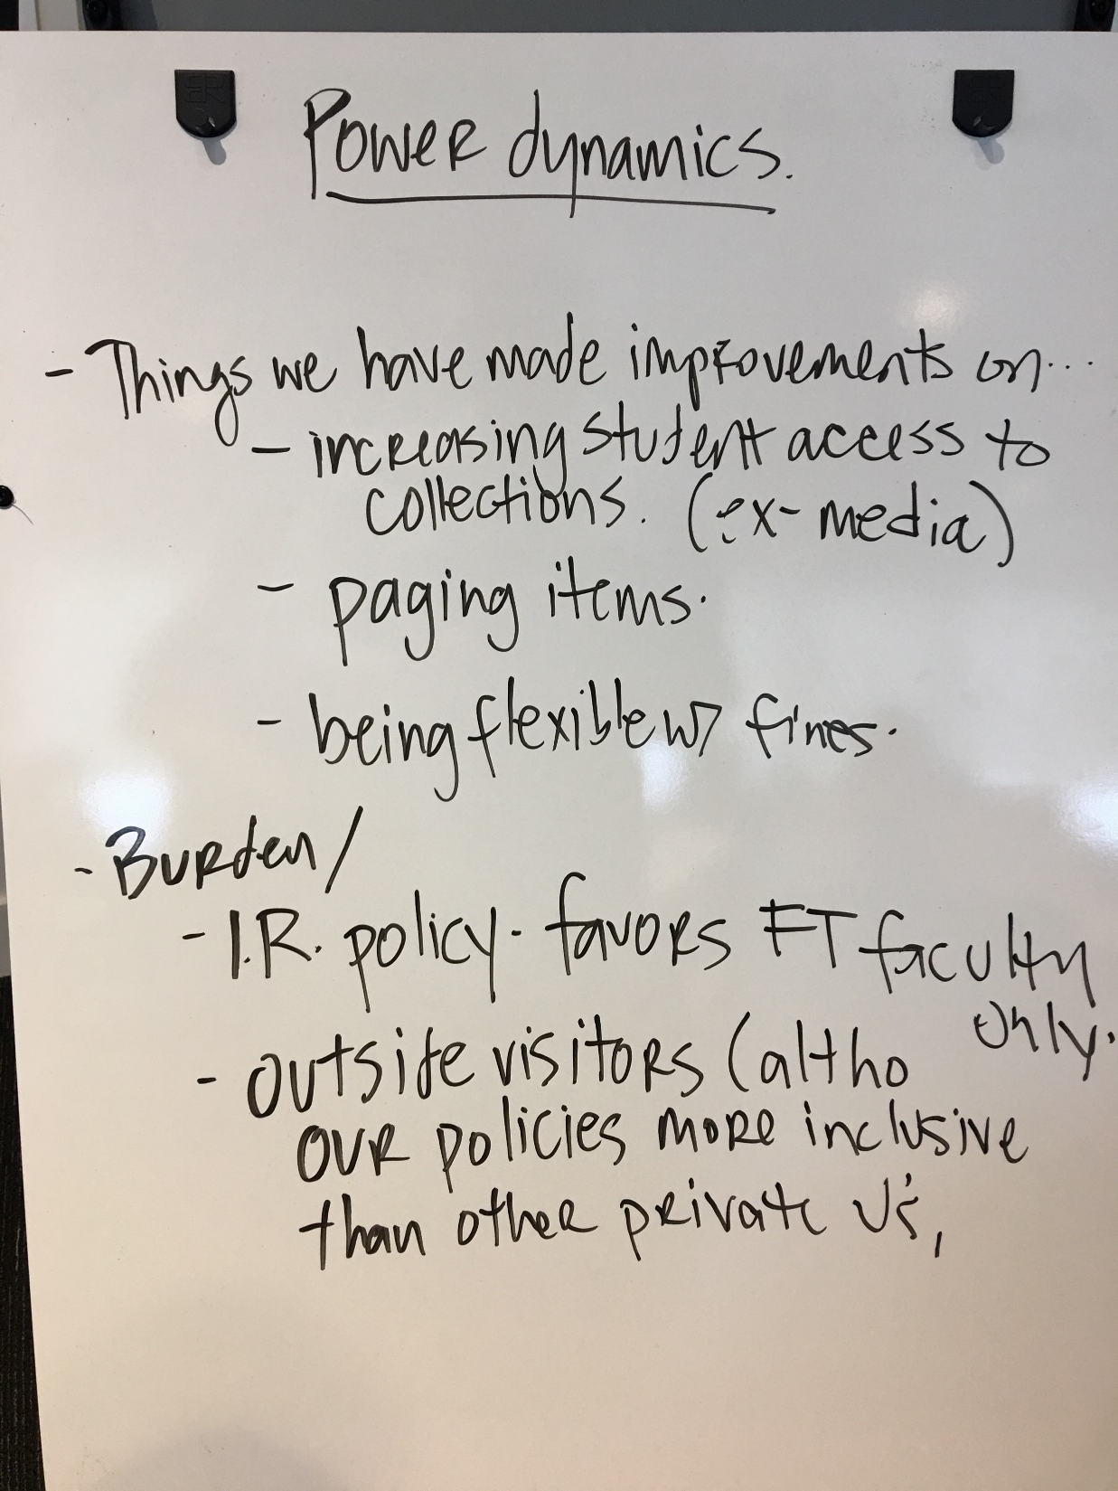
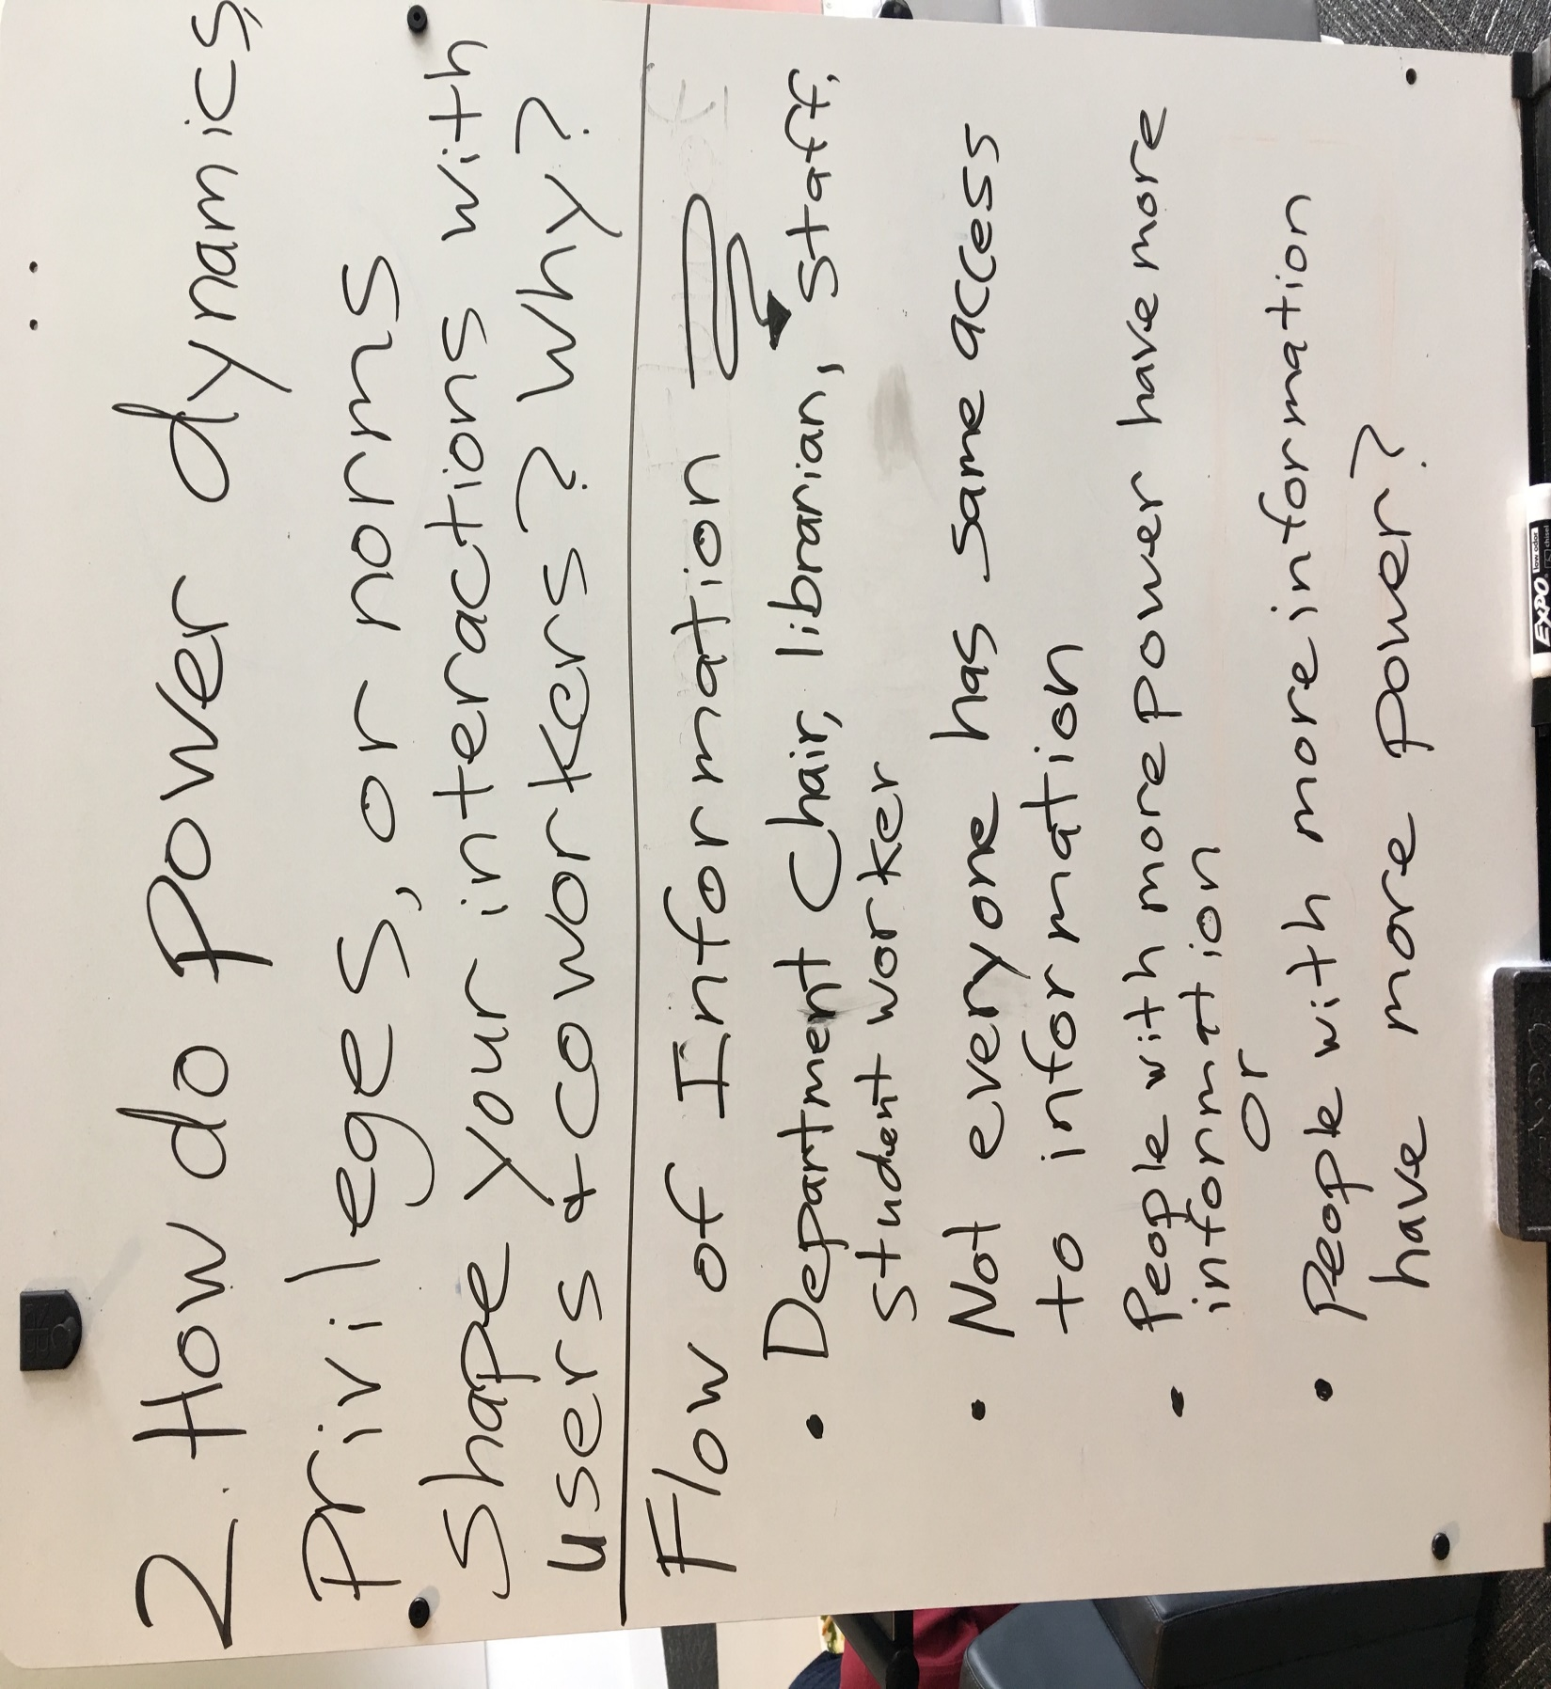
Notes:
Aisha

Slide 13
Lessons Learned
Limit jargon, or choose carefully and explain clearly
Build in time for the whole group to hear from one another after every activity or topic
Plan ample time to discuss in small groups
Designate one MC for the day to handle introductions and smooth transitions
Notes:
Desirae (<1 min)
Now that you’ve experience some of the exercises that were part of our staff development day, I’ll share our 7 most important lessons learned so you can improve upon what we did if you choose to adapt some of what we’ve shared. This is based on our own observations and participant feedback.
Limit jargon, or choose carefully and explain clearly. This was the impetus for creating the Resource Guide to share with all staff beforehand. You’ll be able to access the guide through our toolkit link.
Build in time for the whole group to hear from one another after every activity or topic. We didn’t do this for 1 or 2 of the topics because of time, but the group really would have liked to.
Plan ample time to discuss in small groups. We thought we’d planned a decent amount of time, but the conversations were really rich. People wanted more time to discuss.
Designate one MC for the day to handle introductions and smooth transitions. We didn’t have one but wished we did.

Slide 14
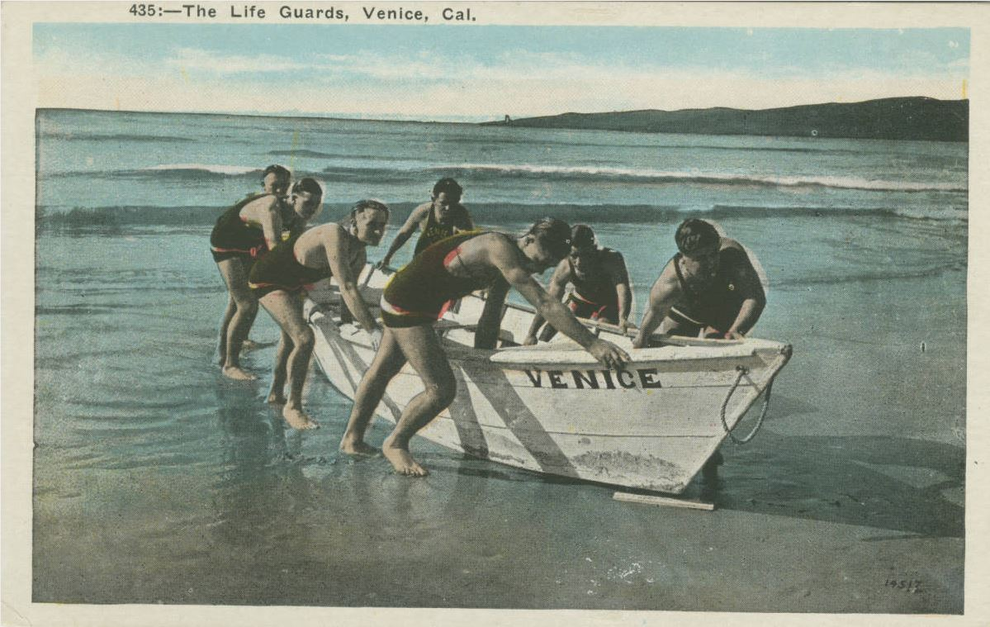
Lessons Learned
5. Allow more time to recruit speakers. Make your expectations very explicit
6. Staff loved getting out of the library together
7. Send thank you notes and small gifts of appreciation
“The Life Guards, Venice, California.” Werner Von Boltenstern Postcard Collection, Loyola Marymount University Special Collections. http://digitalcollections.lmu.edu/cdm/ref/collection/ chgface/id/235,
Notes:
Desirae (<1 min)
5. Allow more time to recruit speakers. This is especially true for summer events. Make your expectations very explicit...but be prepared for a speaker to go off-script and think about how you’ll respond and allow for discussion.
6. Staff loved getting out of the library together. This did a wonderful job promoting collegiality, but we have to be aware of and plan for physical accessibility considerations.
7. Send thank you notes and small gifts of appreciation. We used reproduction postcards from our Special Collections, like the one pictured here. This small gesture went a long way.

Slide 15
Results, or So What?
Reporting Out
  Summary of discussions and post-event survey shared
Changes for our Patrons
  Borrowing policies: extended loan periods, eliminating fines?
  Signage Task Force
Communication & Transparency within the Library
  All-Staff Meeting on Communication
  Sharing meeting minutes & upcoming agenda
Notes:
Desirae (<1 min)
So what? Thinking back to our goals for the day, these were the main results. First, we wanted to walk it like we talk it, so we reported out a summary of the day’s discussions and the results of the post-event survey to all staff.
Second, some positive changes were brought about for our patrons as a result of the day. We extended undergraduate loan periods to one semester, matching graduate students’ loan periods. We are also working on reducing or eliminating fines. Signage in our physical library came up as an issue multiple times, and a task force has been formed to evaluate and improve it.
Third, we’ve seen improvements in communication and transparency within our library. Our program inspired the next regular all-staff meeting, which further probed issues of internal communication and raised possible solutions. One solution has been to share our Management Council’s meeting minutes and upcoming agenda with all staff ahead of that group’s weekly meetings Sharing meeting minutes from library committees is also becoming more of a norm than it has been.

Slide 16
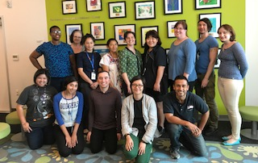
Results, or So What?
Volunteering
  Conversations about staff performing
  community service
  Children’s Institute, Inc.
Renewing Our Commitment
  Dean's “State of the Library” address & Annual Report
  “Social justice” more visible, more of an explicit part of our decision-making
Notes:
Desirae (<1 min)
Fourth, we’re continuing conversations about library staff performing community service together and possibly during work hours. A group of us spent a work day volunteering at the Children’s Institute Los Angeles library, which you can see in this photo.
Fifth and last, social justice featured prominently in our dean’s subsequent “State of the Library” address to all staff and in our library’s Annual Report, which is distributed to a variety of stakeholders. Overall, social justice has become a much more visible and explicit part of our decision-making, from conversations about strategic planning to textbooks and college affordability.

Slide 17

Social Justice Toolkit https://lmu.box.com/v/sjtoolkit
A Change Is Gonna Come:
Renewing Information Workers’ Commitment to Social Justice
CARL 2018: The Academic Library in Times of Change
April 14, 2018
Notes:
Desirae (<1 min)
You can download all of our materials— both from our original event and this presentation— from our Social Justice Toolkit using this URL. This includes the Resource Guide, all activities, PowerPoints, and the Staff Development Day Agenda.
If you’d like to share what you’ve jotted down on our handouts today, we’ll collect them, scan them, and post them alongside our materials in the toolkit so we can continue learning from one another.

Slide 18
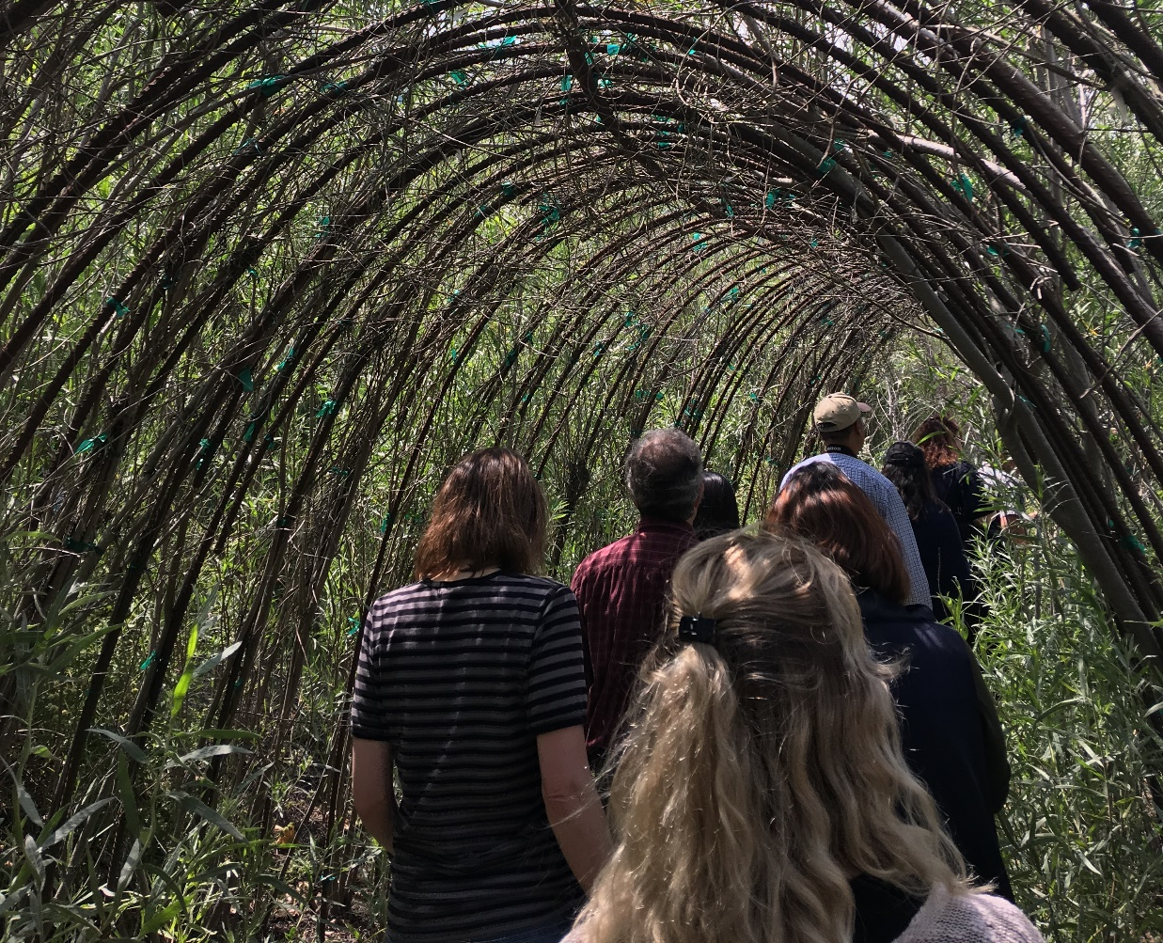
Questions?
Notes:
Desirae (10 min for questions)
Now we have time for questions, comments, or anything you’d like to share that relates to what we’ve discussed today.
Have you participated a staff development day with a social justice theme, or goals and outcomes? Would you like to share?

