Slide 1
Addressing Student & Instructor Needs
through Library Support for
OER
Josh Bolick
KU Libraries
jbolick@ku.edu
Rebel Cummings-Sauls
KSU Libraries
cads@ksu.edu
Notes:
These slides CC-BY unless otherwise noted.

Slide 2

“…higher education shall be equally accessible to all…”
-UN Universal Declaration of Human Rights
Notes:
Josh: Starting point: UN Universal Decl. of Human Rights in 1948; Article 26 states:

Slide 3
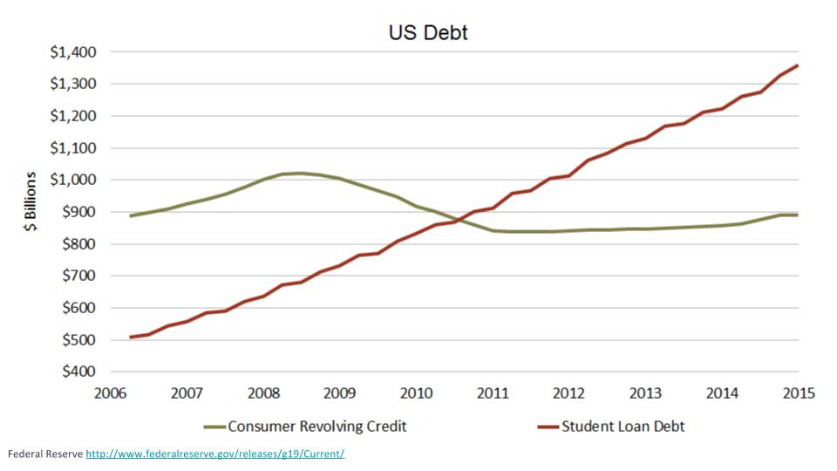
Affordability is a problem
Notes:
Josh: But we’ve not achieved that goal of universal access and in fact are moving rapidly away from it. The cost of attending college has been rapidly increasing for some time.

Slide 4
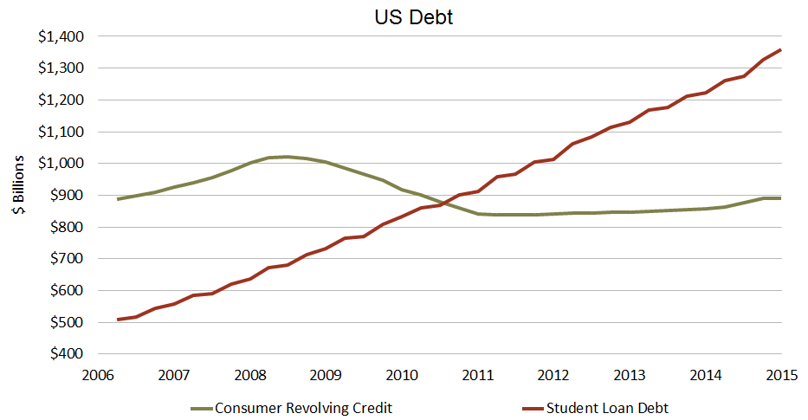
Federal Reserve http://www.federalreserve.gov/releases/g19/Current/
Notes:
Josh: This increase is evidenced by student loan debt. Cost of education is different than when we were undergrads. Student loan debt v. credit card debt. Note bubble and collapse in 2008; education debt never checked up, better nearly triples in years shown here. The rapidly increasing cost of education is complex, lots of components: tuition and fees, room and board, transportation, personal expenses, etc.
KSU’s Class of 2014 average borrower owed $26,779.

Slide 5
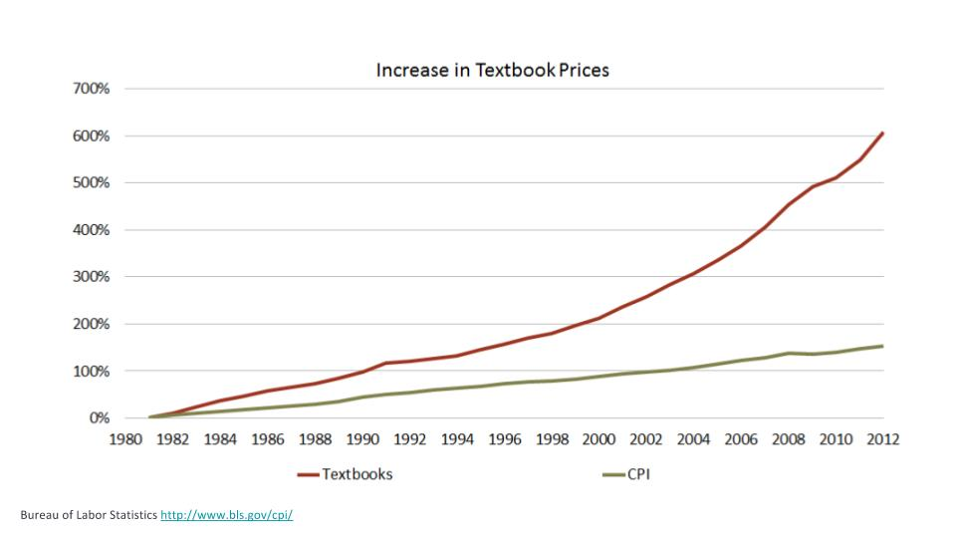
Textbook affordability in particular
Notes:
Josh: Textbooks are a particular point of pain for students. And the only aspect of affordability that professors/instructors can directly address as selectors of teaching materials.

Slide 6
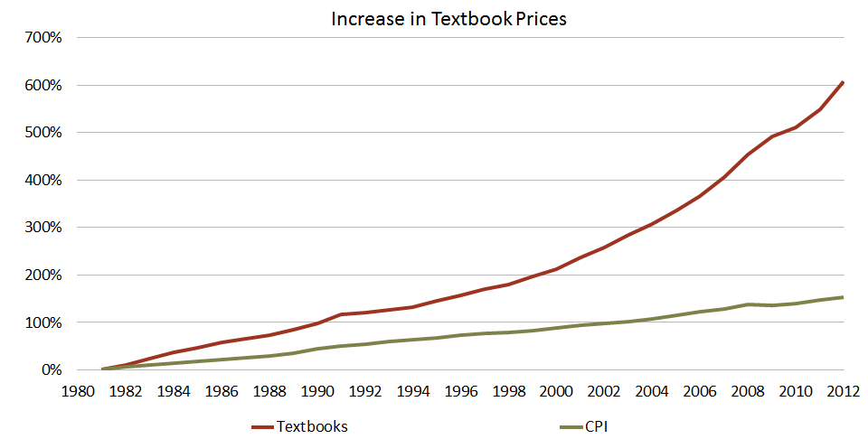
Bureau of Labor Statistics http://www.bls.gov/cpi/
Notes:
Josh: Textbooks have seen huge increase in last 30+ years, 4x rate of inflation. Single highest increasing consumer product, more than medical and housing.

Slide 7
How are Students Coping with the Cost?
Purchase an older edition of the textbook
Delay purchase of the textbook
Never purchase the textbook
Share the textbook with other students
Illegally download the textbook
Delay taking the class
Take a course with no or low cost textbook
Sell the textbook back early
Place the purchase on a credit card
Notes:
Rebel: Given what we now know about rising text costs and related financial difficulty: how do students cope? A few strategies. All expose students to risks, most of them academic risks. This is not what we want for our students.

Slide 8
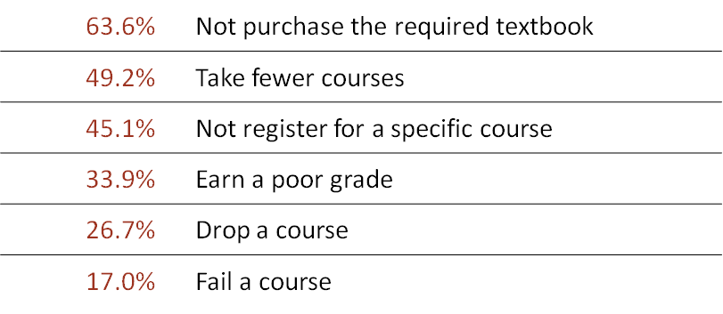
“In your academic career, has the cost of required textbooks caused you to:”
http://www.openaccesstextbooks.org/pdf/2012_Florida_Student_Textbook_Survey.pdf
Notes:
Rebel: Evidence: 2012 FL Virtual Campus Survey data. Having a real detrimental impact on student choices and success, not to mention lost revenue in the age of DFW. This is a huge problem. Updated in 2016 with very little change, some slightly better, some slightly worse.

Slide 9
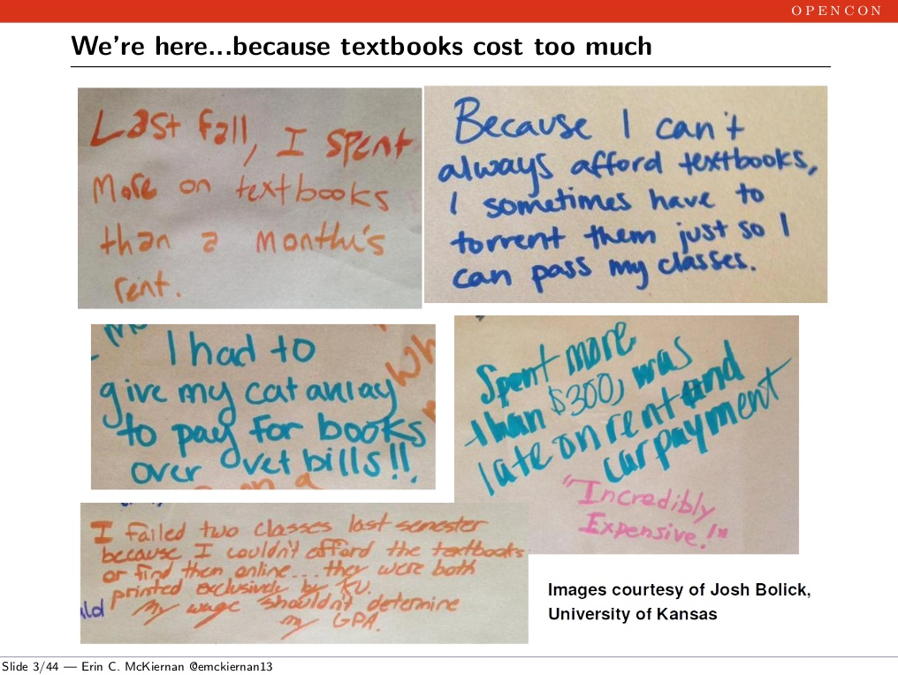
Notes:
Josh: Evidence: ask your students. This from KU. 76 responses filling 16’x3’ paper.

Slide 10
KSU Climate Survey
Manner | n | %
Difficulty affording tuition | 1,569 | 67.5
Difficulty in affording housing | 1,251 | 53.8
Difficulty purchasing my books | 1,242 | 53.4
Difficulty affording food | 917 | 39.4
48% (n= 2,325) of Student Respondents Reported Experiencing Financial Hardship...
Notes:
Rebel: Evidence: ask your students. This from KSU 2014 Campus Climate Survey.
KSU students reported for the 2014-2015 period their textbook costs were $1,000.

Slide 11
Open
Educational
Resources
Notes:
Rebel: One solution, in a complex mix of strategies to mitigate costs: Open educational resources

Slide 12
Open
Educational
Resources
Notes:
Rebel: Also known as OER.

Slide 13
Hewlett Foundation Definition:
“OER are teaching, learning, and research resources that reside in the public domain or are released under an intellectual property license that permits their free use and repurposing by others”
http://www.hewlett.org/programs/education/open-educational-resources
Notes:
Rebel: Hewlett defines OER thusly. Note: free to read/access, and free to reuse.

Slide 14
Open = Free + Permissions
Retain
Reuse
Revise
Remix
Redistribute
5Rs:
5Rs from David Wiley http://www.opencontent.org/definition/
Notes:
Josh: Open is free + reuse rights, David Wiley’s 5Rs. All of these things enable innovative pedagogy in ways that traditionally “all rights reserved” material can’t.

Slide 15
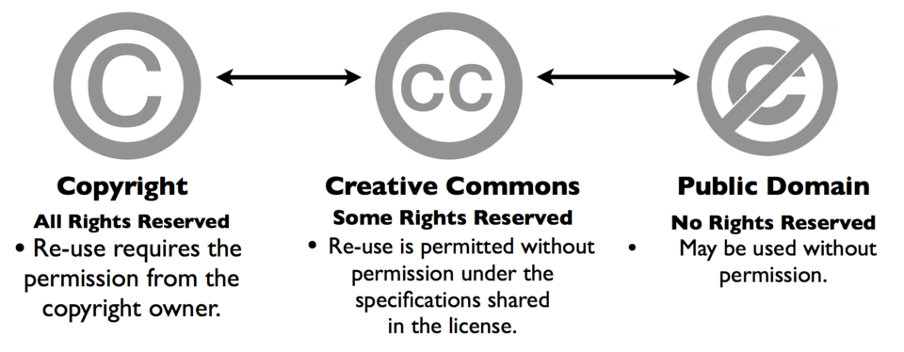
Spectrum of Rights
Graphic from http://tlinnovations.populr.me/copyright
Notes:
Josh: Free + reuse (open) frequently accomplished through creative commons. Continuum C to PD, with CC in the middle. OER happens in the (animated) red box.

Slide 16

Examples of OER
Notes:
Rebel: Overview of OpenStax College. Based at Rice University in Houston, OpenStax is using grant funding from Hewlett and Gates to replication a commercial text production process to create highly polished open textbooks for the highest enrollment courses in the US.

Slide 17

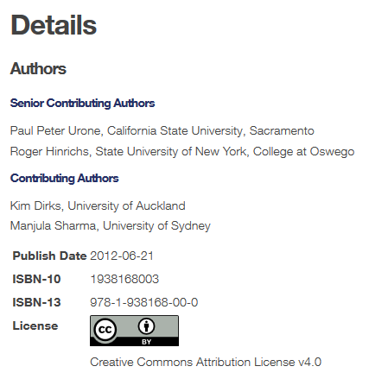
Examples of OER: OpenStax Physics
Notes:
Josh: The OpenStax Physics book is in use at KU. Overview of features of the book, print and digital editions, sales on Amazon and through KU Bookstore, possibilities as a result of open license, estimated savings as a result of adoption nearly $100K over 4 semesters.

Slide 18
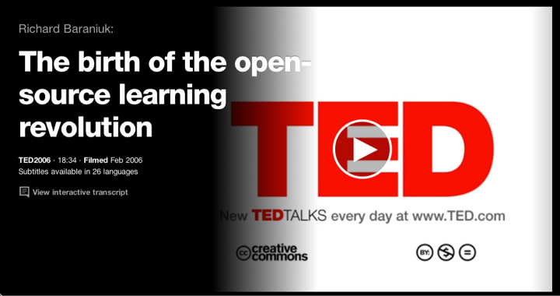
Examples of OER: TED Talks
Notes:
Josh: Another example of OER is TED Talks: BY NC ND. Use this in a classroom, and it’s OER.

Slide 19
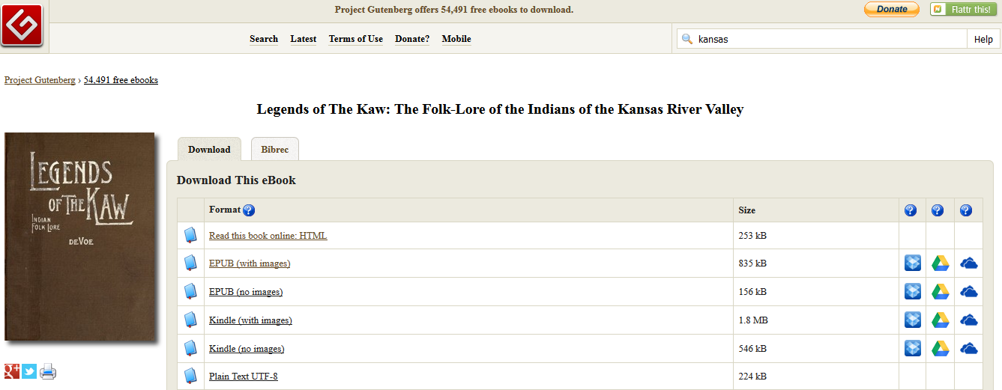
Examples of OER: Public Domain
Notes:
Rebel: Example of public domain content as OER. Everything in the Gutenburg Project, other releases of pre-1923 publications.

Slide 20
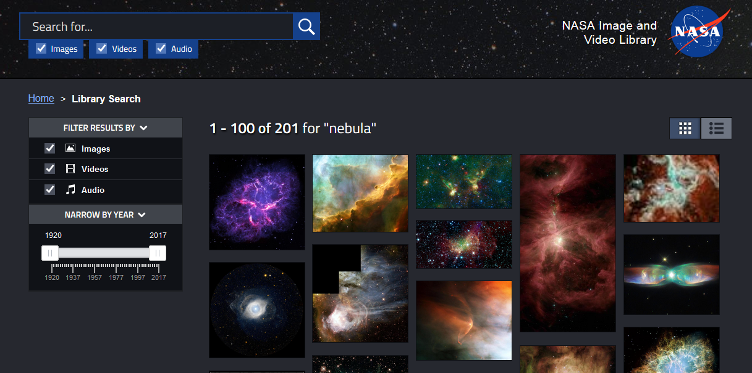
Examples of OER: Public Domain
Notes:
Rebel: another example of public domain content as OER: scientific images by NASA or other federal agency (because documents created by fed not protected by copyright.

Slide 21
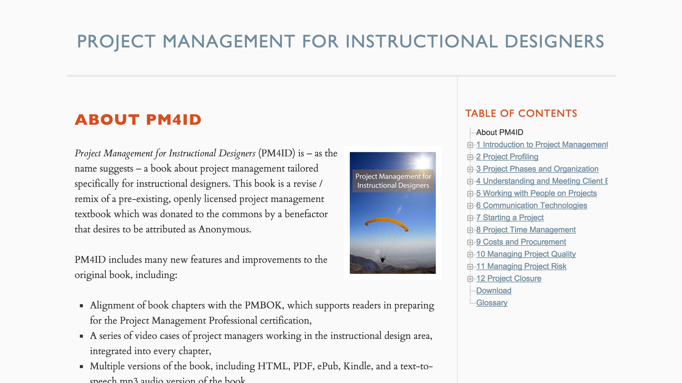
PM4ID
Notes:
Josh: In a course taught by David Wiley, he led graduate students at BYU in adapting an existing open textbook about project management, revised it to take out examples about international business, replaced them with examples from instructional design, replaced copyrighted imaged with openly licensed images, shot and embedded videos, and even created interactive, mastery-check assessments and embedded these within the book. Then released it as Project Management for Instructional Designers.
Since then: alignment with the Project Management Professional certification exam; an expanded glossary; and downloadable HTML, PDF, ePub, MOBI, and MP3 versions of the book. All created as course assignments, which shows you the potential for pedagogical innovation with open textbooks.

Slide 22
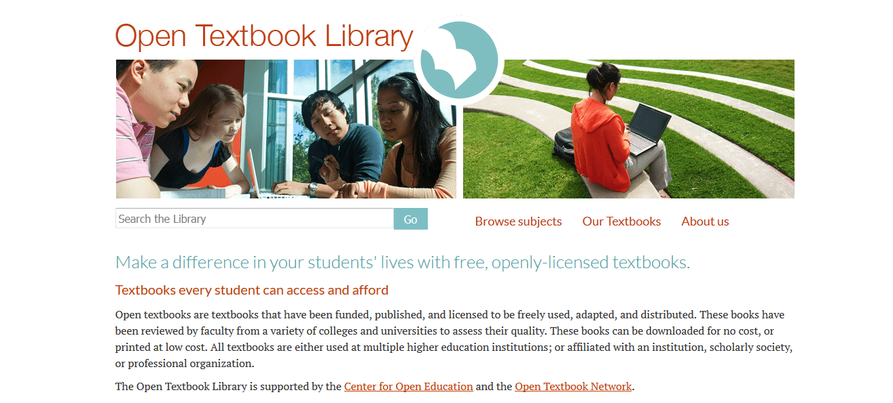
open.umn.edu/opentextbooks/
Notes:
Josh: quick overview of OTL. Over 380 openly licensed books that meet 4 criteria: open licensed, complete (no chapters or modules), portable format (downloadable, usable offline, so no website-based OER), and affiliated with an institution of higher learning or scholarly society, or in use at multiple institutions.

Slide 23

oercommons.org
Notes:
Rebel: www.oercommons.org is a non-profit collection of open educational resources that range from single lessons or exercises to full courses. Browse by subject, education level, etc.

Slide 24

merlot.org
Notes:
Rebel: https://www.merlot.org/ is a long standing project from the California State University system, which includes whole courses, textbooks, lectures, videos, audio, lessons, slides, exercises, demonstrations, and other modular learning object which may be integrated into courses or lectures, or modified to meet local needs subject to the license applied to the item.

Slide 25
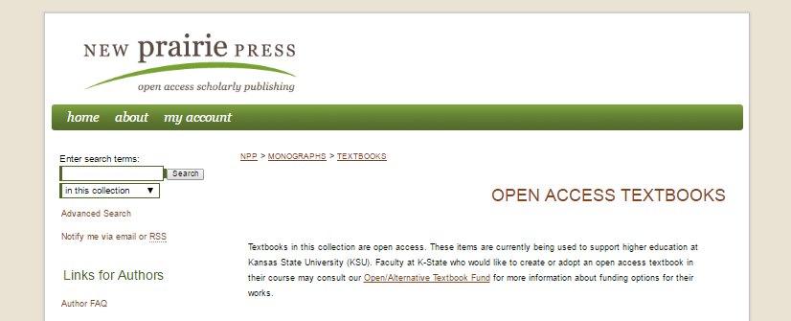





newprairiepress.org/textbooks/
Notes:
Rebel: Overview of New Prairie Press at KSU and KSU textbook creation work.

Slide 26
OER at your institutions?
Notes:
Rebel: Audience participation: what strategies are audience currently using at their own institutions, if any? Do they have OER initiatives? Perceived barriers?

Slide 27
OER Program at KSU
Open and Alternative Textbooks allowed
Started in 2013
Grants up to $5,000
Partners: Faculty, Staff, Students, President, Provost, Foundation, Donors
OTN Membership supported by Provost Grant Funding
Student Fee $10/course
Notes:
Rebel: Overview of KSU OER Program: outreach, grants, OTN membership, etc.
Alternative= Not just a textbook but integrated learning resource; also allows for the use of library resources and faculty created resources that are not openly available to the world, just their students.

Slide 28
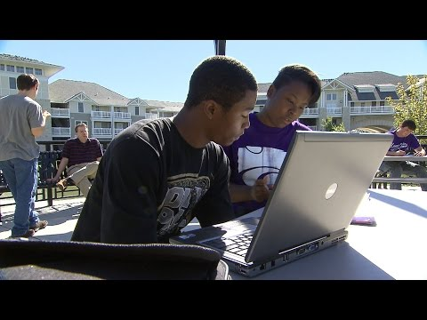
KSU Open/Alternative Textbook Initiative
Notes:
Rebel: Short video overview of KSU Open/Alternative Textbook Initiative.

Slide 29
OER Program at KU
OTN Membership: Workshops and Network
  Adoption as a result: Theory of Music
Grants: Adopt, Adapt, Create
  Haitian Creole
  Statics and Dynamics
Library Publishing: Tajik Persian
Events: Open Education Week
Partnerships: CTE, CODL, Bookstore!
Outreach Outreach Outreach
Notes:
Josh: Overview of KU OER Program: OTN membership, outreach, grants

Slide 30
Strategies for Supporting OER Implementation
Broad Campus Support
Information Sessions
Open Textbook Reviews
Supporting Instructor Options
Notes:
Rebel: So based on our experience building these programs at our 2 institutions, we derived these broad general strategies. We’ll discuss each in context.

Slide 31
Nourishing Broad Campus Support
Across all campus constituents:
Students
Faculty
Staff
Administration
Different interests/needs!
Notes:
Student support, ROI, and student success have been huge factors for garnishing broad campus support. Recognizing that different constituents have different interests, need tailored message/outreach to get buy in. Main message: engage groups across institution on the topic.
Have faculty share their experiences
KSU- Program started by faculty and library; not seen as admin. project
89% of Student fee goes back to department-KSU

Slide 32
Information Sessions
Librarians
  Sometimes Faculty Partners
One-on-one Meetings
  “Let’s get a coffee!”
Group Meeting Presentations
  Tailored to department/center/unit audience
OTN Workshops
Notes:
Included with OTN Membership. ROI may or may not be immediately seen. Outside Speaker may draw in larger crowd.
Even just one conversion will mean student savings. Low cost with potential high reward.

Slide 33
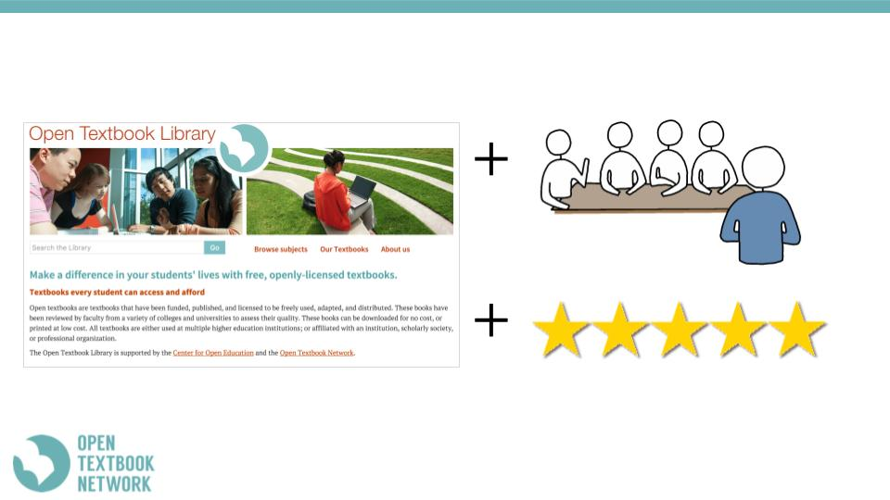
Open Textbook Reviews
OTN data shows that engagement leads to adoption
educate
engage
RESULTS!
Notes:
Logic/result of reviews: education about impact of high costs texts on students and learning, opportunity of OER to address these issues; engagement with OER by connecting instructors with open texts in their areas and having them engage with them, examine, potentially write a review. OTN has proven results with this model leading to adoptions of open texts. This model could be replicated outside of Open Textbook Network.

Slide 34
Supporting Instructor Options
OER as increasing academic freedom
Forward example open content
Stress customization/pedagogy options of open
Support flexible implementation
Using technology/forms they are comfortable with
Notes:
In building an OER initiative, you must support instructors in their own needs/understandings. Example: Discuss how open licensing increases academic freedom. Send example materials in an instructor’s discipline, etc.

Slide 35
QUESTIONS?
Josh Bolick
KU Libraries
https://openaccess.ku.edu/oer
jbolick@ku.edu
Rebel Cummings-Sauls
KSU Libraries
http://www.lib.k-state.edu/open-textbook
cads@ksu.edu
Notes:
Please contact us if you have questions!

