Slide 1
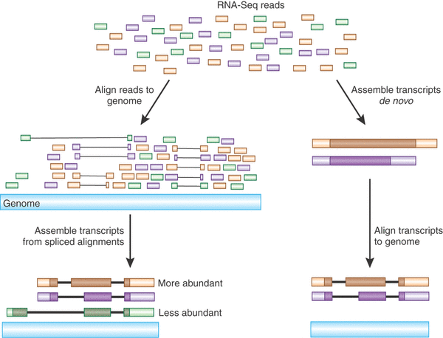

Transcriptome Analysis Using
RNA-Seq Technology
Ray Enke Ph.D.
James Madison University
Department of Biology, Harrisonburg VA
contact: enkera@jmu.edu
Twitter: @Enke_Lab

Slide 2
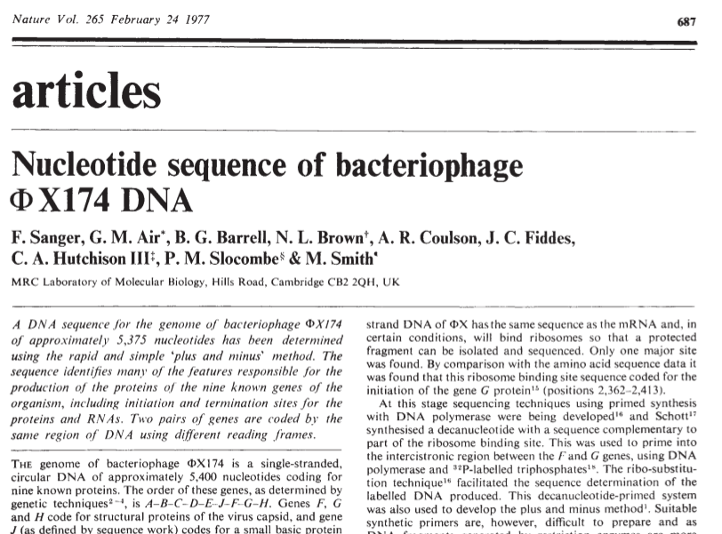



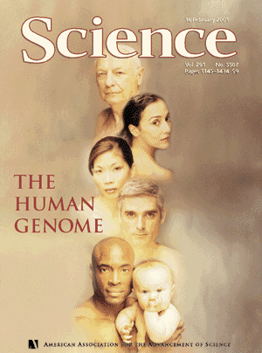
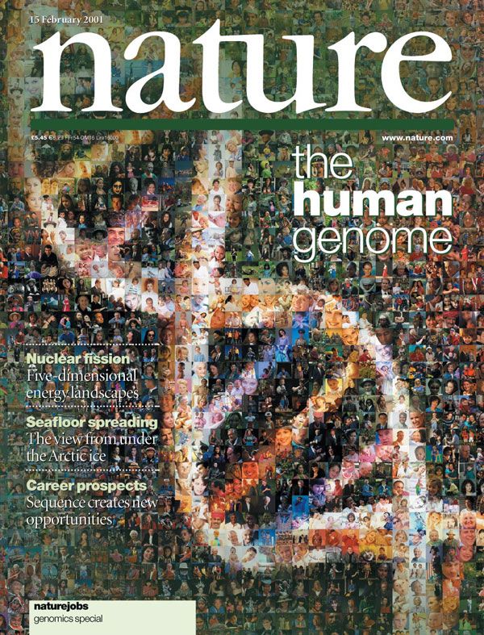
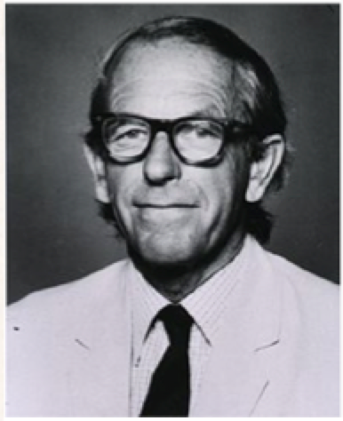
Milestones in Genome Sequencing
1977. Sanger et al.
1st Complete Organism
Bacteriophage; 5375 bp
1995. Fleischmann et al.
1st Free Living Organism
H. influenza 1.8 Mb
1998. 1st Multicellular Organism
C. elegans; 97 Mb
all completed using Sanger sequencing
2000. Arabidopsis
1st Plant Genome.
135 Mb
2001. Venter et al., IHGSC
Human Genome; 3.2 Gb
~13 years + ~$3 billion
Fred Sanger
1918-2013

Slide 3
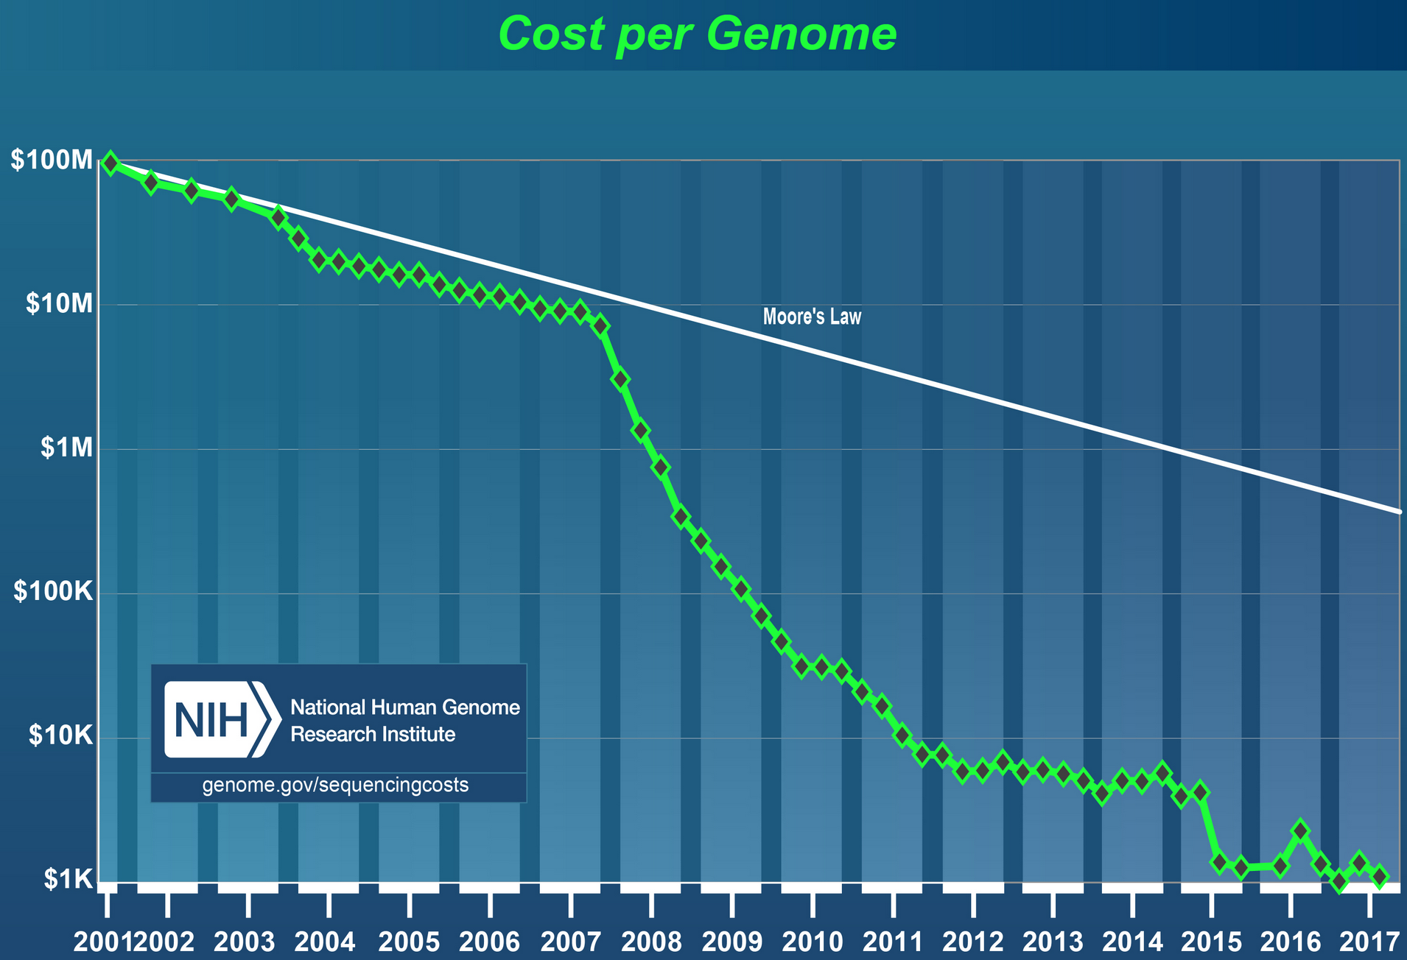
The Impact of Next Generation Sequencing (NGS)
(human)
Completion of Human Genome Project (2001)
advent of NGS tech
10,000X reduction in DNA sequencing cost from 2007-15
Source: NHGRI

Slide 4
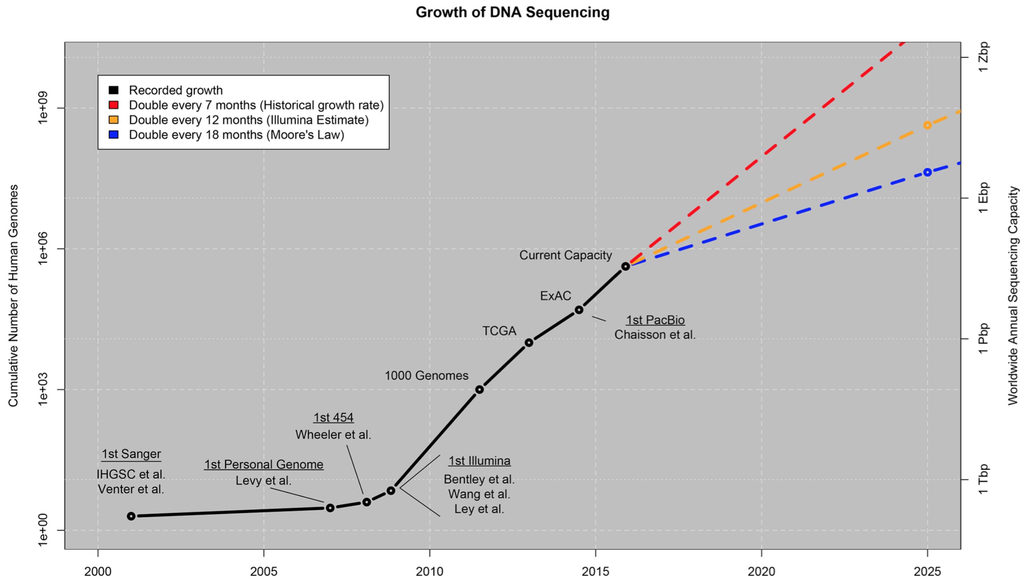
The Impact of Next Generation Sequencing (NGS)
Stephens et al., 2015 PLOS Bio
Reduced cost of NGS has resulted in explosion of genomic data

Slide 5
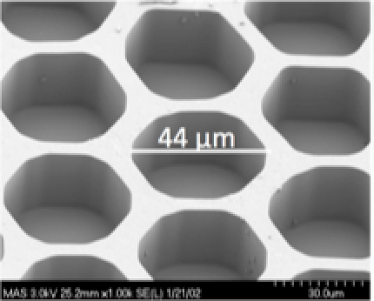
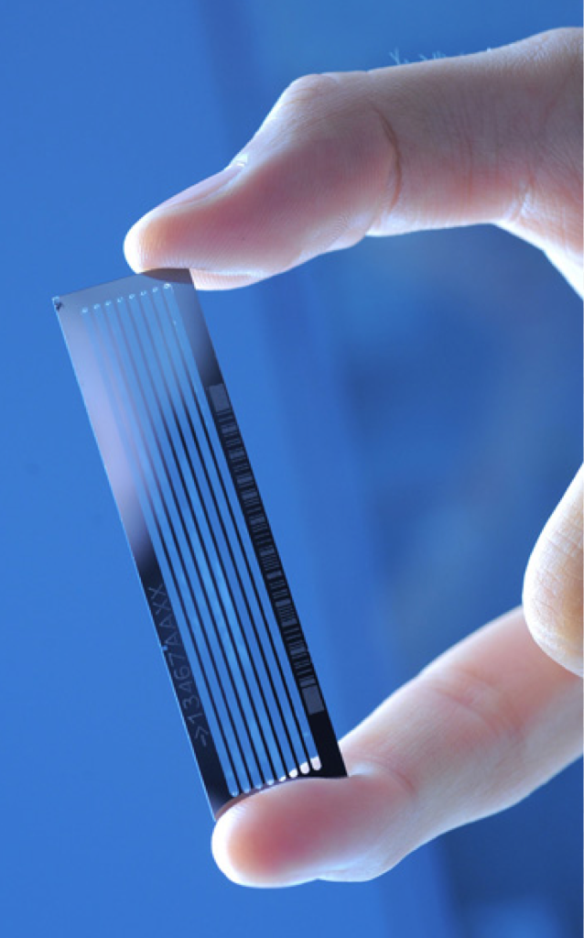
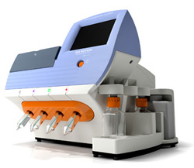
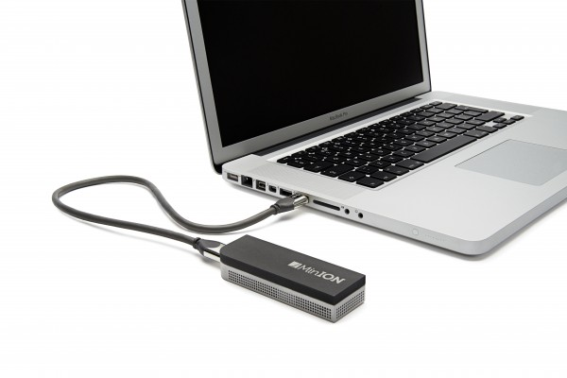
Next Generation Sequencing (NGS)
Roche 454 (2007)
Illumina (2009)
Ion Torrent (2010)
Nanopore MinION (2014)
“Next gen” massively parallel sequencing
Based on sequencing by synthesis
“3rd generation!”

Slide 6
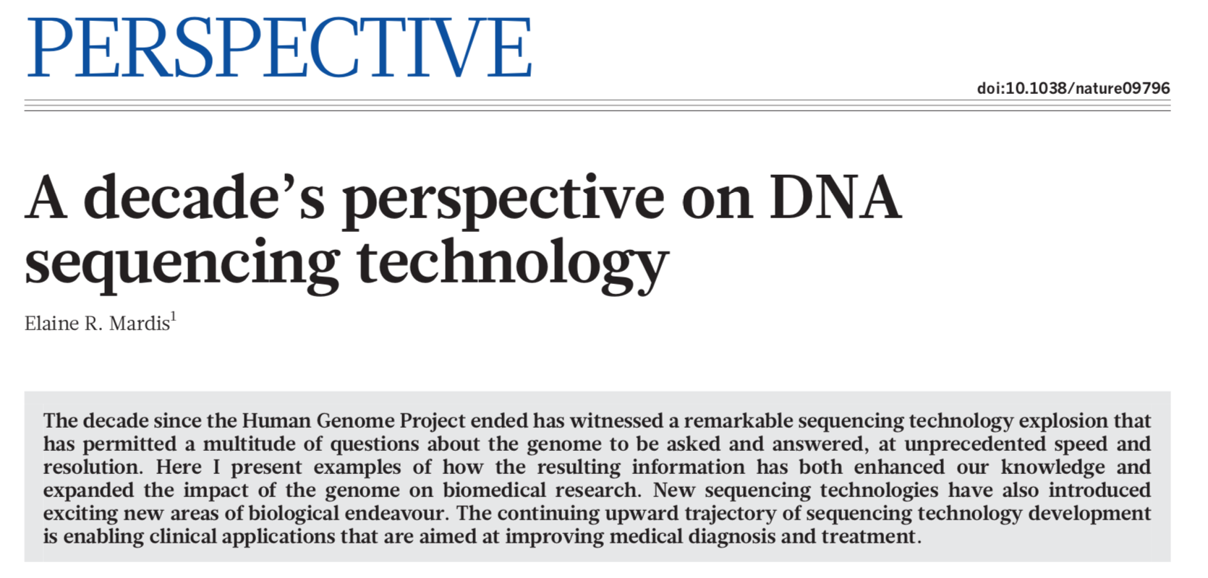
What else can you sequence besides genomes?
from Mardis NGS 2011 paper
De novo genome sequencing: sequencing and assembling a previously unsequenced genome (e.g. Human Genome Project)
Link to paper: http://bit.ly/Mardis_paper
Notes:
What is the genetic factor?

Slide 7
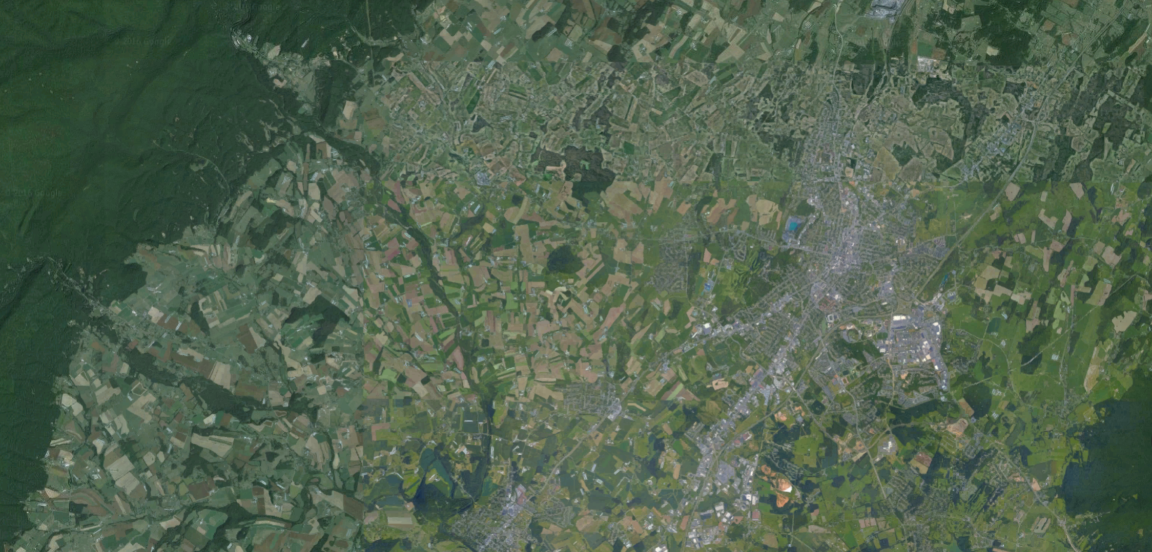
Genome Sequencing: Map Analogy
Harrisonburg, VA: think of a genome assembly like a map
the map itself is insightful
Additional information layered on top of the map offers new insight
Notes:
Cloning, transformation, culturing bact are all time-consuming steps
96 individual sequence reads/sequencer

Slide 8
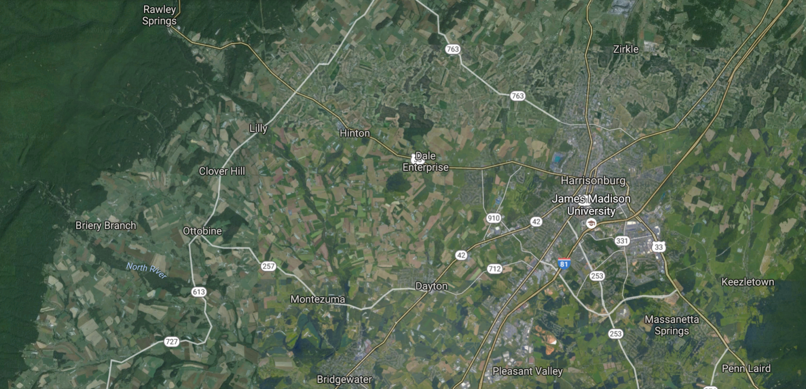
Genome Sequencing: Map Analogy
Example annotations:
Roads, towns, landmarks
Harrisonburg, VA: think of a genome assembly like a map
the map itself is insightful
Additional information layered on top of the map offers new insight
Notes:
Cloning, transformation, culturing bact are all time-consuming steps
96 individual sequence reads/sequencer

Slide 9
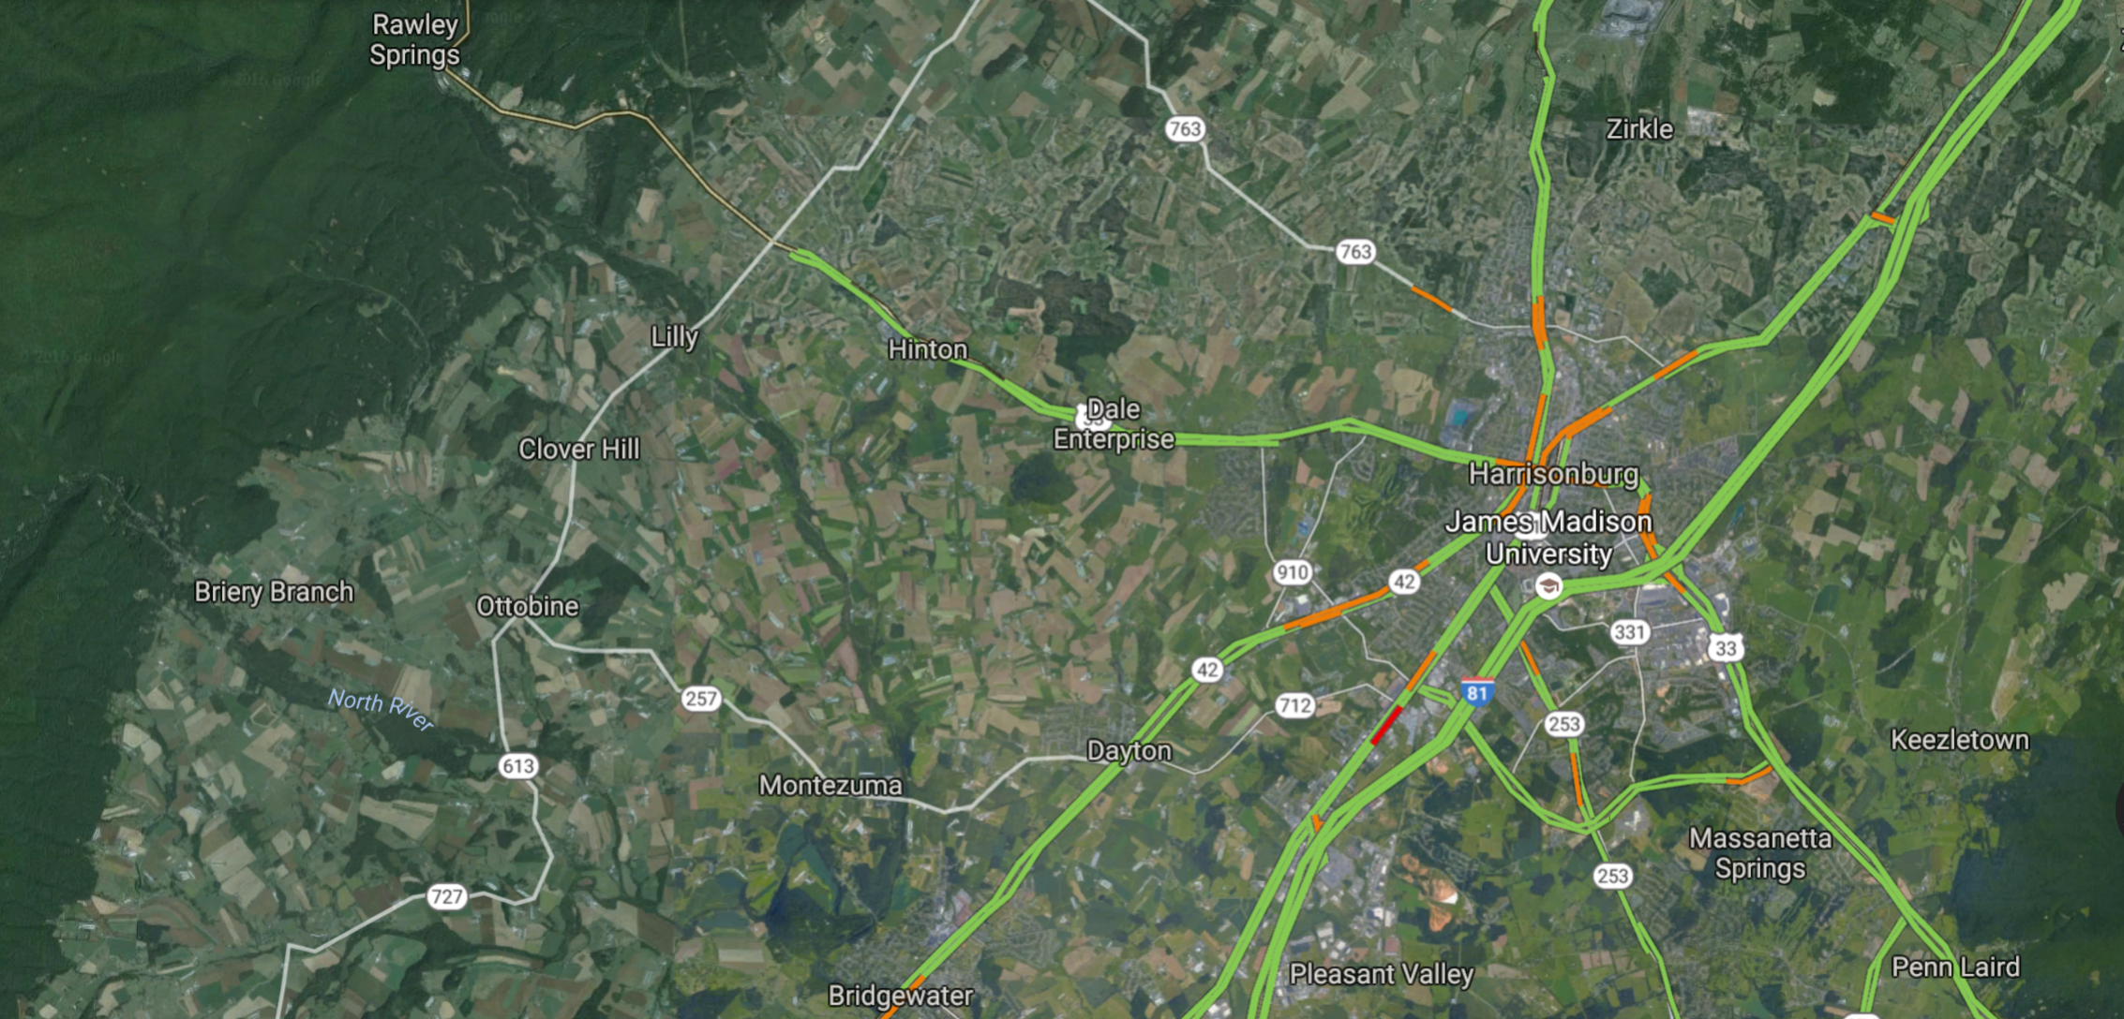
Genome Sequencing: Map Analogy
Example annotations:
Roads, towns, landmarks
Live traffic patterns
Harrisonburg, VA: think of a genome assembly like a map
the map itself is insightful
Additional information layered on top of the map offers new insight
Notes:
Cloning, transformation, culturing bact are all time-consuming steps
96 individual sequence reads/sequencer

Slide 10
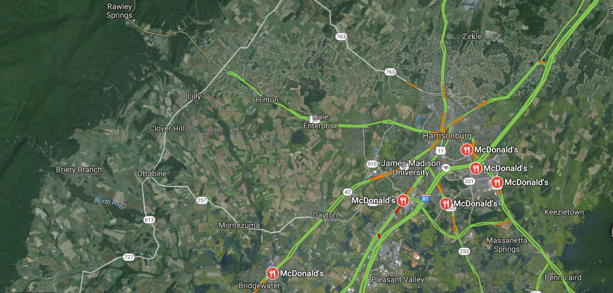
Genome Sequencing: Map Analogy
Example annotations:
Roads, towns, landmarks
Live traffic patterns
McDonald’s Locations
Harrisonburg, VA: think of a genome assembly like a map
the map itself is insightful
Additional information layered on top of the map offers new insight
Notes:
Cloning, transformation, culturing bact are all time-consuming steps
96 individual sequence reads/sequencer

Slide 11
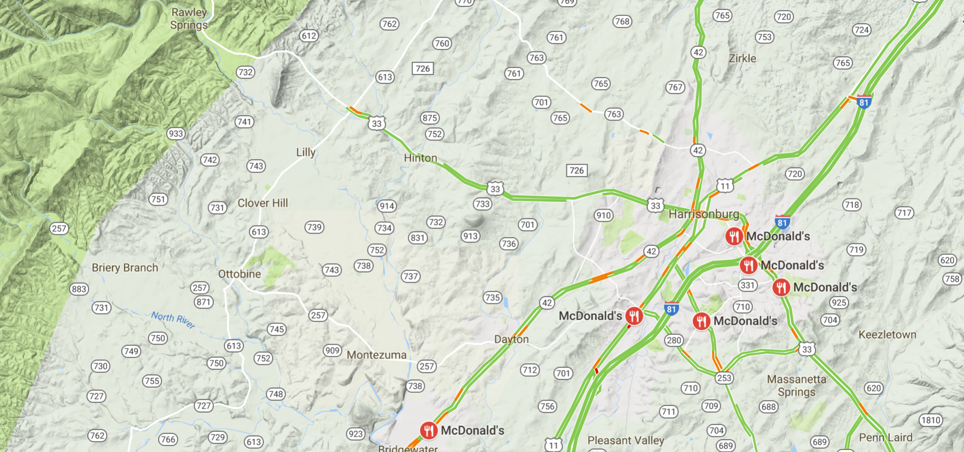
Genome Sequencing: Map Analogy
Example annotations:
Roads, towns, landmarks
Live traffic patterns
McDonald’s Locations
Terrain & topology
Harrisonburg, VA: think of a genome assembly like a map
the map itself is insightful
Additional information layered on top of the map offers new insight
Notes:
Cloning, transformation, culturing bact are all time-consuming steps
96 individual sequence reads/sequencer

Slide 12
What else can you sequence besides genomes?
from Mardis NGS 2011 paper
De novo genome sequencing: sequencing and assembling a previously unsequenced genome (e.g. Human Genome Project)
Genome re-sequencing: improve quality of genome assembly; obtain info about genome variation w/in species (e.g. 1000 Genomes Project)
Chromatin Immunoprecipitation (ChIP)-seq:
  which genomic regions are associated with my favorite protein (e.g. transcription factors, transcriptional repressors)
  which genomic regions are associated with my favorite histone modifications (e.g. H3K27 acetylation; H3K9 methylation)
Whole Genome Bisulfite Sequencing (WGBS): which genomic regions are methylated (e.g. CpG DNA methylation)
Transcriptome sequencing (RNA-Seq): which regions of the genome are functional (transcribed) in a specific tissues/cell type
Notes:
What is the genetic factor?

Slide 13
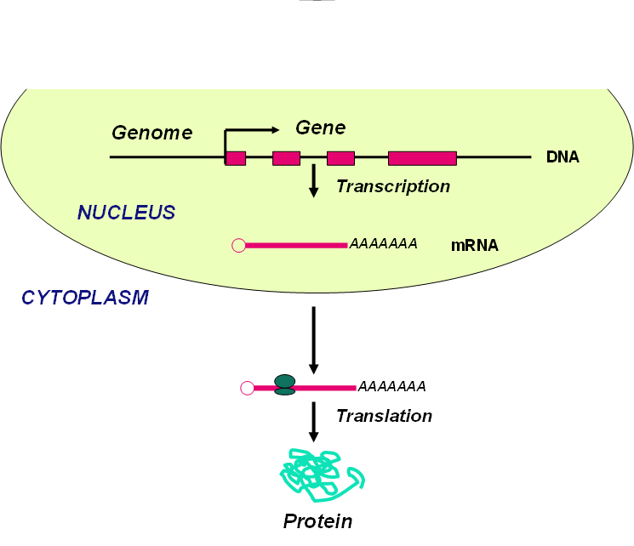
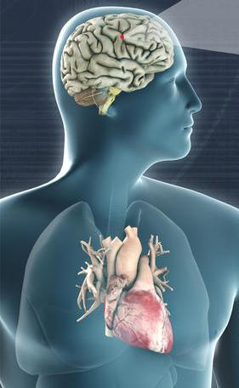
All cells within an individual:
have identical DNA sequence (for the most part)
But potential for different gene expression profiles
(e.g. heart vs brain)
Much of diversity lies in differential gene expression

Slide 14
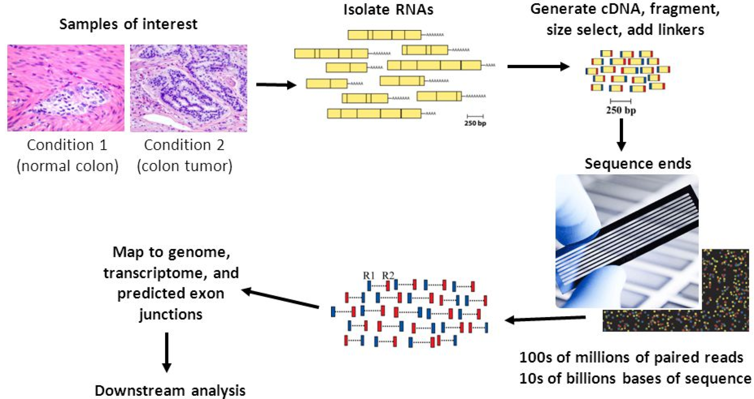
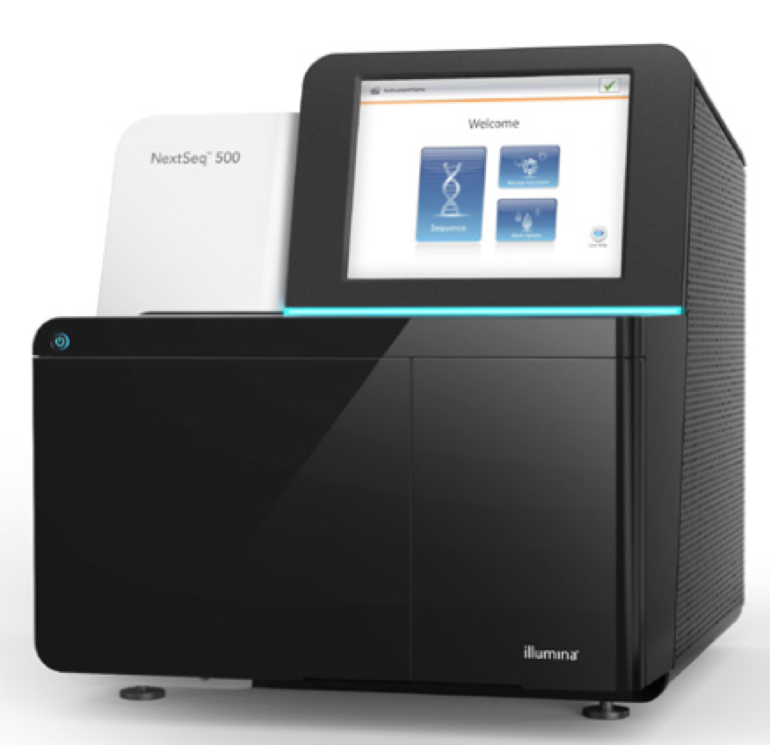

RNA-Seq Analysis of Gene Expression
Sequence all cDNA copies of RNA from target cells (any species)

Slide 15
RNA-Seq Analysis of Gene Expression
Sequence all cDNA copies of RNA from target cells (any species)
Generate millions-billions of sequence reads corresponding to cDNAs

Slide 16
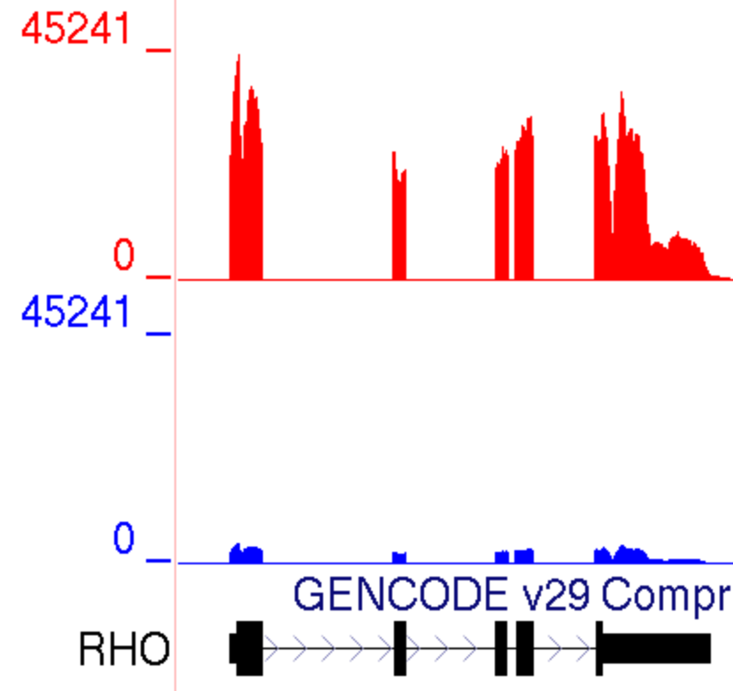
RNA-Seq Analysis of Gene Expression
condition 1
condition 2
Sequence all cDNA copies of RNA from target cells (any species)
Generate millions-billions of sequence reads corresponding to cDNAs
Map individual sample reads to a reference genome
Count-based statistical analysis of reads/sample to determine differential expression

Slide 17
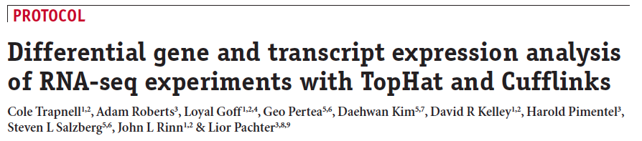
RNA-Seq Bioinformatics Analysis: The Tuxedo Protocol
Trapnell et al., Nature protocols 7: 562-578 (2012)
Link to paper: http://bit.ly/Tuxedo_protocol
Notes:
CummeRbund

Slide 18
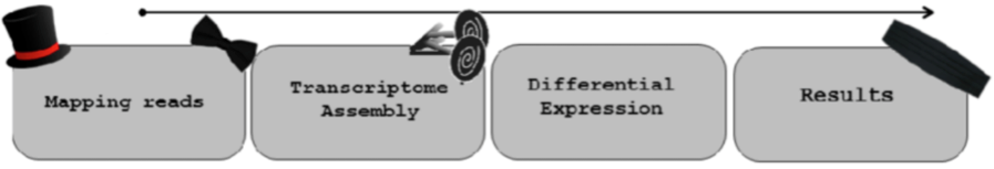
RNA-Seq Bioinformatics Analysis: The Tuxedo Protocol
Trapnell et al., Nature protocols 7: 562-578 (2012)
Tuxedo Suite Pipeline
Transcript assembly
Differential Expression
Data Visualization
Mapping reads
TopHat & Bowtie
CuffLinks
CuffDiff
CummeRbund
Notes:
CummeRbund

Slide 19
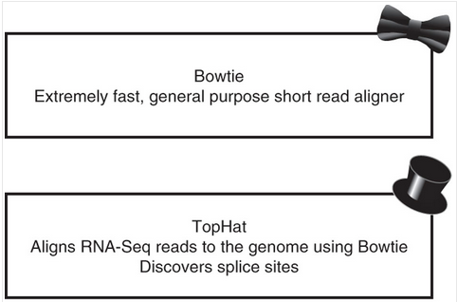
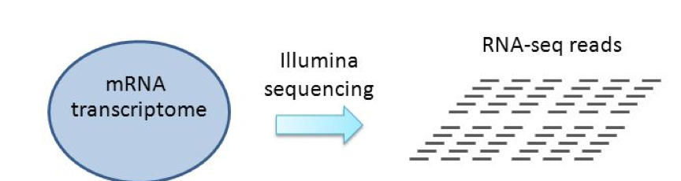
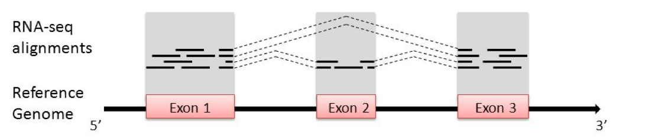
RNA-Seq Tuxedo Protocol: Read Alignment
  Rapidly aligns identical match reads to a reference genome assembly
    -(ie similar to millions of simultaneous BLAST searches)

Slide 20
RNA-Seq Tuxedo Protocol: Read Alignment
  Rapidly aligns identical match reads to a reference genome assembly
    -(ie similar to millions of simultaneous BLAST searches)
  What’s the limitation of Bowtie for sequences corresponding to mRNAs?

Slide 21
RNA-Seq Tuxedo Protocol: Read Alignment
  Rapidly aligns identical match reads to a reference genome assembly
    -(ie similar to millions of simultaneous BLAST searches)
  What’s the limitation of Bowtie for sequences corresponding to mRNAs?

Slide 22
RNA-Seq Tuxedo Protocol: Read Alignment
  Rapidly aligns identical match reads to a reference genome assembly
    -(ie similar to millions of simultaneous BLAST searches)
  TopHat: splice-aware aligner for reads spanning intron junctions

Slide 23
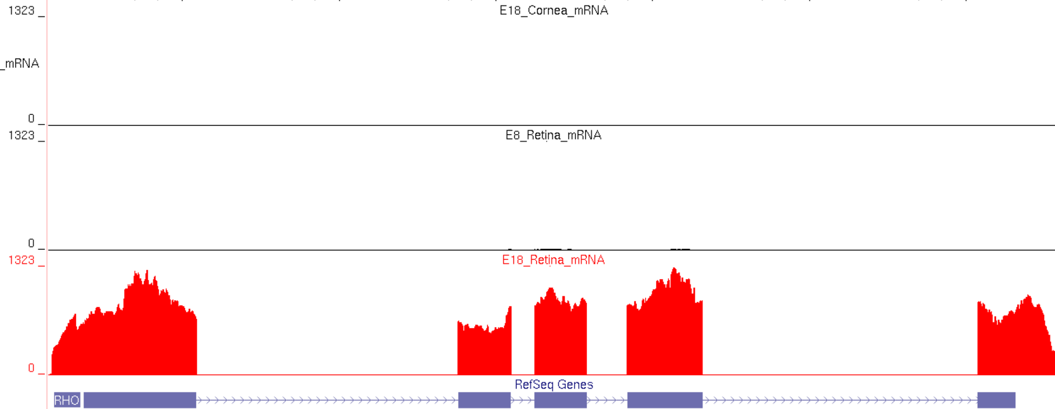
RNA-Seq Tuxedo Protocol: Read Alignment
TopHat read alignments visualized in the UCSC Genome Browser
Chicken RHODOPSIN (RHO) gene
Embryonic Day 18 cornea mRNA
Embryonic Day 8 retina mRNA
Embryonic Day 18 retina mRNA
Q: Based on RNA-seq alignment data, what’s the expression pattern for the RHO gene?
A: RHO is expressed in the embryonic Day 18 retina but not in the other 2 tissues.

Slide 24
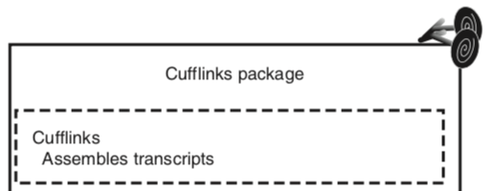
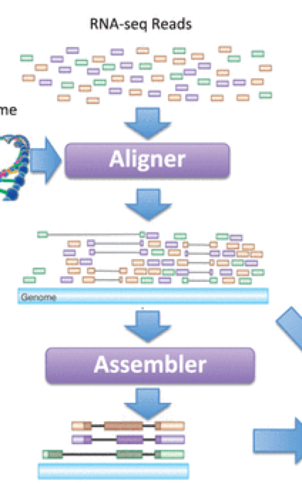
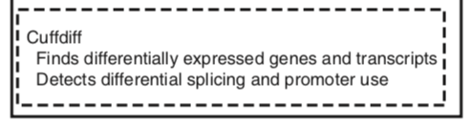

RNA-Seq Tuxedo Protocol: Differential Expression Analysis
  Cufflinks: assembles aligned reads into gene models/transcripts
TopHat/Bowtie
Cufflinks
Notes:
Cufflinks and Cuffdiff implement a linear statistical model to estimate an assignment of abundance to each transcript that explains the observed reads with maximum likelihood (Trapnell 2012)

Slide 25
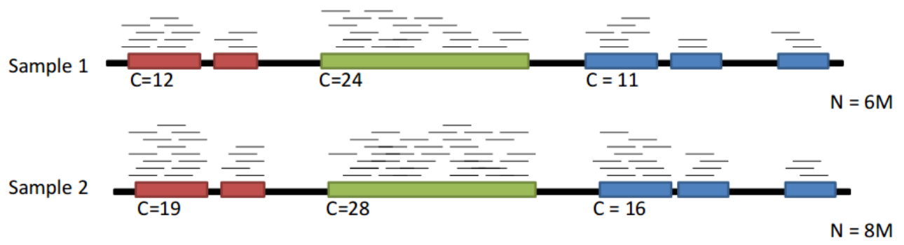
RNA-Seq Tuxedo Protocol: Differential Expression Analysis
  Cufflinks: assembles aligned reads into gene models/transcripts
  Cuffdiff: statistical analysis of each sample in replicate calculating differentially expressed genes (DEGs)
Notes:
Cufflinks and Cuffdiff implement a linear statistical model to estimate an assignment of abundance to each transcript that explains the observed reads with maximum likelihood (Trapnell 2012)

Slide 26
RNA-Seq Tuxedo Protocol: Differential Expression Analysis
  Cufflinks: assembles aligned reads into gene models/transcripts
  Cuffdiff: statistical analysis of each sample in replicate calculating differentially expressed genes (DEGs)
gene #1
gene #2
gene #3
Notes:
Cufflinks and Cuffdiff implement a linear statistical model to estimate an assignment of abundance to each transcript that explains the observed reads with maximum likelihood (Trapnell 2012)

Slide 27
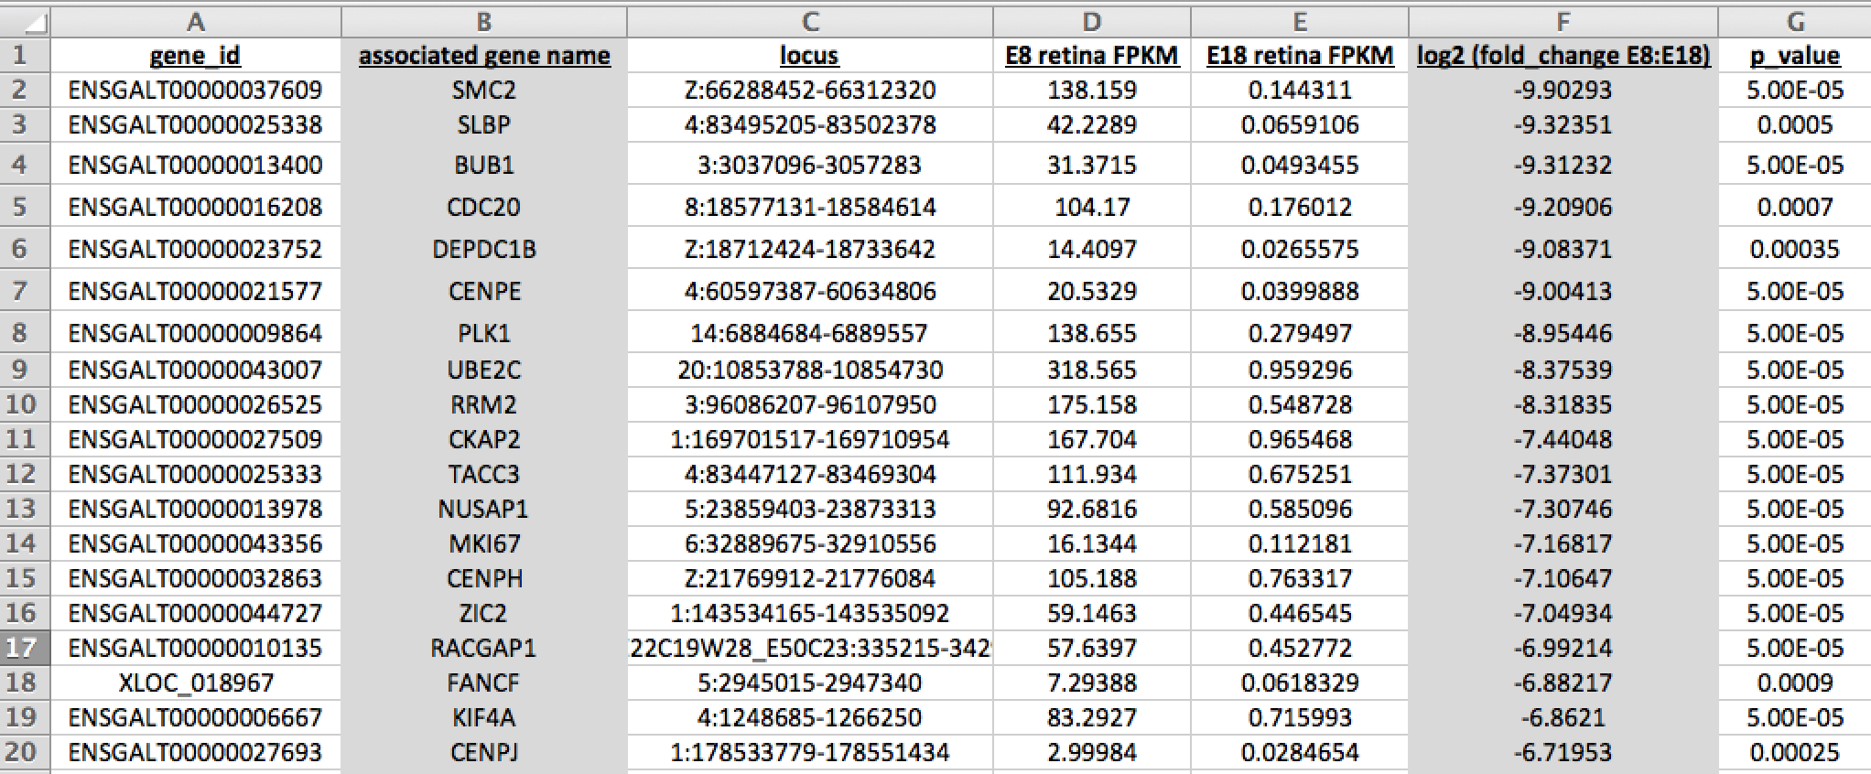
RNA-Seq Tuxedo Protocol: Cuffdiff Output
12,939 differentially expressed genes (DEGs) between E8 retina & E18 retina
Each DEG has a calculated fold change and p-value
How can we efficiently visualize these data?

Slide 28

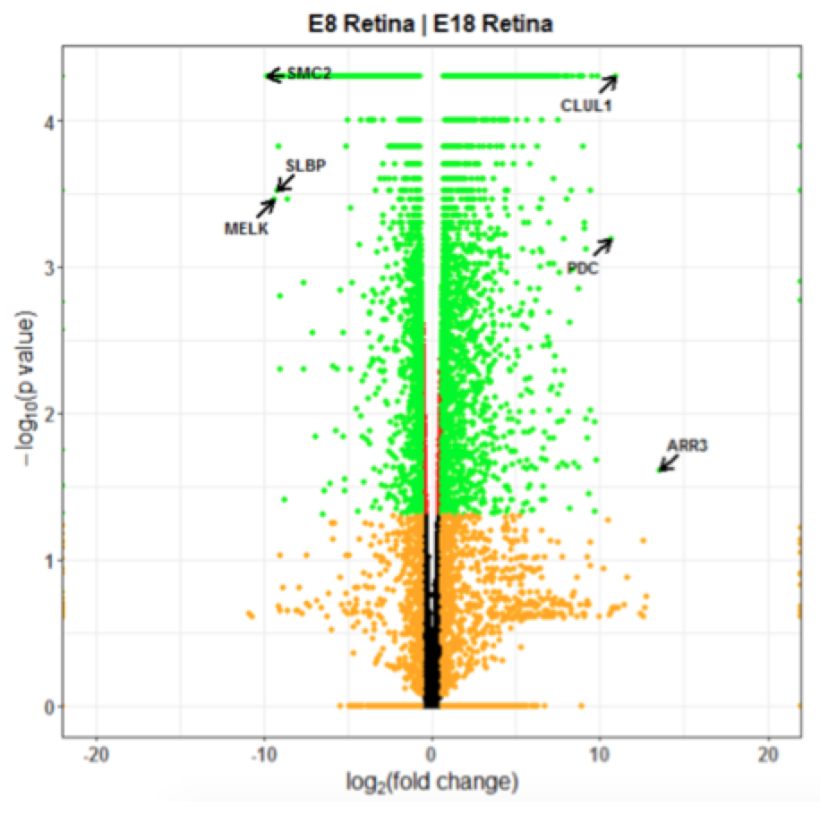
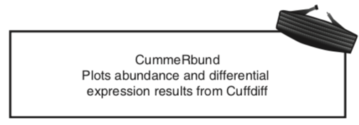
RNA-Seq Tuxedo Protocol: Data Visualization
  CummeRbund: RStudio package for generating RNA-Seq data visualizations
Significant upregulated DEGs
Significant donwregulated DEGs
Volcano plot visualizes all DEGs based on p-value and fold change
Can also highlight candidate genes of interest
Notes:
Cufflinks and Cuffdiff implement a linear statistical model to estimate an assignment of abundance to each transcript that explains the observed reads with maximum likelihood (Trapnell 2012)

Slide 29
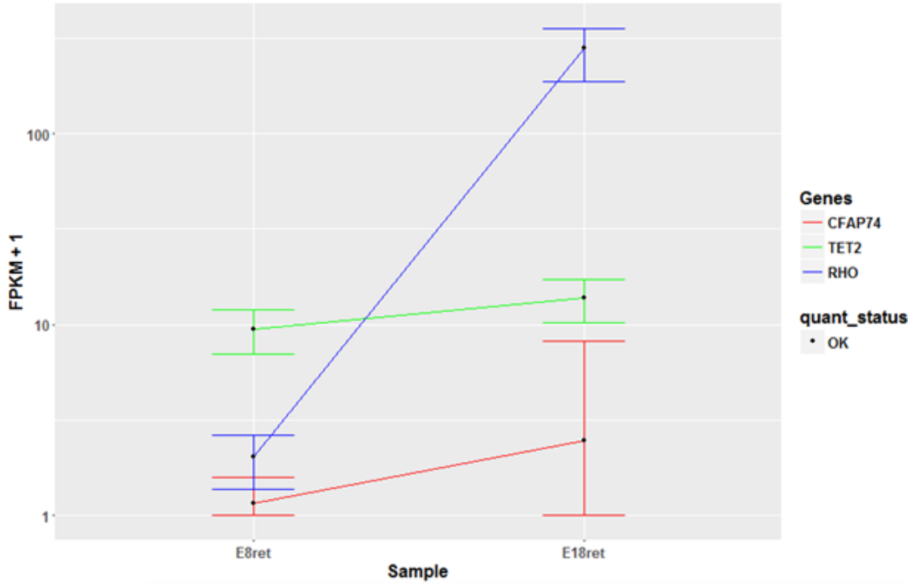
RNA-Seq Tuxedo Protocol: Data Visualization
  CummeRbund: RStudio package for generating RNA-Seq data visualizations
Gene expression plots visualize selected DEGs based on normalized expression (FPKM) in sample groups
Notes:
Cufflinks and Cuffdiff implement a linear statistical model to estimate an assignment of abundance to each transcript that explains the observed reads with maximum likelihood (Trapnell 2012)

Slide 30
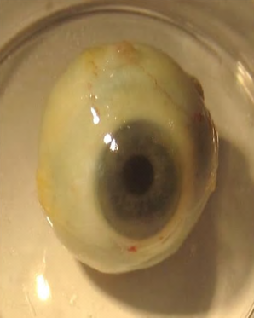
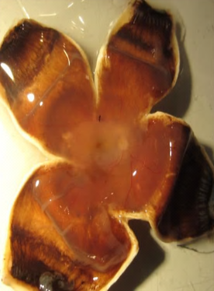
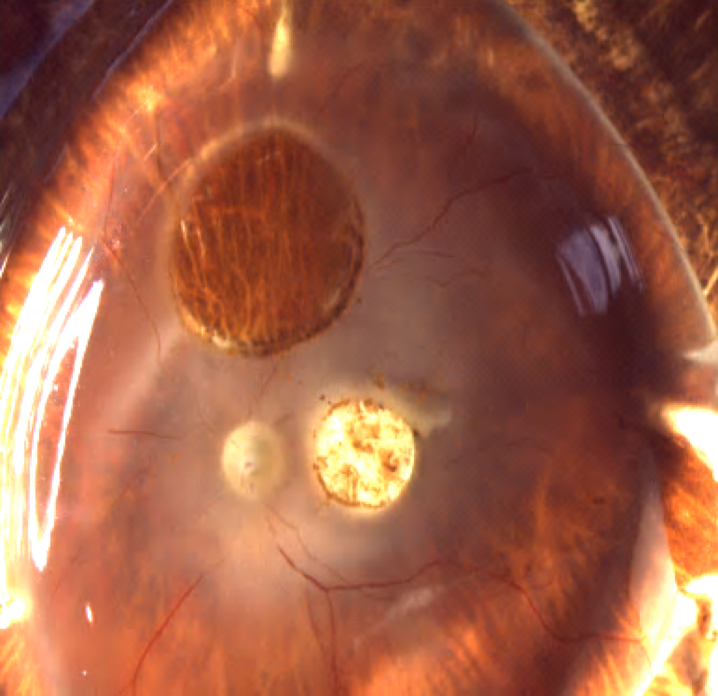
Hands on Lab Assignment: RNA-Seq Analysis of the Human Retina
Post mortem human donor eyes
Peripheral Retina (rich in rod PRs)
Peripheral Retina
Macula
Macula (rich in cone PRs)
Visualize similarities & differences in rod vs cone photoreceptors mRNA transcriptomes
Tuxedo Suite Pipeline
Transcript assembly
Differential Expression
Data Visualization
Mapping reads
TopHat & Bowtie
CuffLinks
CuffDiff
CummeRbund

Slide 31
Hands on Lab Assignment: RNA-Seq Analysis of the Human Retina
Post mortem human donor eyes
Peripheral Retina (rich in rod PRs)
Peripheral Retina
Macula
Macula (rich in cone PRs)
Assignment Prior to Lab:
Read online tutorial Webvision to learn basics of the eye & retina: http://bit.ly/Webvision1
  Part 1 “Overview” & Part 2 “Central and Peripheral Retina Compared”
View 3 short online tutorial videos to learn the basics of the UCSC Genome Browser: http://www.openhelix.com/ucsc
  Video 1: “Intro & Credits” (~7 min), video 2 “Basic Searches (~8min), video 3: “Understanding Displays” (~22min)
  Robert et al., Biology of Reproduction 2002

Slide 32
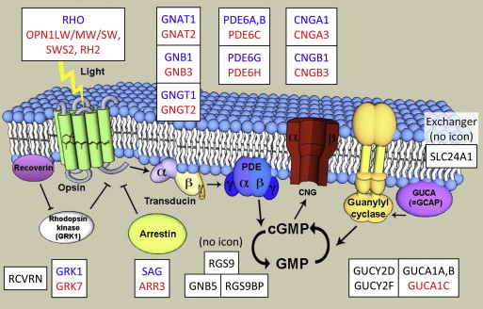
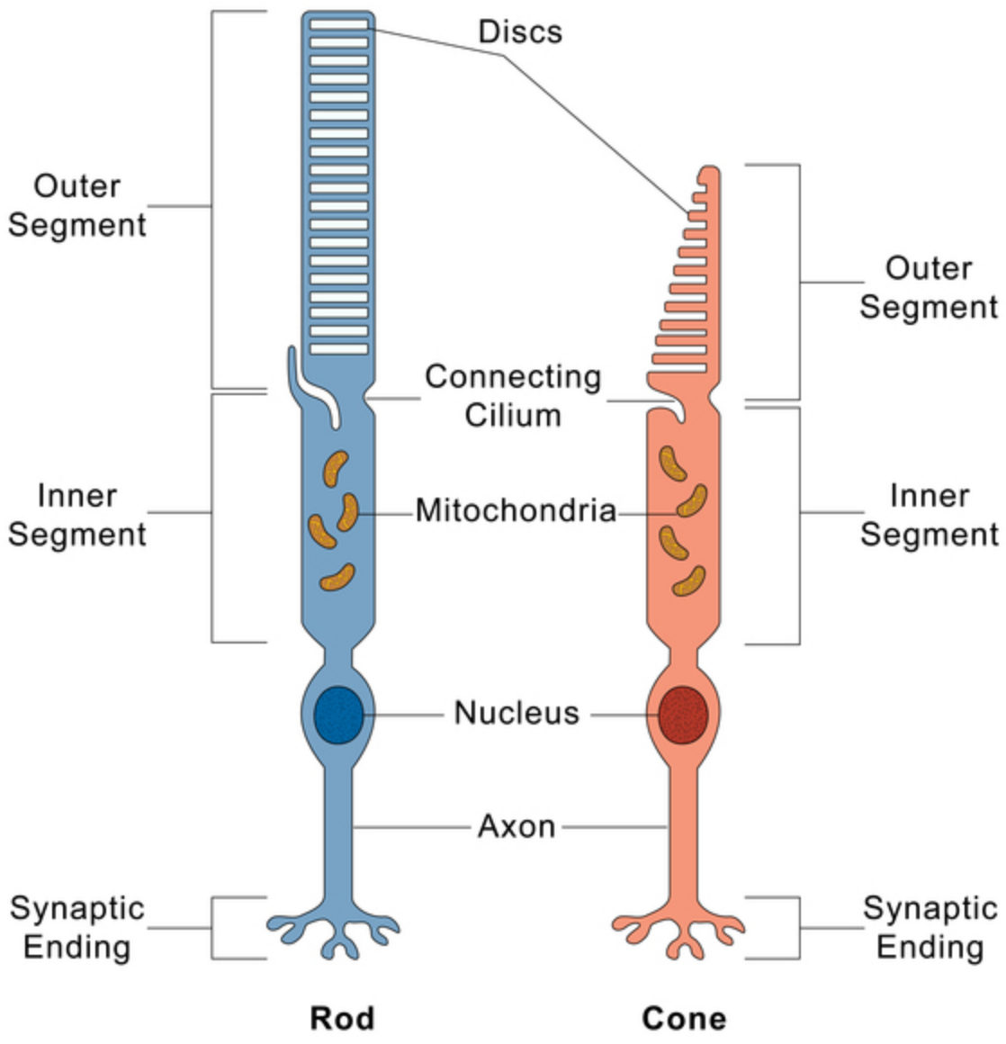
Photoreceptor outer segment discs are the site of phototransduction
Zoom in view of PR outer segment
Phototransduction is initiated when photons of light are absorbed by opsin proteins triggering a G-protein cascade. Rod-specific genes (blue) and cone-specific genes (red) code for PR cell-specific phototransduction proteins.

