Slide 1

Rediscovering
HELEN CRAIK’S LOST POEMS: looking at (and looking beyond) the Burns connection
Patrick Scott

Slide 2
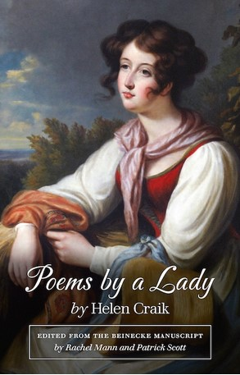

Helen Craik
1751-1825

Slide 3
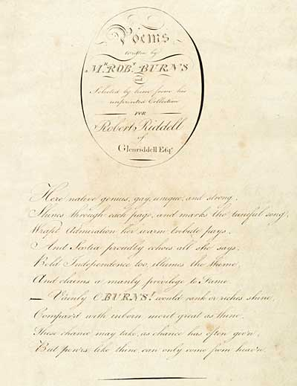
Poems Written by M^{r} ROB^{t} BURNS...
for Robert Riddell of Glenriddell Esq.
Here native genius, gay, unique, and strong,
Shines through each page, and marks the tuneful song:…
Vainly, O Bums! would rank or riches shine,
Compar'd with inborn merit great as thine;
These chance may take, as chance has often giv’n;
But pow’rs like thine can only come from heav’n.

Slide 4
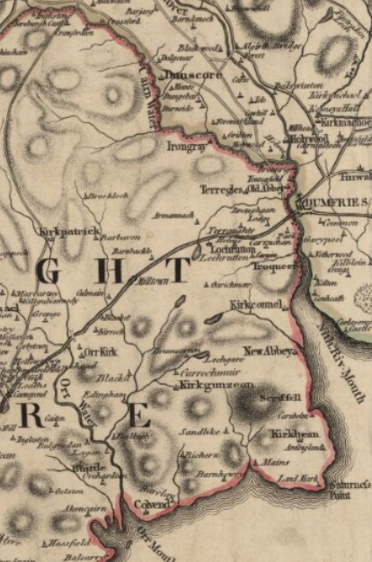
Helen Craik born Arbigland, 1751 left Arbigland, 1792 died Flimby, Cumberland,
1825

Slide 5
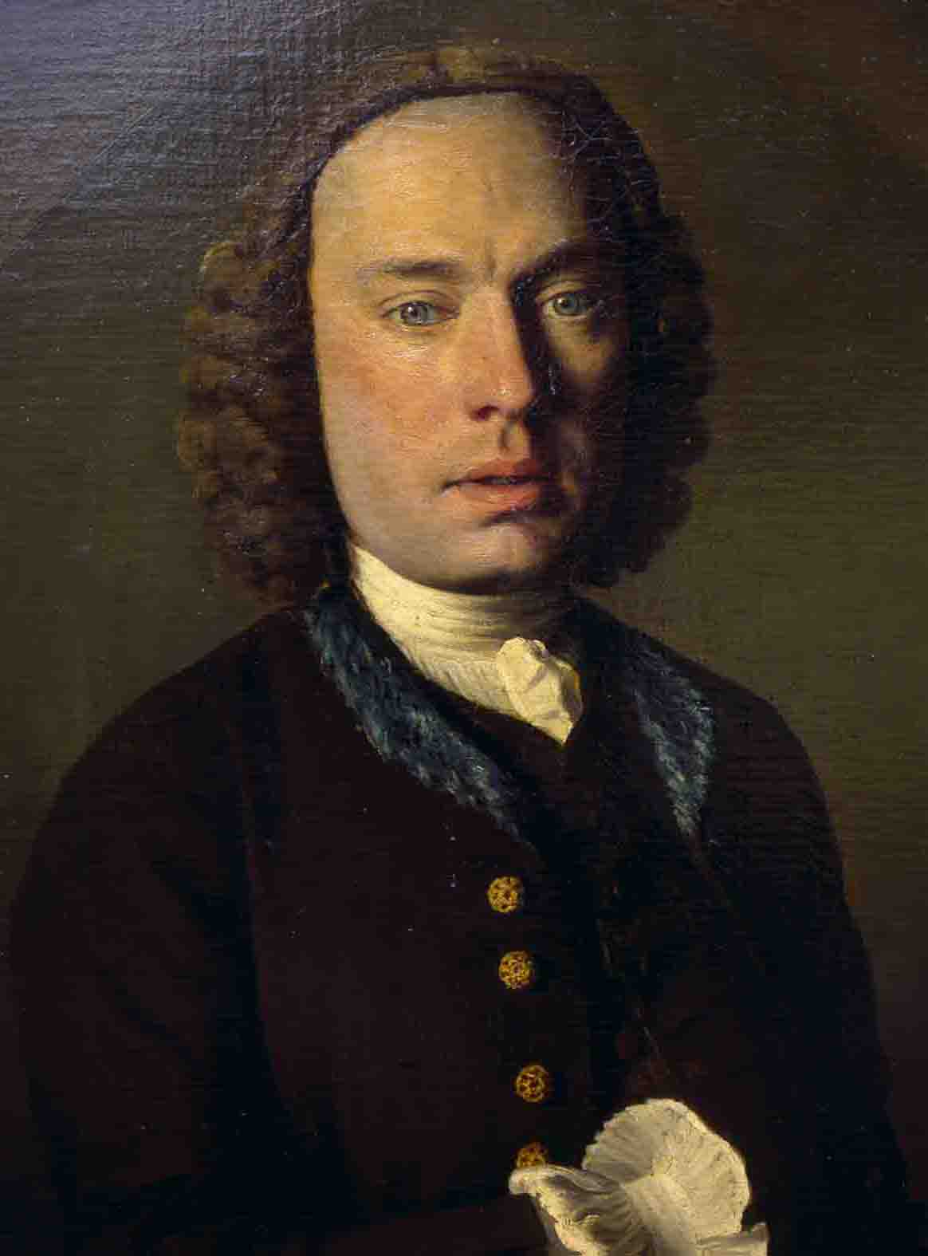
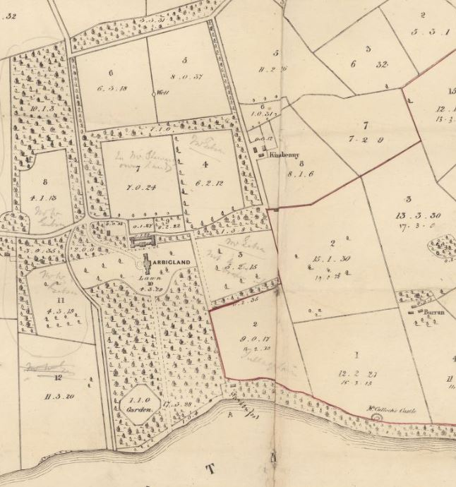
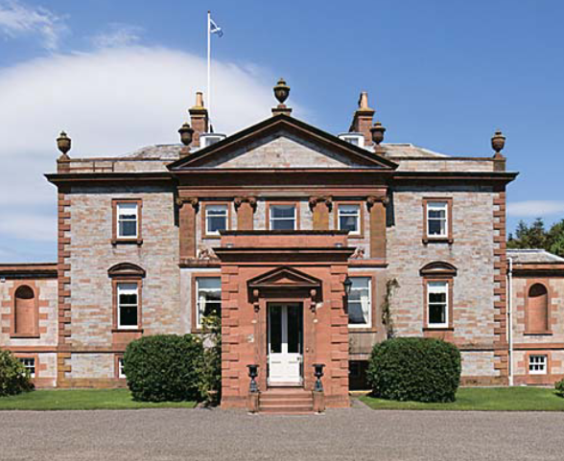
The Craiks of Arbigland,
1679-1852

Slide 6
The phases of Helen Craik’s writing
1. ca 1770-1792, at Arbigland: manuscript poems: three notebooks with overlapping contents
2. 1796-1805, at Flimby: five novels (18 volumes), published by William Lane Minerva Press
3. 1811-1822, at Flimby: prose memoirs of her father, in periodicals

Slide 7
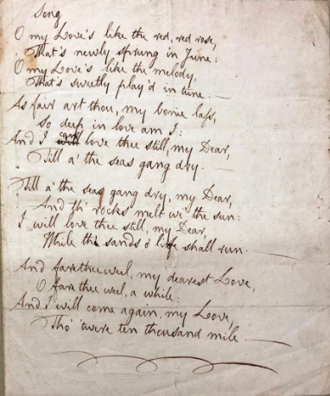
ODNB 2004:
“Most of her poetry is now lost”
May 2020: a reference query about the ‘missing’ Bemis MS of Burns’s “Red, red rose,” traced it to the Lilly Library
May-September 2020: provenance
MSS at the Lilly led back to Helen Craik, and so to articles about her notebooks from 1919-1924

Slide 8
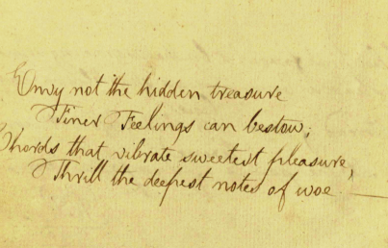
The clue: Burns had inscribed four lines on a blank leaf in one of Craik’s notebooks
September 2020: Craik’s notebook with the four lines was confirmed as at Yale, in the Beinecke Library

Slide 9
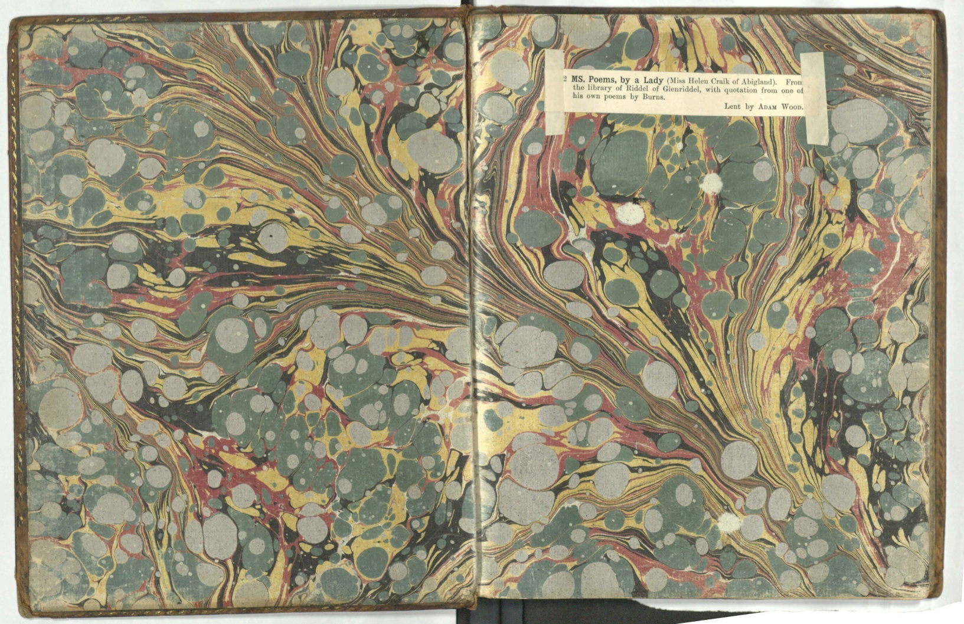
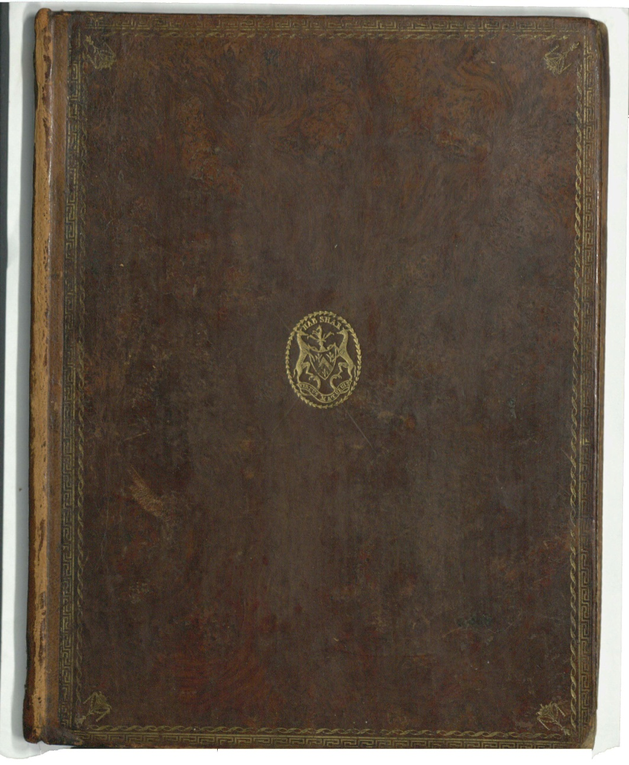
[Helen Craik],
Poems by a Lady
[1790]
Beinecke Library
MS Osborn c 375

Slide 10
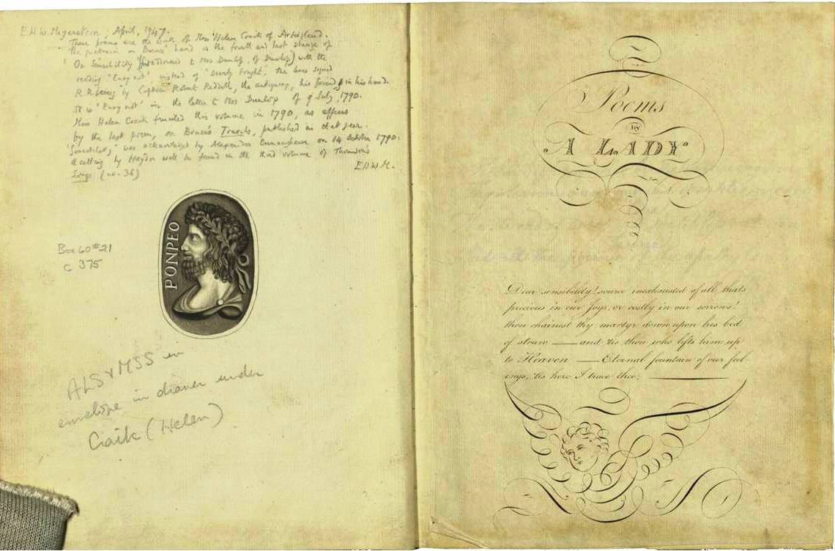
Title-page: note facing by E.W.H. Meyerstein, 1947

Slide 11
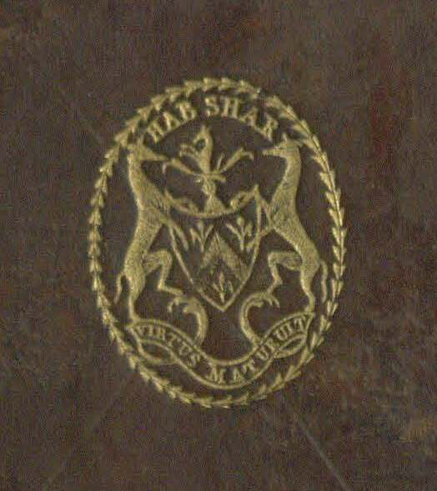
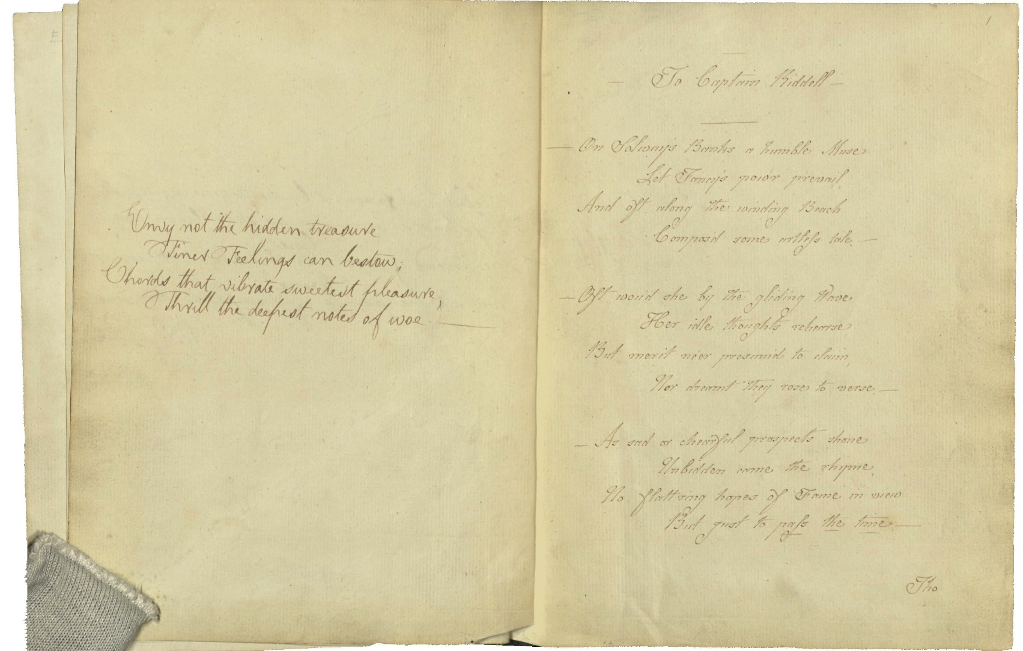
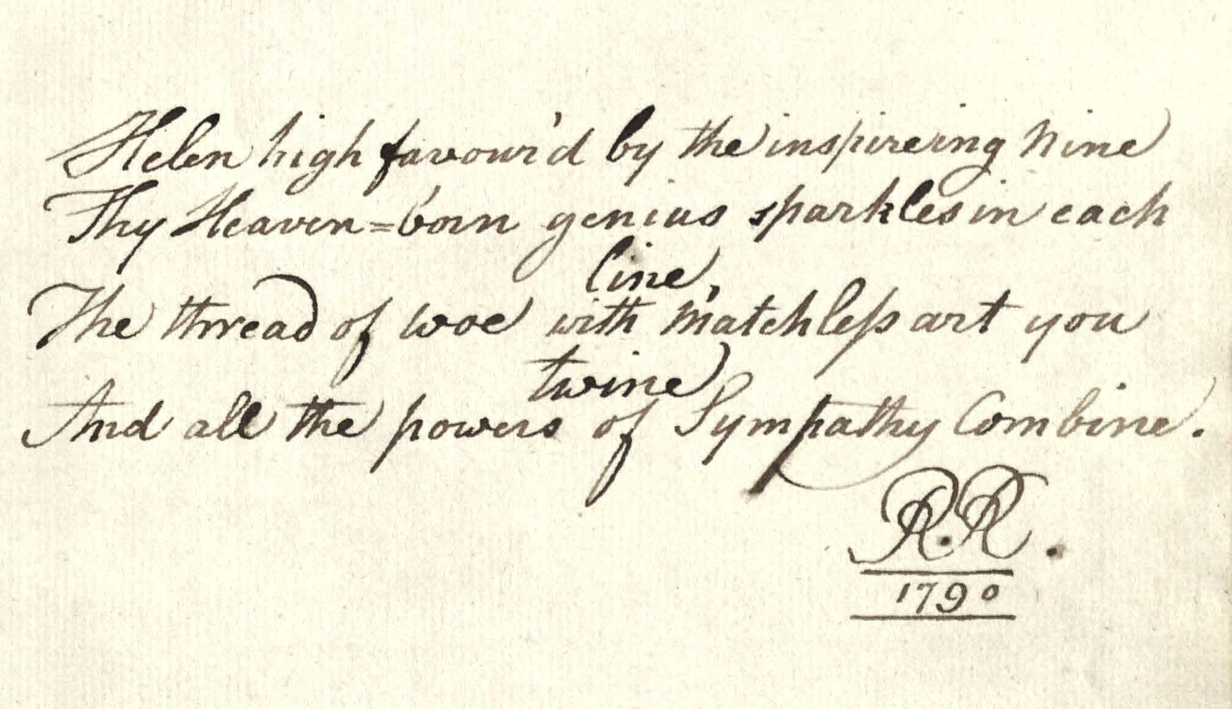
A fair copy Craik wrote for Robert Riddell
https://collections.library.yale.edu/catalog/31902102

Slide 12
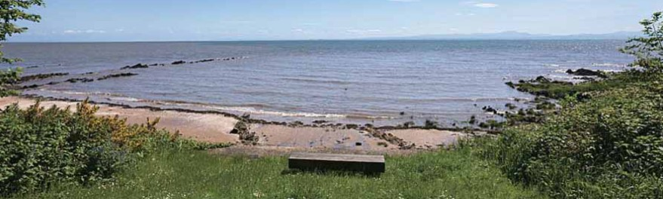
To Captain Riddell (MS. pp. 1-2)
On Solway’s Banks a humble Muse
Let Fancy’s pow’r prevail,
And oft along the winding Beach
Compos’d some artless tale.—
—Oft wou’d she by the gliding Wave,
Her idle thoughts rehearse
But merit ne’er presum’d to claim,
Nor dreamt they rose to verse.—
—As sad or cheerful prospects shone
Unbidden came the rhyme,
No flat’ring hopes if Fame in view
But just to pass the time.—
Tho partial Friends wou’d sometimes smile
And think the page might do,
Yet much she fears the judging eye
Of Coila’s Bard and you.—
Alone from Gratitude you know
The thoughtless promise came;
Which may my humble Muse subject
To bold presumptuous name.—
O! then indulgent view the Lines
Which trembling I impart
They reach not to the Critic’s head
Nor rise above the heart.—

Slide 13
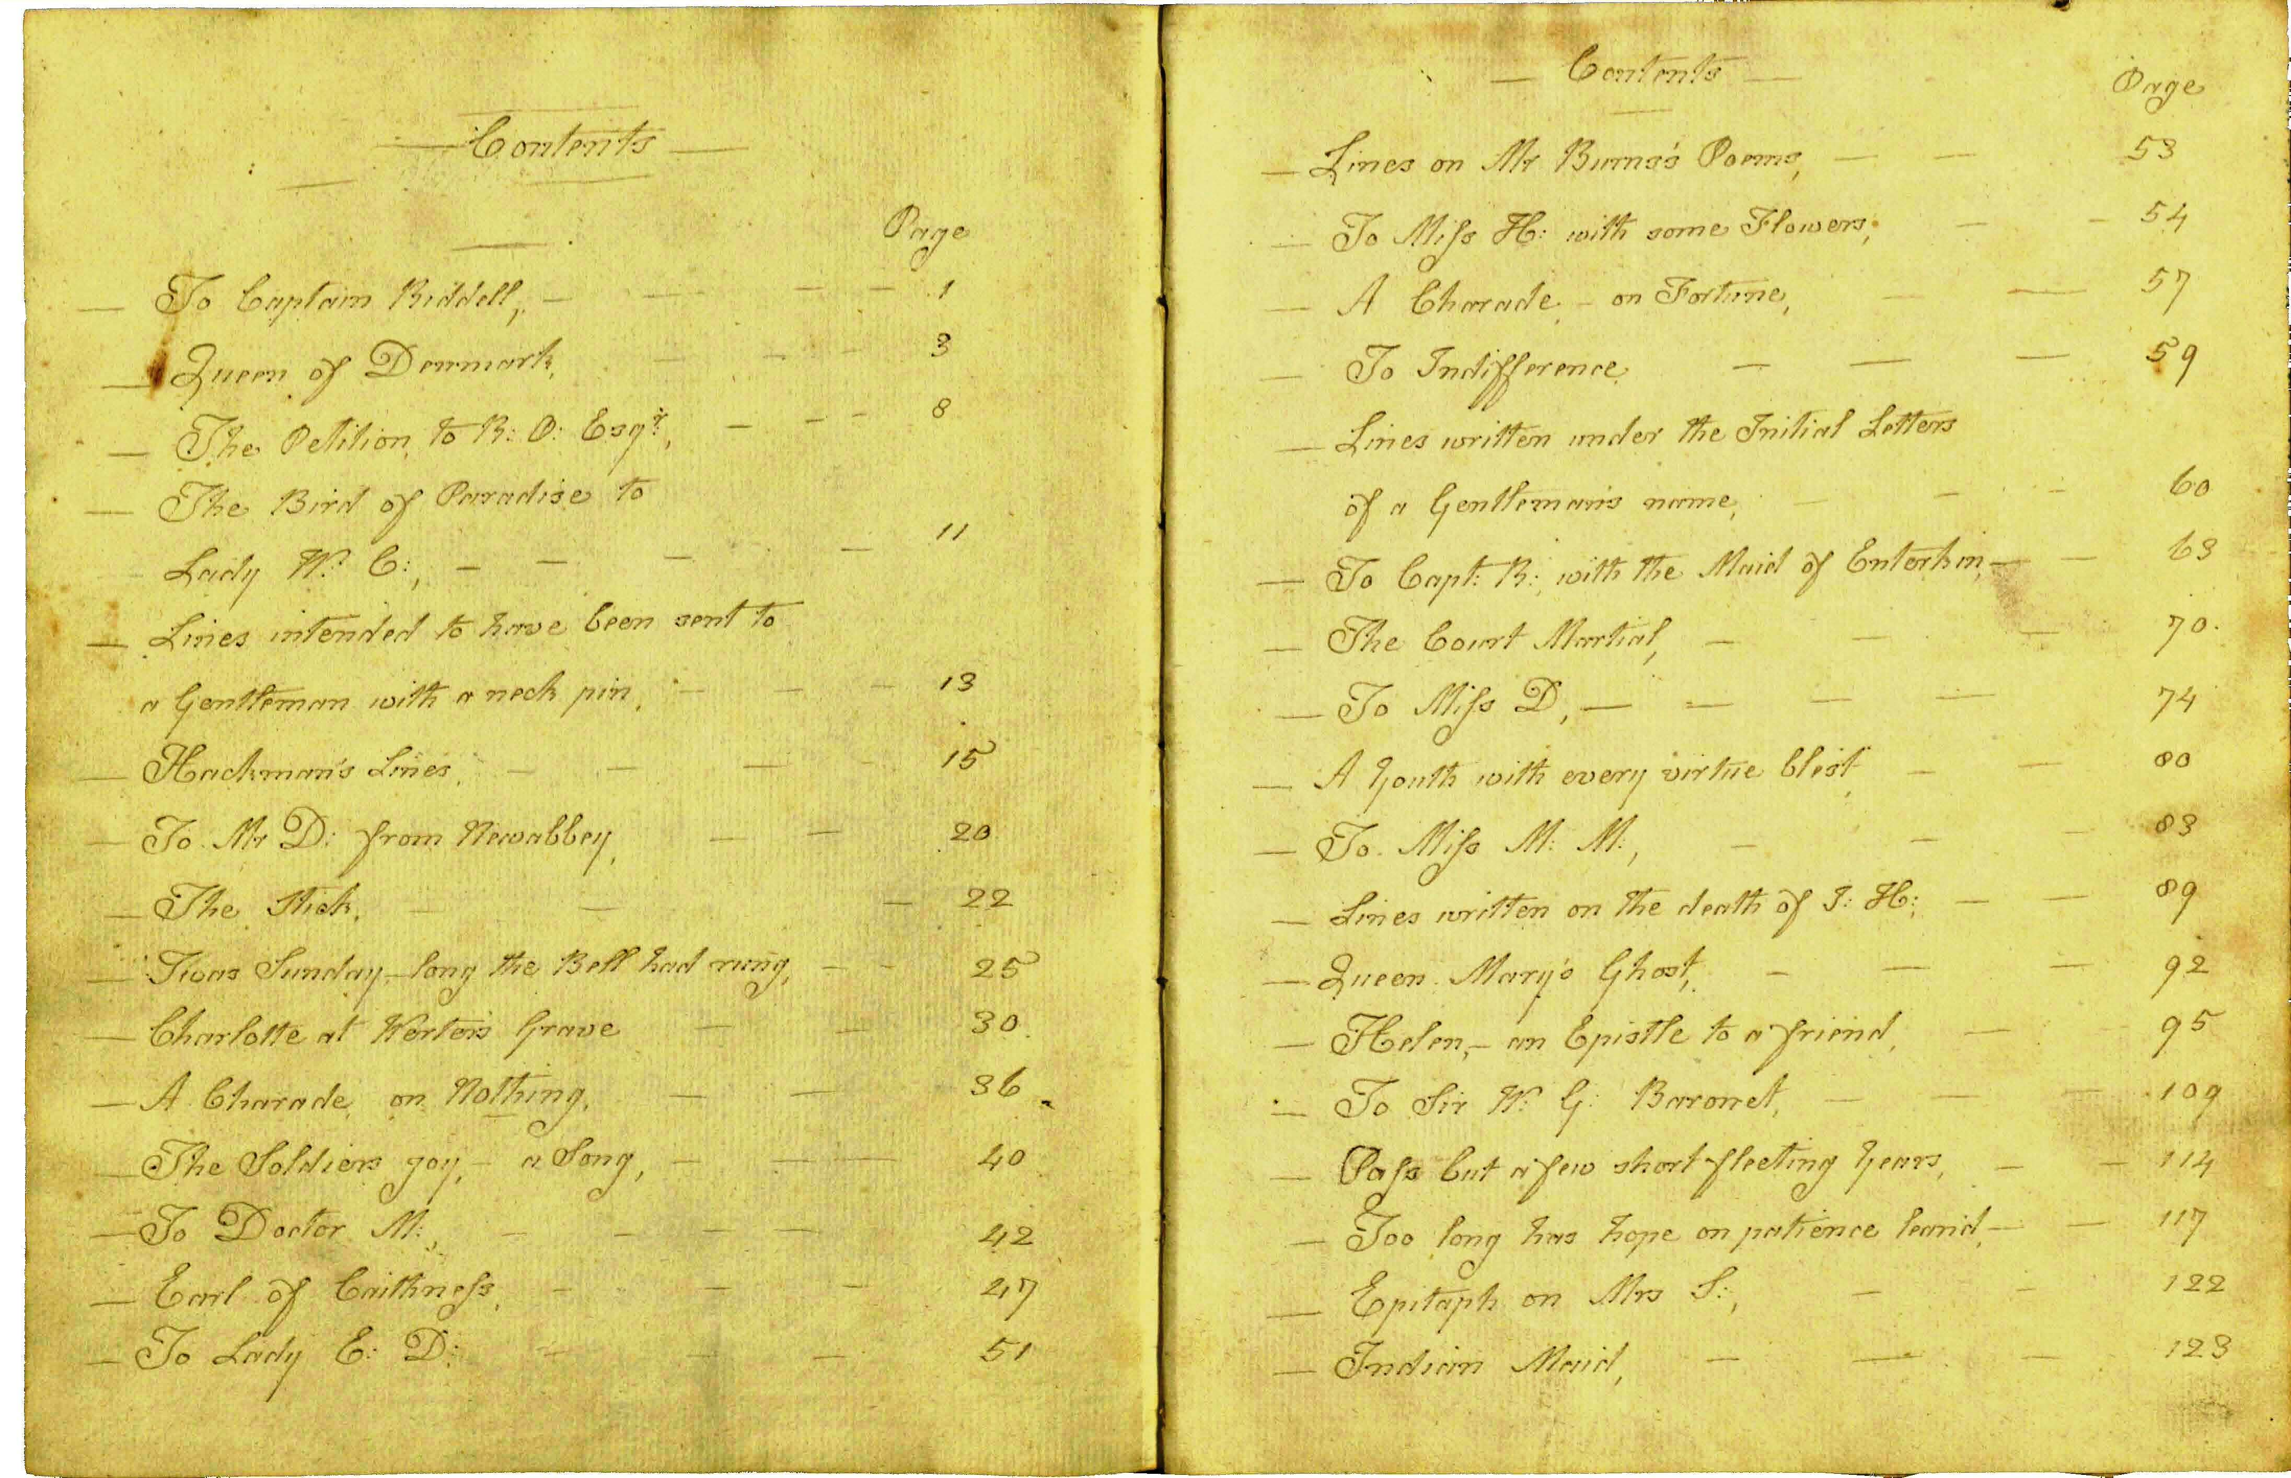
Thirty-nine poems, some 171 MS pages
narrative poems, satires, verse-letters to friends

Slide 14
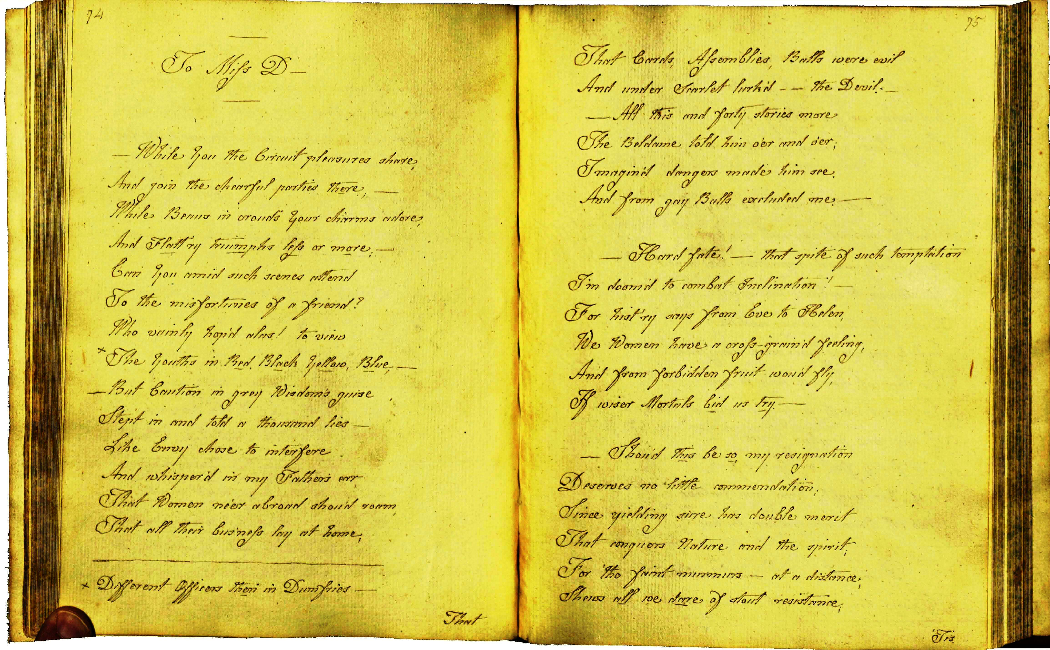

Slide 15
And tell how . . . . .’s gracious Bride
Attention paid the Voter tribe
For she, by dint of sage reflection
Foresaw their use at next Election
Where if poor . . . . . .’s fairly beat
Triumphant . . . . . mounts the seat
And seven years hence returns again
To try his Int’rest on the plain. —
—Of smart bon mots who said the brightest?
What Hero’s head with drink was lightest?
—But that perhaps were hard to tell
Where most seem anxious to excell
But say—did . . . . . . .’s dame appear
Or was the Knight of . . . . . . there?—
Is she from Censure free again?
And does the World from sneers refrain?
Or did the Room, when they came thither
Hear scandal and small talk together? —
extracts from
To Miss D----
For Circuit news I long to hear,
And what worth writing happen’d there.—
—If any new peculiar grace
Your fancy fixt on G . . . . .’s face,
Or if her mighty head and feather
Drew all your admiration thither?—
—Does Lady . . . . . . . . seem inclin’d
To view the moss with willing mind?
—For sure I think so large a jointure
Through any Bog might make her
venture.—
—But tell me,—did she make appearance
In di’mond Necklace, or in Earrings
And was the Laird’s dear Hundred grounds
Laid out on trifling caps and gowns!

Slide 16
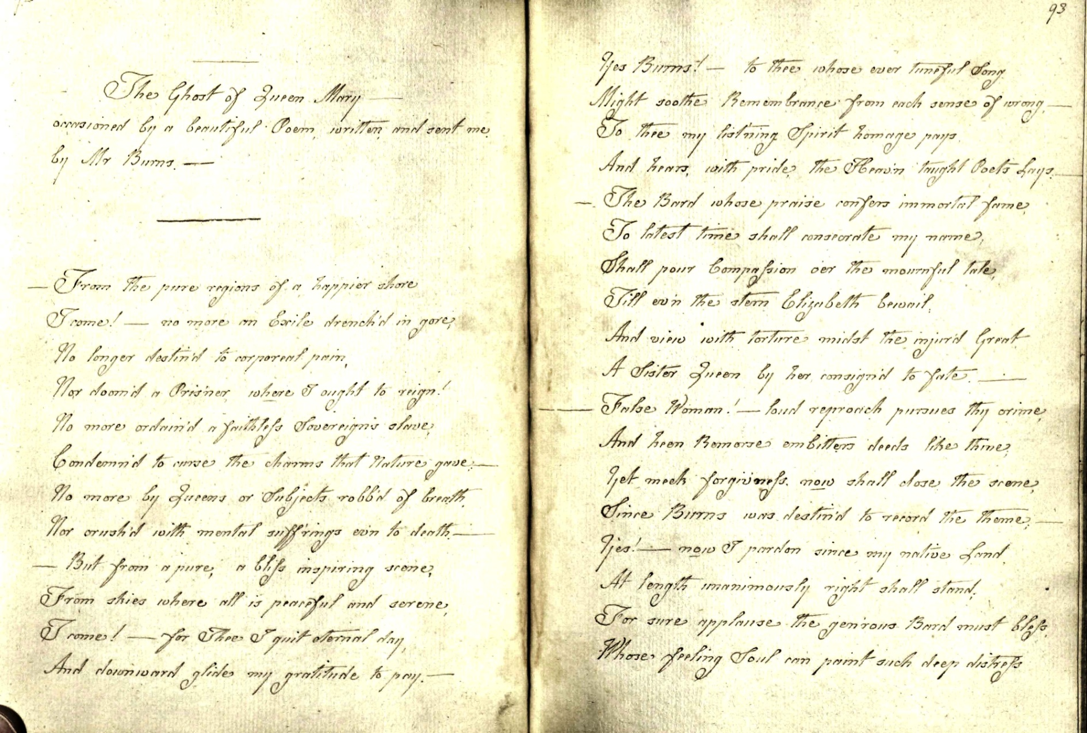
Craik responding to Burns’s “Lament of Mary Queen of Scots”

Slide 17
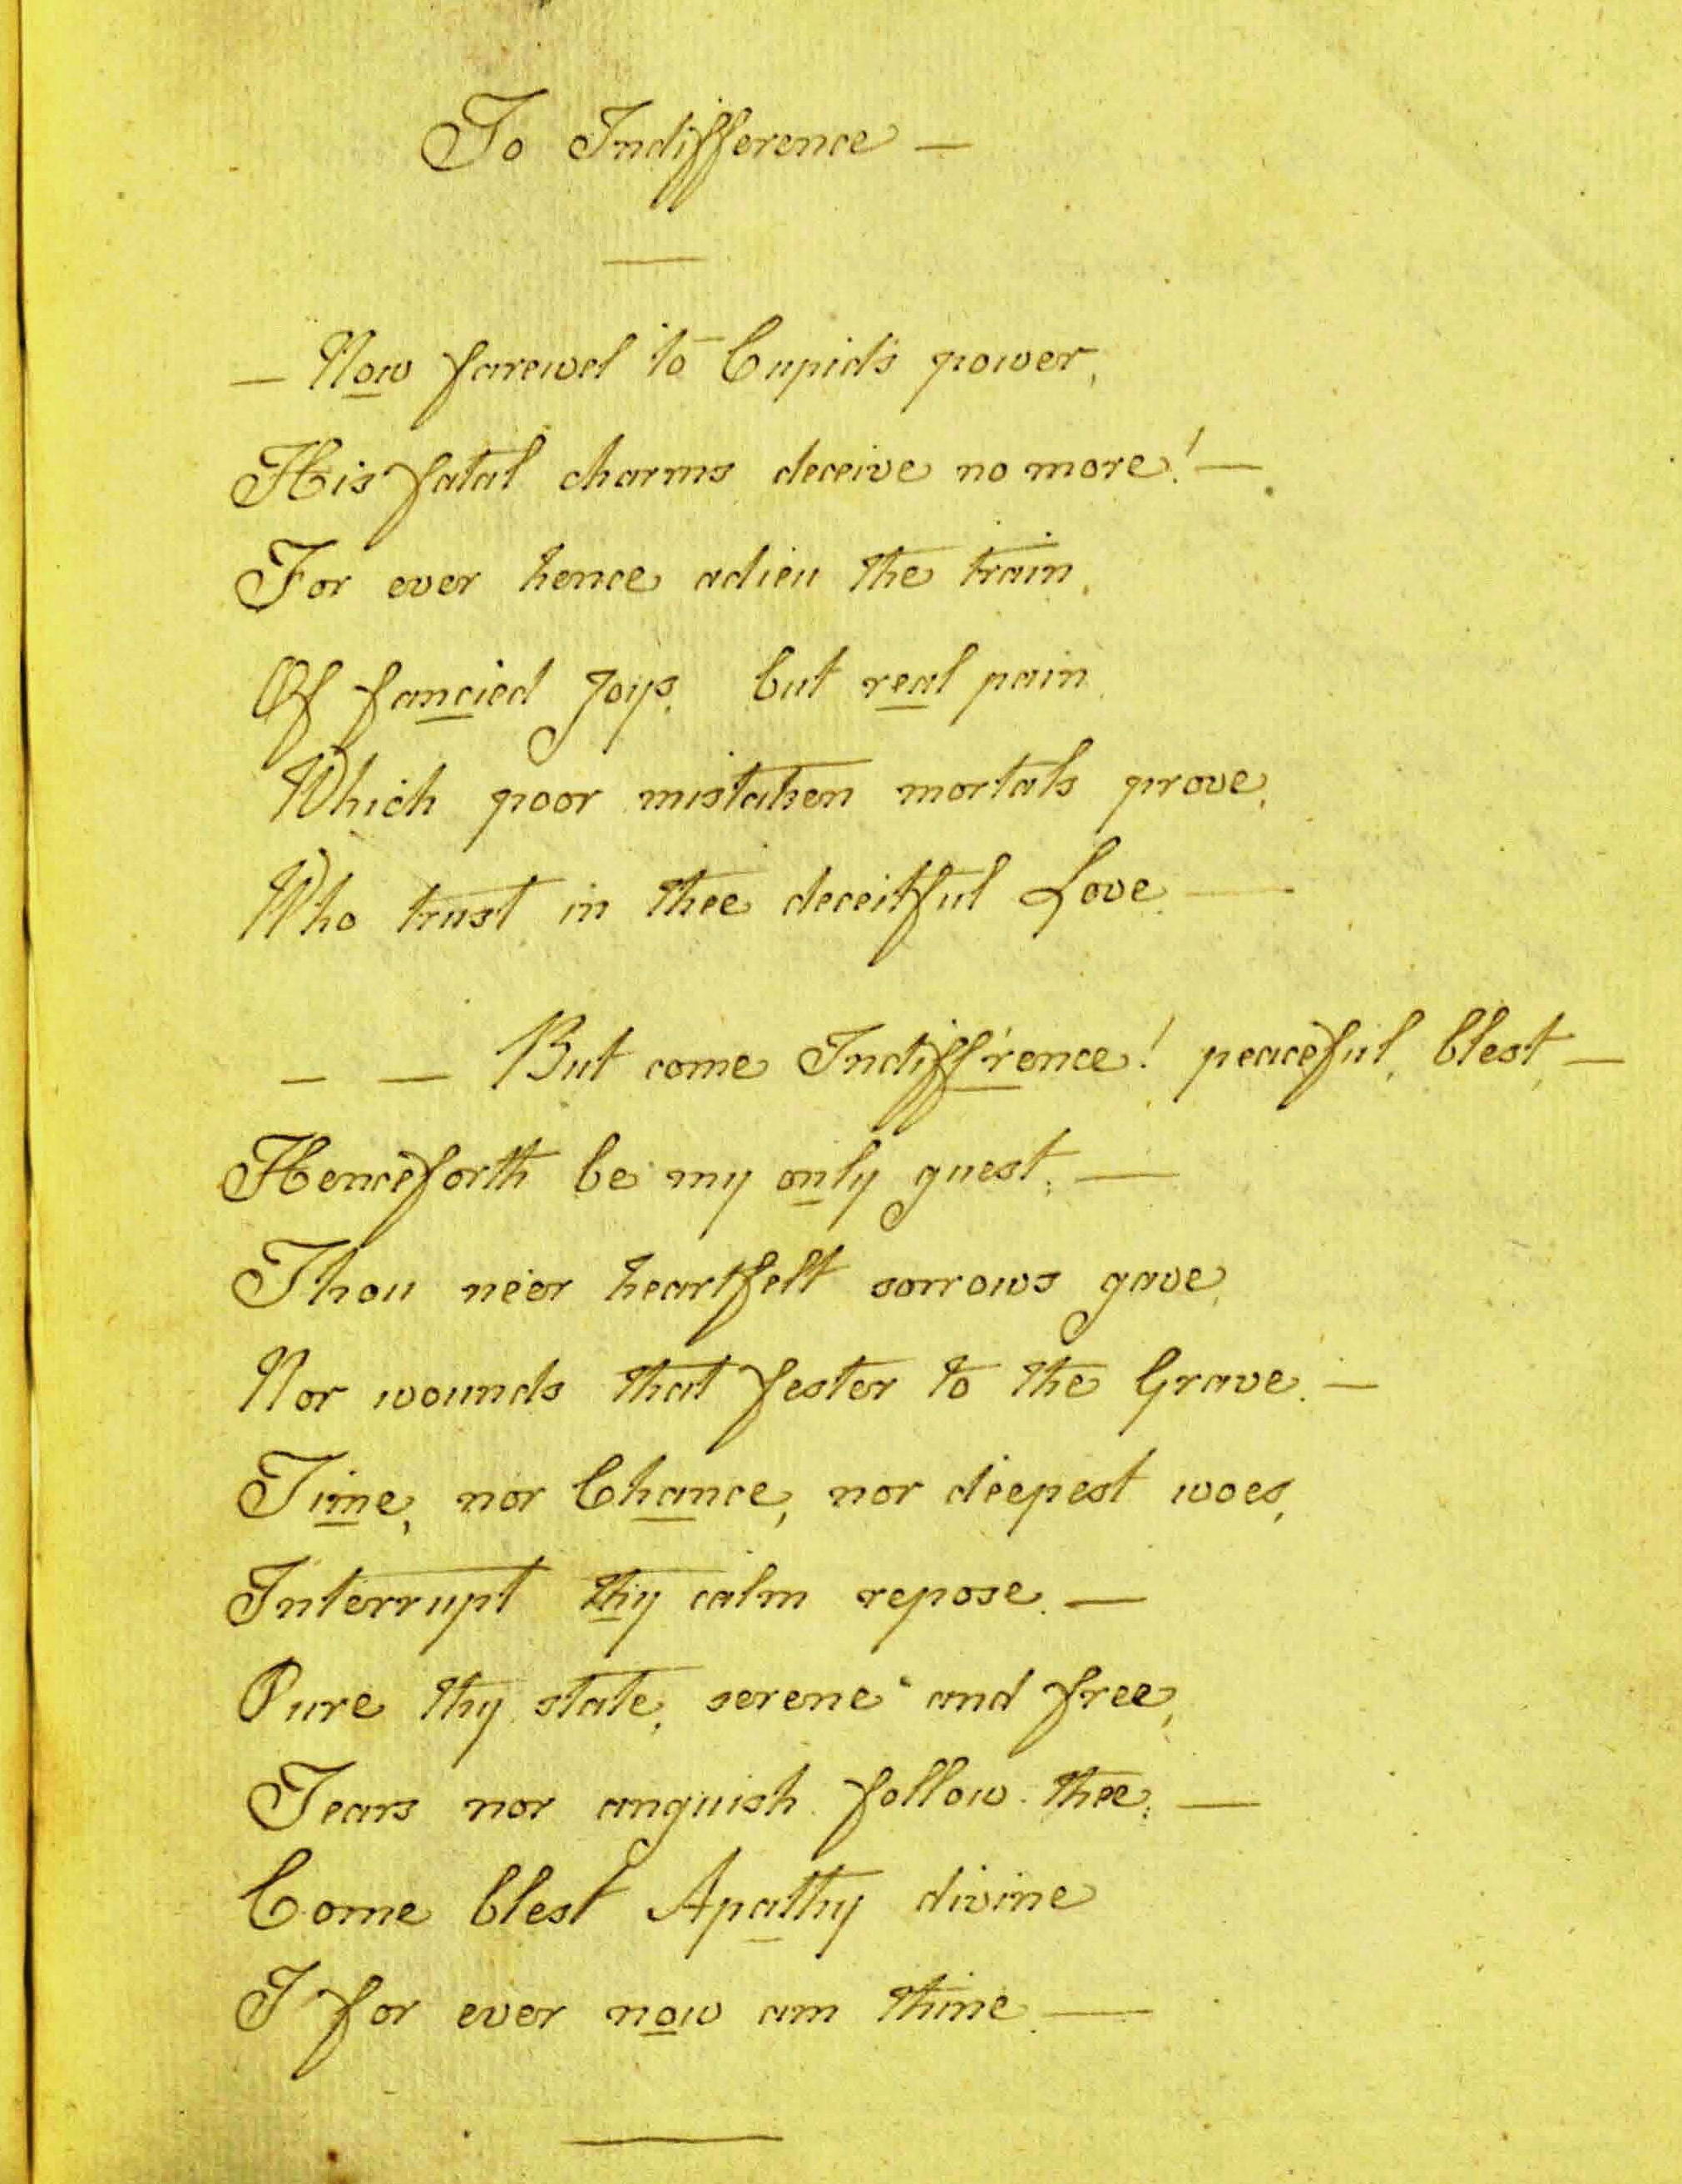
To Indifference (MS p. 29)
—Now farewel to Cupid’s power,
His fatal charms deceive no more!—
For ever hence adieu the train,
Of fancied joys, but real pain.
Which poor mistaken mortals prove,
Who trust in thee deceitful Love—
—But come Indiff’rence! peaceful, blest,—
Henceforth be my only guest;—
Thou ne’er heartfelt sorrows gave,
Nor wounds that festor to the Grave.—
Time, nor Chance, nor deepest woes,
Interrupt thy calm repose.—
Pure thy state, serene and free,
Tears nor anguish follow thee:—
Come blest Apathy divine
I for ever now am thine.—

Slide 18
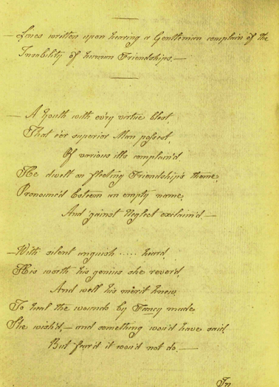
Lines Written Upon Hearing A Gentleman Complain Of The Instability Of Human Friendships (MS pp. 80-82)
To heal the wounds by Fancy made,
She wish’d,—and something wou’d have said,
But fear’d it wou’d not do.—
—In cold oblivion’s frozen shade
His mem’ry long had left the Maid,
For newer friends to range:
But these he found, as time or chance
Led Fortune’s ever varying dance,
Were likeways apt to change.—
—Yet still with melting eye she view’d
A youth so gentle, wise and good,
The prey of discontent.
And oft she wish’d some pitying Pow’r
Wou’d hush in time’s propitious hour
The sighs his bosom sent.—

Slide 19
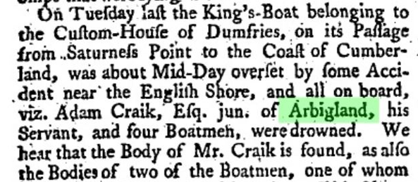
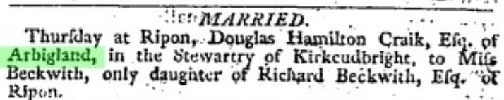
July 23 1782
February 1792 Craik leaves Arbigland
May 1790 Craik gives Riddell the Beinecke MS
(Burns adds his inscription in June)
March 8 1792
1924 Arnott on Craik’s secret romance and the suicide or murder of the mysterious Mr. Dunn

Slide 20
The three Craik notebooks reported in 1919-24:
1. The Wood Notebook (now Beinecke), a fair copy written for Robert Riddell of Craik’s poems up to 1790, later owned by the Arbigland Craiks; reported by Gibson in 1881, exhibited Glasgow 1896, owned by Meyerstein, 1947, sold Sotheby’s 1956.
2. The Young or Neilson Notebook (unlocated), Neilson’s chief source, with overlapping contents, opening with “The Maid of Enterkin” (late 1780s) and including poems written after Craik left Arbigland in 1792. This was Craik’s own notebook, left to her cousin and executor, Gilbert Young, sold at Sotheby’s in 1913.
3. The Henderson Notebook (unlocated), also used by Neilson, originally written for Craik’s cousin Anne Staig, given by to General Goldie, sold at Dowell’s in 1908, to R.J. Henderson, of Penicuik.

Slide 21
Leaving Arbigland, I
(Arnott, 1924, from the
Young Notebook)
Deprived of peace—to calumny a prey,
HERE Helen wept her lonely hours away;
Though guiltless, forc’d imputed guilt to bear,
No justice destin’d—and no pity near.
Forlorn! neglected!—happier prospects flown,
And doom’d to expiate errors not her own,
HERE oft to grief unbounded sway she gave
And wearied heav’n with pray’rs to reach the Grave!
The shelt’ring Grave!—that cure for human smart,
The last sad refuge of a broken heart!
Scotia! from thee my streaming eyes I turn,
Now doom’d to rest in SOME far distant urn!
Exil’d from all I valu’d!—country, home!
Near Solway’s banks, no more, alas! to roam;
O’er youthful scenes where pleasure led the way,
Where fond remembrance oft shall ling’ring stray
‘Lines Written in the Summerhouse at
Arbigland in 1792’

Slide 22
Leaving Arbigland, II
(Arnott, 1924, from the
Staig/Henderson
Notebook)
MY LOVE FOR MY COUNTRY!!! from whence must it flow?
From falsehood—injustice—each species of woe?
From cunning’s deep fountain too winding to sound,
From Avarice grasping at all seen around;
From the envy of some who with malice pursued me,
From the coolness of Those who mistakenly view’d me;
From inhuman connections—from Nephews and Nieces
Who all for the best tore my conduct to pieces;
Being formed by self-int’rest with morals so civil
As for sixpence to sell half their kin to the Devil;
Yet that once they spoke truth must I think be confest
Since THEIR WORDS I can echo ‘’twas all for the best!!’*
‘Lines addressed to
Miss Young on receiving a present of a
Tartan Handkerchief from her Mother’
Helen Craik,
Flimby Lodge,
1811
with this money, and the handsome increase made to it by my late ever respected relatives here, I am now, thank God and them, in rather more than easy circumstances; and can say, what many richer people cannot say, that I am healthy, happy, and contented.

Slide 24
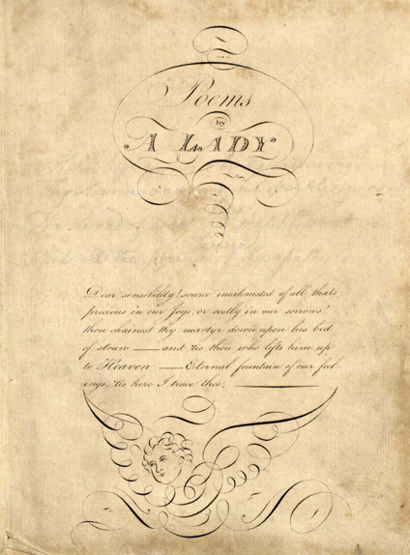

Slide 25
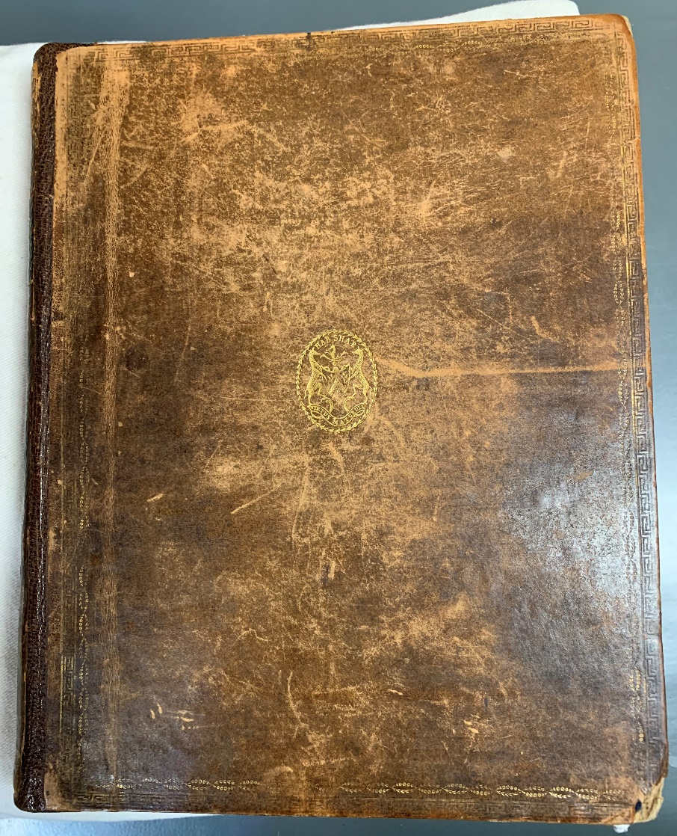

Slide 26
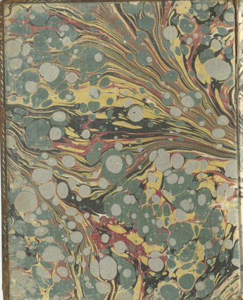
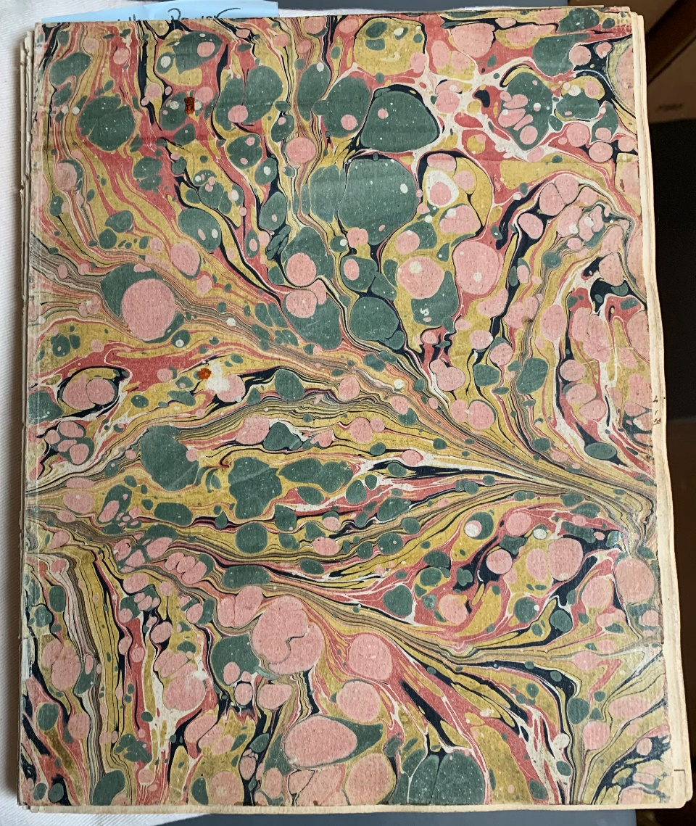

Slide 27
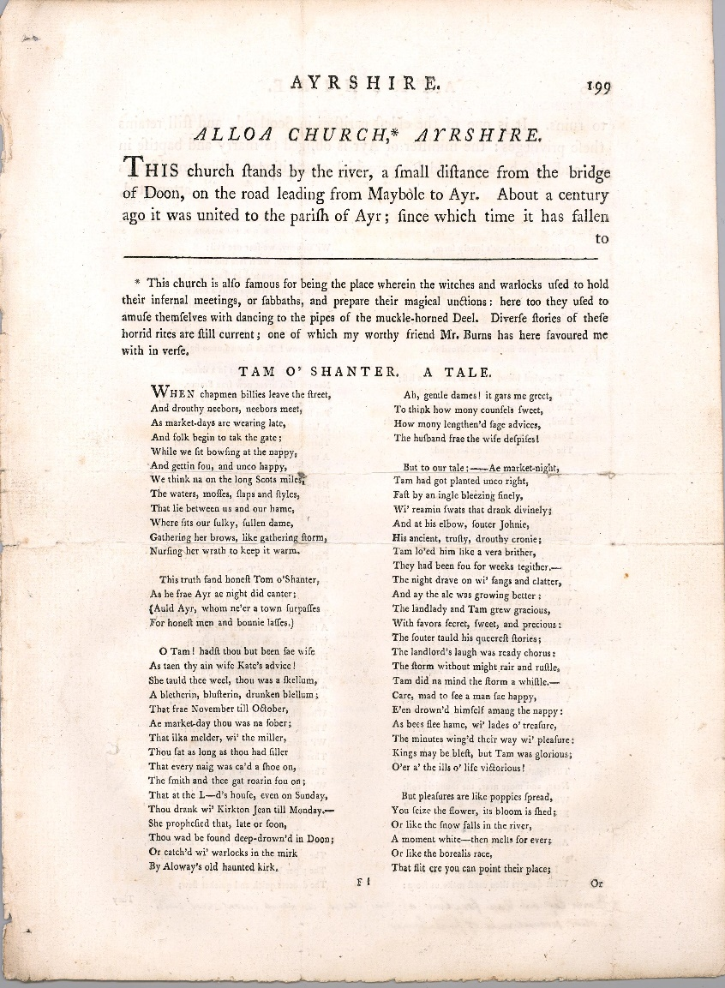
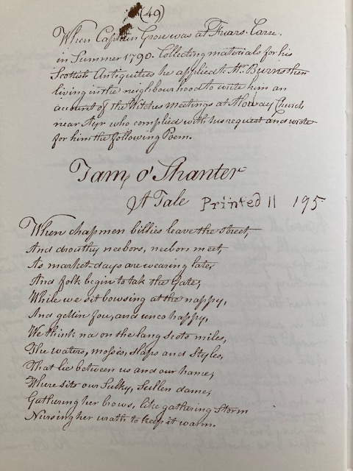
Burns’s only narrative poem, written in late summer or fall 1790

Slide 28
Helen Craik
1751-1825

