Slide 1
Digital Preservation @ GVSU: lessons learned in year 1
Patrick Roth
Head of Systems & Technology
GVSU Libraries
rothpa@gvsu.edu

Slide 2

About GVSU
Located in Allendale Michigan
Public Liberal Arts University
Passed 25,000 total enrolled students in Fall 2014
4 Libraries
  Mary Idema Pew Library – Allendale Campus
  Steelcase Library – Pew Campus
  Frey Learning Center – Center for Health Sciences
  Seidman House – Allendale Campus

Slide 3
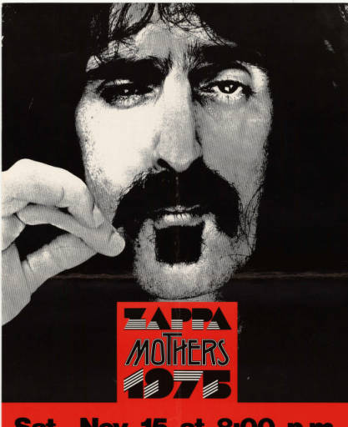
About University Archives & Special Collections
Opened in 1960
Staffed by 1 person until 2005
Hired the University Archivist in 2005
  Began digitizing items and putting them in CONTENTdm
Hired Metadata & Digital Curation Librarian in 2011 (member of the Technical Services team)
Hired Assistant Archivist in 2014

Slide 4

Digital Preservation
Metadata & Digital Curation Librarian started pushing for a preservation solution.
No infrastructure…had to go with a hosted solution
2014 we choose Preservica

Slide 5
Preservica
Provides both a full suite of preservation functionality as well as a public access portal
Will allow us to cancel our subscription to CONTENTdm
Utilizes cloud storage (Amazon Glacier and S3)
Can automate ingest, automate creation of access files.

Slide 6
What have we done so far
1/3 of the way through ingesting existing digital collections
Worked with Preservica to get a batch ingest of CONTENTdm items
Working with ProQuest to get Preservica items to show up in our discovery layer…issues with OAI-PMH

Slide 7

Assumptions going in
Annual growth of 1-2 TB
No new staff positions
A long term solution for us
Keep doing what we are doing…just with preservation worked in.

Slide 8

What we learned
We were only right about 1 thing: No new staff positions.

Slide 9
So what’s happened?
Growth is off the charts!
  Just given a 16TB collection about Native Americans in West Michigan
  Approached about new projects more frequently
Work has shifted around due to changes in staffing…which is probably good.
Beginning to ask about how long Preservica can be a solution for us.

Slide 10

Challenges
Budget
  Cloud storage is going to get expensive and our budget isn’t growing
  We have no infrastructure
  One of those is going to have to change
Need to change how collections are evaluated and accepted
  Not just content, but size, file types, processing hours, budget, etc.

Slide 11
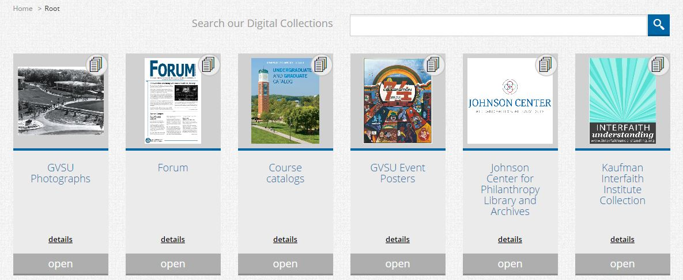
Public Access
Preservica is slowly improving it, but it needs some usability work
  Too many clicks to view you material
  Video player isn’t the best
  Can’t view a video and transcript at the same time

Slide 12

The Future
May need to change platforms if budget or infrastructure doesn’t improve
Figure out how to fund new collections
Learn how to say no or direct donor to other places that will take their stuff

Slide 13
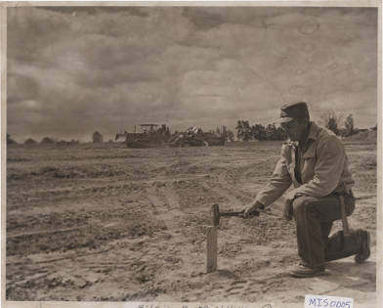
Questions?
Contact info:
Patrick Roth
rothpa@gvsu.edu

