Slide 1
Doing even more with less
Exploring batch processing and outsourcing in academic libraries

Slide 2



Patrick Roth, Head of Systems and Technology
Jeffrey Daniels, Head of Knowledge Access and Resource Management Services

Slide 3
Grand Valley State University Libraries
GVSU is a public liberal arts university in western Michigan, with 25,000+ students
$4.8 million annual library materials budget
70 library staff members (9 staff members in technical services)
Overall collection of 1.4 million plus
300+ databases, 60,000+ ejournal titles, 1,000,000+ ebook titles
2012 ACRL Excellence in Academic Libraries Award

Slide 4
Batch processing & outsourcing
We’re not pitching something new here, lot of scholarship out there on these concepts
“Shelf ready: A cost-benefit analysis”
  Rebecca Schroeder and Jared L. Howland at BYU
  Shelf ready 5.7% cheaper to process
  To the shelf 17 or more days faster than non shelf ready
  47% less processing time
“Navigating the currents of Vendor-Supplied cataloging”
  Helen Heinrich at California State University
  From IFLA conference proceedings back in 2008
  Good walk through of the entire process of using marc records for ejournals from Serials Solutions in 2006

Slide 5
If this isn’t new, why are we talking?
Staff lines are precious
  In the article “Staffing trends in college and university libraries”, Gillian Gremmels points to A study by The Oberlin Group, showing that 82.5% of eliminated or lost positions between 2008-2012 were from technical service areas.
  GVSU rarely adds new faculty lines, when they do, it’s not in the library
While changing rapidly, technical services type work remains the same or is increasing
  Print monographic purchasing is down, but other resources also require “processing”
New areas of focus at GVSU
  Authorities line turns into Scholarly Communications Support
  Traditional cataloger line turn into Web Services Librarian
  Retirement allowed for Metadata and Digital Curration Support
GVSU Libraries have made a commitment to exploring any opportunity to outsource or streamline work flows

Slide 6
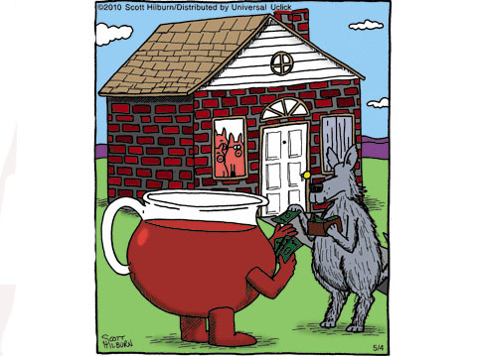

Slide 7

Vendor provided marc records
GVSU has over 60,000 full text ejournals
To copy catalog and test the links – 5 minutes to handle each title in house
420 minutes (7 hours) = 84 records per day
714 work days for the original 60,000, almost 3 years
Photo Credit: http://www.flickr.com/photos/30744708@N00/311380970/

Slide 8
Vendor provided marc records
Past 2 ½ years averaged between 7,000-10,000 updates per month
Takes one staff member about 4 hours
For one staff member
  3 minutes per record and only 7,000.
  21,000 minutes of work / 7 hours per day / 50 work days or 10 weeks
To accomplish it in the same half day
  At 240 minutes of work / 3 minutes per record / one staff member = 80 updates
  7,000 updates in four hours work take 87.5 staff members

Slide 9
Vendor provided marc records
This is just the work of the updates, doesn’t even count the larger project of gathering the information from all of our journal providers
Clearly an extreme example, but with smaller streaming video and ebook packages the math does begin to add up
High priority at GVSU, negotiate for marc records
Popular streaming video subscription that we wanted for content, waited 3 years until they could provide marc records AND updates.
Ebook reference collection, marc records weren’t free, we paid for them, they were so bad we redid them

Slide 10
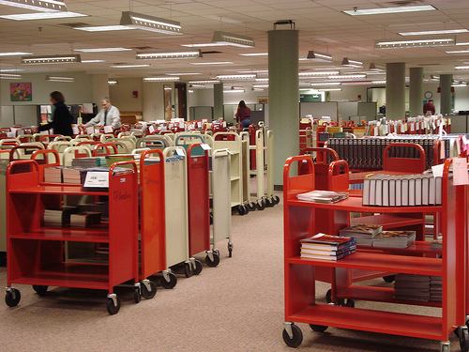
Shelf ready
Another example of outsourcing that many libraries already use
Main concern, misleading to call it “shelf ready”
For every box of 100 books, 5-10 don’t come complete
Call numbers have to be confirmed
Photo Credit: http://www.flickr.com/photos/78199693@N00/2368353431/

Slide 11
Closer to shelf ready
Electronic invoice speeds up acquisitions
Shrinking staff but still fast turnaround
We could never move the volume we do without pre-processing
With pre-processing 2 to 3 minutes per book, without easily 8 to 10 minutes per book
GVSU has one full time cataloger, only able to do this because of pre-processing

Slide 12
Let’s just call it Pre-processing
Example of the pendulum swinging back
Set up a standing order with a new vendor
They didn’t do everything we needed
Staff would have to touch each book anyway
With the small number of books it would save us that much time and it does cost extra

Slide 13
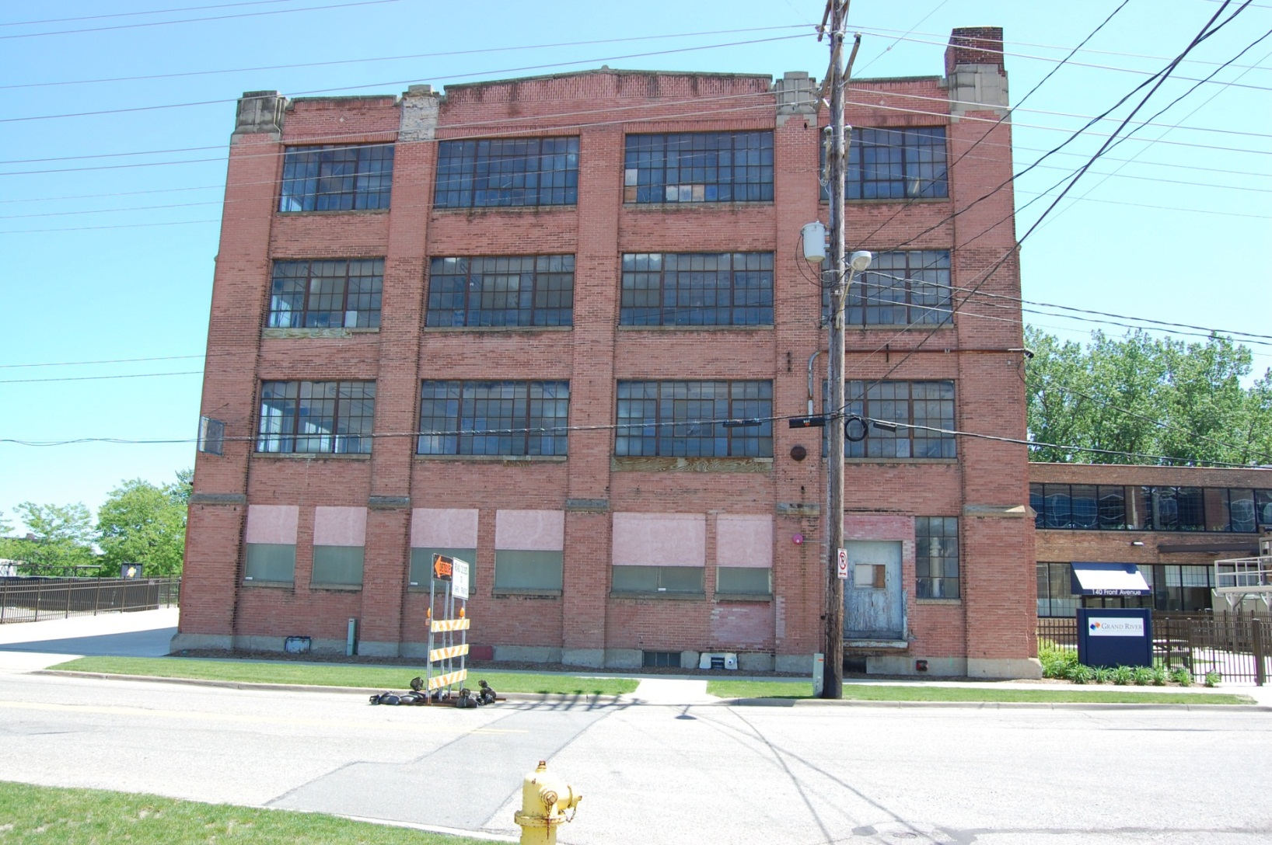
Weeding Storage Facility
New Library = Get rid of storage facility
2^{1/2} month time frame for weeding
Traditional weed would take too long & we wouldn’t get rid of enough
Used data driven de-selection
  List of items sent to SCS
  Returned a list of withdrawal candidates
  Used batch processing to edit records & do record maintenance

Slide 14

Record Maintenance
Suppress all candidates
Update retained items with rationales and un-suppress
Withdraw all items not being retained
Remove holdings from OCLC

Slide 15

Traditional Weed
Initial suppression of record
  ~1 min/record (~80 work days)
Updating retained items
  ~2 min/record (~22 work days)
Withdrawal of item & OCLC Holdings removal
  ~2 min/record (~138 work days)
Not including time spent moving items around…
VERY TIME CONSUMING!!!

Slide 16

“Batch” Weed
Batch record maintenance
  <1 min/record for each step
  About 4 total hours of updates
OCLC Bibliographic Batchload to remove holdings
  1 file export (Took about 2 hours to read directions and send file)
Tech Services didn’t touch a single item

Slide 17

AS/RS Loading
AS/RS – Automated Storage & Retrieval System
Holds up to 600,000 volumes, arranged in bins by height (10”, 12”, 15”), not in order Call # order
Each book assigned to a specific cell upon entry into system
This is our second AS/RS – loading the first one took 6 weeks and 60,000 volumes we loaded
We had 5 weeks and 188,000 volumes to load

Slide 18

“Batch” AS/RS Loading
Can’t move faster…what can we do?
Shift Time!
Front load the work
  New method: Do all of the assigning of sizes, pre-boxing books, labeling etc. even assign bins. How?
  Write a program that stores a DB of all information and can then upload it to AS/RS system

Slide 19

AS/RS Loading
Cost of 1st AS/RS Load(60,000 Vol.):
  30 days of loading (~10 hrs./day)
    6 staff (~$36,000)
Cost of new loading (~188,000 volumes):
  Programming/Testing
    100 hrs. of student programming ($1,000)
    30 hrs. of staff & vendor testing ($780)
    Special equipment :$3000
  2 Weeks of loading
    Staff time during load($3,120)
    Student time during load ($6,552)
    Total cost: $14,452
    Loaded 1st way would have cost ~$113,000

Slide 20

Foreign language cataloging
Changes to the curriculum at GVSU have resulted in an increase of Arabic, Chinese, Japanese and Russian books being ordered
We don’t order our foreign language titles from a book jobber that offers pre processing, cataloging is handled in house
Lucky to have staff comfortable reading and copy cataloging in the romantic languages
Photo Credit: http://www.flickr.com/photos/11831859@N05/1467604861/

Slide 21
Foreign language cataloging
We are working with Backstage Library Works
With a mix of copy and original cataloging we’re paying 20/25 dollars per book
This is a huge money commitment and we’ve had to add a new line item to an already shrinking budget
But still better than guessing, up to half of the books ordered don’t come with an ISBN
Turn around time, even with shipping the books out is quicker than sitting on them till we can find someone to help

Slide 22
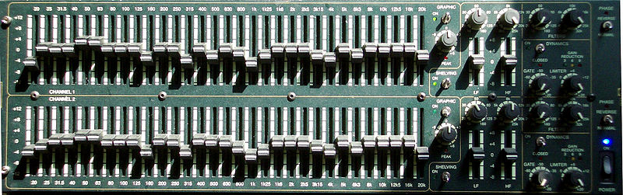
Good enough?
We all want to do and be the very best at everything
What can you get done with the resources you have?
What’s the alternative if it can’t be perfect?
What will benefit the patrons?
Return on Investment?
Photo credit: http://commons.wikimedia.org/wiki/File:Grafischer_EQ.jpg

Slide 23
What factors should we look for?
What does the vendor offer?
  Can we afford it? Can you afford not to?
  Ask, you’ll be surprised what they will throw in to close the deal
Will it eliminate boredom or even worse, human error?
  Not always- picking the correct record can use the human touch
Will it save time?
  Will staff still need to touch the books?
  Does it take longer to set up than to run?
  How many times do you have to do this? (once? Weekly? Monthly?)
  Don’t forget, shifting time can be as valuable as saving time.
What can I do with that staff time?
  Keep up with existing work
  What keeps getting put off?
Does it add value for your patrons?

Slide 24

Questions?
Patrick Roth
rothpa@gvsu.edu
616-331-2615
Jeffrey Daniels
danielsj@gvsu.edu
616-331-2702

Slide 25
Sources:
Gremmels, G. (2013). Staffing trends in college and university libraries. Reference Services Review, 41(2), 233-252.
Heinrich, H. (2008). Navigating the Currents of Vendor-Supplied Cataloging. IFLA Conference Proceedings, 1-18.
Hilburn, S. (2010, May 4) The Argyle Sweater. [Cartoon] Retrieved from http://www.gocomics.com/theargylesweater/
Schroeder, R., & Howland, J. L. (2011). Shelf-ready: A cost-benefit analysis. Library Collections, Acquisitions, & Technical Services, 35(4), 129-134. doi:10.1016/j.lcats.2011.04.002

