Slide 1

Information Literacy & Faculty Collaboration:
A new model for Student Learning Success
ASEE/ELD 2012, San Antonio: Lightening Talks, P. Watkins, MLIS

Slide 2
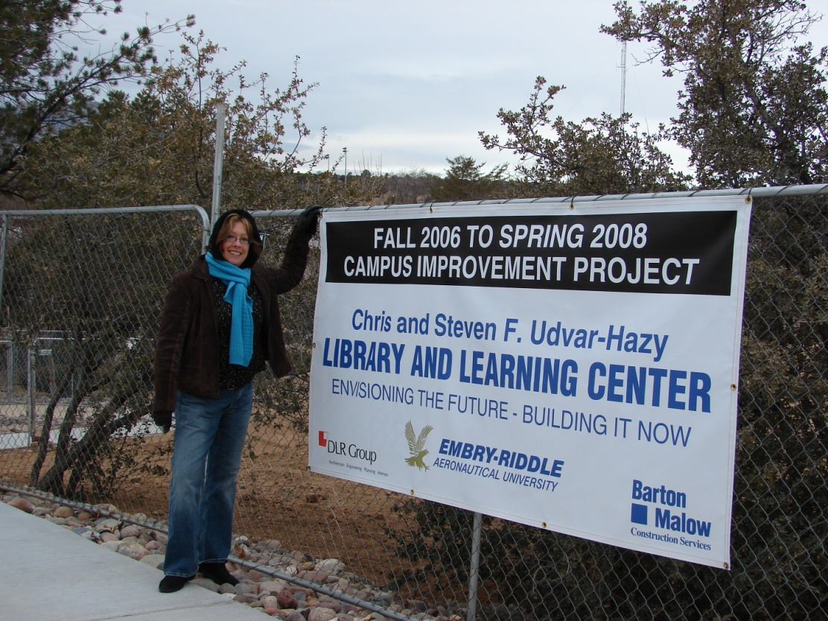
In the beginning:
2008 – New Hazy Library
2010 - 2 library white papers: ERAU Libraries: Innovating to meet the needs of 21st Century Learners and Innovative Library Technology
“… enhance the educational experience @ ERAU to support our students’ education as 21st Century citizens, fully engaged in research, information and media literacy and critical thinking …” (Mar 2010)
2010-2012: SACS-QEP development

Slide 3
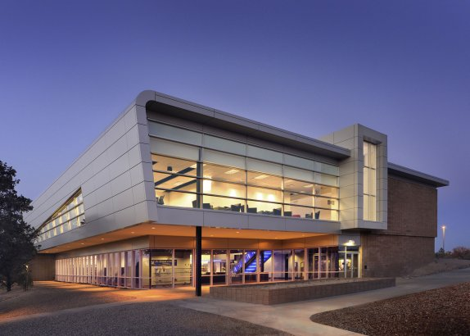
Hazy Library & Learning Center

Slide 4

2012 – SACS acceptance
ERAU QEP

Slide 5
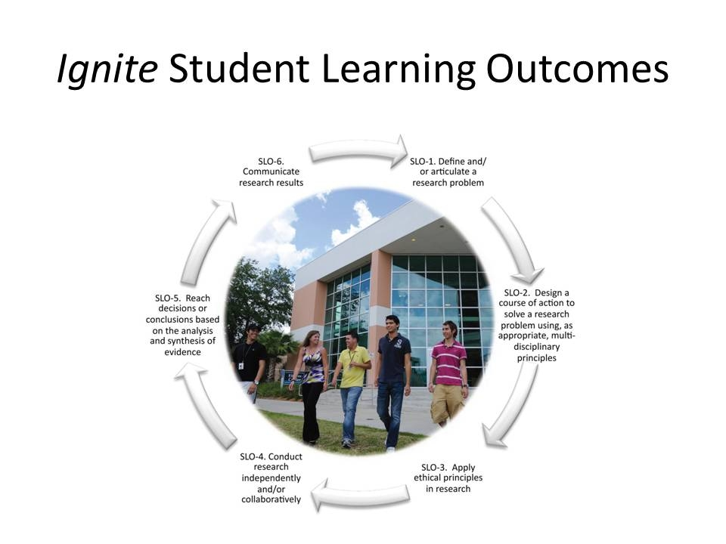
SLOs

Slide 6
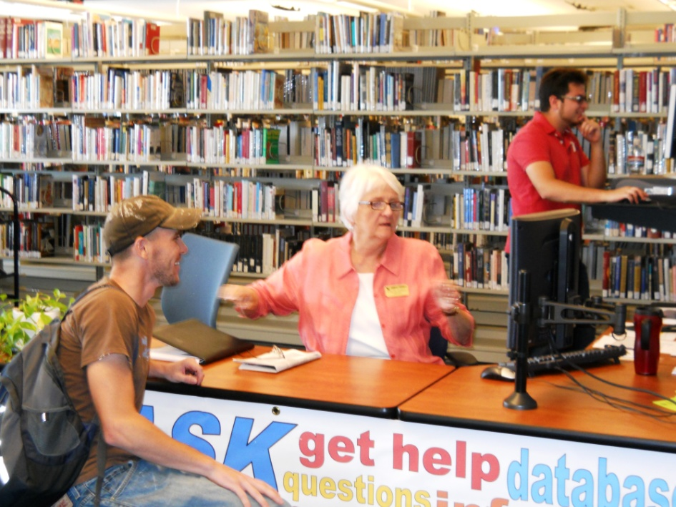
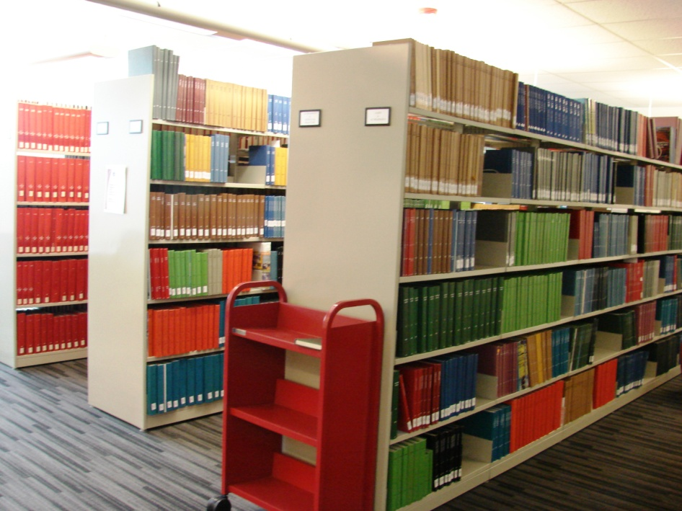
Then …
Reference Desk
Bound journals

Slide 7
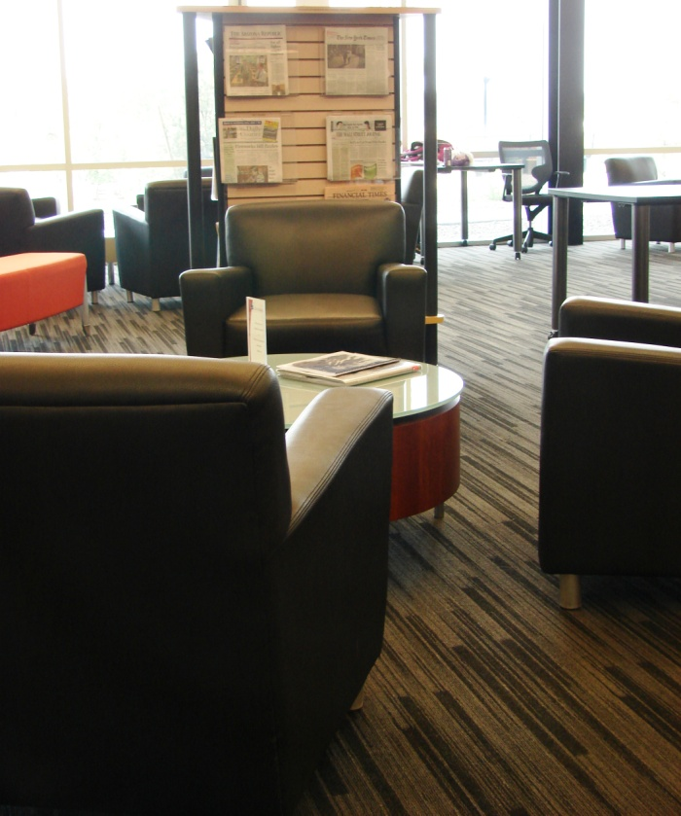
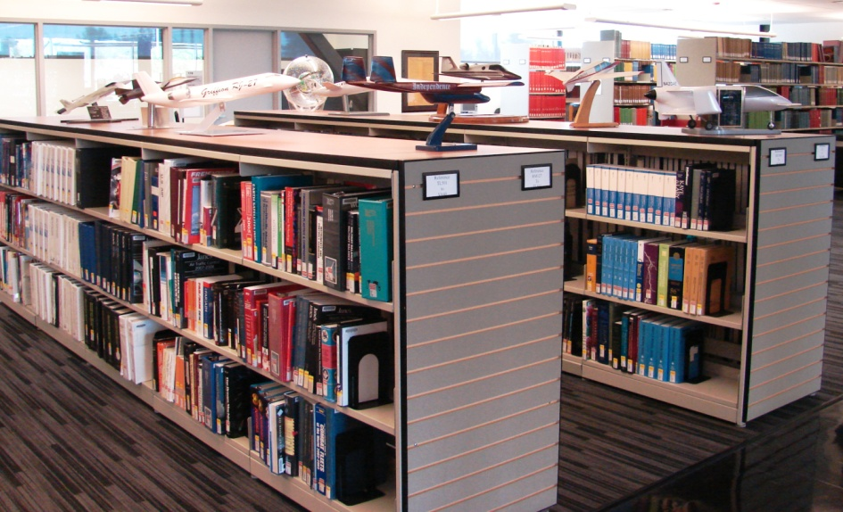
Morphing …
Reference Collection
Living Room

Slide 8
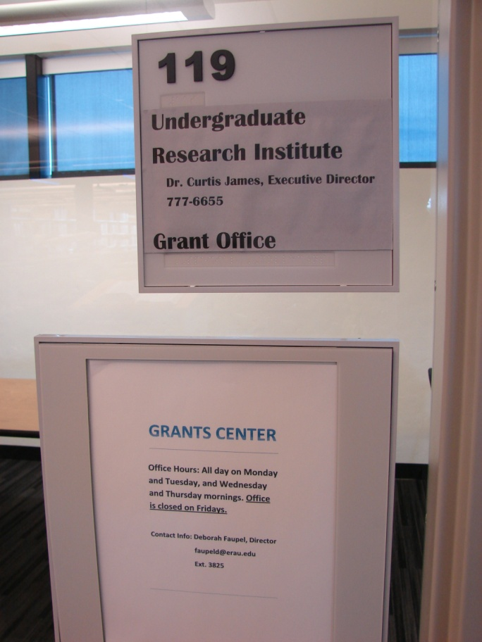
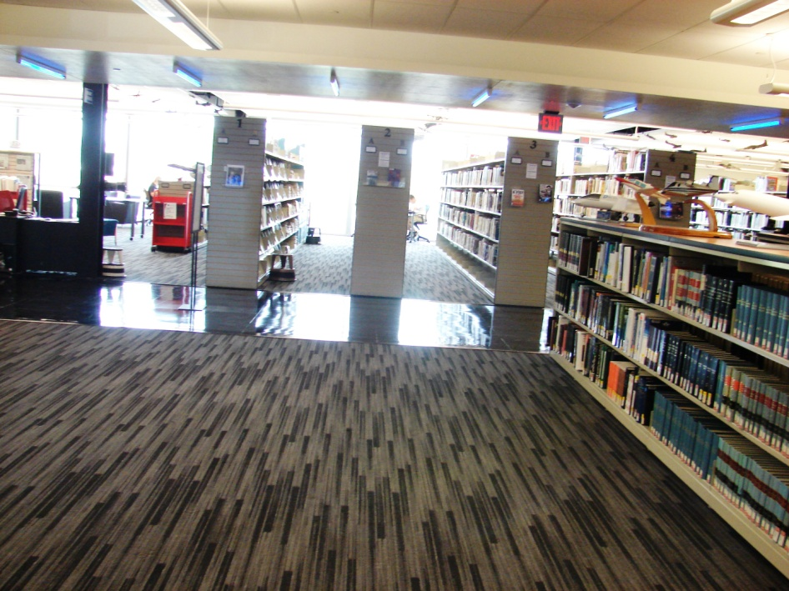
NOW: Re-purpose space +
URI Research Collaboration
Open space
URI

Slide 9
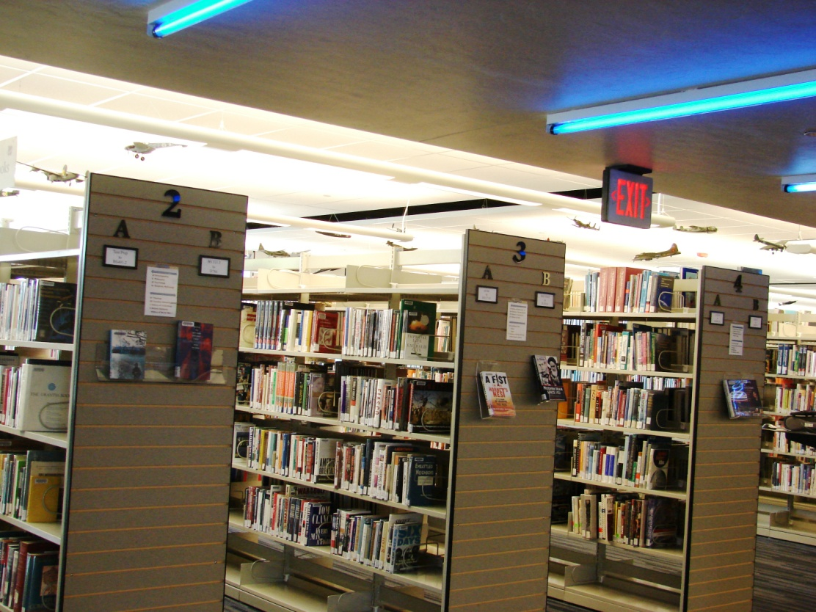
Future
Library Strategic Plan = expand campus presence
HEAVY WEEDING
+++ Instruction, Assessment
NEW Reference model
+++ Faculty collaboration
QEP research
CHANGE!!

