Slide 1



The Case of the Missing Voting Box
Or, how I learned to love Engineers Week by creating an activity students truly
LEGOS
Notes:
notes

Slide 2


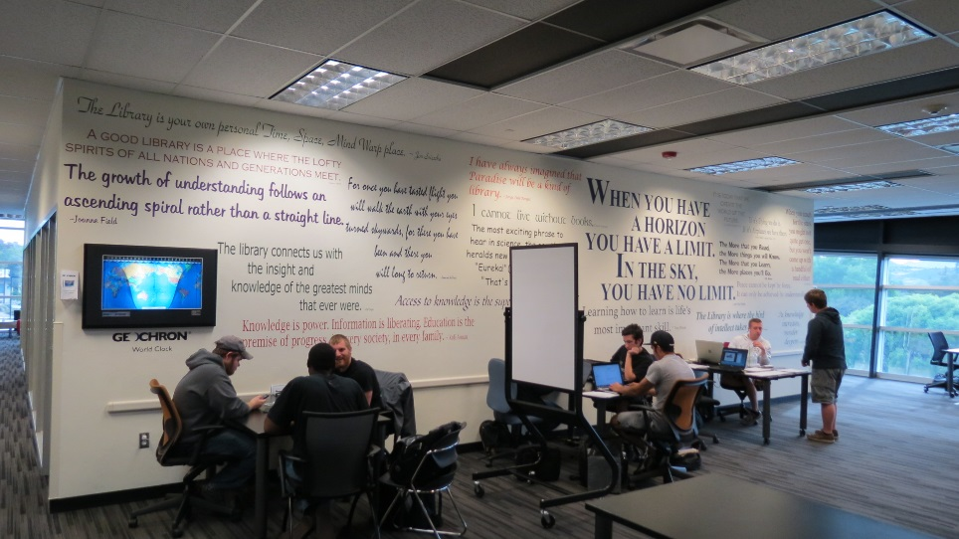
Challenge
February=Finals
Stress. Study
Heads-down
PLANS?
Spring Break!!

Slide 3
Timeline
2010
Engineering Trivia contest (Prize: Model Airplane)
2013 Engineering Film Festival
(Refreshments, Raffle: Pizza & gift Certificates
2012
Engineering Trivia contest (Prize: Star Wars Lego Kit)
2015
Lego Contest
(Top 3. People’s Choice. BIG Star Wars Lego Kits)
2014
Lunch & Learn with IEEE
(Pizza & Presentation by Plosker, Pizza & IEEE swag!)

Slide 4
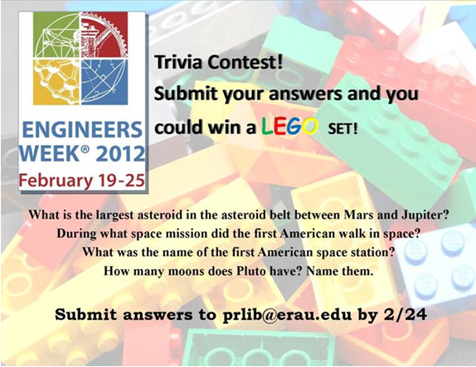
2012

Slide 5
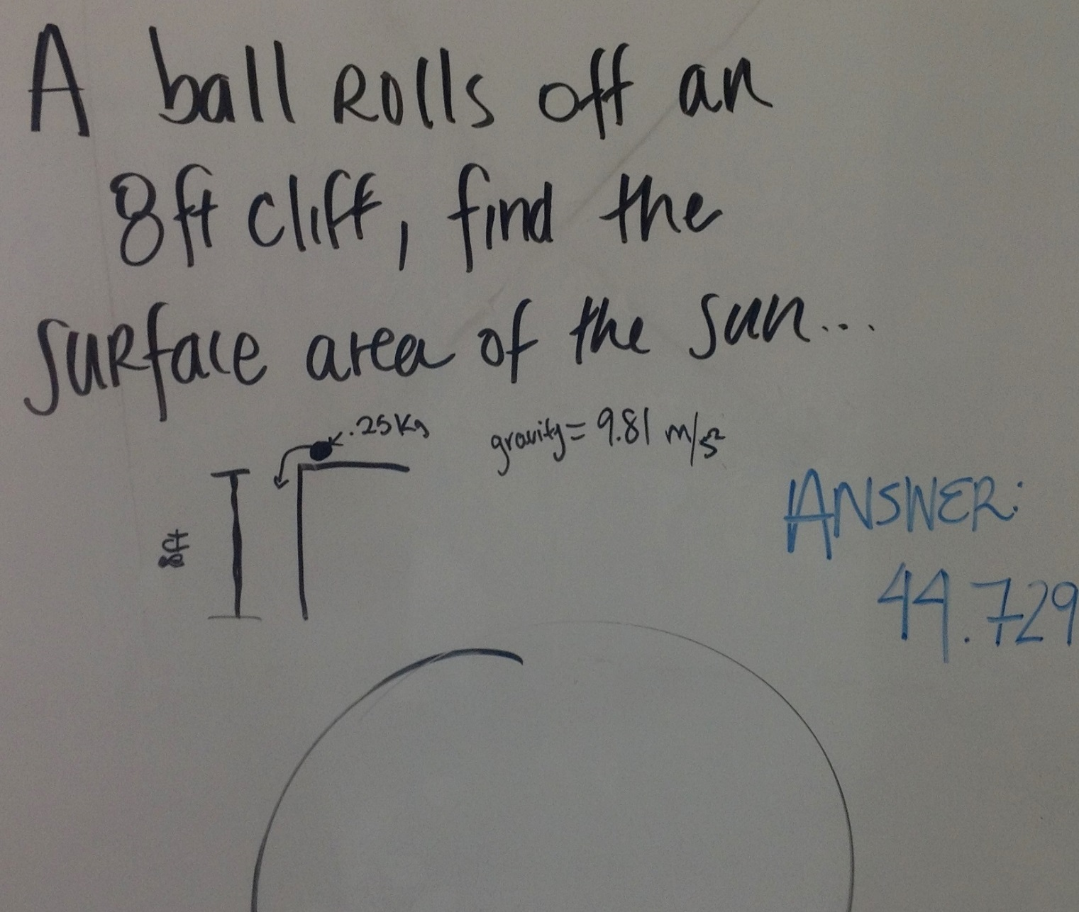

Slide 6
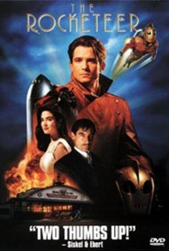


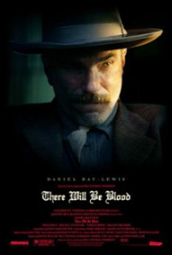
3 movies, 3 nights. 14 Attendees.

Slide 7

2014
• When/Where: Wednesday, February 19th, AC1-room 104, 12:40-– 1:50 p.m. Lunch and IEEE ‘stuff’/giveaways courtesy of IEEE. Raffle for t-shirts.
• Who: Presentation by George Plosker, IEEE Client Services Manager; Sponsored by Hazy Library & ERAU-Prescott & College of Engineering.
• What: Discover research tips, how to use IEEE Xplore for research, articles & papers on: Systems engineering, Robotics, UAV/Drones, Network Security, Avionics, Military Satellite Communications, Optics, Aerospace & Defense, and more.

Slide 8

2015

Slide 9
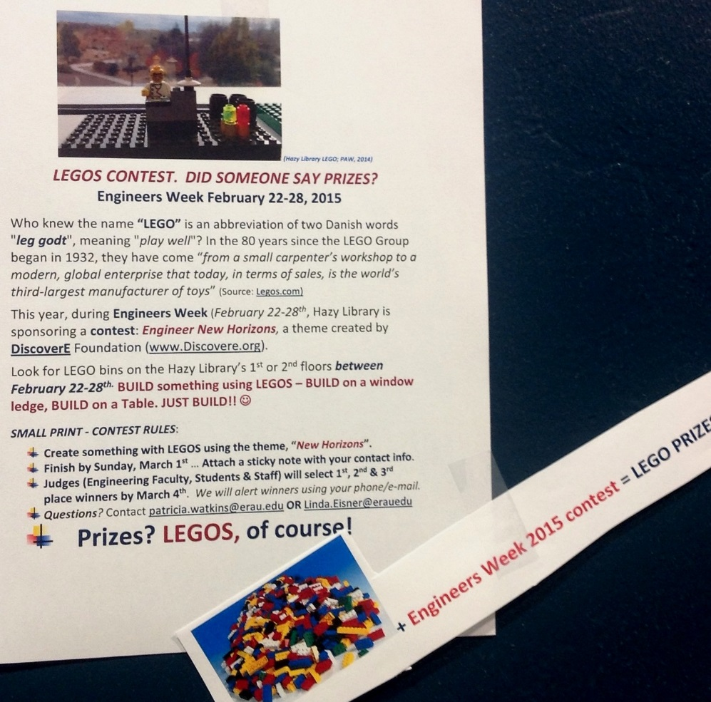
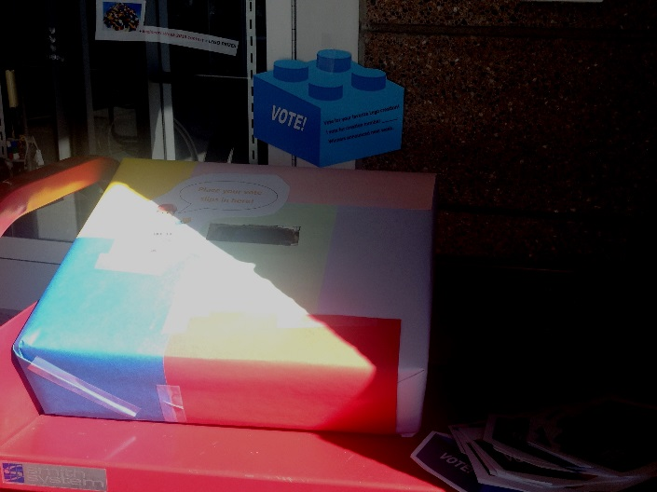
2015
Lego contest
Campus Choice Vote Box

Slide 10
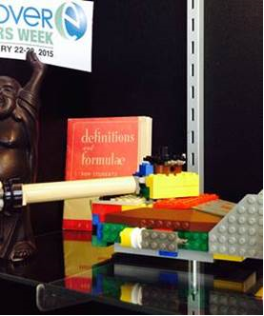
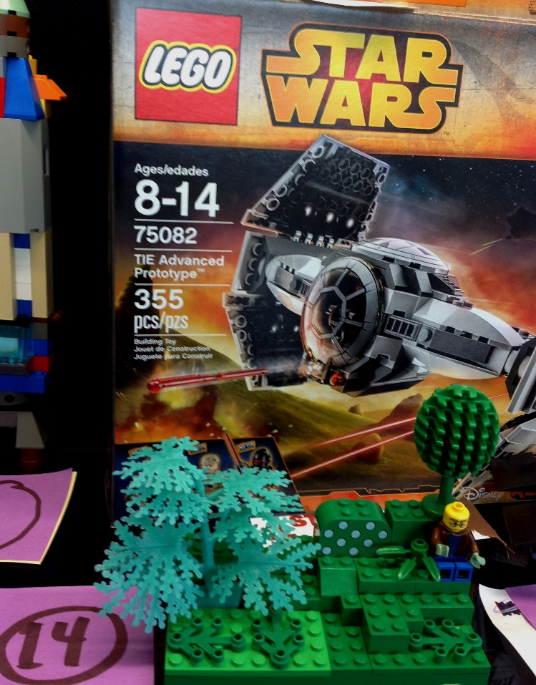
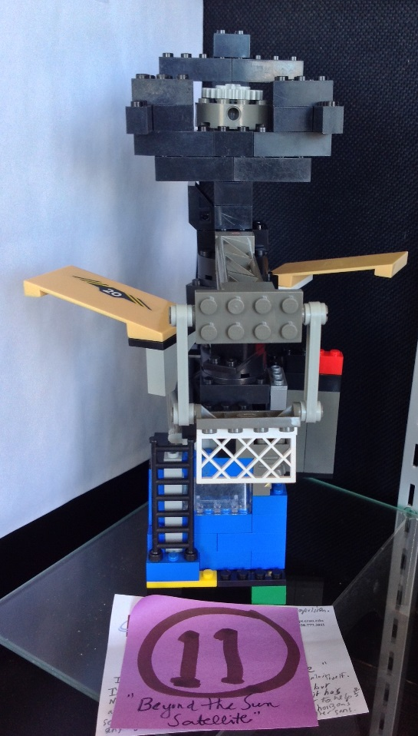
Engineers Week: Lego Contest, Vestibule Display

Slide 11
Dear Faculty, Staff, and Students:
The Legos Voting Box in the Library Vestibule has gone Missing! (We are NOT payng ransom!) BUT, IF you see it, please Return It, NO QUESTIONS ASKED! A replacement box is now in place & we EXTENDED the Voting Deadline. tomorrow - High NOON.
2015
Lego contest

Slide 12
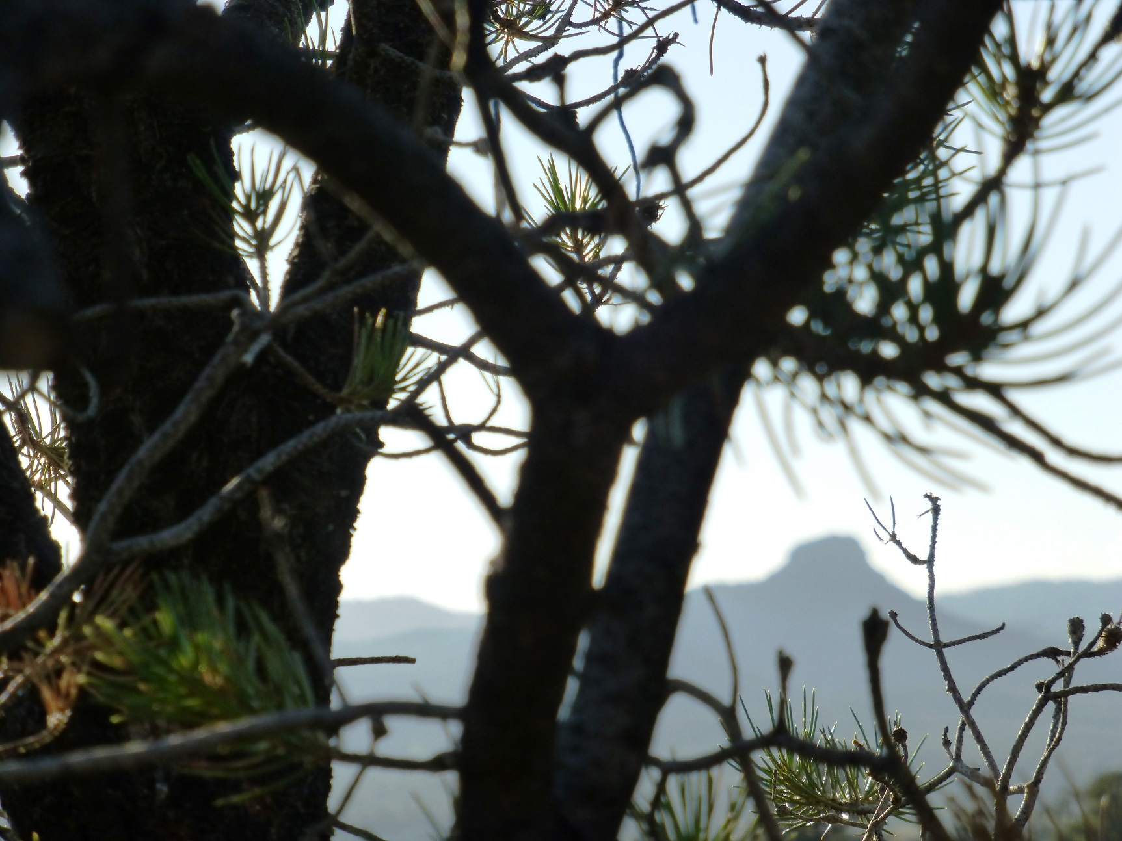
(Photo: paw)

Slide 13
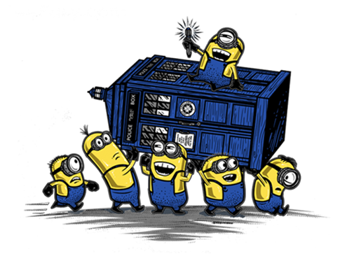
Dear Faculty, Staff, & Students: FOUND!
the Legos Voting Box (No RANSOM Paid!)
An EAGLE-Eye library student employee found it – mystery solved!! (Thx, Mr. Holmes!)
Voting continues till high noon, tomorrow, Thursday, March 5th.
No 2nd vote needed: if you haven’t voted yet, “just do it”!

Slide 14
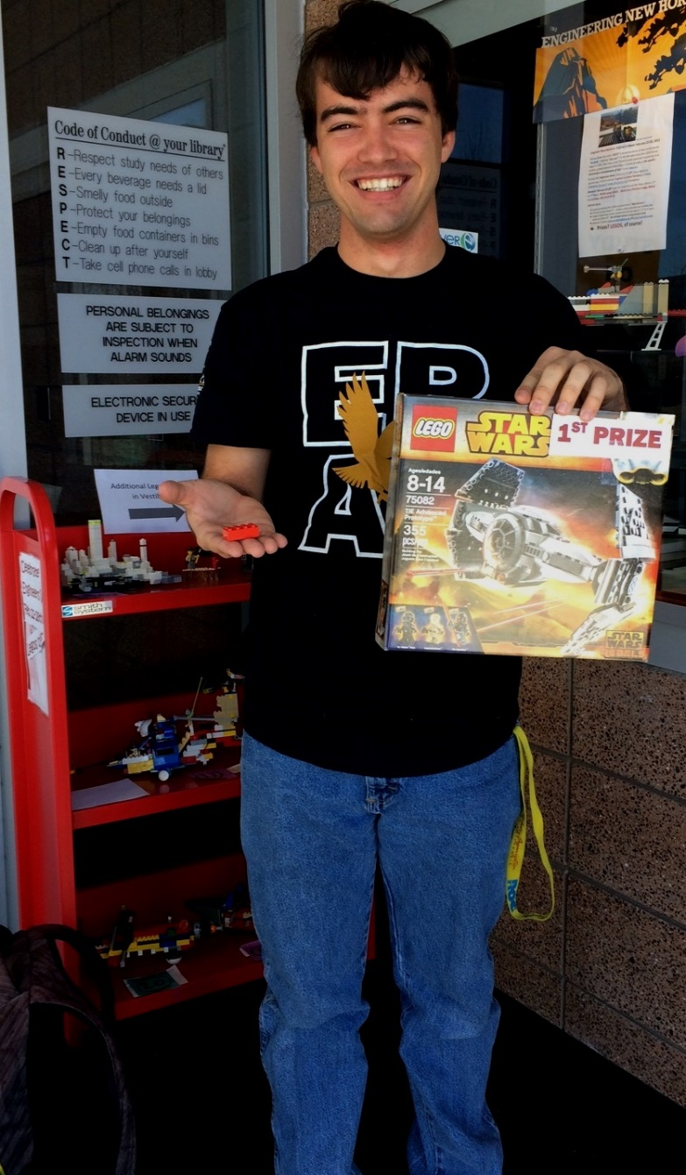
1st Prize
Red Brick #3

Slide 15
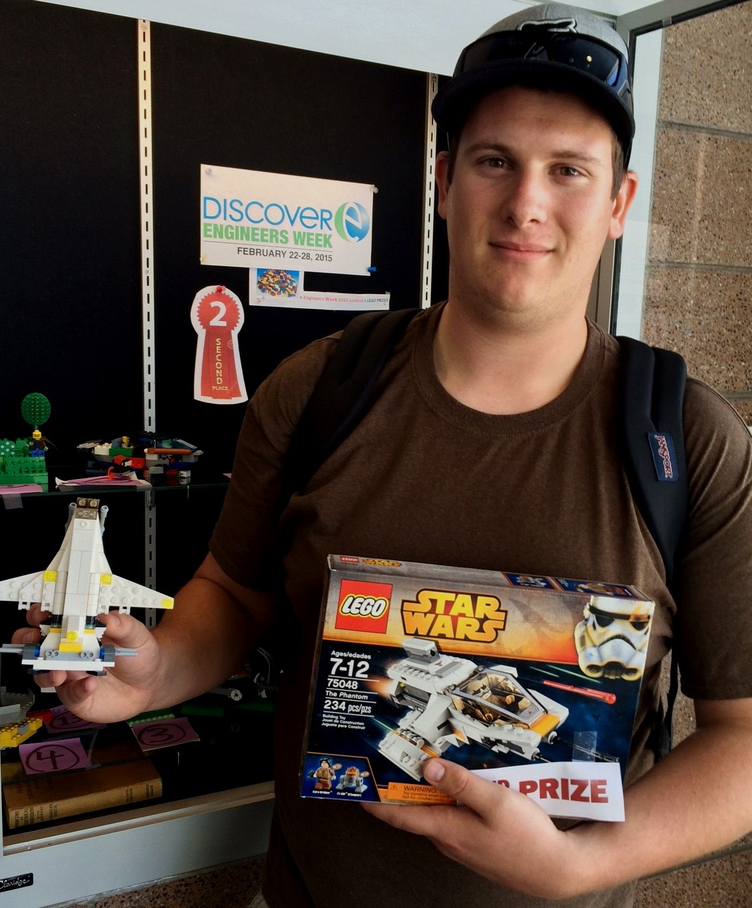
2nd prize
Arkbird

Slide 16
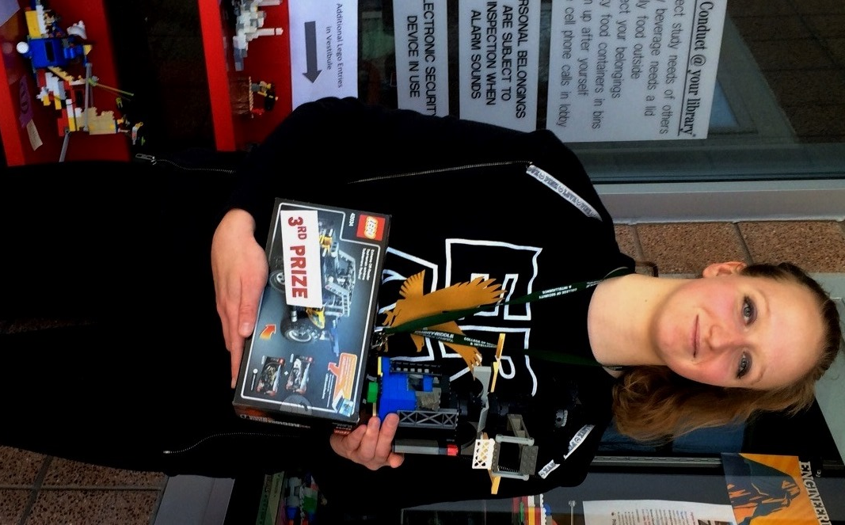
3rd Prize
Beyond the Sun Satellite

Slide 17

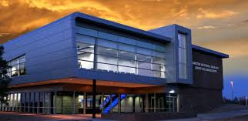
Mystery solved!
Engineers Week 2015 @ ERAU-Prescott

