Slide 1
Using Perceptual Maps for Career and College Counseling
Oscar McKnight PhD. LPCC-S: Dir., Psychological Counseling/Health Services
Ashland University
Kerri Carmichael, LPC: Professional Counselor
Ashland University
Gregory Pollock, LPCC-S: Clinical Counselor
Private Practice

Slide 2
OVERVIEW
Perceptual mapping is a modeling technique used in business to visually display relationships and perceptions of customers.
In business, perceptual maps are often called product positioning maps. Conceptually, perceptual maps foster a better and deeper understanding of products and services in terms of public perception or actual outcomes.
In short, marketers attempt to position products, product line, brand, or company type relative to their competition or competency. For counselors, this process facilitates open and honest discussion relative to personal expectations and goals.

Slide 3
PRESENTATION GOALS
Understand the history and intent of Perceptual Mapping in Business; and, how to modify and administer a perceptual map for career/college counseling.
Understand how to interpret and use a Perceptual Map given a multiple variable (axis) system; and, how to encourage/motivate the student/client in a realistic appraisal of self, career and college.

Slide 4
PERCEPTUAL MAP AS A PROCESS
Simply stated, a perceptual map is a two-dimensional graph displaying product or service attributes. This process leads to both a quick intuitive and cognitive understanding.

Slide 5
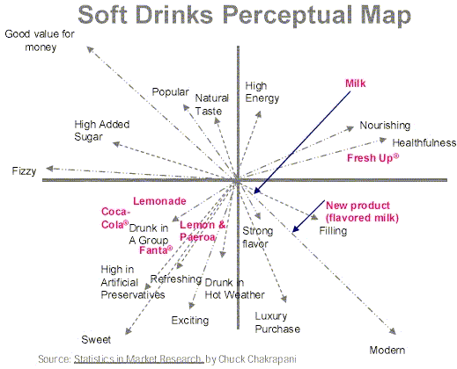
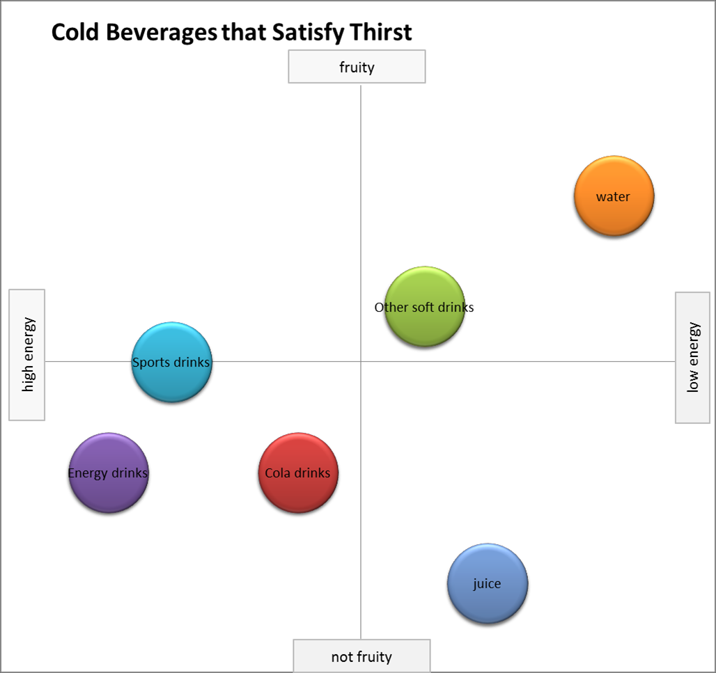
A Few Examples of Perceptual Maps

Slide 6
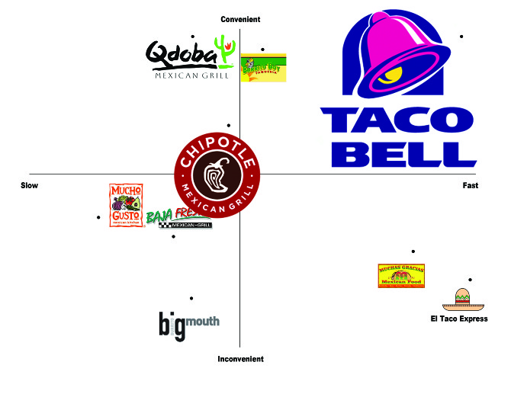
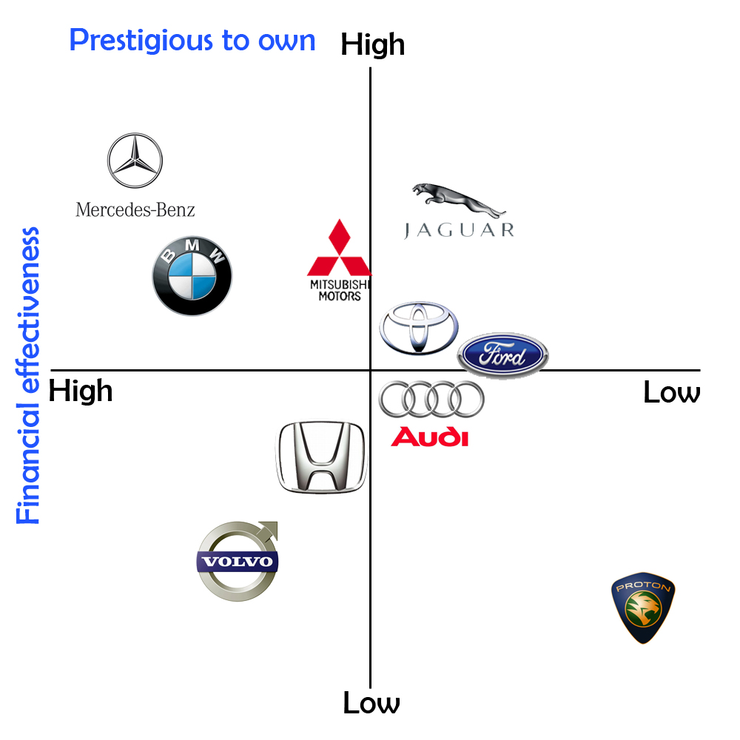
A Few Examples of Perceptual Maps

Slide 7
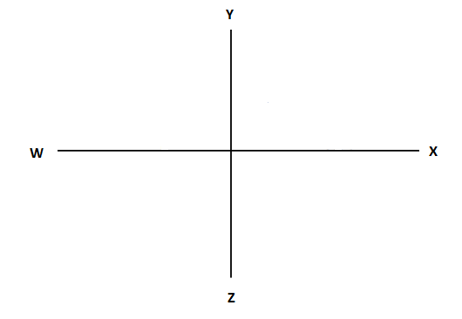
Let’s Start Simple

Slide 8
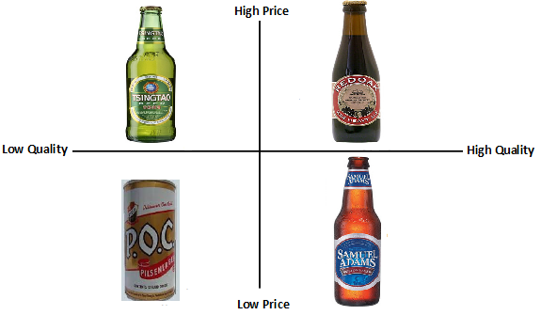
For example, in business:
Some maps are perceptual and empirical (personal-preference) maps

Slide 9
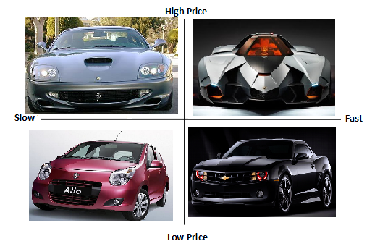
Some perceptual maps are strictly data driven (empirical evidence)

Slide 10
TRANSFERRING PERCEPTUAL MAPPING TO COUNSELING
The process of perceptual mapping can be transferred easily to the counseling field; for example, when examining college selection or career direction.
In career counseling and assessment, this process allows the student/client to evaluate career and college thoughts, beliefs, values, and personal skill sets across multiple dimensions as introduced by the student/client.
These maps display not only perceptions, but can also be used to establish personal goals given known outcomes.
Incongruence or congruence between perceptual and empirical maps becomes the foundation of the counseling process.
The process becomes an opportunity for personal growth.

Slide 11
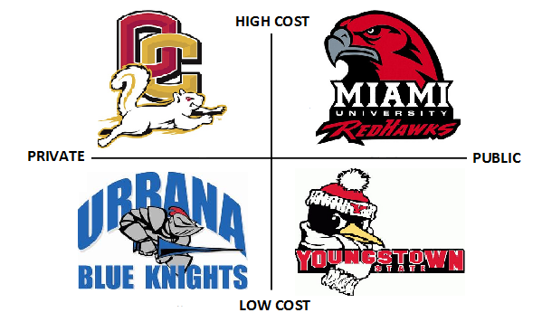
Example: Applying a perceptual map to college selection

Slide 12
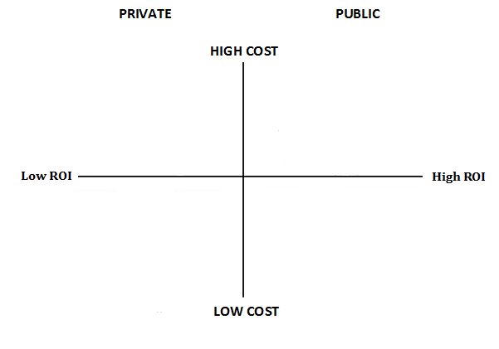
Remember, multiple variables for evaluation are possible, for example:

Slide 13
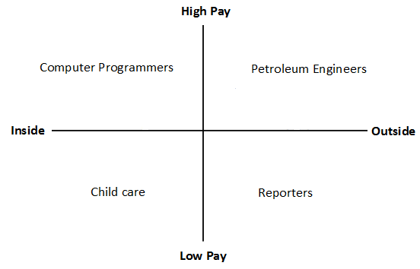
When applying a perceptual map to employment, an example could be:

Slide 14
PERCEPTUAL MAPS: MANY OPTIONS
COLLEGE PARADIGMS | CAREER PARADIGMS
ROI vs. Cost ACT/SAT Scores vs. GPA Graduation Rate vs. Net Cost Footprint vs. ACT | Dress Code vs. Income Entrepreneurial vs. Security Hours’ Work vs. Income Profit Status vs. Benefits

Slide 15

NOW YOU TRY
Use the handout and create a perceptual map using any self-selected or reviewed variables

Slide 16
TYPICAL OUTCOMES WHEN USING PERCEPTUAL-MAPPING FOR COLLEGE OR CAREER EXPLORATION
1. Clients feel better and more confident about their decisions
2. Process reduces stress; career and college exploration or selection can be stressful
3. Allows a client to identify and rank-order specific goals
4. Early use of the process, can lead to new goal-related behaviors
5. Affords the client an opportunity to speak with a skilled and competent professional

Slide 17
TYPICAL OUTCOMES WHEN USING PERCEPTUAL-MAPPING FOR COLLEGE OR CAREER EXPLORATION
6. Provides a forum and springboard to talk about troubling or private concerns
7. Allows for greater self-fulfillment and self-mastery
8. The process can be a reality check
9. Sanctions a non-bias and impartial look at personal options
10. Encourages a broader understanding of complexity of decision-making

Slide 18

Questions?

