Slide 1

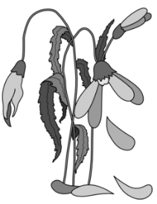
13 Surefire Ways To Kill Your Private Practice
(Data Driven – Best Practice)

Slide 2


PRESENTER(S)
Oscar McKnight Ph.D. LPCC-S LSW DCC
Kerri Carmichael MA PC DCC
Greg Pollock M.A. Ed LPCC-S

Slide 3
OVERVIEW: BACKGROUND AND RESEARCH DESIGN
BACKGROUND
Study initially designed to present at a business marketing conference
RESEARCH DESIGN
370 Electronic Surveys sent to counselors in private practice
Electronic Surveys completed and returned
Participant Selection - Database(s)
www.goodtherapy.org/
http://therapists.psychologytoday.com
http://www.networktherapy.com
http://www.therapytribe.com/

Slide 4






Slide 5
13 Deadly Ways to Kill Your
Private Practice
NO social networks | 0.55
NO Business Plan | 0.48
NO sales Training | 0.47
NO sales Experience | 0.39
NO Business Training | 0.33
NO Limitation Pro Bono | 0.25
NO Business Experience | 0.24
NO Set Price Point | 0.23
NO Marketing Experience | 0.22
NO Niche Market | 0.22
NO Reserve Assets | 0.20
NO marketing Training | 0.16
NO online Presence | 0.14

Slide 6
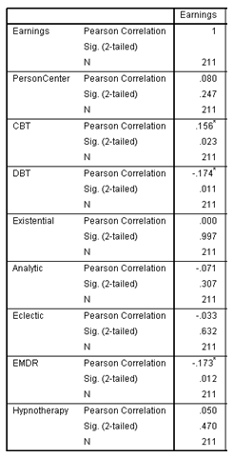

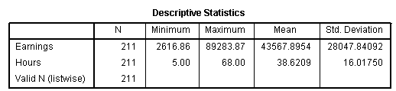
Therapeutic Technique and Earnings

Slide 7
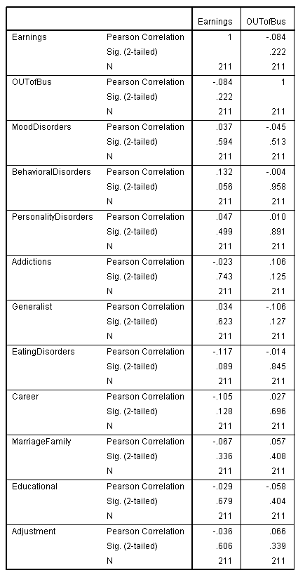

Specialization, Earnings and Success

Slide 8
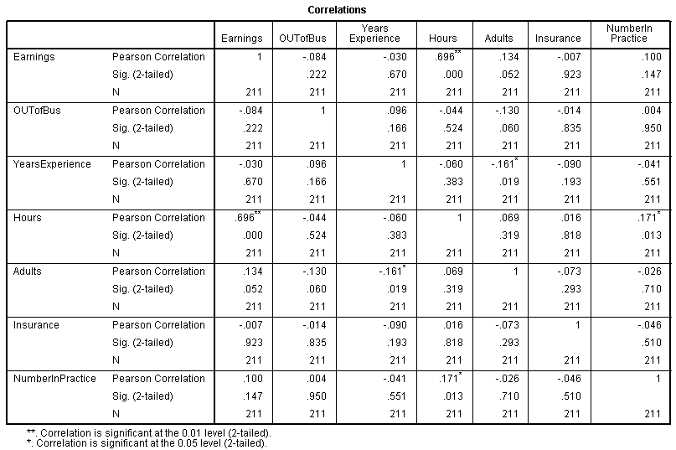
Demographics, Earnings and Success

Slide 9
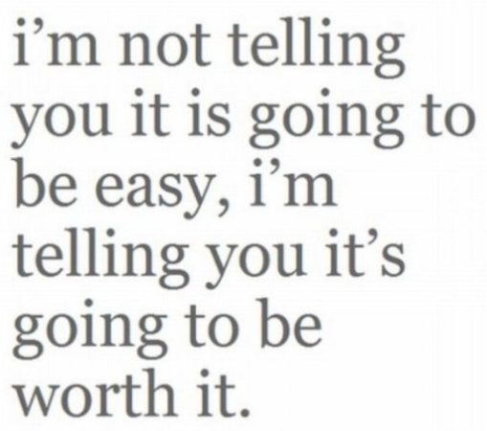




IN THE END

Slide 10


