Slide 1


Massillon City Schools

Slide 2
Ohio School Board Association
Capital Conference and Trade Show
“Assessing Curriculum for College Success”
A joint project of the Massillon City Schools and the Ashland University Telego Center for Educational Improvement

Slide 3
Presenters
Dr. Oscar McKnight, Assistant Dean, Student Affairs, Ashland University
Dr. David Silverberg, Consultant, Ashland University
Dr. Angela Chapman, Curriculum Director, Massillon City Schools
Dr. Lynne Kulich, Coordinator of Instruction, Massillon City Schools
Dr. Gene Linton, Director of Professional Development, Ashland University

Slide 4
Why this Project?
The district is fortunate to have a great teaching and administrative staff
Students perform well on school assignments and this is reflected on grade cards
Student success on the ACT is not at the same level of success as grade card performance
Student college enrollment and success after high school is not at the expected level

Slide 5
Questions to consider
Are students utilizing their learning potential?
    Self administered survey to elementary through high school students
    Survey will be administered to parents of primary students at a school event
To what extent are the new learning standards being taught and assessed?
    Groups of teachers met with facilitator and reviewed what is being taught and assessed

Slide 6
The Student Success Survey
Online
5 minutes to complete
Assesses Learning Potential
Non-Judgmental
Prescriptive
Self-Selected Intervention
Copies sent to student, parent and school
School System Analytics available

Slide 7
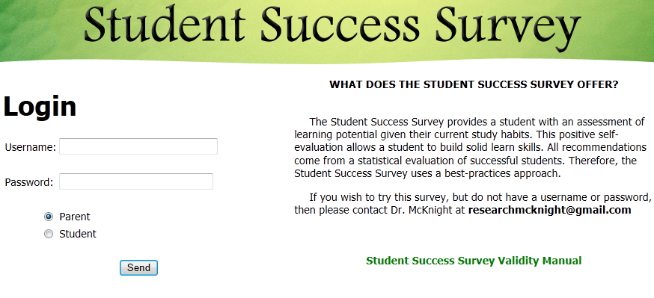
Online Student Success Survey

Slide 8
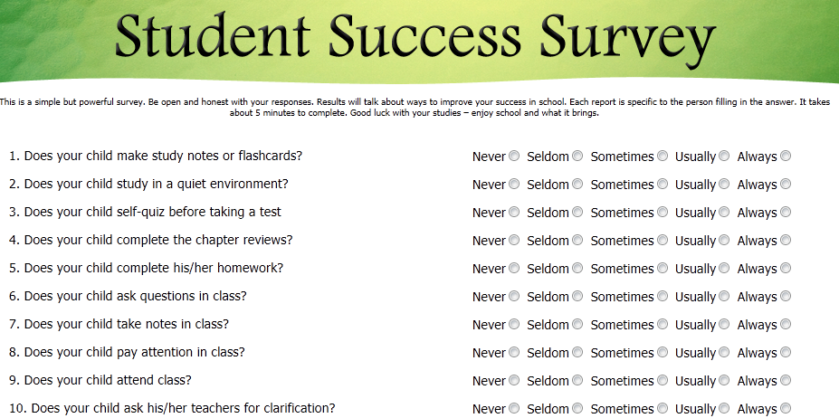
Quantitative Questions
(Sample)

Slide 9
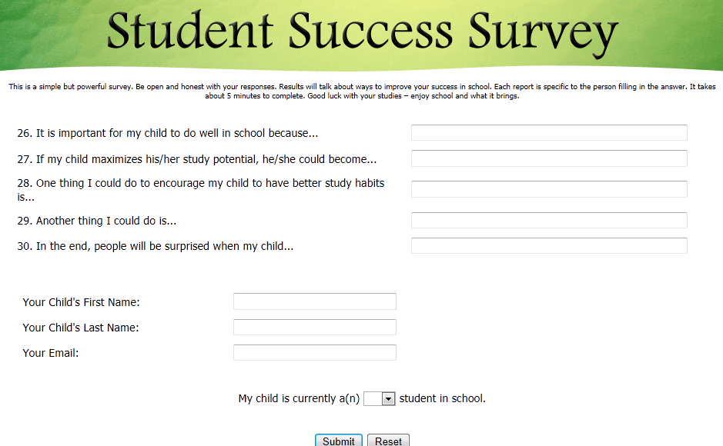
Qualitative Questions

Slide 10
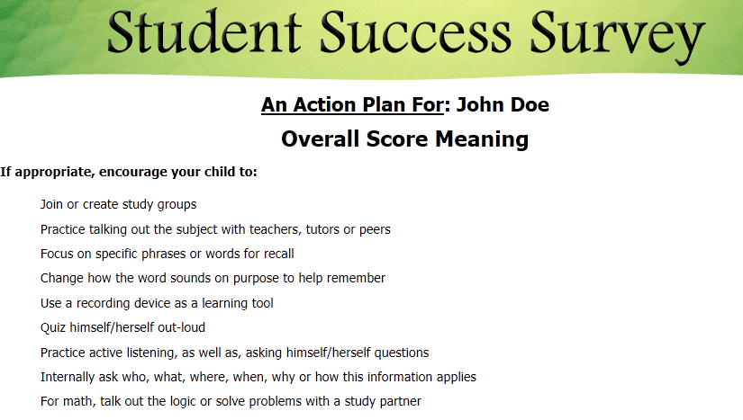
Sample Output

Slide 11
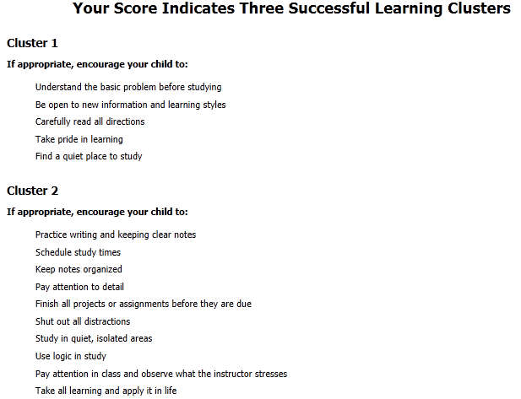
Survey Recommendations
(Sample)

Slide 12
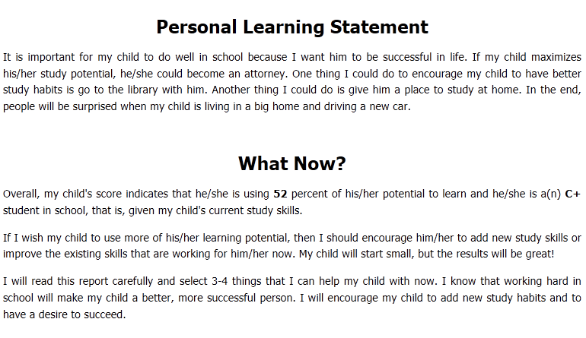
Parental Written Goals

Slide 13
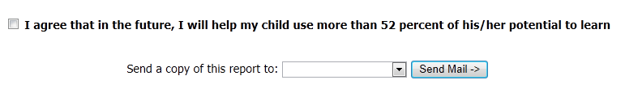
Total Agreement

Slide 14
Curriculum Audit of Massillon City Schools
The Study
Dr. Silverberg
OSBA Conference
11/11/13

Slide 15
Overview
The Study
  Winter/Spring of 2012-2013
  Intent – Examination of Implementation of the
  K-12 Standards into Teaching & Assessment
  Ohio’s New Learning Standards
    English Language Arts
    Math
    Science - Includes Reading & Writing Standards
    Social Studies - Includes Reading & Writing Standards

Slide 16
Considerations
Horizontal Alignment
  Across Grade-Level
  Building-to-Building
  Reading & Writing Across the Curriculum
Vertical Alignment
  At Grade-Level (Note on Differentiation)
  From Grade-Level to Grade-Level
  From Grade-Band to Grade-Band (El/IS/JHS/HS)

Slide 17
A-School-A-Day
    Franklin Elementary School
    Gorrell Elementary School
    Whittier Elementary School
    Intermediate School
    Junior High School
    Washington High School

Slide 18
Focus Groups
  Big Picture
  120 Teachers
  1,288 Standards
  Group Design
  Content Area or Grade-Band
  Teacher-Only Sessions
  1 to 1.5 Hours Each
  Tension & Transparency
  Resources
  Standards

Slide 19
Inquiry-Based Approach
Invitation to share openly
  Do you teach this standard?
  Do you use summative assessments to evaluate student learning for this standard?
Responses recorded into spreadsheets
  Yes
  No
  So/So
    Inconsistent implementation
    Teacher-to-teacher basis
    Some sub-standards and not others
  No Grade-Level Standards

Slide 20
Data Analysis
Results Logged Into Spreadsheets
  Content Area
  Building
  Grade-Level
  Taught (Yes, No, So-So)
  Assessed (Yes, No, So-So)
Qualitative Responses Noted
Report Delivered
  Administrative Meeting
  Faculty
    Whole Group Findings
    Content & Grade-Level Workshops

Slide 21
Report
District & Building-Level Findings
  Commendations
  Recommendations
Content-Area Sections: Math, ELA, Sci., SS
  Major Findings by Grade-Band (El, IS, JHS, HS)
    Strengths
    Needs
  Findings by Building
    Grade-Level Results

Slide 22
Detailed Analysis
(Hypothetical)
Earth
Science
Space
Science
4th Grade Taught | 4th Grade Assessed | 5th Grade Taught | 5th Grade Assessed

Slide 23
Major Content-Area Findings
(Hypothetical)
Science Standards
Content Reading & Writing
Taught Taught
Yes 51% Yes 35%
So-So 40% So-So 48%
No 9% No 17%
Assessed Assessed
Yes 33% Yes 26%
So-So 38% So-So 51%
No 29% No 23%

Slide 24
Major District Findings: Commendation
Buy-In For Curriculum Audit & Improvement Process
“This experience itself is Professional Development.”

Slide 25
Contact Information
David Silverberg, Ed.D.
Telego Center Fellow
Founders School of Continuing Education
Ashland University
dsilverb@ashland.edu
330-998-2873

Slide 26
Massillon City Schools
Dr. Angela Chapman
Curriculum Director
Dr. Lynne Kulich
Coordinator of Instruction

Slide 27
Action Plan:
Analyze the Data and Review the Recommendations
Report out the Findings
Prioritize Curricular Needs
Begin the work

Slide 28
Reflections from the Teacher Surveys ?
55% of the teachers reported teaching the CCSS
32% of the teachers reported assessing the CCSS
No evidence of curricular alignment amongst the 3 elementary buildings
Very little evidence of consistent writing instruction or assessment in K-12
Notes:
Although we were regularly assessing students we weren’t effectively assessing what we were teaching.

Slide 29
Recommendations from the Audit:
Professional Development:
  Horizontal Continuity Between Elem. School
  Vertical Alignment Across Levels
  Content-Area Reading and Writing
  Developmentally Appropriate Summative Assessments
Resources:
  New Textbooks & Materials
  Increase Technology Access

Slide 30
Reporting on the Findings:
Group Presentation to All Principals
Shared results at District waiver day on Aug. 30th
  Teachers had access to an electronic copy of the audit
  Whole group meeting with all staff
  Small group meetings by grade level/content
  All staff completed an electronic survey

Slide 31
Notes:
Pull survey monkey feedback

Slide 33
Reflections from the Student Surveys:
Students reflect on their future careers
Students have a desire to do well in school, but lack the study skills to do so
Students need to be explicitly taught study skills
Students admit that they don’t spend time studying, reviewing additional resources or preparing for exams
Notes:
1% of students admit to scheduling time to study however 3.8% of students want to do well in school.
3.2% expect to do well on tests yet

Slide 34
Ashland University Student Success Survey: Assessing Learning Potential (Spring 2013)
Recommendations:
Encourage all students to read, review and select 4 new learning behaviors.
Students should write out a plan for Success
Stress the importance of the 10 areas rated the lowest by students
Give the parents a brief overview of the results
Use the data to develop a system of specific intervention
Notes:
See student goal setting worksheet

Slide 35
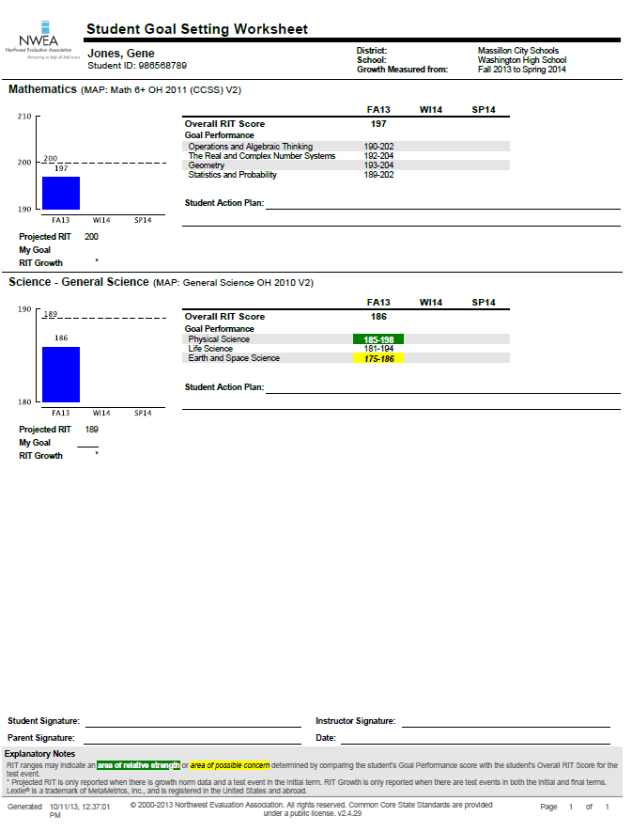
Student Goal Setting Worksheet

Slide 36
Curriculum Audit Opportunities:
Provided an overall analysis of the “State of the Curriculum, Instruction & Assessment”
Gave all teachers voice and honored their feedback and input through an open evaluation process
Provided useful data to prioritize curricular needs
Identified strengths and weaknesses
Buy-In for the Audit
  “This experience itself is Professional Development”

Slide 37
Curriculum Audit Challenges:
  A few teachers were unable to make connections and did not take ownership of the data
  The audit was implemented during a “transition” year for the Common Core State Standards

Slide 38
Using the data to guide the OIP Process:
All of the recommendations from the audit were used to guide the OIP Process
Used the recommendations to plan Professional Development
Used the data to prioritize curricular needs
Notes:
See OIP Goals, Recommendations

Slide 39
Phase I Action Steps:
Developed a Common Core Transition Plan
Implement a K-12 Writing Initiative
Facilitate Vertical Alignment Meetings
Explicitly Teach & Model Study Skills
Align assessments to Instruction
Implement MAP Assessments (K-10)
Align Math Curriculum K-6
  Teachers can earn graduate credit from Ashland University for their work

Slide 40
Phase II Action Steps:
ELA alignment K-6
Science alignment K-8
Allocate additional time for vertical collaboration meetings
Establish a district wide curriculum committee
Support opportunities for Co-teaching with regular and special education teachers
Establish a district wide, teacher-led professional develop program

Slide 41

Questions ?

Slide 42
Contact Information:
Dr. Angela Chapman, Curriculum Director achapman@massillonschools.org
Dr. Lynne Kulich, Coordinator of Instruction
lkulich@massillonschools.org
Phone: 330-830-3900
Web: www.massillonschools.org
Blog: mcsdcurriculumcorner.blogspot.com

Slide 43
Contact Information:
Dr. David Silverberg, Adjunct Professor and Consultant, Ashland University Telego Center for Educational Improvement dsilverb@ashland.edu 330-998-2873
Dr. Oscar McKnight, Director of Counseling and Health Services, Ashland University
omcnigh@ashland.edu (419) 289-5065
Dr. Gene Linton, Director of the Telego Center for Educational Improvement, Executive Director of Professional Development Services, Ashland University elinton@ashland.edu (419) 289-5921

