Slide 1
From one-shot instruction to co-teaching
Dr. Olga Koz, Graduate Education Librarian
okoz@kennesaw.edu

Slide 2
Content:
Instruction types: definitions, process, and pros/cons
One-shot instruction
Co-teaching a course
2. Where to start
3. Models
4. Evaluation

Slide 3




Definitions
Il instruction
Library Instruction
Bibliographic
Instruction
Research
Instruction
$$=$$
$$=$$
$$=$$
Similar
Overlapping
Different
Use interchangeably

Slide 4
One shot instruction
Common practice of giving a lesson in information literacy or conducting library instruction sessions as a “guest speaker.” Typically the lesson is not associated with the course learning outcomes or assignments. Commonly, it is a single, skills-based class session. Sometimes, the lesson is tied with research-oriented assignments.
Learn more in: Online Distance Education and Embedded Librarianship Integration
Notes:
Librarian is not aware of the syllabus, assignments, how the lesson fit in

Slide 5

Instructor & Librarian (one shot instruction)
Goals
Mindset
Process
May share goals but not necessarily
Librarian may be aware of the course learning outcomes
May have different mindset, philosophy (teaching vs. service), vocational differences
Coordination is required but the collaboration or cooperation is not

Slide 6

Pros & Cons (one shot instruction)
Pros
Not a resource-intensive task
May be substituted with an online tutorial or flipped
Could be a part of micro-teaching or nano-teaching
Research studies confirmed effectiveness for teaching of 1-2 skills
Cons
Research studies² confirmed minimal impact on the course learning outcomes or the development critical thinking skills
Focus on skills only
Doesn’t address the complexity of concepts
Passive learning
Notes:
Mery, Y. m., Newby, J. m., & Peng, K. k. (2012). Why One-shot Information Literacy Sessions Are Not the Future of Instruction: A Case for Online Credit Courses. College & Research Libraries, 73(4), 366-377.
Results show that students who participated in the online course demonstrated significant improvement in their test scores compared to the other students. This study shows freshman students' needs for more comprehensive information literacy instruction.
20. Rui Wang, "The Lasting Impact of a Library Credit Course," Portal: Libraries and the Academy 6, no. 1 (Jan. 2006): 79-92. 21. Burkhardt, Kinnie, and Cournoyer, "Information Literacy Successes Compared." 22. Joanna M. Burkhardt, "Assessing Library Skills: A First Step to Information Literacy," portal: Libraries and the Academy 7, no. 1 (2007): 25^9. 23. Mulherrin, Kelley, Fishman, and Orr, "Information Literacy and the Distant Student."

Slide 7
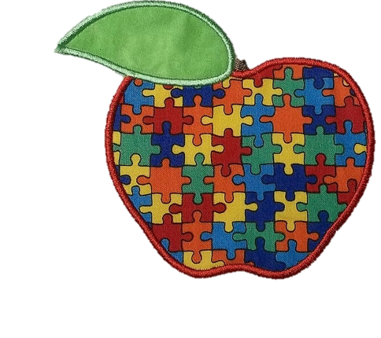
Co-teaching
Two or more educators or other certified staff share instructional responsibility for a group of students in a single classroom, for specific content, with mutual ownership, pooled resources, and joint accountability. Although each individual’s level of participation may vary

Slide 8


Co-teachers
Goal
Mindset
Process
Coordinate their work to achieve common goals, course objectives, or learning outcomes
Share belief system, mindset, and teaching philosophy but may have unique expertise, knowledge and use of different teaching methods
Use a cooperative process in the course design and delivery

Slide 9
Pros & Cons
Pros
Cons
The results (learning outcomes & grades) are better
Students’ engagement rates are higher
Personalized and experiential learning
Inquiry based learning
Active learning
Resource intensive
Requires additional learning/training for a librarian
Requires time to build relationships and align attitudes, values, and teaching strategies

Slide 10
Where to start
Shared values
Assessment or Evaluation
Attitudes
Shared Goals
Shared Concerns
Teaching & instructional design
Mutual Benefits
Communication
Trust
Notes:
The literature demonstrates that the librarian–faculty collaboration is very important to the work of librarians. Collaborations are often indexed as librarian–faculty relationships but little research has actually explored the relationship between them. Relationship marketing emphasizes customer retention through the presence of commitment and trust and is well suited to librarians and the academic community. A focus on communication, shared values and benefits of the relationship would build stronger ties and foster commitment and trust with teaching faculty. There is much to be studied about the relationship between librarians and faculty and in the future studies should focus on relationship building on an elemental level.

Slide 11

Perceptions & Attitudes Studies
An increase in the share of faculty members who believe that their undergraduate students have poor research skills
Increase in the perceived importance of the role of the library in helping undergraduate students develop research, critical analysis, and information literacy skills.
Ithaka S+R US Faculty Survey 2015
"Librarian-faculty relations have long been a significant component of the profession of librarians.
For faculty, however, librarian-faculty relations are of little or no concern.”
Christiansen, et al. (2004)
Notes:
For at least 40 years, academic librarians have been writing about faculty perceptions of librarians in academe. In particular, the notion that teaching faculty do not
, in general, view librarians as their academic equals, nor as central to the teaching process,
Early writings about faculty perceptions of librarians in academe focused on organizational culture and the role of status, gender and ego in perpetuating faculty-librarian conflict. For example, in 1968, Robert Blackburn wrote an article about
college libraries in which he attributed faculty-librarian conflict to competing roles, jealousies, and competition for control over students, egos, and status aspirations (pp. 171-77)

Slide 12
Role, status, and skills
Librarians Role
Status
Skills & Expertise
Resources Managers & Providers
Teachers
Scholarly Communication
Teaching faculty
Clinical faculty
Research support
Academic support
Staff (IT)
Instructional design, instructional technologies (e.s.LMS)
Subject specialist (second master or bachelor degree)
Teaching & Research experience

Slide 13
Faculty survey “What do you expect from a librarian?”
Flexibility
Somebody who can quickly grasp what do I want
Knowledge of university/program/departmental requirements
Somebody who knows how to design and deliver
Familarity with concepts and literature in my field
Lack of time

Slide 14


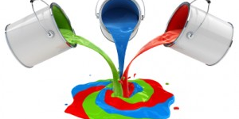
Models of collaboration
Course integrated instruction session
Co-teaching
Embedded resources/librarian
Co-design a course or create a learning module or an assignment
Conduct instructions, provide feedback and support to students during the whole course or during “assignment time”
Ask for an research assignment/rubric/course learning outcomes
Customize your group session
Ask for the syllabus and the course outline
Discuss what resources are needed
Ask to be a part of the discussion board
Notes:
Librarians and teaching faculty have many mutual goals and concerns.
Both want students to develop a greater understanding of and respect for
books, journals, and other intellectual property. Both want to enhance student
literacy, particularly information literacy, and help students become writers,
problem solvers, critical thinkers, and self-directed, lifelong learners. Lastly, both
want to build the social and learning community on campus.

Slide 15

Evaluation
Quazi-experimental study on using all three instructional models
2 control groups (graduate students from Capstone courses and EdD students from 4 Conceptual Framework courses)
Citation analysis and the rubric based analysis of students’ works (literature reviews)
Notes:
The study is in progress so I willnot report the results yet. However similar study indicated higher grades and better quality of students works in courses where librarians was a co-teacher

Slide 16
References
1.Christiansen, L., Stombler, M., & Thaxton, L. (2004). A Report on Librarian-Faculty Relations from a Sociological Perspective. Journal Of Academic Librarianship, 30(2), 116-121. doi:10.1016/j.acalib.2004.01.003
2. Mery, Y. M., Newby, J. M., & Peng, K. K. (2012). Why One-shot Information Literacy Sessions Are Not the Future of Instruction: A Case for Online Credit Courses. College & Research Libraries, 73(4), 366-377.
3. Phelps, S. F. & Campbell, N. (2012). Commitment and trust in Librarian-Faculty relationships: A systematic review of the literature. Journal of Academic Librarianship, 38(1), 13-19. doi:10.1016/j.acalib.2011.11.003

